Slide 1
CSC 219-Final Project Descent classification for crime data in Los Angeles. Project Type-B
Saunvid Ganbavale-302967288
Aayush Bhavsar-303261075
Omkar Walunj-303269226

Slide 2
Dataset – Los Angeles City Crime Data from 2020 to Present
This dataset provides comprehensive information about crime incidents reported in Los Angeles from January 2020 to June 2023. It includes details such as the type of crime, date and time of occurrence, Victim's Descent, Victim's Age, Gender and other relevant attributes.
The dataset is sourced from the Los Angeles Police Department and offers valuable insights into crime patterns and trends in the city.
It helps police and others in several ways like predicting the background of crime victims in Los Angeles. Also, it helps them figure out how to stop crimes in certain areas or among specific groups of people.

Slide 3
Dataset: https://catalog.data.gov/dataset/crime-data-from-2020-to-present
Dataset information: https://data.lacity.org/Public-Safety/Crime-Data-from-2020-to-Present/2nrs-mtv8
Total Rows: 844k rows and each row is a crime incident

Slide 4
Goal
To achieve multi-class classification for Victim Descent (Target Feature).
Victim Descent Code: A - Asian, B – Black, C – Chinese, D – Cambodian, F – Filipino, G – Guamanian, H - Hispanic/Latin/Mexican, I –American Indian/Alaskan Native, J – Japanese, K – Korean, L – Laotian, O – Other, P - Pacific Islander, S – Samoan, U – Hawaiian, V – Vietnamese, W – White, X –Unknown, Z - Asian Indian.
Total 19 categories.
Models: FCNN, LSTM, BiLSTM, BERT

Slide 5
FCNN
Performed one hot encoding on categorical features Victim Descent, Victim Sex, Status, Area name.
Normalization is performed on numerical features like Victim's Age.
Our input features have shape of (716675, 35) and output features have shape of (716675, 20).
Activation functions such as ’Relu’ and ’Softmax’ were used.
Callbacks like model checkpoint and early stopping to improve training efficiency, prevent overfitting, and monitor model performance.

Slide 6
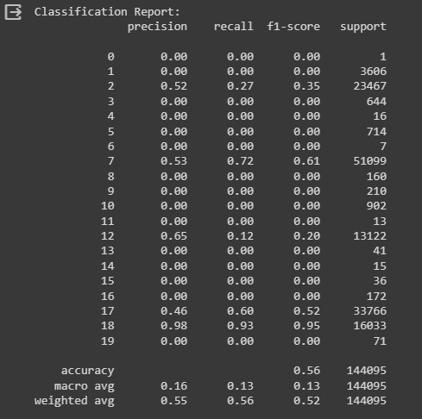
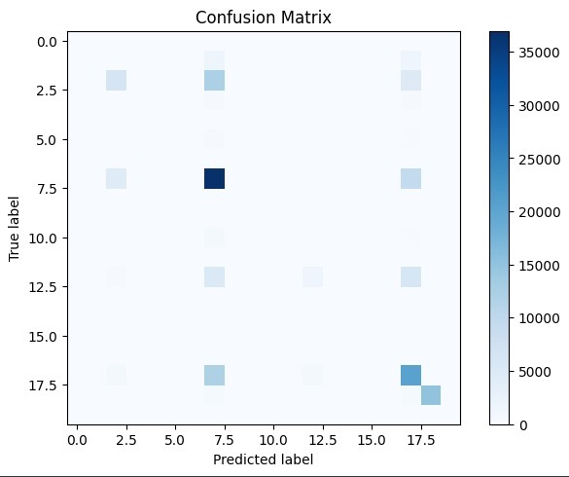
FCNN model classification report and confusion matrix

Slide 7
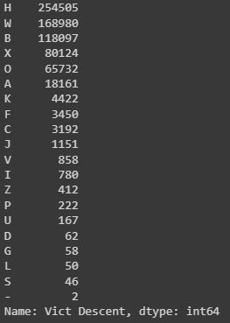
Highly imbalanced data
Unique counts of Victim Descent categories in the dataset.

Slide 8
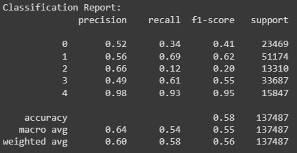
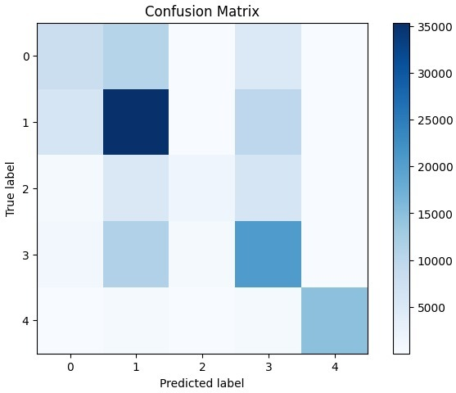
FCNN model classification report and confusion matrix with top 5 features

Slide 9
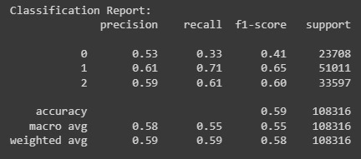
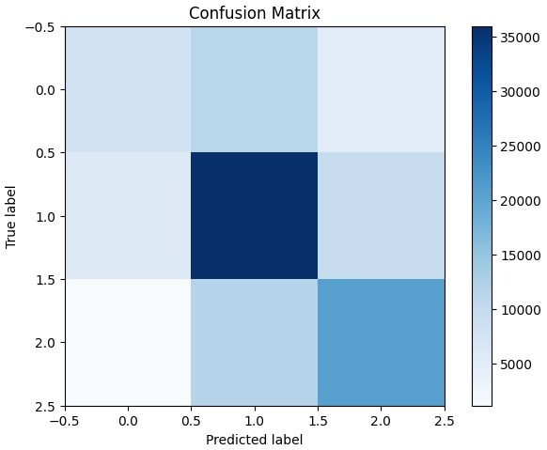
FCNN model classification report and confusion matrix with top 3 features.

Slide 10
FCNN model classification report and confusion matrix with top 3 features with hyperparameter tuning

Slide 11
LSTM
This concatenated column will be used for text classification problem to classify victim descent in our datset.
Performed labelled encoding on our target feature that is victim descent.
Tokenized the text data in concatenated column and applied post padding.

Slide 12
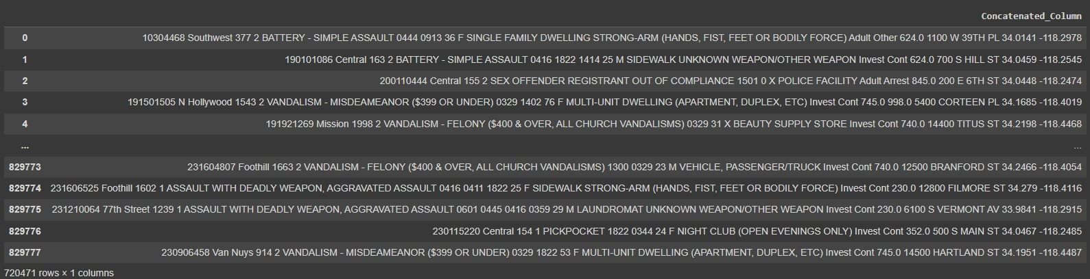
Concatenating all the input features into single column.

Slide 13
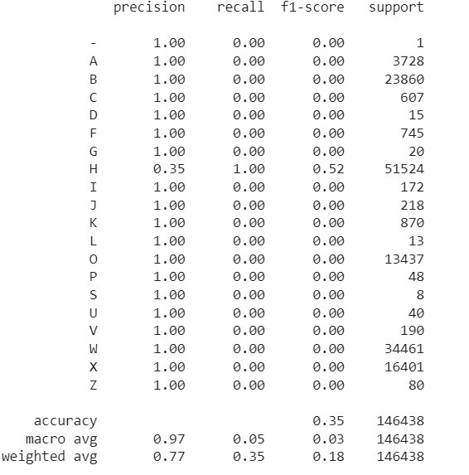
LSTM model classification report

Slide 14
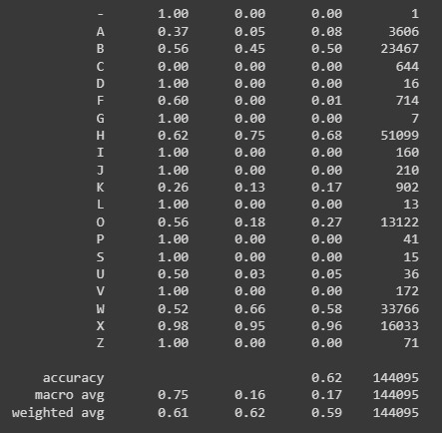
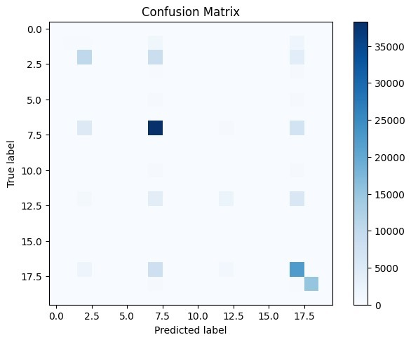
BILSTM model classification report and confusion matrix
Performing oversampling on minority classes of our imbalanced dataset.

Slide 15
BERT
A pre-trained natural language processing model developed by Google is used for text classification in our data set. Maximum accuracy is obtained in this model i.e. 68 percent for a single epoch.

Slide 16
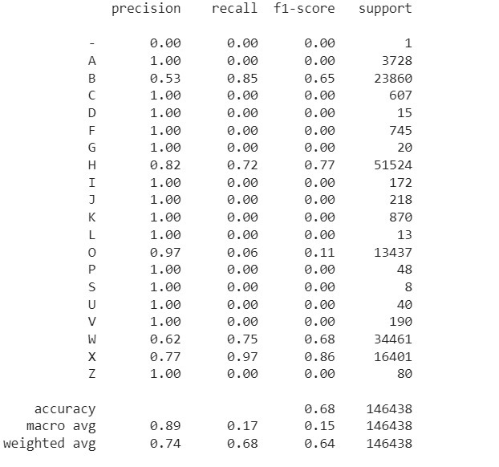
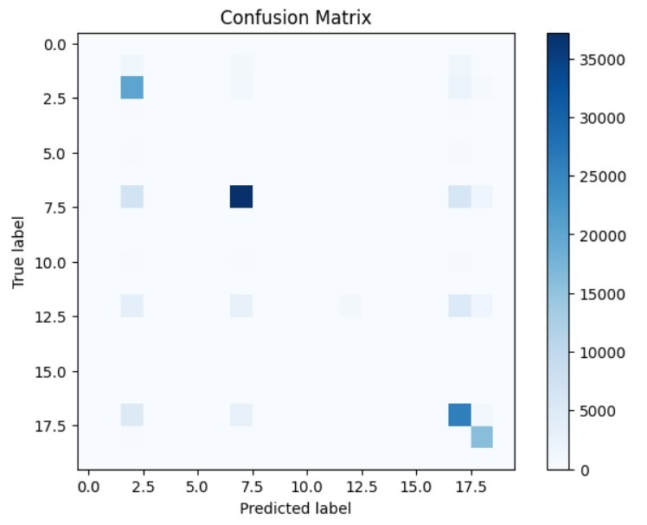
Bert model classification report and confusion matrix

Slide 17
Model accuracy comparison
Model | Accuracy
FCNN (20 categories) | 55 %
FCNN (2) (minority classes) | 58 %
FCNN(3) (majority classes) | 60 %
FCNN-Hyperparameter Tuning | 59 %
LSTM | 35 %
Bidirectional LSTM | 61 %
BERT | 72 %

Slide 18
Challenges
Exploring the multi class classification problem for the first time.
The dataset was highly imbalanced so getting a good accuracy score was very difficult.
Took a lot of time training the large dataset (800k) rows.
Had to train models multiple times in different notebooks due to RAM size issues.

