Slide 1
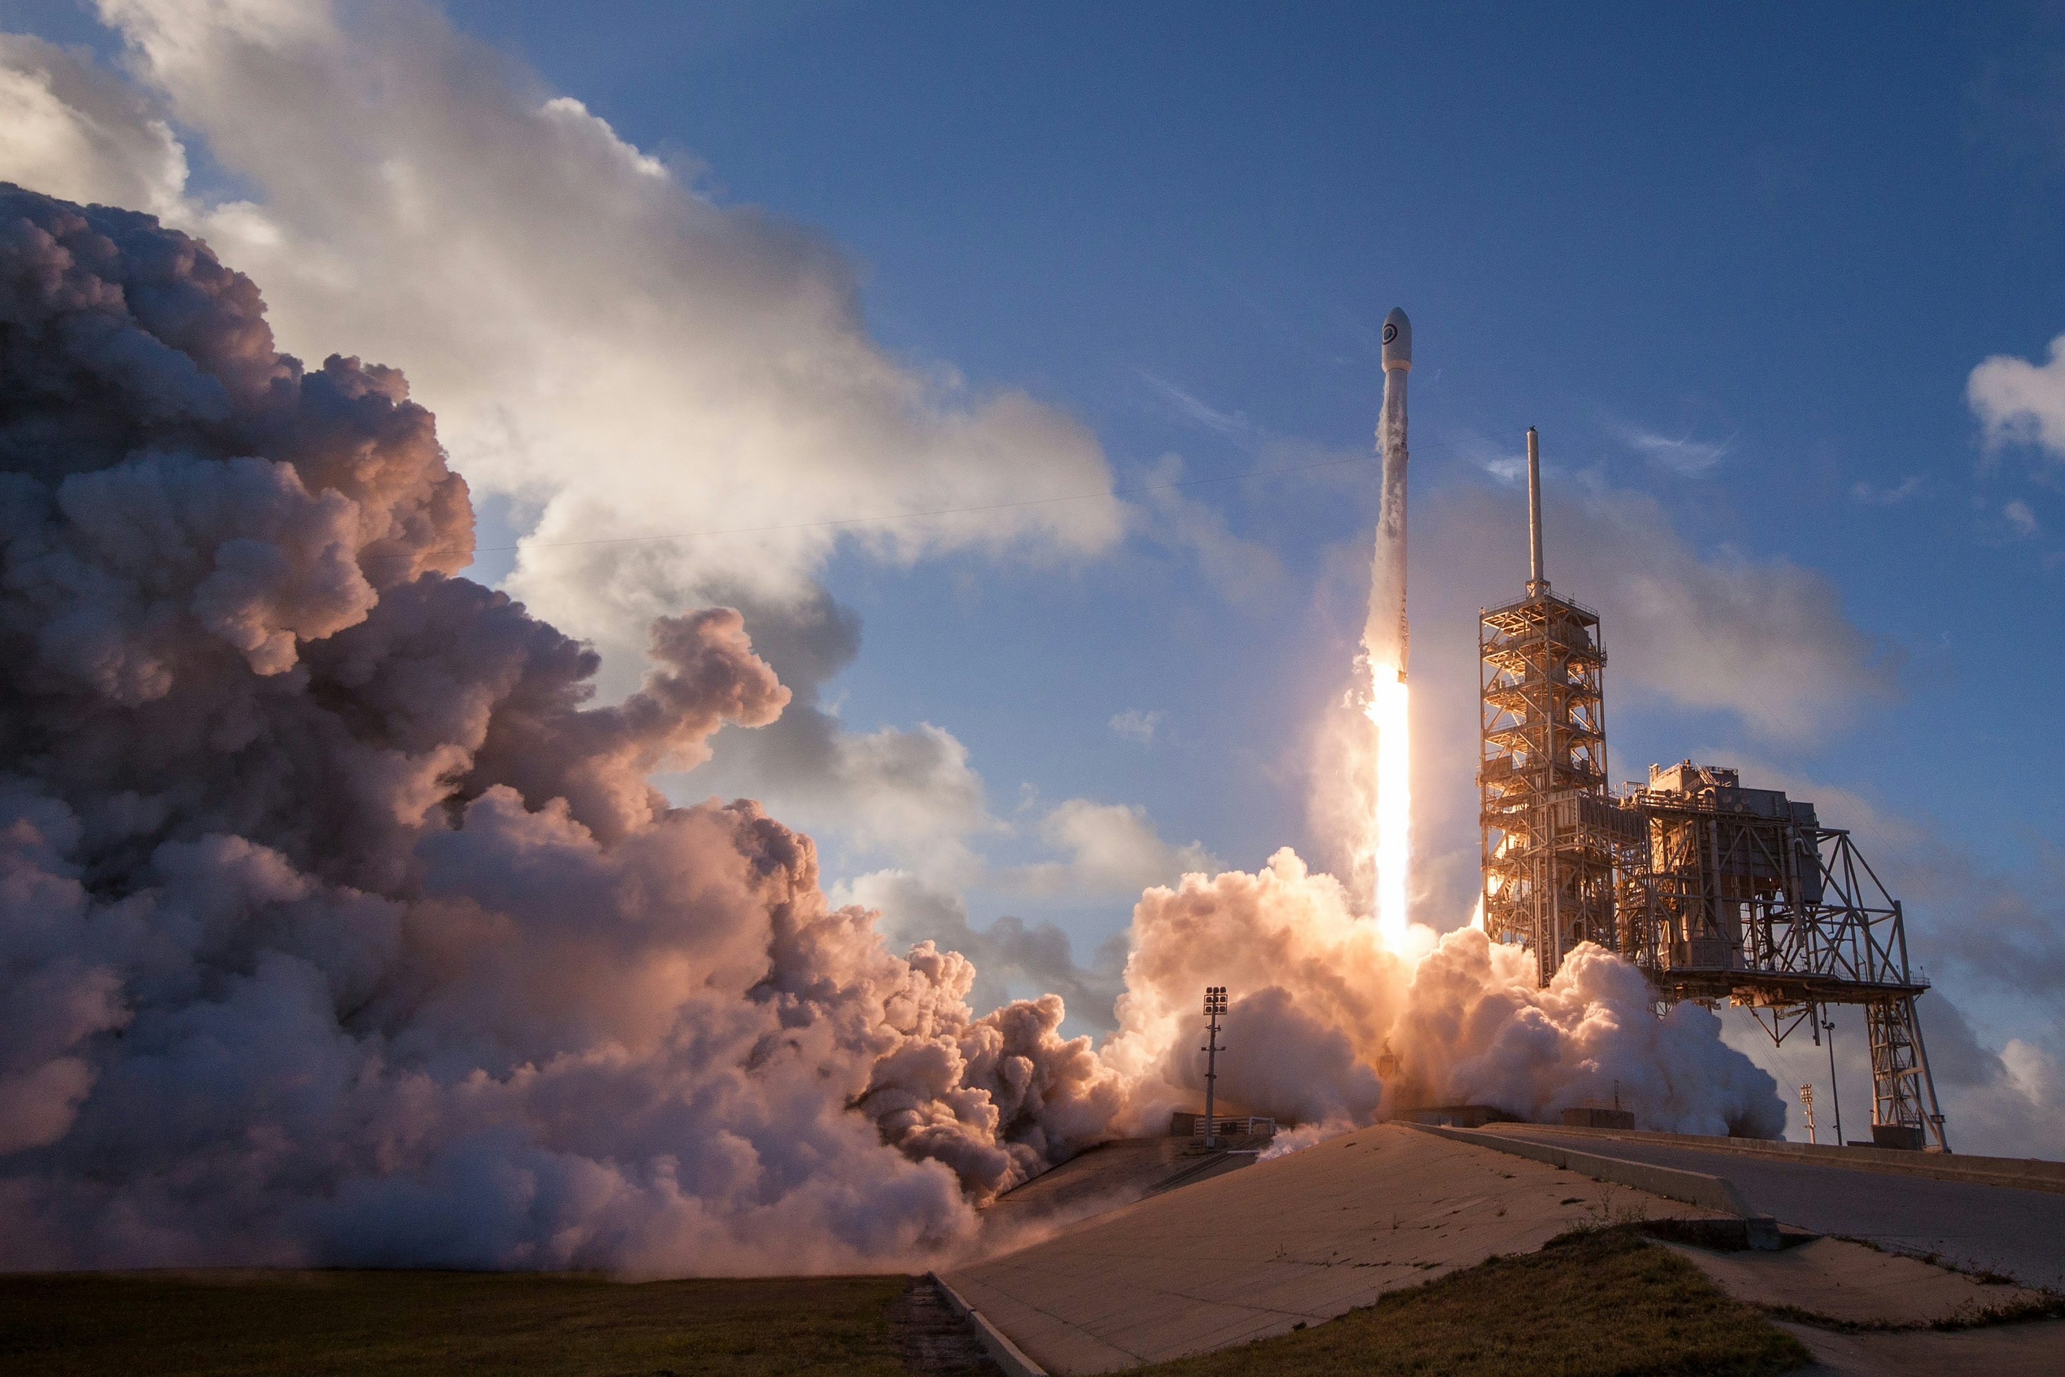
RoPred

Slide 2
Outline
Problem Statement
Project Overview
Key Features
Technical Stack
Impact

Slide 3
Problem Statement
Satellite launches are complex and costly operations that involve multiple phases, including planning, testing, launch, and deployment. Despite extensive preparations, unforeseen issues can lead to failures or delays, causing significant financial and operational setbacks. Accurately predicting the likelihood of success or failure at various phases of a satellite launch can help space agencies and companies mitigate risks, optimize resources, and improve overall mission success rates.

Slide 4
Project Overview
This project aims to develop a predictive model that forecasts the success or failure of satellite launches at various phases—planning, testing, launch, and deployment. By analyzing historical launch data, technical parameters, and environmental factors, the model will provide phase-wise risk assessments, enabling space agencies and companies to make informed decisions, mitigate risks, and optimize resources. The outcome is a decision-support tool that enhances mission success rates, reduces financial losses, and improves operational efficiency in the complex process of satellite launches.

Slide 5
Key Features
Data Collection:
Gather historical data on satellite launches, including mission details, rocket specifications, launch conditions, technical parameters, and outcomes.
Include environmental factors such as weather conditions, atmospheric pressure, and solar activity at the time of launch.
Collect data on pre-launch tests, rocket health, payload integration, and other technical checks.
Decision Support System:
Develop a web-based interface that displays predictions, risk levels, and recommendations for each phase of the launch.
Provide actionable insights, such as suggestions to delay the launch, conduct additional tests, or adjust mission parameters based on the model’s predictions.

Slide 6
Key Features
Machine Learning Model:
Develop a classification model (e.g., logistic regression, random forests, gradient boosting, or neural networks) to predict the success of each phase of the launch process.
Train the model on historical launch data, with the target variable being the success or failure of each phase.
Phase-wise Prediction:
Planning Phase: Predict potential delays or issues based on mission complexity and resource allocation.
Testing Phase: Evaluate the probability of technical failures during rocket testing and integration.
Launch Phase: Predict the likelihood of a successful launch based on weather conditions, rocket health, and other factors.

Slide 7
Key Features
Real-Time Monitoring and Updates:
Continuously update the model with real-time data as the launch process progresses.
Allow for dynamic risk assessments and predictions based on evolving conditions, such as unexpected weather changes or technical issues during testing.
Post-Launch Analysis:
Store and analyze data from successful and unsuccessful launches to refine the model and improve future predictions.
Use the analysis to identify patterns or common factors associated with launch failures, leading to better preventive measures.

Slide 8
Technical Stack:
Backend: Python, TensorFlow/PyTorch (for machine learning), Flask/Django (for API development).
Frontend: React.js or Angular.js for the user interface.
Data Sources: NASA's public launch database, weather APIs, space agency technical reports.
Database: PostgreSQL, MongoDB (for storing launch data, model results, and real-time updates).
APIs: Integration with real-time weather and environmental data services.

Slide 9
Impact
This project would help space agencies and commercial space companies reduce the risks associated with satellite launches by providing data-driven insights and predictions at critical phases. The ability to predict and mitigate potential failures before they occur can save millions of dollars, improve mission success rates, and enhance the overall reliability of space exploration and satellite deployment efforts.

Slide 10
