Slide 1
Spectral Clustering
Royi Itzhak

Slide 2
Spectral Clustering
Algorithms that cluster points using eigenvectors of matrices derived from the data
Obtain data representation in the low-dimensional space that can be easily clustered
Variety of methods that use the eigenvectors differently
Difficult to understand….

Slide 3
Elements of Graph Theory
A graph G = (V,E) consists of a vertex set V and an edge set E.
If G is a directed graph, each edge is an ordered pair of vertices
A bipartite graph is one in which the vertices can be divided into two groups, so that all edges join vertices in different groups.

Slide 4
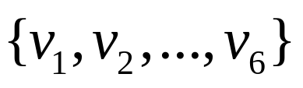
Similarity Graph
Distance decrease similarty increase
Represent dataset as a weighted graph G(V,E)
V={x_{i}} Set of n vertices representing data points
E={W_{ij}} Set of weighted edges indicating pair-wise similarity between points
0.1
0.8
1
5
0.8
0.8
0.6
6
2
4
0.7
0.8
0.2
3

Slide 5
Similarity Graph
Wij represent similarity between vertex
If Wij=0 where isn’t similarity
Wii=0

Slide 6
Graph Partitioning
Clustering can be viewed as partitioning a similarity graph
Bi-partitioning task:
  Divide vertices into two disjoint groups (A,B)
A
B
1
5
2
4
6
3
V=A U B
Graph partition is NP hard

Slide 7
Clustering Objectives
Traditional definition of a “good” clustering:
  Points assigned to same cluster should be highly similar.
  Points assigned to different clusters should be highly dissimilar.
Apply these objectives to our graph representation
0.1
0.8
1
5
0.8
0.8
0.6
6
2
4
0.7
0.8
0.2
3
Minimize weight of between-group connections

Slide 8
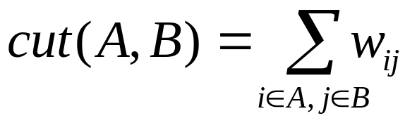
Graph Cuts
Express partitioning objectives as a function of the “edge cut” of the partition.
Cut: Set of edges with only one vertex in a group.we wants to find the minimal cut beetween groups. The groups that has the minimal cut would be the partition
A
B
0.1
0.8
1
0.8
5
0.8
cut(A,B) = 0.3
0.6
6
2
4
0.8
0.2
0.7
3

Slide 9
Graph Cut Criteria
Criterion: Minimum-cut
  Minimise weight of connections between groups
min cut(A,B)
Degenerate case:
Optimal cut
Minimum cut
Problem:
  Only considers external cluster connections
  Does not consider internal cluster density

Slide 10
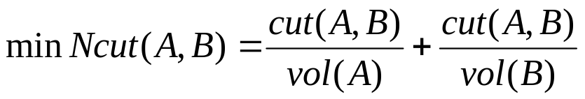
Graph Cut Criteria (continued)
Criterion: Normalised-cut (Shi & Malik,’97)
  Consider the connectivity between groups relative to the density of each group.
  Normalise the association between groups by volume.
    Vol(A): The total weight of the edges originating from group A.
Why use this criterion?
  Minimising the normalised cut is equivalent to maximising normalised association.
  Produces more balanced partitions.

Slide 11
Second option
The previous criteria was on he weight
This following criteria is on the size of the group

Slide 12
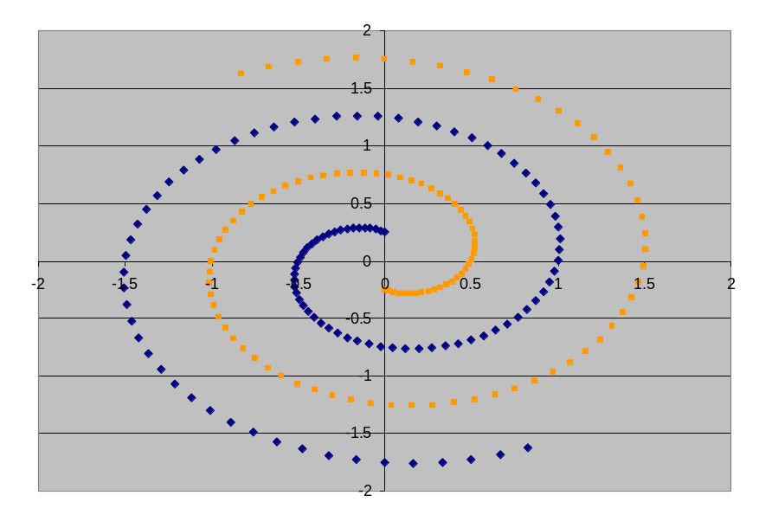
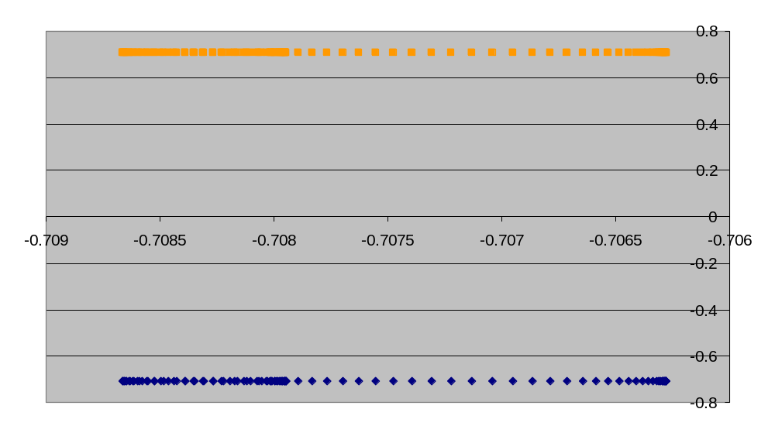
Example – 2 Spirals
Dataset exhibits complex cluster shapes
K-means performs very poorly in this space due bias toward dense spherical clusters.
In the embedded space given by two leading eigenvectors, clusters are trivial to separate.

Slide 13
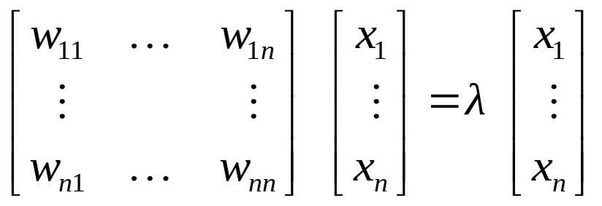
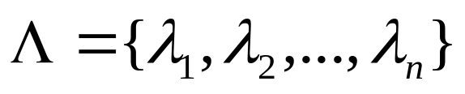
Spectral Graph Theory
Possible approach
  Represent a similarity graph as a matrix
  Apply knowledge from Linear Algebra…
The eigenvalues and eigenvectors of a matrix provide global information about its structure.
Spectral Graph Theory
  Analyse the “spectrum” of matrix representing a graph.
  Spectrum : The eigenvectors of a graph, ordered by the magnitude(strength) of their corresponding eigenvalues.

Slide 14
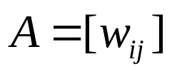
Matrix Representations
Adjacency matrix (A)
  n x n matrix
  : edge weight between vertex x_{i} and x_{j}
 | x₁ | x₂ | x₃ | x₄ | x₅ | x₆
x₁ | 0 | 0.8 | 0.6 | 0 | 0.1 | 0
x₂ | 0.8 | 0 | 0.8 | 0 | 0 | 0
x₃ | 0.6 | 0.8 | 0 | 0.2 | 0 | 0
x₄ | 0 | 0 | 0.2 | 0 | 0.8 | 0.7
x₅ | 0.1 | 0 | 0 | 0.8 | 0 | 0.8
x₆ | 0 | 0 | 0 | 0.7 | 0.8 | 0
0.1
0.8
1
0.8
5
0.8
0.6
2
4
6
0.8
0.7
3
0.2
Important properties:
  Symmetric matrix
  Eigenvalues are real
  Eigenvector could span orthogonal base

Slide 15
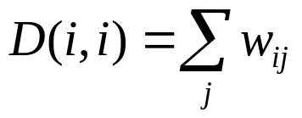
Matrix Representations (continued)
Degree matrix (D)
  n x n diagonal matrix
  : total weight of edges incident to vertex x_{i}
 | x₁ | x₂ | x₃ | x₄ | x₅ | x₆
x₁ | 1.5 | 0 | 0 | 0 | 0 | 0
x₂ | 0 | 1.6 | 0 | 0 | 0 | 0
x₃ | 0 | 0 | 1.6 | 0 | 0 | 0
x₄ | 0 | 0 | 0 | 1.7 | 0 | 0
x₅ | 0 | 0 | 0 | 0 | 1.7 | 0
x₆ | 0 | 0 | 0 | 0 | 0 | 1.5
0.1
0.8
1
5
0.8
0.8
0.6
2
4
6
0.8
0.7
3
0.2
Important application:
  Normalise adjacency matrix

Slide 16
Matrix Representations (continued)
L = D - A
Laplacian matrix (L)
  n x n symmetric matrix
 | x₁ | x₂ | x₃ | x₄ | x₅ | x₆
x₁ | 1.5 | -0.8 | -0.6 | 0 | -0.1 | 0
x₂ | -0.8 | 1.6 | -0.8 | 0 | 0 | 0
x₃ | -0.6 | -0.8 | 1.6 | -0.2 | 0 | 0
x₄ | 0 | 0 | -0.2 | 1.7 | -0.8 | -0.7
x₅ | -0.1 | 0 | 0 | 0.8- | 1.7 | -0.8
x₆ | 0 | 0 | 0 | -0.7 | -0.8 | 1.5
0.1
0.8
1
0.8
5
0.8
0.6
2
4
6
0.7
0.8
0.2
3
Important properties:
  Eigenvalues are non-negative real numbers
  Eigenvectors are real and orthogonal
  Eigenvalues and eigenvectors provide an insight into the connectivity of the graph…

Slide 17
Another option – normalized laplasian
Laplacian matrix (L)
  n x n symmetric matrix
1.00 | -0.52 | -0.39 | 0.00 | -0.06 | 0.00
-0.52 | 1.00 | -0.50 | 0.00 | 0.00 | 0.00
-0.39 | -0.50 | 1.00 | -0.12 | 0.00 | 0.00
0.00 | 0.00 | -0.12 | 1.00 | -0.47 | -0.44
-0.06 | 0.00 | 0.00 | 0.47- | 1.00 | -0.50
0.00 | 0.00 | 0.00 | -0.44 | -0.50 | 1.00
0.1
0.8
1
0.8
5
0.8
0.6
2
4
6
0.7
0.8
0.2
3
Important properties:
  Eigenvectors are real and normalize
  Each Aij (which i,j is not equal) =

Slide 18
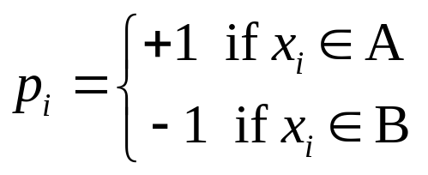
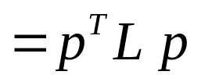
Find An Optimal Min-Cut (Hall’70, Fiedler’73)
Express a bi-partition (A,B) as a vector
Laplacian matrix
The laplacian is semi positive
The Rayleigh Theorem shows:
  The minimum value for f(p) is given by
  the 2nd smallest eigenvalue of the Laplacian L.
  The optimal solution for p is given by the corresponding eigenvector λ₂, referred as the Fiedler Vector.
We can minimise the cut of the partition by finding a non-trivial vector p that minimises the function

Slide 19

Proof
Based on
Consistency of Spectral Clustering
By Ulrike von Luxburg1, Mikhail Belkin2, Olivier Bousquet
Max Planck Institute for Biological Cybernetics
Pages 2-6

Slide 20
Proof
Some definitions:
Define f as follows
Only the vertex that have edge between them from different set would be meaningful
For each edge the sum is on the diagonal
Hence it would be equal to zero only than vol(s)=vol(s’) now it could definite as

Slide 21
Continue …
From simple algebra..
The relaxation method is for each vector on
Eigen value worth
Because the min of eigenvalue is 0 it doesn’t give us any information ,and that’s why its bw(g)=2nd eigenvalue

Slide 22
Spectral Clustering Algorithms
Three basic stages:
  Pre-processing
    Construct a matrix representation of the dataset.
  Decomposition
    Compute eigenvalues and eigenvectors of the matrix.
    Map each point to a lower-dimensional representation based on one or more eigenvectors.
  Grouping
    Assign points to two or more clusters, based on the new representation.

Slide 23
Spectral Bi-partitioning Algorithm
 | x₁ | x₂ | x₃ | x₄ | x₅ | x₆
x₁ | 1.5 | -0.8 | -0.6 | 0 | -0.1 | 0
x₂ | -0.8 | 1.6 | -0.8 | 0 | 0 | 0
x₃ | -0.6 | -0.8 | 1.6 | -0.2 | 0 | 0
x₄ | 0 | 0 | -0.2 | 1.7 | -0.8 | -0.7
x₅ | -0.1 | 0 | 0 | -0.8 | 1.7 | -0.8
x₆ | 0 | 0 | 0 | -0.7 | -0.8 | 1.5
Pre-processing
  Build Laplacian
  matrix L of the
  graph
Decomposition
  Find eigenvalues X
  and eigenvectors Λ
  of the matrix L
0.0
0.4
0.2
0.1
0.4
-0.2
-0.9
0.4
0.4
0.2
0.1
-0.
0.4
0.3
Λ =
2.2
X =
0.4
0.2
-0.2
0.0
-0.2
0.6
2.3
0.4
-0.4
0.9
0.2
-0.4
-0.6
2.5
0.4
-0.7
-0.4
-0.8
-0.6
-0.2
3.0
0.4
-0.7
-0.2
0.5
0.8
0.9
  Map vertices to corresponding components of λ₂
x₁
0.2
x₂
0.2
x₃
0.2
x₄
-0.4
x₅
-0.7
x₆
-0.7

Slide 24
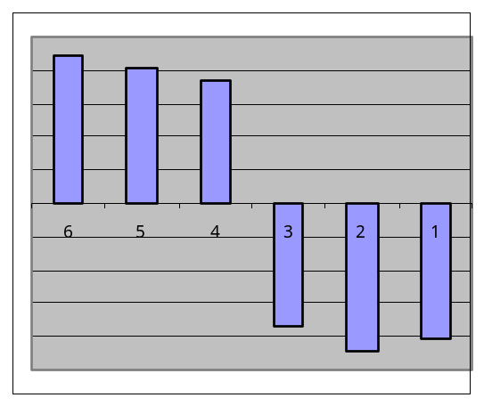
Spectral Bi-partitioning Algorithm
The matrix which represents the eigenvector of the laplacian the eigenvector matched to the corresponded eigenvalues with increasing order
0.41 | -0.41 | -0.65 | -0.31 | -0.38 | 0.11
0.41 | -0.44 | 0.01 | 0.30 | 0.71 | 0.22
0.41 | -0.37 | 0.64 | 0.04 | -0.39 | -0.37
0.41 | 0.37 | 0.34 | -0.45 | 0.00 | 0.61
0.41 | 0.41 | -0.17 | -0.30 | 0.35 | -0.65
0.41 | 0.45 | -0.18 | 0.72 | -0.29 | 0.09

Slide 25
Spectral Bi-partitioning (continued)
Grouping
  Sort components of reduced 1-dimensional vector.
  Identify clusters by splitting the sorted vector in two.
How to choose a splitting point?
  Naïve approaches:
    Split at 0, mean or median value
  More expensive approaches
    Attempt to minimise normalised cut criterion in 1-dimension
x₁
0.2
Split at 0
Cluster A: Positive points
Cluster B: Negative points
x₂
0.2
A
B
x₃
0.2
x₄
-0.4
x₅
-0.7
x₁
0.2
x₄
-0.4
x₆
-0.7
x₂
0.2
x₅
-0.7
x₃
0.2
x₆
-0.7

Slide 26
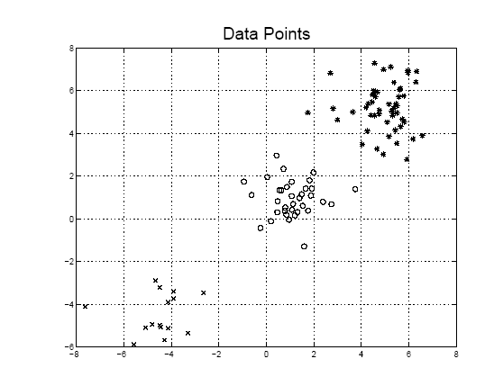
3-Clusters
Lets assume the next data points

Slide 27
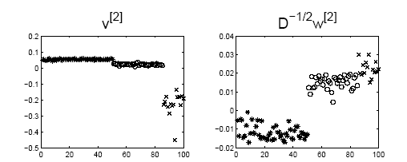
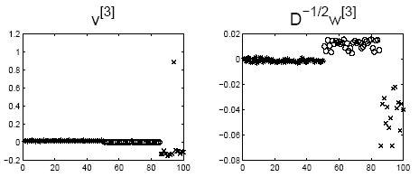
If we use the 2nd eigen vector
If we use the 3rd eigen vector

Slide 28
K-Way Spectral Clustering
How do we partition a graph into k clusters?
Two basic approaches:
  Recursive bi-partitioning (Hagen et al.,’91)
    Recursively apply bi-partitioning algorithm in a hierarchical divisive manner.
    Disadvantages: Inefficient, unstable
  Cluster multiple eigenvectors (Shi & Malik,’00)
    Build a reduced space from multiple eigenvectors.
    Commonly used in recent papers
    A preferable approach…but its like to do PCA and then k-means

Slide 29
Recursive bi-partitioning (Hagen et al.,’91)
Partition using only one eigenvector at a time
Use procedure recursively
Example: Image Segmentation
  Uses 2nd (smallest) eigenvector to define optimal cut
  Recursively generates two clusters with each cut

Slide 30
Why use Multiple Eigenvectors?
Approximates the optimal cut (Shi & Malik,’00)
  Can be used to approximate the optimal k-way normalised cut.
Emphasises cohesive clusters (Brand & Huang,’02)
  Increases the unevenness in the distribution of the data.
  Associations between similar points are amplified, associations between dissimilar points are attenuated.
  The data begins to “approximate a clustering”.
Well-separated space
  Transforms data to a new “embedded space”, consisting of k orthogonal basis vectors.
NB: Multiple eigenvectors prevent instability due to information loss.

Slide 31

K-Eigenvector Clustering
K-eigenvector Algorithm (Ng et al.,’01)
  Pre-processing
  Construct the scaled adjacency matrix
  Decomposition
    Find the eigenvalues and eigenvectors of A'.
    Build embedded space from the eigenvectors corresponding to the k largest eigenvalues.
  Grouping
    Apply k-means to reduced n x k space to produce k clusters.

Slide 32
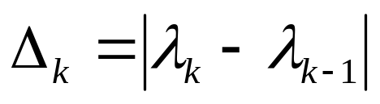
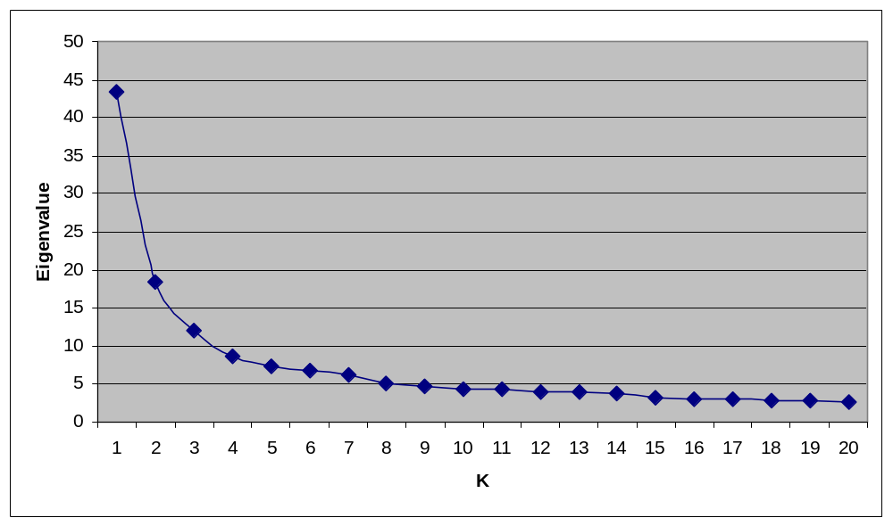
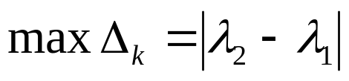
Aside: How to select k?
Eigengap: the difference between two consecutive eigenvalues.
Most stable clustering is generally given by the value k that maximises the expression
Largest eigenvalues
of Cisi/Medline data
λ₁
Choose k=2
λ₂

Slide 33
Conclusion
Clustering as a graph partitioning problem
  Quality of a partition can be determined using graph cut criteria.
  Identifying an optimal partition is NP-hard.
Spectral clustering techniques
  Efficient approach to calculate near-optimal
  bi-partitions and k-way partitions.
  Based on well-known cut criteria and strong theoretical background.

Slide 34
Selecting relevant genes with spectral approach

Slide 35
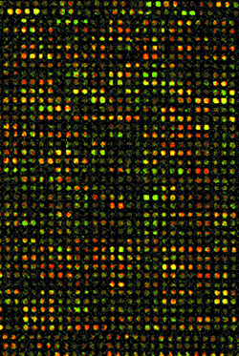
Genomics
The microarray technology provides
many measurements of gene
expressions for different sample
tissues.
tissue samples
Goal: recognizing the relevant
genes that separate between
cells with different biological
characteristics (normal vs. tumor,
different subclasses of tumor cells)
Classification of Tissue Samples (type of
Cancer, Normal vs. Tumor)
Find Novel Subclasses (unsupervised)
Find Genes responsible for classification
(new insights for drug design).
Gene expressions
Few samples (~50) and large dimension (~10,000)

Slide 36
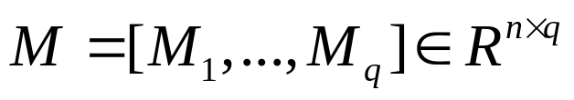




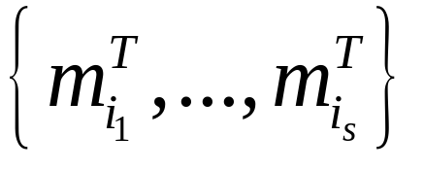




Problem Definition
lets the microarray data matrix define by M
The gene expression levels form the rows of M
Normalized gene vector
which are most “relevant” with respect to an
inference (learning) task.
tissue vector

Slide 37











Feature Subset Relevance - Key Idea
Working Assumption: the relevant subset of rows induce columns that are coherently clustered.

Slide 38


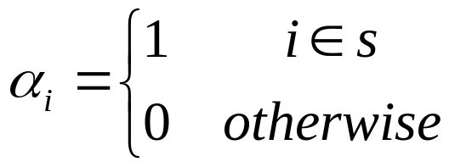

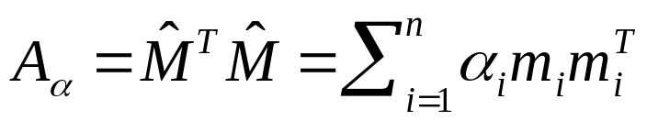
How to measure cluster coherency? We wish to avoid explicitly clustering
for each subset of rows. We wish a measure which is amenable to
continuous functional analysis.
key idea: use spectral information from the affinity matrix
How to represent ?
subset of features
Correlation matrix between I’th and j’th
Column (symmetric-positive)

Slide 39
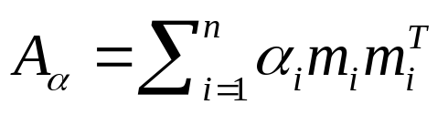
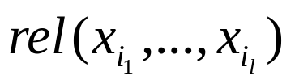
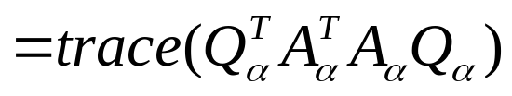
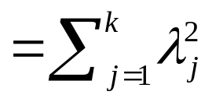


Definition of Relevancy
The Standard Spectrum
General Idea:
Select a subset of rows from the sample matrix M such that the resulting
affinity matrix will have high values associated with the first k eigenvalues.
subset of features
consists of the first k eigenvectors of

Slide 40
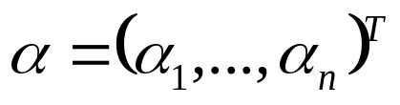
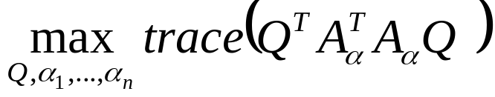

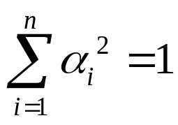
Optimization Problem
Let
for some unknown real scalars
Motivation: from spectral clustering it is known
that the eigenvectors tend to be discontinuous
and that may lead to an effortless sparsity
property.
subject to

Slide 41



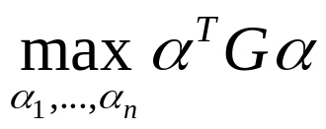
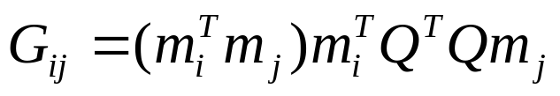
The Algorithm
If were known, then is known and Q is simply the first k eigenvectors of
If Q were known, then the problem becomes:
subject to
where
is the largest eigenvector of G

Slide 42

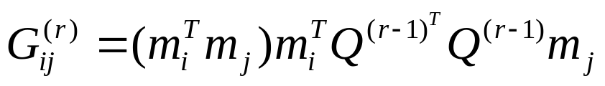

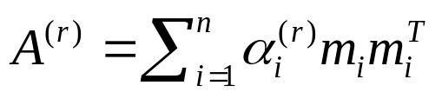



The Algorithm
Power-embedded
1. Let be defined
2. Let be the largest eigenvector of
3. Let
4. Let
5.
orthogonal iteration
“QR” factorization step
6. Increment
Note that r-is the index of iterations

Slide 43


The algorithm need 3 conditions:
the algorithm converges to a local maximum
At the local maximum
The vector is sparse

Slide 44
The experiment
Giving some data sets: blood cell
Myeloid cell: HL-60 U937.
T cell-Jurkat,
Leukemia cell NB4
The dimensionality of the expression data was 7229 genes
over 17 sampeles
The goal is to find cluster of the expression level of the gene without any restriction.

Slide 45
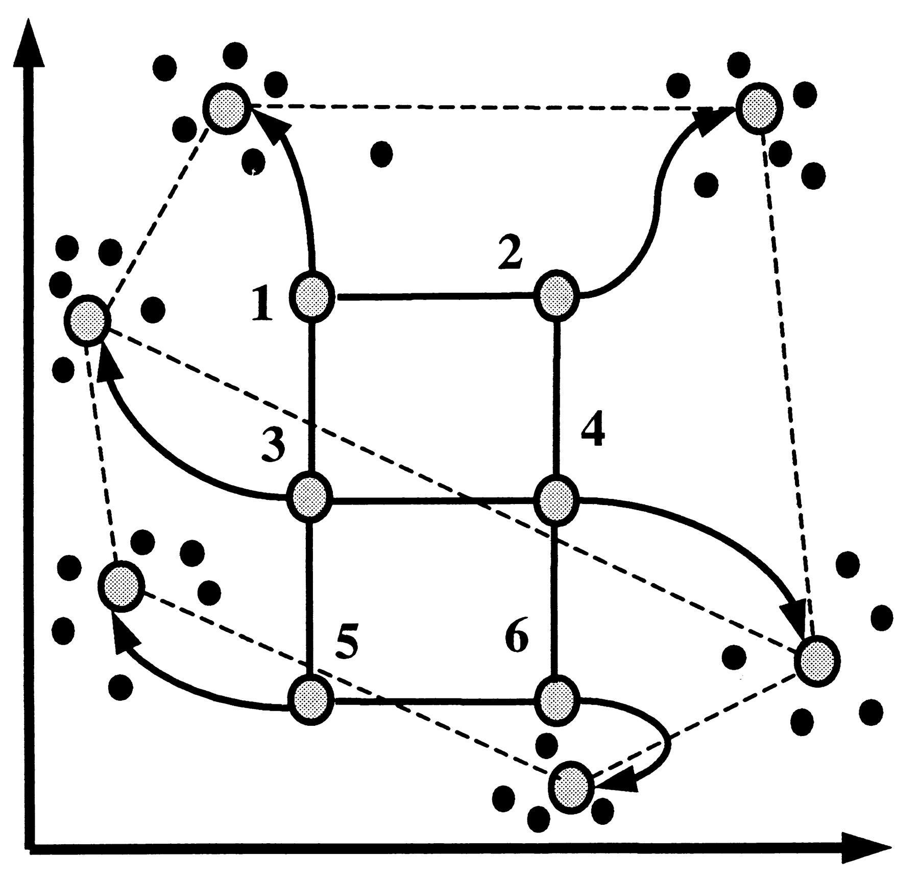
SOM
Principle of SOMs. Initial geometry of nodes in 3 × 2 rectangular grid is indicated by solid lines connecting the nodes. Hypothetical trajectories of nodes as they migrate to fit data during successive iterations of SOM algorithm are shown. Data points are represented by black dots, six nodes of SOM by large circles, and trajectories by arrows.
Copyright ©1999 by the National Academy of Sciences

Slide 46
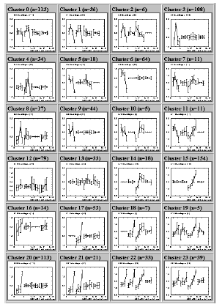
S.O.M Results
the time course data with s.o.m and after pre-processing of the data
The results was 24 cluster each cluster
consists 6-113 genes

Slide 47
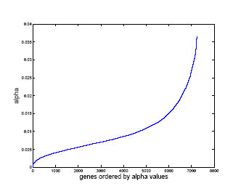
Q-alpha
After applying to Q-alpha algorithm- was found that
The set of relevant genes was consists from small number of relevant genes on the you can see plot of the sorted –alpha The profile of the values indicates sparsity meaning that around 95% of the values are of an order of magnitude smaller than the remaining 5%.

Slide 48
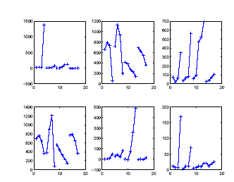
continue
A plot of 6 of the top 40 genes that correspond to clusters 20, 1, 22/23, 4, 15, 21 In each of the six panels time courses of all four cell lines are shown (left to
right) HL-60, U937, NB4, Jurkat.

Slide 49
Another example
Another dataset :
1. DLCL, reffered to as ”lymphoma” 7, 129 genes over 56 samples
2. Childhood medulloblastomas referred to as ”brain”. The
dimensionality of this dataset was 7, 129 and there were 60 samples
3. Breast tumors reffered to as ”breast met”. The dimensionality
of this dataset was 24,624 and there were 44 samples where
4. The fourth breast tumors for which corresponding lymph nodes either were cancerous or not, referred to as ”lymph status”. The dimensionality of this dataset is 12, 600 with 90 samples

Slide 50
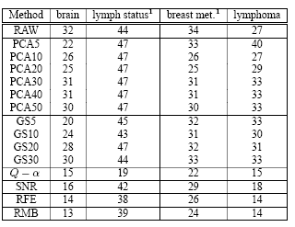
The results-using leave one out algorithm
Compare to unsupervised method like PCA,GS and supervised methods like SNR,RMB,RFE

Slide 51
The slide you all waited for

