Slide 1
Objective
Circular trading is a form of tax evasion in Goods and Services Tax where a group of fraudulent taxpayers aims to mask illegal transactions by superimposing several fictitious transactions among themselves in a short period.
Due to the vast database of taxpayers, it is infeasible for authorities to manually identify groups of circular traders and the illegitimate transactions they are involved in.
This work uses big data analytics and graph representation learning techniques to propose a framework to identify communities of circular traders.

Slide 2
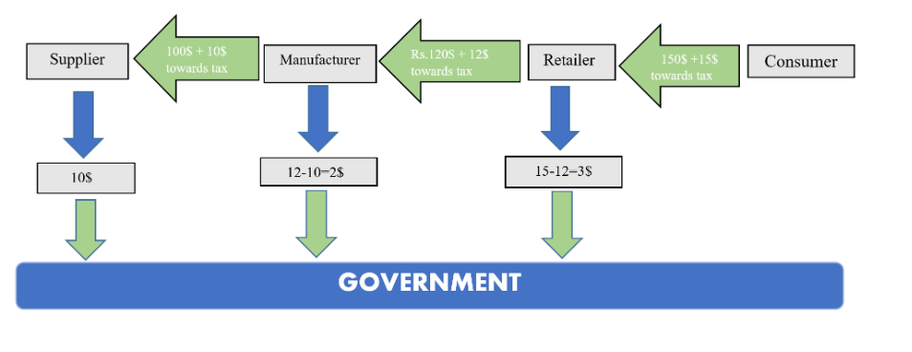
Goods and Services Tax (GST): is a comprehensive, multi-stage, destination based tax that is levied on every value addition.

Slide 3
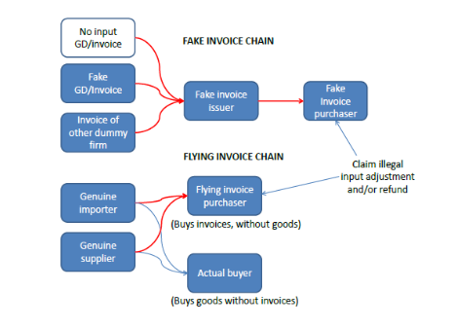
Invoice Trading
Invoice trading is a tax evasion method, in which a dealer sells their goods to the end-user and collects the corresponding tax without issuing an invoice of sale.
Later, they issue a illegitimate invoice to a third party.

Slide 4
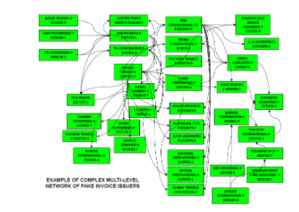

Slide 5
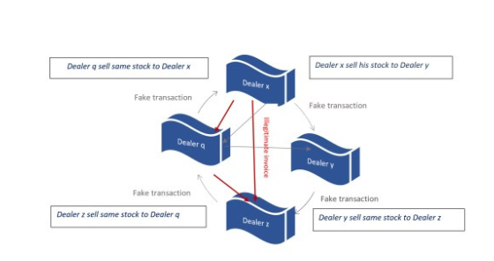
To mask these illegitimate transactions, malicious dealers create many shell companies and show high-valued fake sales and purchases among themselves and shell companies without adding any significant value to the product itself

Slide 6
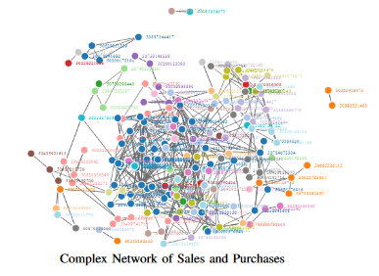
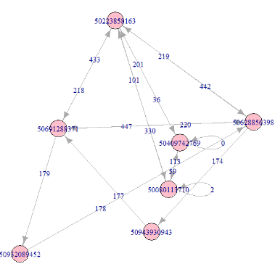
This form of tax evasion in GST where a group of fraudulent taxpayers aims to mask illegal transactions by superimposing several dummy transactions without value addition among themselves in a short period is called circular trading.

Slide 7
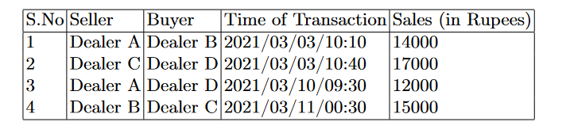
Data Set Used and Directed Graph Construction
Constructed an edge labelled directed multigraph called sales flow graph using this data set.
Each vertex in this graph corresponds to an individual dealer.
Each directed edge denotes one sales transaction in the data set.
Each edge contains two attributes, where the first one is the time of sales of the corresponding transaction and the second one is the monetary outflow associated with this transaction

Slide 8
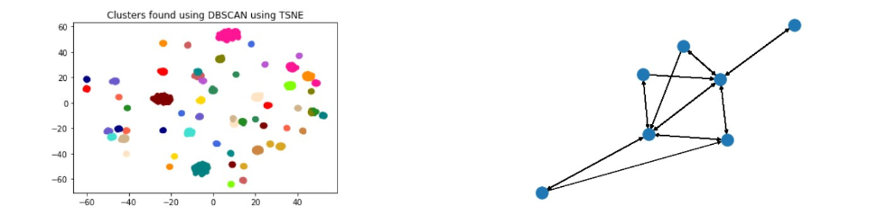
Procedure
Convert the graph explained earlier to an edge-weighted undirected simple graph. Weight of an edge xy in this graph is directly proportional to the number of three cycles and two cycles containing both x and y.
Generate embeddings for each node of the undirected graph using node2vec algorithm.
Apply DBSCAN algorithm to find clusters of nodes that are densely connected together.

