Slide 1

node2vec: Scalable Feature Learning for Networks

Slide 2
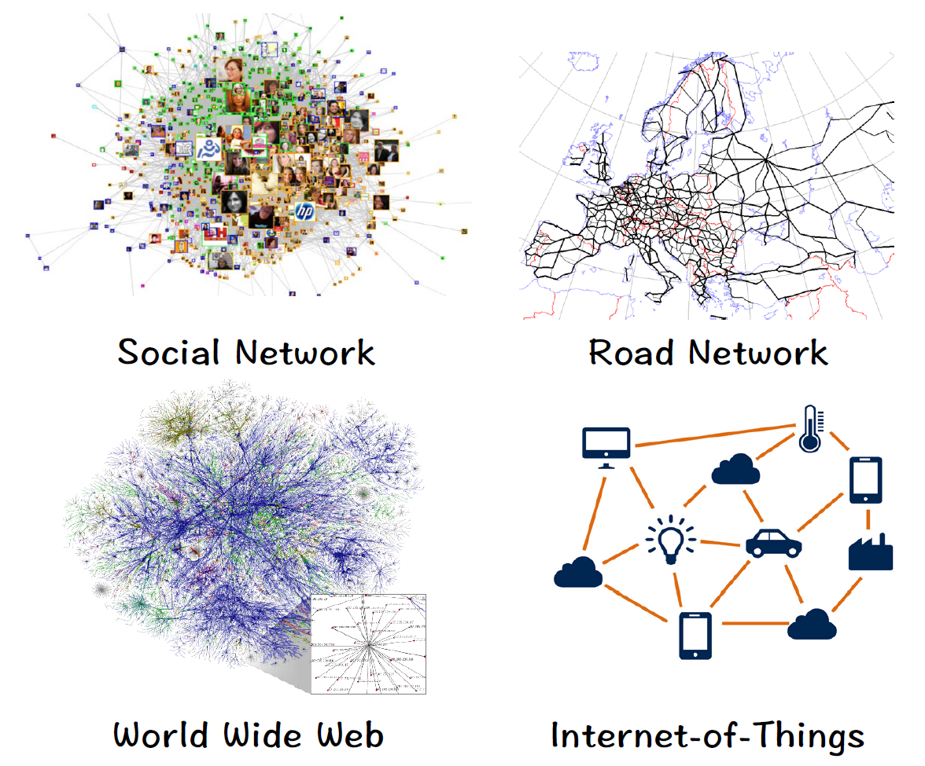
Background: Networks
Examples include:
Social, Road, World Wide Web & IoT etc.
A flexible and general data structure.
Many types of data can be formulated as networks.

Slide 3
How Node2vec take random walks
Parameters for generation of random walks
Number of walks starting from each node (r) : 10
Walk Length (l) : 80
Parameters p and q
Parameters for generation of embedding
Context Size (k) : 10
Dimensionality (D) : 128

Slide 4
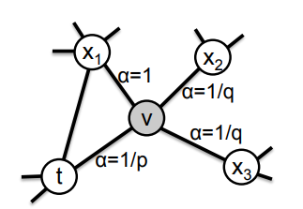
Biasing the selection of next node
Last edge in random walk : t → v
Currently at node v
How to select next node from v neighbors ?
How much do you like to go back to t ?
⟶ parameter “p”
How much do you like to go far from t ?
⟶ parameter “q”

Slide 5


Classic Search Strategies
The problem of sampling neighborhoods of a source node can be viewed as a form of local search.
There are two extreme sampling strategies for generating neighborhood sets:
Breadth-first Sampling (BFS)
Depth-first Sampling (DFS)

Slide 6


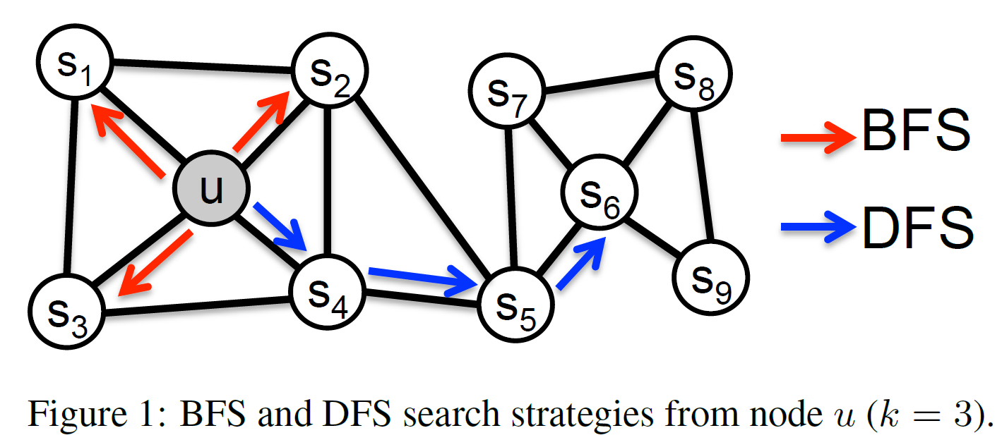
Breadth-first Sampling (BFS)
Neighborhood is restricted to nodes which are immediate neighbors of the source .
For a neighborhood of size BFS samples nodes . .

Slide 7

BFS Structural Equivalence
Nodes that have similar structural roles in networks should be embedded closely together.
E.g., nodes and in fig
Restricting search to nearby nodes, BFS gives microscopic view.
Network roles such as bridges and hubs can be inferred using BFS.

Slide 8

Depth-first Sampling (DFS)
Neighborhood consists of nodes sequentially sampled at increasing distances from the source node .
For a neighborhood of size DFS samples nodes .

Slide 9

DFS Homophily
Nodes that are highly interconnected and belong to similar network communities should be embedded closely together.
E.g., nodes and in fig
DFS sampled nodes reflect a macro-view of nodes neighborhood.

Slide 10
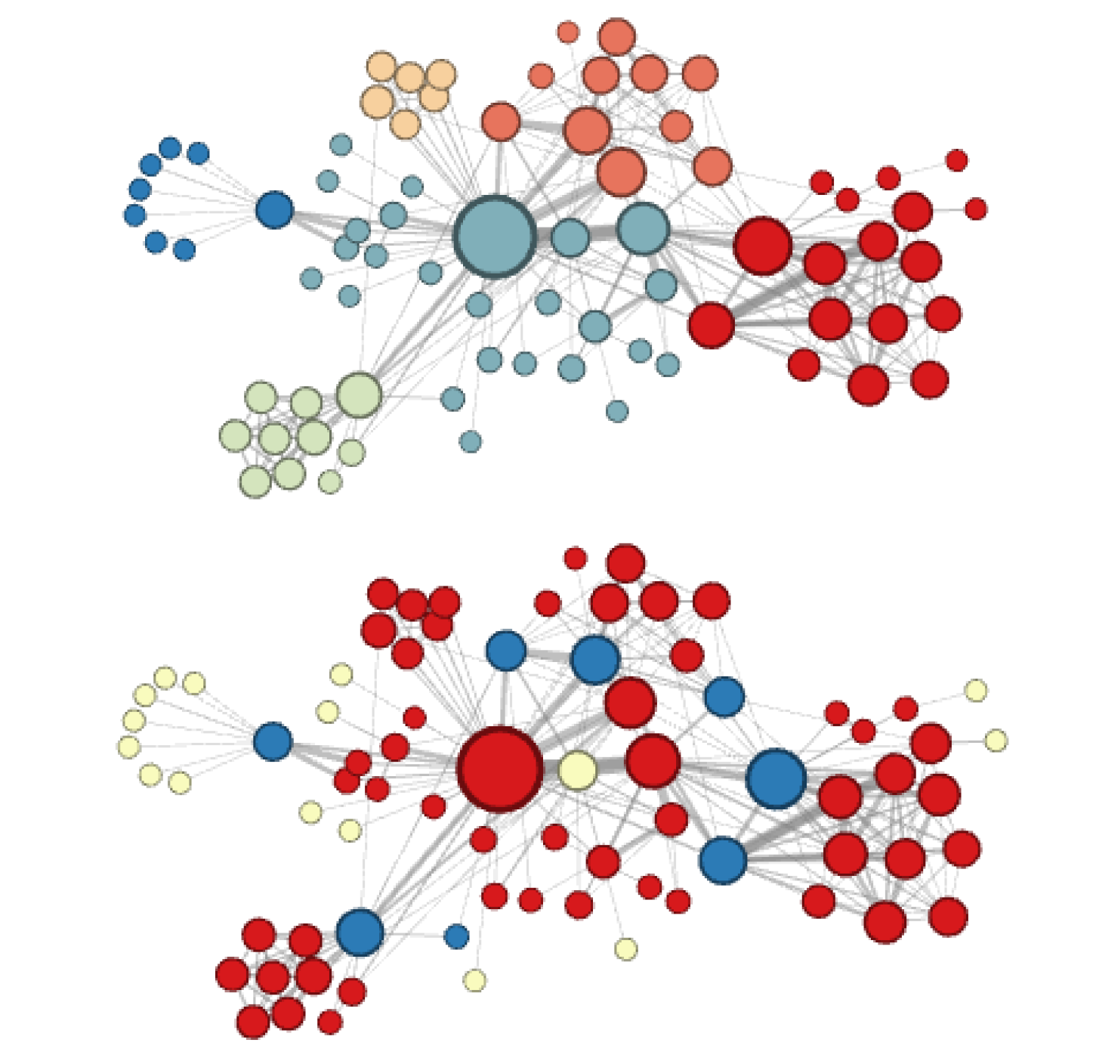
Visualization of Les Miserables Network
Generated by node2vec
Label colors reflecting:
Homophily (top)
Structural Equivalence (bottom)

Slide 11
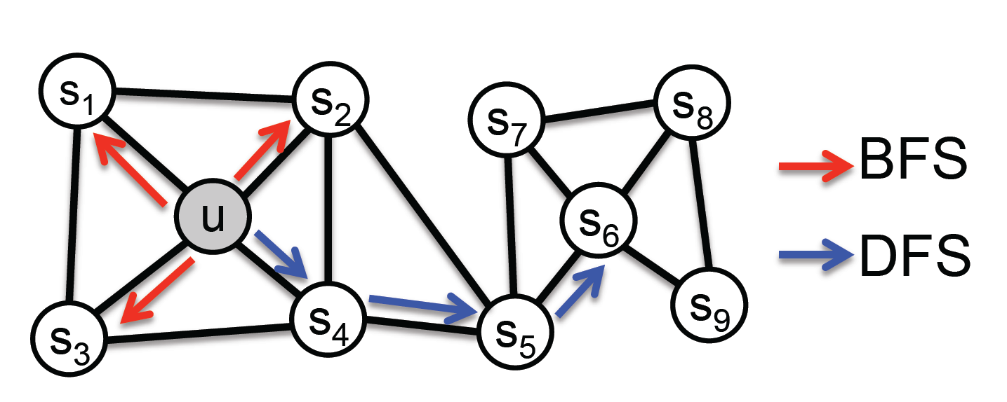
Main Idea
By choosing an appropriate notion, node2vec can learn representations that organize nodes based on their
network roles (structural equivalence) (BFS approach)
communities (homophily) (DFS approach)

