Slide 1
Word Vector Model

Slide 2
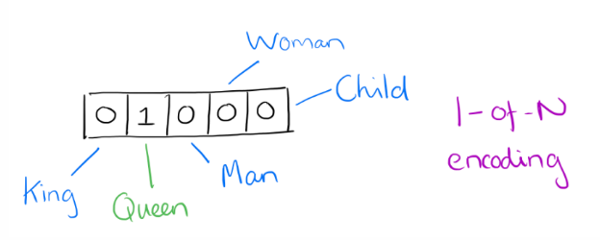
Word Vectors: One-Hot Encoding
Suppose our vocabulary has only five words: King, Queen, Man, Woman and Child. We can represent each word by a 0/1 vector of length five.
We could encode the word ‘Queen’ as:
King | Queen | Man | Woman | Child

Slide 3
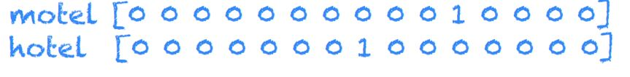
Word Vectors
In a simple 1-of-N (or ‘one-hot’) encoding every element in the vector is associated with a word in the vocabulary.
The encoding of a given word is simply the vector in which the corresponding element is set to one, and all other elements are zero.
One-hot representation:

Slide 4
Limitations of One-hot encoding
Word vectors are not comparable
Using such an encoding, there is no meaningful comparison we can make between word vectors other than equality testing.

Slide 5
Distributional Representation
Take a vector space with several hundred dimensions (say 300).
Each word is represented by a real vector of length 300.
King : 0.9, 0.8, 0.9, 0.9, ……..
Queen : 0.9, 0.2, 0.9, 0.9,………
Man : 0.1, 0.8, 0.2, 0.2,………
Woman : 0.1, 0.2, 0.2, 0.2,……
CEO: : 0.9, 0.5, 0.8, 0.8,…..
The representation of a word is spread across all of the dimensions in the vector, and each dimension in the vector convey some meaning of the word.
Power, Manliness, social connections, richness

Slide 6
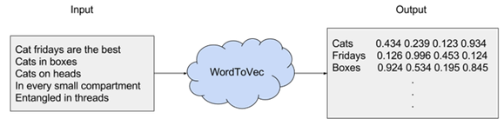
Word2Vec – A distributed representation
Any word in the corpus is given a distributional representation by an embedding in a d-dimensional vector.
For Example:

Slide 7
Word Embeddings
Similar words should have similar embeddings
Regularities should be observed as constant vector offsets between pairs of words sharing a particular relationship.

Slide 8
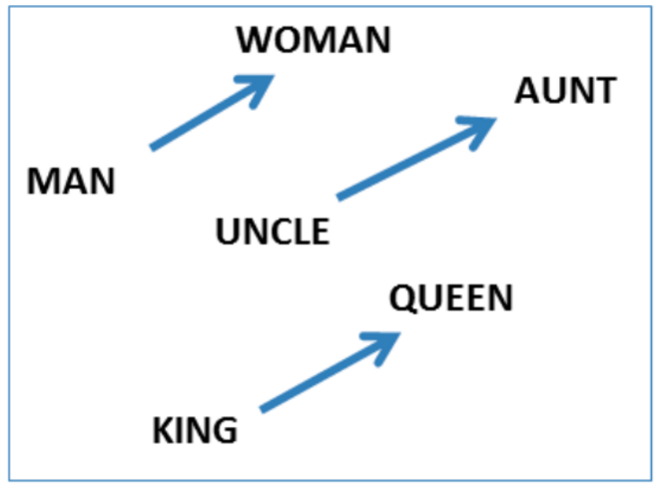
For a variety of semantic relations.
man - woman is same as king - queen

Slide 9
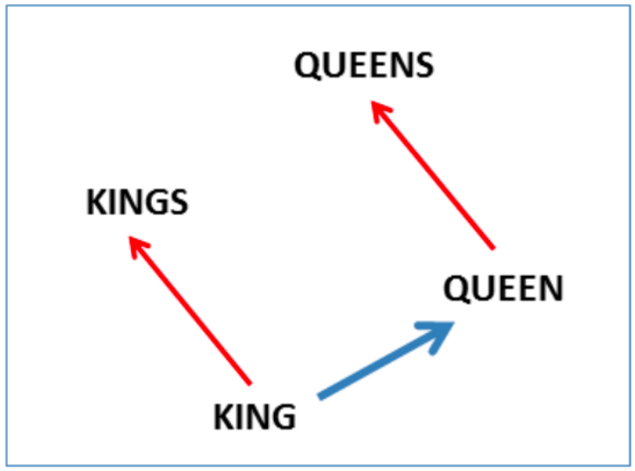

Slide 10
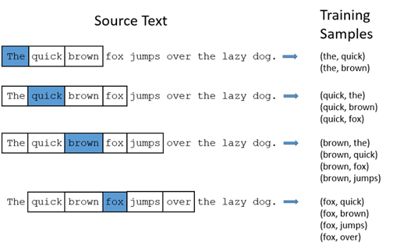
Word2Vec uses words upto k positions away from each word to create context of a given word.

Slide 11
Word2Vec: Data generation (window size = 2)
Example: d1 = “king brave man” , d2 = “queen beautiful women”
word | Word one hot encoding | neighbor | Neighbor one hot encoding
king | [1,0,0,0,0,0] | brave | [0,1,0,0,0,0]
king | [1,0,0,0,0,0] | man | [0,0,1,0,0,0]
brave | [0,1,0,0,0,0] | king | [1,0,0,0,0,0]
brave | [0,1,0,0,0,0] | man | [0,0,1,0,0,0]
man | [0,0,1,0,0,0] | king | [1,0,0,0,0,0]
man | [0,0,1,0,0,0] | brave | [0,1,0,0,0,0]
queen | [0,0,0,1,0,0] | beautiful | [0,0,0,0,1,0]
queen | [0,0,0,1,0,0] | women | [0,0,0,0,0,1]
beautiful | [0,0,0,0,1,0] | queen | [0,0,0,1,0,0]
beautiful | [0,0,0,0,1,0] | women | [0,0,0,0,0,1]
woman | [0,0,0,0,0,1] | queen | [0,0,0,1,0,0]
woman | [0,0,0,0,0,1] | beautiful | [0,0,0,0,1,0]

Slide 12
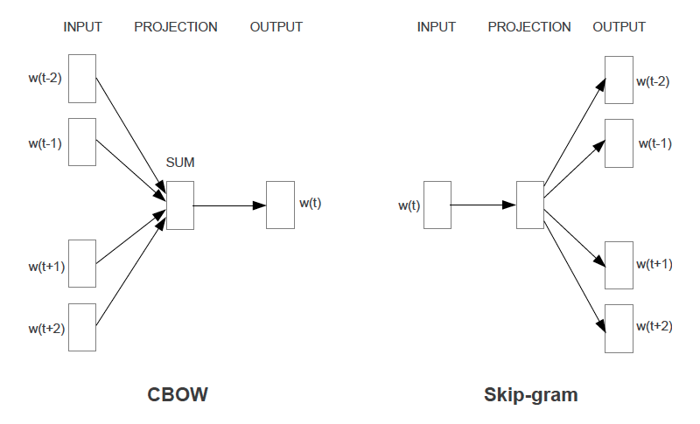
Two Variations: CBOW and Skip-grams

Slide 13
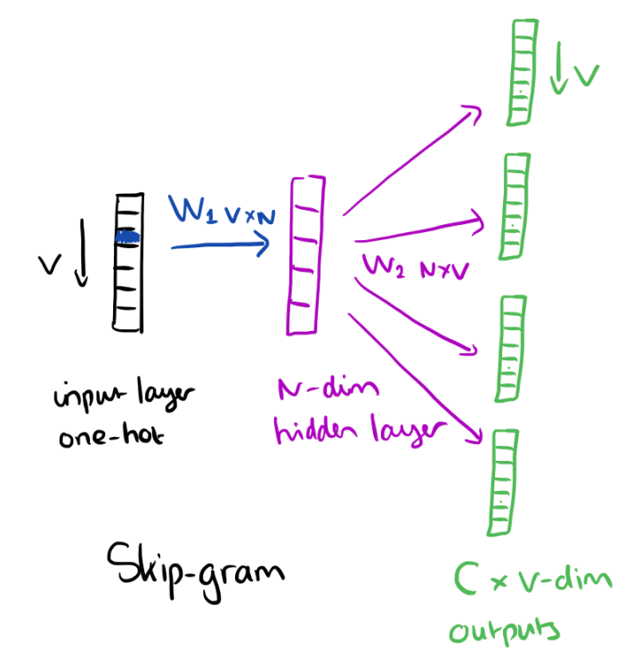
Skip-gram Model
It is constructed with the focus word as the single input vector, and the target context words as output layer

Slide 14
How does word2Vec work?
Represent each word as a d dimensional vector.
Represent each context as a d dimensional vector.
Initialize all vectors to random weights.
Arrange vectors in two matrices, U and V each of dimensions n*d and d*n respectively, where n is the number of words in corpus.

Slide 15
Word2Vec : Neural Network representation
Input layer
Hidden layer (linear)
Output (softmax)
Size n
Size d
Size n
U
V
w1
w2

Slide 16
Objective Function
The hidden layer simply amounts to copying the corresponding row from the weights matrix U (No activation function).
At the output layer, we now output probability of each word in corpus (using soft max activation).
The training objective is to maximize the summed prediction probabilities across all context words.

Slide 17
Word2Vec : Neural Network representation
Input layer
Hidden layer
Output (sigmoid)
king
1
0
0
0.5
brave
0
w1
0.5
man
0
w2
0
0
0
0
0

Slide 18
Word2Vec : Neural Network representation
Input layer
Hidden layer
Output (sigmoid)
0
0.5
king
brave
1
0
0
w1
0.5
man
0
w2
0
0
0
0
0

Slide 19
Word2Vec : Neural Network representation
Input layer
Hidden layer
Output (sigmoid)
0
0.5
king
0
0.5
brave
man
1
w1
0
0
w2
0
0
0
0
0

Slide 20
Word2Vec : Neural Network representation
Input layer
Hidden layer
Output (sigmoid)
0
0
0
0
0
w1
0
queen
1
w2
0
0
0.5
beautiful
0
0.5
women

Slide 21
Word2Vec : Neural Network representation
Input layer
Hidden layer
Output (sigmoid)
0
0
0
0
0
w1
0
0
w2
0.5
queen
beautiful
1
0
0
0.5
women

Slide 22
Word2Vec : Neural Network representation
Input layer
Hidden layer
Output (sigmoid)
0
0
0
0
0
w1
0
0
w2
0.5
queen
1
0.5
beautiful
women
0
0

Slide 23
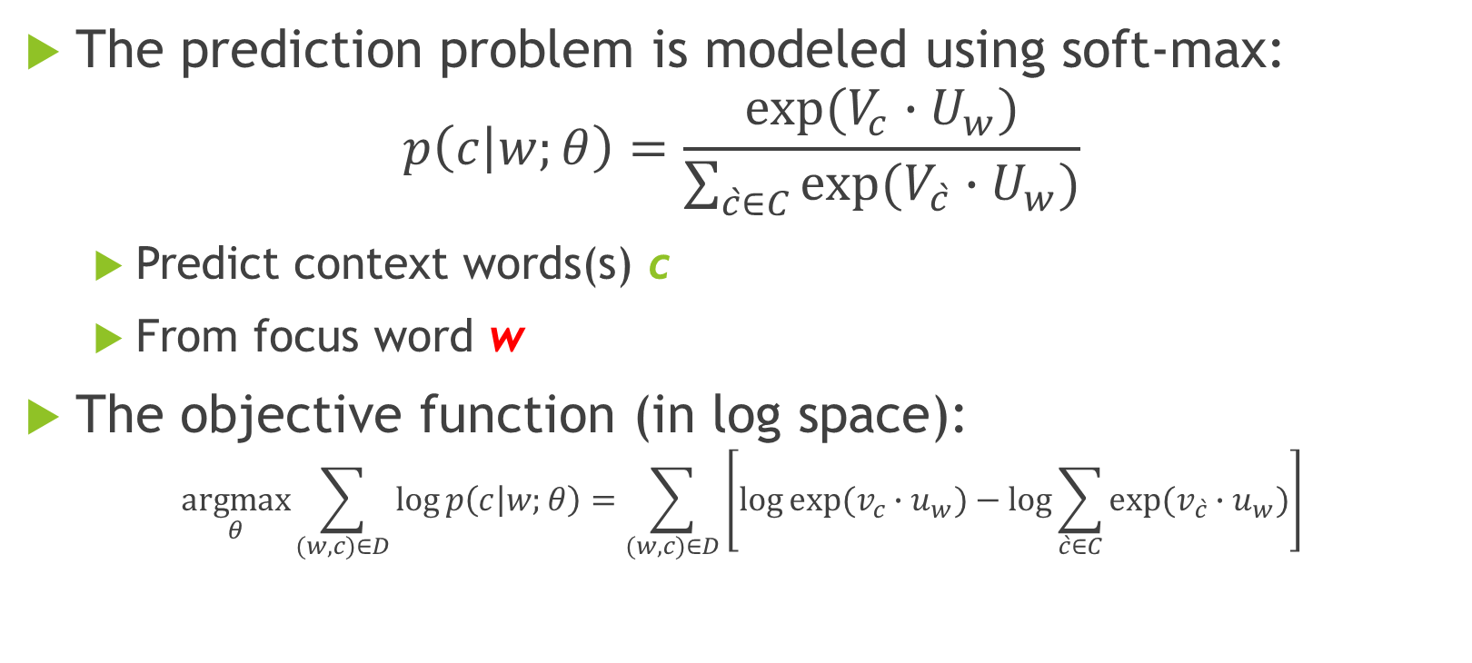
Skip-Ngram: Training method
The prediction problem is modeled using soft-max:
$$p\left(c | w;θ\right)=\frac{exp⁡(V_{c}∙U_{w})}{\sum_{\grave{c}∈C}{exp⁡(V_{\grave{c}}∙U_{w})}}$$
Predict context words(s) c
From focus word w
The objective function (in log space):
$$\underset{θ}{argmax}{\sum_{(w,c)∈D}{\log{p\left(c | w;θ\right)}}=\sum_{(w,c)∈D}{\left[\log{exp⁡(v_{c}∙u_{w})}−\log{\sum_{\grave{c}∈C}{exp⁡(v_{\grave{c}}∙u_{w})}}\right]}}$$

Slide 24
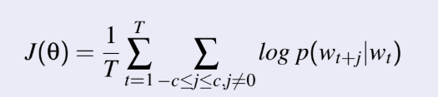
Skip-gram Model
Objective Function: Maximize the log probablility of any context word given
the current center word:

