Slide 1


Karnatak Law Society’s
Gogte Institute Of Technology, Belagavi
(A Permanently Affiliated and Autonomous Institute under Visvesvaraya Technological University, Belagavi | Accredited by NAAC A+ & NBA)
Department of Electronics and Communications Engineering
Internet of Things
By
^{Seema D Rathod}
(2GI20EC118)
Under the Guidance of:
Dr. Anupama S Awati
Assistant Professor, Dept. of ECE, KLSGIT, Belagavi

Slide 2
Executive Summary
Name: Government Tool Room and Training Center (GTTC)
Year of Establishment: 1997
Location: Industrial Estate, Udyambag, Belagavi 590008.
Contact: 0831-2442407/ 9141630309
Name of the Managing Director: Dr. Dinesh Kumar Y. K, I.F.S.
Name of the Principal: Sri B. G. Moger
Email: gttc_bgm@yahoo.com
Website: https://gttc.karnataka.gov.in/page/GTTC+Centres/Belagavi+STU-08/en
ABOUT:
GTTC was established in 1997 at Belagavi with the participation of the Karnataka State Government, in collaboration with the Government of Denmark under the Bilateral Development Co-operation Agreement. Proliferation of technology for development of the industries with supply of skilled manpower is the key to meet the needs of the global requirement.
VISION:
To emerge as an International Centre of Excellence in Training, Production, R&D and Consultancy Services, in Tooling, Precision Manufacturing Technologies, Mechatronics and Electronics - from concept to end-product
MISSION:
To continuously improve training skills, and develop innovative processes to optimize production, using the latest facilities, methodologies, trends and techniques to Meet the needs of all stakeholders and be the Leader in training.

Slide 3
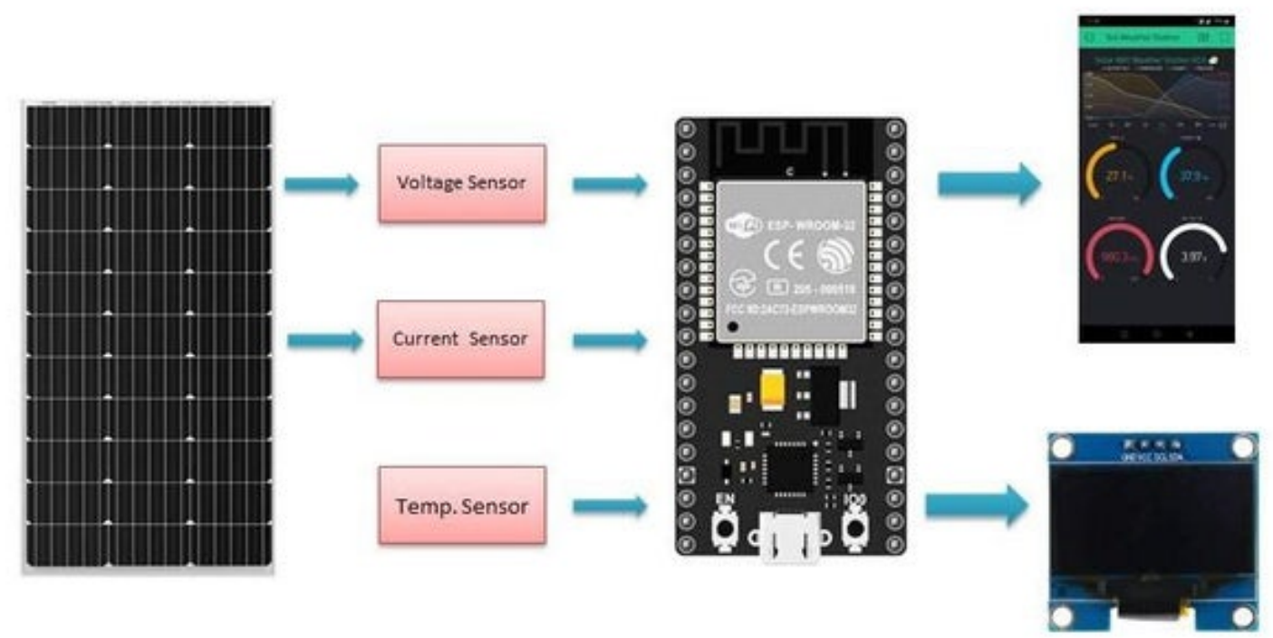
Introduction
IoT Fundamentals
Hardware and Sensor Integration
Data Acquisition and Processing
IoT Application and Case Studies

Slide 4
Internship Project Statement and Objectives
Project Statement:
Smart Solar Panel Monitoring System using IoT
Objectives:
Develop a solar panel monitoring system using IoT for clear insights into solar parameters, energy production, enhancing plant performance analysis.
You can track all the important parameters of the solar PV system in real-time from your smartphone providing transparency on system efficiency, simplifying monitoring and management.
Utilize IoT platforms for data processing, analysis, and visualization, enabling stakeholders to access and interpret solar panel performance metrics.

Slide 5
Internship Work Carried Out
How is the internship project implemented? The internship project is implemented through hands-on activities involving programming with Arduino IDE, interfacing with ESP32 microcontrollers, and utilizing ThingWorx and KepServer for IoT connectivity and data visualization.
Data Sources?
Data sources include sensors such as ACS758 for current measurement and ADS1115 for voltage measurement, interfaced with ESP32 microcontrollers.
Language used?
The primary language used for programming is C/C++ for Arduino IDE
Methods Used?
Methods used include setting up hardware connections, measuring sensor values, creating Blynk dashboards, and integrating with ThingWorx for data visualization.

Slide 6
Internship Work Carried Out
Methods Used?
Methods used include setting up hardware connections, measuring sensor values, creating Blynk dashboards, and integrating with ThingWorx for data visualization.
Which software?
Software utilized includes Arduino IDE for programming microcontrollers, ThingWorx for IoT platform development, and potentially Blynk for mobile/web dashboard creation.
Which Hardware?
Hardware components used may include ESP32 microcontrollers, ACS758 current sensor, ADS1115 ADC module, and OLED display for data visualization.

Slide 7
Internship Outcomes
Skills and qualifications you think that you have gained from the internship.
1. Programming Skills :
Proficiency in Arduino IDE, including libraries such as Blynk, Adafruit ADS1115, ACS758 and SSD1306 (OLED) and Etc.
Experience with Thingworx and KepServer connection and making user interface with thingworx.
2. Setting up the Circuit:
Setting the connection of ACS758, ADS1115 and OLED display to ESP32 .
Measuring the voltage by voltage divider rule.
Measuring the values of sensors and fetching the raw data from function.
3. Setting up the Blynk web/ Mobile dashboard:
Creating the templates and datastreams.
Adding the device and connecting with the Virtual pins.

Slide 8
Kind of responsibilities you have undertaken during the internship period.
1. Hardware Connections
2. Manual Calculations and Implementing it in code
3. Understanding the Pins and Data sheets
How do you think the internship activities that you carried out are correlated with your classroom knowledge?
1. Application of Theoretical concepts
2. Hands-on Programming and Implementation
3. Problem-Solving Skill
4. Communication and Collaboration
5. Continuous Learning and Adaptability

Slide 9
Thank You

