Slide 1

SENTENCE SIMILARITY USING BERT MODEL
BY-
AAYUSH BHARDWAJ(9920103136)
UNDER THE GUIDANCE OF-
DR. KRISHNA ASAWA

Slide 2
PROBLEM STATEMENT
Given a pair or set of sentences written in different languages, the objective of the multilingual sentence similarity problem is to compute a similarity score or similarity measure that quantifies the degree of semantic or structural similarity between these sentences. The similarity score should capture the underlying meaning or relatedness between sentences, irrespective of the languages in which they are written.

Slide 3
Objectives
Develop a model or system that can handle sentences in multiple languages with ease.
Ensure that the model captures the semantic meaning of sentences accurately, considering synonyms, paraphrases, and nuanced language-specific expressions.
Develop techniques for aligning sentences in different languages to facilitate meaningful cross-lingual comparisons. Translation may be required to create a common representation.
Explore the use of multilingual word embeddings or contextual embeddings (e.g., BERT, GPT) as a foundation for sentence similarity computation.

Slide 4
Work Done
Research in sentence similarity using BERT-based models has yielded a range of effective methods, such as Sentence-BERT, Universal Sentence Encoder, InferSent, and RoBERTa. These models have consistently achieved state-of-the-art performance on diverse sentence similarity benchmarks, highlighting the utility and versatility of BERT-based approaches in accurately measuring the semantic similarity between sentences.

Slide 5
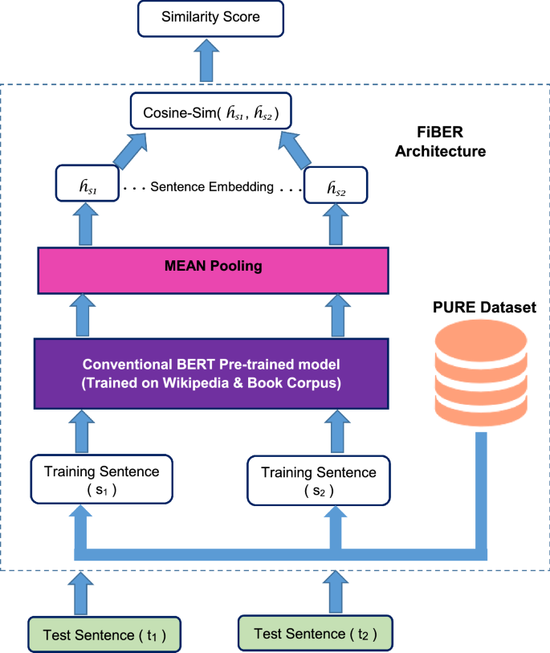
Proposed Design

Slide 6
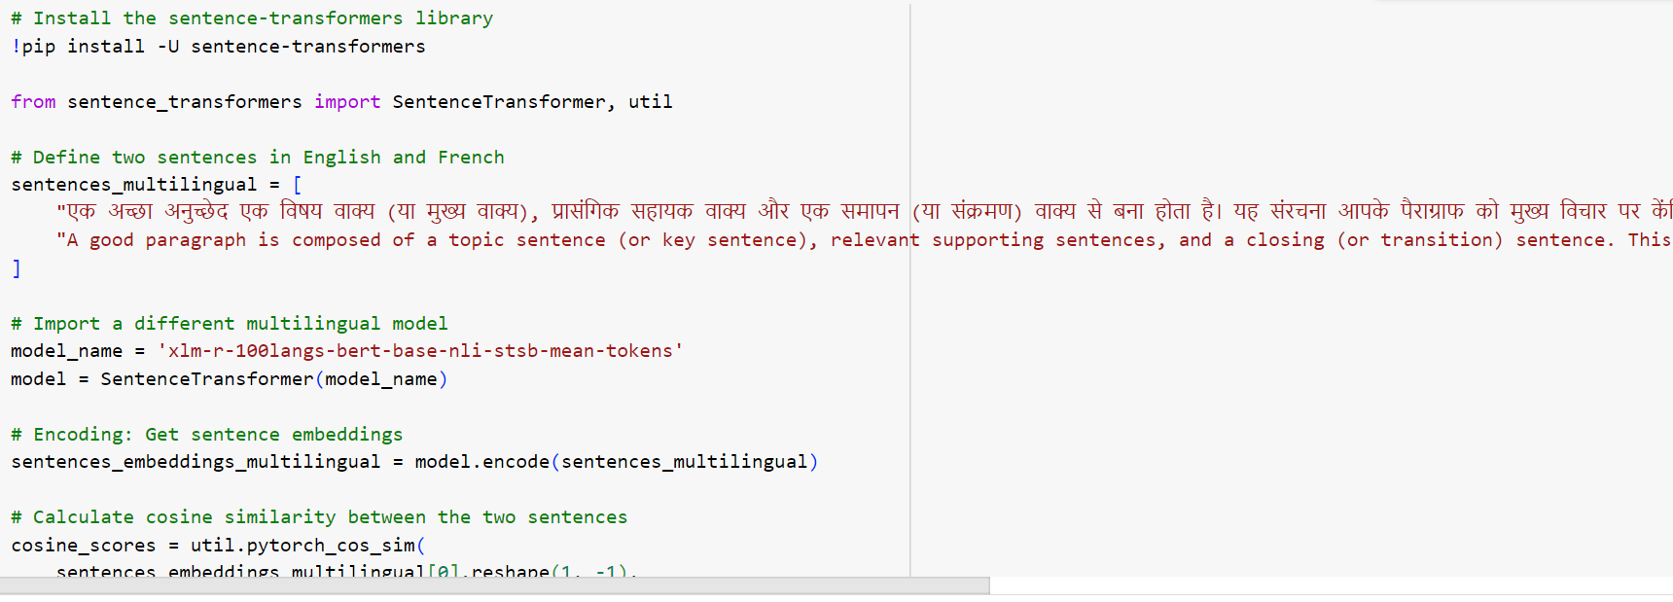
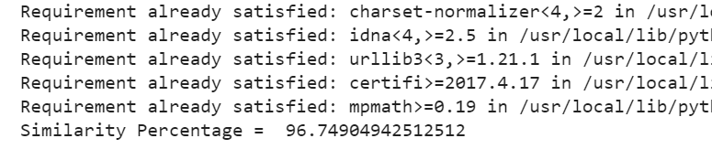
Implementation

Slide 7
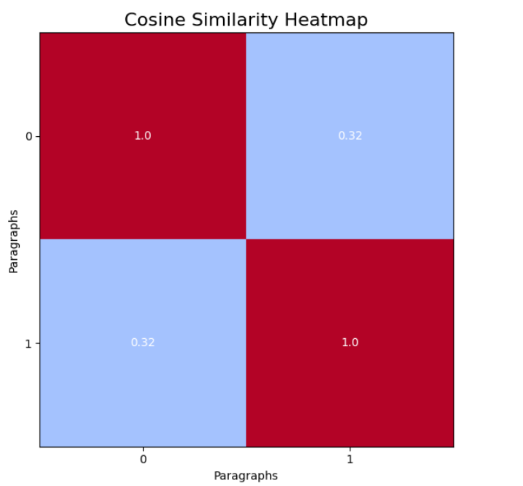
Implementation

Slide 8
Software Used
PYTHON
SCIKIT-LEARN
NUMPY LIBRARY
BERT MODEL

Slide 9
Multilingual sentence similarity, a crucial area in natural language processing (NLP), has been a subject of extensive research. The fundamental aim of this task is to accurately quantify the semantic similarity between sentences composed in different languages. Several effective methodologies have emerged in this field, such as multilingual extensions of BERT, XLM-R, mUSE, and LASER, which have consistently achieved state-of-the-art results on diverse multilingual benchmarks. Ongoing research in multilingual sentence similarity holds the potential to further enrich cross-lingual communication and advance a wide array of multilingual NLP applications by refining our ability to measure sentence relatedness across linguistic boundaries.
Conclusion

Slide 10
Future Scope
The future of multilingual sentence similarity holds promise for:
Enhanced multilingual models.
Cross-modal similarity (e.g., text to image).
Support for low-resource languages.
Domain-specific applications.
Ethical considerations for fairness.
Educational tools and global business applications.
Policy analysis and diplomacy.
Improved human-machine interaction.
It will continue to impact various domains and facilitate cross-lingual communication and understanding.

