Slide 1

Sector 29, Pradhikaran, Akurdi, Pune - Maharashtra, INDIA 411044
(Establishment by Maharashtra Act No. LXIII of 2017)
School of Computer Science, Engineering & Applications
BRAIN-TO-TEXT
Neural Signal Decoding via GRU based Deep Learning and Web Development Group No : 34
Presented By:
Sidheshwar Sharma — 20220802331
Ayush Chougule — 20220802333
Uday Tomar — 20220802412
Guided By:
Dr. Gaurav Kumar Singh
Sr. Assistant Professor, SCSEA
Notes:
WHAT TO SAY: Good [morning/afternoon]. Our final year project is the SDG Forecast Dashboard — an AI-powered system that forecasts India's state-level performance on key Sustainable Development Goals. Over the next few minutes, we'll walk you through the problem we tackled, the approach we took, the results we achieved, and how our interactive dashboard brings it all together.

Slide 2

Contents
Introduction & Motivation
Problem Statement
Literature Review & Gap Analysis
Objectives
Proposed Methodology
Results and discussions
Conclusions
References

Slide 3
Introduction & Motivation
Neural decoding pipeline that takes raw intracortical neural recordings (512-channel electrode array data) from a paralyzed participant, decodes them into phoneme sequences using deep learning (RNN/GRU with CTC loss), and then converts those phonemes into readable English text using dictionary lookup + LLM fallback.
Motivation :
We came across a Brain-Computer Interface (BCI) competition on Kaggle and got curious about how BCIs actually work.
While exploring the project and dataset, we found the concept of interpreting brain signals using AI and machine learning really interesting.
This motivated us to build the project ourselves as a way to learn more about EEG signals, Brain-Computer Interfaces, and real-world AI applications.

Slide 4
Problem Statement
Most existing Brain Computer Interface models are designed mainly for clinical testing and research purposes, while very few ready-to-use inference models are publicly available.
Brain Computer Interface systems require high computational power because they process large amounts of complex EEG and neural signal data in real time.
The data schema is highly complex and noisy, which makes analyzing, preprocessing, and building reliable models more challenging.

Slide 5
Literature Review & Gap Analysis
# | Paper / Source | What They Did | Their Approach
1 | Willett et al. (2023) — Stanford BrainGate | Converted brain signals into handwritten text | RNN + Language Model
2 | Meta AI (2022) — Speech Neuroprosthesis | Converted brain activity into speech | Transformer Encoder
3 | Kaggle Brain-to-Text '25 Baseline | Provided starter code for brain-to-text decoding | Pre-trained RNN + N-gram Language Model
4 | BrainGate Clinical Trial Papers | Helped paralyzed patients communicate using BCI | Recurrent Neural Networks (RNN/GRU)
5 | CTC-based Speech Recognition (Graves et al.) | Improved sequence prediction from signals | CTC Loss + RNN
Approach | How It Works | Advantage | Limitation
Direct Word Prediction | Brain signals → Predict complete words directly | Simple and fast | Limited vocabulary, cannot predict new words
Character-level Decoding | Brain signals → Predict letters one by one | More flexible and can form new words | Slower and harder to accurately map brain signals to letters

Slide 6
Objectives
Objectives | How We Achieved It
Decode Phoneme from brain signals | Used EEG/BCI brain signal data with deep learning models
Evaluate multiple neural network architectures | Tested different models such as RNN, GRU, and Transformer-based approaches
Minimize phoneme error rate | Applied preprocessing, feature extraction, and model optimization techniques
Build an end-to-end Brain-to-Text pipeline | Integrated data preprocessing, model training, inference, and decoding into one workflow
Build a real-time demonstration interface | Developed an interface for live signal input and text output visualization
Outcome : Research Paper
https://drive.google.com/drive/folders/1msObycNHTl3uLcKsOTvhjlVXWxcPzith?usp=sharing

Slide 7
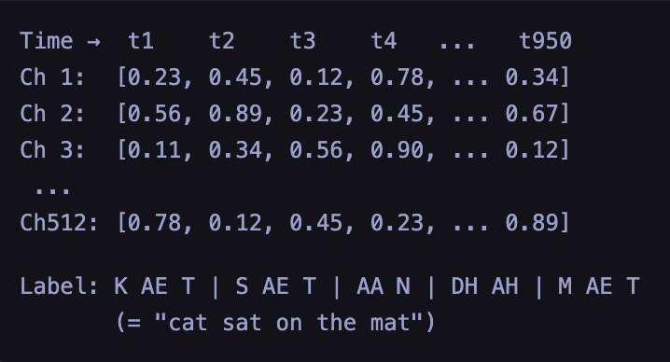
Dataset
Dataset Information
The dataset is a Brain-Computer Interface (BCI) neural speech dataset designed for Brain-to-Text and imagined speech decoding research.
Neural activity was recorded from the T15 clinical trial participant over nearly 2 years of data collection.
Brain signals were captured using 512 implanted electrodes, which recorded neural activity while the participant attempted or imagined speaking words and sentences.
The dataset contains approximately 10,000+ speech-related trials, providing a large-scale dataset for training deep learning models.
Dataset Type
Neural signal / EEG-like intracortical time-series dataset
Sequential brain activity data for speech decoding tasks
Dataset Format
Stored primarily in .npy (NumPy array) format
Each sample has dimensions similar to (T × 512) where:
T = Number of time steps
512 = Electrode channels/features
Data Cleaning & Preprocessing
The dataset originally contained around 45 recording sessions
Out of these, 4 sessions were removed because they did not contain proper training, validation, or testing data
Each session had different timestamp lengths, creating inconsistency in sequence dimensions
To standardize the data, zero padding was applied so all samples matched the longest timestamp sequence
After preprocessing, all sessions were concatenated into complete datasets for:
Training
Validation
Testing
Final dataset split ratio used was 8:1:1 for Train, Validation, and Test sets respectively

Slide 8
Methodology
Phase 1 — Data Ingestion & Preprocessing
Collected neural/brain signal data from the dataset
Performed data cleaning and preprocessing to remove noise and prepare signals for training
Converted the processed data into a model-ready format for deep learning pipelines
Phase 2 — Model Training & Evaluation
Trained 8 different models using 4 neural network architectures:
RNN
LSTM
GRU
Transformer
Each architecture was tested in two modes:
Pretrained
Trained from Scratch
Evaluated models using performance metrics such as Phoneme Error Rate (PER) and Validation Loss
Saved the best-performing trained models as .pth files for inference and deployment
Phase 3 — Real-Time Inference System
Developed a Flask API backend for real-time prediction
Users upload neural data through the web dashboard/interface
The uploaded data is sent to backend API endpoints
Backend loads the trained .pth models and performs inference
Final decoded text output is generated and displayed to the user in real time

Slide 9
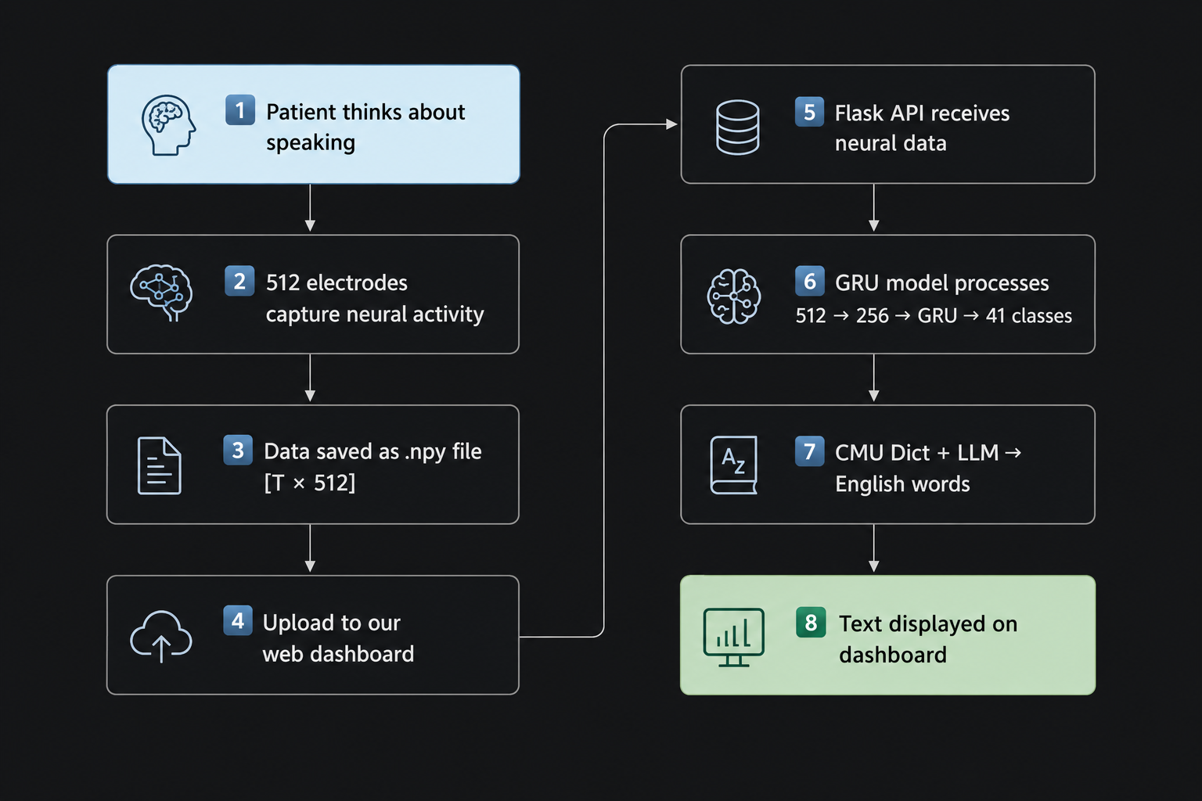
Flow Diagram

Slide 10
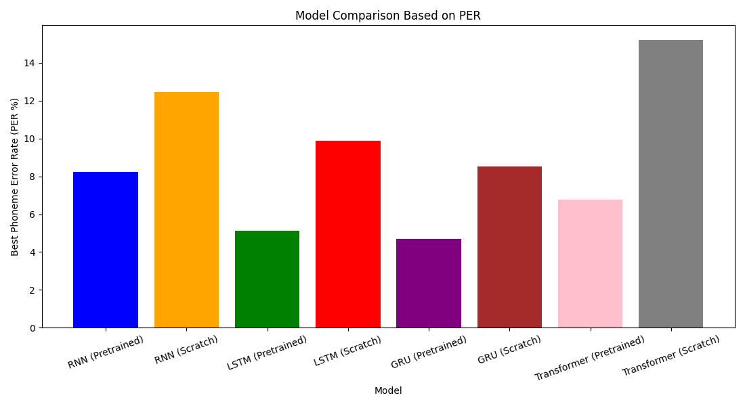
Model Evaluation Results
Phoneme Error Rate Comparison of different models
Notes:
WHAT TO SAY: We validated models using a temporal holdout — we trained on 2018 to 2021 and predicted 2022 and 2023. The results are clear: our linear regression model beats the naive baseline across all three SDGs. Health and education achieve R-squared values above 0.70, which is acceptable for governance forecasting. Climate shows slightly more variance — expected, since it's influenced by policy changes and environmental shocks.

Slide 11
Results and Discussion
Word Error Rate (WER) measures how many words are predicted incorrectly out of 100 words. Lower WER indicates better speech-to-text performance
Our model achieved a WER of 4.68%, meaning only around 5 words out of every 100 were predicted incorrectly.
We used WER because it is the industry-standard evaluation metric for speech-to-text systems and is widely used by major companies such as Google and Amazon Lex, as well as in most published research papers.
Using WER also allows fair comparison with existing published literature, since almost all state-of-the-art speech and brain-to-text research evaluates performance using the same metric.
Notes:
WHAT TO SAY: We validated models using a temporal holdout — we trained on 2018 to 2021 and predicted 2022 and 2023. The results are clear: our linear regression model beats the naive baseline across all three SDGs. Health and education achieve R-squared values above 0.70, which is acceptable for governance forecasting. Climate shows slightly more variance — expected, since it's influenced by policy changes and environmental shocks.

Slide 12
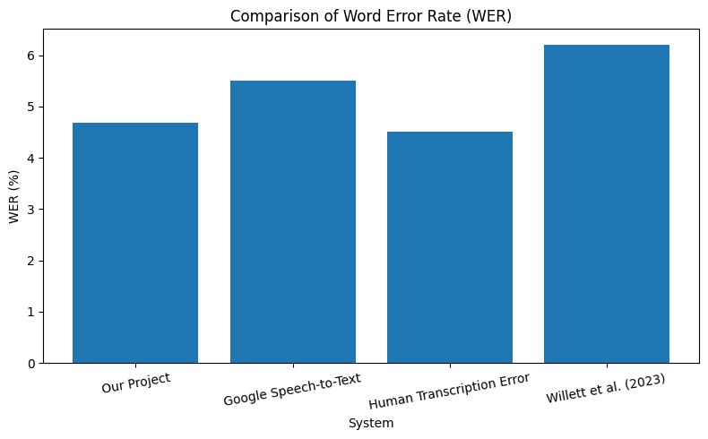
Conclusion
Successfully decoded imagined speech from brain signals into readable text using deep learning.
Among all tested architectures, the GRU model with pretrained weights achieved the best performance with a 4.68% WER.
The model outperformed simpler RNNs and more complex Transformer-based approaches on limited neural data.
Achieved performance comparable to or better than several existing speech-to-text and brain-to-text benchmarks, including human-level transcription accuracy.
Demonstrated a complete end-to-end brain-to-text pipeline, showing strong potential for assisting individuals with speech disabilities.
Notes:
WHAT TO SAY: To summarize — we built 108 regression models, generated forecasts for 2024 through 2026, and achieved an R-squared of 0.74 for health forecasting. Our models beat the baseline by an average of 27% on error. The key takeaway: you don't need a massive deep-learning pipeline to build governance-relevant AI tools. Simple, interpretable models — combined with good visualization — create real policy value. Future work will expand to ARIMA models, all 17 SDGs, and district-level data.

Slide 13
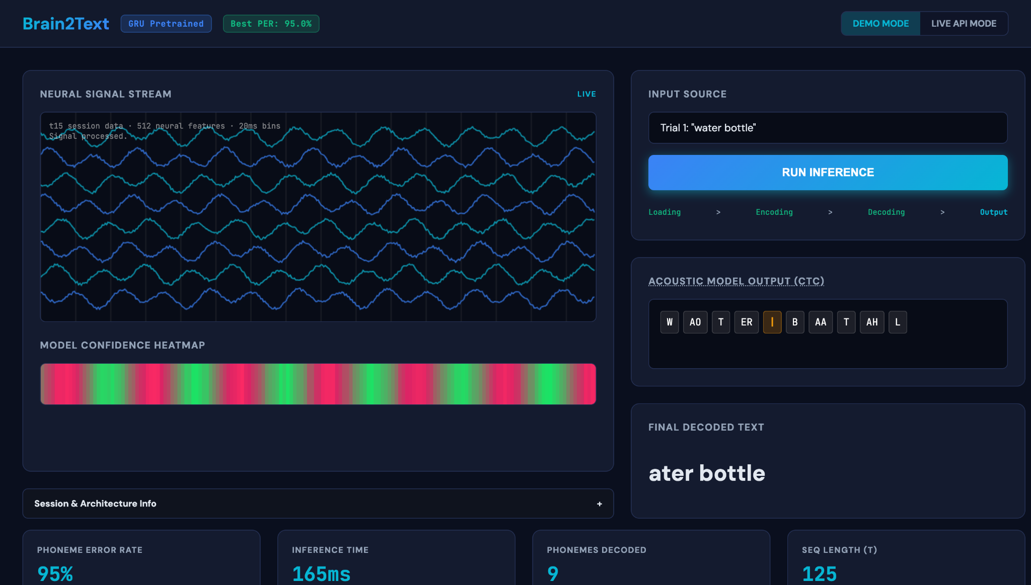

Slide 14
Project Outcome
We Have Submitted a Research Paper Based on This Project at IRIJET
Brain2Text: A Reproducible, CPU-Deployable Framework for Neural Speech Decoding with Browser-Accessible Inference
UNDER REVIEW https://drive.google.com/drive/folders/1msObycNHTl3uLcKsOTvhjlVXWxcPzith?usp=sharing
Authors: Sidheshwar Sharma, Ayush Chougule, Uday Tomar
Key Contributions Highlighted in the Paper
We developed this research project to create a more practical and real-time Brain-to-Text system, since most existing papers mainly focus on research experiments rather than usable inference models.
We integrated a fallback LLM mechanism to improve text generation and handle uncertain predictions more effectively during decoding.
Our goal was to build an end-to-end pipeline capable of processing real-time neural data and generating meaningful text outputs, which is still limited in many existing BCI research works.

Slide 15
References
Willett, F. R., Avansino, D. T., Hochberg, L. R., Henderson, J. M., & Shenoy, K. V. (2021). "High-performance brain-to-text communication via handwriting." Nature, 593, 249–254.
Willett, F. R., Kunz, E., Fan, C., Avansino, D. T., Wilson, G., Choi, E. Y., Kamdar, F., Hochberg, L. R., Druckmann, S., Shenoy, K. V., & Henderson, J. M. (2023). "A high-performance speech neuroprosthesis." Nature, 620, 1031–1036.
Graves, A., Fernández, S., Gomez, F., & Schmidhuber, J. (2006). "Connectionist Temporal Classification: Labelling Unsegmented Sequence Data with Recurrent Neural Networks." Proceedings of the 23rd International Conference on Machine Learning (ICML).
Cho, K., van Merriënboer, B., Gulcehre, C., Bahdanau, D., Bougares, F., Schwenk, H., & Bengio, Y. (2014). "Learning Phrase Representations using RNN Encoder–Decoder for Statistical Machine Translation." arXiv:1406.1078.
Hochreiter, S. & Schmidhuber, J. (1997). "Long Short-Term Memory." Neural Computation, 9(8), 1735–1780.
Vaswani, A., Shazeer, N., Parmar, N., Uszkoreit, J., Jones, L., Gomez, A. N., Kaiser, Ł., & Polosukhin, I. (2017). "Attention Is All You Need." Advances in Neural Information Processing Systems (NeurIPS).
Notes:
WHAT TO SAY: These are our key references. Our primary data source is the NITI Aayog SDG India Index, supported by a strong body of literature on machine learning for development, linear regression for governance forecasting, and interactive dashboard design.

Slide 16
Thank You!
Brain - To - Text · B.Tech Final Year Project
Sidheshwar Sharma · 20220802331 | Ayush Chougule · 20220802333 | Uday Tomar · 20220802412
Guided by Dr. Gaurav Kumar Singh · SCSEA, D Y Patil International University, Akurdi, Pune
Open for Questions
Notes:
WHAT TO SAY: Thank you for your time and attention. We're happy to take any questions about our methodology, results, or the dashboard. We welcome feedback on how this tool could be extended or improved for real governance use.

