Slide 1


Slide 2
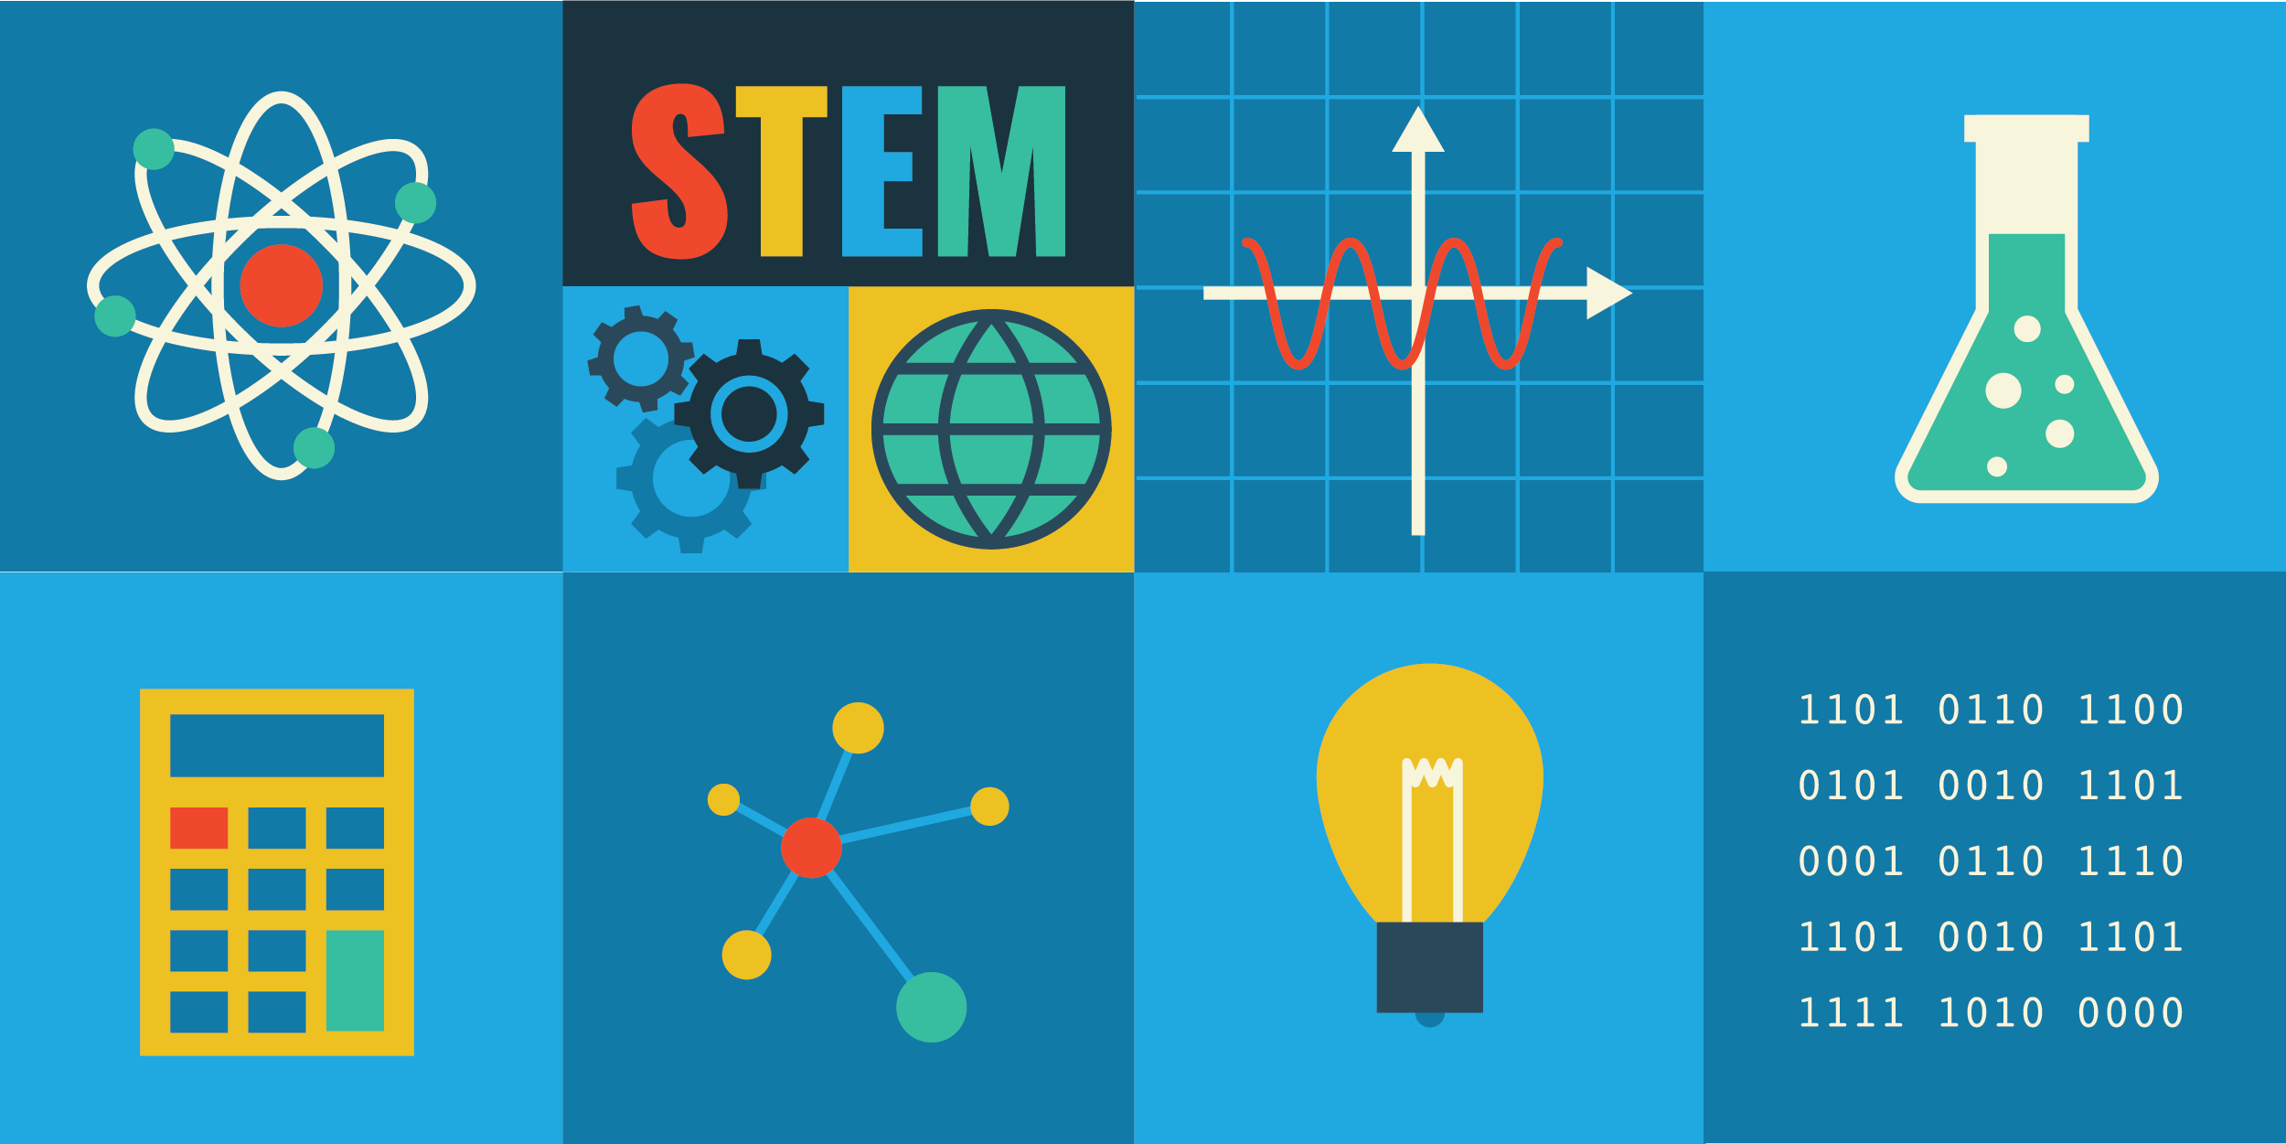
STEM

Slide 3
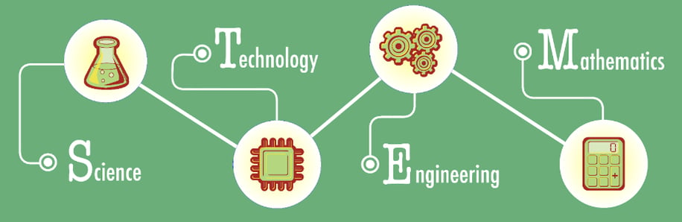
What is STEM ?
STEM stands for Science, Technology, Engineering, and Mathematics. It is an educational approach that integrates these subjects to help students develop creativity, problem-solving, and innovation skills. STEM education equips students with the knowledge and skills needed for future careers and effective problem-solving.

Slide 4
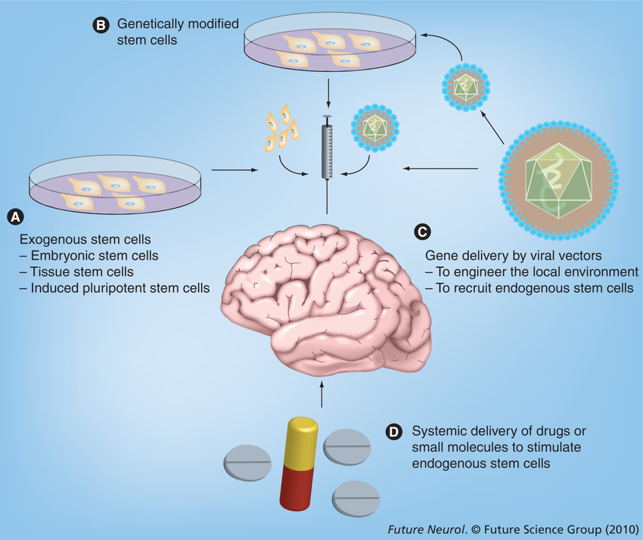
Main components of STEM
Science: Science studies the natural world and the principles behind it.
It includes subjects like Physics, Chemistry, Biology, and Environmental Science.
Science teaches us how the universe and things around us work.

Slide 5
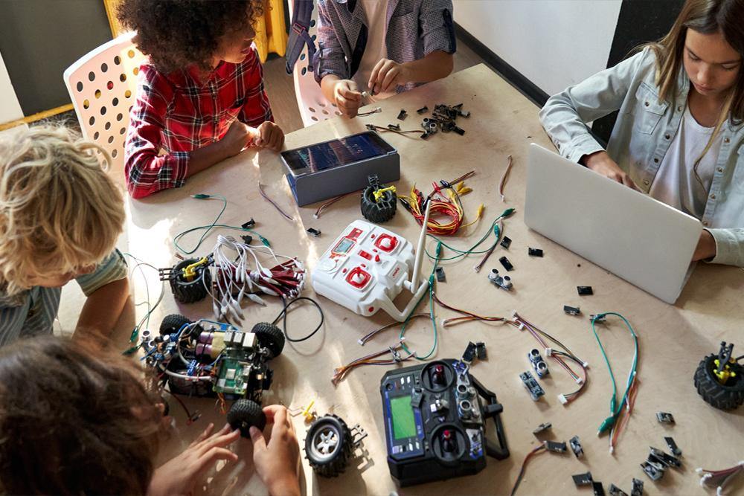
Technology:
It involves the development and use of digital tools, software and technical systems.
For example, coding, artificial intelligence (AI), robotics, and cybersecurity.
The main objective of technology is to make life simple and effective.

Slide 6

Engineering:
It deals with problem-solving and designing.
Machines, bridges, buildings and other structures are created through engineering.
It is a combination of creativity and technical knowledge.

Slide 7
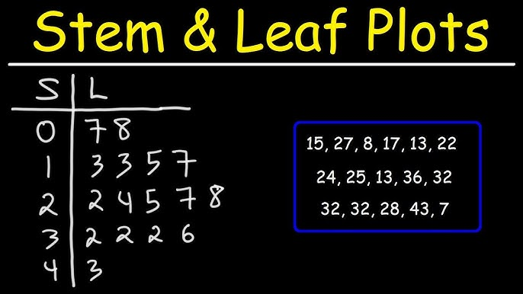
Mathematics:
Mathematics provides the foundation for analyzing data, problem solving, and reasoning.
It includes areas like arithmetic, geometry, statistics, and algebra.
Mathematics connects every part of STEM.

Slide 8
Why STEM?
Create and Learn New Things: STEM helps you understand science, technology, engineering, and math, sparking creativity to build apps, run experiments, and design gadgets.
Inventions: STEM prepares you for careers in exciting fields like robotics, AI, and spacecraft design.
Solve Problems: STEM teaches you how to think logically and solve real-world problems like saving energy or fixing design issues.

Slide 9
Why is Science important ?
New Medicines: Science helps develop life-saving medicines like vaccines, antibiotics, and cancer treatments.
Understanding the Environment: It helps us address environmental issues like pollution and climate change, supporting sustainable development.
Space Exploration: Science enables space travel, including landing on the Moon, studying Mars, and developing satellite technology.

Slide 10
Why is Technology important ?
Talking to Friends: Technology allows us to connect with friends and family anytime, anywhere through mobiles and social media.
Online Study: It makes education accessible with virtual classes, online courses, and e-learning, especially helpful during the pandemic.
Game Play: Technology enhances entertainment with interactive and educational games on computers, mobiles, and consoles.

Slide 11
Why is Engineering important ?
New Inventions: Engineering drives innovation, creating technologies like appliances, robots, and smart homes that simplify life.
Transportation: Engineering enables fast, safe travel with cars, bullet trains, and airplanes.
Farming: Engineering improves farming with tractors, harvesters, and irrigation, reducing labor and increasing production.

Slide 12
Why is Mathematics important ?
Buying things from the shop: Mathematics helps calculate prices, apply discounts, and manage payments, teaching money accounting.
In making trains and rockets: Mathematics is crucial in engineering and science, used to design, calculate speed, and improve vehicle and rocket efficiency.
In counting scores in games: Mathematics is used to calculate scores and analyze performance in sports like cricket and football, aiding in strategy formulation.

Slide 13
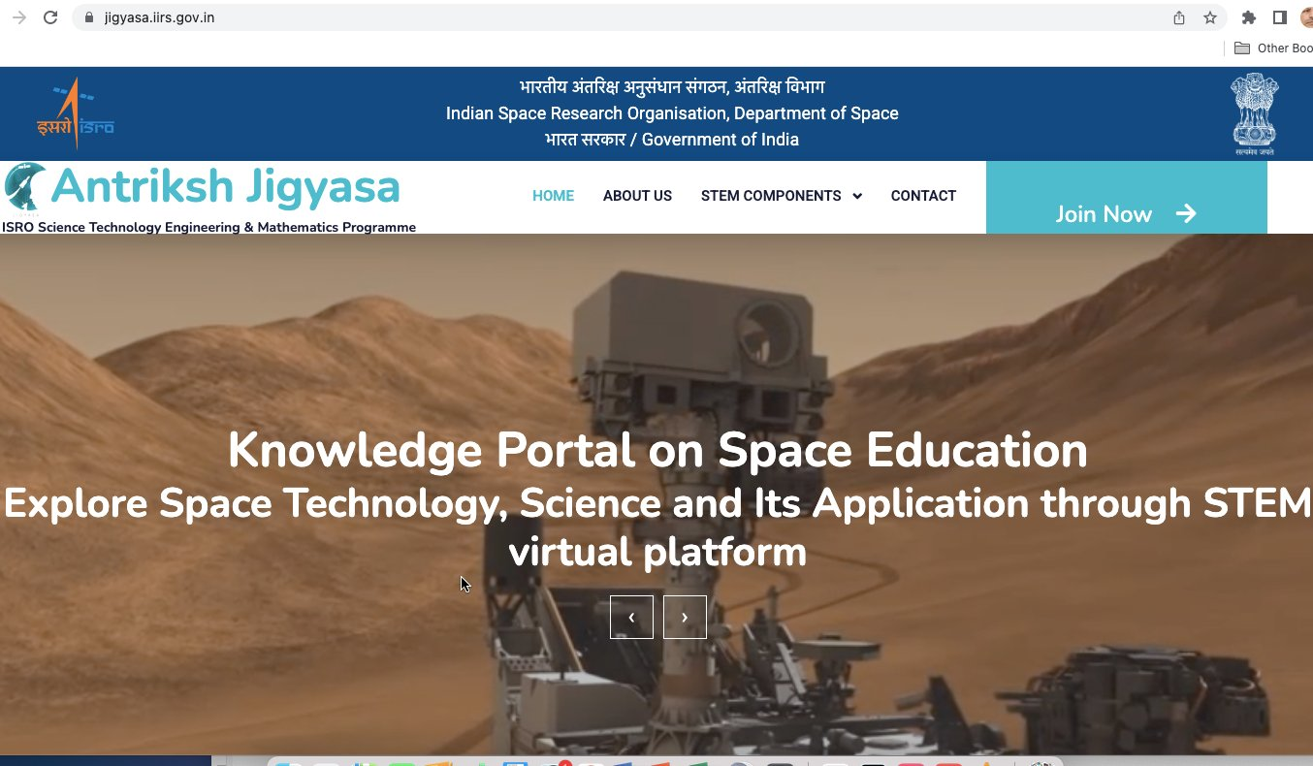
Contribution of STEM in India
India has made major strides in STEM, with ISRO's Chandrayaan and Mangalyaan missions highlighting its space achievements.
The Digital India initiative has expanded digital access, improving education, healthcare, and services, while creating new opportunities across sectors.

Slide 14



Thank You

