Slide 1
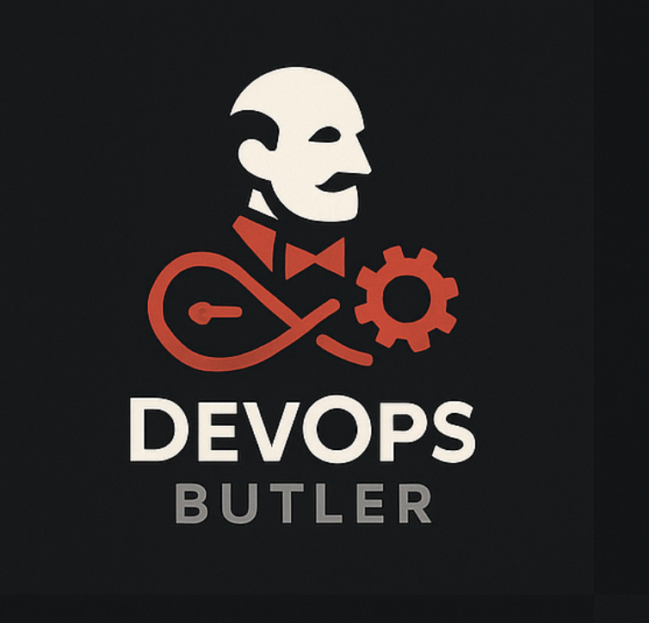
DevOps Butler

Slide 2
Zero-Configuration Deployments from Git to Container Agenda
The Problem: The Complexity of Modern Deployments
The Solution: Introducing DevOps Butler
Core Features: What Makes It Powerful?
How It Works: The Automated Deployment Pipeline
Technology Stack: The Tools Behind the Magic
Live Demonstration
Testing & Results
Conclusion & Future Roadmap
Q&A

Slide 3
The Problem: The Deployment Dilemma
Developers want to ship code, not manage infrastructure. However, the path from code to a running application is filled with challenges:
Complex Configuration: Manual docker commands, writing shell scripts, and managing ports is tedious and error-prone.
Repetitive Manual Steps: Cloning, building, running, and cleaning up for every change consumes valuable time.
Lack of Visibility: The build process is often a "black box," making it hard to debug failures quickly.
Resource Conflicts: Stale containers and conflicting port assignments can halt development.

Slide 4
The Solution: A Personal PaaS
DevOps Butler is a sophisticated, automated deployment assistant that transforms a Git repository into a running, containerized application with a single click.
It is a self-hosted, lightweight Platform-as-a-Service (PaaS) that automates the entire deployment pipeline, providing a seamless, zero-configuration experience for developers.
Our Vision: To deliver a convenient and powerful local PaaS experience, abstracting away the complexities of container orchestration.

Slide 5
Core Features
🚀 One-Click Deployments Start an entire deployment from a Git URL with a single click.
🧠 Intelligent Analysis Automatically detects Dockerfile or docker-compose.yml to choose the optimal deployment strategy.
📡 Real-time Logging Live, color-coded logs are streamed via WebSockets directly to your browser.
⚡ Idempotent Deployments Automatically cleans up previous deployments before starting new ones to prevent conflicts.
🗑️ Full Lifecycle Management A beautiful UI to view all running applications and a "destroy" function for complete cleanup.

Slide 6
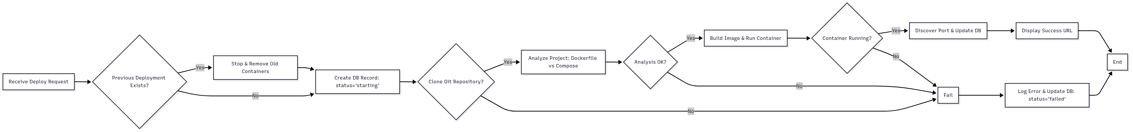
How It Works: The Automated Pipeline

Slide 7
The Technology Stack
DevOps Butler is built on a modern, high-performance, and open-source tech stack.
Backend Framework: FastAPI (Python)
Frontend: HTML5, CSS3, JavaScript (Vanilla)
Real-time Communication: WebSockets
Database: SQLite with SQLModel ORM
Orchestration Engine: Python (subprocess, asyncio)
Containerization: Docker & Docker Compose

Slide 8
Live Demonstration
Let's see DevOps Butler in action!

Slide 9
Testing & Result Analysis
Test Case Category | Description | Result
Deployment Pipeline | Dockerfile, docker-compose, broken configs, invalid URLs. | Pass
Lifecycle Management | Destroy, redeploy (idempotency), non-existent containers. | Pass
UI & Real-time Logs | Live log streaming, URL display, history updates. | Pass
User Authentication | Registration, successful login, failed login attempts. | Pass

Slide 10
Conclusion
DevOps Butler successfully delivers on its promise of zero-configuration deployments.
It effectively automates a complex and error-prone workflow.
It provides a superior developer experience through its intuitive UI and real-time feedback.
The architecture is robust and reliable, with features like idempotency and complete resource cleanup.
It serves as a powerful foundation for a more comprehensive, production-ready PaaS.

Slide 11
Future Roadmap
Multi-Environment Support: Staging, Production environments.
Automatic Health Checks: Monitor and restart unhealthy applications.
Resource Monitoring: Track CPU, memory, and disk usage.
Custom Domains & SSL/TLS Support: Map custom domains with automatic HTTPS.
PaaS Transformation: Deploy to cloud providers like AWS, GCP, or Azure.

Slide 12
Thank You Questions?
Find the project on GitHub:
https://github.com/aayush786-21/DevOps-Butler

