Slide 2
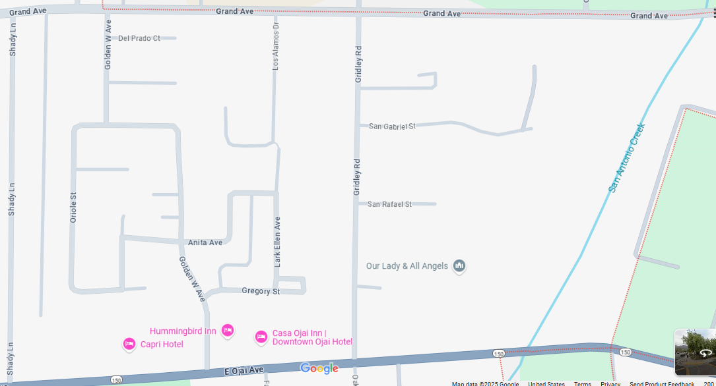
Map from Google Map
Let’s take an example of this google map.
We are going to make intersections nodes and then the connection the edges.
Let’s see how we can do that.

Slide 3
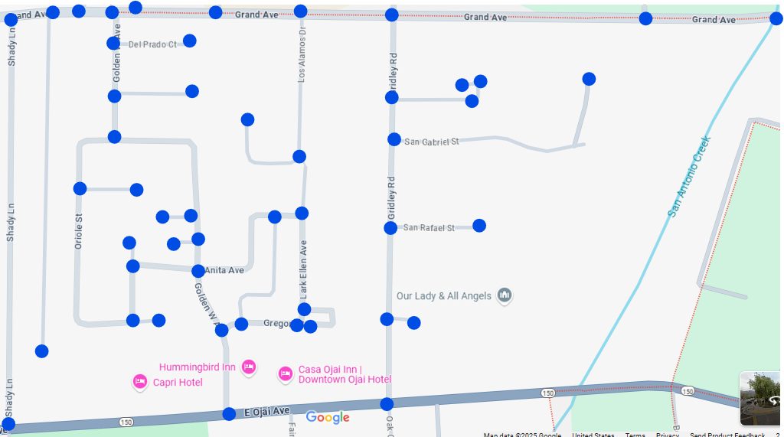
Nodes representation
This is how we can represent Nodes.

Slide 4
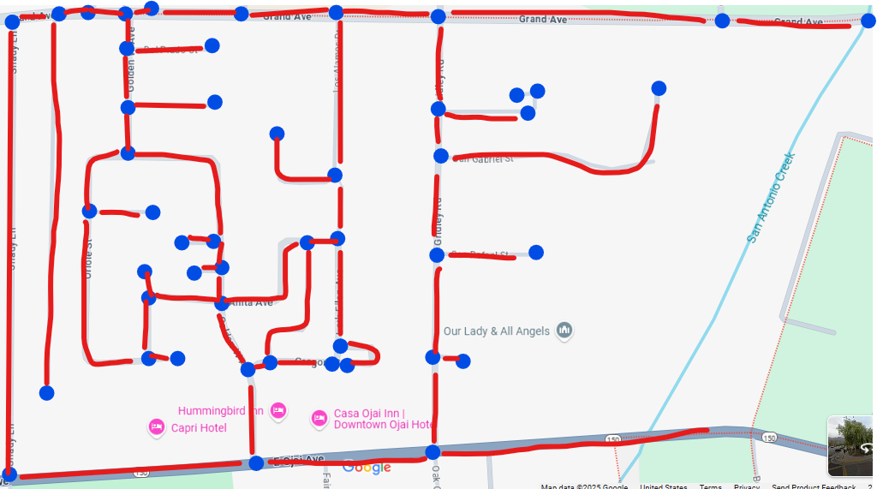
Both node and edge representation
This is how we can represent a map into a graph.
Blue are nodes and red are edges.

Slide 5
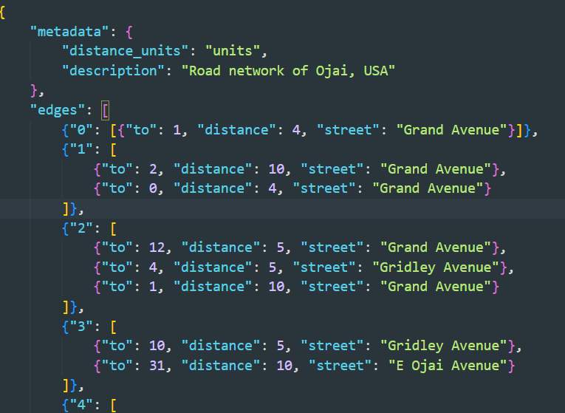
How can we represent this in code?
There are two ways: making an adjacency matrix or making an adjacency list.
We are using adjacency list to store our graph.
This is JSON format so its not technically a graph just data.

