Slide 1

PAYMENTS · BANKING · FINSERV
AI-Powered
Self-Serve Analytics
Reducing Decision Latency from Days to Seconds
Democratize analytics using AI
Aayush · Badal · Snehal

Slide 2



SITUATION
Businesses generate massive data but rely on centralized analytics teams
Millions
100%
SQL
Daily Transactions
Analytics Team Owned
BI Tools Need
RESULT
Business users cannot explore data independently — they wait in line for analyst support

Slide 3

COMPLICATION
Centralized analytics slows decision-making
5–7
GAP 1
GAP 2
GAP 3
GAP 4
Lack of Explainable and Context-Aware Insights
Inconsistent Metric Definitions Across Teams
Insufficient Governance, Transparency, and Trust Controls
Limited Analytics Accessibility and Turnaround
DAYS per request
Every day of delay = missed revenue, undetected fraud, unresolved failures

Slide 4

THE QUESTION
How can businesses access instant,
governed analytics without depending
on data teams?
“
Can analytics be as simple as asking a question?
Natural language interface
Real-time insights
Business-context understanding
Governance & compliance
The core challenge

Slide 5





SOLUTION
AI-powered self-serve analytics enables conversational data exploration
"Why did success rate drop today?"
NL → SQL
Auto Insights
Natural language to SQL translation
Automated insights & visualizations
"Which tier has the highest average payment? "
Hypothesis
Governance
Hypothesis-driven root-cause analysis
Governed, compliant outputs

Slide 6

HOW IT WORKS
The platform combines AI understanding
with autonomous analytics
INPUT
PROCESSING
OUTPUT
Natural language query
NL2SQL engine
Answers & visualizations
Data schema & glossary
Hypothesis generator
SQL + reasoning trace
Governance policies
Query optimization

Slide 7
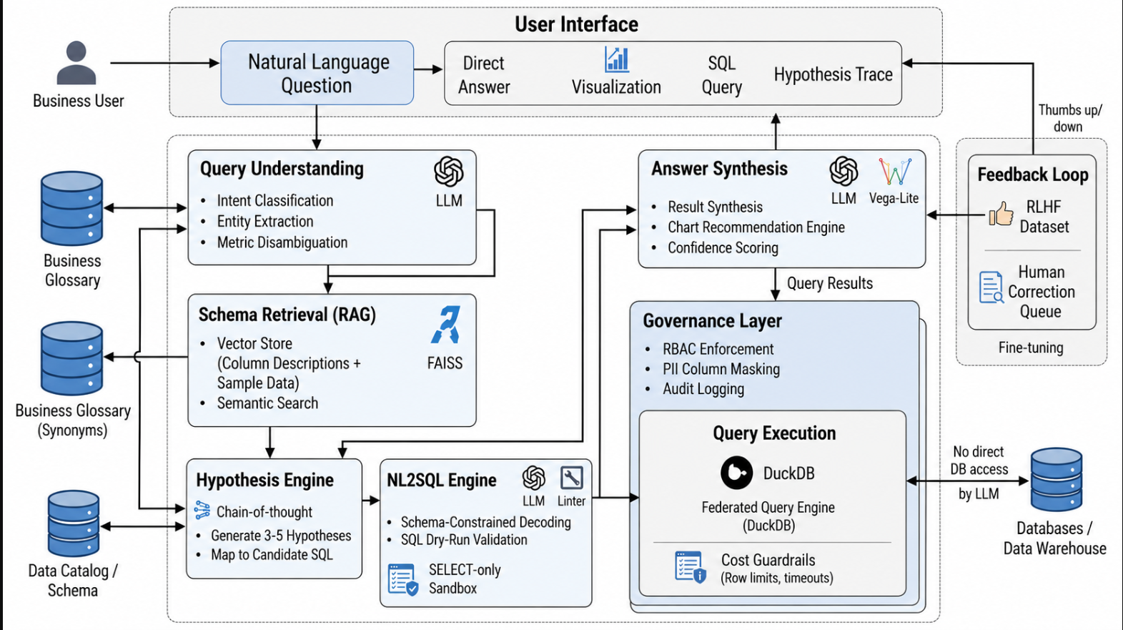
SYSTEM ARCHITECTURE

Slide 8



KEY CAPABILITIES
The platform delivers intelligent analytics
beyond traditional BI tools
Natural Language
Root-Cause Analysis
No SQL needed — ask in plain English
Autonomous investigation with hypothesis engine
AI Insights
Governance & Security
Proactive, AI-generated insights from your data
RBAC, audit trails, and explainable outputs

Slide 9
VERTICAL — PAYMENTS
Real-time intelligence engine
for payments
IMPACT
Failure Diagnosis
Instantly identify root causes of payment failures
Faster Incident Response
Gateway Insights
Reduced Downtime
Compare gateway performance in real-time
Regional Analysis
Improved Success Rates
Drill down into regional transaction patterns

Slide 10



VERTICAL — BANKING
Governed decision intelligence
in banking
Fraud Detection
Loan Performance
Compliance Reporting
Real-time fraud pattern analysis
Portfolio analytics & risk signals
Automated, audit-ready reports
✓ Explainable outputs
✓ RBAC & audit trails
✓ Secure data access
Explainable outputs
RBAC & audit trails
Secure data access

Slide 11

BUSINESS IMPACT
Analytics turnaround time reduces
from days to seconds
QUERY RESOLUTION
ANALYST DEPENDENCY
DECISION SPEED
Before
After
Before
After
Before
After
5–7 days
< 60 sec
High
Low
Slow
Real-time
Faster business decisions
Improved operational efficiency
Scalable analytics access

Slide 12
COMPETITIVE ADVANTAGE
Unlike BI tools, the platform delivers autonomous, context-aware analytics
Traditional BI
Proposed Platform
Static dashboards
vs
Conversational analytics
User-driven insights
vs
AI-generated insights
Partial governance
vs
Built-in governance
Slow analysis
vs
Real-time analysis

Slide 13
RISKS & MITIGATION
Governance and explainability ensure
trust and reliability
Incorrect SQL
Feedback loop & query validation
Security Concerns
RBAC + data masking policies
Misinterpretation
Business glossary & context layer
Low Trust
Explainable outputs with reasoning

Slide 14

PROGRAM VISION
The platform evolves toward
autonomous decision intelligence
STATE 1
STATE 2
STATE 3
Foundation
MVP
DFS
Build, Validate and Test Analytical Logic
Packaged, Decision-Ready Intelligence
Understand data
availability, quality, and
structure
Problem Understanding, Gaps
What affects outcomes, and does the analysis hold under testing?
Deliver Consumable, Trusted Insights for decisions

Slide 15

THE FUTURE
AI-powered analytics will transform
how businesses interact with data
Dashboards
Conversations
Reports
Decisions
“The future of analytics is intelligent conversations with data.”

