Slide 1
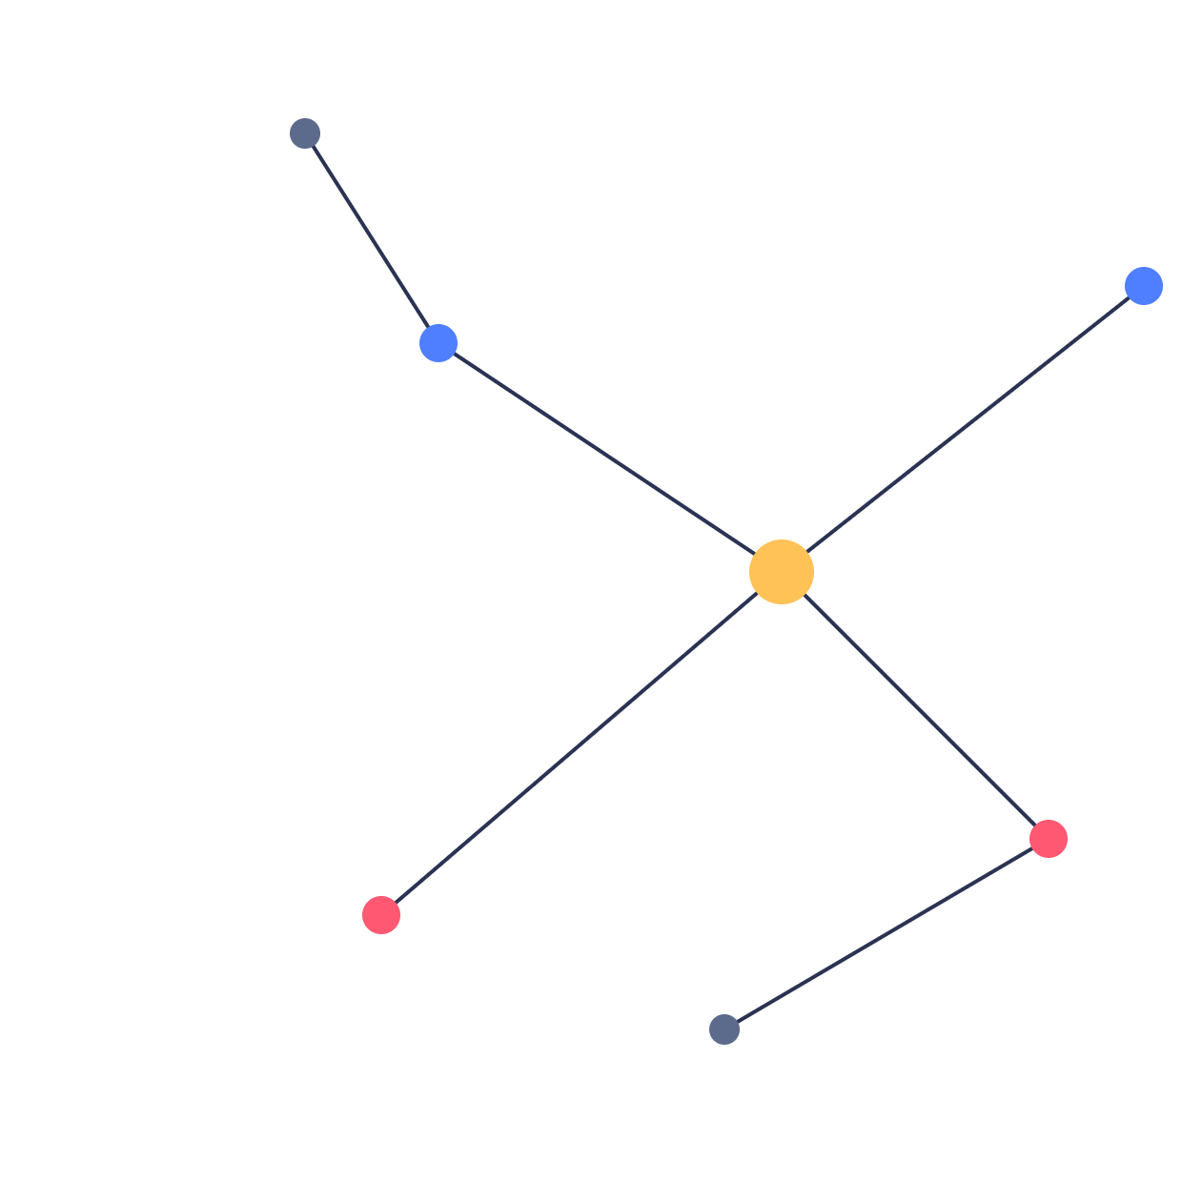
ET AI HACKATHON 2.0 · AI FOR DIGITAL PUBLIC SAFETY
CyberInvestigator
See the fraud network, not just the transaction.
Team CyberInvestigator
Notes:
Good afternoon judges. We're presenting CyberInvestigator, an AI fraud network intelligence platform built for the ET AI Hackathon 2.0, under the Digital Public Safety track: defeating counterfeiting, fraud, and digital arrest scams.

Slide 2
THE PROBLEM
Investigators get evidence after the fact, not intelligence before mass victimisation
1.14M
₹1,776 Cr
Record FICN seizures
cybercrime complaints in India in 2023
lost to digital arrest scams
nationwide, and climbing
up 60% year over year
first nine months of 2024 alone
industrialised, multi-state operations
Notes:
1.14 million cybercrime complaints in India in 2023, up 60 percent year over year. Digital arrest scams alone cost citizens 1,776 crore rupees in just nine months of 2024. FICN seizures are hitting record highs too. The pattern behind these numbers: police get evidence one transaction at a time, after the money is already gone. What's missing is intelligence before mass victimisation, not more evidence after it.

Slide 3
OUR APPROACH
A fraud network intelligence platform — not another fraud classifier
01
Detects coordinated fraud rings
02
Identifies the ringleader
Louvain community detection over shared devices, UPI, money flow
Betweenness centrality on the directed money-flow graph
03
Scores every entity, explainably
04
Reconstructs the lead-time story
Rules + IsolationForest + RandomForest, fused with human-readable reasons
When a ring became detectable vs. how many victims fell after
05
Maps cross-jurisdiction spread
06
Answers investigator questions live
DBSCAN geo-clustering across districts and states
Tool-calling LLM agent, cites entity & transaction IDs
07
Seals court-admissible evidence
One click produces a SHA-256 hash-chained Intelligence Package
Notes:
Our answer isn't another fraud classifier that flags individual suspicious transactions. It's a network intelligence platform. It finds coordinated rings via graph community detection, names the ringleader via betweenness centrality, scores every entity with an explainable fused model, reconstructs exactly when a ring became detectable, maps cross-jurisdiction spread, answers investigator questions live through a tool-calling agent that cites IDs, and seals court-admissible evidence with a hash chain.

Slide 4
ARCHITECTURE
Detection runs entirely in-process
Synthetic Dataset — persons, accounts, UPI, devices, IP, transactions
▼
Entity Resolution & Features
Scoring Engine Rule engine + ML fusion
Graph Engine NetworkX
▼
FastAPI + Hash-Chained Ledger
Neo4j Aura
(optional)
▼
React Command Centre graph / map / globe / evidence
Tool-Calling Agent
(optional, OpenRouter)
No hard dependency on Neo4j or the LLM agent — remove either one and the platform still detects rings.
Notes:
Raw transaction and complaint data flows through entity resolution and feature engineering, into our scoring and graph engines, exposed through FastAPI with a hash-chained ledger, and rendered in a React command centre. The key point: detection runs entirely in-process with NetworkX, pandas and scikit-learn, no external graph database required. Neo4j and the LLM agent are optional enhancers wired in at the edges. Remove either one and the platform still runs and still detects rings. That's a deliberate scalability and reliability choice, not a limitation.

Slide 5
THE LEAD-TIME NUMBER
#3
62
+
victim at which the ring became detectable
more victims fell afterward
Earlier action stops fraud. It doesn't just document it.
Notes:
This is the single number that matters most for business impact. On our demo dataset, one ring became detectable at victim number 3, yet 62 more victims fell afterward. Earlier action on this exact case would have stopped the majority of the harm. That's the difference between detecting fraud and preventing it.

Slide 6
EXPLAINABLE AI, PROVEN NOT CLAIMED
A realistic score, not an inflated one
Three signals fused into one score:
0.77
Rule engine (transparent, additive) · IsolationForest (anomaly) · RandomForest (supervised)
Caught a shortcut, and removed it:
Account age alone gave the model an unfair boost — identified as a data leak during testing, and removed before this score was reported.
PR-AUC, supervised model
Every flag ships a human-readable reason, e.g. “Shares a device with 9 other accounts.”
Notes:
Every score is explainable: a transparent rule engine, an IsolationForest anomaly model, and a supervised RandomForest are fused into one number, with human-readable reasons attached to every flag. Our supervised model scores a PR-AUC of 0.77, not an inflated 1.0. We specifically tested for and removed a data leak where account age alone gave the model an unfair shortcut. That's rigor, not luck.

Slide 7
COURT-ADMISSIBLE EVIDENCE
Tamper with one record, break the whole chain
Package #1
→
Package #2
→
Package #3
SHA-256: 9f2a...
hash(prev + data)
hash(prev + data)
Edit any past package → its hash no longer matches → every later link breaks, provably.
Directly answers the brief's requirement: intelligence packages must be auditable for legal admissibility.
Notes:
One click produces a SHA-256 hash-chained Intelligence Package. Every package's hash is chained to the previous one. Tamper with any past record and the chain breaks, provably. That's a direct, checkable answer to the brief's requirement for auditability and legal admissibility.

Slide 8
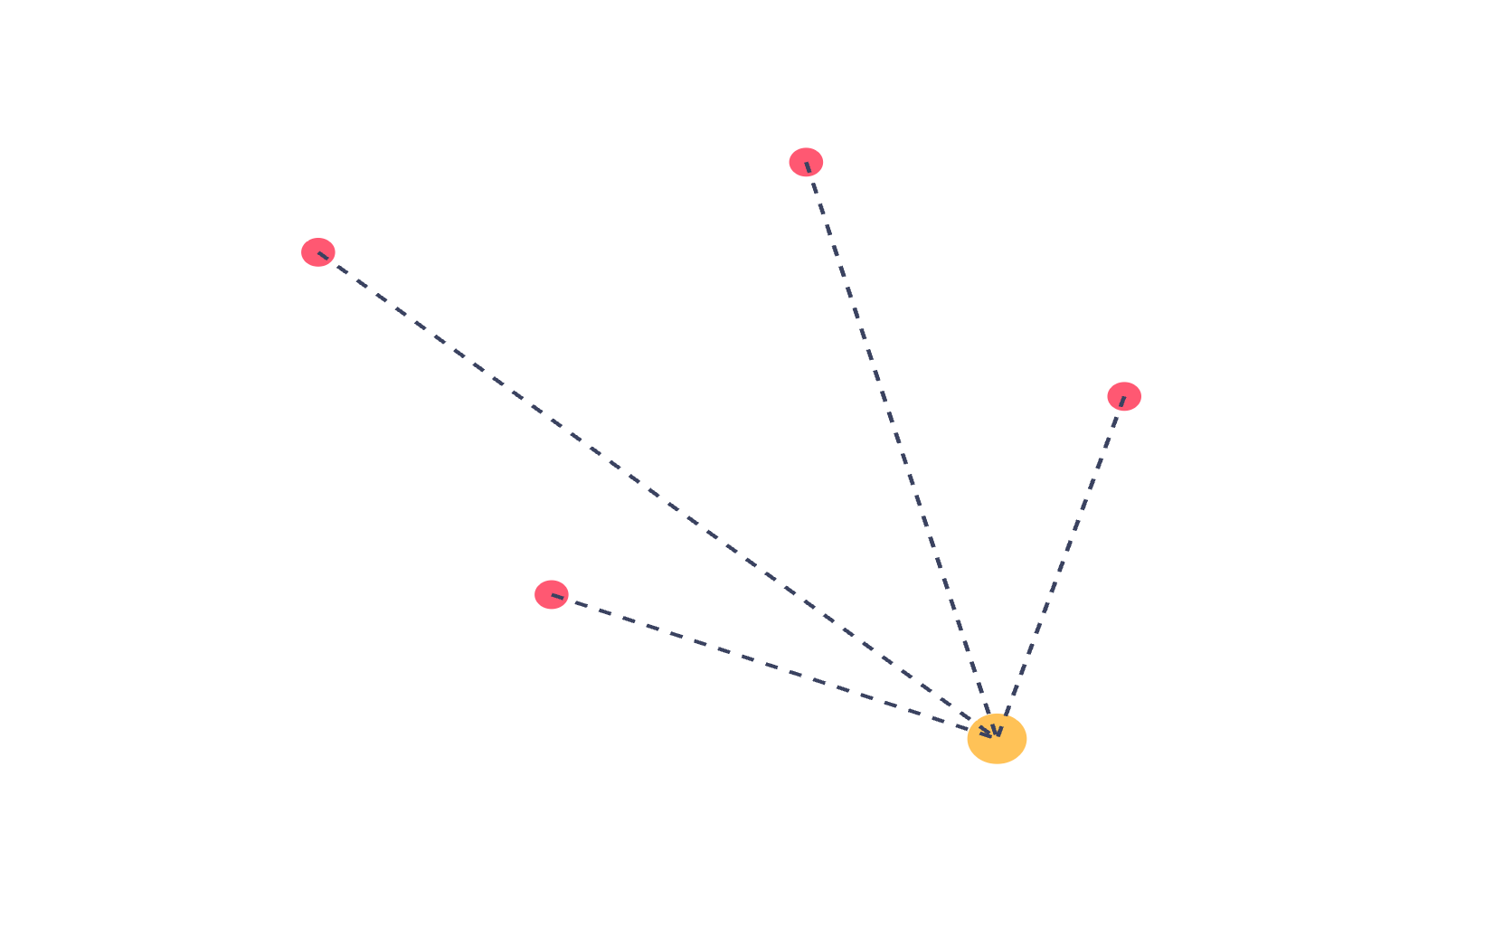
CROSS-JURISDICTION INTELLIGENCE
No single police station sees the whole ring. We do.
Victims and mule accounts, geo-clustered by DBSCAN, plotted independent of administrative boundaries.
A live map and rotating globe view let an investigator see a ring's full geographic footprint in one screen.
Local jurisdiction only sees its own complaints. This is the view that connects them.
DBSCAN geo-cluster · one ring, four states
Notes:
No single police station ever sees the whole ring. DBSCAN geo-clustering and a live map show a ring's victims and mules spanning districts and states. We see the whole picture; they only see their slice of it.

Slide 9
JUDGING CRITERIA SCORECARD
Every point of the rubric, answered by a feature
Innovation
25%
Tool-calling, ID-citing agent + hash-chained court-admissible packages
Business Impact
25%
The lead-time number — victims prevented if acted on earlier
Technical Excellence
20%
Louvain, betweenness, WCC, shortest-path — verified against real data, not just claimed
Scalability
15%
Modular monolith today, no hard dependency on Neo4j or the LLM
UX
15%
One command centre — graph, map, agent and evidence in a single flow
Notes:
Here's how we map directly onto the five judging criteria: Innovation, Business Impact, Technical Excellence, Scalability, and UX, each answered by a specific, checkable feature, not a marketing claim.

Slide 10
SCALABILITY & WHAT'S NEXT
Deliberately scoped narrow today, built to grow
Today → National scale
Modular monolith → microservice split along existing internal boundaries
Batch pipeline → queue-based ingestion for continuous volume
A deliberate choice, not a gap
Counterfeit-currency computer vision and call interception were scoped out — different tech stacks entirely. We went deep on the highest-leverage track instead of wide across five shallow ones.
Roadmap
· RandomForest → XGBoost + SHAP, per-feature attribution
· Live Neo4j-backed graph view
· Citizen-facing fraud-check widget
Notes:
Today this runs as a modular monolith, one process, clean internal boundaries. The path to national scale is well understood: split into microservices, move to queue-based ingestion. On the roadmap: XGBoost with SHAP for feature attribution, a live Neo4j-backed graph view, and a citizen-facing fraud-check widget.

Slide 11
Thank You
See the fraud network, not just the transaction.
Team CyberInvestigator
github.com/AayushG10/cyber-intelligence-knowledge-base-investigator
Notes:
Thank you. CyberInvestigator: see the fraud network, not just the transaction. Repo link on screen, happy to answer questions.

