Slide 1
Liquibase Demo
Manish Gandhi, Dodda
3/6/2021

Slide 2

Liquibase Overview
Liquibase is an open-source database migration tool that provides organizations with an effortless way to track, version, and deploy database schema changes.
It is different than other database migration tools because the software understands the changes you are making based on how you specify those changes.
Liquibase will be a great tool for implementing DevOps to Databases.

Slide 3










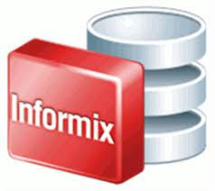







Liquibase Supported Databases
Liquibase supports broad range of databases.

Slide 4


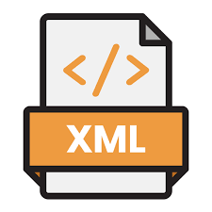

Liquibase Terminology
Changelog - acts as a ledger of changes and contains a list of changesets (units of change) that Liquibase can execute on a database.
Changeset - a unit of change that occurs to a database and is indicated by a changeset tag <changeset> in XML or --changeset author:id in SQL.

Slide 5








Liquibase Database Update Workflow
Changelog1
Changelog3
update
Rollback
Snapshot
diff
generateChangeLog
…….
Changelog2
Database
CLI
CI Tools (Jenkins)
Developers

Slide 6


Conclusion - Liquibase Offerings
Licensed – Additional changers apply
Pro – 33$/month
Business – 99$/month
Enterprise – 249$/month
Targeted Rollback*
Open source – Free
Rollback
Community Support

Slide 7
Q&A Thank You

