Slide 1
Signals & Systems Final Project: Fast Fourier Transform
Presented by:
Bishesh Adhikari Aayush Jha

Slide 2
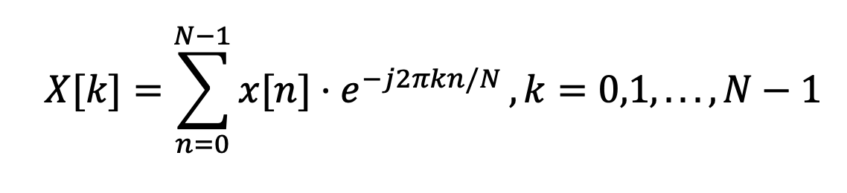
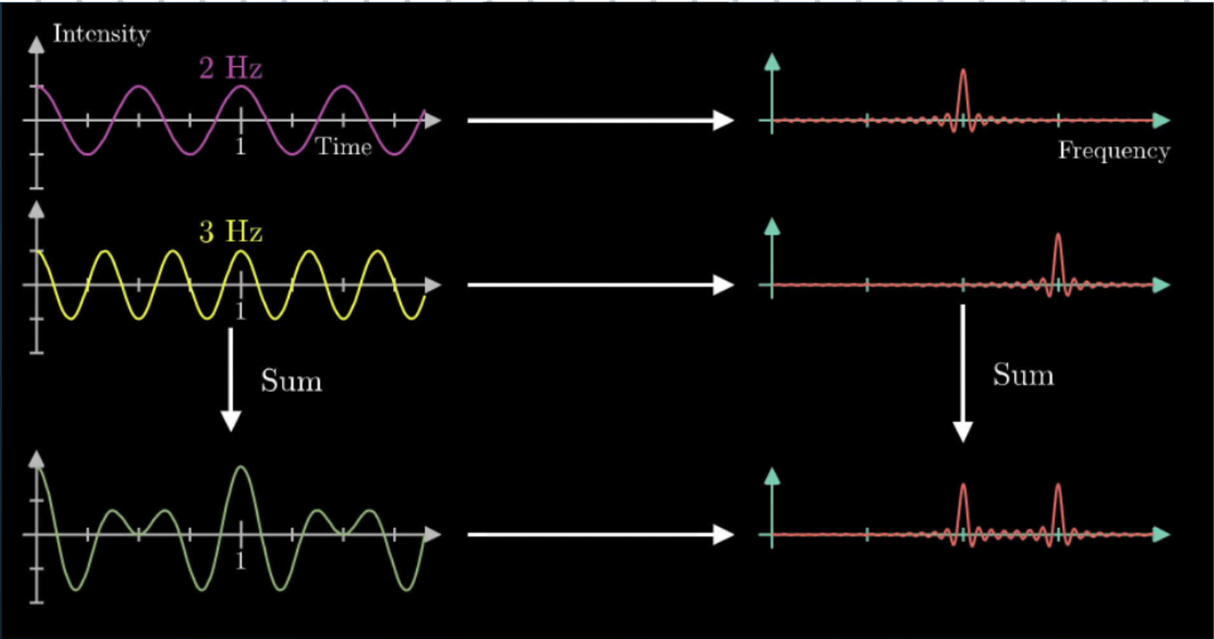
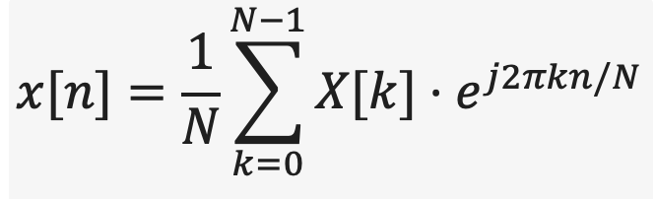
Discrete Fourier Transform

Slide 3
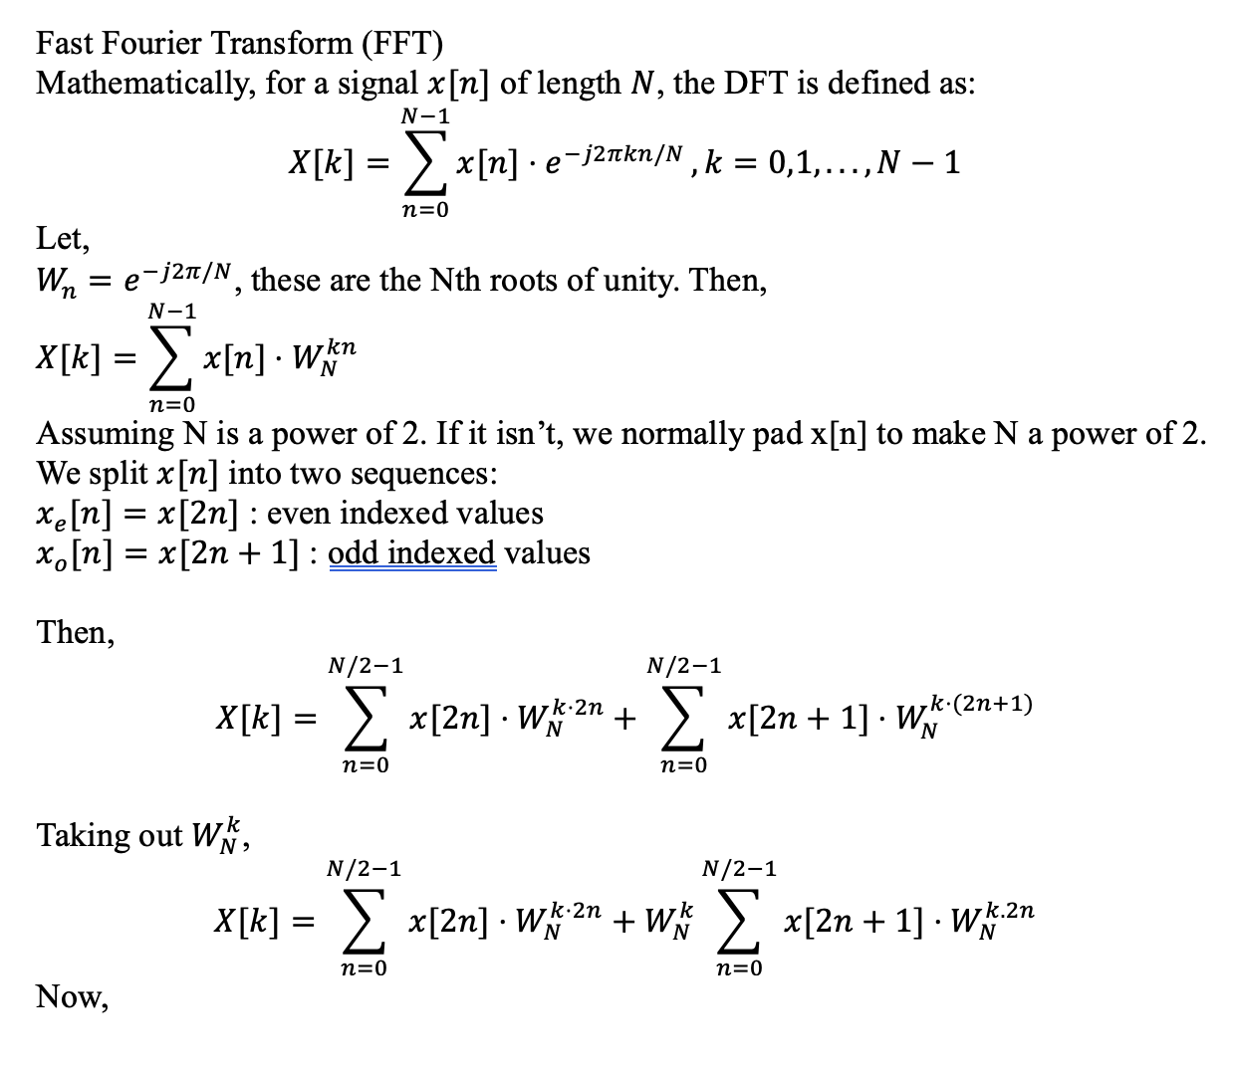
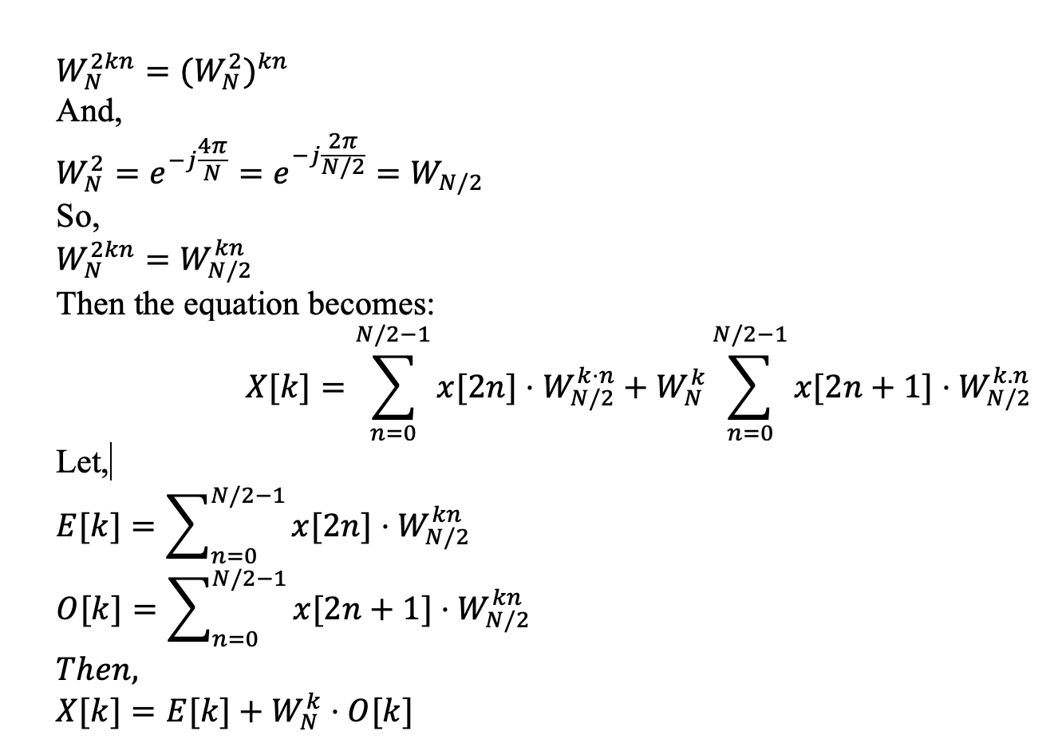
Fast Fourier Transform

Slide 4
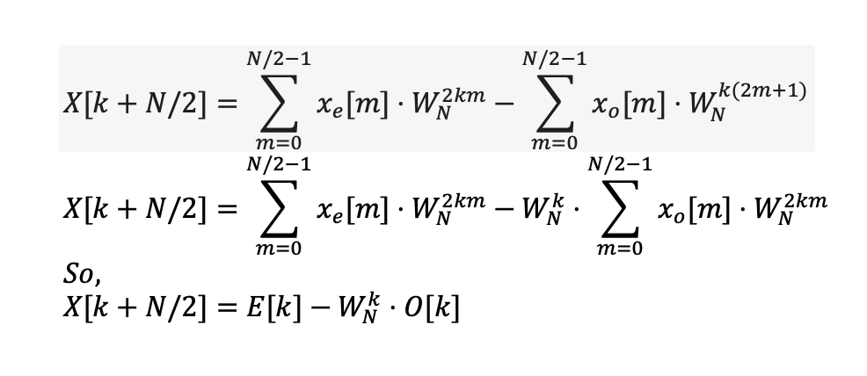
Fast Fourier Transform

Slide 5
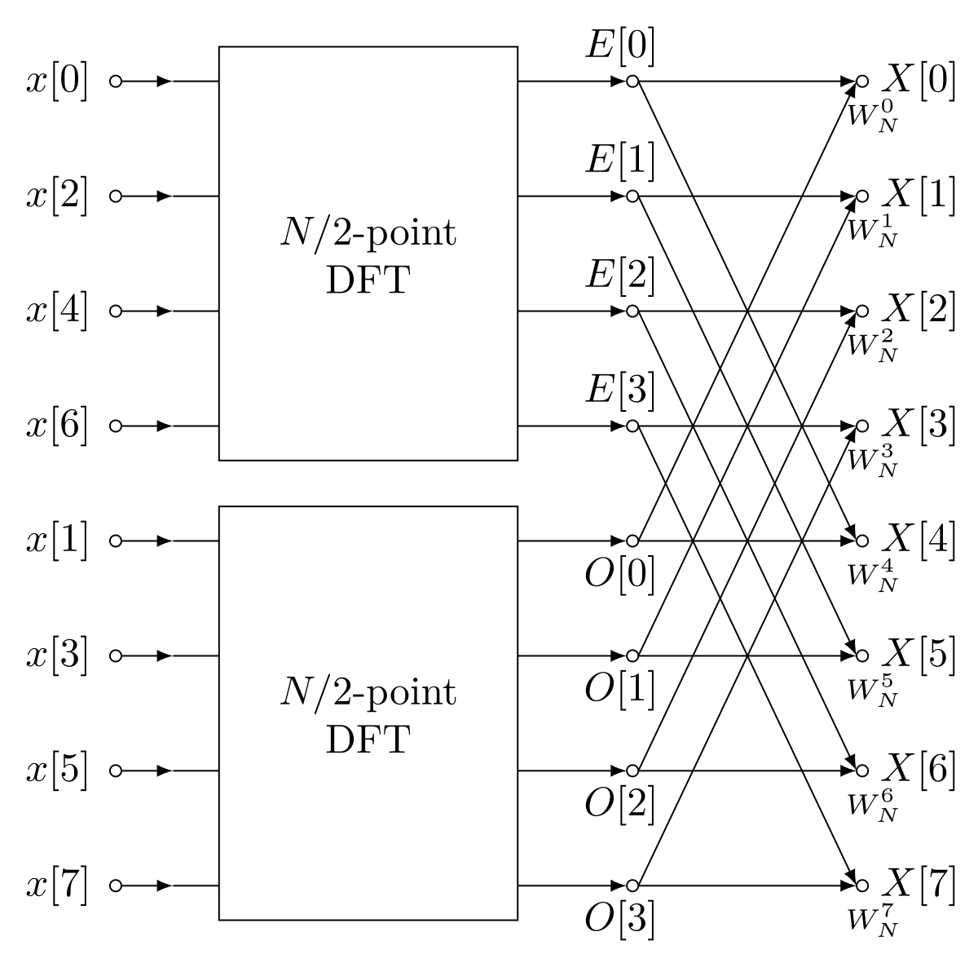
Fast Fourier Transform

Slide 6
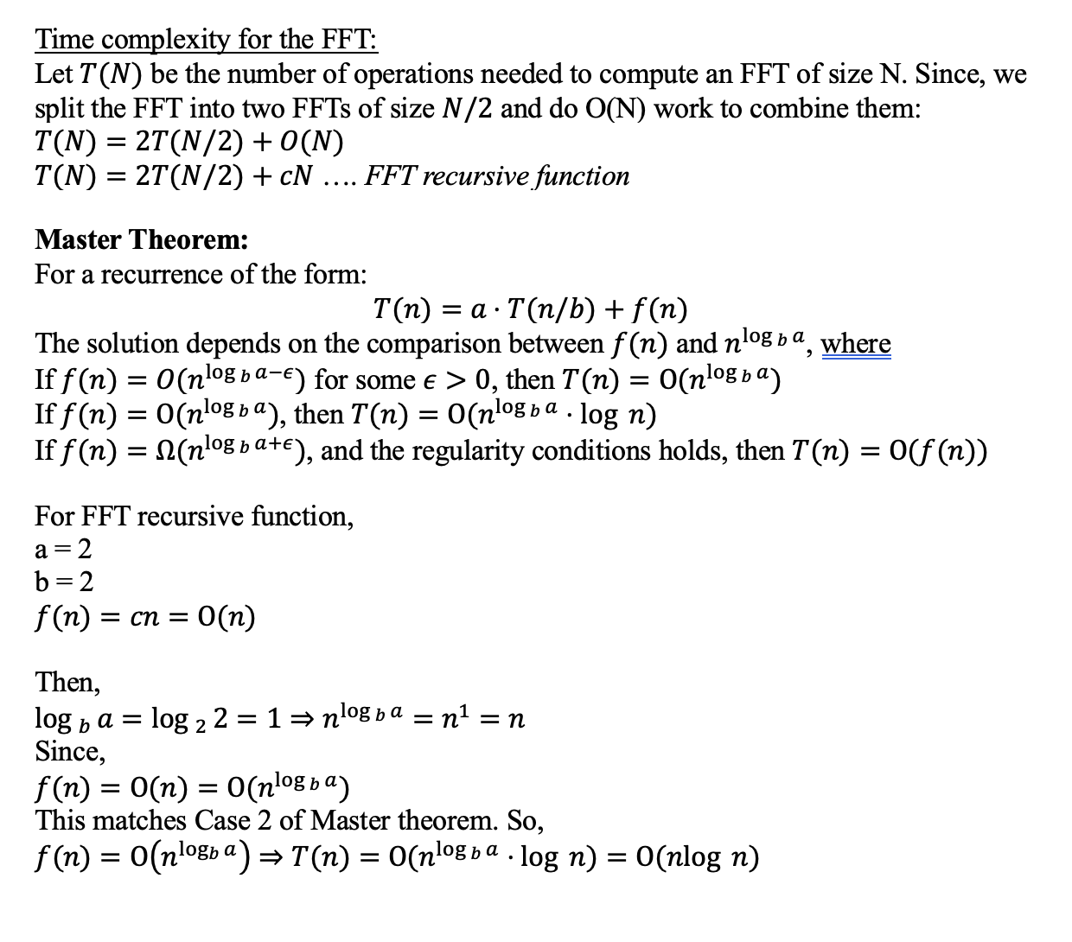
Fast Fourier Transform

Slide 7
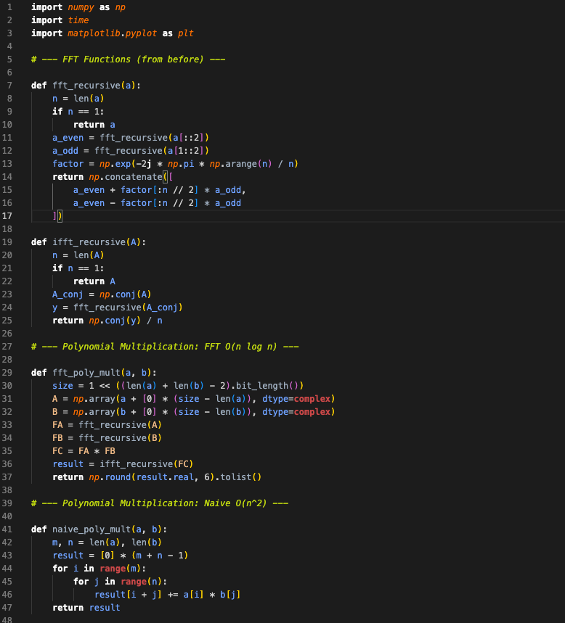
Applications: Polynomial Multiplication

Slide 8
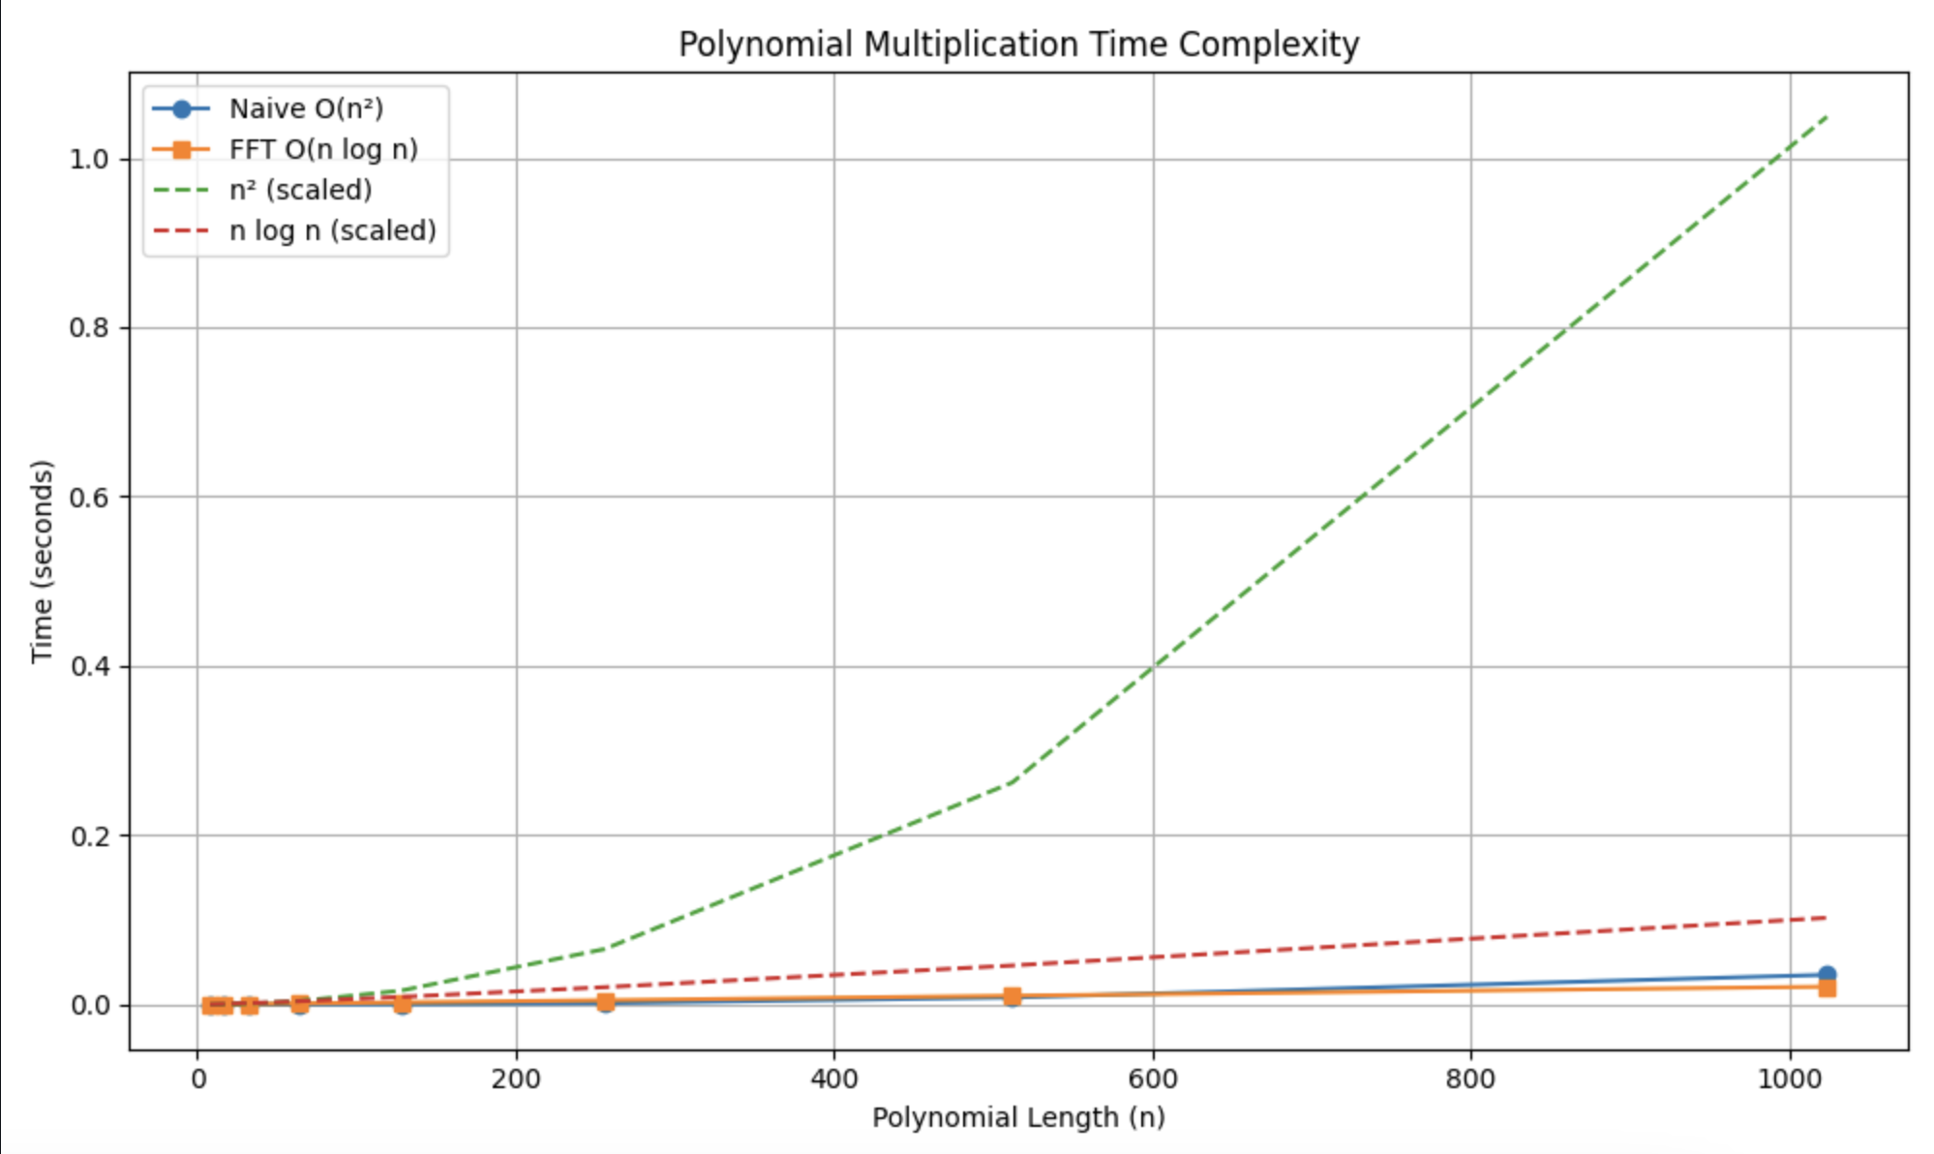
Applications: Polynomial Multiplication

Slide 9
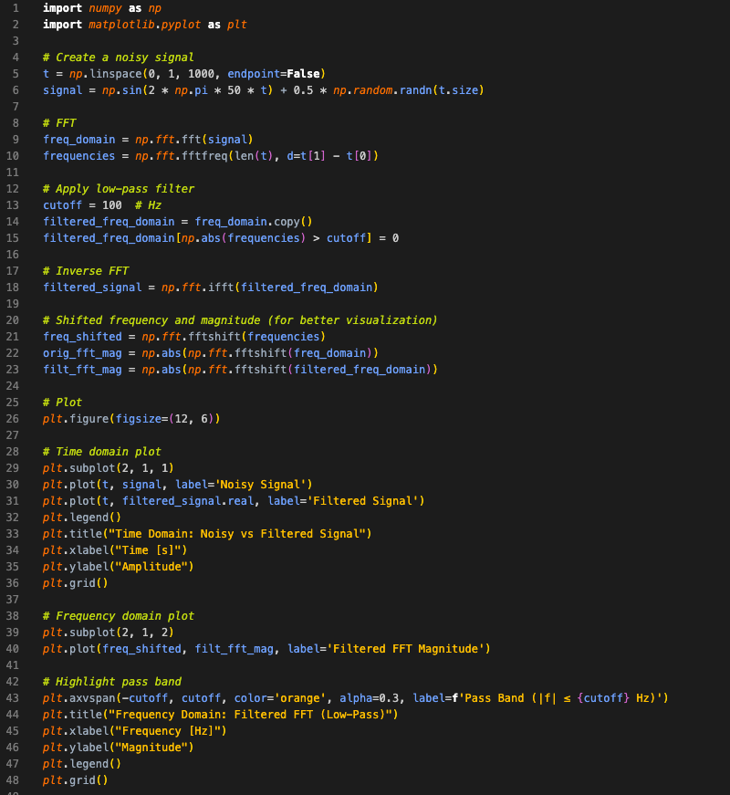
Applications: Denoising

Slide 10
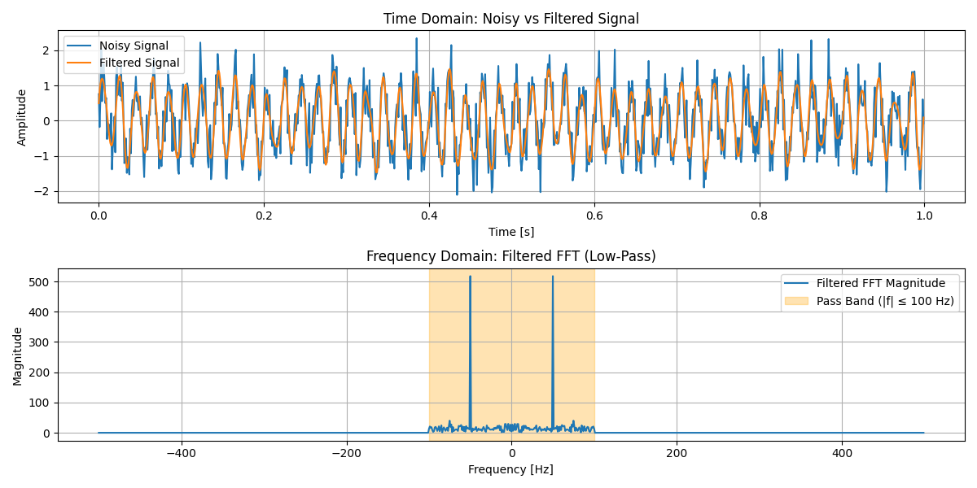
Applications: Denoising

Slide 11
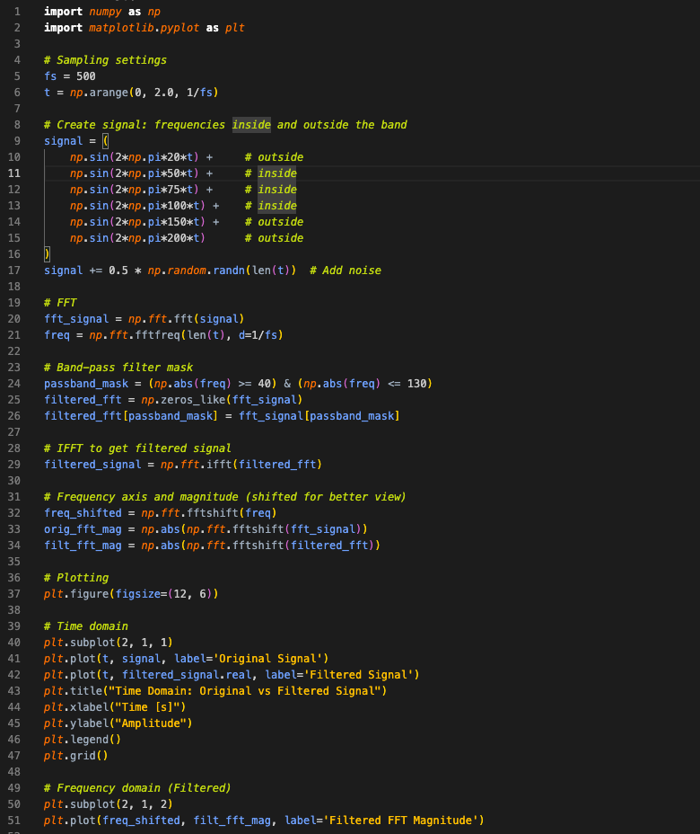
Applications: Band Pass Filter

Slide 12
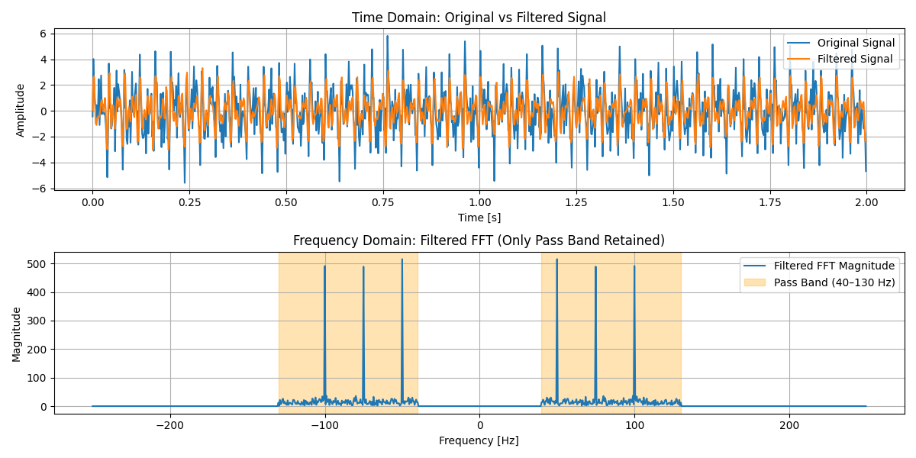
Applications: Band Pass Filter

Slide 13
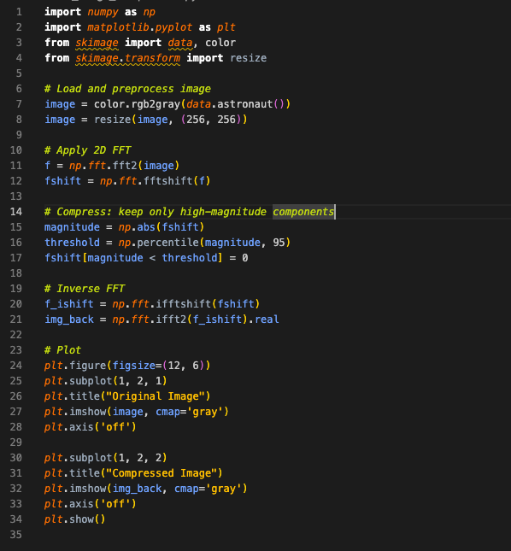
Applications: Image Compression

Slide 14
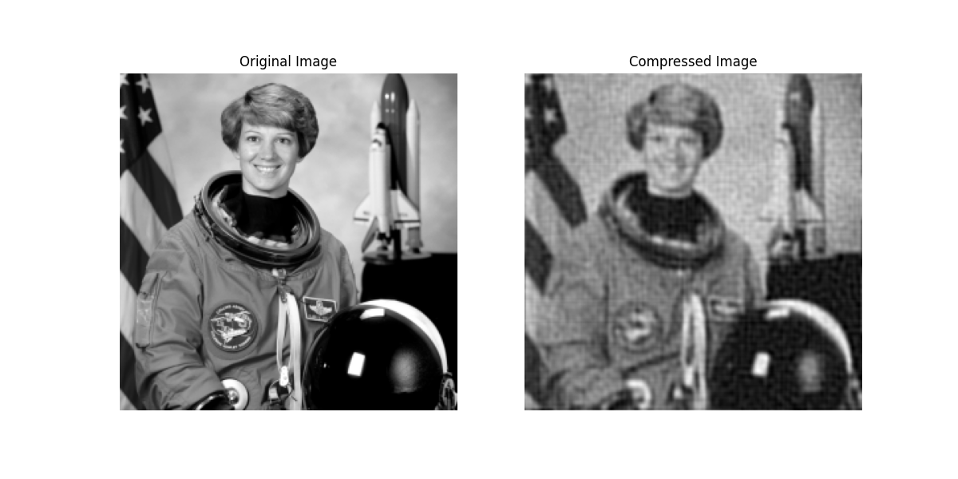
Applications: Image Compression

Slide 15
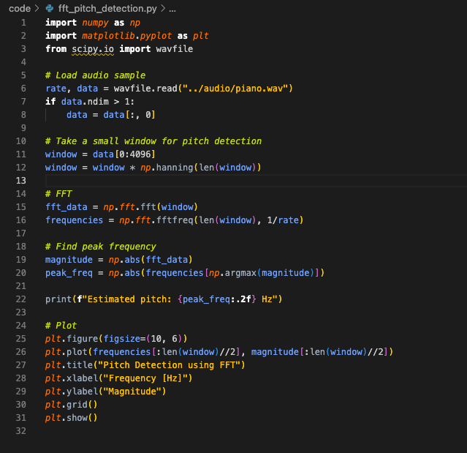
Applications: Pitch Detection

Slide 16
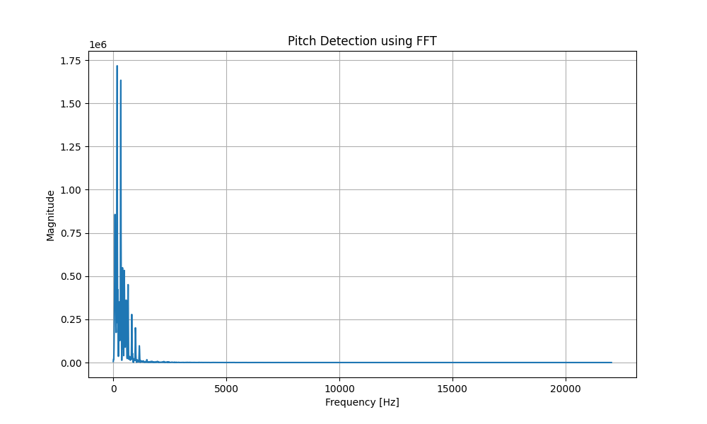
Applications: Pitch Detection

Slide 17
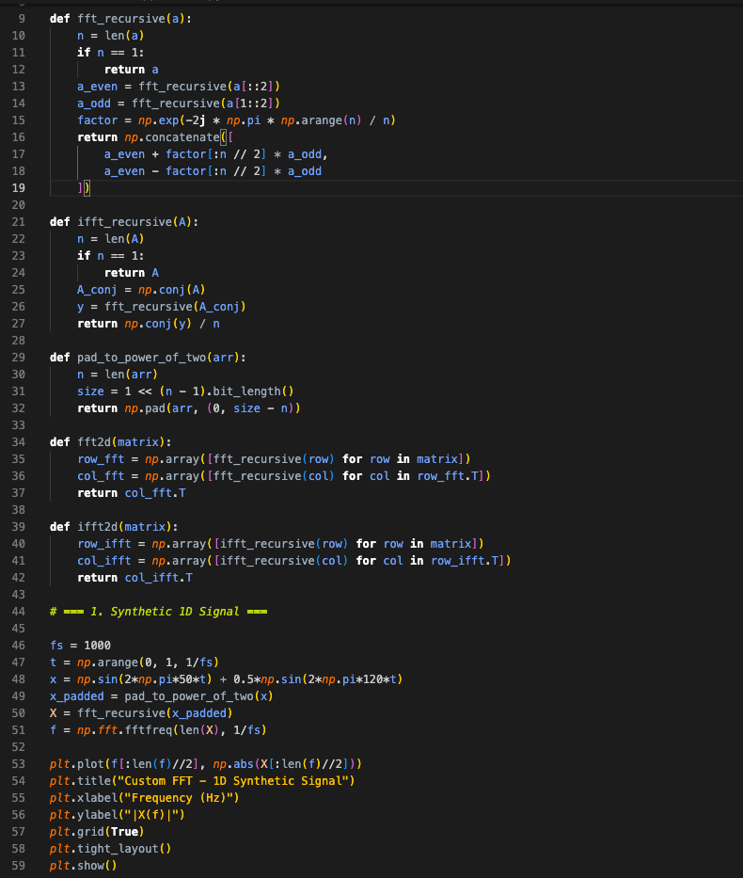
Applications: Synthetic 1D Signal Analysis

Slide 18
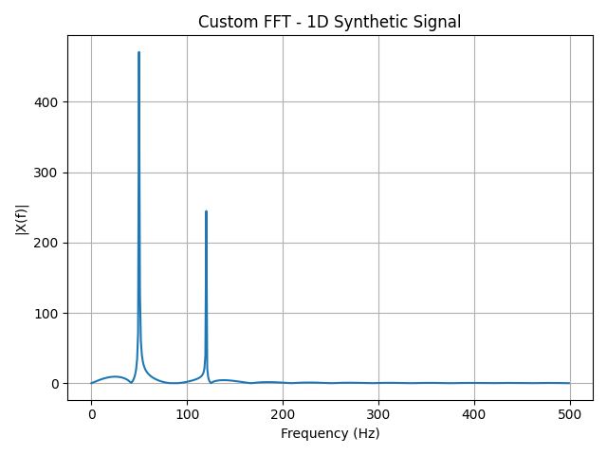
Applications: Synthetic 1D Signal Analysis

Slide 19
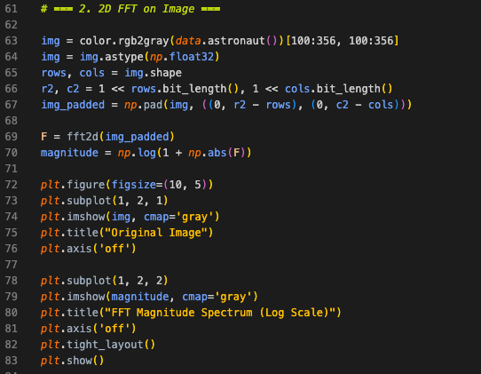
Applications: 2D FFT on image

Slide 20
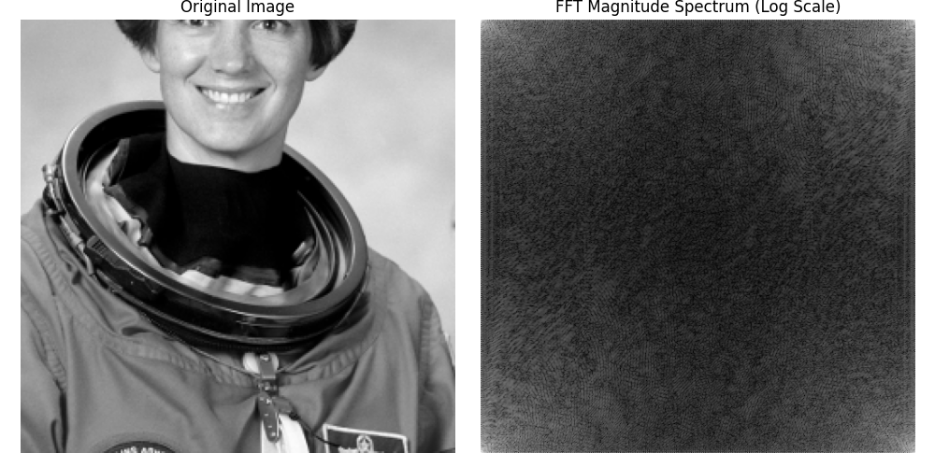
Applications: 2D FFT on image

Slide 21
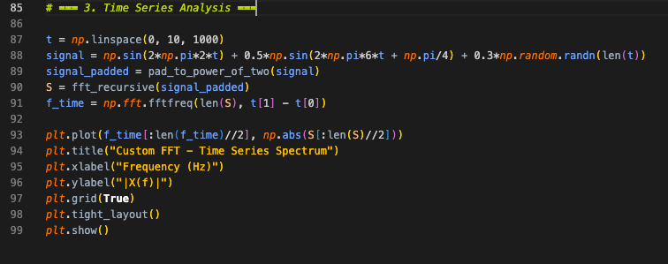
Applications: Time Series Analysis

Slide 22
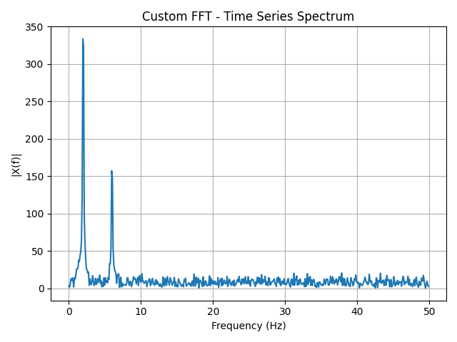
Applications: Time Series Analysis

Slide 23
Thank You!

