Slide 1
CS-E4740 Federated Learning “FL Algorithms” Dipl.-Ing. Dr.techn. Alexander Jung

Slide 2
For example Question 6 on Mocha optimal choice of parameters is mentioned in introduction of Chapter 7 in Lecture notes, referring that it will be explained in section 7.2. but then there is no mention of optimal parameters in that section. Is it so that the algorithm learns this parameter?
Also there is no mention of uniqueness (Question 7) nor quantitative measure of variation between local hypothesis maps (Question 3). Maybe it was so that these should be somehow induced from the material but I did not see the connections.

Slide 3
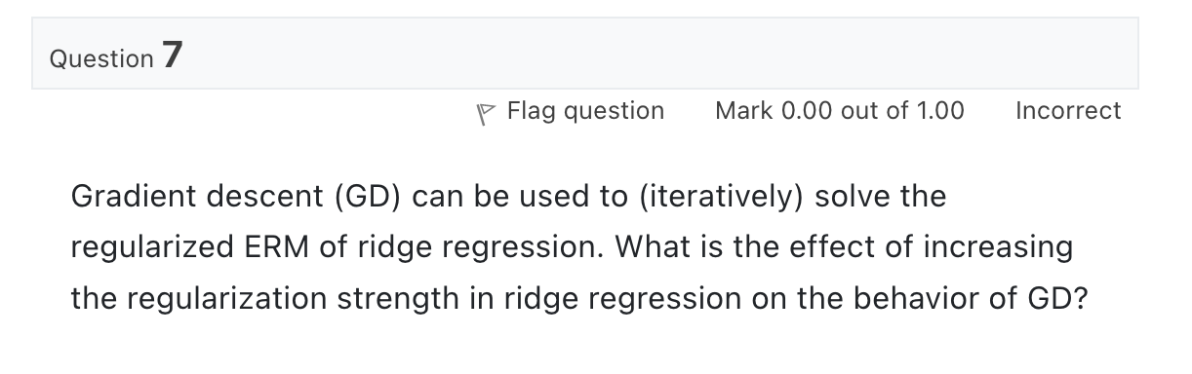
Quiz “Gradient Methods”

Slide 4
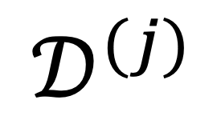
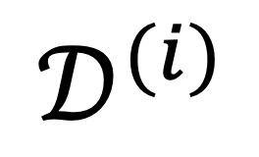
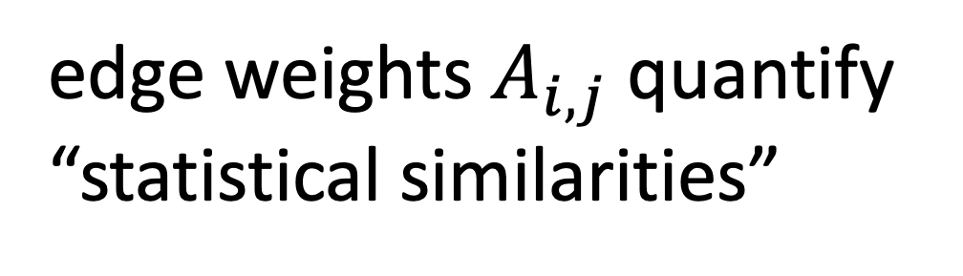

The Empirical Graph
$$𝒟^{(i)}$$
local dataset
edge weights $A_{i,j}$ quantify
“statistical similarities”
$$𝒟^{(j)}$$

Slide 5
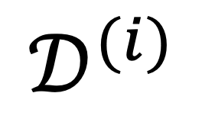
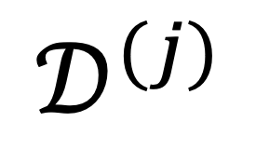
Networked Models.
$$𝒟^{(i)}$$
local model for each node
couple models at connected nodes
“similar"
$$𝒟^{(j)}$$

Slide 6
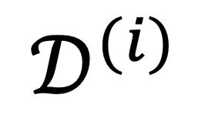
Local Parametric Models
$$𝒟^{(i)}$$
model params
“similar"
Notes:
Starting with a given empirical graph we define a networked model. Each node is equipped with some parametric model with paramters of weights w. These local models could be linear regression models or deep neural nets. Our methods allow to abstract from the details of the local models and only need a loss function that provides a score for a given choice of weights.

Slide 7
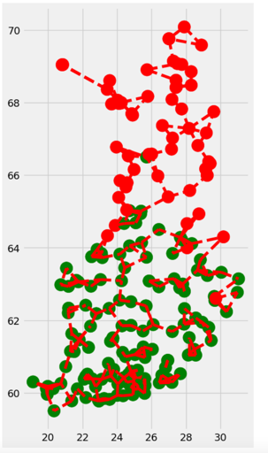
Clustering Assumption
the local datasets form clusters
datasets in same can be approximated as realizations of i.i.d. RVs with prob. dist p(x,y;c)
more edges inside clusters

Slide 8
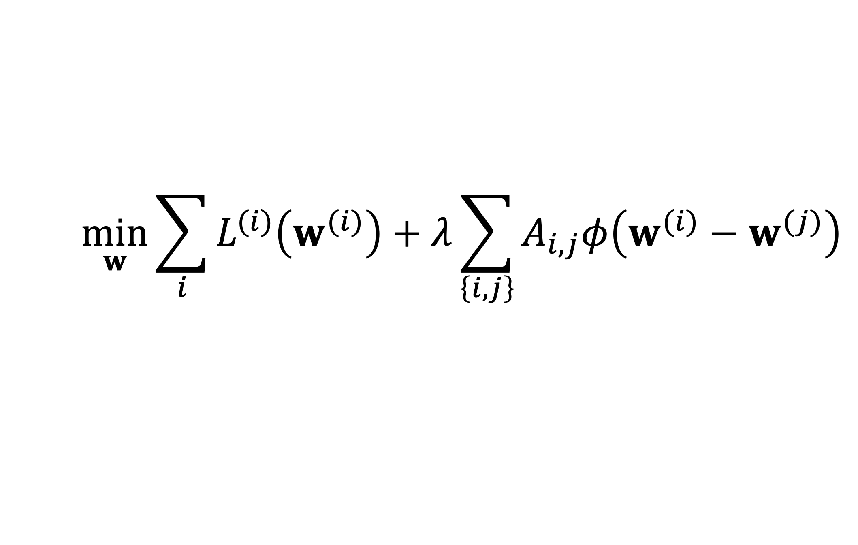
GTV Minimization
$$\min_{w}{\sum_{i}{L^{(i)}\left(w^{(i)}\right)}+λ\sum_{\left\{i,j\right\}}{A_{i,j}φ\left(w^{(i)}−w^{(j)}\right)}}$$
increasing
average local loss
“clusteredness”

Slide 9
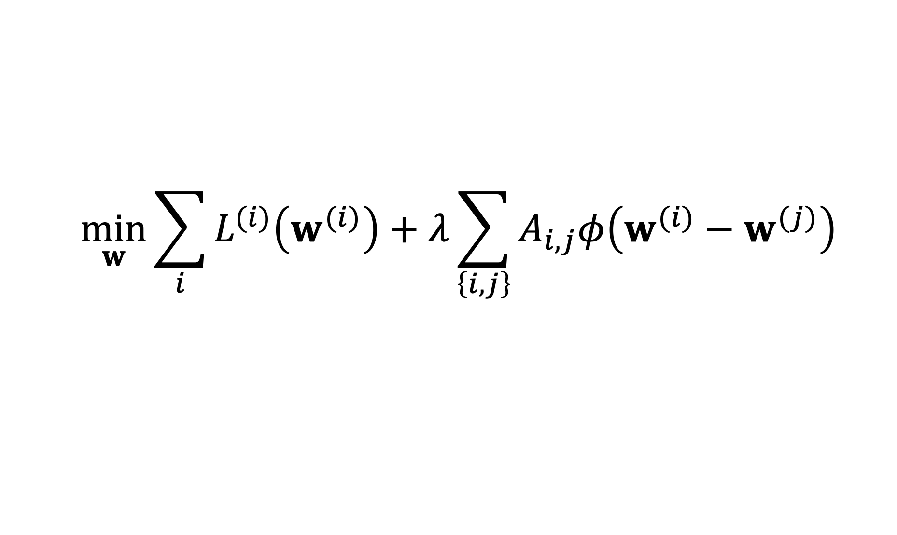
Two Key Questions of ML
$$\min_{w}{\sum_{i}{L^{(i)}\left(w^{(i)}\right)}+λ\sum_{\left\{i,j\right\}}{A_{i,j}φ\left(w^{(i)}−w^{(j)}\right)}}$$
computational aspects: how to compute (approximate) solutions efficiently ?
statistical aspects: are the solutions any good?

Slide 10
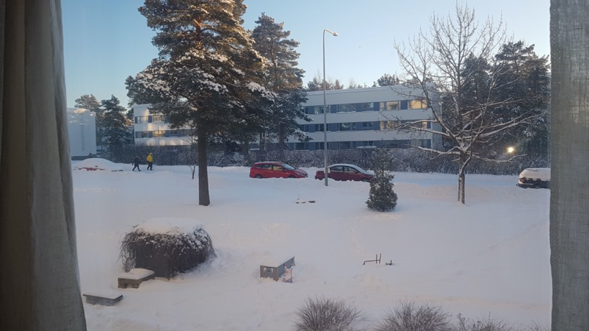
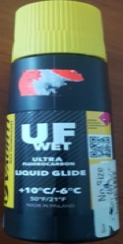
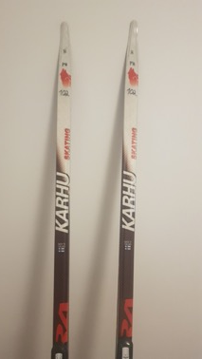

morning temperature = - 10 (minimum daytime temp.)
maximum daytime temperature ?
Notes:
﻿Consider waking up some morning during winter in Finland
and looking outside the window.
It seems to become a nice sunny day which is ideal for a
ski trip. To choose the right gear (clothing, wax) it is
vital to have some idea for the maximum daytime temperature
which is typically reached around early afternoon.
If we expect a maximum daytime temperature of around plus
10 degrees, we might not put on the extra warm jacket
but rather take only some extra shirt for change.

Slide 11
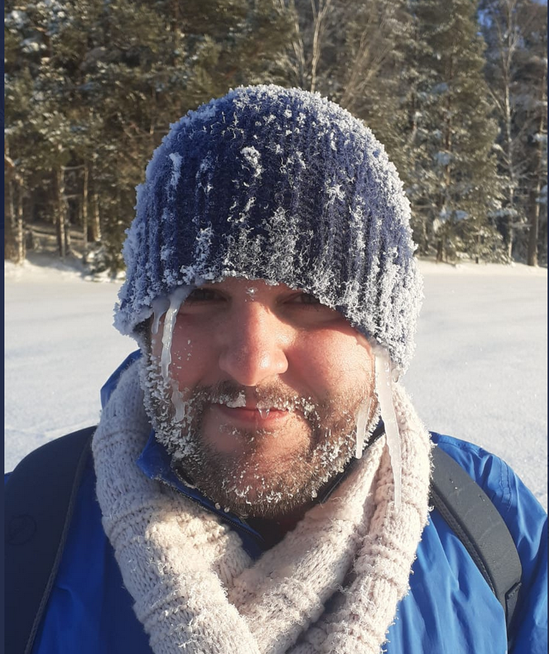
Notes:
﻿Consider waking up some morning during winter in Finland
and looking outside the window.
It seems to become a nice sunny day which is ideal for a
ski trip. To choose the right gear (clothing, wax) it is
vital to have some idea for the maximum daytime temperature
which is typically reached around early afternoon.
If we expect a maximum daytime temperature of around plus
10 degrees, we might not put on the extra warm jacket
but rather take only some extra shirt for change.

Slide 12

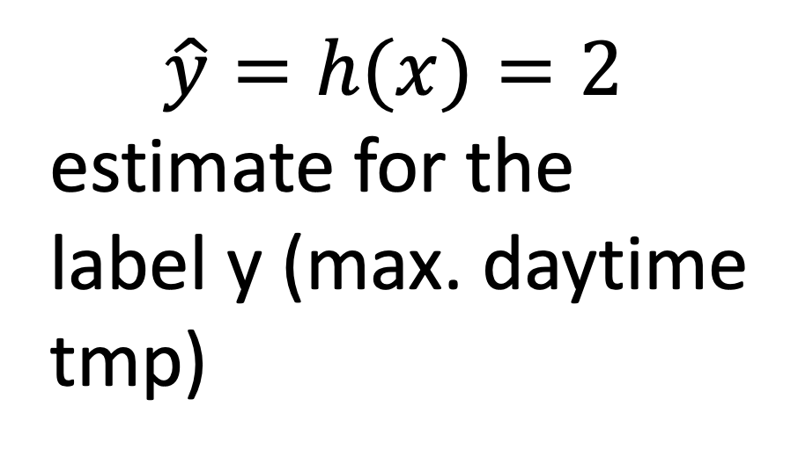
Train a Model/Learn Hypothesis
$$\hat{y}=h(x)=2$$
estimate for the
label y (max. daytime
tmp)
h(x)
feature x = -10 minimum
daytime temperature

Slide 13


Example: Weather Prediction

Slide 14
Network of Weather Stations

Slide 15
Computational Aspects

Slide 16





A FL Setting

Slide 17
Requirements
run in ad-hoc nets of low-cost devices
robustness against node/link failures
robustness against “stragglers”

Slide 18

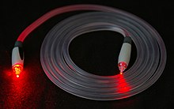
Another FL Setting…
https://www.google.com/about/datacenters/
https://en.wikipedia.org/wiki/Optical_fiber

Slide 19
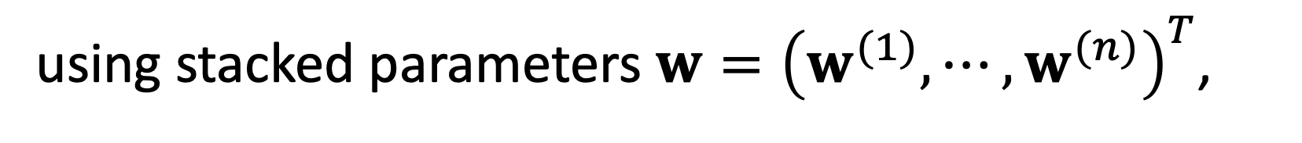
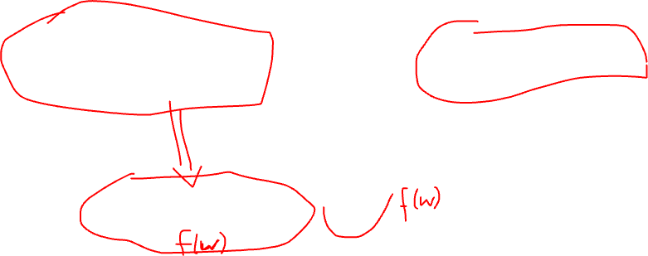
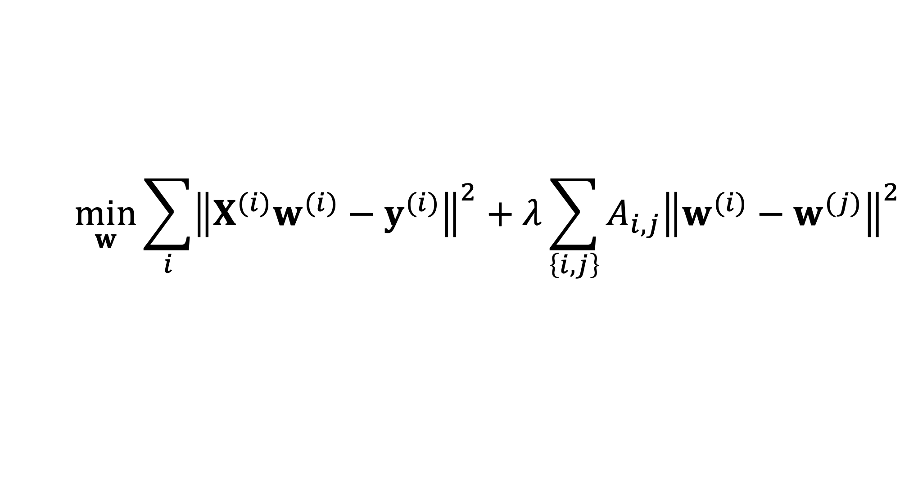
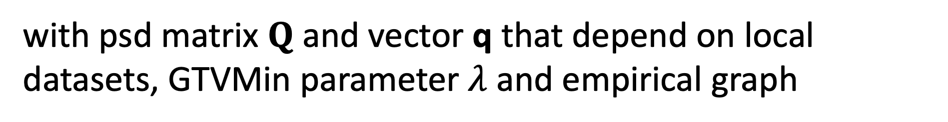
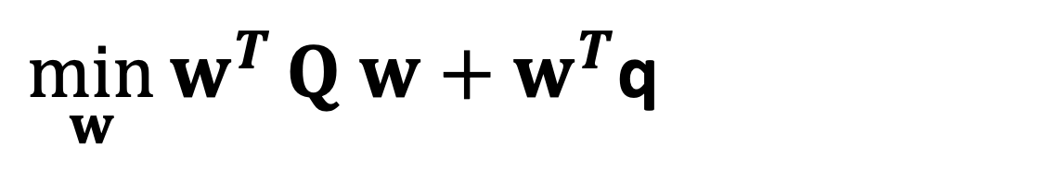
GTV Min. for Local Lin.Reg.
$$\min_{w}{\sum_{i}{{\left\|X^{(i)}w^{(i)}−y^{(i)}\right\|}^{2}}+λ\sum_{\left\{i,j\right\}}{A_{i,j}{\left\|w^{(i)}−w^{(j)}\right\|}^{2}}}$$
using stacked parameters $w={\left(w^{(1)},⋯,w^{(n)}\right)}^{T}$,
$\min_{w}{w^{T}}Q w+w^{T}$q
with psd matrix $Q$ and vector q that depend on local datasets, GTVMin parameter $λ$and empirical graph

Slide 20
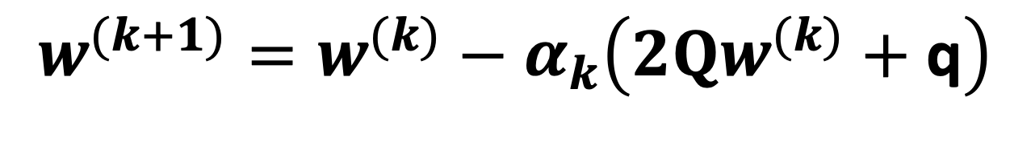

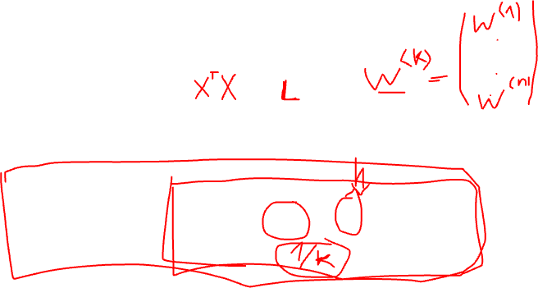
GTV Min. for Local Lin.Reg.
$$\min_{w}{w^{T}}Q w+w^{T}\text{q}$$
can be solved using gradient methods
$$w^{(k+1)}=w^{(k)}−α_{k}\left(2Qw^{(k)}+\text{q}\right)$$

Slide 21
Statistical
Aspects

Slide 22
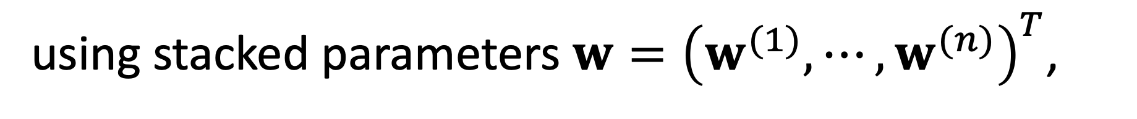
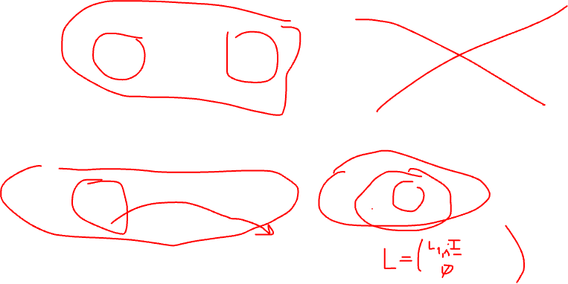

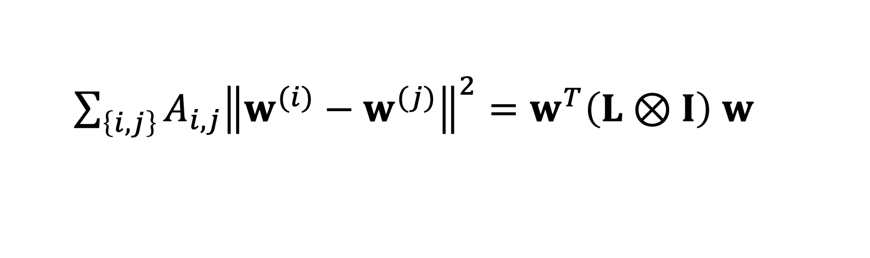
GTV Min. for Local Lin.Reg.
$$\min_{w}{\sum_{i}{{\left\|X^{(i)}w^{(i)}−y^{(i)}\right\|}^{2}}+λ\sum_{\left\{i,j\right\}}{A_{i,j}{\left\|w^{(i)}−w^{(j)}\right\|}^{2}}}$$
using stacked parameters $w={\left(w^{(1)},⋯,w^{(n)}\right)}^{T}$,
$\sum_{\left\{i,j\right\}}{A_{i,j}{\left\|w^{(i)}−w^{(j)}\right\|}^{2}}=w^{T}\left(L⊗I\right)$ $w$
with the graph Laplacian $L$

Slide 23

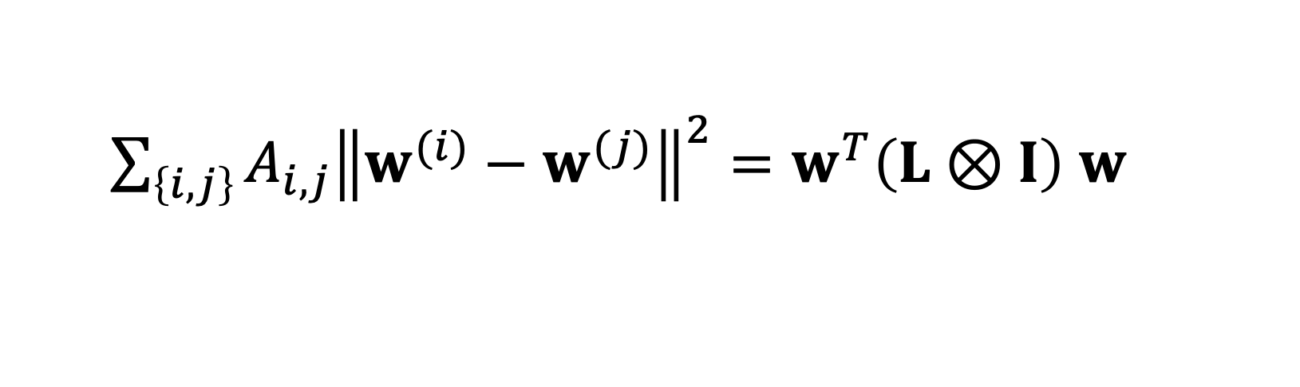
Spectral Clustering
for large $λ,$GTVMin is to minimize
$\sum_{\left\{i,j\right\}}{A_{i,j}{\left\|w^{(i)}−w^{(j)}\right\|}^{2}}=w^{T}\left(L⊗I\right)$ $w$
local model parameters composed of
eigvecs. of L corresponding to smallest eig.vals

Slide 24
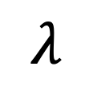

Clustering of GTVMin Solutions
0
$$λ$$
personalized
clustered
global

Slide 25
Interpretations

Slide 26



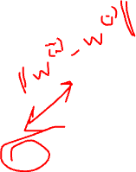
Multi-Task Learning
each local dataset/model is separate learning task
Notes:
We then aim at learning separate weights for each local dataset. This is a multi-task learning problem with each local data being a separate learning task. To have any chance at solving this multi-task learning problem we exploit similarities' between the individual tasks that is tied to the network structure.

Slide 27

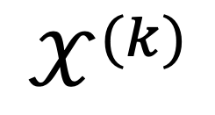
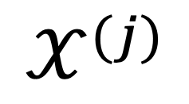
Locally Weighted Learning
$$𝒳^{(j)}$$
pool local datasets of nodes
in the same cluster
$$𝒳^{(i)}$$
$$𝒳^{(k)}$$
William S. Cleveland, Susan J. Devlin, Eric Grosse,
“Regression by local fitting: Methods, properties, and computational algorithms,”
Journal of Econometrics, Volume 37, Issue 1, 1988.

Slide 28
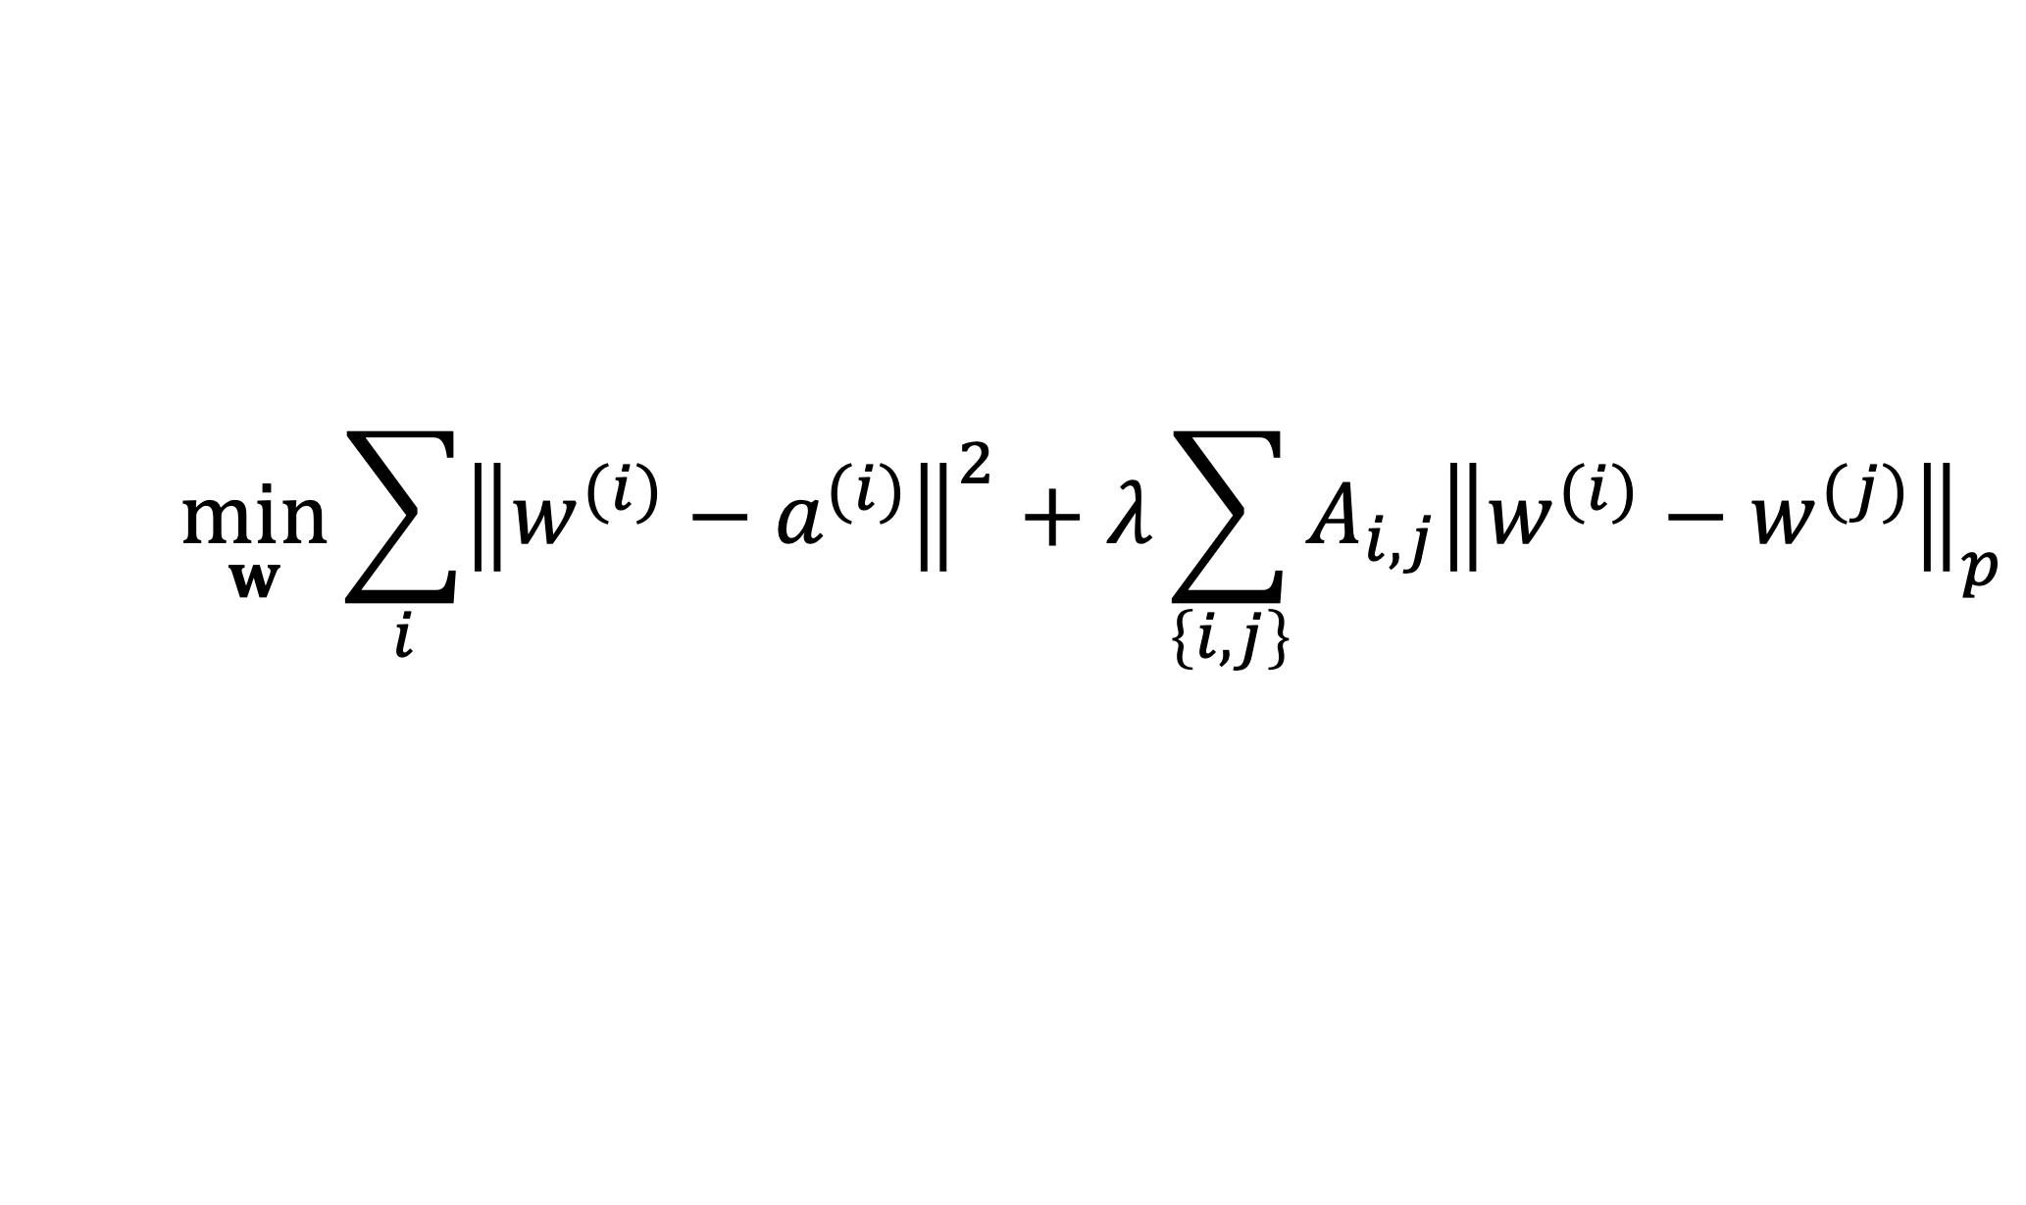

Generalized Convex Clustering
$$\min_{w}{\sum_{i}{{\left\|w^{(i)}−a^{(i)}\right\|}^{2}}+λ\sum_{\left\{i,j\right\}}{A_{i,j}{\left\|w^{(i)}−w^{(j)}\right\|}_{p}}}$$
D. Sun, K.-C. Toh, Y. Yuan;
Convex Clustering: Model, Theoretical Guarantee and Efficient Algorithm, JMLR, 22(9):1−32, 2021
Notes:
We then aim at learning separate weights for each local dataset. This is a multi-task learning problem with each local data being a separate learning task. To have any chance at solving this multi-task learning problem we exploit similarities' between the individual tasks that is tied to the network structure.

Slide 29
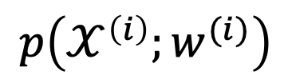
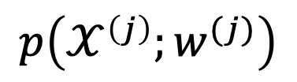
(Probabilistic) Graphical Model
separate prob. space for each local dataset
traditionally, PGMs use a common
prob. space for all local datasets
$$p\left(𝒳^{\left(i\right)};w^{(i)}\right)$$
$$p\left(𝒳^{\left(j\right)};w^{(j)}\right)$$
AJ, "Networked Exponential Families for Big Data Over Networks," in IEEE Access, vol. 8, pp. 202897-202909, 2020, doi: 10.1109/ACCESS.2020.3033817.
Notes:
We then aim at learning separate weights for each local dataset. This is a multi-task learning problem with each local data being a separate learning task. To have any chance at solving this multi-task learning problem we exploit similarities' between the individual tasks that is tied to the network structure.

Slide 30
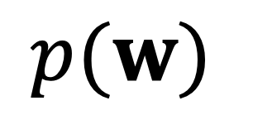
Approx. Hierarch. Bayes’ Model
i.i.d. draw
$$p(w)$$
i.i.d. draw
Lyu, B., Hanzely, F., and Kolar, M., “Personalized Federated Learning with Multiple Known Clusters”, arXiv e-prints, 2022. doi:10.48550/arXiv.2204.13619.

Slide 31
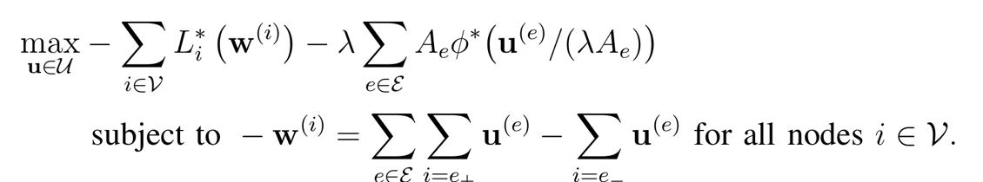




Non-Linear Min-Cost-Flow
augmented “collector node”

Slide 32
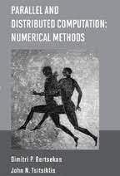

Non-Linear Min-Cost-Flow

Slide 33
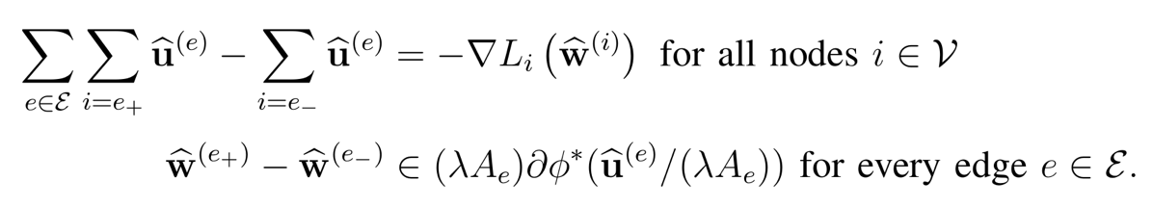
Electrical Network. (“AI is new Electricity!”)
Kirchhoff’s Current Law
Generalized Ohm Law

Slide 34
GTVMin
for
Non-Param. Models
Notes:
The local loss function encapsulates the local dataset from the perspective of federated learning algorithms. We only need the local dataset to construct a local loss function to score different choices for the parameters.

Slide 35
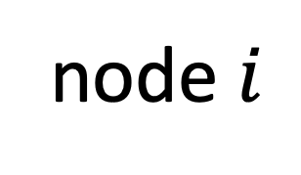
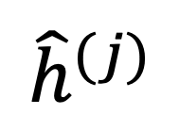
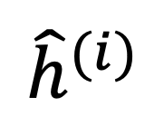
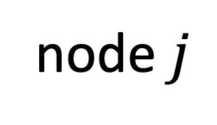
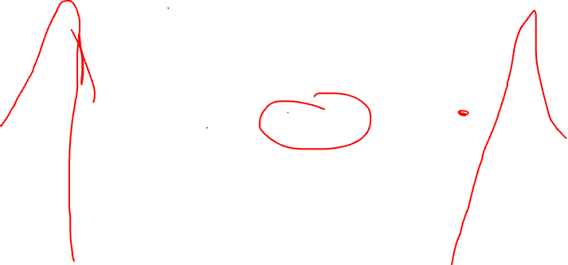
Variation of Non-Param. Models
node $i$
node $j$
$${\hat{h}}^{(j)}$$
$${\hat{h}}^{(i)}$$
test set that is
shared by node i and j

Slide 36
Wrap Up.
couple local model training via regularization
regularizer obtained via GTV (over empirical graph)
FL algorithms = optimization methods for GTV min
GTVmin pools local datasets into clusters
cluster structure depends on emp.graph and local data!

Slide 37
Thank you for
your attention!

