Slide 1

CS-E4740 Federated Learning “FL Flavors”

Slide 2
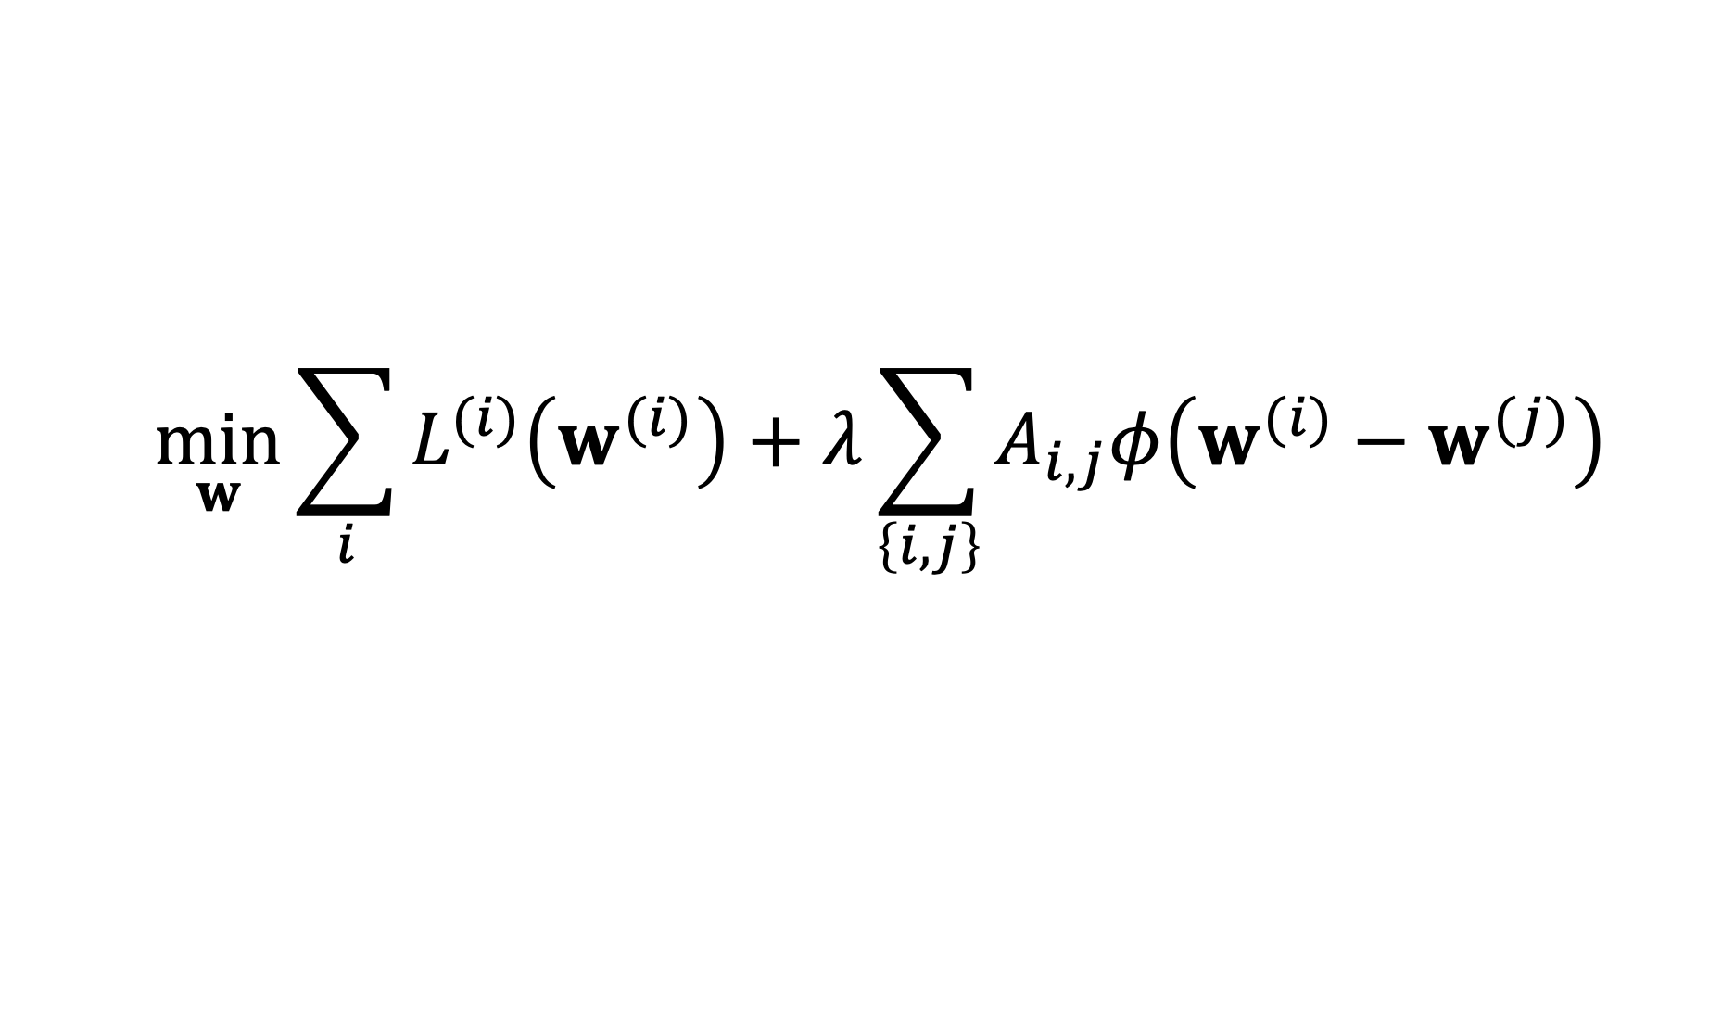
FL Design Principle
$$\min_{w}{\sum_{i}{L^{(i)}\left(w^{(i)}\right)}+λ\sum_{\left\{i,j\right\}}{A_{i,j}φ\left(w^{(i)}−w^{(j)}\right)}}$$
computational aspects: how to compute (approximate) solutions efficiently ?
statistical aspects: are the solutions any good?

Slide 3
FL Flavors
Centralized FL
Decentralized FL
Personalized FL
Vertical FL
Horizontal FL

Slide 4
FL Flavors
Centralized FL
Decentralized FL
Personalized FL
Vertical FL
Horizontal FL

Slide 5


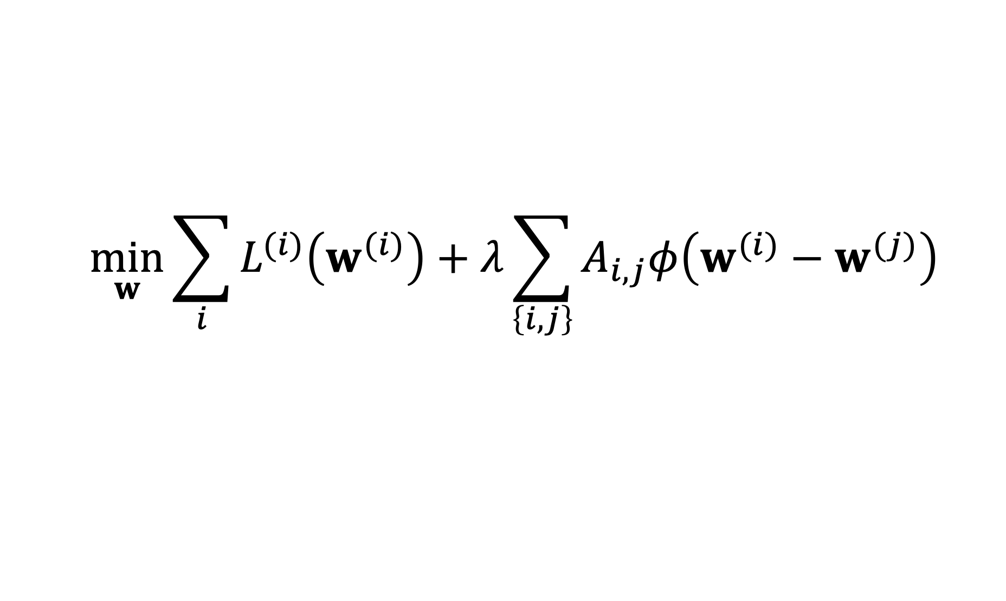
Centralized FL
$$\min_{w}{\sum_{i}{L^{(i)}\left(w^{(i)}\right)}+λ\sum_{\left\{i,j\right\}}{A_{i,j}φ\left(w^{(i)}−w^{(j)}\right)}}$$

Slide 6
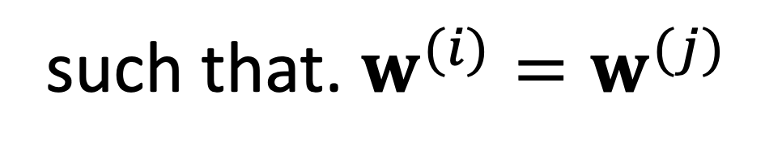
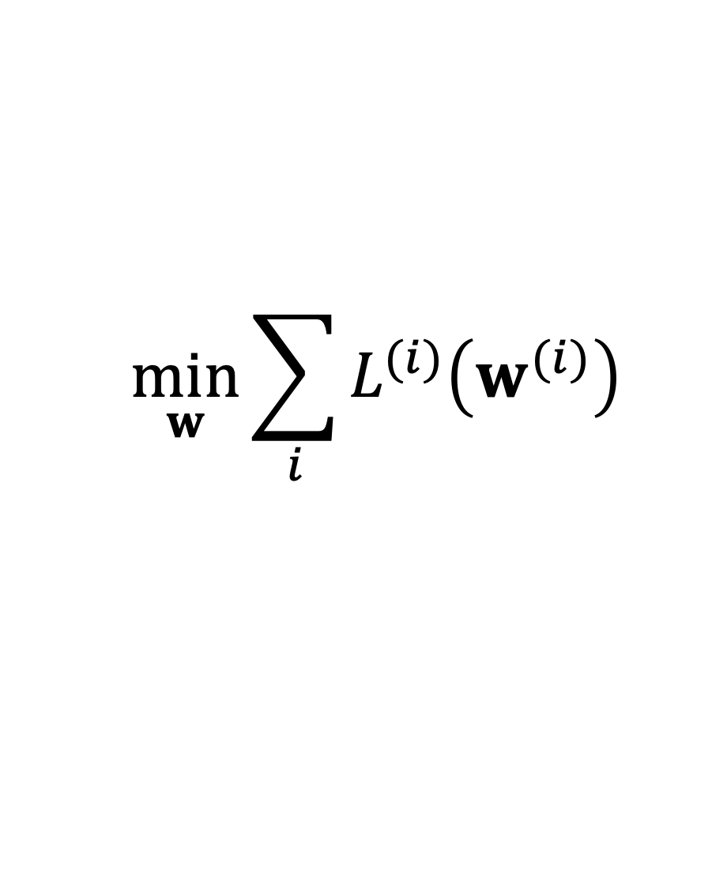
Global Model
$$\min_{w}{\sum_{i}{L^{(i)}\left(w^{(i)}\right)}}$$
such that. $w^{(i)}=w^{(j)}$

Slide 7
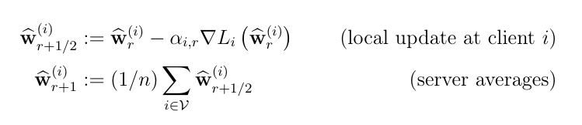
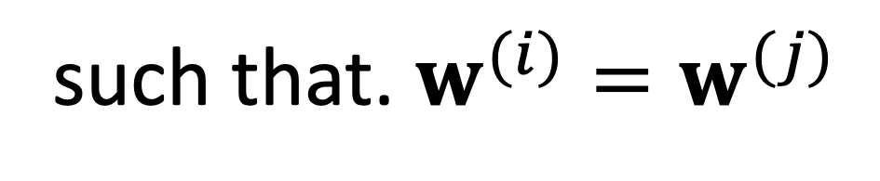
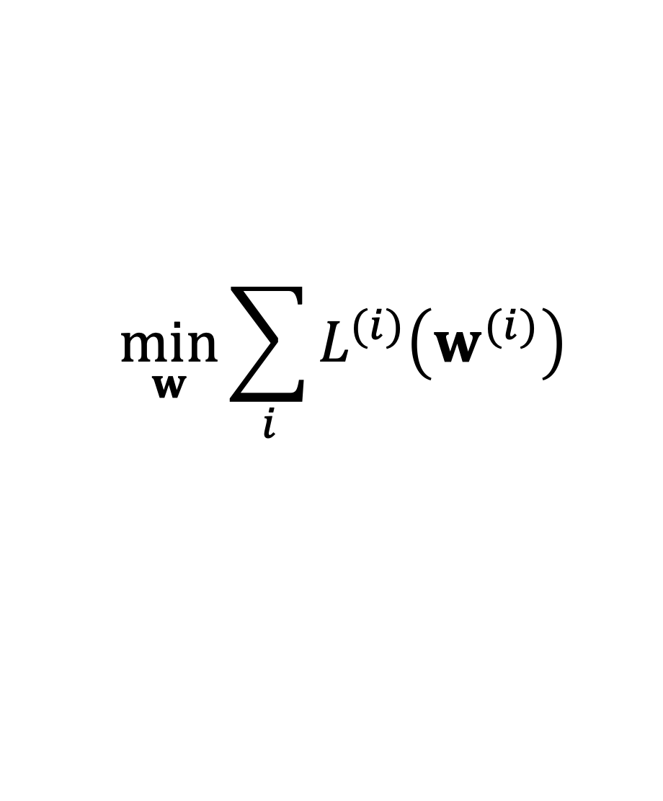
Projected SGD
$$\min_{w}{\sum_{i}{L^{(i)}\left(w^{(i)}\right)}}$$
such that. $w^{(i)}=w^{(j)}$

Slide 8
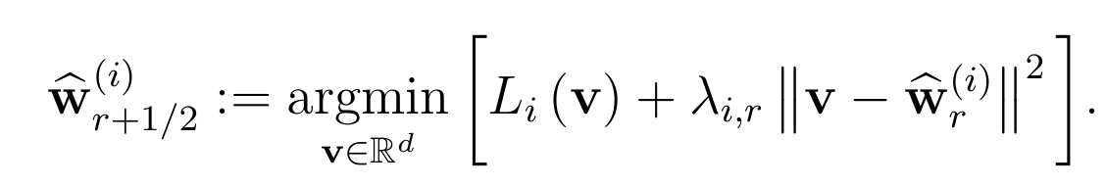
FedAvg
replace gradient step with local optimization:

Slide 9



Horizontal FL
local dataset 1
labels
$$x^{(1)}$$
$$x^{(2)}$$
local dataset 2
local dataset 3
$$x^{(m)}$$
features

Slide 10


Vertical FL
local dataset 2
local dataset 3
local dataset 1
labels
$$x^{(1)}$$
$$x^{(m)}$$

Slide 11
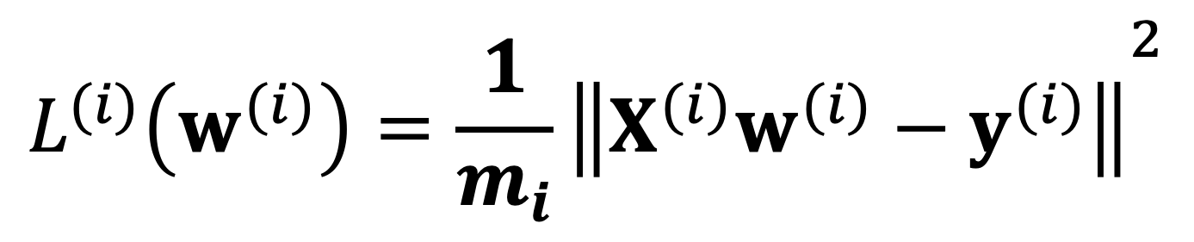
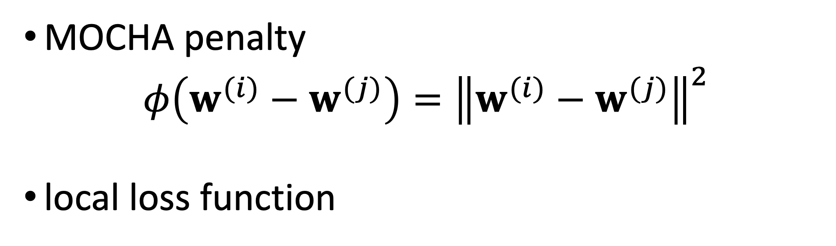
Special Case
MOCHA penalty
$$φ\left(w^{(i)}−w^{(j)}\right)={\left\|w^{(i)}−w^{(j)}\right\|}^{2}$$
local loss function
$${L^{(i)}\left(w^{(i)}\right)=\frac{1}{m_{i}}\left\|X^{(i)}w^{(i)}−y^{(i)}\right\|}^{2}$$

Slide 12
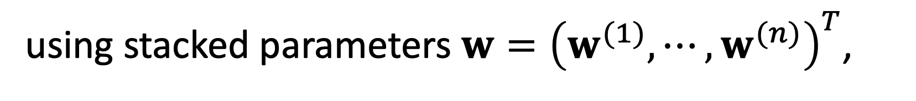
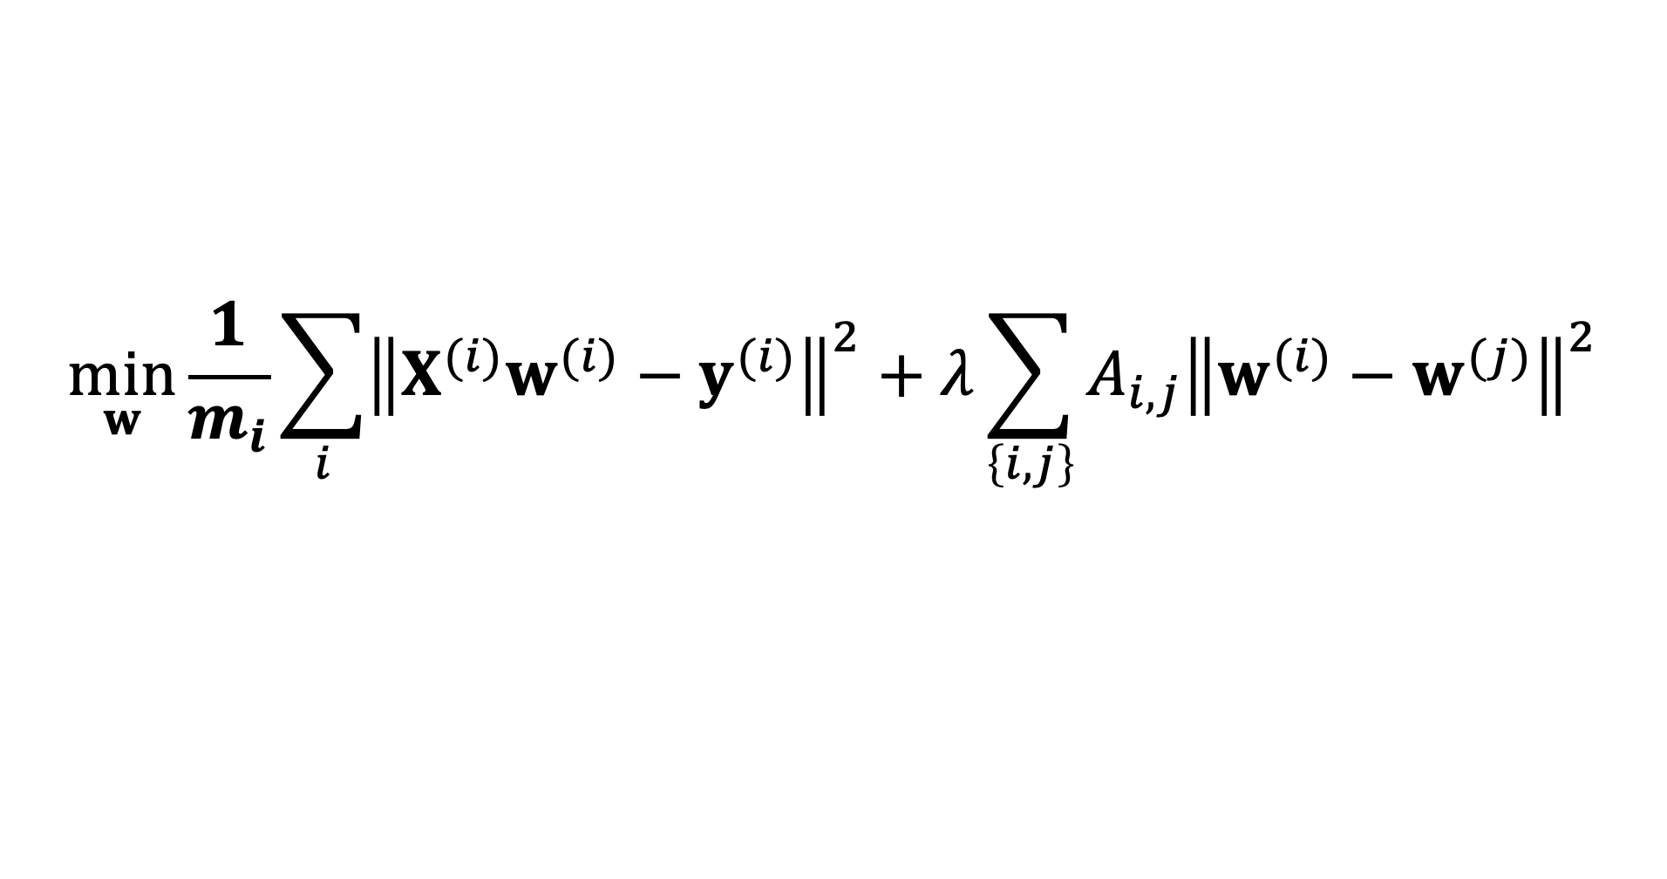


GTV Min. for Local Lin.Reg.
$$\min_{w}{\frac{1}{m_{i}}\sum_{i}{{\left\|X^{(i)}w^{(i)}−y^{(i)}\right\|}^{2}}+λ\sum_{\left\{i,j\right\}}{A_{i,j}{\left\|w^{(i)}−w^{(j)}\right\|}^{2}}}$$
using stacked parameters $w={\left(w^{(1)},⋯,w^{(n)}\right)}^{T}$,
$\min_{w}{w^{T}}Q w+w^{T}$q
with psd matrix $Q$ and vector q that depend on local datasets, GTVMin parameter $λ$and empirical graph

Slide 13
Thank you for
your attention!

