Slide 1
CS-E4740 Federated Learning A FL Design Principle Dipl.-Ing. Dr.techn. Alexander Jung

Slide 2
What are main components of ML and how are they combined?

Slide 3
Previous Lecture:
Networked Data and Models
Today:
Loss and Optimization

Slide 4


Weather Stations.

Slide 5
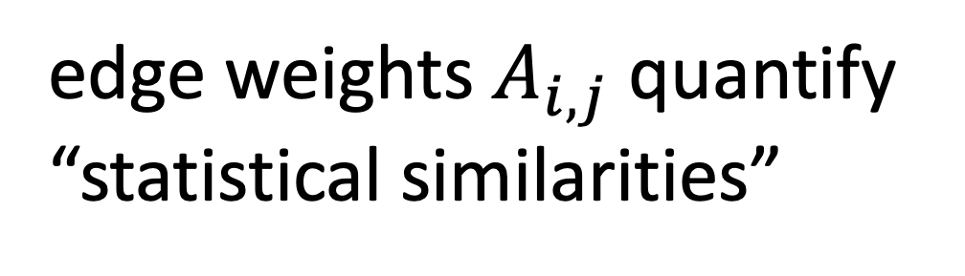
The Empirical Graph
local dataset
edge weights $A_{i,j}$ quantify
“statistical similarities”
Notes:
We represent networked data using an undirected weighted graph which we refer to as the empirical graph. The nodes of the empirical graph represent individual local datasets, e.g., generated by a particular person or by a particular IoT sensing device. Two nodes are connected by an edge if they are similar in a domain-specific sense. This similarity notion might be be obtained from spatio-temporal proximity as in contact networks for disease spread or by presence/absence of direct communication links. Our research studies how to combine the geometry of the network or network topoloy with the geometry of local models that are used for each local dataset.

Slide 6
Networked Models.
local model for each node
couple models at connected nodes
“similar"
Notes:
Starting with a given empirical graph we define a networked model. Each node is equipped with some parametric model with paramters of weights w. These local models could be linear regression models or deep neural nets. Our methods allow to abstract from the details of the local models and only need a loss function that provides a score for a given choice of weights.

Slide 7
Networked Parametric Models.
model params
“similar"
Notes:
Starting with a given empirical graph we define a networked model. Each node is equipped with some parametric model with paramters of weights w. These local models could be linear regression models or deep neural nets. Our methods allow to abstract from the details of the local models and only need a loss function that provides a score for a given choice of weights.

Slide 8
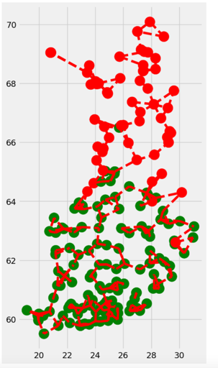
Clustering Assumption
the local datasets form clusters
datasets in same can be approximated as realizations of i.i.d. RVs with prob. dist p(x,y;c)
high edge density inside clusters

Slide 9
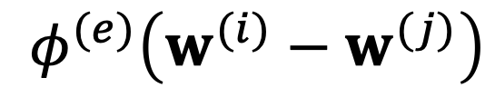
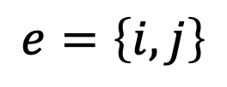
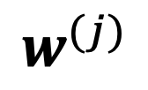
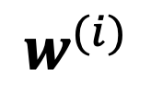
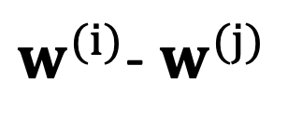
Measure Clustering via Variation
local model params
$$w^{(i)}$$
require similar params at ends of edge e
penalty function measures
$$e=\left\{i,j\right\}$$
“variation”
$$φ^{(e)}\left(w^{(i)}−w^{(j)}\right)$$
$$w^{(j)}$$
$w^{(i)}$- $w^{(j)}$
Notes:
The local loss function encapsulates the local dataset from the perspective of federated learning algorithms. We only need the local dataset to construct a local loss function to score different choices for the parameters.

Slide 10
Generalized Total Variation (GTV)
force model params at well
connected nodes to be similar
by requiring small GTV
1
2

Slide 11
Two Special Cases of GTV.
total variation
graph Laplacian quadratic from is GTV with

Slide 12
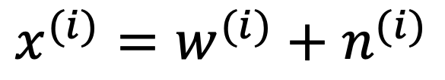
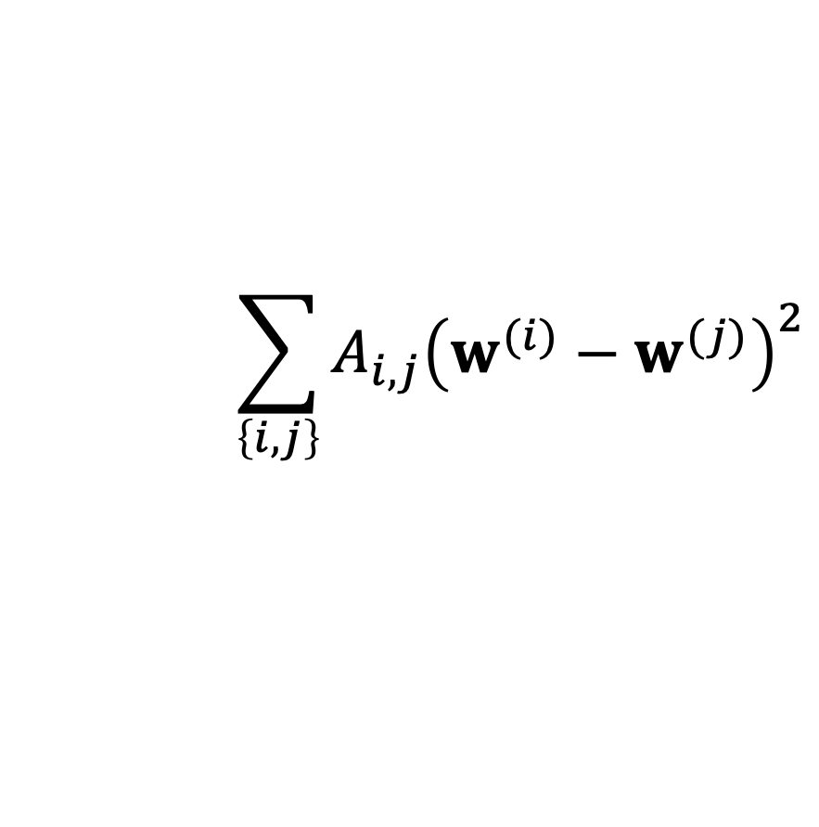
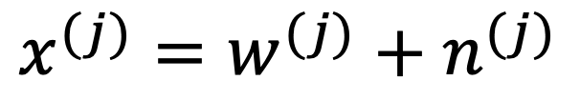
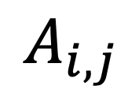
Smooth Graph Signals.
$$x^{(i)}=w^{(i)}+n^{(i)}$$
$$A_{i,j}$$
$$x^{(j)}=w^{(j)}+n^{(j)}$$
low pass constraint on
$$\sum_{\left\{i,j\right\}}{A_{i,j}{\left(w^{(i)}−w^{(j)}\right)}^{2}}$$

Slide 13

Local Loss Function.
model params
measure quality of params by local loss function
$$L^{(i)}\left(w^{(i)}\right)$$

Slide 14
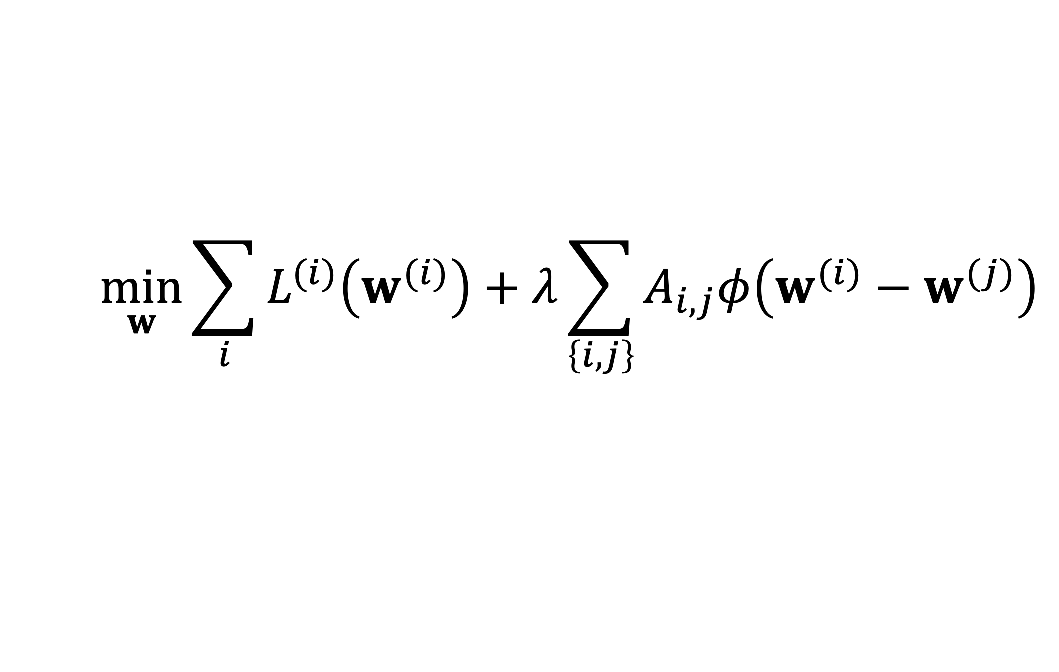
GTV Minimization
$$\min_{w}{\sum_{i}{L^{(i)}\left(w^{(i)}\right)}+λ\sum_{\left\{i,j\right\}}{A_{i,j}φ\left(w^{(i)}−w^{(j)}\right)}}$$
increasing
average local loss
“clusteredness”

Slide 15
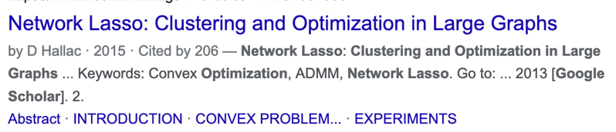
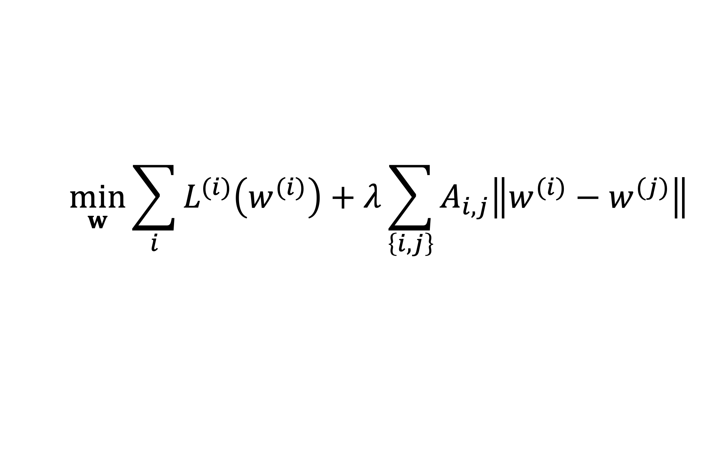
Network Lasso
$$\min_{w}{\sum_{i}{L^{(i)}\left(w^{(i)}\right)}+λ\sum_{\left\{i,j\right\}}{A_{i,j}\left\|w^{(i)}−w^{(j)}\right\|}}$$

Slide 16
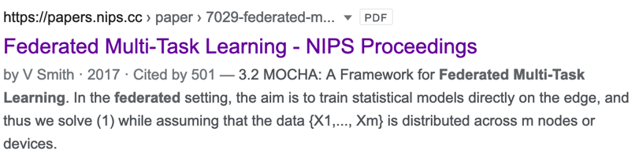
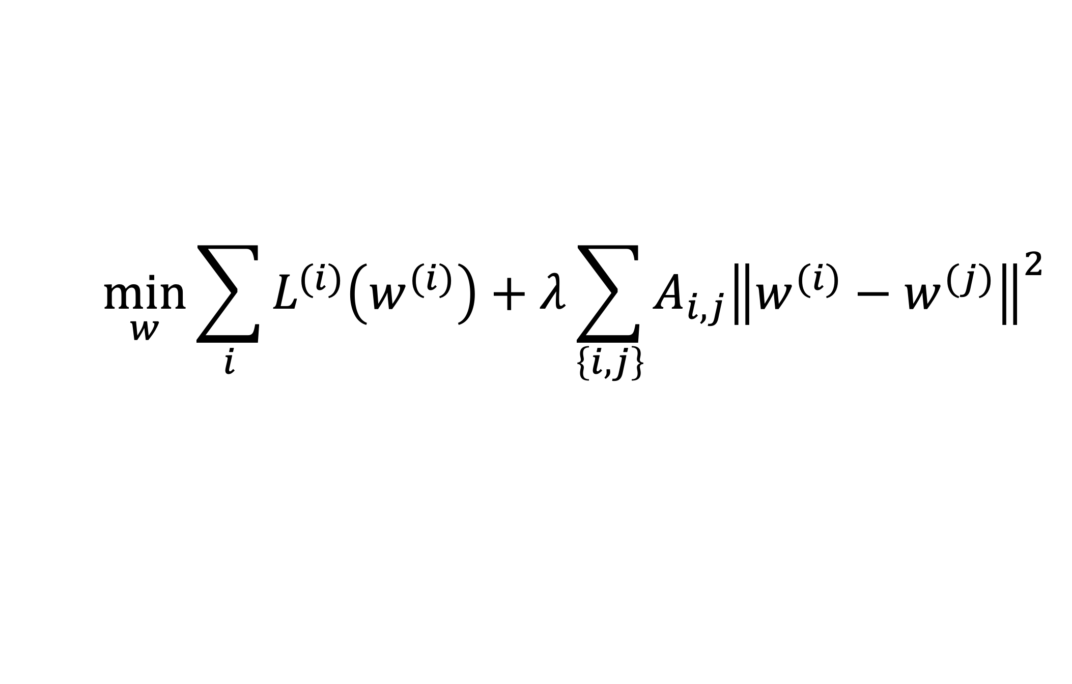
Special Case: “MOCHA”
$$\min_{w}{\sum_{i}{L^{(i)}\left(w^{(i)}\right)}+λ}\sum_{\left\{i,j\right\}}{A_{i,j}{\left\|w^{(i)}−w^{(j)}\right\|}^{2}}$$

Slide 17
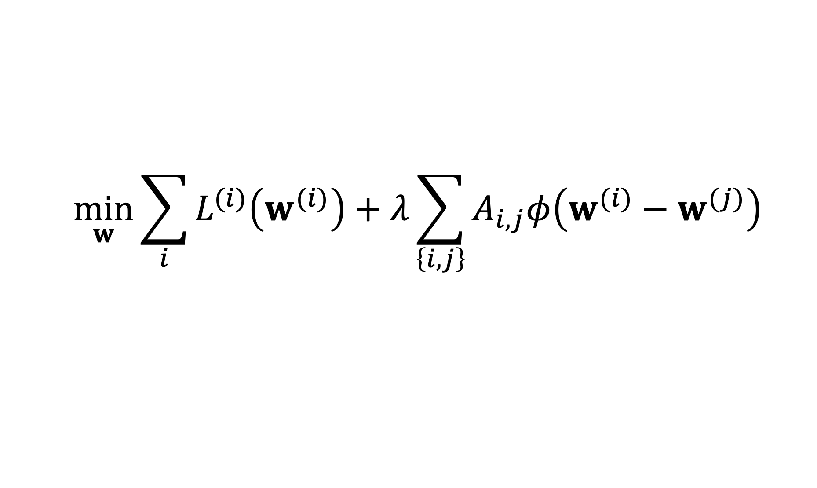
Two Key Questions of ML
$$\min_{w}{\sum_{i}{L^{(i)}\left(w^{(i)}\right)}+λ\sum_{\left\{i,j\right\}}{A_{i,j}φ\left(w^{(i)}−w^{(j)}\right)}}$$
computational aspects: how can we efficiently compute solutions (approximately)
statistical aspects: are the solutions any good?

Slide 18
Computational Aspects

Slide 19





A FL Setting

Slide 20
Requirements
run in ad-hoc nets of low-cost devices
robustness against node/link failures
robustness against “stragglers”

Slide 21

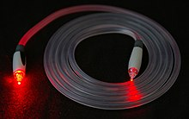
Another FL Setting…
https://www.google.com/about/datacenters/
https://en.wikipedia.org/wiki/Optical_fiber

Slide 22
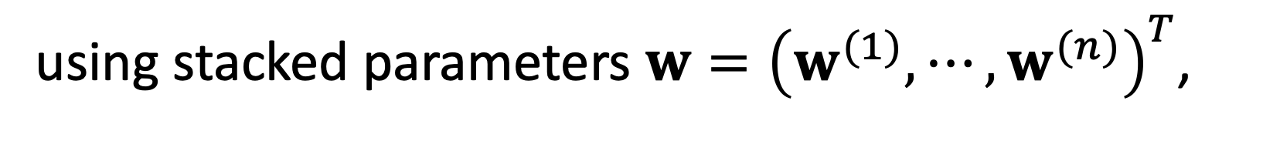
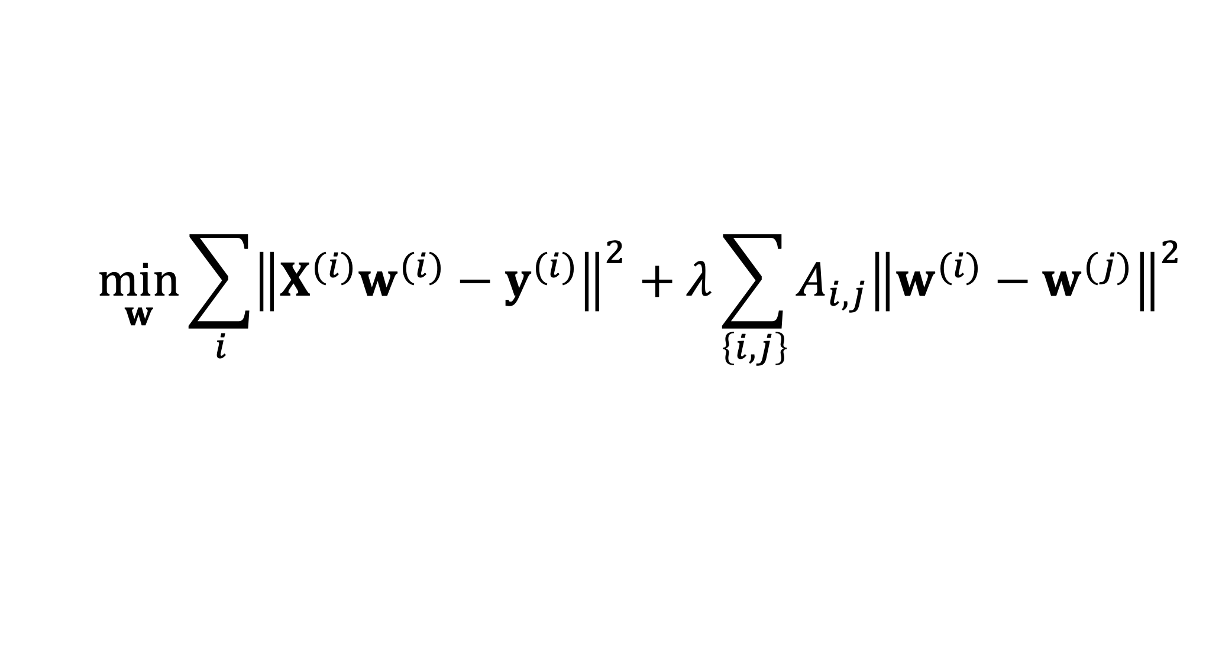
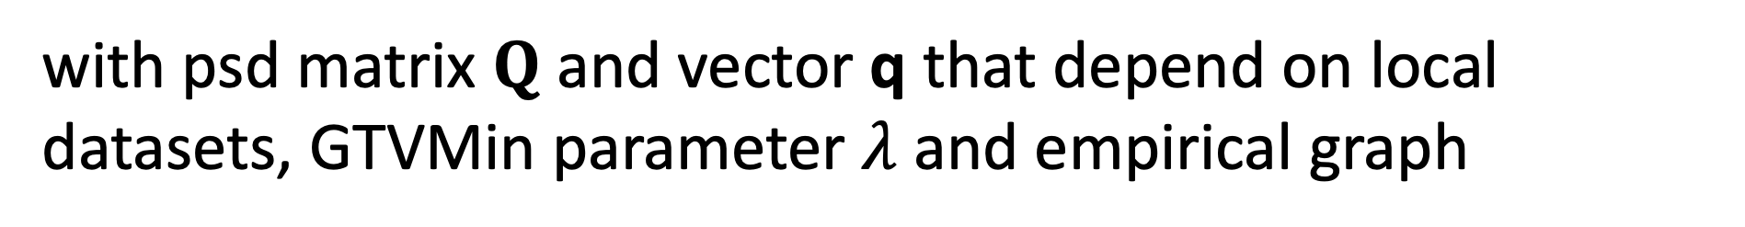
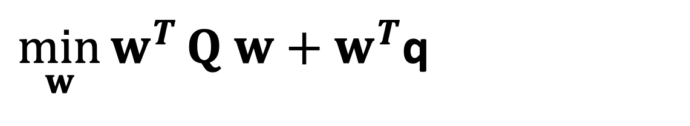
GTV Min. for Local Lin.Reg.
$$\min_{w}{\sum_{i}{{\left\|X^{(i)}w^{(i)}−y^{(i)}\right\|}^{2}}+λ\sum_{\left\{i,j\right\}}{A_{i,j}{\left\|w^{(i)}−w^{(j)}\right\|}^{2}}}$$
using stacked parameters $w={\left(w^{(1)},⋯,w^{(n)}\right)}^{T}$,
$\min_{w}{w^{T}}Q w+w^{T}$q
with psd matrix $Q$ and vector q that depend on local datasets, GTVMin parameter $λ$and empirical graph

Slide 23
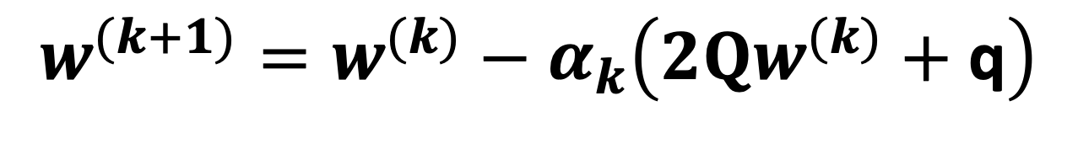

GTV Min. for Local Lin.Reg.
$$\min_{w}{w^{T}}Q w+w^{T}\text{q}$$
can be solved using gradient methods
$$w^{(k+1)}=w^{(k)}−α_{k}\left(2Qw^{(k)}+\text{q}\right)$$

Slide 24
Statistical
Aspects

Slide 25
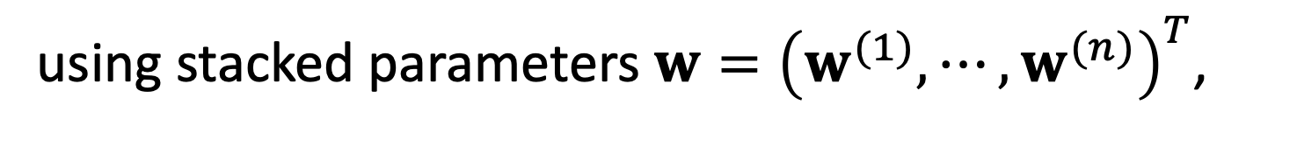

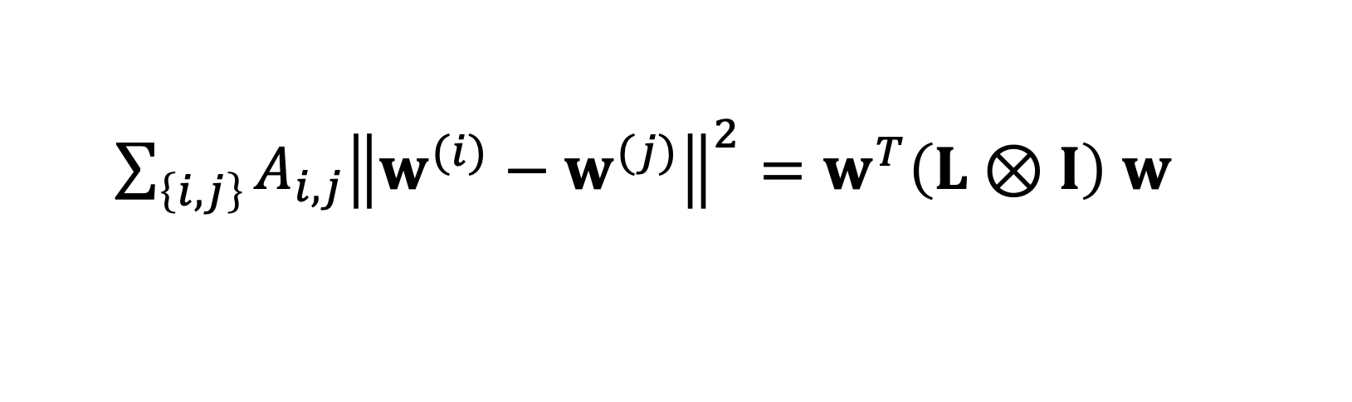
GTV Min. for Local Lin.Reg.
$$\min_{w}{\sum_{i}{{\left\|X^{(i)}w^{(i)}−y^{(i)}\right\|}^{2}}+λ\sum_{\left\{i,j\right\}}{A_{i,j}{\left\|w^{(i)}−w^{(j)}\right\|}^{2}}}$$
using stacked parameters $w={\left(w^{(1)},⋯,w^{(n)}\right)}^{T}$,
$\sum_{\left\{i,j\right\}}{A_{i,j}{\left\|w^{(i)}−w^{(j)}\right\|}^{2}}=w^{T}\left(L⊗I\right)$ $w$
with the graph Laplacian $L$

Slide 26

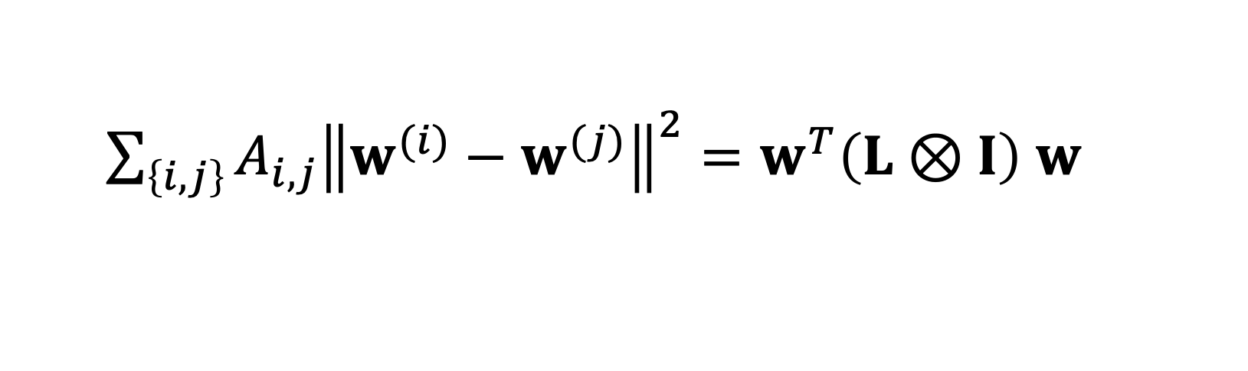
Spectral Clustering
for large $λ,$GTVMin is to minimize
$\sum_{\left\{i,j\right\}}{A_{i,j}{\left\|w^{(i)}−w^{(j)}\right\|}^{2}}=w^{T}\left(L⊗I\right)$ $w$
local model parameters should be composed
of eigvecs. of L corresponding to smallest eig.vals

Slide 27
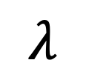
Clustering of GTVMin Solutions
0
$$λ$$
personalized
clustered
global

Slide 28
Interpretations

Slide 29



Multi-Task Learning
each local dataset/model is separate learning task
Notes:
We then aim at learning separate weights for each local dataset. This is a multi-task learning problem with each local data being a separate learning task. To have any chance at solving this multi-task learning problem we exploit similarities' between the individual tasks that is tied to the network structure.

Slide 30

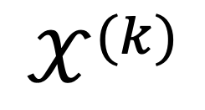
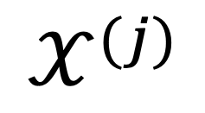
Locally Weighted Learning
$$𝒳^{(j)}$$
pool local datasets of nodes
in the same cluster
$$𝒳^{(i)}$$
$$𝒳^{(k)}$$
William S. Cleveland, Susan J. Devlin, Eric Grosse,
“Regression by local fitting: Methods, properties, and computational algorithms,”
Journal of Econometrics, Volume 37, Issue 1, 1988.

Slide 31
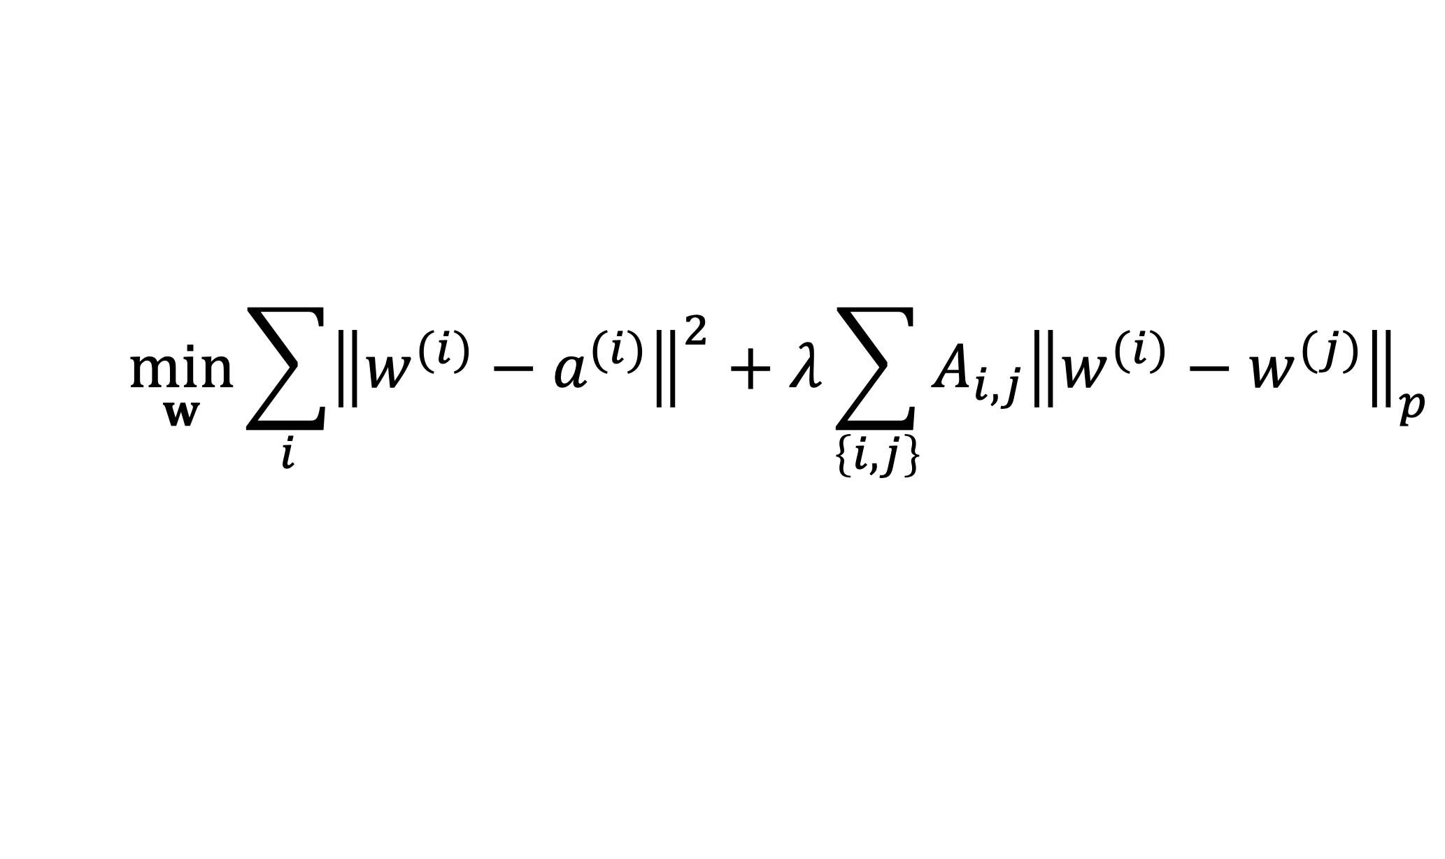
Generalized Convex Clustering
$$\min_{w}{\sum_{i}{{\left\|w^{(i)}−a^{(i)}\right\|}^{2}}+λ\sum_{\left\{i,j\right\}}{A_{i,j}{\left\|w^{(i)}−w^{(j)}\right\|}_{p}}}$$
D. Sun, K.-C. Toh, Y. Yuan;
Convex Clustering: Model, Theoretical Guarantee and Efficient Algorithm, JMLR, 22(9):1−32, 2021
Notes:
We then aim at learning separate weights for each local dataset. This is a multi-task learning problem with each local data being a separate learning task. To have any chance at solving this multi-task learning problem we exploit similarities' between the individual tasks that is tied to the network structure.

Slide 32
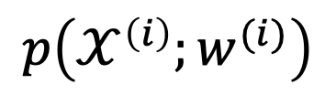
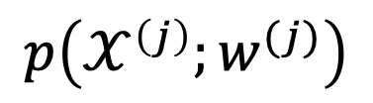
(Probabilistic) Graphical Model
separate prob. space for each local dataset
traditionally, PGMs use a common
prob. space for all local datasets
$$p\left(𝒳^{\left(i\right)};w^{(i)}\right)$$
$$p\left(𝒳^{\left(j\right)};w^{(j)}\right)$$
AJ, "Networked Exponential Families for Big Data Over Networks," in IEEE Access, vol. 8, pp. 202897-202909, 2020, doi: 10.1109/ACCESS.2020.3033817.
Notes:
We then aim at learning separate weights for each local dataset. This is a multi-task learning problem with each local data being a separate learning task. To have any chance at solving this multi-task learning problem we exploit similarities' between the individual tasks that is tied to the network structure.

Slide 33
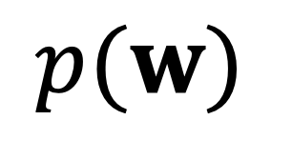
Approx. Hierarch. Bayes’ Model
i.i.d. draw
$$p(w)$$
i.i.d. draw
Lyu, B., Hanzely, F., and Kolar, M., “Personalized Federated Learning with Multiple Known Clusters”, arXiv e-prints, 2022. doi:10.48550/arXiv.2204.13619.

Slide 34
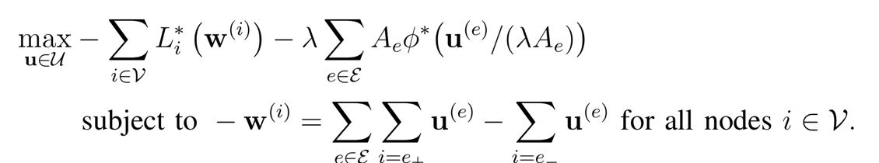

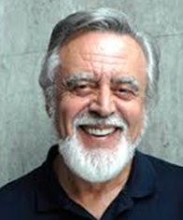


Non-Linear Min-Cost-Flow
augmented “collector node”

Slide 35
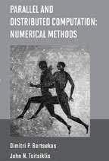
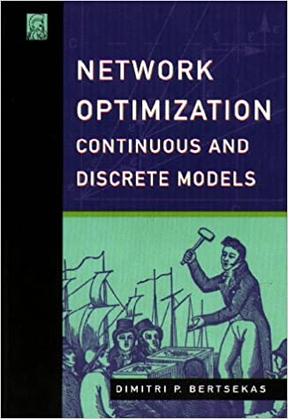
Non-Linear Min-Cost-Flow

Slide 36
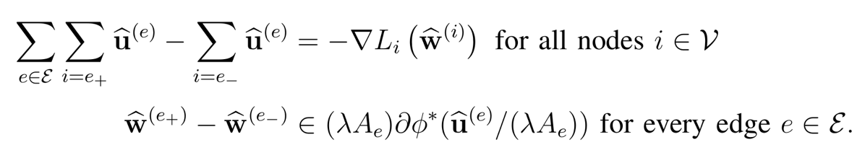
Electrical Network. (“AI is new Electricity!”)
Kirchhoff’s Current Law
Generalized Ohm Law

Slide 37
GTVMin
for
Non-Param. Models
Notes:
The local loss function encapsulates the local dataset from the perspective of federated learning algorithms. We only need the local dataset to construct a local loss function to score different choices for the parameters.

Slide 38
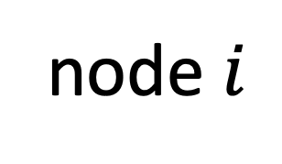
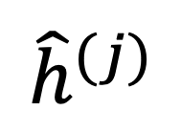
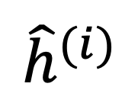
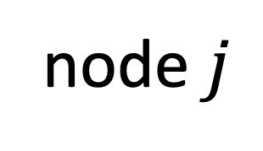
Variation of Non-Param. Models
node $i$
node $j$
$${\hat{h}}^{(j)}$$
$${\hat{h}}^{(i)}$$
test set that is
shared by node i and j

Slide 39
Wrap Up.
couple local model training via regularization
regularizer obtained via GTV (over empirical graph)
FL algorithms = optimization methods for GTV min
GTVmin pools local datasets into clusters
cluster structure depends on emp.graph and local data!

Slide 40
Thank you for
your attention!

