Slide 1
CS-E4740 Federated Learning “Network Models”
Dipl.-Ing. Dr. techn. Alexander Helmut Jung

Slide 2
What are main components of ML and how are they combined?

Slide 3


Plain Old Machine Learning.
h(x)
(y-h(x))²
label y (max.tmp.)
feature x (min.tmp.)

Slide 4
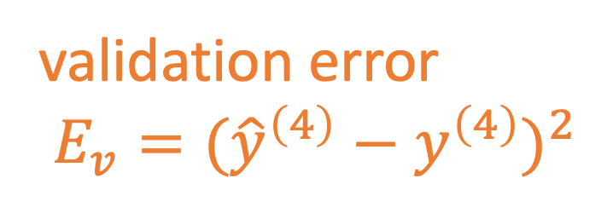
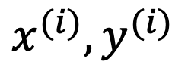
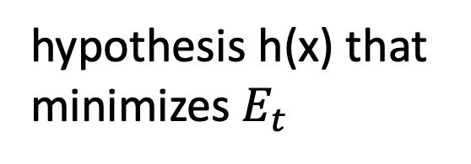
Train and Validate.
hypothesis h(x) that
minimizes $E_{t}$
$$x^{(i)},y^{(i)}$$
label y
validation error
$E_{v}=({\hat{y}}^{\left(4\right)}−y^{\left(4\right)})^{2}$
feature x

Slide 5
Basic Idea of Model Selection
choose model with smallest validation error!
training validation
error error
model 1
degree 1 polyn.
model 2:
degree 3 polyn.
Notes:
it seems that larger models (higher polyn. degree) results in larger validation error. is this always the case?

Slide 6
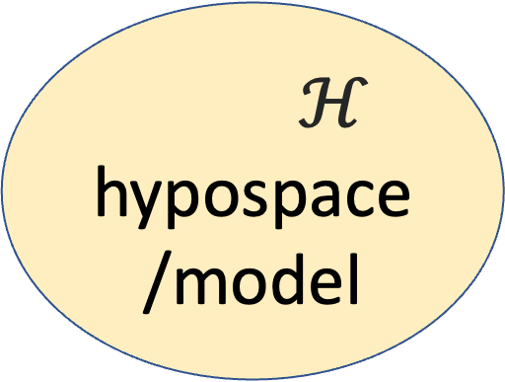
Data and Model Size
$$\left(x^{(1)},y^{(1)}\right)$$
training set
m
$$\left(x^{(2)},y^{(2)}\right)$$
$ℋ$
hypospace/model
$$\left(x^{(m)},y^{(m)}\right)$$
nr. of features n
crucial parameter is the
ratio d/m
eff. dimension d
Notes:
The sample size m is the nr. of different datapoints in the training set

Slide 7
training error
validation error
“critical value” (d/m=1)
d / m

Slide 8
Networked Data

Slide 9
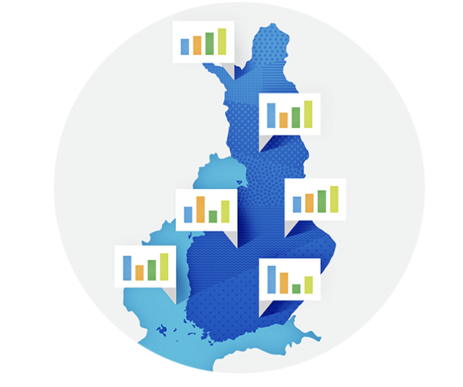
Networked Weather Data

Slide 10
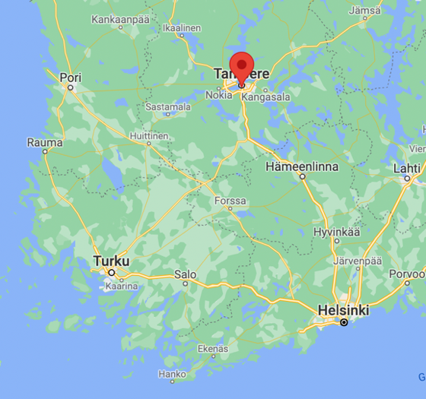

Slide 11
ImageNet.
“…ImageNet is an image database organized according to the WordNet hierarchy (currently only the nouns), in which each node of the hierarchy is depicted by hundreds and thousands of images…”
https://image-net.org/

Slide 12
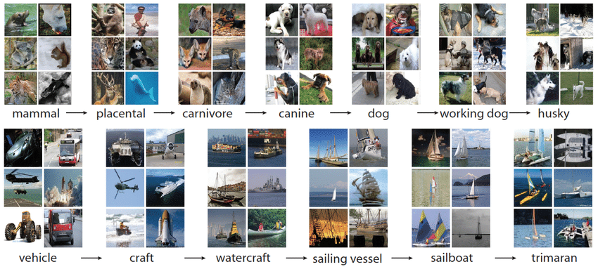
Devopedia. 2021. "ImageNet." Version 16, April 7. Accessed 2023-02-11. https://devopedia.org/imagenet

Slide 13
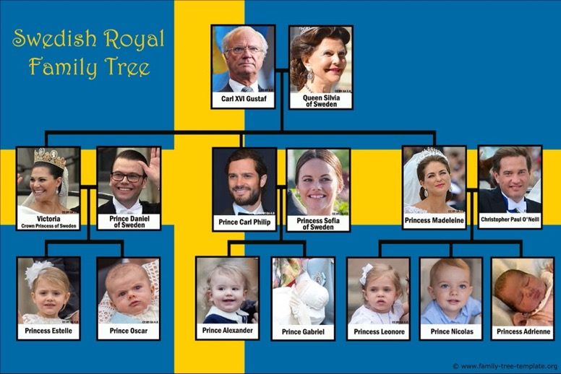
Noble Networks.

Slide 14
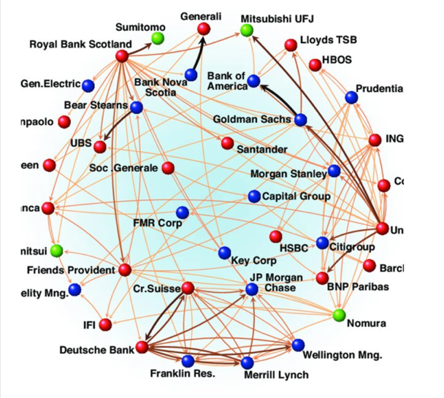
Finance Networks.

Slide 15
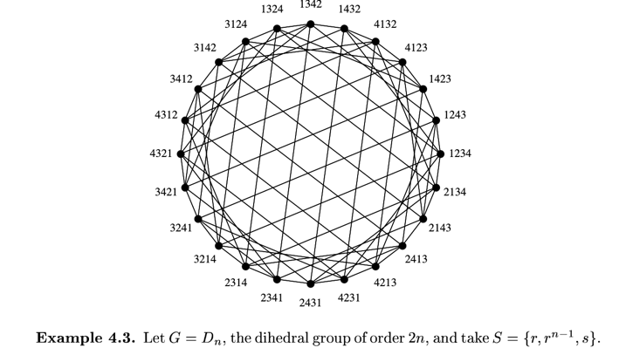
Algebraic Networks
Petteri Kaski, Eigenvectors and spectra of Cayley graphs, 2002

Slide 16
Point Cloud Networks.
label y
feature x

Slide 17
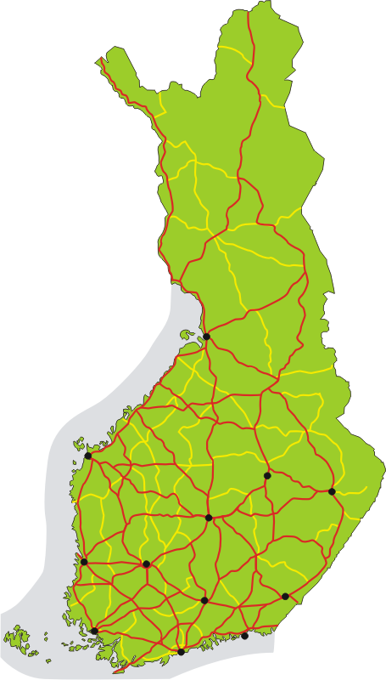
Road Network

Slide 18
Business Process
A
B
C

Slide 19
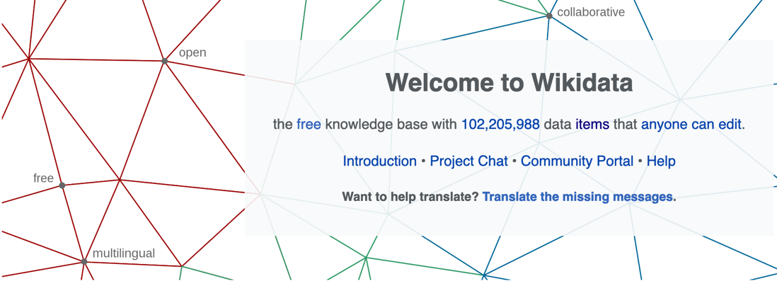
https://www.wikidata.org/wiki/Wikidata:Main_Page

Slide 20
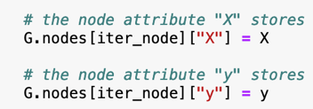

Empirical Graph - Nodes
2
each node carries:
local dataset
i=1
3
4

Slide 21
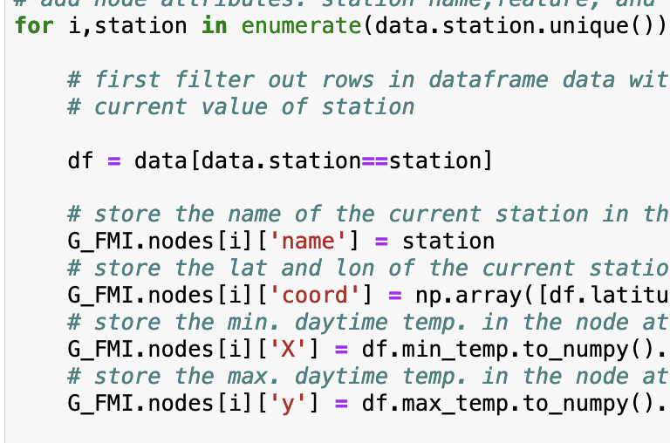
Attach Local Datasets to Nodes
name of FMI station
latitude, longitude of FMI station
use min. daytime tmp. as feature of
datapoint (=some day)
use max. daytime tmp. as labels of
datapoint (= some day)

Slide 22

Empirical Graph - Edges
2
i=1
undirected edge indicates
“similarity”
3
4
edge weight $A_{3,4}$ = level of similarity

Slide 23
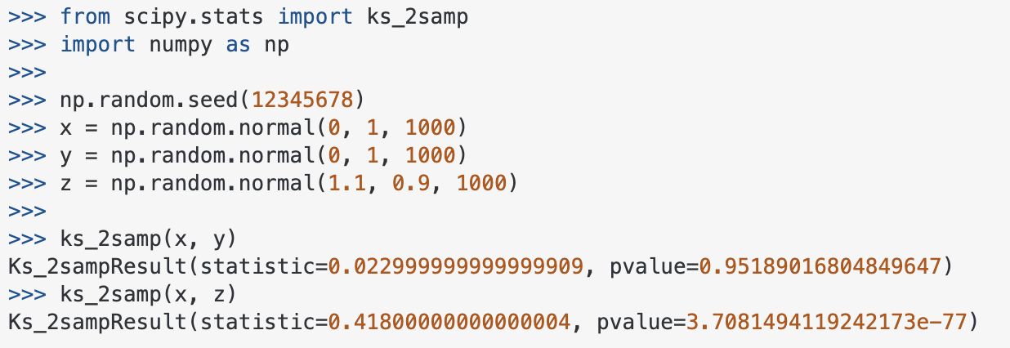
How To Measure Statistical Sim.?
https://stackoverflow.com/questions/10884668/two-sample-kolmogorov-smirnov-test-in-python-scipy
https://en.wikipedia.org/wiki/Kolmogorov%E2%80%93Smirnov_test
Notes:
We represent networked data using an undirected weighted graph which we refer to as the empirical graph. The nodes of the empirical graph represent individual local datasets, e.g., generated by a particular person or by a particular IoT sensing device. Two nodes are connected by an edge if they are similar in a domain-specific sense. This similarity notion might be be obtained from spatio-temporal proximity as in contact networks for disease spread or by presence/absence of direct communication links. Our research studies how to combine the geometry of the network or network topoloy with the geometry of local models that are used for each local dataset.

Slide 24
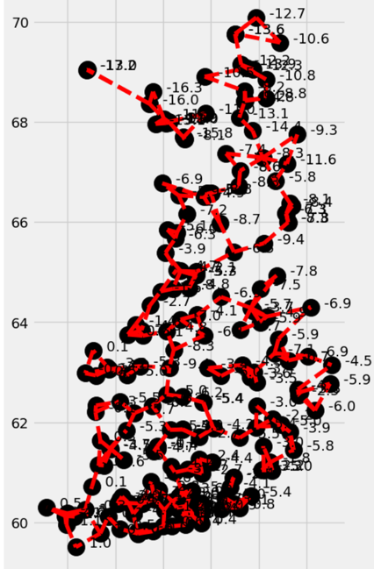
Spatio-Temporal Similarity
connect FMI stations with its k nearest neighbours (use geodesic distance)

Slide 25
How to choose Empirical Graph?
empirical graph is design choice
more edges means more comp./comm.
sufficiently many edges between similar datasets

Slide 26


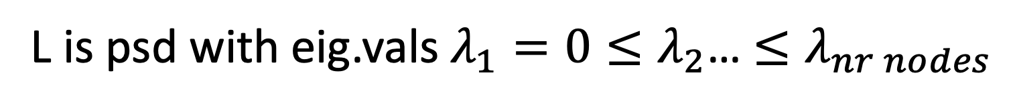
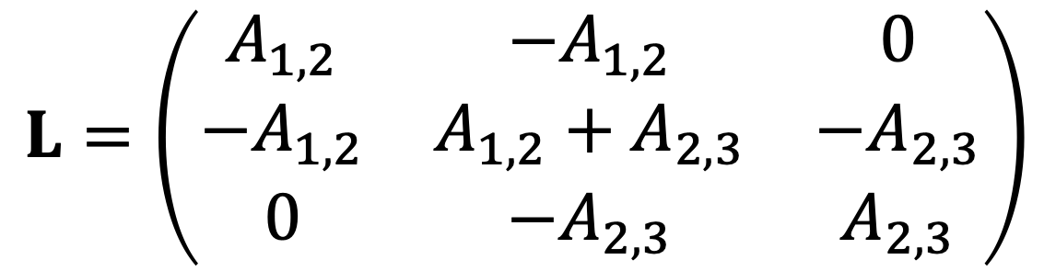
Graph Laplacian Matrix
2
i=1
$$A_{1,2}$$
$$A_{2,3}$$
3
$$L=\left(\begin{matrix}A_{1,2} & −A_{1,2} & 0 \\ −A_{1,2} & A_{1,2}+A_{2,3} & −A_{2,3} \\ 0 & {−A}_{2,3} & A_{2,3}\end{matrix}\right)$$
L is psd with eig.vals $λ_{1}=0≤λ_{2}$… $≤λ_{nr nodes}$

Slide 27
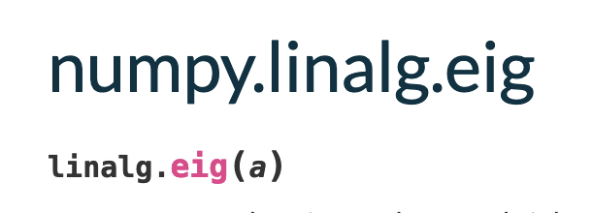

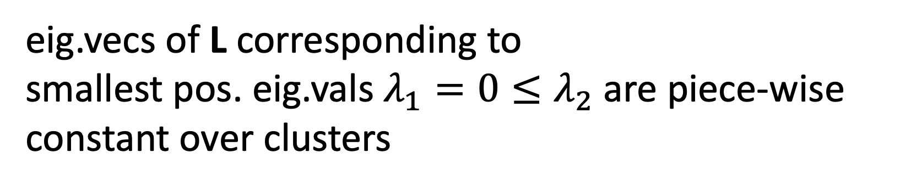
Spectral Graph Clustering
eig.vecs of L corresponding to
smallest pos. eig.vals $λ_{1}=0≤λ_{2}$ are piece-wise constant over clusters
1
i=0
$$A_{0,1}$$
4
3
2
5

Slide 28
What is Component 2
of ML ?

Slide 29

Local Model for Local Data
2
each node carries:
local dataset
local model
i=1
undirected edge indicate
“similarity”
3
4

Slide 30
Networked Models

Slide 31
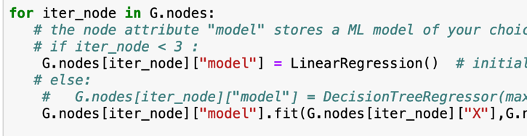
Option 1: Train Separately

Slide 32


Pro: Personalization

Slide 33

Con: Overfitting

Slide 34
Option 2: Global Model

Slide 35
Pro: No Overfitting

Slide 36
Con: Low Accuracy

Slide 37

Option 3: Networked FL

Slide 38
Networked FL
maintain local models for each node (local dataset)
local models are trained on local datasets
couple the training of local models
coupling via clustering (global model per cluster)
different clustering methods

Slide 39
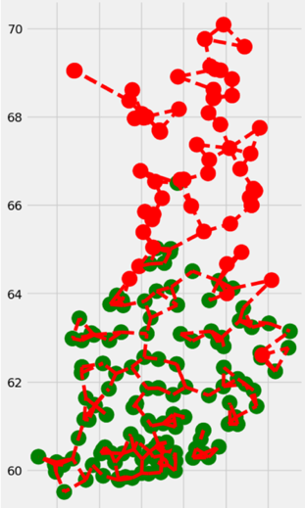
Coupling of Local Models
coupling based on edges
local models at connected nodes should deliver similar predictions

Slide 40
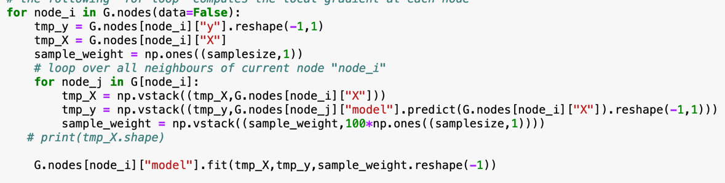
Coupling via Regularization
node i
node j
local data
local model
local data
local model

Slide 41
Clustering Assumption
local dataset
= single datapoint!
local datasets often too small
let’s pool or cluster them but how ?

Slide 42
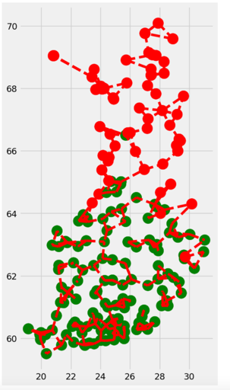
Clustering Assumption
the local datasets form clusters.
local datasets in same cluster c contain data points that can
be approximated as realizations of i.i.d. RVs with prob. dist p(x,y;c)

Slide 43
Cluster-Wise Training
pool local datasets of nodes in
same cluster to train ML model
trained model is used for all nodes in same cluster
pooling via regularization

Slide 44
Wrap-Up.
emp. graph with nodes carrying local datasets and models
undirected weighted edges represent similarities
different sources for similarity
emp. graph is a design choice

Slide 45
Any Questions ?

