Slide 1

CS-E4740 Federated Learning “Main FL Flavors”

Slide 2
Logistics
lectures in zoom by default
Lab 2 started
no lectures next week
peer grading draft available in Section “FL Project”

Slide 3
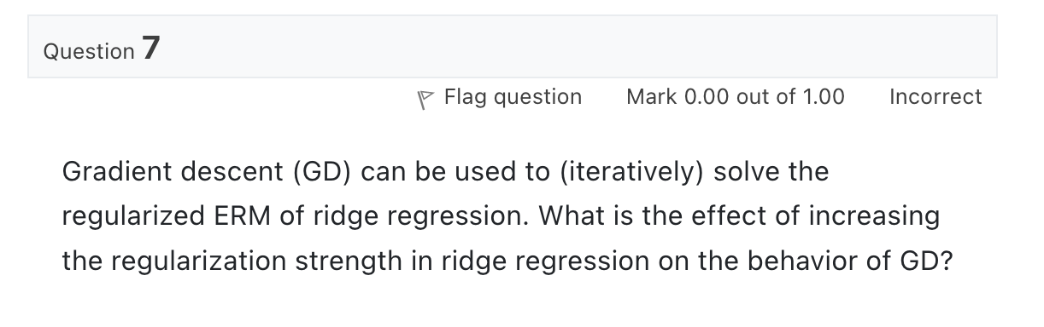
Quiz “Gradient Methods”

Slide 4
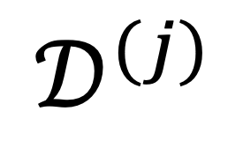
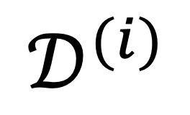

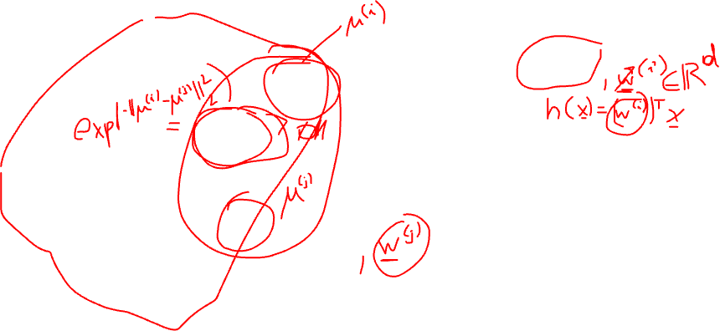
The Empirical Graph
$$𝒟^{(i)}$$
local dataset
edge weights $A_{i,j}$ quantify
“statistical similarities”
$$𝒟^{(j)}$$

Slide 5
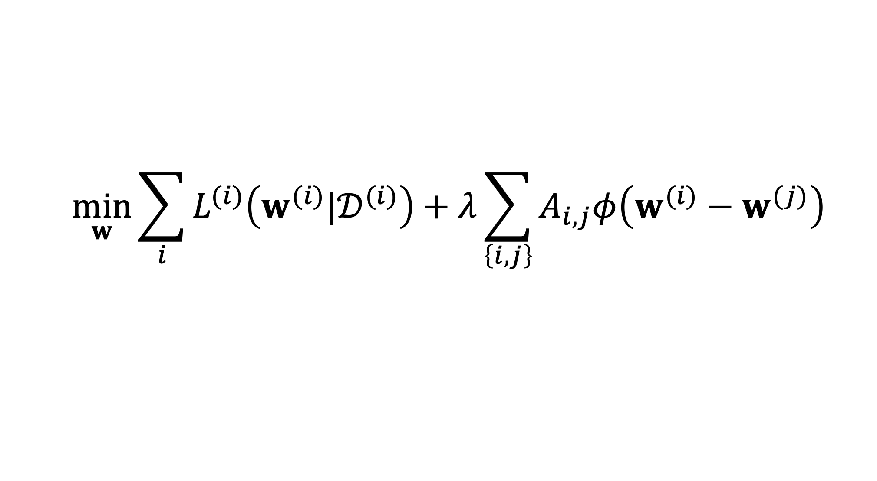

GTV Minimization
$$\min_{w}{\sum_{i}{L^{(i)}\left(w^{(i)}|𝒟^{(i)}\right)}+λ\sum_{\left\{i,j\right\}}{A_{i,j}φ\left(w^{(i)}−w^{(j)}\right)}}$$
increasing
average local loss
“clusteredness”

Slide 6
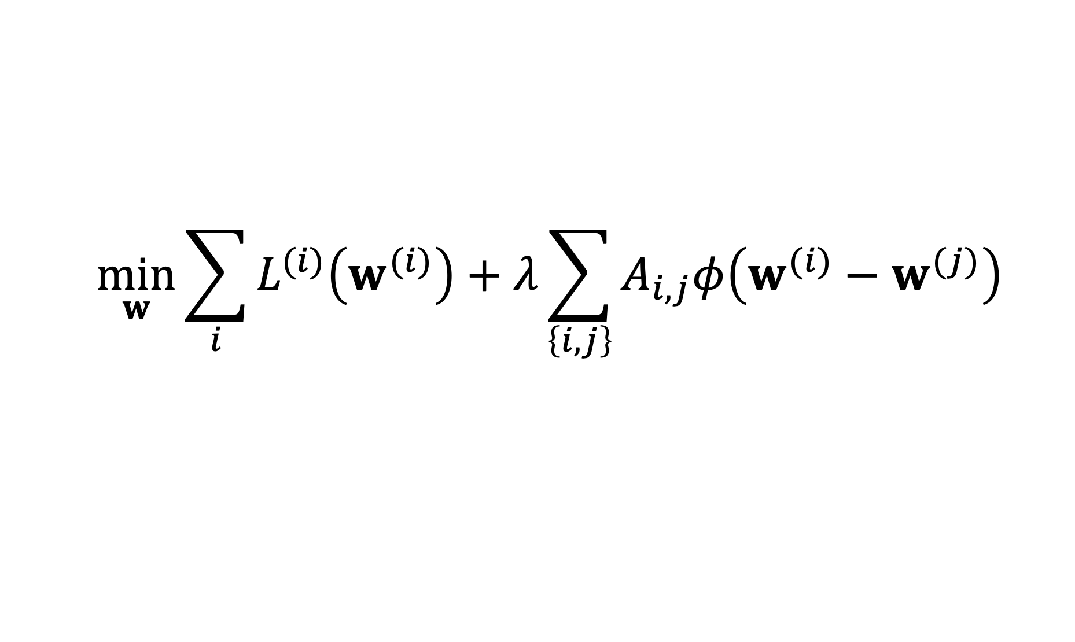
Two Key Questions of FL
$$\min_{w}{\sum_{i}{L^{(i)}\left(w^{(i)}\right)}+λ\sum_{\left\{i,j\right\}}{A_{i,j}φ\left(w^{(i)}−w^{(j)}\right)}}$$
computational aspects: how to compute (approximate) solutions efficiently ?
statistical aspects: are the solutions any good?

Slide 7
Two Key Questions of FL
$$\min_{w}{\sum_{i}{L^{(i)}\left(w^{(i)}\right)}+λ\sum_{\left\{i,j\right\}}{A_{i,j}φ\left(w^{(i)}−w^{(j)}\right)}}$$
computational aspects: how to compute (approximate) solutions efficiently ?
statistical aspects: are the solutions any good?

Slide 8
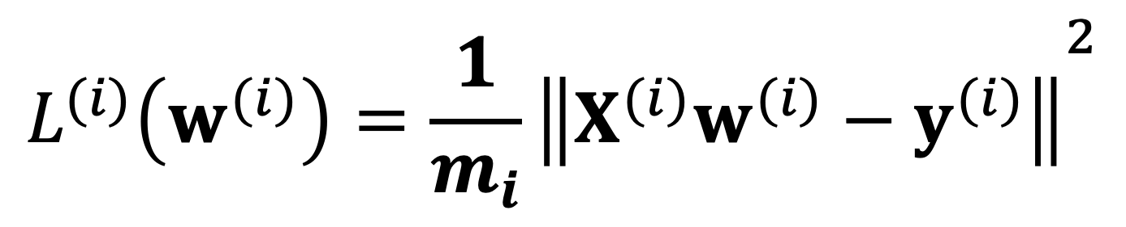
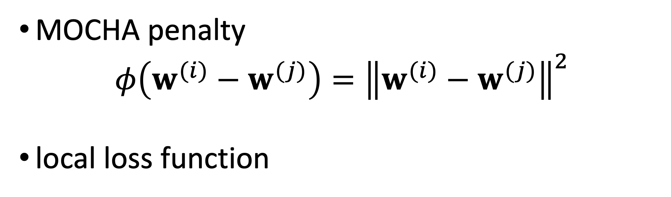
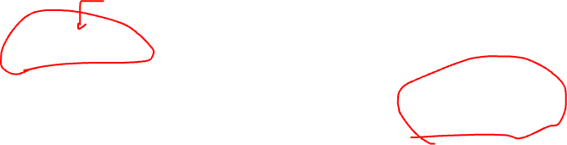
Networked Lin.Reg.
MOCHA penalty
$$φ\left(w^{(i)}−w^{(j)}\right)={\left\|w^{(i)}−w^{(j)}\right\|}^{2}$$
local loss function
$${L^{(i)}\left(w^{(i)}\right)=\frac{1}{m_{i}}\left\|X^{(i)}w^{(i)}−y^{(i)}\right\|}^{2}$$

Slide 9

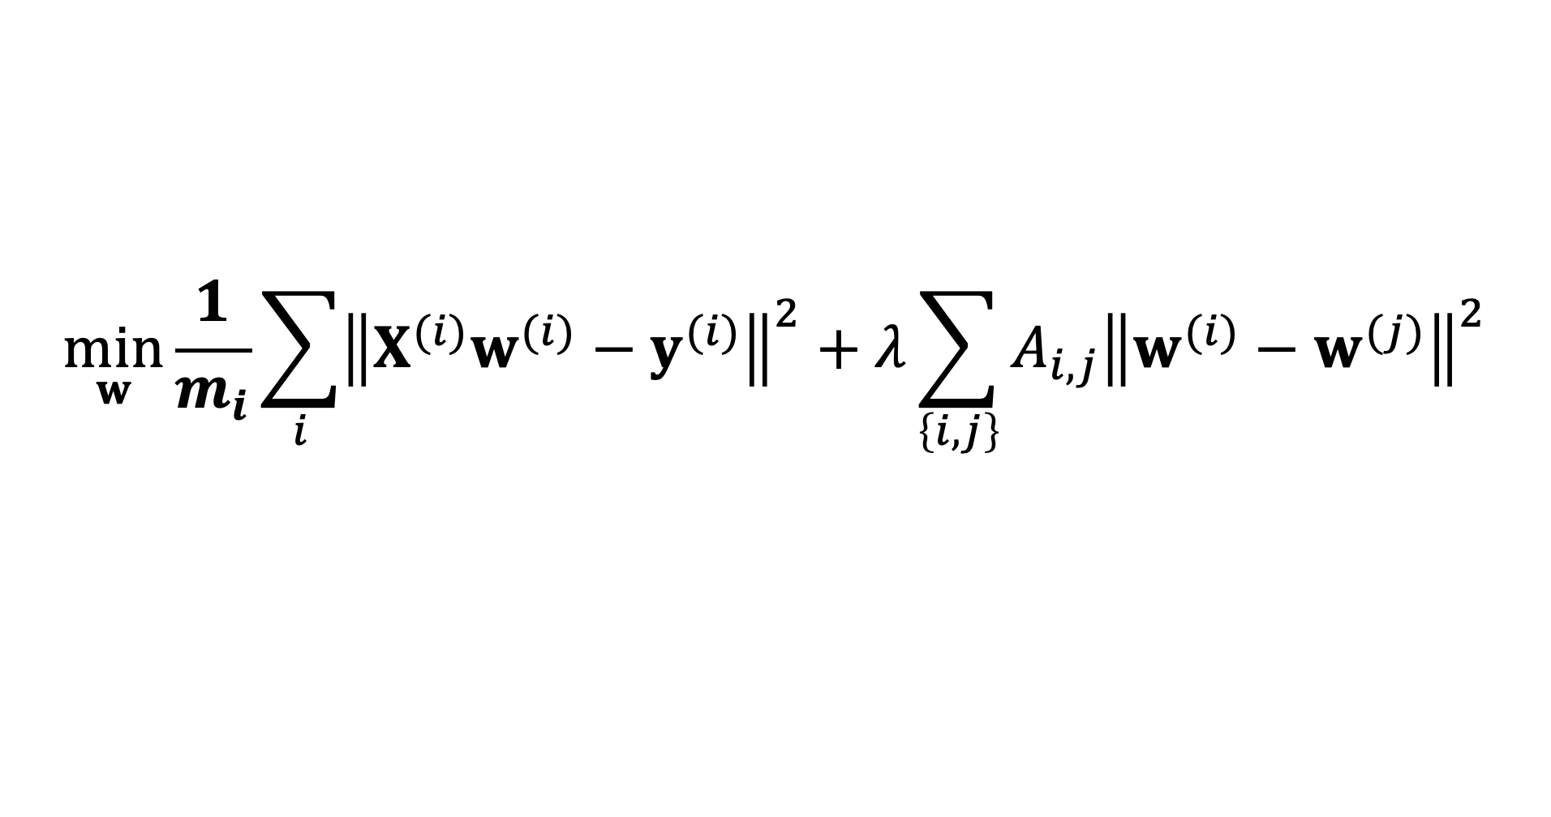


GTV Min. for Local Lin.Reg.
$$\min_{w}{\frac{1}{m_{i}}\sum_{i}{{\left\|X^{(i)}w^{(i)}−y^{(i)}\right\|}^{2}}+λ\sum_{\left\{i,j\right\}}{A_{i,j}{\left\|w^{(i)}−w^{(j)}\right\|}^{2}}}$$
using stacked parameters $w={\left(w^{(1)},⋯,w^{(n)}\right)}^{T}$,
$\min_{w}{w^{T}}Q w+w^{T}$q
with psd matrix $Q$ and vector q that depend on local datasets, GTVMin parameter $λ$and empirical graph

Slide 10
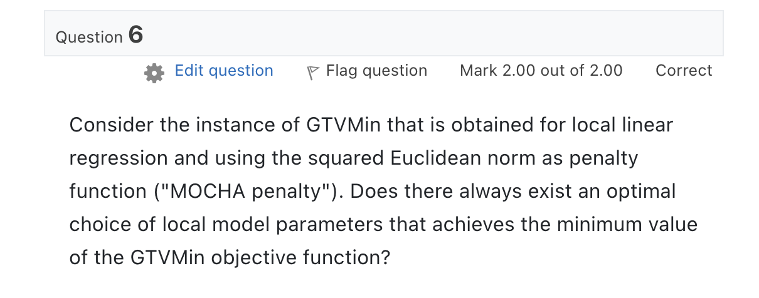

Slide 11
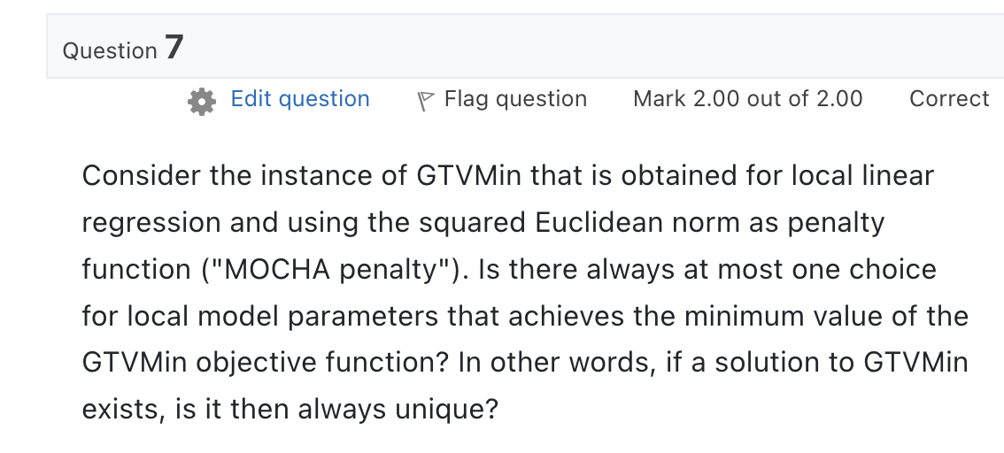

Slide 12
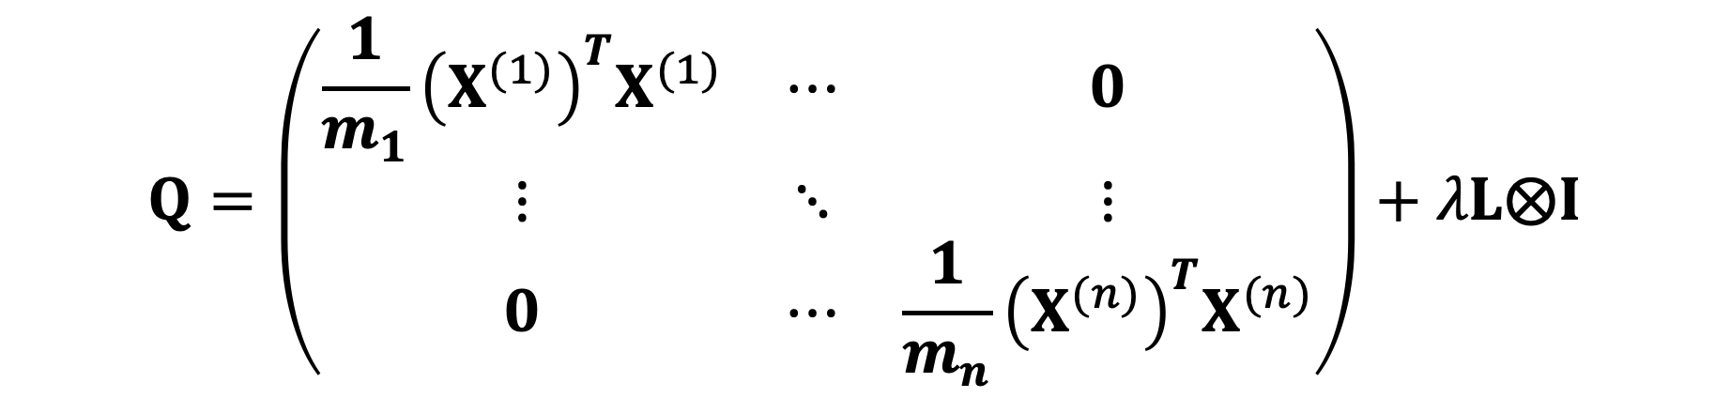


GTV Min. for Local Lin.Reg.
$\min_{w}{w^{T}}Q w+w^{T}$q
using stacked parameters $w={\left(w^{(1)},⋯,w^{(n)}\right)}^{T}$,
$$Q=\left(\begin{matrix}\frac{1}{m_{1}}{\left(X^{(1)}\right)}^{T}X^{(1)} & ⋯ & 0 \\ ⋮ & ⋱ & ⋮ \\ 0 & ⋯ & \frac{1}{m_{n}}{\left(X^{(n)}\right)}^{T}X^{(n)}\end{matrix}\right)+λL⨂I$$

Slide 13


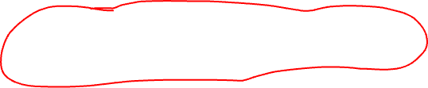
GTV Min. for Local Lin.Reg.
$$\min_{w}{w^{T}}Q w+w^{T}\text{q}$$
can be solved using gradient methods
$$w_{r+1}=w_{r}−α_{r}\left(2Qw_{r}+\text{q}\right)$$

Slide 14

Quiz “FL Algorithms”
tests your solutions to coding assignment in notebook “FLAlgorithms.ipynb”

Slide 15
Thank you for
your attention!

