Slide 1
CS-E4740 Federated Learning “FL Design Principle” Dipl.-Ing. Dr.techn. Alexander Jung

Slide 2
What are the main components of ML and
how are they combined?

Slide 3
Previous Lecture:
Networked Data and Models
Today:
Loss and Optimization

Slide 4
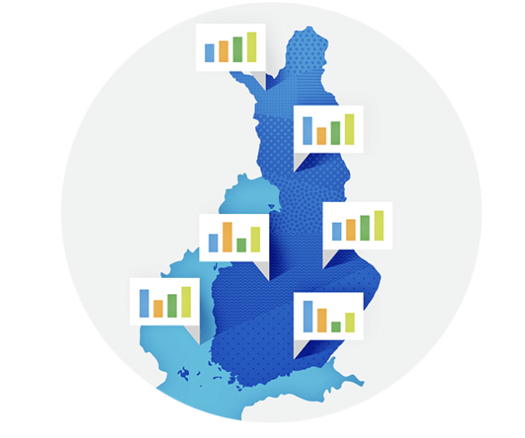

Weather Stations

Slide 5
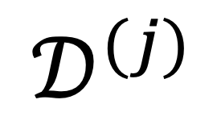
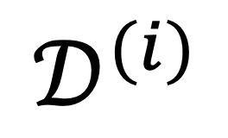
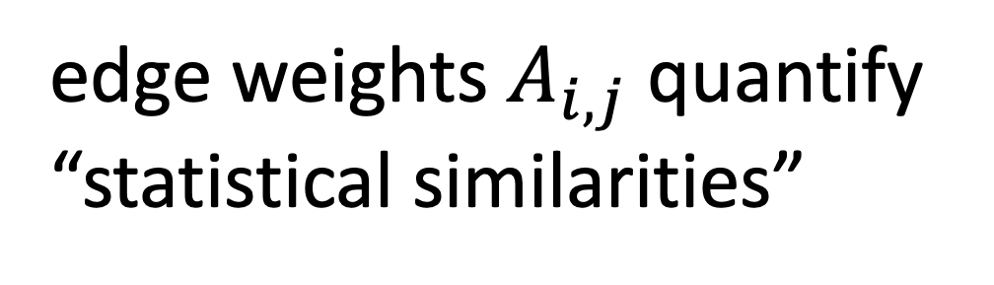
The Empirical Graph
$$𝒟^{(i)}$$
local dataset
edge weights $A_{i,j}$ quantify
“statistical similarities”
$$𝒟^{(j)}$$

Slide 6
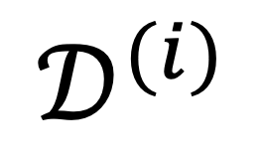
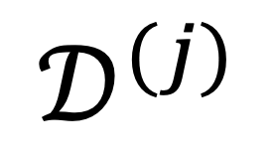
Networked Models.
$$𝒟^{(i)}$$
local model for each node
couple models at connected nodes
“similar"
$$𝒟^{(j)}$$

Slide 7
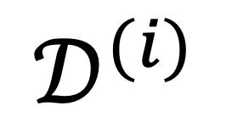
Local Parametric Models
$$𝒟^{(i)}$$
model params
“similar"
Notes:
Starting with a given empirical graph we define a networked model. Each node is equipped with some parametric model with paramters of weights w. These local models could be linear regression models or deep neural nets. Our methods allow to abstract from the details of the local models and only need a loss function that provides a score for a given choice of weights.

Slide 8
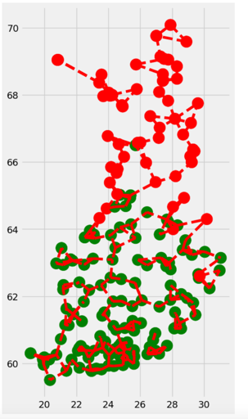
Clustering Assumption
the local datasets form clusters
datasets in same can be approximated as realizations of i.i.d. RVs with prob. dist p(x,y;c)
more edges inside clusters

Slide 9
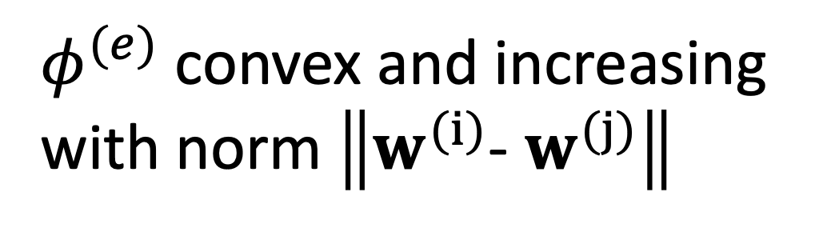
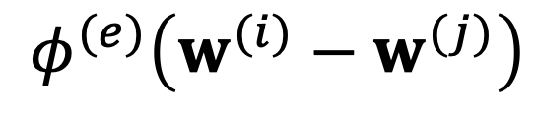
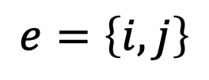
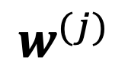
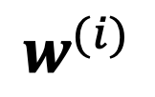
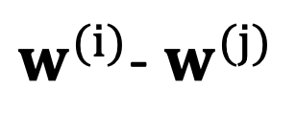
Measure Clustering via Variation
local model params
$$w^{(i)}$$
require similar params at ends of edge e
penalty function measures
“variation”
$$e=\left\{i,j\right\}$$
$$φ^{(e)}\left(w^{(i)}−w^{(j)}\right)$$
$$w^{(j)}$$
$φ^{(e)}$ convex and increasing
with norm $\left\|w^{(i)}\text{− }w^{(j)}\right\|$
$w^{(i)}$- $w^{(j)}$
Notes:
The local loss function encapsulates the local dataset from the perspective of federated learning algorithms. We only need the local dataset to construct a local loss function to score different choices for the parameters.

Slide 10
Generalized Total Variation (GTV)
force model params at well
connected nodes to be similar
by requiring small GTV
1
2

Slide 11
Two Special Cases of GTV
total variation
graph Laplacian quadratic from is GTV with

Slide 12
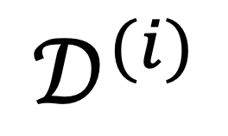

Local Loss Function
model params
$$𝒟^{(i)}$$
measure quality of params by local loss function
$$L^{(i)}\left(w^{(i)}\right)$$

Slide 13
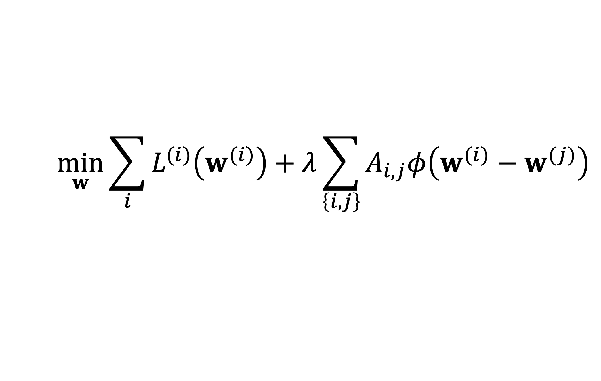
GTV Minimization
$$\min_{w}{\sum_{i}{L^{(i)}\left(w^{(i)}\right)}+λ\sum_{\left\{i,j\right\}}{A_{i,j}φ\left(w^{(i)}−w^{(j)}\right)}}$$
increasing
average local loss
“clusteredness”

Slide 14

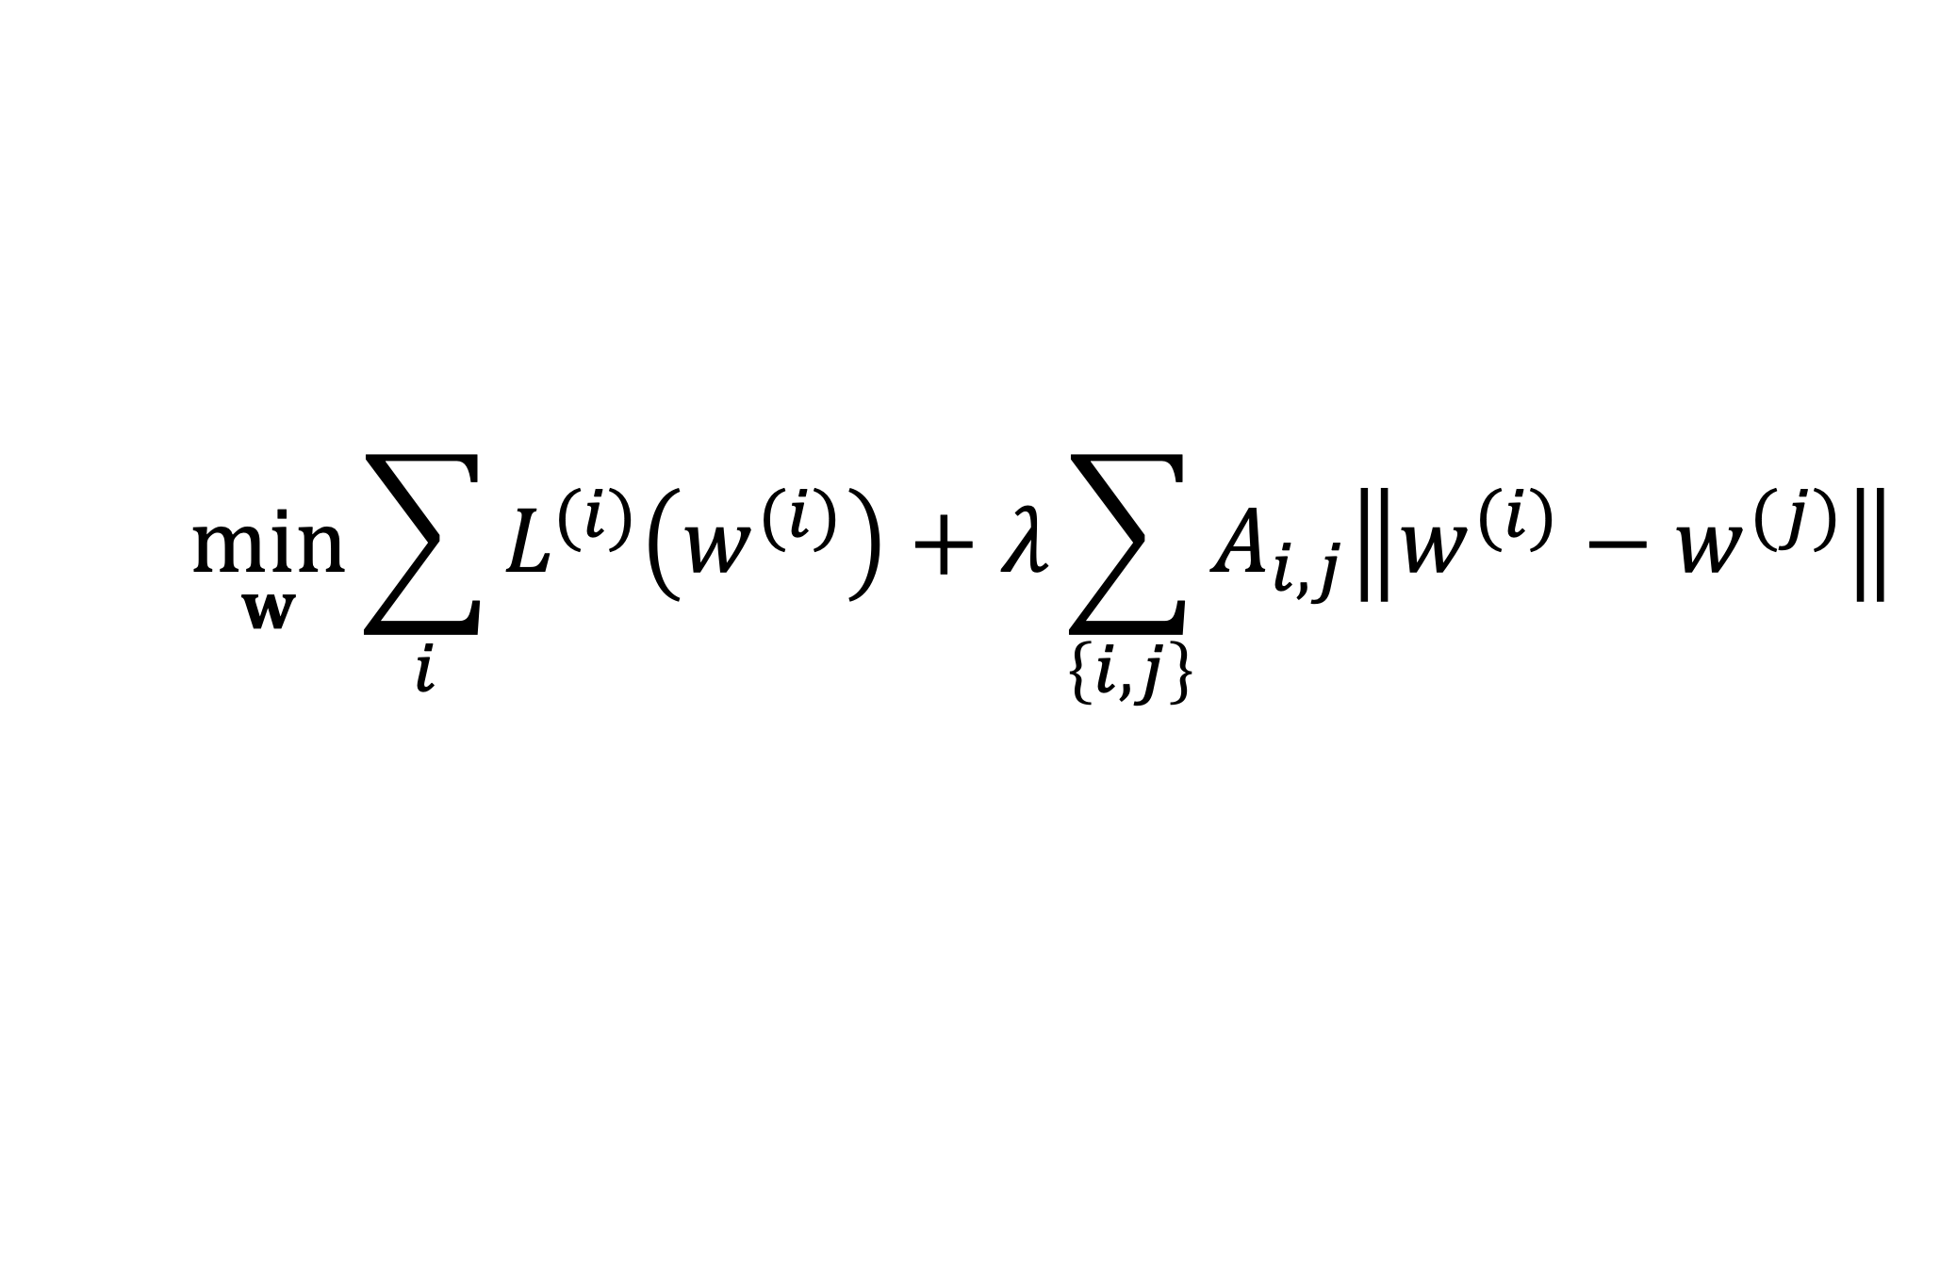
Network Lasso
$$\min_{w}{\sum_{i}{L^{(i)}\left(w^{(i)}\right)}+λ\sum_{\left\{i,j\right\}}{A_{i,j}\left\|w^{(i)}−w^{(j)}\right\|}}$$

Slide 15
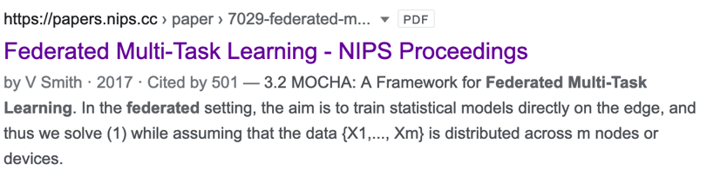
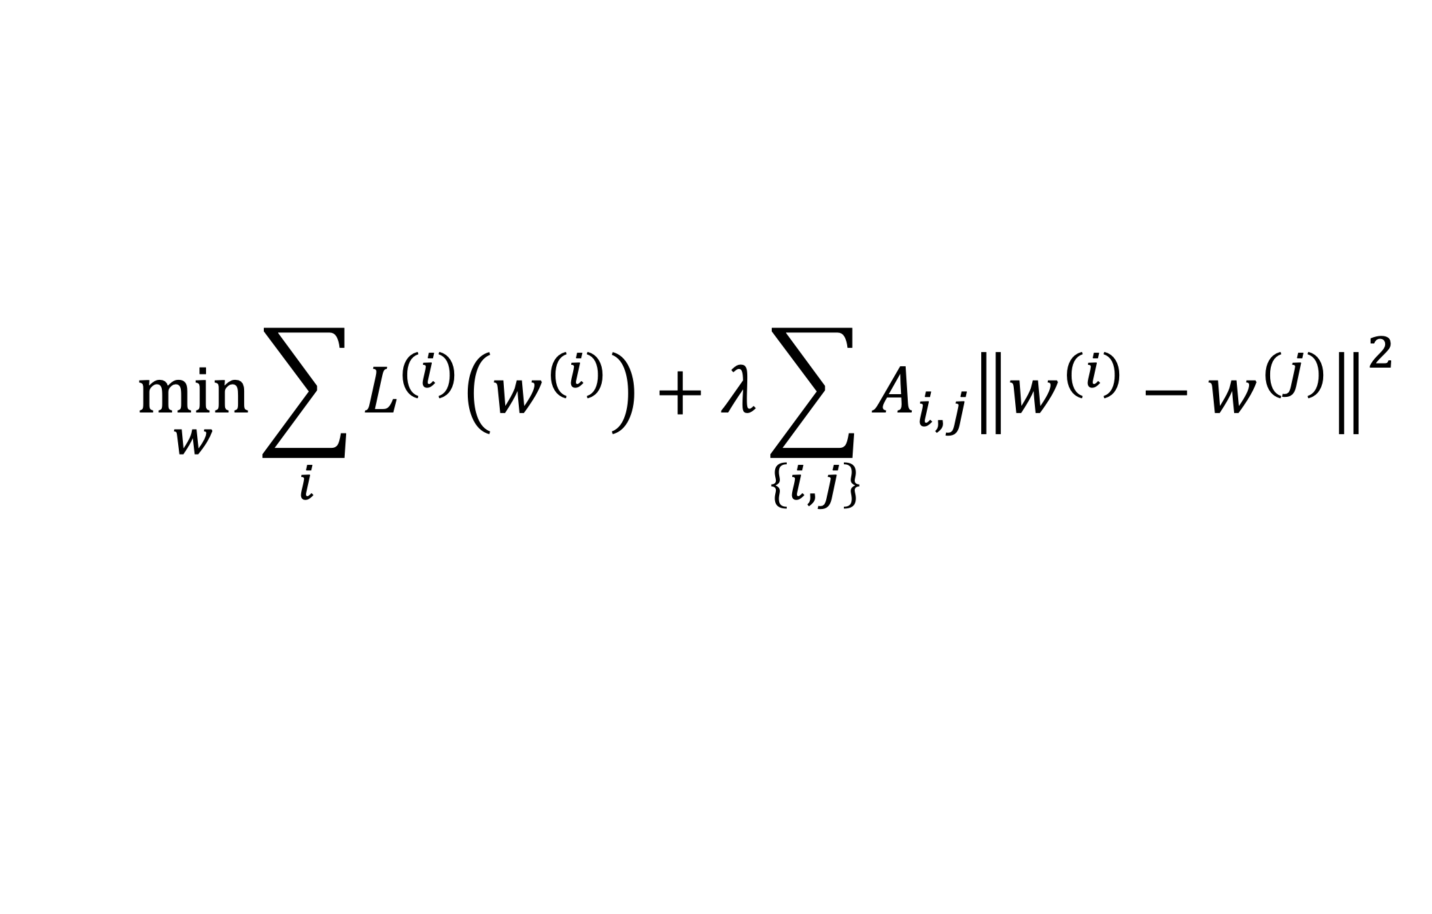
Special Case: “MOCHA”
$$\min_{w}{\sum_{i}{L^{(i)}\left(w^{(i)}\right)}+λ}\sum_{\left\{i,j\right\}}{A_{i,j}{\left\|w^{(i)}−w^{(j)}\right\|}^{2}}$$

Slide 16
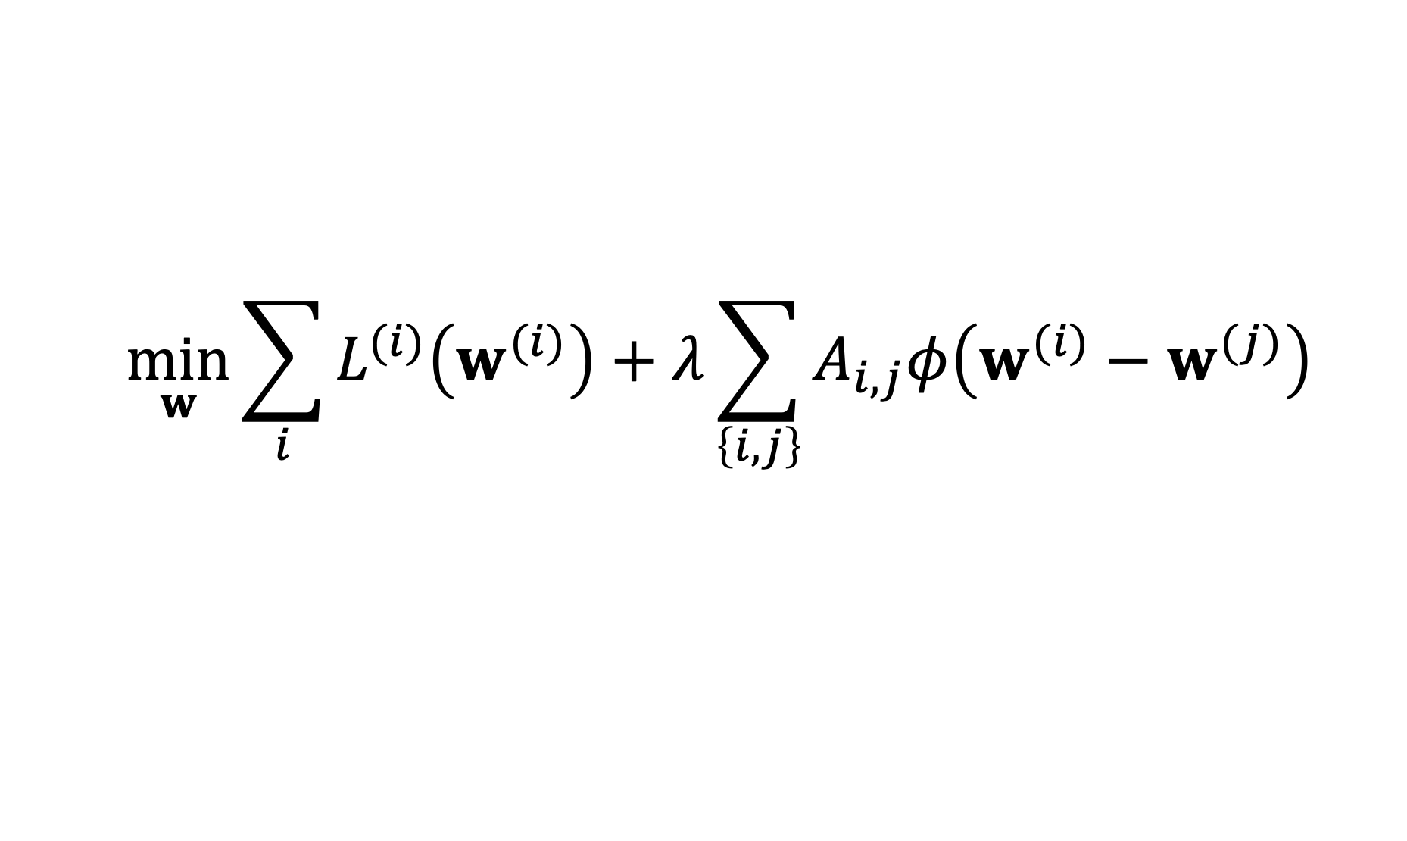
Two Key Questions of ML
$$\min_{w}{\sum_{i}{L^{(i)}\left(w^{(i)}\right)}+λ\sum_{\left\{i,j\right\}}{A_{i,j}φ\left(w^{(i)}−w^{(j)}\right)}}$$
computational aspects: how to compute (approximate) solutions efficiently ?
statistical aspects: are the solutions any good?

Slide 17
Computational Aspects

Slide 18





A FL Setting

Slide 19
Requirements
run in ad-hoc nets of low-cost devices
robustness against node/link failures
robustness against “stragglers”

Slide 20
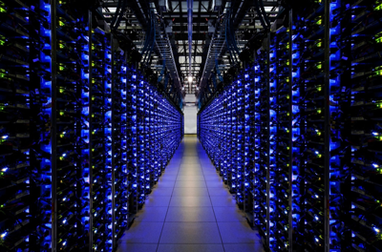
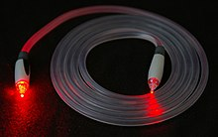
Another FL Setting…
https://www.google.com/about/datacenters/
https://en.wikipedia.org/wiki/Optical_fiber

Slide 21
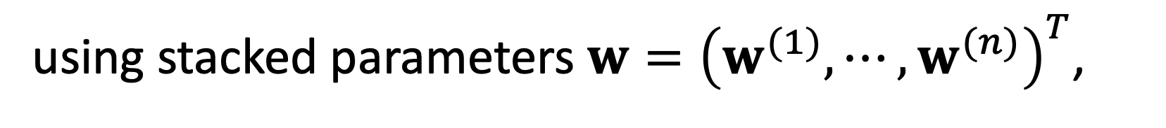
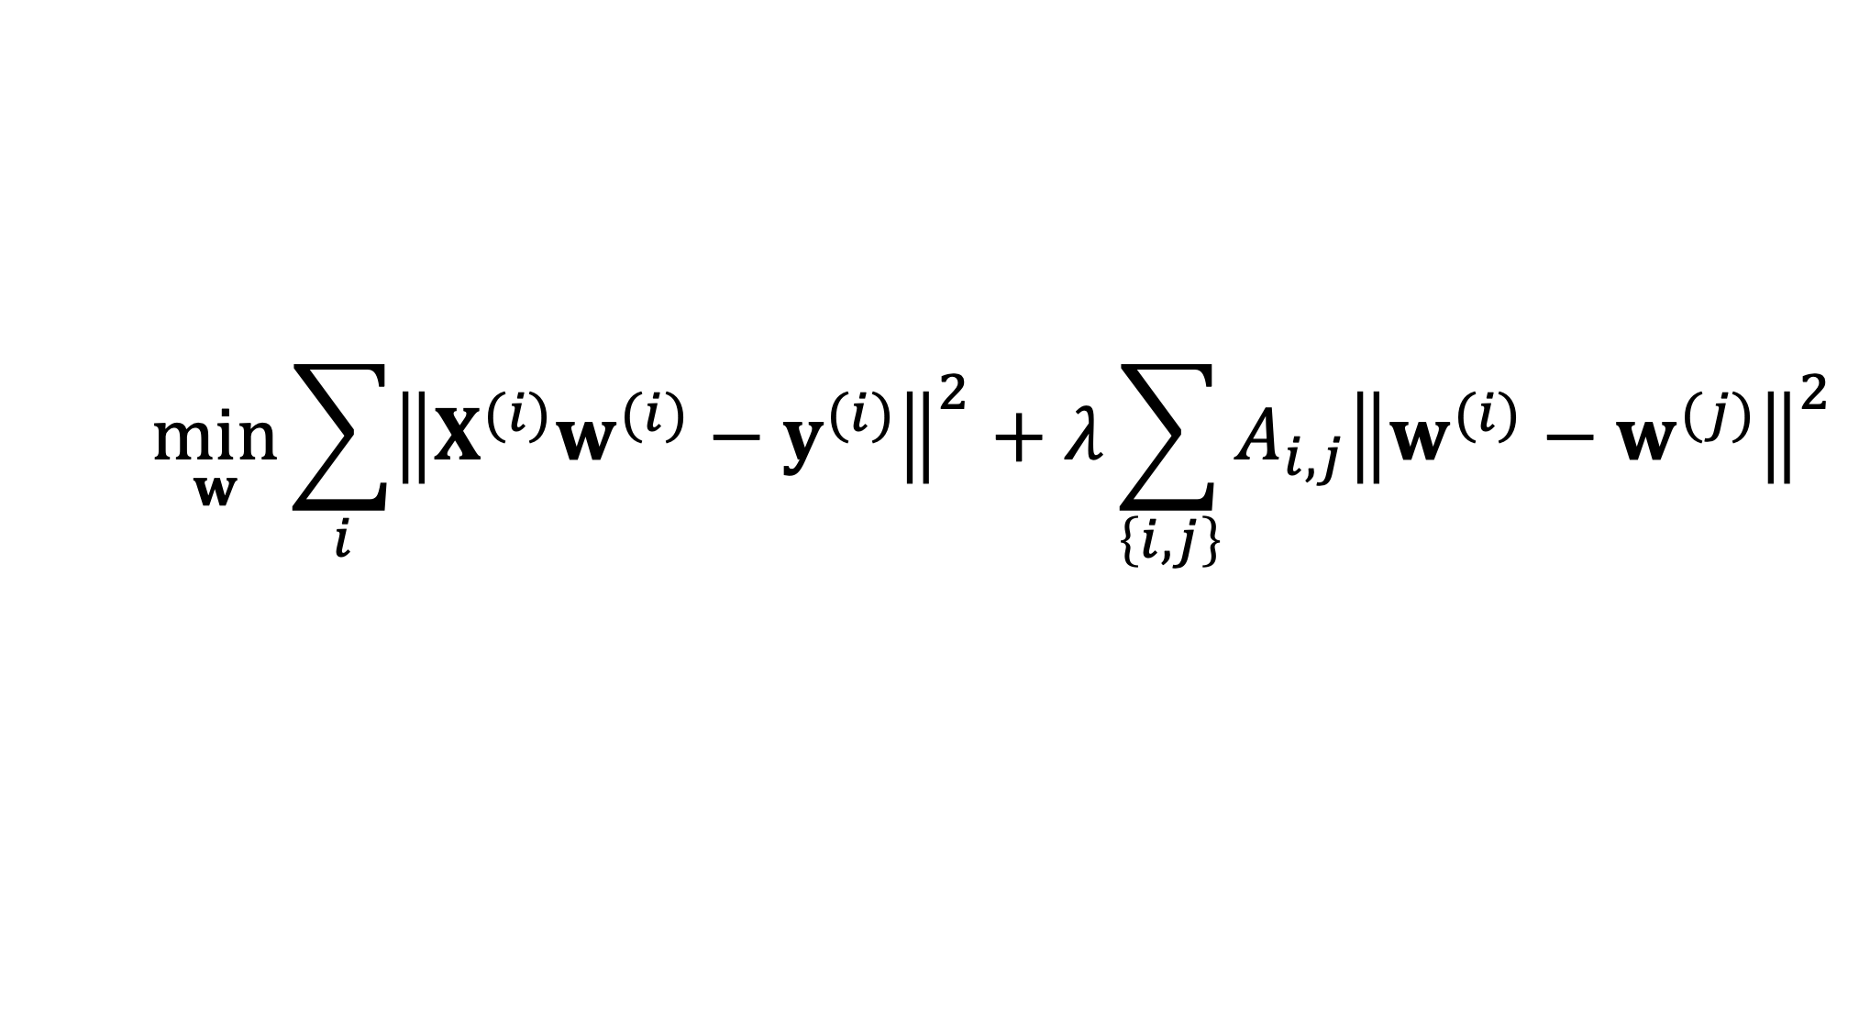
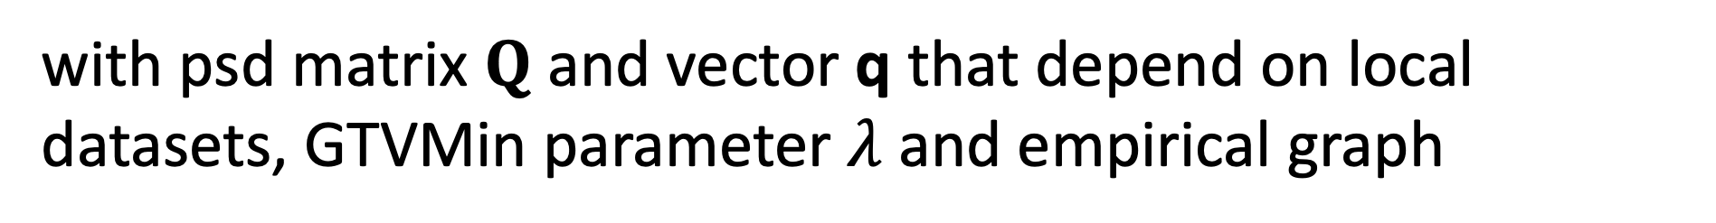
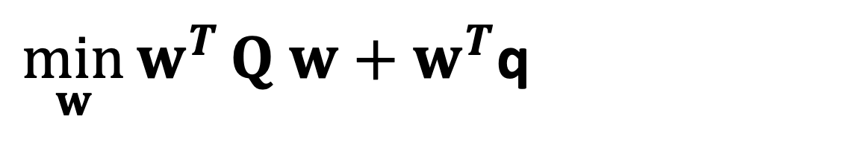
GTV Min. for Local Lin.Reg.
$$\min_{w}{\sum_{i}{{\left\|X^{(i)}w^{(i)}−y^{(i)}\right\|}^{2}}+λ\sum_{\left\{i,j\right\}}{A_{i,j}{\left\|w^{(i)}−w^{(j)}\right\|}^{2}}}$$
using stacked parameters $w={\left(w^{(1)},⋯,w^{(n)}\right)}^{T}$,
$\min_{w}{w^{T}}Q w+w^{T}$q
with psd matrix $Q$ and vector q that depend on local datasets, GTVMin parameter $λ$and empirical graph

Slide 22
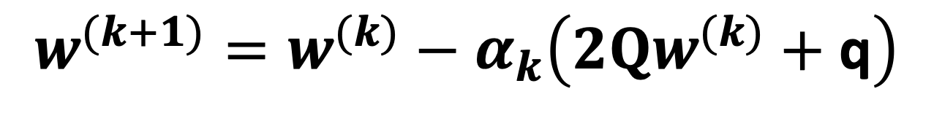

GTV Min. for Local Lin.Reg.
$$\min_{w}{w^{T}}Q w+w^{T}\text{q}$$
can be solved using gradient methods
$$w^{(k+1)}=w^{(k)}−α_{k}\left(2Qw^{(k)}+\text{q}\right)$$

Slide 23
Statistical
Aspects

Slide 24
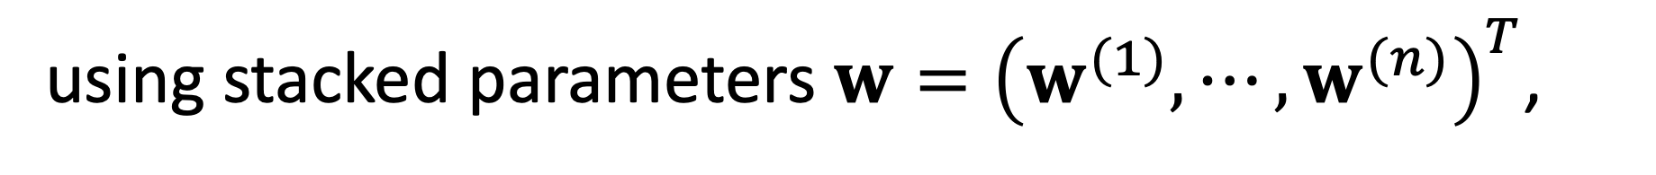

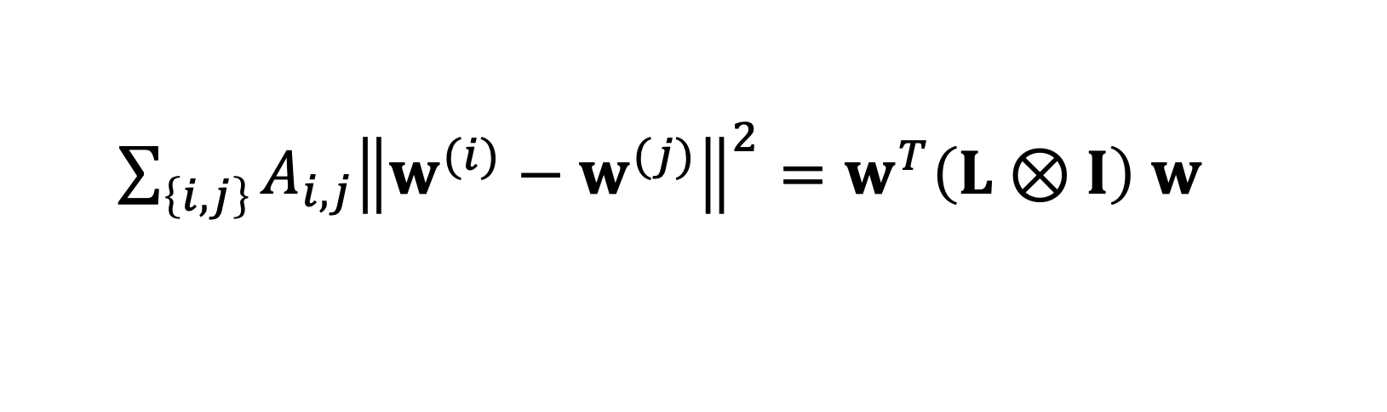
GTV Min. for Local Lin.Reg.
$$\min_{w}{\sum_{i}{{\left\|X^{(i)}w^{(i)}−y^{(i)}\right\|}^{2}}+λ\sum_{\left\{i,j\right\}}{A_{i,j}{\left\|w^{(i)}−w^{(j)}\right\|}^{2}}}$$
using stacked parameters $w={\left(w^{(1)},⋯,w^{(n)}\right)}^{T}$,
$\sum_{\left\{i,j\right\}}{A_{i,j}{\left\|w^{(i)}−w^{(j)}\right\|}^{2}}=w^{T}\left(L⊗I\right)$ $w$
with the graph Laplacian $L$

Slide 25
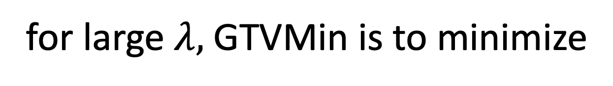
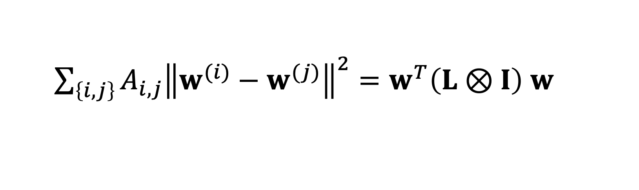
Spectral Clustering
for large $λ,$GTVMin is to minimize
$\sum_{\left\{i,j\right\}}{A_{i,j}{\left\|w^{(i)}−w^{(j)}\right\|}^{2}}=w^{T}\left(L⊗I\right)$ $w$
local model parameters composed of
eigvecs. of L corresponding to smallest eig.vals

Slide 26
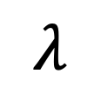
Clustering of GTVMin Solutions
0
$$λ$$
personalized
clustered
global

Slide 27
Interpretations

Slide 28



Multi-Task Learning
each local dataset/model is separate learning task
Notes:
We then aim at learning separate weights for each local dataset. This is a multi-task learning problem with each local data being a separate learning task. To have any chance at solving this multi-task learning problem we exploit similarities' between the individual tasks that is tied to the network structure.

Slide 29

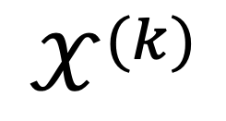
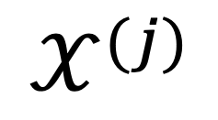
Locally Weighted Learning
$$𝒳^{(j)}$$
pool local datasets of nodes
in the same cluster
$$𝒳^{(i)}$$
$$𝒳^{(k)}$$
William S. Cleveland, Susan J. Devlin, Eric Grosse,
“Regression by local fitting: Methods, properties, and computational algorithms,”
Journal of Econometrics, Volume 37, Issue 1, 1988.

Slide 30
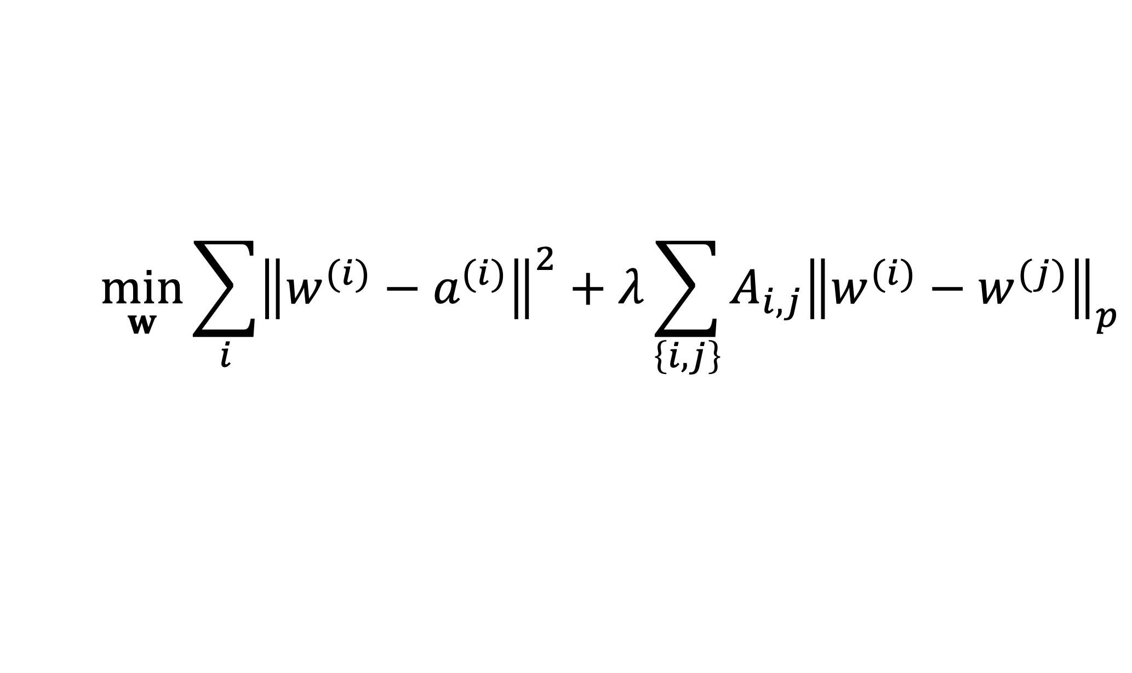
Generalized Convex Clustering
$$\min_{w}{\sum_{i}{{\left\|w^{(i)}−a^{(i)}\right\|}^{2}}+λ\sum_{\left\{i,j\right\}}{A_{i,j}{\left\|w^{(i)}−w^{(j)}\right\|}_{p}}}$$
D. Sun, K.-C. Toh, Y. Yuan;
Convex Clustering: Model, Theoretical Guarantee and Efficient Algorithm, JMLR, 22(9):1−32, 2021
Notes:
We then aim at learning separate weights for each local dataset. This is a multi-task learning problem with each local data being a separate learning task. To have any chance at solving this multi-task learning problem we exploit similarities' between the individual tasks that is tied to the network structure.

Slide 31
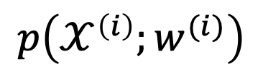
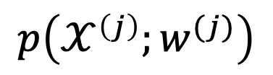
(Probabilistic) Graphical Model
separate prob. space for each local dataset
traditionally, PGMs use a common
prob. space for all local datasets
$$p\left(𝒳^{\left(i\right)};w^{(i)}\right)$$
$$p\left(𝒳^{\left(j\right)};w^{(j)}\right)$$
AJ, "Networked Exponential Families for Big Data Over Networks," in IEEE Access, vol. 8, pp. 202897-202909, 2020, doi: 10.1109/ACCESS.2020.3033817.
Notes:
We then aim at learning separate weights for each local dataset. This is a multi-task learning problem with each local data being a separate learning task. To have any chance at solving this multi-task learning problem we exploit similarities' between the individual tasks that is tied to the network structure.

Slide 32
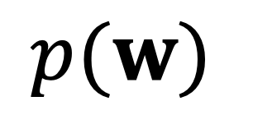
Approx. Hierarch. Bayes’ Model
i.i.d. draw
$$p(w)$$
i.i.d. draw
Lyu, B., Hanzely, F., and Kolar, M., “Personalized Federated Learning with Multiple Known Clusters”, arXiv e-prints, 2022. doi:10.48550/arXiv.2204.13619.

Slide 33
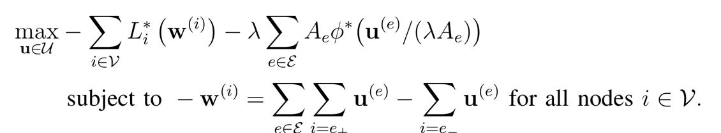

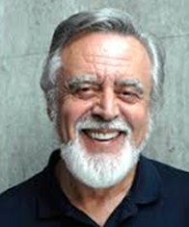


Non-Linear Min-Cost-Flow
augmented “collector node”

Slide 34
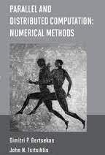
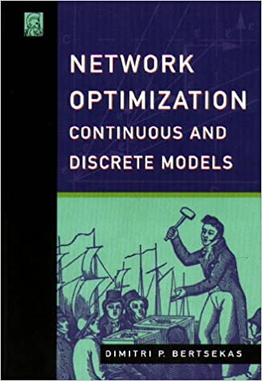
Non-Linear Min-Cost-Flow

Slide 35
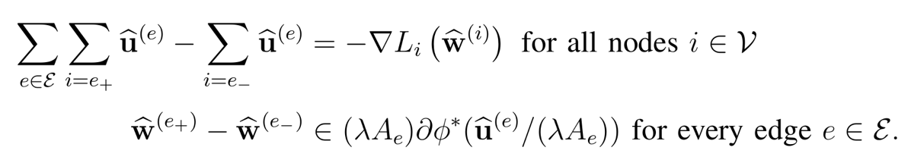
Electrical Network. (“AI is new Electricity!”)
Kirchhoff’s Current Law
Generalized Ohm Law

Slide 36
GTVMin
for
Non-Param. Models
Notes:
The local loss function encapsulates the local dataset from the perspective of federated learning algorithms. We only need the local dataset to construct a local loss function to score different choices for the parameters.

Slide 37
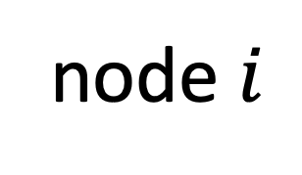
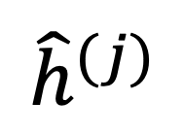
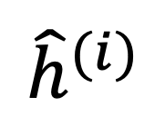
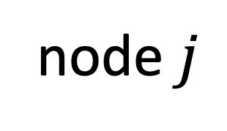
Variation of Non-Param. Models
node $i$
node $j$
$${\hat{h}}^{(j)}$$
$${\hat{h}}^{(i)}$$
test set that is
shared by node i and j

Slide 38
Wrap Up.
couple local model training via regularization
regularizer obtained via GTV (over empirical graph)
FL algorithms = optimization methods for GTV min
GTVmin pools local datasets into clusters
cluster structure depends on emp.graph and local data!

Slide 39
Thank you for
your attention!

