Slide 1
CS-E4740 Federated Learning “FL Algorithms” Dipl.-Ing. Dr.techn. Alexander Jung

Slide 2
For example Question 6 on Mocha optimal choice of parameters is mentioned in introduction of Chapter 7 in Lecture notes, referring that it will be explained in section 7.2. but then there is no mention of optimal parameters in that section. Is it so that the algorithm learns this parameter?
Also there is no mention of uniqueness (Question 7) nor quantitative measure of variation between local hypothesis maps (Question 3). Maybe it was so that these should be somehow induced from the material but I did not see the connections.

Slide 3
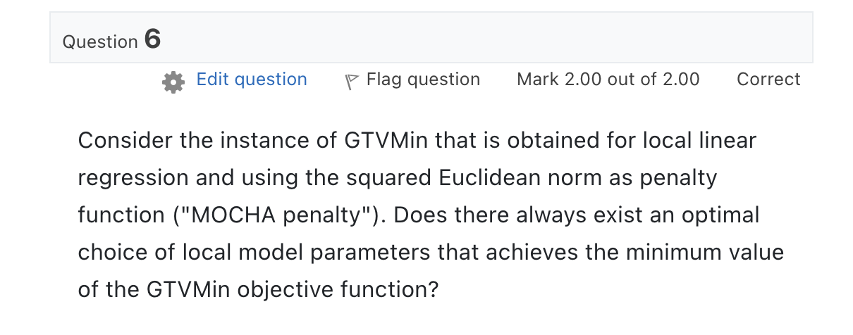

Slide 4
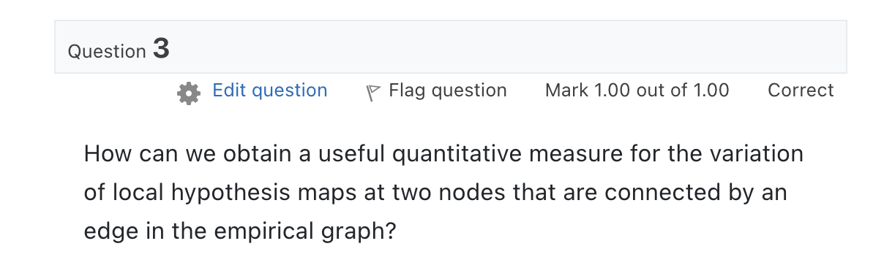

Slide 5
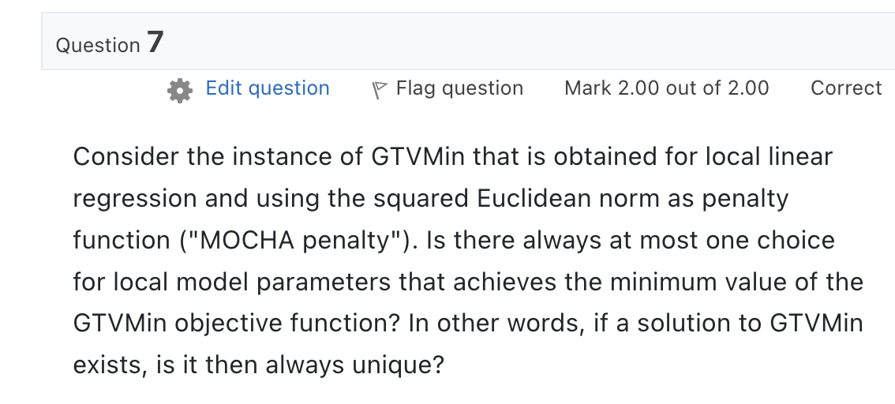

Slide 6
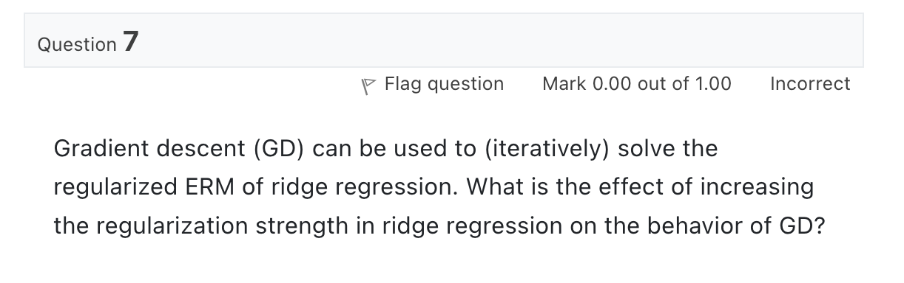
Quiz “Gradient Methods”

Slide 7
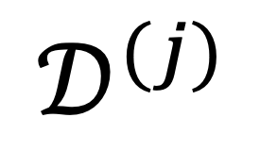
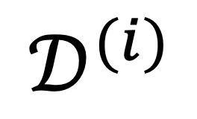


The Empirical Graph
$$𝒟^{(i)}$$
local dataset
edge weights $A_{i,j}$ quantify
“statistical similarities”
$$𝒟^{(j)}$$

Slide 8
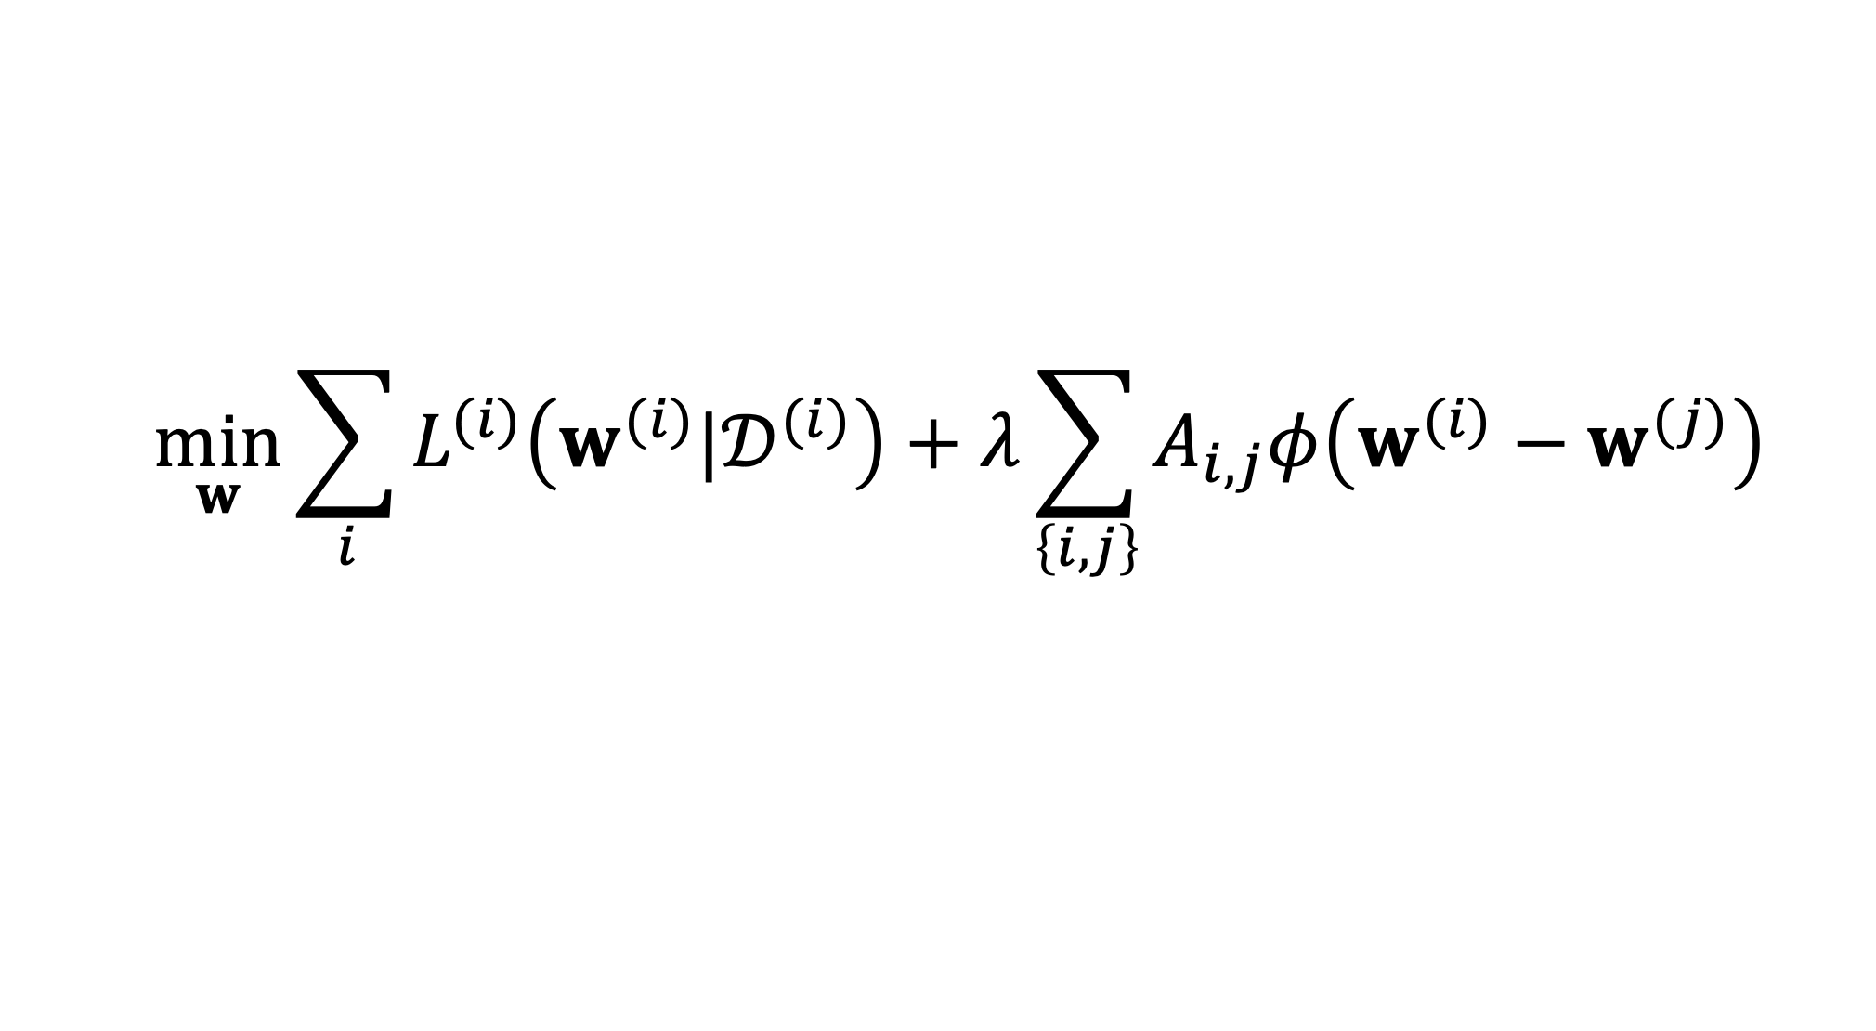
GTV Minimization
$$\min_{w}{\sum_{i}{L^{(i)}\left(w^{(i)}|𝒟^{(i)}\right)}+λ\sum_{\left\{i,j\right\}}{A_{i,j}φ\left(w^{(i)}−w^{(j)}\right)}}$$
increasing
average local loss
“clusteredness”

Slide 9
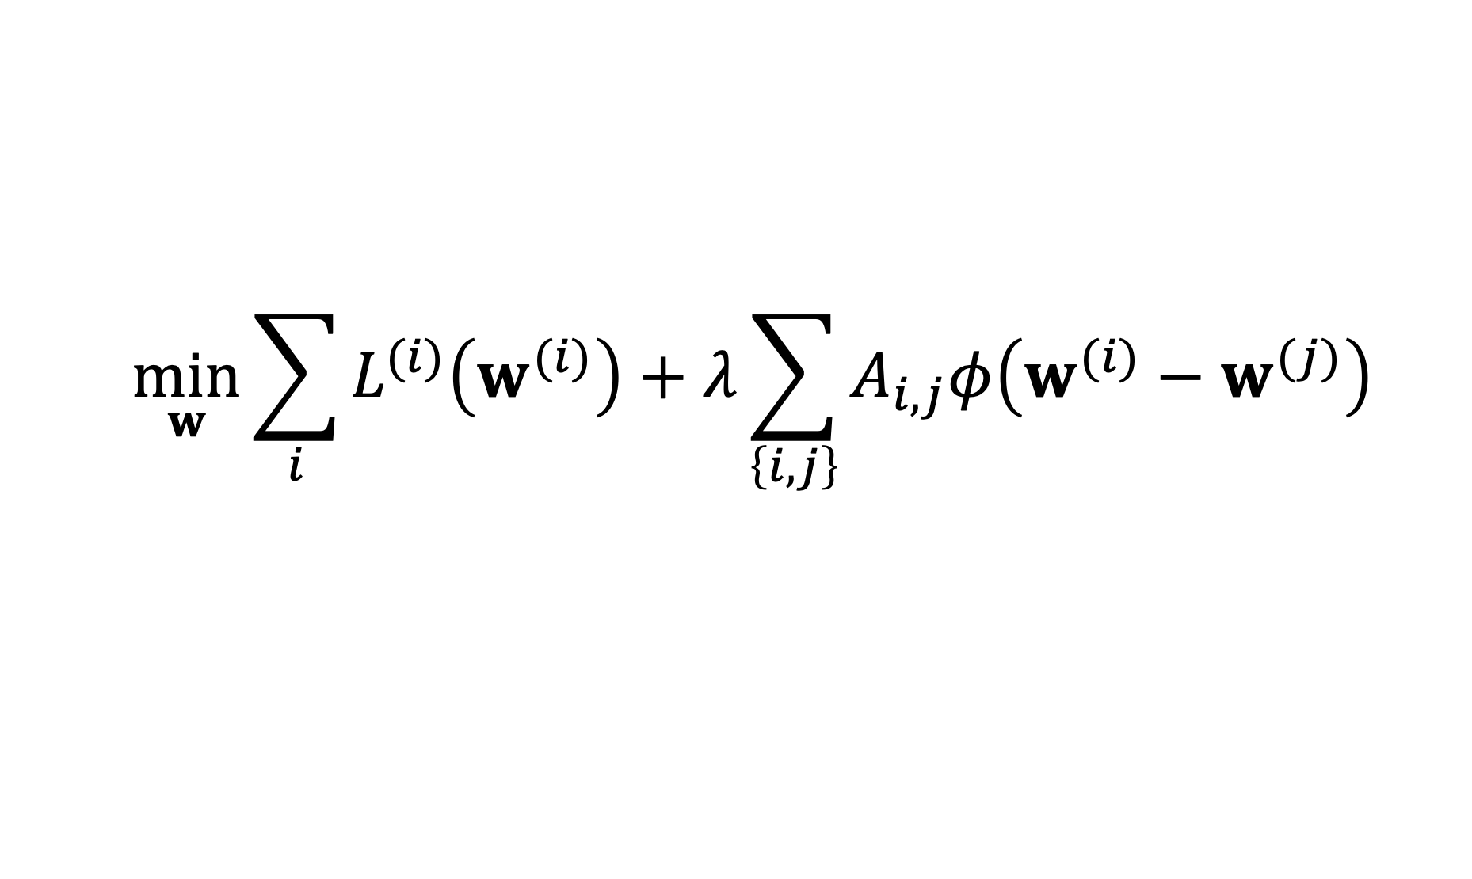
Two Key Questions of FL
$$\min_{w}{\sum_{i}{L^{(i)}\left(w^{(i)}\right)}+λ\sum_{\left\{i,j\right\}}{A_{i,j}φ\left(w^{(i)}−w^{(j)}\right)}}$$
computational aspects: how to compute (approximate) solutions efficiently ?
statistical aspects: are the solutions any good?

Slide 10
Two Key Questions of FL
$$\min_{w}{\sum_{i}{L^{(i)}\left(w^{(i)}\right)}+λ\sum_{\left\{i,j\right\}}{A_{i,j}φ\left(w^{(i)}−w^{(j)}\right)}}$$
computational aspects: how to compute (approximate) solutions efficiently ?
statistical aspects: are the solutions any good?

Slide 11
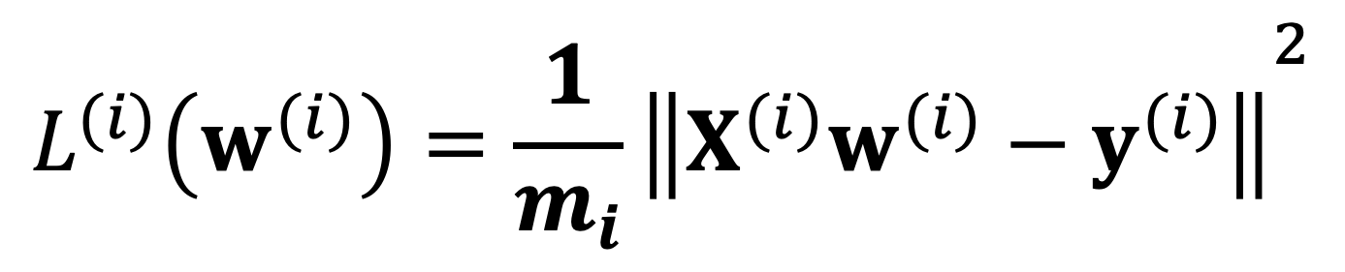
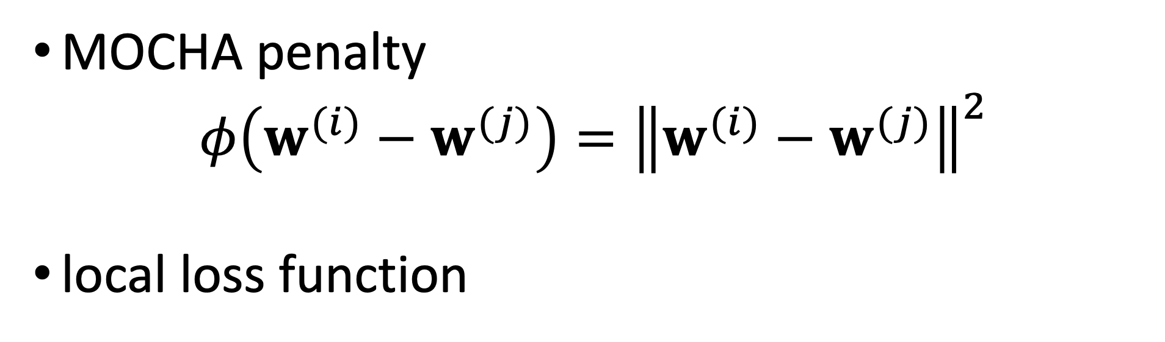
Networked Lin.Reg.
MOCHA penalty
$$φ\left(w^{(i)}−w^{(j)}\right)={\left\|w^{(i)}−w^{(j)}\right\|}^{2}$$
local loss function
$${L^{(i)}\left(w^{(i)}\right)=\frac{1}{m_{i}}\left\|X^{(i)}w^{(i)}−y^{(i)}\right\|}^{2}$$

Slide 12

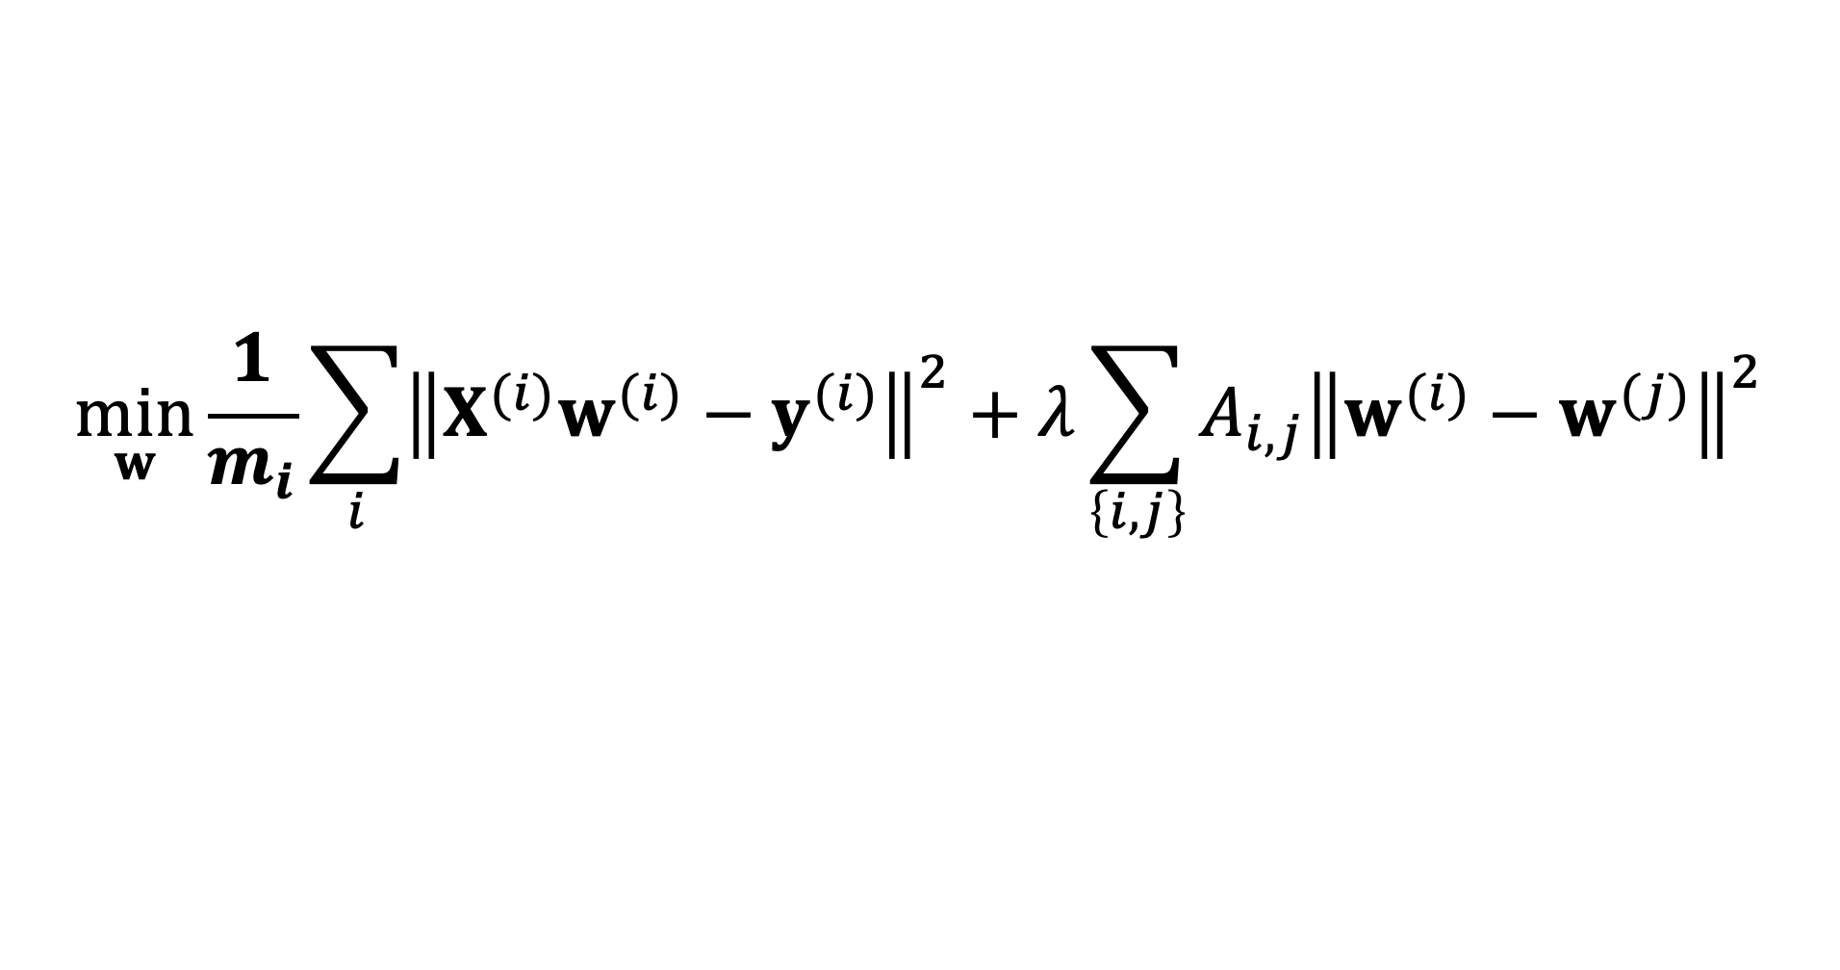


GTV Min. for Local Lin.Reg.
$$\min_{w}{\frac{1}{m_{i}}\sum_{i}{{\left\|X^{(i)}w^{(i)}−y^{(i)}\right\|}^{2}}+λ\sum_{\left\{i,j\right\}}{A_{i,j}{\left\|w^{(i)}−w^{(j)}\right\|}^{2}}}$$
using stacked parameters $w={\left(w^{(1)},⋯,w^{(n)}\right)}^{T}$,
$\min_{w}{w^{T}}Q w+w^{T}$q
with psd matrix $Q$ and vector q that depend on local datasets, GTVMin parameter $λ$and empirical graph

Slide 13
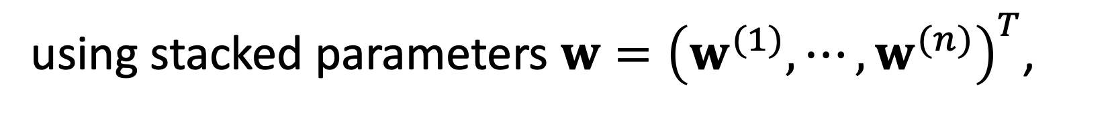
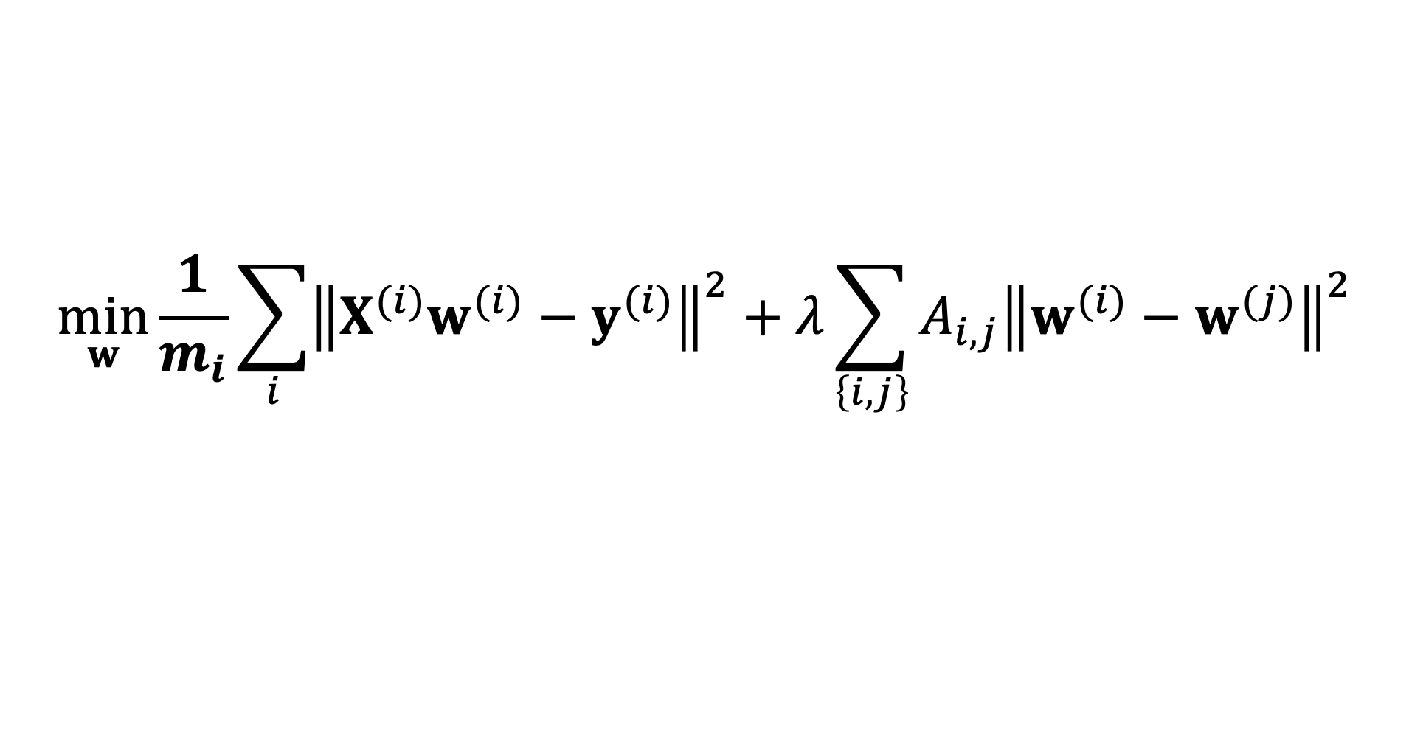

GTV Min. for Local Lin.Reg.
$$\min_{w}{\frac{1}{m_{i}}\sum_{i}{{\left\|X^{(i)}w^{(i)}−y^{(i)}\right\|}^{2}}+λ\sum_{\left\{i,j\right\}}{A_{i,j}{\left\|w^{(i)}−w^{(j)}\right\|}^{2}}}$$
using stacked parameters $w={\left(w^{(1)},⋯,w^{(n)}\right)}^{T}$,
$$Q=\left(\begin{matrix}\frac{1}{m_{1}}{\left(X^{(1)}\right)}^{T}X^{(1)} & ⋯ & 0 \\ ⋮ & ⋱ & ⋮ \\ 0 & ⋯ & \frac{1}{m_{n}}{\left(X^{(n)}\right)}^{T}X^{(n)}\end{matrix}\right)+λL⨂I$$

Slide 14


GTV Min. for Local Lin.Reg.
$$\min_{w}{w^{T}}Q w+w^{T}\text{q}$$
can be solved using gradient methods
$$w_{r+1}=w_{r}−α_{r}\left(2Qw_{r}+\text{q}\right)$$

Slide 15
Quiz “FL Algorithms”
tests your solutions to coding assignment
read in local datasets for FMI weather stations listed in ”….csv”
train

Slide 16
Thank you for
your attention!

