Slide 1
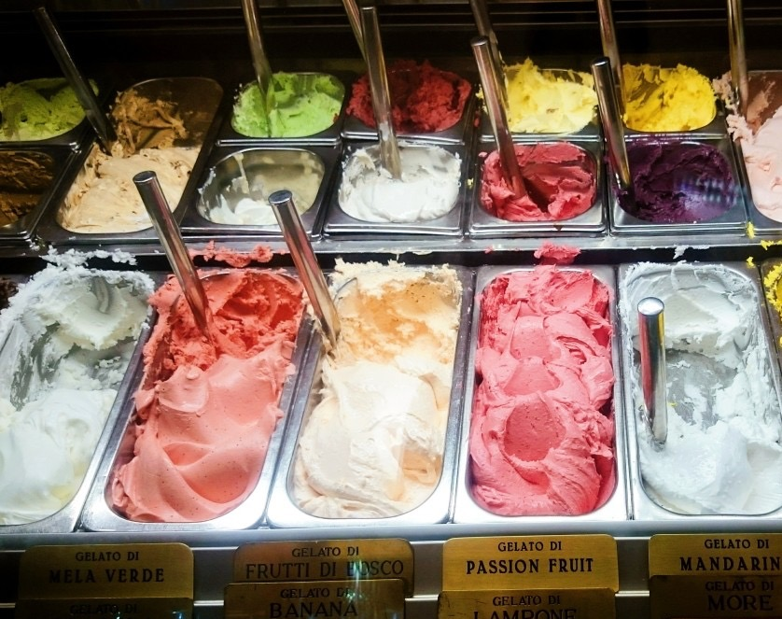
CS-E4740 Federated Learning “FL Flavors”

Slide 2
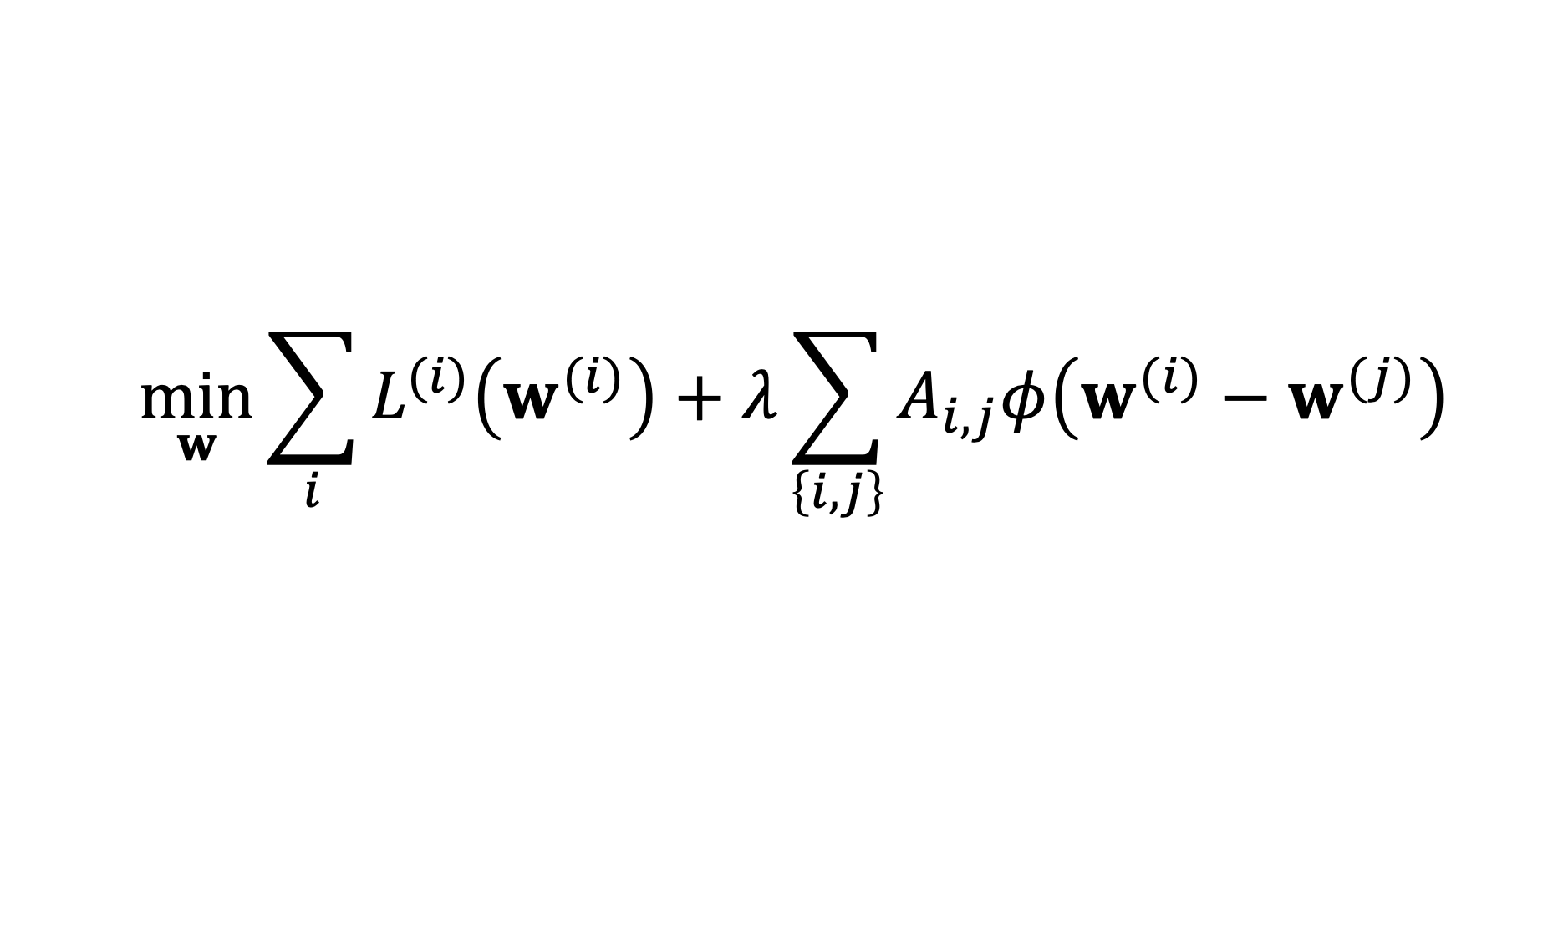
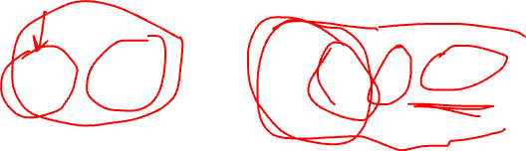
FL Design Principle
$$\min_{w}{\sum_{i}{L^{(i)}\left(w^{(i)}\right)}+λ\sum_{\left\{i,j\right\}}{A_{i,j}φ\left(w^{(i)}−w^{(j)}\right)}}$$
computational aspects: how to compute (approximate) solutions efficiently ?
statistical aspects: are the solutions any good?

Slide 3
FL Flavors
Centralized FL
Decentralized FL
Personalized FL
Vertical FL
Horizontal FL

Slide 4
FL Flavors
Centralized FL
Decentralized FL
Personalized FL
Vertical FL
Horizontal FL

Slide 5


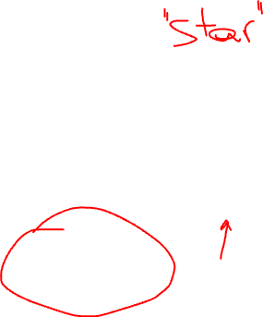
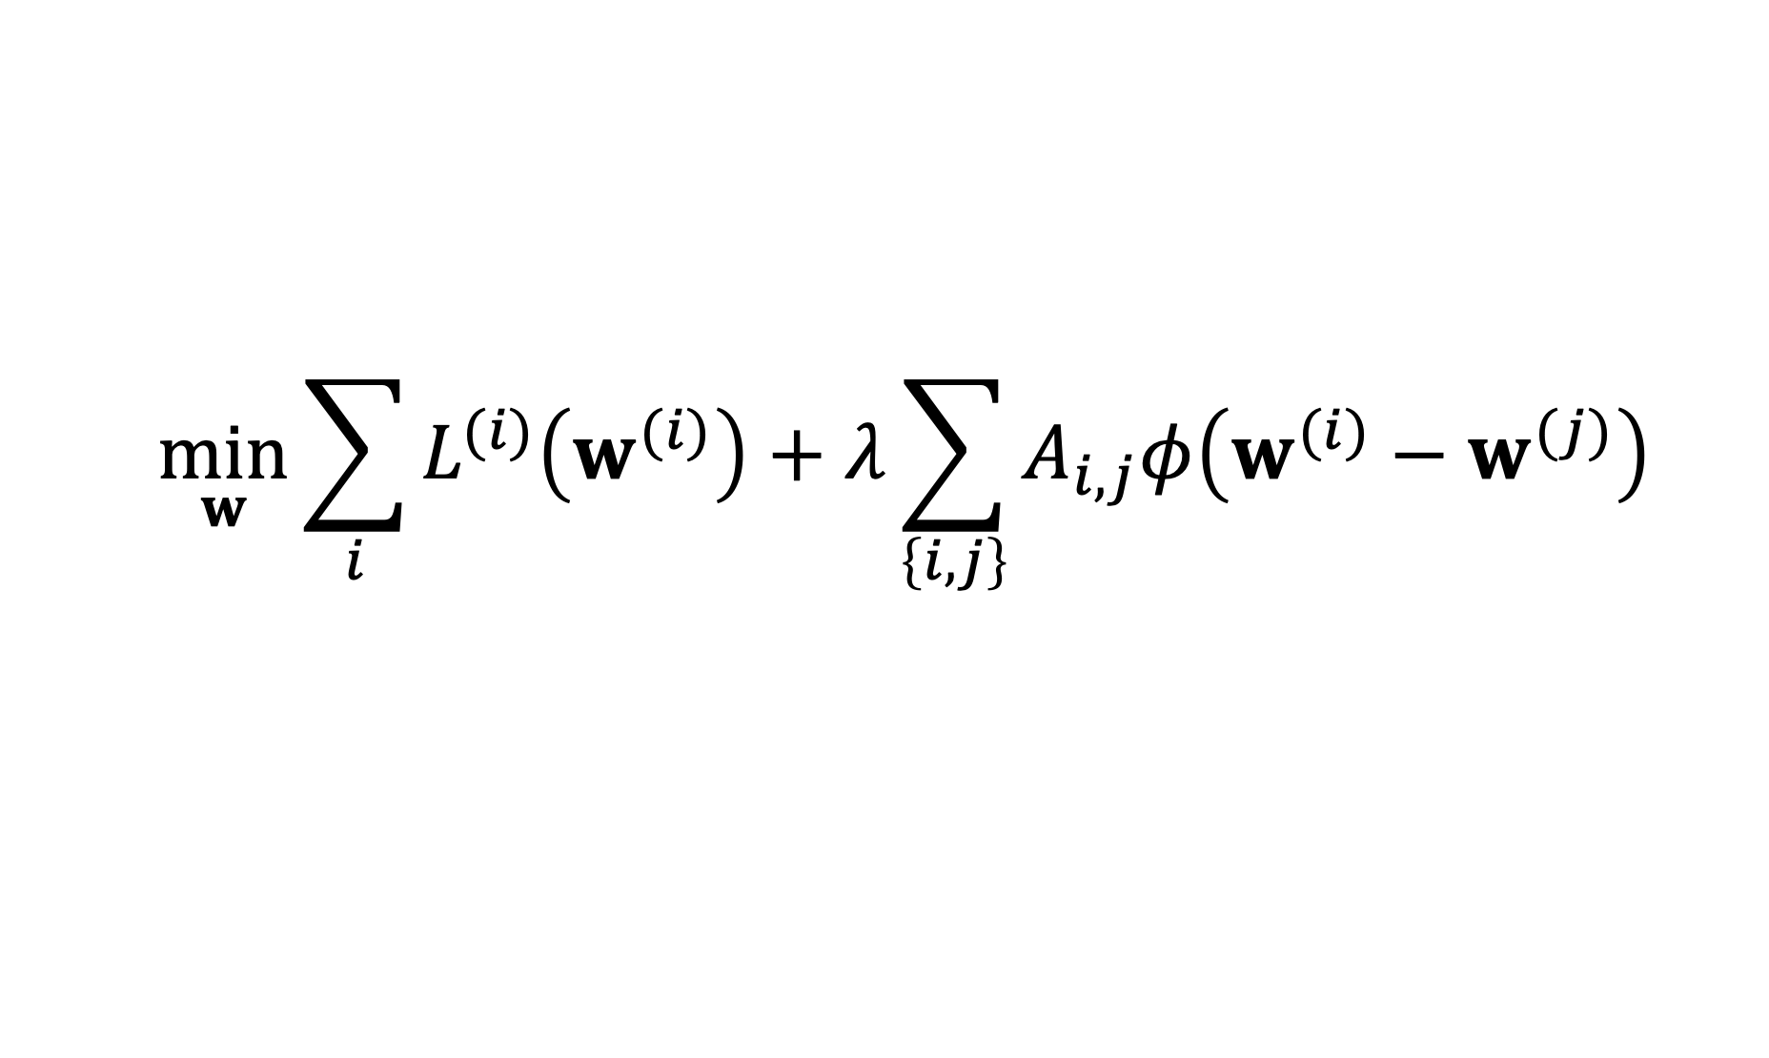
Centralized FL
$$\min_{w}{\sum_{i}{L^{(i)}\left(w^{(i)}\right)}+λ\sum_{\left\{i,j\right\}}{A_{i,j}φ\left(w^{(i)}−w^{(j)}\right)}}$$

Slide 6
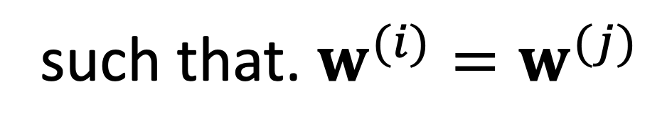
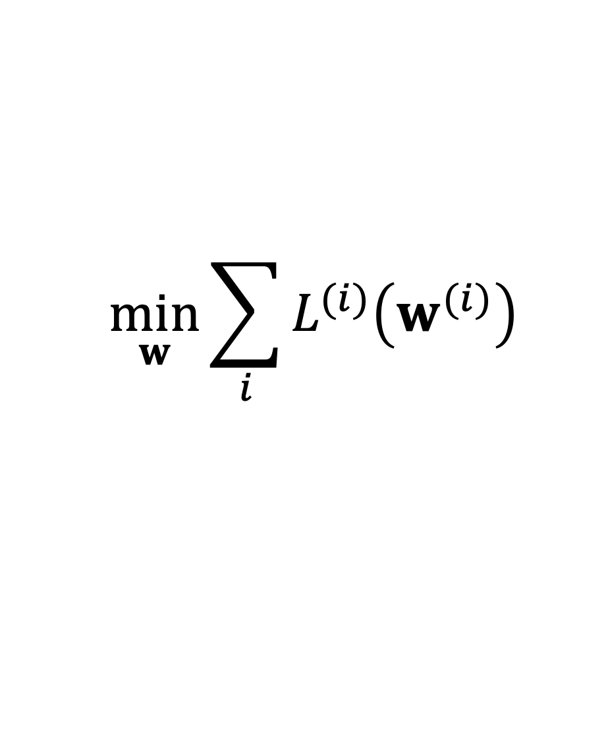
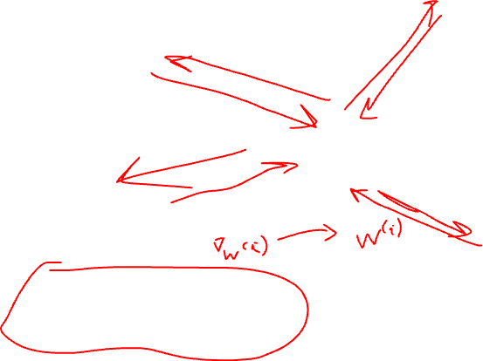
Global Model
$$\min_{w}{\sum_{i}{L^{(i)}\left(w^{(i)}\right)}}$$
such that. $w^{(i)}=w^{(j)}$

Slide 7
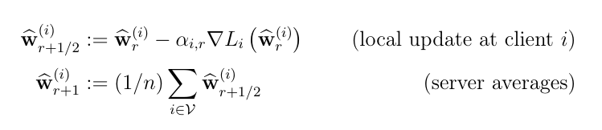
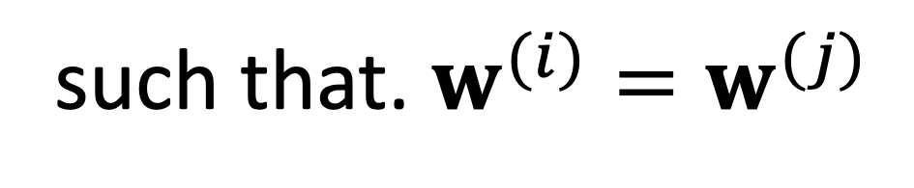
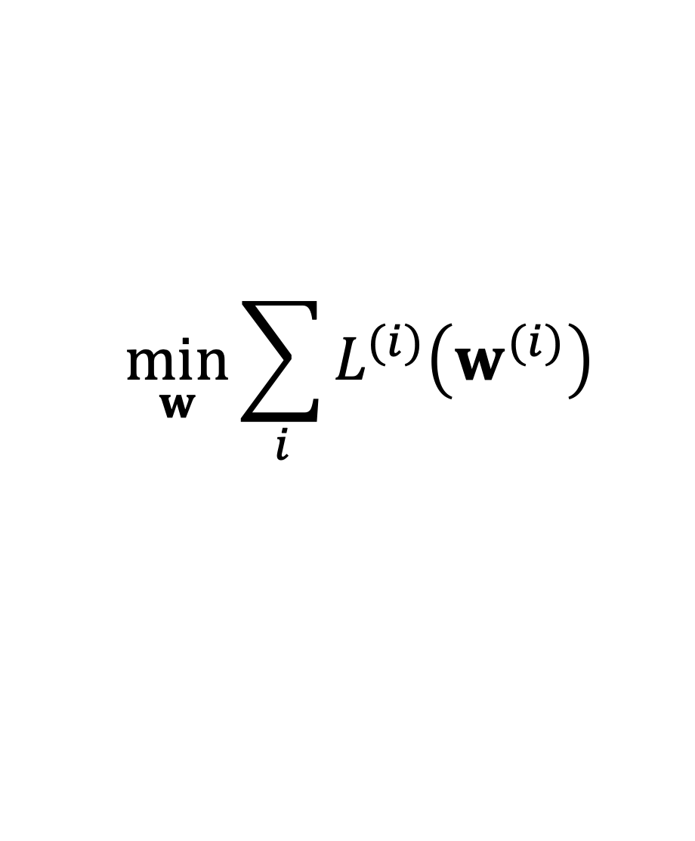
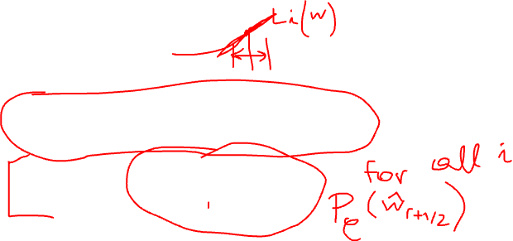
Projected SGD
$$\min_{w}{\sum_{i}{L^{(i)}\left(w^{(i)}\right)}}$$
such that. $w^{(i)}=w^{(j)}$

Slide 8
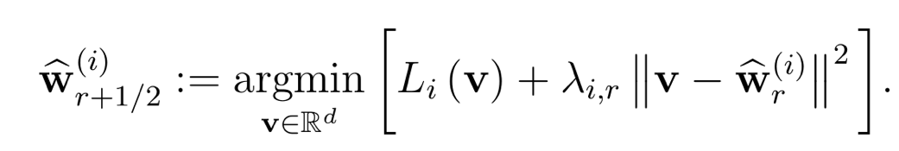
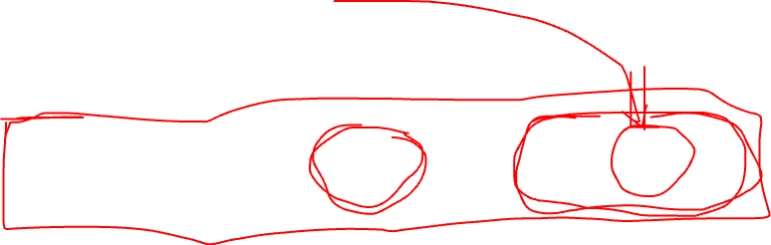
FedAvg
replace gradient step with local optimization:

Slide 9
FL Flavors
Centralized FL
Decentralized FL
Personalized FL
Vertical FL
Horizontal FL

Slide 10
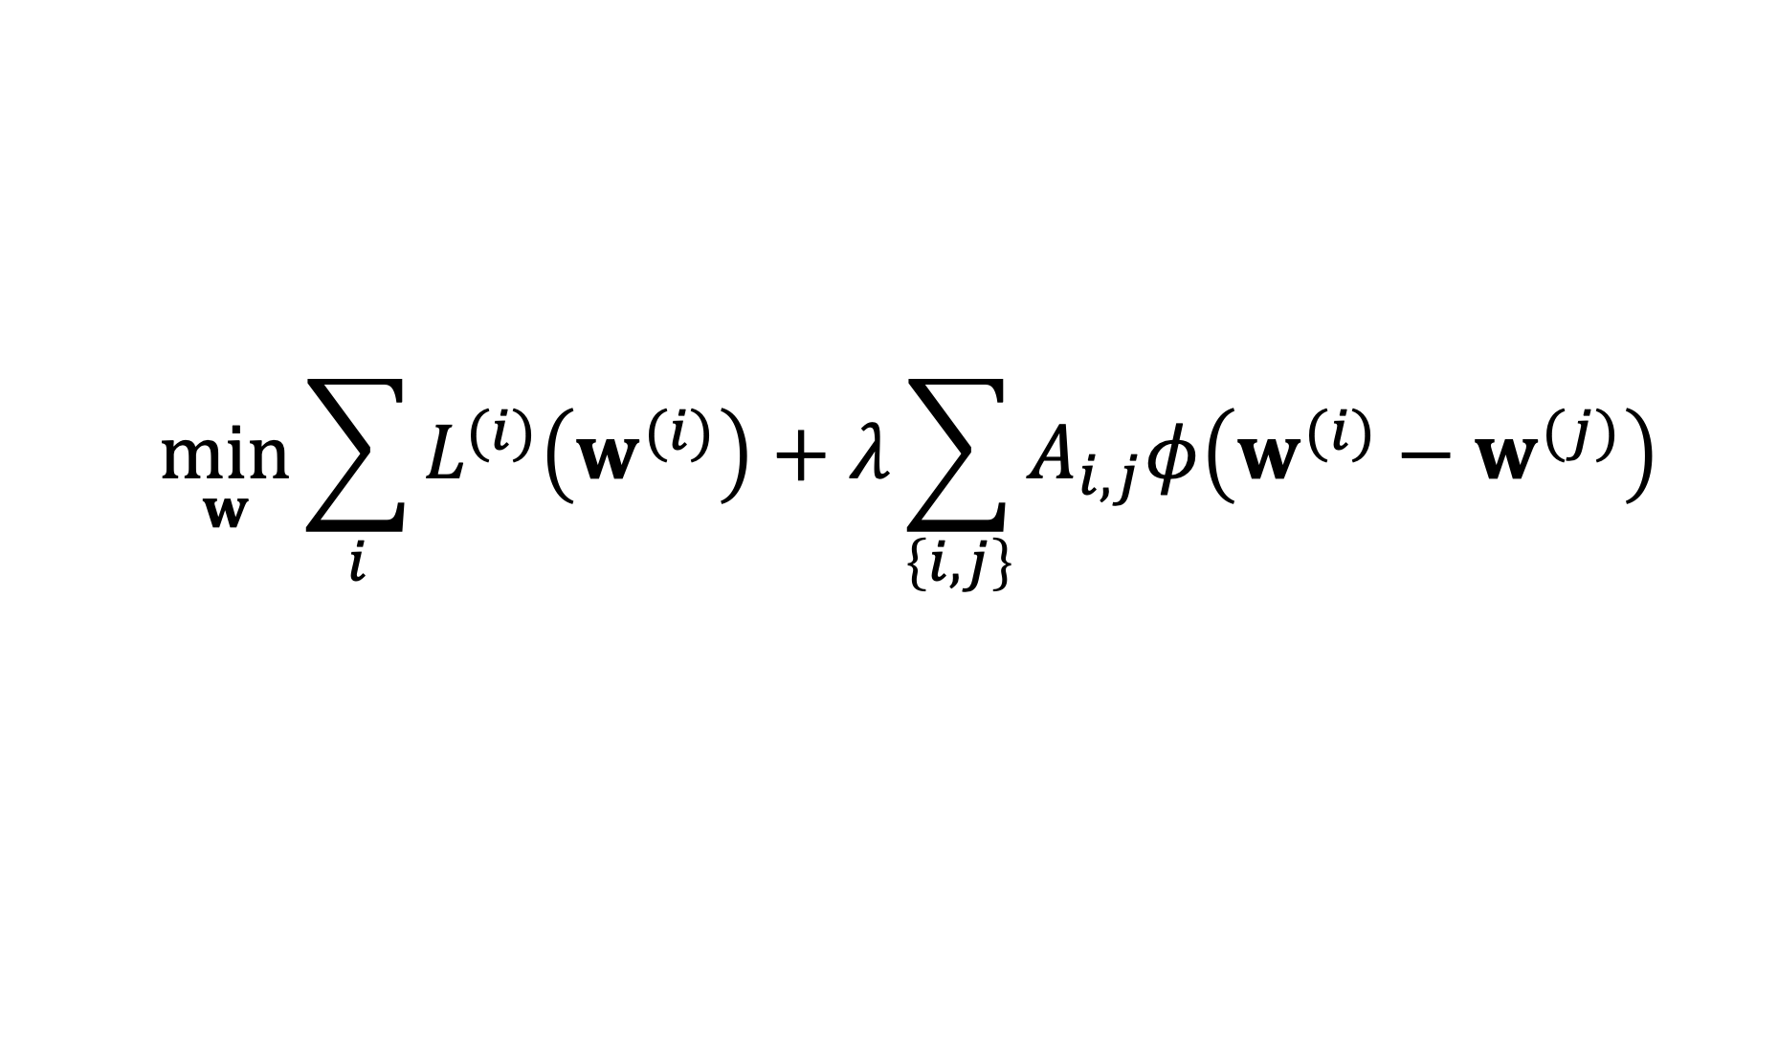
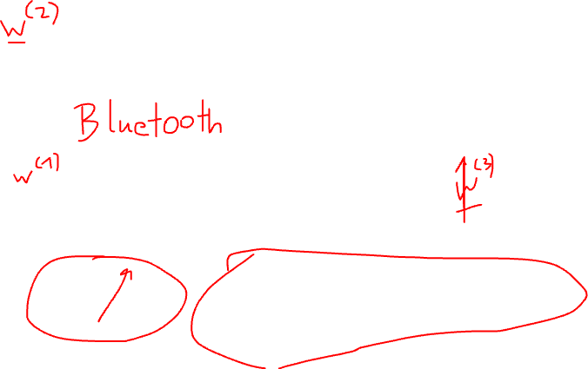
FL Design Principle
$$\min_{w}{\sum_{i}{L^{(i)}\left(w^{(i)}\right)}+λ\sum_{\left\{i,j\right\}}{A_{i,j}φ\left(w^{(i)}−w^{(j)}\right)}}$$

Slide 11


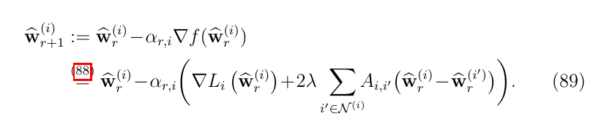
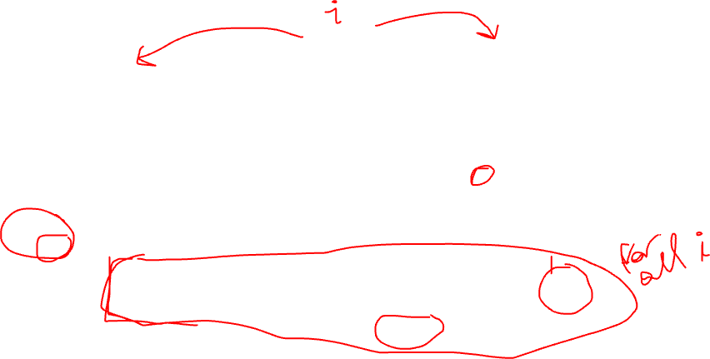
FedSGD

Slide 12
FL Flavors
Centralized FL
Decentralized FL
Personalized FL
Vertical FL
Horizontal FL

Slide 13
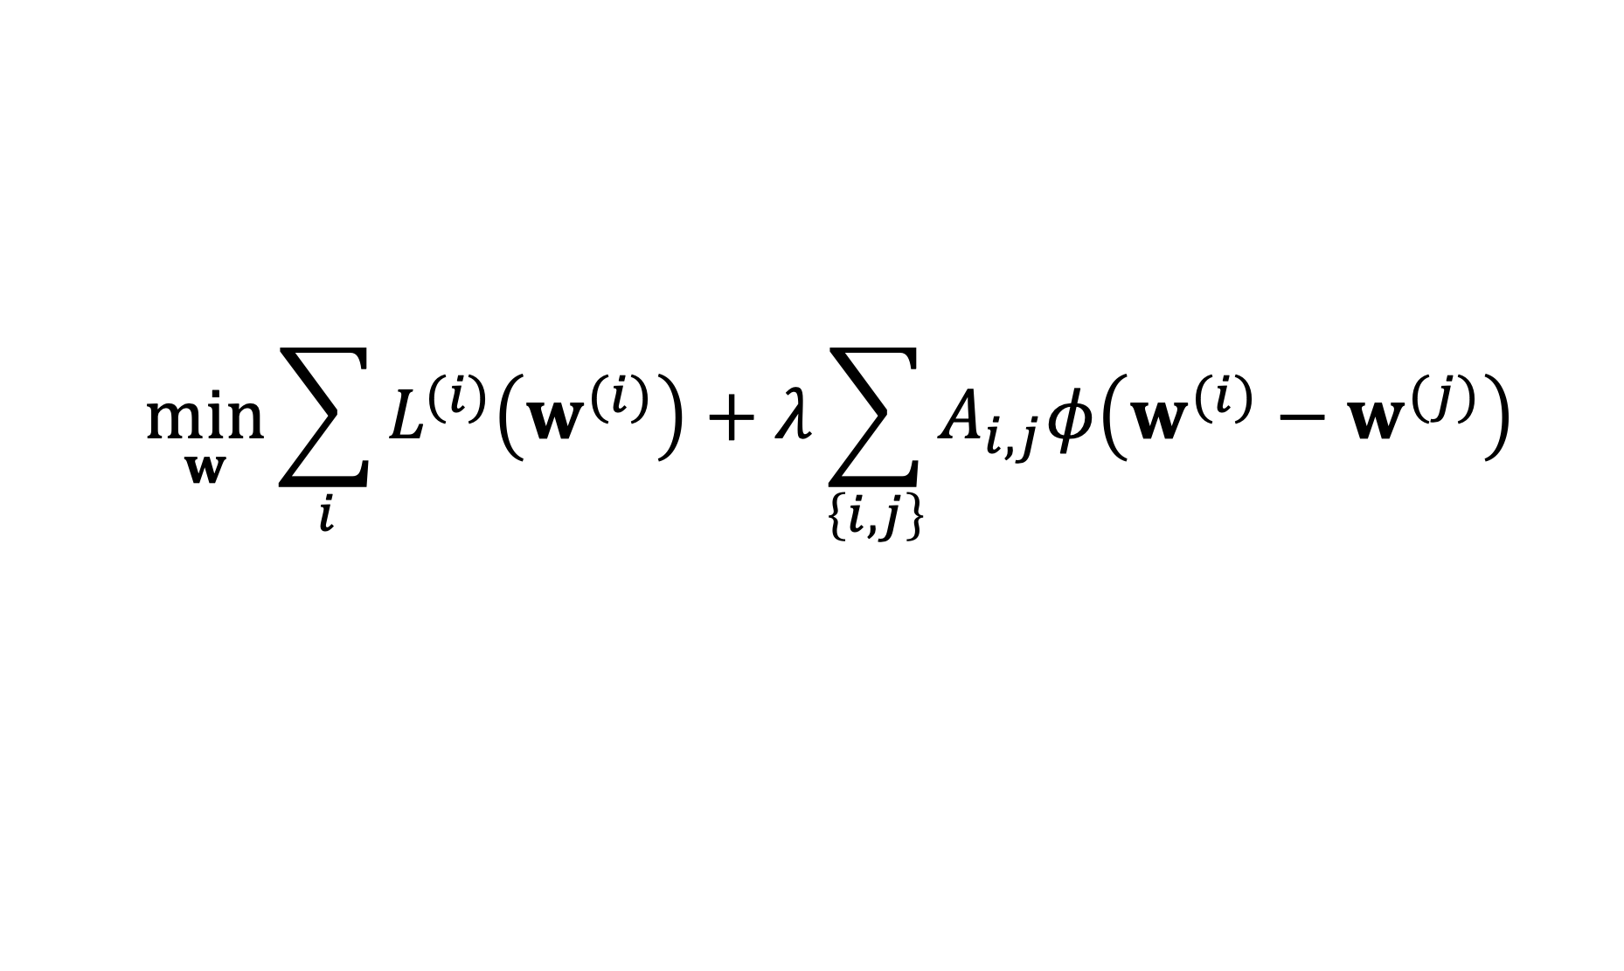
Layer-Wise Coupling
$$\min_{w}{\sum_{i}{L^{(i)}\left(w^{(i)}\right)}+λ\sum_{\left\{i,j\right\}}{A_{i,j}φ\left(w^{(i)}−w^{(j)}\right)}}$$

Slide 14
FL Flavors
Centralized FL
Decentralized FL
Personalized FL
Vertical and Horizontal FL

Slide 15



Horizontal FL
local dataset 1
labels
$$x^{(1)}$$
$$x^{(2)}$$
local dataset 2
local dataset 3
$$x^{(m)}$$
features

Slide 16


Vertical FL
local dataset 2
local dataset 3
local dataset 1
labels
$$x^{(1)}$$
$$x^{(m)}$$

Slide 17


Vertical and Horizonal FL
$$x^{(1)}$$
$$x^{(m)}$$

Slide 18


Quiz – “FL Flavors”
Helene
Isabella
Emily
Anika
each wants to learn a linear model

Slide 19
Thank you for
your attention!

