Slide 1
CS-E4740 Federated Learning “Graph Learning” Dipl.-Ing. Dr.techn. Alexander Jung

Slide 2
FL Project
allowed models listed in mycourses “FL project”
these models require numeric feature vectors
what if your project involves non-numeric data?
you are free to choose/construct features
transform text into numeric feature vectors !

Slide 3
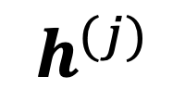
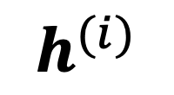
Networked Data+Model
$$h^{(i)}$$
val set
train set
node j
$$h^{(j)}$$
node i

Slide 4

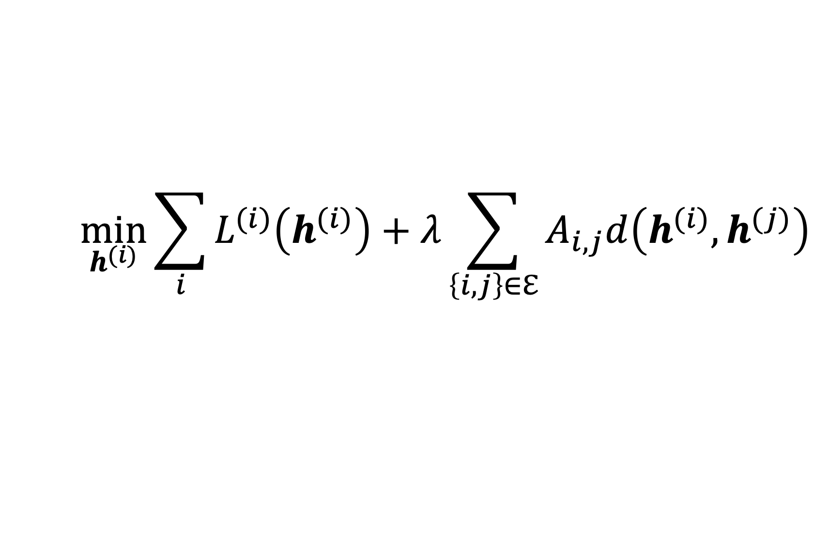
FL Design Principle
$$\min_{h^{(i)}}{\sum_{i}{L^{(i)}\left(h^{(i)}\right)}+λ\sum_{\left\{i,j\right\}∈ℇ}{A_{i,j}d\left(h^{(i)},h^{(j)}\right)}}$$
what edges $\left\{i,j\right\}∈ℇ$ and weights $A_{i,j}$ ?

Slide 5
Choosing Edges = Model Selection
$$\min_{h^{(i)}}{\sum_{i}{L^{(i)}\left(h^{(i)}\right)}+λ\sum_{\left\{i,j\right\}∈ℇ}{A_{i,j}d\left(h^{(i)},h^{(j)}\right)}}$$
try different choices for emp.graph
solve GTVMin for each choice
pick emp.graph with smallest val err.

Slide 6
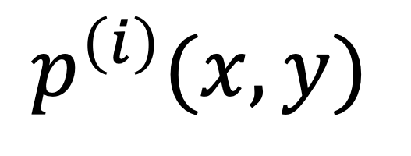
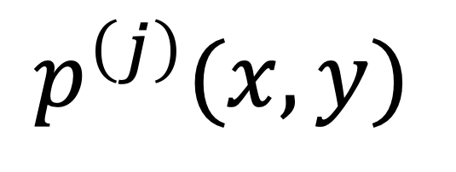
Probabilistic Models
$$p^{\left(i\right)}(x,y)$$
node j
node i
$$p^{\left(j\right)}(x,y)$$

Slide 7
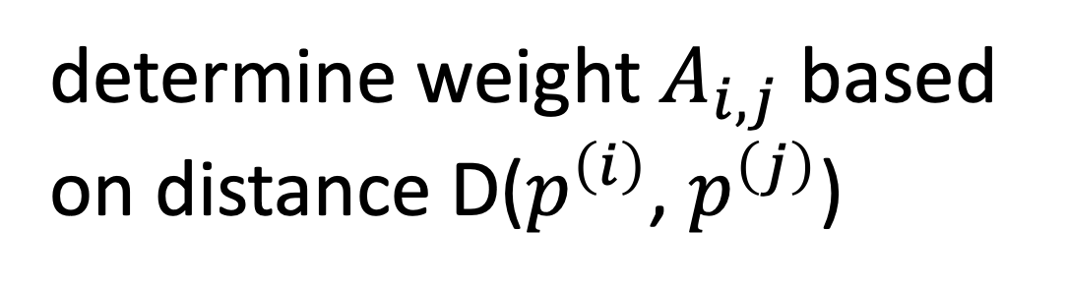
Graph Learning via Distances
$$p^{\left(i\right)}(x,y)$$
determine weight $A_{i,j}$ based
on distance D($p^{\left(i\right)}$, $p^{\left(j\right)}$)
node j
node i
$$p^{\left(j\right)}(x,y)$$

Slide 8
k Nearest-Neighbor
node i
k = 2

Slide 9
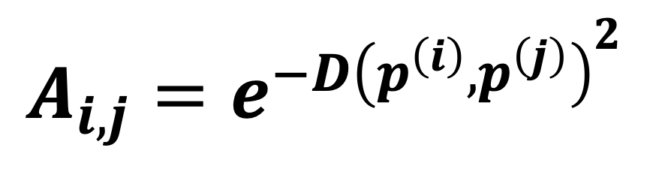
Fully Connected Weighted
$$A_{i,j}=e^{−D{\left(p^{\left(i\right)},p^{\left(j\right)}\right)}^{2}}$$
node i

Slide 10
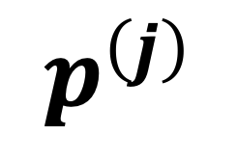
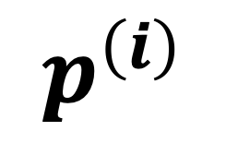
Distance between Prob. Dist.
$$p^{\left(j\right)}$$
$$p^{\left(i\right)}$$

Slide 11


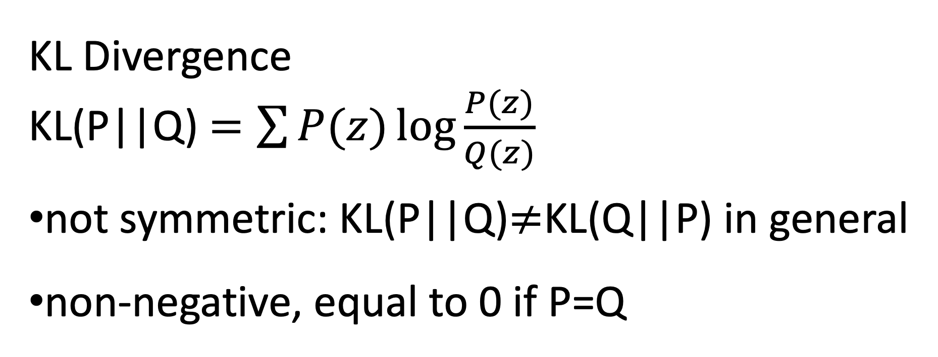
KL Divergence
KL(P||Q) $=\sum{P(z)\log{\frac{P(z)}{Q(z)}}}$
not symmetric: KL(P||Q)$≠$KL(Q||P) in general
non-negative, equal to 0 if P=Q

Slide 12
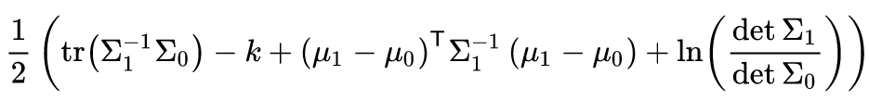
KL between two multiv. normal dist.
https://en.wikipedia.org/wiki/Kullback%E2%80%93Leibler_divergence

Slide 13
KL between Bernoulli RVs

Slide 14
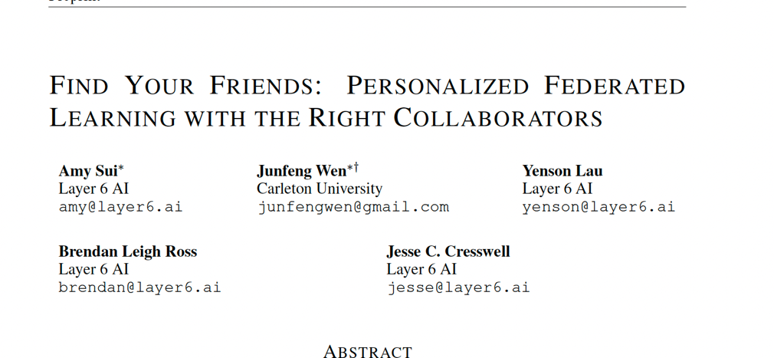

Slide 15
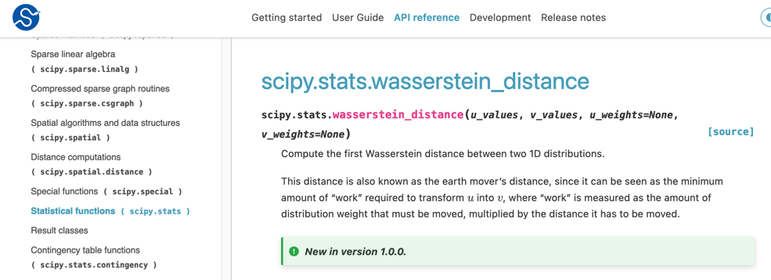
FL project: what if the package is not available on jupyter.cs.aalto?
-> compute it on your own computer and then use results as “manually” chosen edges, weights of emp. graph

Slide 16
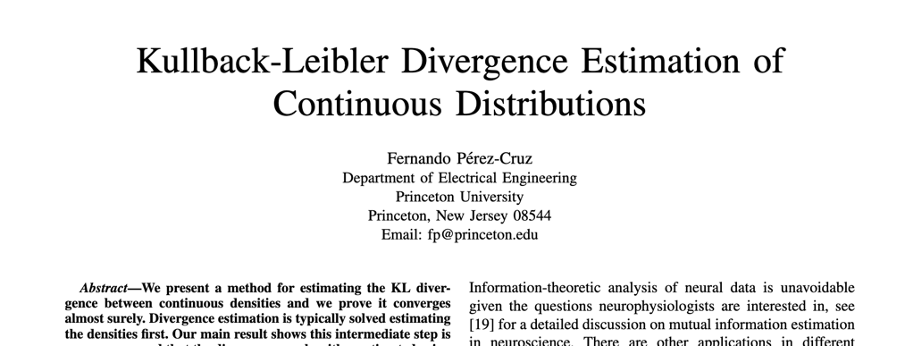

Slide 17


Quiz – “FL Flavors”
Helene
Isabella
Emily
Anika
each wants to learn a linear model

Slide 18
Thank you for
your attention!

