Slide 1

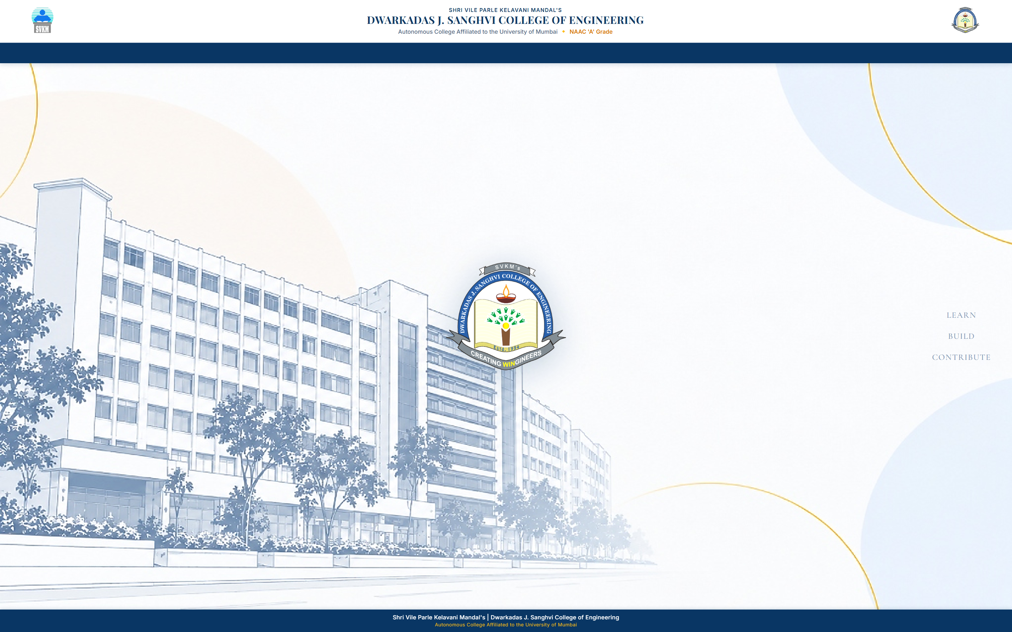
DJSCE ACADEMIC SYSTEMS · OJT PROJECT
SVKM's DJSCE
Dwarkadas J. Sanghvi College of Engg.
AttendTrack
Smart College Attendance & Official Duty Leave Management
EXECUTIVE SUMMARY
“AttendTrack centralizes lecture attendance and official duty-leave requests, helping students, teachers, and coordinators manage attendance workflows through a role-based portal.”
1. Centralized Attendance
LIVE TIMETABLE & LECTURE LOGS
Eliminates fragmented spreadsheets. Integrates real recurring college timetables (EXTC & CE) with live lecture rosters and instant class group tracking.
2. Role-Based Access Control
STRICT USER ISOLATION
Tailored, authenticated portals for Administrators, Faculty, Attendance Coordinators, and Students. Zero cross-student data leakage.
3. Streamlined Duty-Leave Workflows
OCR & DOCX LETTER MATCHING
Intelligent multi-student permission letter extraction. Uses official SAP IDs for strict validation, coordinator approvals, and automatic attendance updates.
🔗 Click image to open AttendTrack Live Demo ↗
Hosted on Vercel: https://attendtrack.vercel.app/
Notes:
SPEAKER SCRIPT:
Good morning, respected professors, evaluators, and college management. Today I am presenting AttendTrack, a smart college attendance and duty-leave management system developed specifically for Dwarkadas J. Sanghvi College of Engineering.
LIVE DEMO ACCESS:
AttendTrack is deployed live on Vercel at https://attendtrack.vercel.app/ . The hero screenshot on this slide is interactive—clicking the image or the blue banner opens the live application directly.
WHAT THIS SLIDE SHOWS:
On the right is the actual live application login interface featuring the official DJSCE institutional identity. On the left, our core proposition is highlighted in three pillars: centralized timetable-driven attendance, strict role-based access, and automated duty-leave letter handling.
TRANSITION:
Let us examine the four distinct user roles that interact with AttendTrack and the capabilities tailored to each.

Slide 2
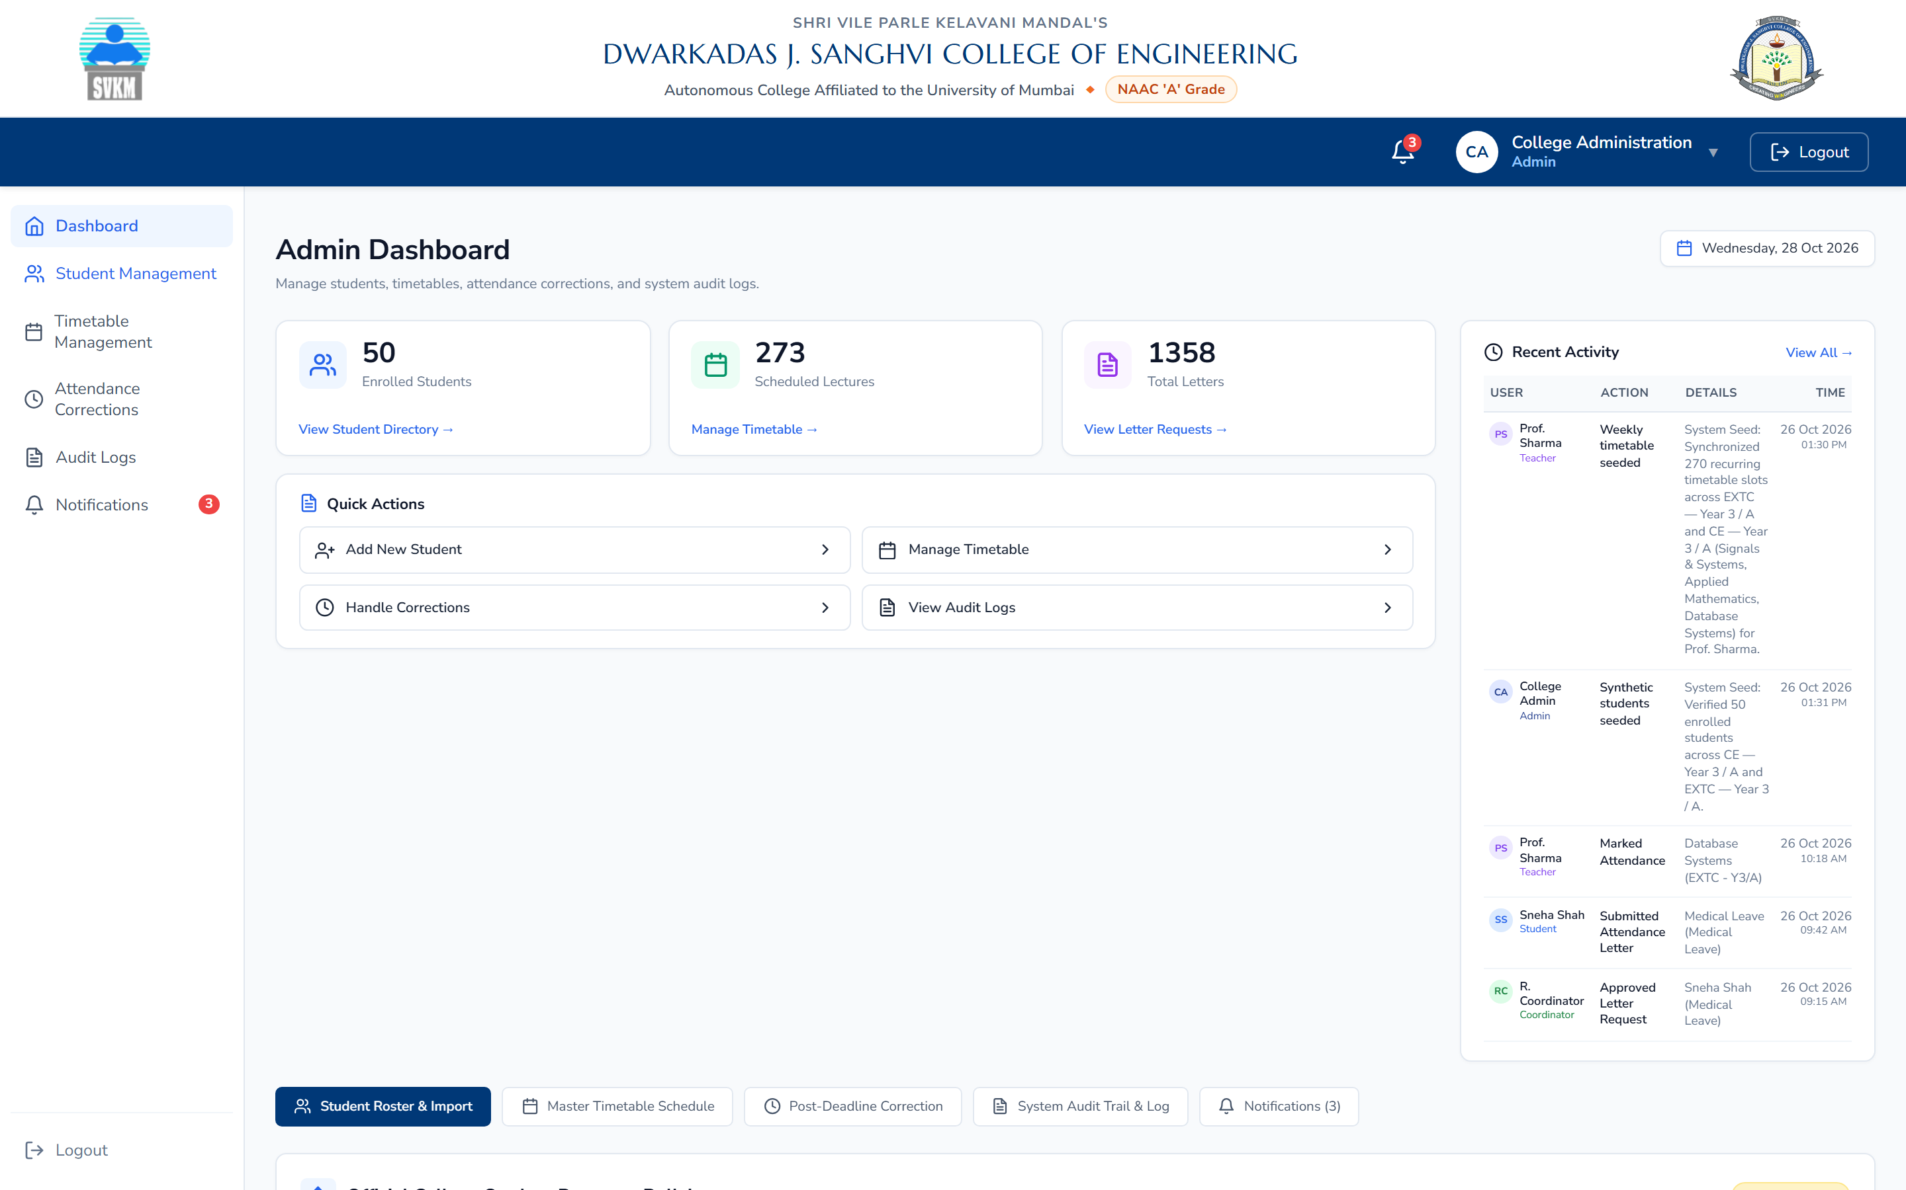
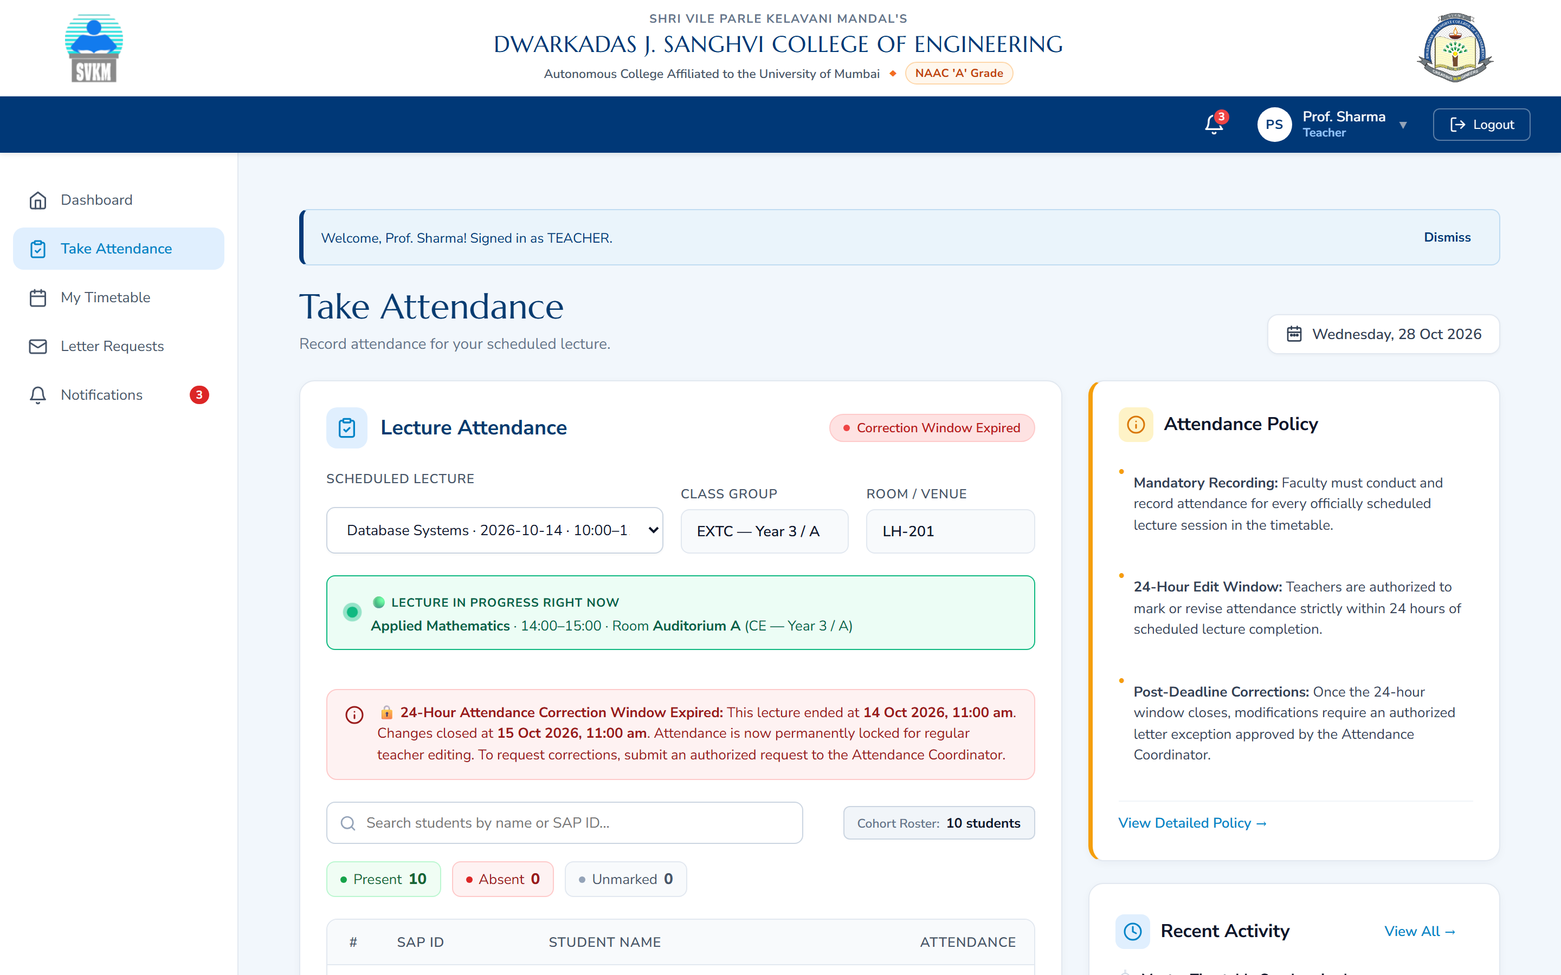
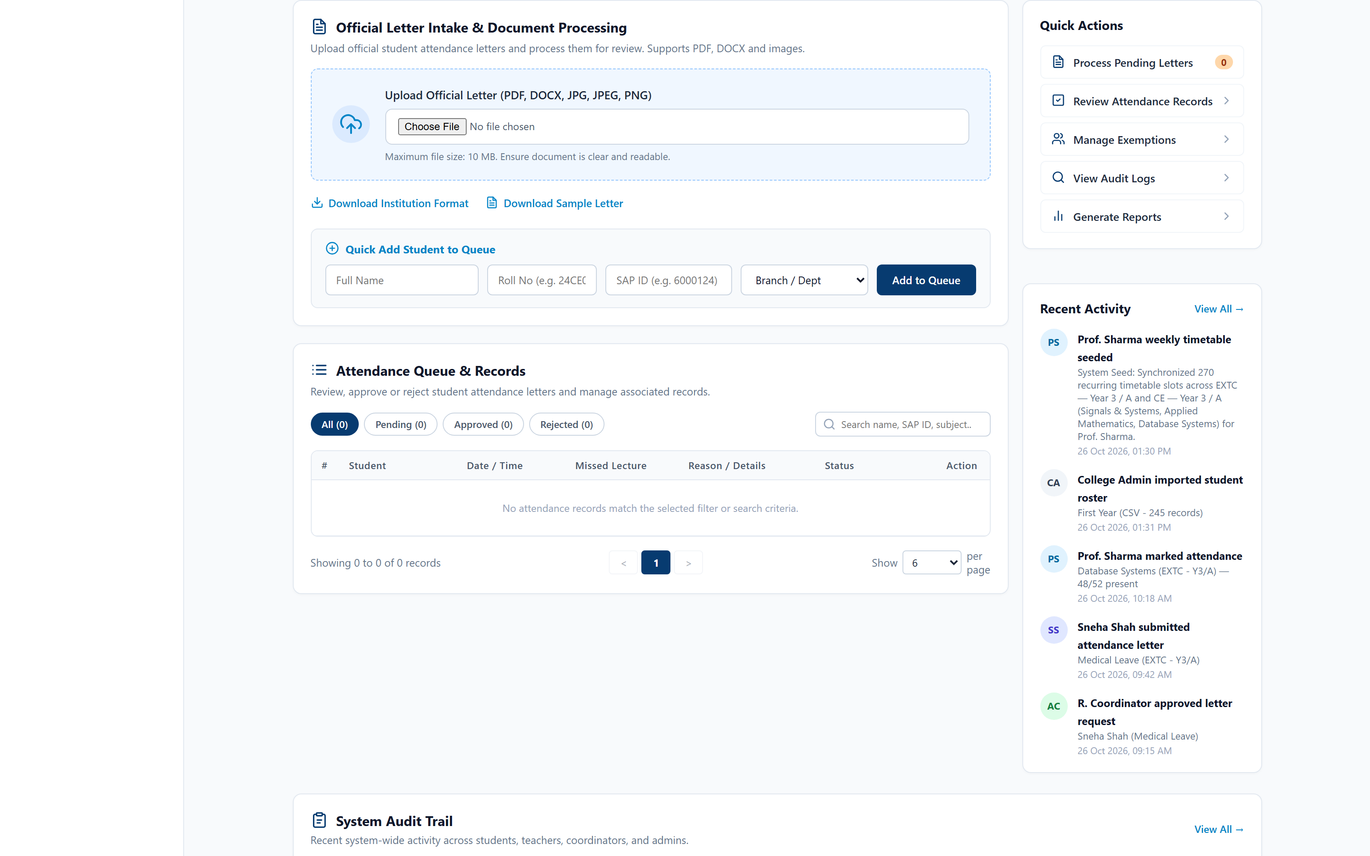
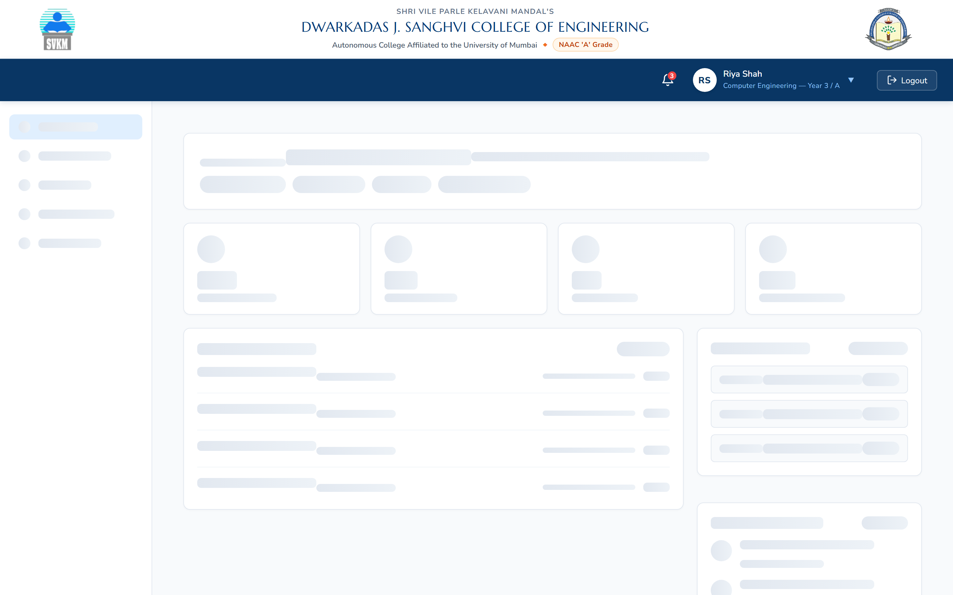
ROLE-BASED ARCHITECTURE & OPERATIONAL SCOPE
SVKM's DJSCE
Dwarkadas J. Sanghvi College of Engg.
One Platform. Four Roles.
Dedicated workspaces designed around institutional responsibilities with strict data isolation
Administrator
INSTITUTIONAL OVERSIGHT
• Manages student records, SAP IDs, class divisions, and academic year settings.
• Oversees persistent audit logs tracking every attendance update and administrative action.
• Applies post-deadline attendance corrections strictly with mandatory audit reasons.
Teacher / Faculty
LECTURE ATTENDANCE
• Accesses assigned class cohorts (EXTC / CE) and real-time weekly lecture timetable.
• Records attendance (Present / Absent / Late) with segmented controls per student.
• Enforces the strict 24-hour attendance correction deadline calculated from lecture end.
Admin Portal: Student database, department cohort filtering, and audit log oversight.
↗ Click image to open AttendTrack
Teacher Portal: Time-aware lecture picker, cohort roster, and 24h editing window monitor.
↗ Click image to open AttendTrack
Attendance Coordinator
OFFICIAL LETTER INTAKE
• Processes official permission letters (medical leave, technical symposiums, sports).
• Validates OCR / DOCX extracted student entries against authoritative roster SAP IDs.
• Approves eligible letters (auto-updating attendance to Present) or rejects with explicit reason.
Student
SELF-MONITORING
• Monitors real-time statutory attendance compliance against Mumbai University's 75% rule.
• Views personal lecture-by-lecture attendance log with official exemption badges.
• Tracks status of submitted permission letters with zero exposure of peer private data.
Coordinator Portal: Multi-student document parsing, SAP ID matching, and review queue.
↗ Click image to open AttendTrack
Student Portal: Statutory 75% compliance monitor, attendance log, and letter history.
↗ Click image to open AttendTrack
Notes:
SPEAKER SCRIPT:
AttendTrack is designed around the reality of college administration: different stakeholders need different tools, and security requires strict separation of privilege.
LIVE DEMO LINKING ARCHITECTURE:
AttendTrack is implemented as a unified, secure Single-Page Application (SPA) on Vercel (https://attendtrack.vercel.app/). Because access to role-specific views is gated by authenticated JWT tokens, all role screenshots link to the verified live application entry point, where evaluators can sign in using pre-configured role credentials (Teacher, Attendance Coordinator, Student, Admin).
WHAT THIS SLIDE SHOWS:
This 4-card matrix displays the four distinct roles implemented in AttendTrack, each paired with actual screenshots of their live workspace:
1. Administration manages foundational student data and reviews persistent audit logs.
2. Teachers mark active lectures within the 24-hour deadline.
3. Attendance Coordinators verify and review duty-leave letters using student SAP IDs.
4. Students monitor their own statutory compliance without being able to see peer records.
TRANSITION:
Now let us trace how these roles interact in practice through our five-stage attendance workflow.

Slide 3
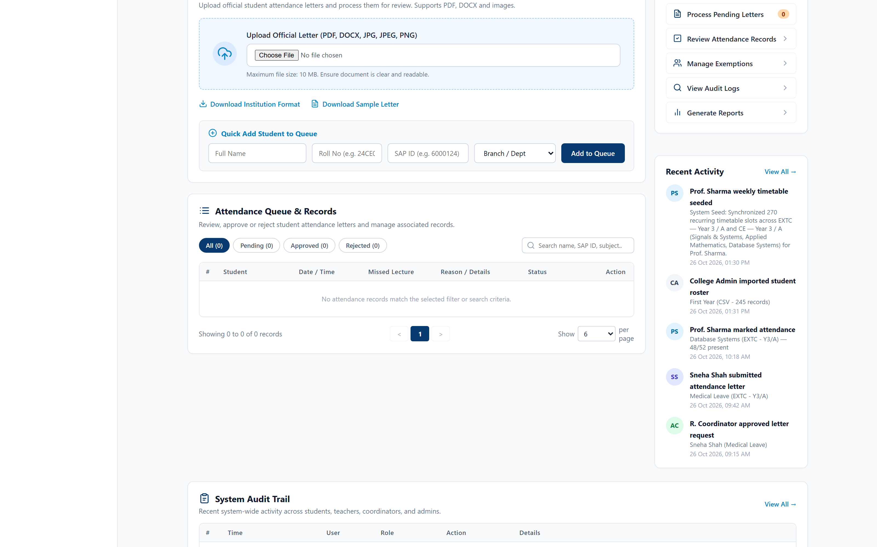
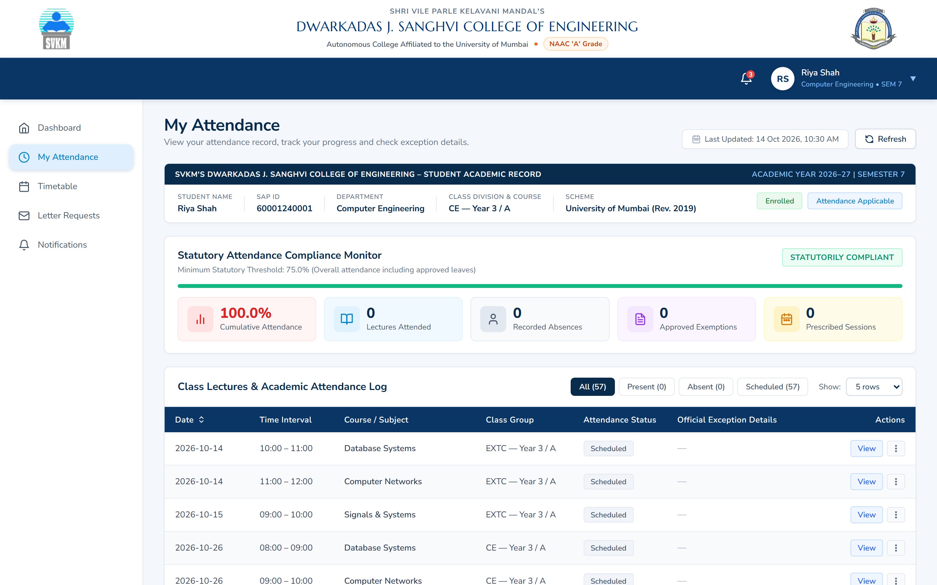
END-TO-END OPERATIONAL WORKFLOW
SVKM's DJSCE
Dwarkadas J. Sanghvi College of Engg.
From Lecture to Attendance Record
How lecture attendance, supporting letters, and coordinator reviews synchronize across the institution
STEP 1
Timetable & Setup
Master timetable slots, class divisions (EXTC/CE), and scheduled sessions are initialized.
STEP 2
Take Attendance
Faculty records attendance (Workflow 01) within the strictly enforced 24h window.
STEP 3
Letter Intake
Duty-leave letter uploaded (Workflow 02/03); OCR extracts student names and SAP IDs.
STEP 4
Coordinator Review
Coordinator verifies SAP ID match against institutional roster; approves or rejects.
STEP 5
Authoritative Sync
Decision persists; student & teacher portals refresh immediately with 'Present' & exemption badge.
STAGE A: TEACHER MARKING
Workflow 01: Regular Attendance
STAGE B: COORDINATOR REVIEW
Workflow 02/03: Duty Leave Letters
STAGE C: STUDENT & PORTAL SYNC
Synchronized State Reflection
Professors view authoritative cohort rosters and record attendance. Enforces 24h deadline.
↗ Click image to open AttendTrack
Official letters parsed via OCR/DOCX. Coordinators approve or reject per student SAP ID.
↗ Click image to open AttendTrack
Approved exemptions update attendance to 'Present' with official exemption badge and 75% monitor.
↗ Click image to open AttendTrack
Notes:
SPEAKER SCRIPT:
This diagram illustrates AttendTrack's end-to-end lifecycle, bridging daily lecture attendance with official duty-leave requests.
LIVE APPLICATION WORKFLOWS:
Each of the three workflow panels below displays a verified screenshot from our live deployment at https://attendtrack.vercel.app/ . Clicking on any workflow image opens the live system directly.
WHAT THIS SLIDE SHOWS:
The 5-step process spans from initial timetable setup to authoritative portal synchronization:
1. Regular lecture attendance (Workflow 01) is recorded by teachers within the 24-hour editing window.
2. Supporting letters for single or multiple students (Workflows 02 & 03) are ingested and parsed using OCR and DOCX text extraction.
3. The Attendance Coordinator verifies SAP IDs and makes an approval or rejection decision.
4. When approved, a database transaction updates the attendance record to Present and attaches the official reference.
5. Both student and teacher portals reflect this updated state immediately without requiring logout or browser restarts.
TRANSITION:
Finally, let us review the key governance benefits, data integrity safeguards, and the path to deployment.

Slide 4
GOVERNANCE, INTEGRITY & DEPLOYMENT ROADMAP
SVKM's DJSCE
Dwarkadas J. Sanghvi College of Engg.
Built for Accountable Attendance Management
Delivering data transparency, strict academic governance, and a verified pathway to deployment
Operational Benefits
ADMINISTRATIVE EFFICIENCY
Data Integrity & Security
ACADEMIC GOVERNANCE
Status & Deployment Roadmap
VERIFIED ARCHITECTURE
✔ Centralized Timetables
Replaces manual paper rolls with live recurring timetables and scheduled class groups.
✔ Structured Duty-Leave Intake
Eliminates lost permission slips by queuing parsed OCR/DOCX requests directly for review.
✔ Statutory Compliance Monitor
Gives students real-time visibility into their 75% attendance threshold with instant deficit alerts.
✔ Cross-Portal Synchronization
Coordinator decisions immediately reflect across student logs and teacher lecture rosters.
✔ Authoritative SAP ID Matching
Uses official 11-digit SAP IDs as primary student keys; rejects ambiguous names or unverified IDs.
✔ Strict 24-Hour Edit Window
Locks teacher attendance edits 24 hours after lecture scheduled end to prevent retrospective tampering.
✔ Immutable Audit Trail
Every submission, correction, approval, and rejection is permanently recorded with actor and timestamp.
✔ Role-Based Privacy Isolation
Strict HMAC token authorization ensures students access only their own academic records.
✔ Fully Implemented & Verified
Complete 4-role UI, 24h deadline rule, multi-student OCR intake, and portal sync passing 100% regression tests.
✔ Dual Storage Architecture
Production-ready Prisma ORM schema with automated development fallback store mode.
✔ Next Step: Postgres DB Hosting
Provision dedicated PostgreSQL instance on college server for permanent persistent storage.
✔ Next Step: LDAP/SSO Integration
Connect with DJSCE central Active Directory / SAP portal for single sign-on.
“AttendTrack aims to make college attendance workflows more transparent, consistent, and accountable.”
Dwarkadas J. Sanghvi College of Engineering · Department of Computer Engineering
🌐 Open Live Demo ↗
https://attendtrack.vercel.app/
Notes:
SPEAKER SCRIPT:
To conclude, AttendTrack is engineered not just as a tracking tool, but as a robust governance platform for our college.
LIVE DEMO CALL-TO-ACTION:
Evaluators and professors can test the entire platform right now by clicking the prominent 'Open Live Demo ↗' button at the bottom right, or navigating to https://attendtrack.vercel.app/ .
WHAT THIS SLIDE SHOWS:
The three pillars summarizing our outcomes:
1. Operational Benefits: Real-time visibility, automated intake, and cross-portal synchronization eliminate administrative delays.
2. Data Integrity & Security: Built around official 11-digit SAP IDs, immutable audit logging, and a strict 24-hour teacher editing deadline.
3. Current Status & Next Steps: The complete 4-role UI and coordinator decision synchronization are fully implemented and verified with automated regression tests. Our next operational milestones are provisioning a dedicated institutional PostgreSQL database server and integrating LDAP single sign-on.
HOW THIS HELPS USERS:
Evaluators and administration can be confident that attendance records are mathematically accurate, auditable, and compliant with university regulations.
CLOSING STATEMENT:
AttendTrack aims to make college attendance workflows more transparent, consistent, and accountable. Thank you, and I look forward to your questions.

