Slide 1
Comparative Study of Automated Testing Tools
Presented by- Aayush Nagpal
University of New Orleans
Software Testing & QA (CSCI 6990)
Supervisor- Dr. Minhaz F. Zibran

Slide 2
Introduction
“persistent people begin their success where others end in failure”
Goal: evaluate and compare several Browser automation testing tools
To accomplish this goal this research will:
1. Research and select a set of tools to be evaluated
2. Develop a metric suite to be used to evaluate the tools
3. Select target application to be tested
4. Document time spent manually testing the application and record data
5. Perform a feature assessment for the tools
6. Test the target applications using the selected automated testing tools.
7. Evaluate and interpret results and the tools
8. Draw inferences and make recommendations

Slide 3
Application under Test(AUT)
WWW.UNO.EDU
Motivation
Large number of potential diverse test cases.
Website is under major renovation( confirmed from administration)
The number of feature available to test would be sufficient to judge tool thoroughly.

Slide 4
Type of Testing in Focus
This study focuses on UI and functional testing of Web Application
Using browser automation tools such as Selenium, Cucumber etc.

Slide 5
Tools
Selenium Webdriver
Motivation: Widely discussed in literature and adopted in industry & Open source
One of the best browser Automation tools out in the market.
Keeping my learning curve in consideration -> Large community
Cucumber
Behavioral Driven tool, Open Source
Helpful for management who cant read code, Living Documentation
There is a huge hype about BDD.
Helium
Open Source
High Level commands.
Reduce hundreds of lines of code in contrast to selenium.

Slide 6
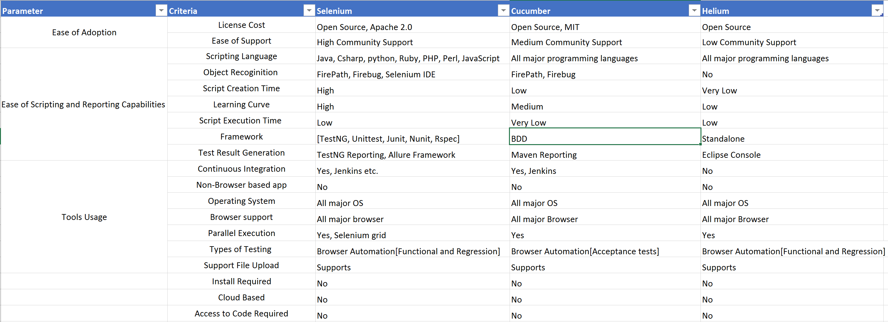
Comparison Matrix

Slide 7
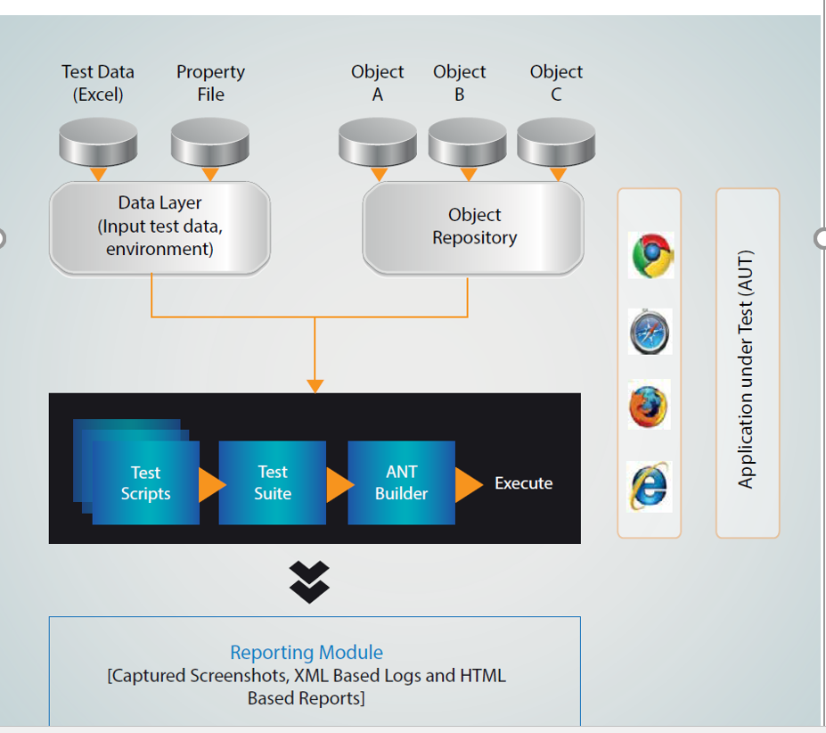
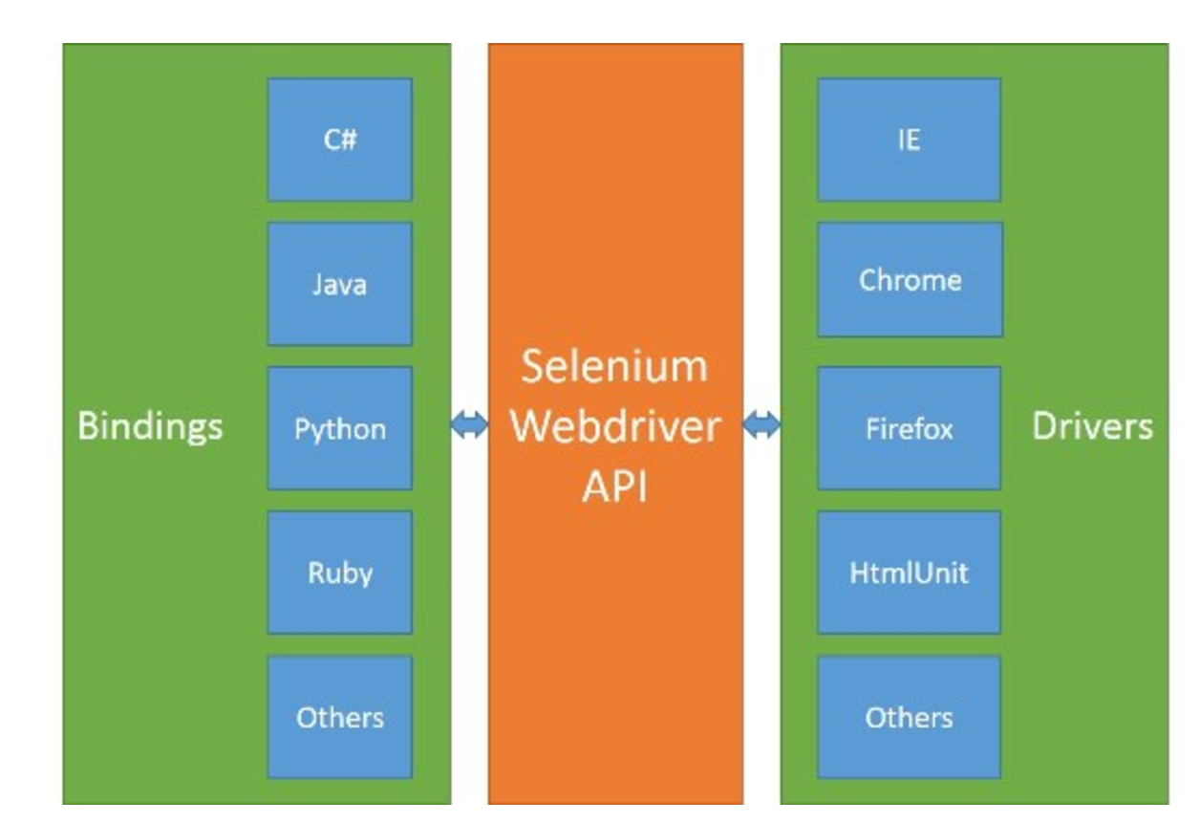
Selenium WebDriver
Language Level Binding
Selenium WebDriver API
Drivers

Slide 8
Selenium WebDriver
Hybrid Framework:
TestNg as testing framework
Motivation:
Test cases can be grouped easily
Supports Annotation
Flexible test Execution
Reporting facility
Build Tool: Ant
Reporting: TestNg, Allure Framework
Locators:
ID, Name, Xpath
driver.findElement (By. <Locator>);
I use Xpath with the help of firbug and firepath plugin
Absolute Xpath: .//div/input[@id = ‘u_0_1’]
Relative Xpath: //input[@id='u_0_1']

Slide 9
TestNg Annotation
@BeforeSuite: The annotated method will be run before all tests in this suite have run.
@AfterSuite: The annotated method will be run after all tests in this suite have run.
@BeforeTest: The annotated method will be run before any test method belonging to the classes inside the tag is run.
@AfterTest: The annotated method will be run after all the test methods belonging to the classes inside the tag have run.
@BeforeClass: The annotated method will be run before the first test method in the current class is invoked.
@AfterClass: The annotated method will be run after all the test methods in the current class have been run.
@BeforeMethod: The annotated method will be run before each test method.
@AfterMethod: The annotated method will be run after each test method.
@Test: The annotated method is a part of a test case

Slide 10
WebDriver Commands
1. Creating New Instance of Firefox browser
Webdriver driver = new FirefoxDriver();
2. Open the expected URL in Browser
driver .get("http://www.google.com ");
3. Get the page title
driver.getTitle();
4. Clicking on any element or button of webpage
driver findElement(By.id(“abc.")).click ();
5. Typing text in textbox area
driver.findElement(By.name("search")).sendKeys(" Name");
6. Shows the URL for current web page
driver.getCurrentUrl( );
7. Ending Browser Session
driver.close();

Slide 11
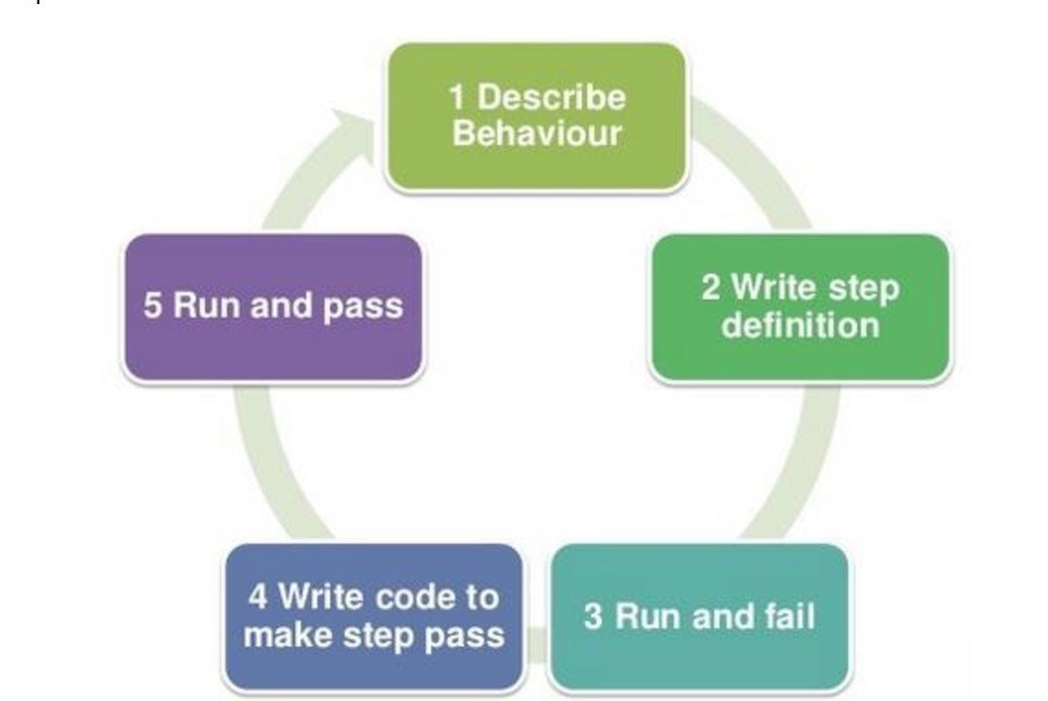
Cucumber

Slide 12
Cucumber Framework Details
Hybrid Framework:
JUnit as testing framework
Build Tool: Maven
Reporting: Surefire

Slide 13
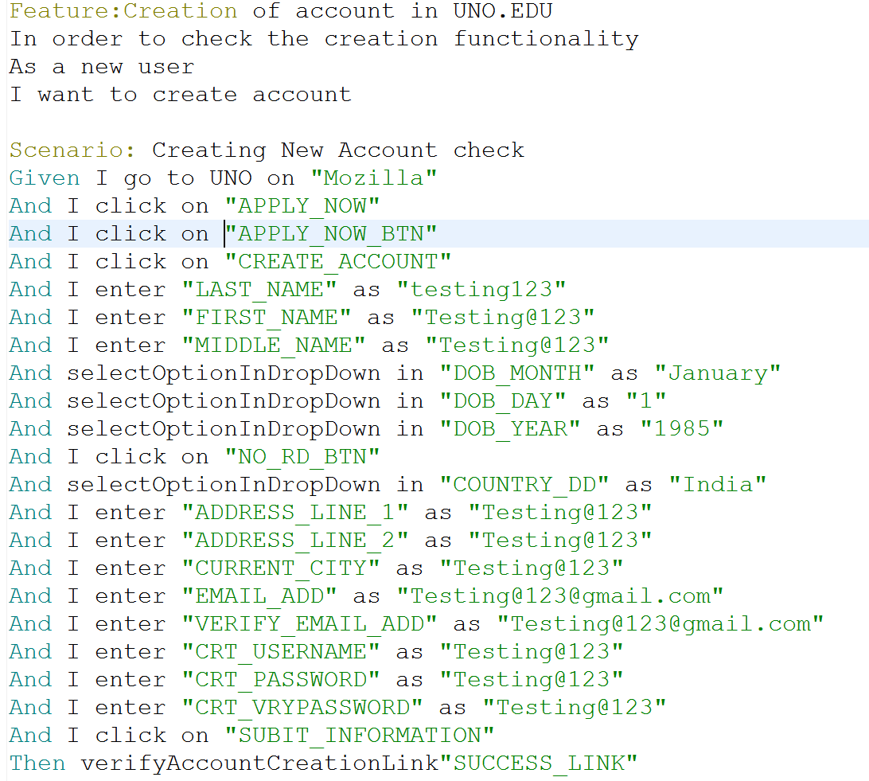
Cucumber

Slide 14
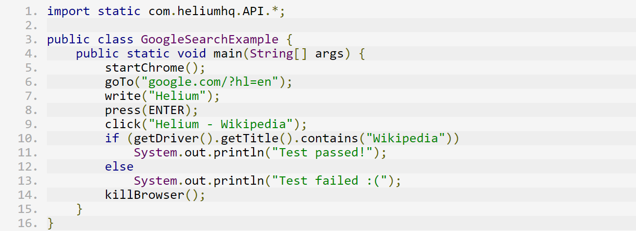
Helium

Slide 15
Proof of Concept
Choose
Choose a few Scenario that covers different parts of the AUT
Select
Select tools based on comparative study
Automate
Automate the chosen scenario.
Generate and analyze
Generate and analyze the reports
Analyze
Analyze the integration of the tools with other tools.

Slide 16

Demo!!

Slide 17
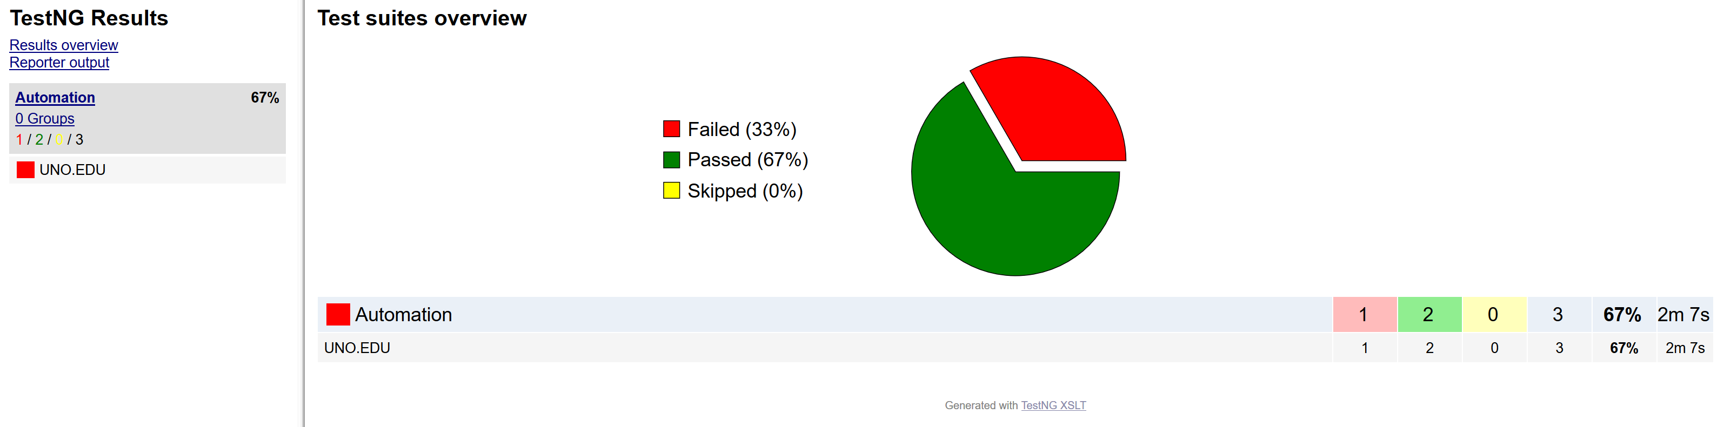
Reports - Selenium

Slide 18
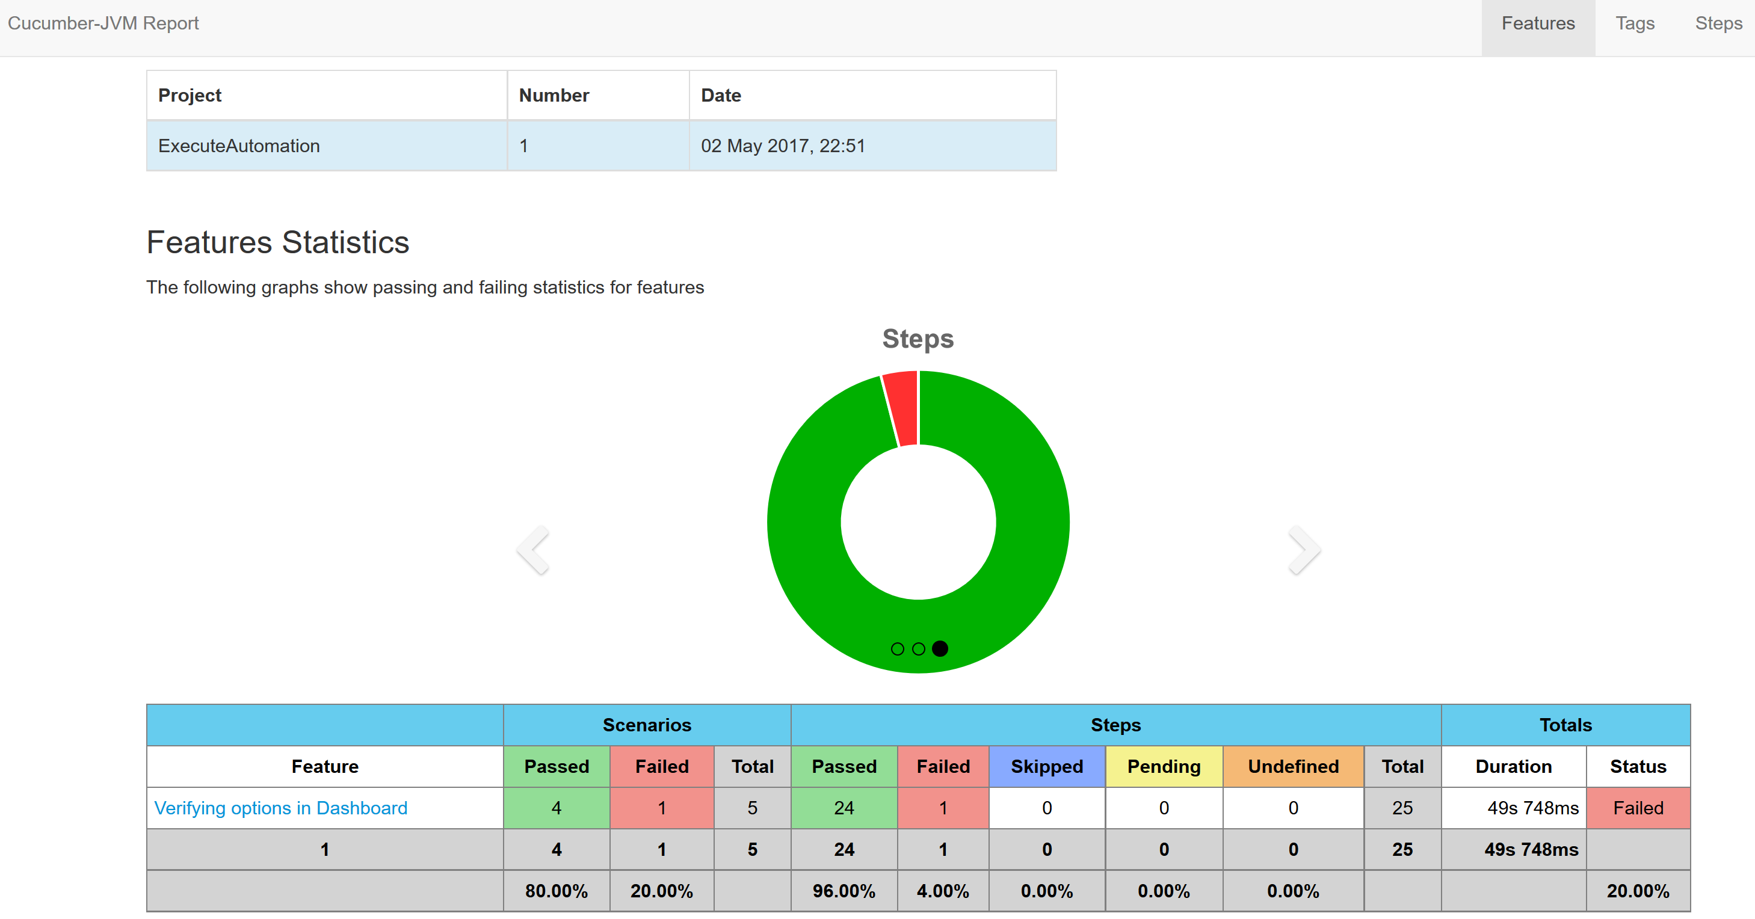
Reports – Cucumber Feature Statistics

Slide 19
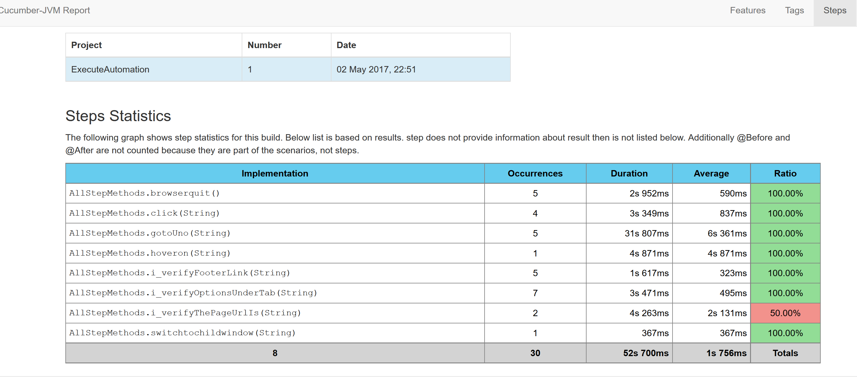
Cucumber Reports

Slide 20
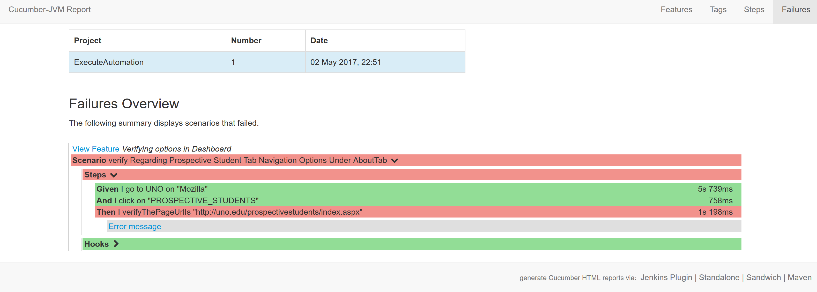
Cucumber Failure Report

Slide 21
Inferences & Recommendation
Selenium would be best to use for more complex testing
Cucumber would be best for Keeping Communication in perspective
Helium- Would be best of a novice and people without background knowledge.

Slide 22
Future Work
Inclusion of database
Handling Alerts
Drag and drop action
Smart Waits or Fluent Waits

Slide 23

Questions?

