Slide 1



Project Title
Jaypee University of Information Technology, Waknaghat - 173234 (India)
Major Project - II (18B19CI891) | AY 2024-25
Mid-Term Evaluation | March 17-22, 2025.
VigilEyeX : An AI-powered system for real-time monitoring and ensuring public safety
Group No.: 57
Team Member (s)
Aayush Sharma (211193)
Parth Sharma (211106)
Aditya Singh (211194)
Supervisor (s)
Name: Dr. Rakesh Kanji
Designation: Assistant Professor(SG)
Department: Computer Science

Slide 2
Outline
Introduction
Problem Statement
Objectives
Work Done (after Major Project - I)
Project Design
Implementation
Experimental Results and Evaluation
Key Learnings
Work Plan (till End-Term Evaluation)
Work Contribution and Attendance
Supervisor Interactions
References

Slide 3
Introduction
Violent behavior in public places is an issue that has to be addressed. Communities are also eroded by violence, which reduces productivity, lowers property values, and disrupts social services. Across the world, violence is a severe public health issue. It affects people at various phases of life, from infants to the elderly.
Recognizing violence is challenging since it must be done on real-time videos captured by a large number of surveillance cameras at any time and in any location. It should be able to make reliable real-time detection and alert corresponding authorities as soon as violent activities occur.
Public video surveillance generates vast security data, but manual review slows decision-making. Automatic violence detection using deep learning addresses this by leveraging MobileNetv2 and LSTM networks. MobileNetv2 excels in spatial feature extraction, while LSTM captures temporal sequences. Together, they enable real-time detection and prompt alerts of violent activities, enhancing the efficiency and accuracy of surveillance systems, ensuring quicker response times by authorities.

Slide 4
Problem Statement
CCTV systems rely on manual monitoring, which is resource-intensive and prone to delays, especially in large environments where human error can result in missed incidents. We propose a cost-effective, real-time violence detection system using a Raspberry Pi to automatically identify violence and notify authorities. It integrates with existing surveillance setups, improving adaptability and response times.

Slide 5
Objectives
The objective is to develop a real-time surveillance system for detecting violent activities in video footage using deep learning, specifically the MobileNet v2 model. To improve accuracy, Long Short-Term Memory (LSTM) networks will analyze temporal sequences of frames. When violence is detected, an integrated alert system will notify authorities with details such as the date, time, and location. Optionally, the system can enhance and include the faces of individuals involved in the alert. This solution will be deployed on a Raspberry Pi for cost-effective integration with existing surveillance setups.

Slide 6
Work Done (after Major Project - I)
Deep Learning Model Enhancement::
Fine-tuned MobileNet v2 for improved violence detection (96% accuracy).
Implemented temporal analysis using LSTM network.
Optimized model parameters for real-time processing.
System Integration & Deployment:
Developed video processing pipeline with OpenCV.
Created Telegram-based alert system with location and timestamp details.
Integrated MTCNN for face detection and enhancement.
Testing & Optimization:
Evaluated performance across varied environmental conditions.
Reduced false positive rate through threshold optimization.
Prepared model for Raspberry Pi deployment.

Slide 7
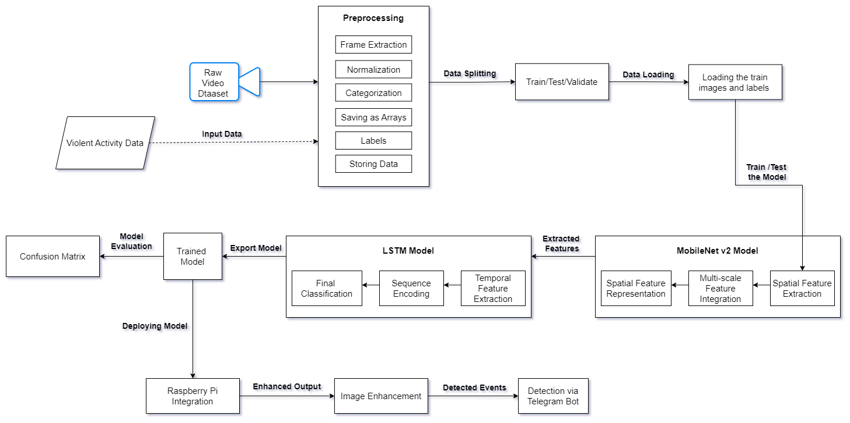
Project Design
Fig. 1 : System Architecture

Slide 8
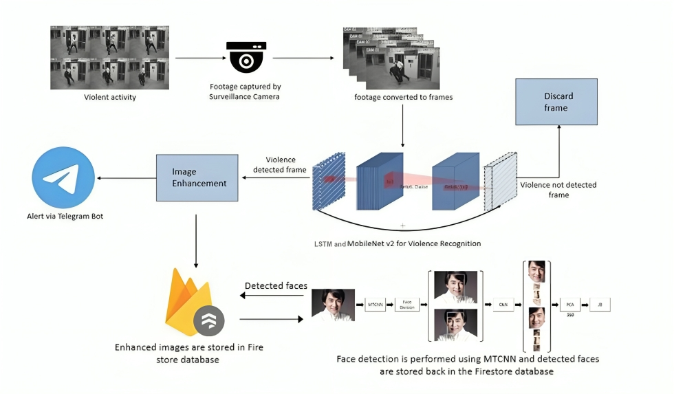
Project Design (cont…)
Fig. 2 : High Level Design

Slide 9
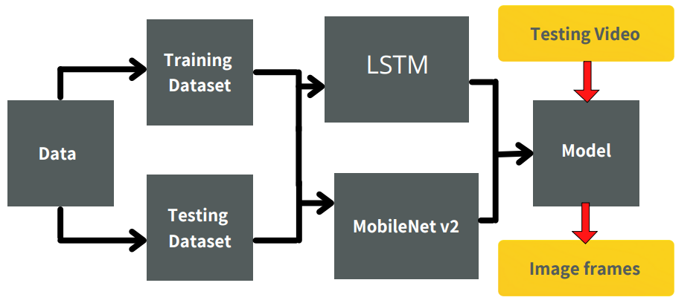
Project Design (cont…)
Fig. 3 : Data Flow Diagram

Slide 10
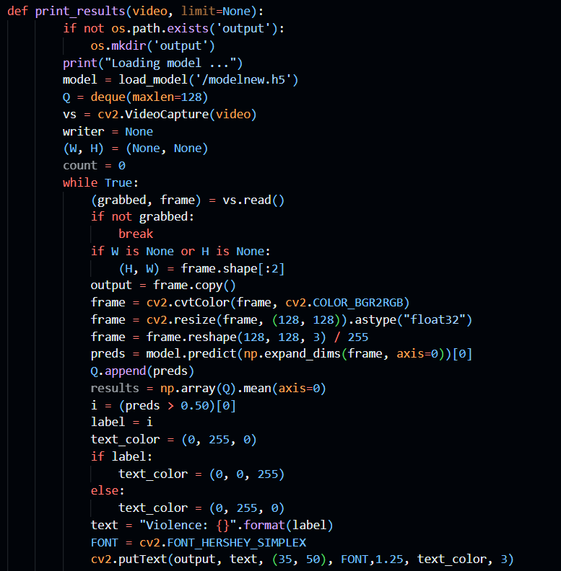
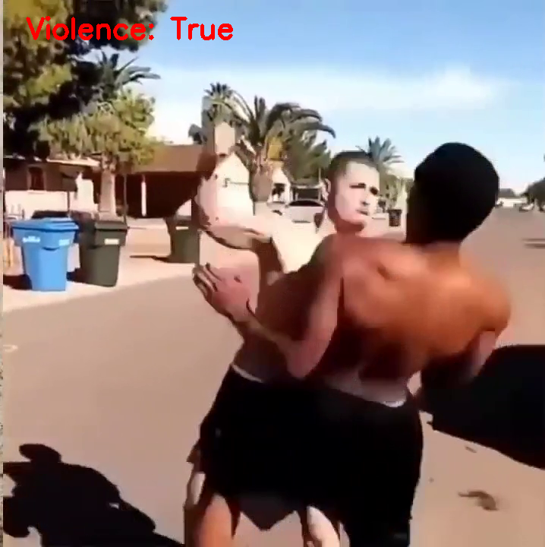
Implementation
1) Phase 1: Model Training
Figure. 4 : Violence Detection System Code
Figure. 5 : Violence Detection System Output

Slide 11
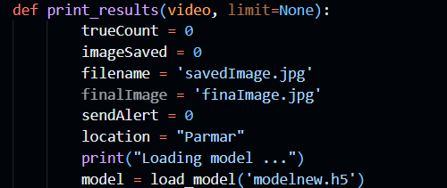
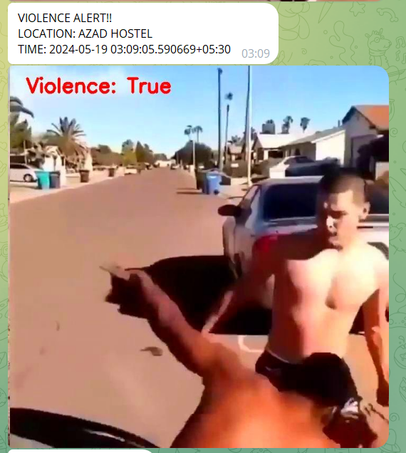
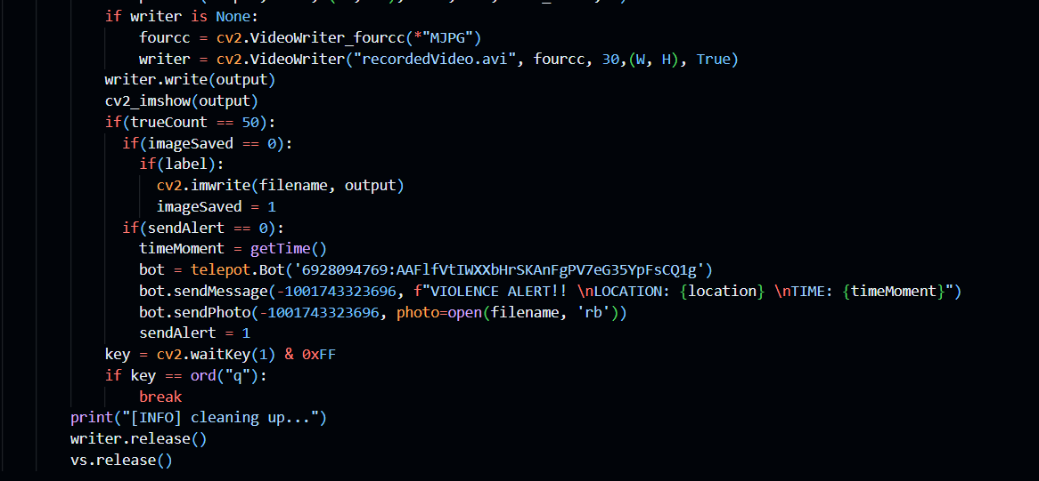
Implementation (cont…)
2) Phase 2: Model Training
Figure. 6 : Violence Alert System Code
Figure. 7 : Violence Alert System Output

Slide 12
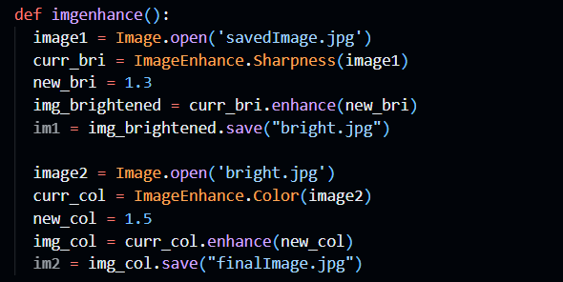
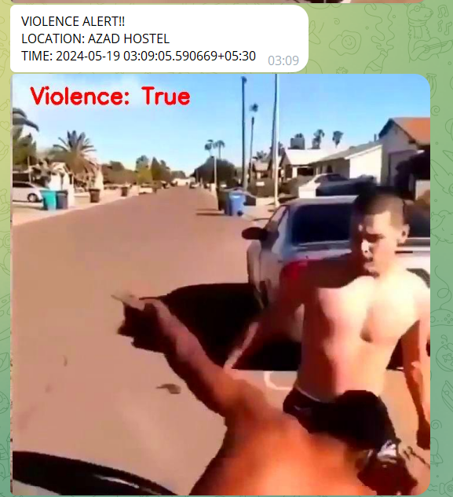
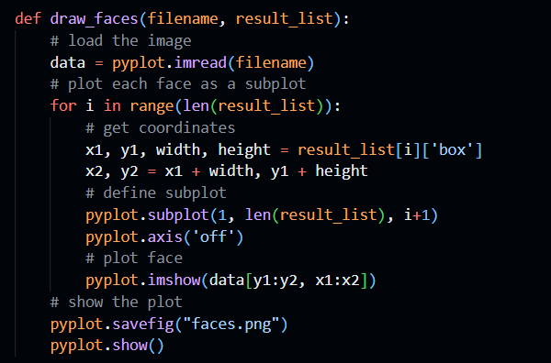
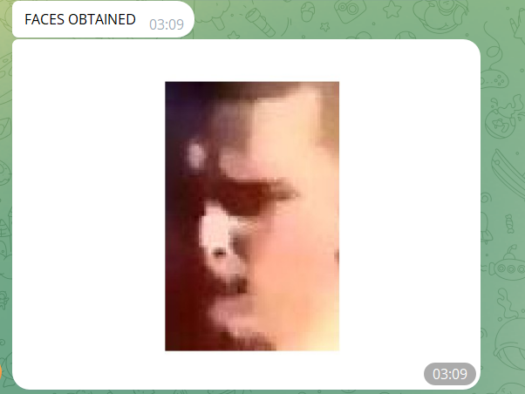
Implementation (cont…)
3) Phase 3: Image Enhancement and Face Detection
Figure. 8 : Image Enhancement and Face Detection Code
Figure. 9 : Image Enhancement and Face Detection Output

Slide 13
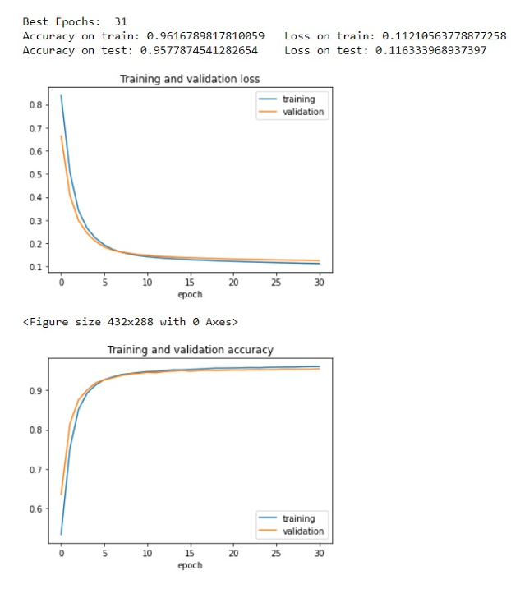
Experimental Results and Evaluation
Figure. 10 : Accuracy and Error of the training set

Slide 14
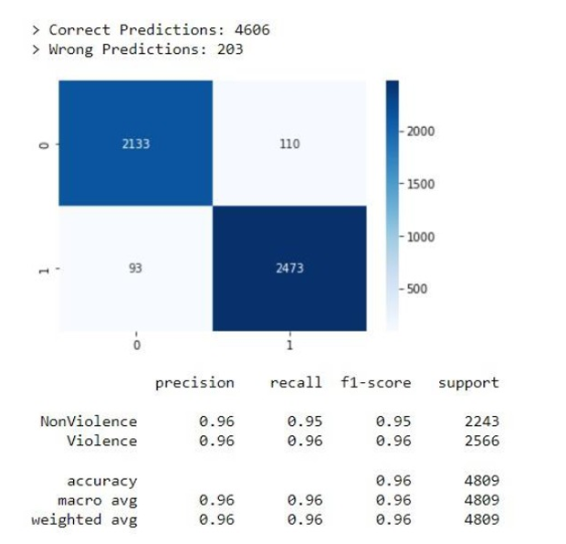
Experimental Results and Evaluation (cont…)
Figure. 11 : Confusion matrix of the trained model

Slide 15
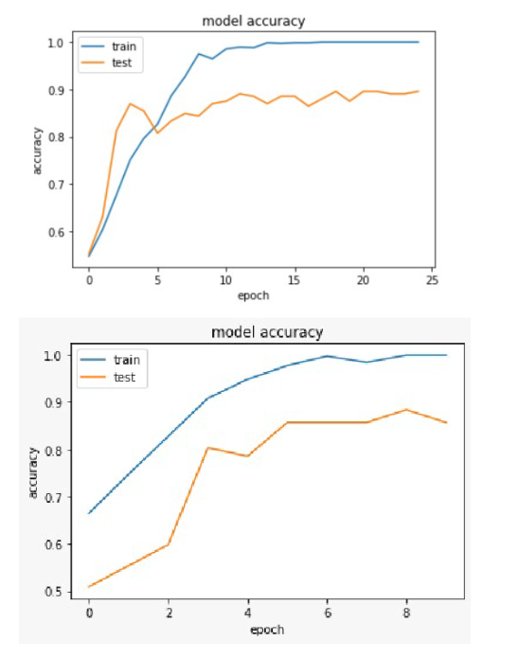
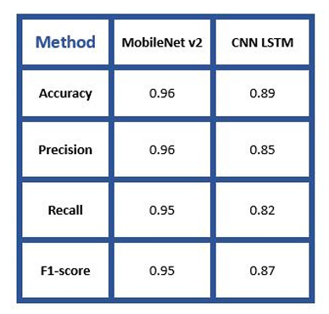
Experimental Results and Evaluation (cont…)
Figure. 12 : Comparison of Training and Testing accuracy of MobileNet v2 and CNN- LSTM Models

Slide 16
Key Learnings
Advanced Deep Learning Techniques:
Mastered ensemble modeling with CNN-LSTM architectures.
Applied transfer learning for specialized violence detection.
Optimized model hyperparameters for real-world performance.
Real-Time System Development:
Implemented efficient video processing for edge devices.
Designed low-latency alert systems with geolocation features.
Utilized parallel processing for improved throughput.
Performance & Deployment:
Applied model quantization to reduce inference time.
Developed solutions for variable environmental conditions.
Implemented security protocols for sensitive alert data

Slide 17
Work Plan (till End-Term Evaluation)
System Enhancement:
Implement multi-camera support with synchronized processing.
Develop severity classification (low, medium, high) for prioritized alerts.
Integrate audio analysis for enhanced detection accuracy.
Web Interface Development:
Create responsive dashboard for real-time monitoring.
Build incident management system with event logging.
Implement user authentication and role-based access.
Edge Deployment:
Optimize model for Raspberry Pi with TensorFlow Lite.
Set up distributed processing for multiple surveillance points.
Implement power management for extended operation.

Slide 18
Work Contribution and Attendance
GitHub Repository URL:
Team Member | Roll No. | Work Done (provide complete details) | Work Contribution (%) | Lines of Code (LoC) | Lab Attendance (%)
1. | 211193 | Deep learning model architecture design. MobileNet v2 training and optimization. Alert system integration with Telegram. Project coordination and documentation. | 35% |  | -
2. | 211106 | Face detection pipeline implementation Image enhancement algorithms. Database integration for incident storage. Performance optimization and testing | 35% |  | -
3. | 211194 | Dataset preparation and preprocessing. Video frame extraction algorithms. User interface design for monitoring. System integration and testing | 30% |  | 80%

Slide 19
Supervisor Interactions (as mentioned in weekly log)
No. of Meetings with Supervisor: 7
Week No. | Duration | Remarks (as mentioned in the weekly log) | Incorporated (Yes/No)
1. | 13/01/2025 - 18/01/2025 | Discussed violence detection algorithms and MobileNetv2 implementation. The supervisor suggested exploring additional datasets for improved model robustness. | Yes
2. | 20/01/2025 - 25/01/2025 | Reviewed initial model training results. Supervisor recommended implementing data augmentation techniques to improve model generalization across different lighting conditions. | Yes
3. | 27/01/2025 - 01/02/2025 | Analyzed early results from violence detection module. Supervisor advised optimizing threshold parameters to reduce false positives in crowded environments. | Yes
4. | 03/02/2025 - 08/02/2025 | Evaluated Telegram alert system implementation. Supervisor proposed adding location mapping and timestamping for better incident documentation. | Yes
5. | 10/02/2025 - 15/02/2025 | Demonstrated face detection and enhancement pipeline. Supervisor recommended addressing privacy concerns through selective face blurring for non-involved parties. | Yes

Slide 20
Supervisor Interactions (cont…)
Week No. | Duration | Remarks (as mentioned in the weekly log) | Incorporated (Yes/No)
6. | 24/02/2025 - 01/03/2025 | Presented system integration progress. Supervisor suggested implementing multithreading for improved processing efficiency on the Raspberry Pi. | Yes
7. | 03/03/2025 - 08/03/2025 | Discussed final implementation strategy and deployment considerations. Supervisor advised on creating comprehensive testing scenarios for system validation. | Yes
8.
9.
10.

Slide 21
References
Traoré, Abdarahmane, and Moulay A. Akhloufi. "Violence detection in videos using deep recurrent and convolutional neural networks." In 2020 IEEE international conference on systems, man, and cybernetics (SMC), pp. 154-159. IEEE, 2020.​
Kang, Min-Seok, Rae-Hong Park, and Hyung-Min Park. "Efficient spatio-temporal modeling methods for real-time violence recognition." IEEE Access 9 (2021): 76270-76285.​
Jebur, Sabah Abdulazeez, Khalid A. Hussein, Haider Kadhim Hoomod, and Laith Alzubaidi. "Novel deep feature fusion framework for multi-scenario violence detection." Computers 12, no. 9 (2023): 175.​
Mumtaz, Nadia, Naveed Ejaz, Shabana Habib, Syed Muhammad Mohsin, Prayag Tiwari, Shahab S. Band, and Neeraj Kumar. "An overview of violence detection techniques: current challenges and future directions." Artificial intelligence review 56, no. 5 (2023): 4641-4666.​
Peixoto, Bruno, Bahram Lavi, Paolo Bestagini, Zanoni Dias, and Anderson Rocha. "Multimodal violence detection in videos." In ICASSP 2020-2020 IEEE International Conference on Acoustics, Speech and Signal Processing (ICASSP), pp. 2957-2961. IEEE, 2020.​
Ye, Liang, Susu Yan, Jialing Zhen, Tian Han, Hany Ferdinando, Tapio Seppänen, and Esko Alasaarela. "Physical violence detection based on distributed surveillance cameras." Mobile Networks and Applications 27, no. 4 (2022): 1688-1699..​
Hussain, Tariq, Arshad Iqbal, Bailin Yang, and Altaf Hussain. "Real time violence detection in surveillance videos using Convolutional Neural Networks." Multimedia Tools and Applications 81, no. 26 (2022): 38151-38173.​
Patel, Mann. "Real-time violence detection using CNN-LSTM." arXiv preprint arXiv:2107.07578 (2021)..​

Slide 22
References (cont…)
Sernani, Paolo, Nicola Falcionelli, Selene Tomassini, Paolo Contardo, and Aldo Franco Dragoni. "Deep learning for automatic violence detection: Tests on the AIRTLab dataset." IEEE Access 9 (2021): 160580-160595.16. ​
Mohtavipour, Seyed Mehdi, Mahmoud Saeidi, and Abouzar Arabsorkhi. "A multi-stream CNN for deep violence detection in video sequences using handcrafted features." The Visual Computer 38, no. 6 (2022): 2057-2072.​
Moaaz, Mostafa Mohamed, and Ensaf Hussein Mohamed. "Violence detection in surveillance videos using deep learning." النشرة المعلوماتية في الحاسبات والمعلومات 2, no. 2 (2020): 1-6.​
Sumon, Shakil Ahmed, Raihan Goni, Niyaz Bin Hashem, Tanzil Shahria, and Rashedur M. Rahman. "Violence detection by pretrained modules with different deep learning approaches." Vietnam Journal of Computer Science 7, no. 01 (2020): 19-40.​
Li, Hongchang, Jing Wang, Jianjun Han, Jinmin Zhang, Yushan Yang, and Yue Zhao. "A novel multi-stream method for violent interaction detection using deep learning." Measurement and Control 53, no. 5-6 (2020): 796-806.​
Ullah, Fath U. Min, Amin Ullah, Khan Muhammad, Ijaz Ul Haq, and Sung Wook Baik. "Violence detection using spatiotemporal features with 3D convolutional neural network." Sensors 19, no. 11 (2019): 2472.​
Li, Ji, Xinghao Jiang, Tanfeng Sun, and Ke Xu. "Efficient violence detection using 3d convolutional neural networks." In 2019 16th IEEE International Conference on Advanced Video and Signal Based Surveillance (AVSS), pp. 1-8. IEEE, 2019.​
​Khan, Samee Ullah, Ijaz Ul Haq, Seungmin Rho, Sung Wook Baik, and Mi Young Lee. "Cover the violence: A novel Deep-Learning-Based approach towards violence-detection in movies." Applied Sciences 9, no. 22 (2019): 4963.​

Slide 23
References (cont…)
Baba, Marius, Vasile Gui, Cosmin Cernazanu, and Dan Pescaru. "A sensor network approach for violence detection in smart cities using deep learning." Sensors 19, no. 7 (2019): 1676..​
Zhou, Peipei, Qinghai Ding, Haibo Luo, and Xinglin Hou. "Violence detection in surveillance video using low-level features." PLoS one 13, no. 10 (2018): e0203668.​
Mumtaz, Aqib, Allah Bux Sargano, and Zulfiqar Habib. "Violence detection in surveillance videos with deep network using transfer learning." In 2018 2nd European conference on electrical engineering and computer science (EECS), pp. 558-563. IEEE, 2018.​
Laptev, Ivan. "On space-time interest points." International journal of computer vision 64 (2005): 107-123.​

Slide 24
Thanks.

