Slide 1



TEAM : ENIGMA
Event: IBM Bank of Baroda AI Innovation Hackathon 2026
HarborAI
Problem Statement: L1
Intelligent Port Operations Optimizer
www.reallygreatsite.com

Slide 2


What is HarborAI?
The Concept
A modular, backend-driven platform designed to optimize port operations and predict container congestion.
Problem Solved
Prevents bottlenecks and delays at maritime ports by forecasting congestion before it happens and recommending optimal resource allocations.
Key Differentiator
Operates entirely on a custom Synthetic Data Platform. It uses a deterministic simulation engine to generate realistic vessel telemetry, port data, and operational metrics instead of relying on external live AIS tracking.

Slide 3

1. Simulation
(The "What is happening?" layer):
2.ML Prediction
(The "What will happen?" layer):
A Python-based deterministic engine that tracks and simulates real-time port activities (vessels, berths, cranes).
Powered by XGBoost, it predicts port congestion risk 6 hours into the future based on current simulation telemetry.
A Four-Pillar Architecture
HarborAI is built on four distinct intelligent layers
3.Optimization
(The "How to fix it?" layer):
4.AI Copilot
(The "Explain it to me" layer):
(Upcoming Phase 5) Utilizes Google OR-Tools to recommend the optimal allocation of berths and cranes.
(Upcoming Phase 9) Integrates IBM watsonx to provide natural language explanations of decisions to port operators.

Slide 4
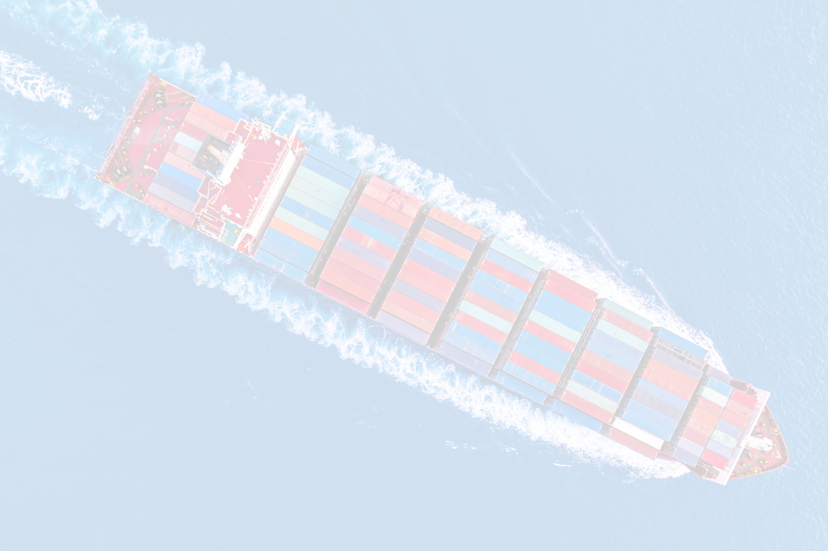
Technology
Stack
Modern, Scalable, and Robust
Backend API
Machine Learning
  Python 3.11+
  FastAPI (High performance, async REST API)
  Pydantic v2 (Data validation)
  XGBoost (Classification)
  scikit-learn
  pandas
  NumPy
Database:
Frontend
  PostgreSQL 16 (Relational storage)
  SQLAlchemy (ORM)
  Alembic (Migrations)
  Next.js 14
  TypeScript
  Tailwind CSS (Modern, responsive UI).
Infrastructure & Deployment
  Docker & Docker Compose for seamless one-click local setup.

Slide 5


Generating Realistic Scenarios
Since live port data is highly restricted, HarborAI generates its own training data.
Scenarios Generated:
  Normal Operations: Standard day-to-day port activities.
  Congestion Stress: High traffic, delays, and resource shortages.
  Demo: Tailored data for presentation purposes.
Features:
  Generates detailed operational history (features) and congestion history (targets) encompassing vessel counts, crane utilization, weather impacts, and tide heights.

Slide 6
Forecasting Congestion
with High Accuracy
Algorithm:
  XGBoost Classifier
Target:
  Predict if congestion will occur in the next 6 hours (Binary Classification).
Performance Metrics:
  Accuracy: 99.9%
  F1 Score: 0.996
  AUC-ROC: 1.000
Training Data:
  Over 6,000 synthetic operational snapshots.
API Integration:
  Exposes a `/api/prediction/congestion` endpoint that accepts 23 real-time port features (like yard utilization, weather, scheduled arrivals) and returns a congestion probability and risk level.

Slide 7
A Fully API-Driven Platform
INTERACTIVE DOCUMENTATION:
OUT-OF-THE-BOX SWAGGER UI (VIA FASTAPI) FOR TESTING AND INTEGRATION.
SIMULATION ENDPOINTS:
CONTROL THE PORT SIMULATION CLOCK (`/SIMULATION/START`, `/SIMULATION/ADVANCE`)
CORE ENDPOINTS:
MANAGE VESSELS, BERTHS, CRANES, AND PORT STATUS (`/API/VESSELS`, `/API/BERTHS`, ETC.)
SIMULATION ENDPOINTS:
CONTROL THE PORT SIMULATION CLOCK (`/SIMULATION/START`, `/SIMULATION/ADVANCE`)

Slide 8


Current Progress
& Next Steps
Completed Phases (0-4):
Pending Phases (5-11):
  Project foundation and Docker environment.
  Domain modeling and PostgreSQL database setup.
  Deterministic Port Simulation Engine.
  Synthetic dataset pipeline (3 core scenarios).
  XGBoost congestion prediction model (Highly accurate).
  Google OR-Tools optimization engine (Berth/Crane allocation).
  Digital Twin visualization & Frontend Planner UI.
  IBM watsonx AI Copilot integration for operator assistance.

Slide 9
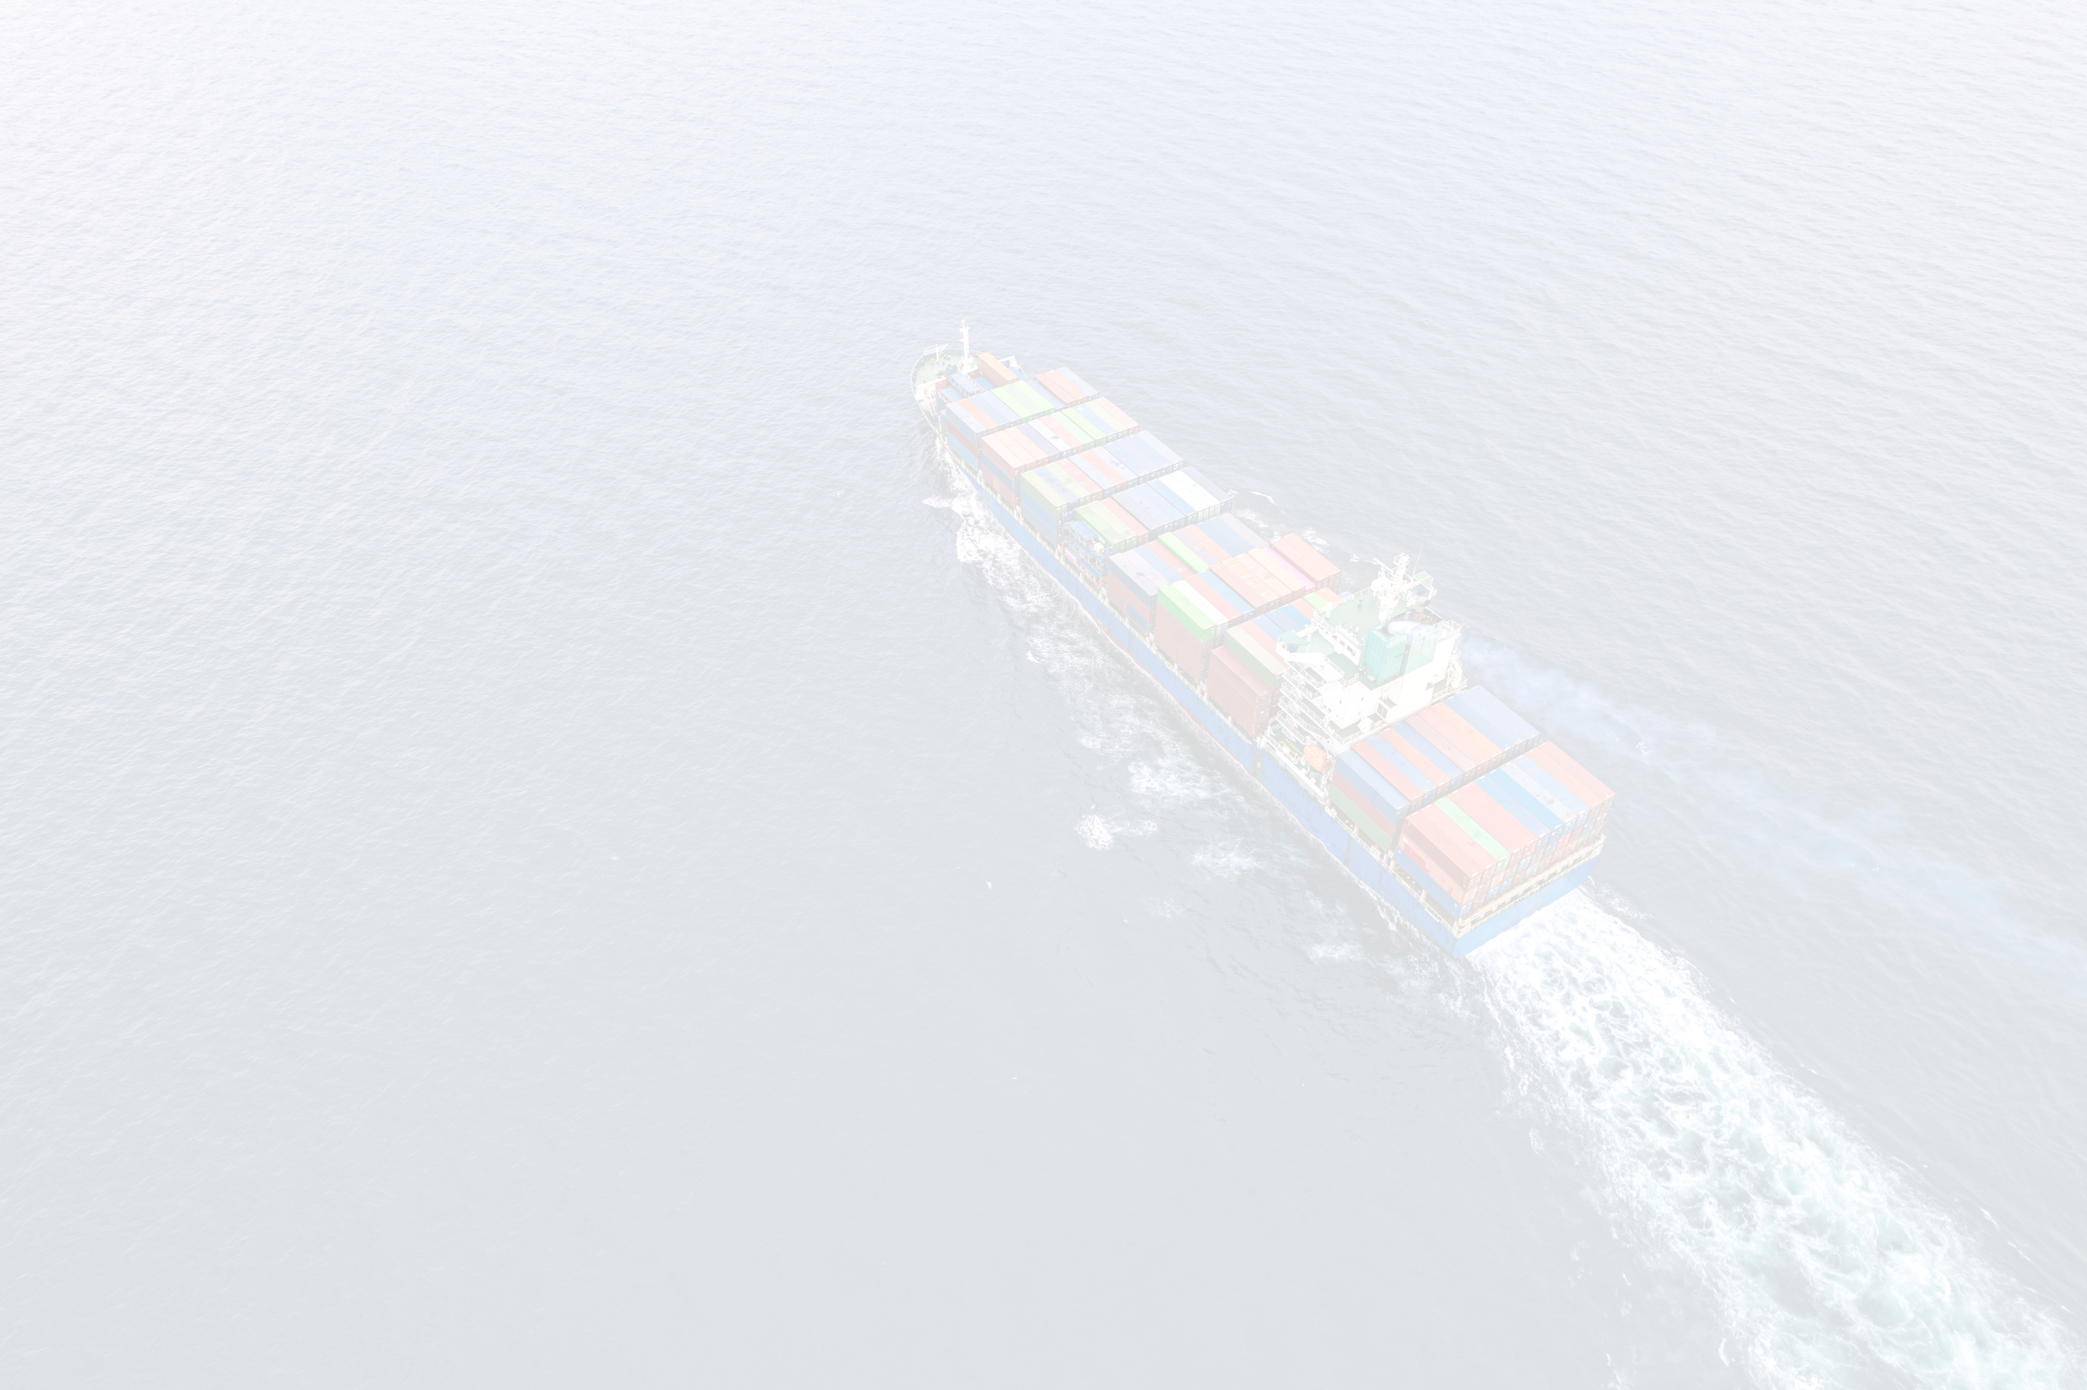
Transforming Port Operations
Proactive over Reactive:
Cost Efficiency:
  Shifts port management from reacting to traffic jams to proactively predicting and preventing them.
  Optimizing crane and berth usage reduces vessel waiting times, saving millions in fuel and demurrage costs.
Proactive over Reactive:
  The simulated data approach means the platform can be customized for any port in the world without exposing sensitive operational data during development.

