Slide 1
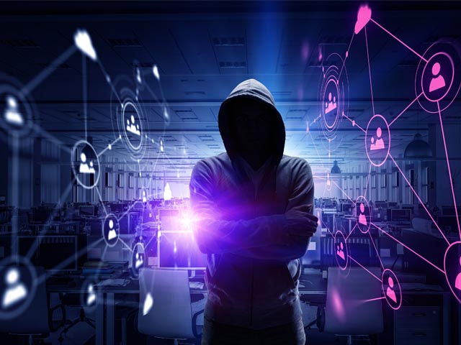
cyber securitY
A Brief Overview

Slide 2
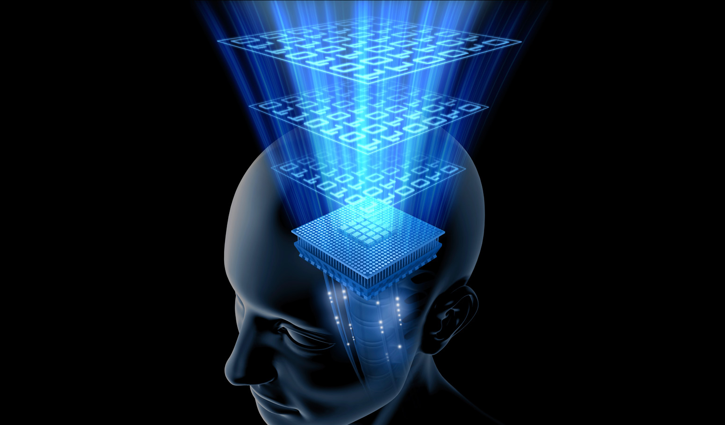
Content at a glance
Cybersecurity
Cyber space
Trojan Horse Attack
Threats
Spamming Attacks
Security – need , meaning & dilemma
Components of an Information System
Access vs. Security
Encryption
Biometric devices

Slide 3
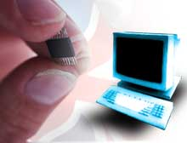
CYBER SECURITY
Cyber security refers to a set of techniques used to protect the integrity of networks, programs and data from attack , damage or unauthorized access.

Slide 4
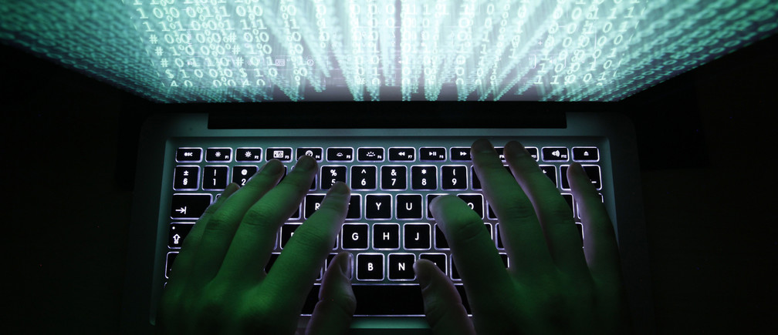
What is Cyberspace ?
Cyberspace is a worldwide network of computers and the equipment that connects them, which by its very design is free and open to the public (the Internet)

Slide 5
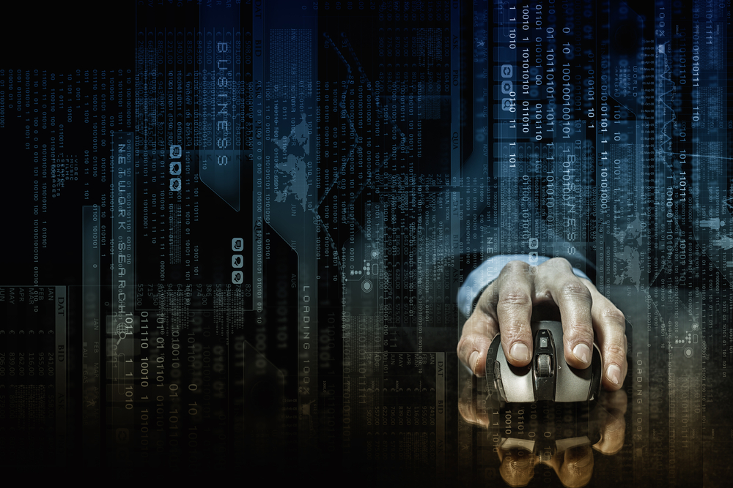
Cyberspace as a Battleground?
Each day, there is an increase in the number of threats against our nation's critical infrastructures.
These threats come in the form of computer intrusion (hacking), denial of service attacks, and virus deployment. Because of this problem, the National Infrastructure Protection Center (NIPC)was created.
Located in the BFI’s headquarters building in Washington, D.C., the NIPC brings together representatives from U.S. government agencies, state and local governments, and the private sector in partnership to protect our nation's critical infrastructures.

Slide 6
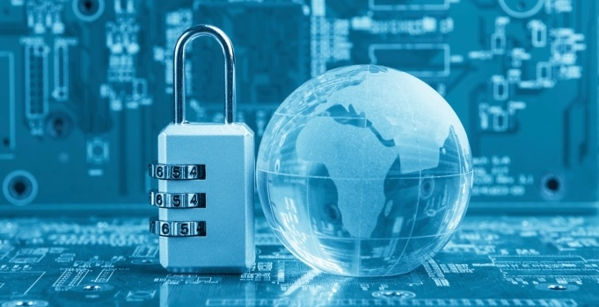
Trojan Horse Attack
Trojan Horse is activated when the software or attachment is executed.
Trojan Horse releases virus, monitors computer activity, installs backdoor, or transmits information to hacker.
Trojan Horse arrives via email or software like free games.

Slide 7
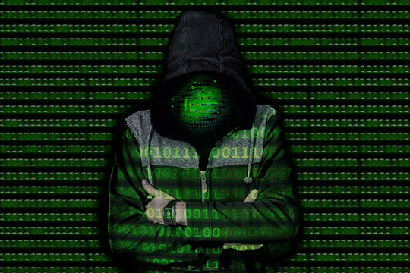
What are the Threats?
These threats come in the form of:
Computer Intrusion (hacking-passive or active)
Denial of service attacks (DOS)
Virus & Worms deployment

Slide 8
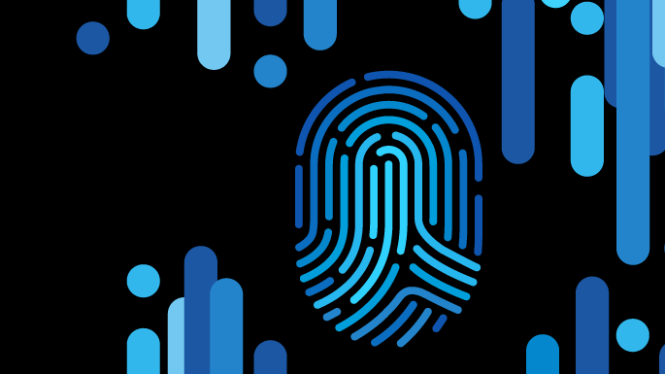
Denial of Service Attacks
In a denial of service attack, a hacker compromises a system and uses that system to attack the target computer, flooding it with more requests for services than the target can handle. In a distributed denial of service attack, hundreds of computers (known as a zombies) are compromised, loaded with DOS attack software and then remotely activated by the hacker.

Slide 9
Spamming Attacks
Sending out e-mail messages in bulk. It’s electronic “junk mail.”
Spamming can leave the information system vulnerable to overload.
Less destructive, used extensively for e-marketing purposes.

Slide 10
What Does it Mean- “Security”?
“Security” is the quality or state of being secure--to be free from danger. But what are the types of security we have to be concern with?
Physical security - addresses the issues necessary to protect the physical items, objects or areas of an organization from unauthorized access and misuse.
Personal security - addresses the protection of the individual or group of individuals who are authorized to access the organization and its operations.
Operations security- protection of the details of a particular operation or series of activities.

Slide 11
What Does it Mean- “Security”?
Communications security - concerned with the protection of an organization’s communications media, technology, and content.
Network security is the protection of networking components, connections, and contents.
Information Security – protection of information and its critical elements, including the systems and hardware that use, store, or transmit that information.

Slide 12
The Need for Security
Industry Need for Information Security
An organization needs information security for four important reasons:
1. To protect the organization’s ability to function,
2. To enable the safe operation of applications implemented on the organization’s IT systems,
3. To protect the data the organization collects and uses, and
4. To safeguard the technology assets in use at the organization.

Slide 13
Shoulder surfing takes many forms.
Some may not be obvious.

Slide 14
C.I.A. TRIANGLE
Confidentiality
INFORMATION
Integrity Availability

Slide 15
The Dilemma of Security
The problem that we cannot get away from in computer security is that we can only have good security if everyone understands what security means, and agrees with the need for security.
Security is a social problem, because it has no meaning until a person defines what it means to them.
The harsh reality is the following: In practice, most users have little or no understanding of security. This is our biggest security hole.

Slide 16
Meaning of Security Lies in Trust
Every security problem has this question it needs to answer first: Whom or what do we trust?
On our daily lives, we placed some sort of technology between us and the “things” we don’t trust. For example lock the car, set the house alarm, give Credit Card number only to the cashier, etc.
So we decided to trust somebody/something to have some sort of security (trust the lock, trust the police, trust the cashier).
We have to have the same scenario for computer & network systems we use today.

Slide 17
Components of an
Information System
People are the biggest threat to information security!!! (WHY? – Because WE are the weakest link)
Social Engineering . It is a system that manipulates the actions of people in order to obtain information about a system in order to obtain access.
Procedures are written blueprints for accomplishing a specific task; step-by-step descriptions.
The obtainment of the procedures by an unauthorized user would constitute a threat to the integrity of the information.

Slide 18
Figure 5
Hardware
Software
People
Procedures
Data
Components of an Information System

Slide 19
Internet
Computer as Subject of Crime
Computer as Object of Crime
Remote System
Hacker

Slide 20
Access vs. Security
When considering security it is important to realize that it is impossible to obtain perfect security. Security is not an absolute. Instead security should be considered a balance between protection and availability.
It is possible to have unrestricted access to a system, so that the system is available to anyone, anywhere, anytime, through any means. However, this kind of random access poses a danger to the integrity of information.
On the other hand complete security of an information system would not allow anyone access at any given time.

Slide 21
Security Access
Balancing Security and Access- Too much security might make access hard to get and people will stop using the system. On the other hand, a too easy access protocol, might be a security hole for the network. A balance must be achieved between those two major “players”

Slide 22
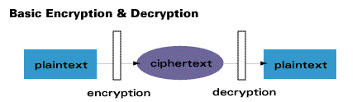

What is Encryption ?
Encryption is the process of converting messages, information, or data into a form unreadable by anyone except the intended recipient. As shown in the figure below, Encrypted data must be deciphered, or decrypted, before it can be read by the recipient.
The root of the word encryption—crypt—comes from the Greek word kryptos, meaning hidden or secret.

Slide 23
Modern Encryption Algorithms
Private Key Encryption
Public Key Encryption
Quantum Cryptography

Slide 24
Private Key Algorithms
Private key encryption algorithms use a single key for both encryption and decryption. In order to communicate using this class of ciphers, the key must be known to both sender and receiver of the message.

Slide 25
Public Key Algorithms
Public key methods require two unique keys per user; one called the public key, and the other called the private key.
The private key is mathematically linked to the public key. While public keys are published, private keys are never exchanged and always kept secret.

Slide 26
Quantum Cryptography
Method of secure key exchange over an insecure channel based on the nature of photons
Polarized photons are transmitted between sender and receiver to create a random string of numbers, the quantum cryptographic key
Perfect encryption for the 21st century
Experimental stages
Very secure

Slide 27
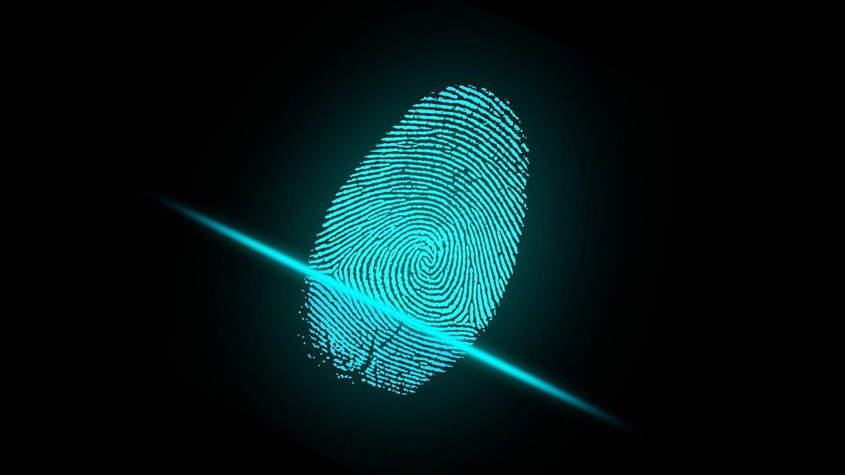
Biometric devices
A biometric device is a security identification and authentication device. Such devices use automated methods of verifying or recognizing the identity of a living person based on a physiological or behavioral characteristic.

Slide 28
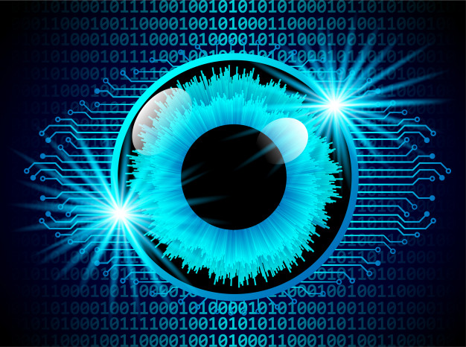
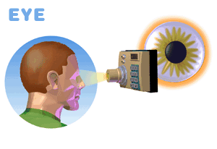
Biometrics Devices
The iris of your eye is the colored part that surrounds your black pupil, the black part. Every iris is different. If a scan of a user’s iris matches the one in the security system’s memory, access is allowed.

Slide 29
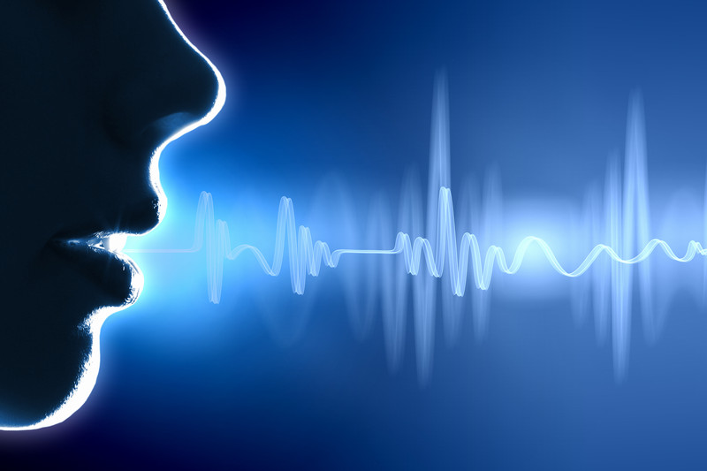
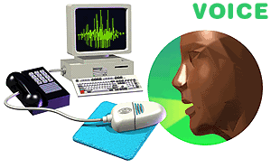
Biometrics Devices
Another trait unique to every individual is his or her voice. The user speaks a specified word or sentence to gain access to a secured computer. Distinct patterns, tones, and other qualities in the voice must match the authorized user’s voice in the computer’s security system.

Slide 30
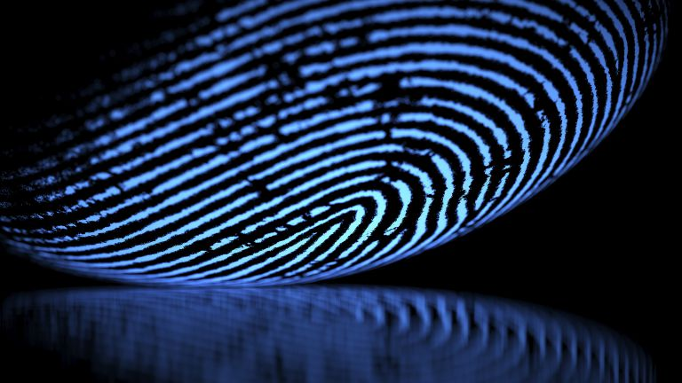
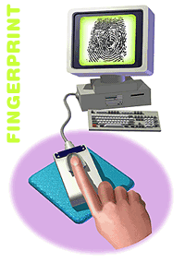
Biometrics Devices
Another biometric option is the fingerprint and its unique identifying characteristics. Placed on a special reading pad, a designated finger’s print is recognized by a computer. A similar biometric device scans a person’s whole hand

Slide 31
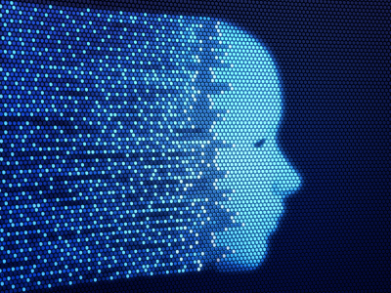
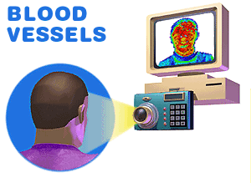
Biometrics Devices
The blood vessels in a person’s face radiate heat. The patterns of those vessels, and the heat scan, are completely individual and could be recognized and required for computer access.

Slide 32


