Slide 1
Pramaan
Prove your edge before you deploy a rupee.
An event-driven backtesting engine and overfitting
diagnostic platform for Indian equities
Aayush Avinash Bankar (246230316006) · Meet Jayeshbhai Patel (246230316133)
GTU Diploma Engineering, Semester 5 · DI05000341 Minor Project · 2026
Reproducible from 30 real runs on 10 NSE symbols · 2019-01-01..2024-12-31

Slide 2
Backtests Lie. Three Specific Lies.
2
Hidden costs
STT, stamp duty, GST, NSE and SEBI turnover are
omitted — gross return is reported as net.
Hidden slippage
Orders are filled at the close price as if a
sized order had no market impact.
Hidden overfitting
One parameter set chosen from many; the Sharpe
ratio is inflated by selection.
Pramaan was built to remove all three — structurally, not by configuration.
A profitable backtest is not evidence of a profitable strategy.
We measure whether a strategy survives reality — before a rupee is deployed.
GTU DI05000341 · Pramaan

Slide 3
Architecture: An Engine That Cannot Cheat
3
Presentation Next.js UI · Streamlit fallback · CLI
API FastAPI REST · documented request contract
Analytics Metrics · Deflated Sharpe · CPCV + embargo
Engine ← the contribution BacktestEngine · Portfolio · Position · IndianCostModel
Strategy + Data SMA · RSI · Momentum · BuyAndHold · fetch → clean → universe
The engine has no dependency on the UI — it runs headlessly with no web framework present. It is never rewritten; bugs are fixed with regression tests.
GTU DI05000341 · Pramaan

Slide 4
Methodology: Remove Every Excuse
4
1 · Zero look-ahead, by construction
2 · The full Indian statutory stack
▪ Signal generated at day t close
▪ Order queued, filled at day t+1 open
▪ Limit orders: pessimistic trade-through only
▪ Future data cannot enter a signal
▪ STT 0.10% on both legs
▪ Stamp duty 0.015% — buy leg only
▪ NSE turnover 0.00297% + SEBI 0.0001%
▪ GST 18% on brokerage + turnover
▪ Almgren–Chriss √-law impact on size
3 · Overfitting is measured, not assumed away
Deflated Sharpe Ratio — the expected maximum Sharpe across N trials, so a fished-for result is penalised
Combinatorial Purged Cross-Validation with embargo, validated against an AR(1) ground truth where the leakage answer is known
GTU DI05000341 · Pramaan

Slide 5
Real Results — 10 NSE Symbols, 2019–2024
5
Strategy | Sharpe | CAGR | Return | Max DD
SMA(20,50) | 0.527 | 11.37% | 88.2% | -14.8%
SMA(10,30) | 0.685 | 13.25% | 107.7% | -14.6%
RSI(14,30,70) | 0.307 | 9.80% | 73.1% | -32.8%
Momentum(20) | 0.186 | 7.43% | 52.4% | -10.3%
Buy-and-hold benchmark | 0.746 | 19.07% | 178.8% | -32.9%
0 of 4 active strategies beat passive ownership.
Best active: sma crossover 10 30 at Sharpe 0.685 — still -0.060 below the benchmark.
Reproducible from experiments/experiment_log.csv · costs enabled · Rs100,000 start · 10% equity sizing
GTU DI05000341 · Pramaan

Slide 6
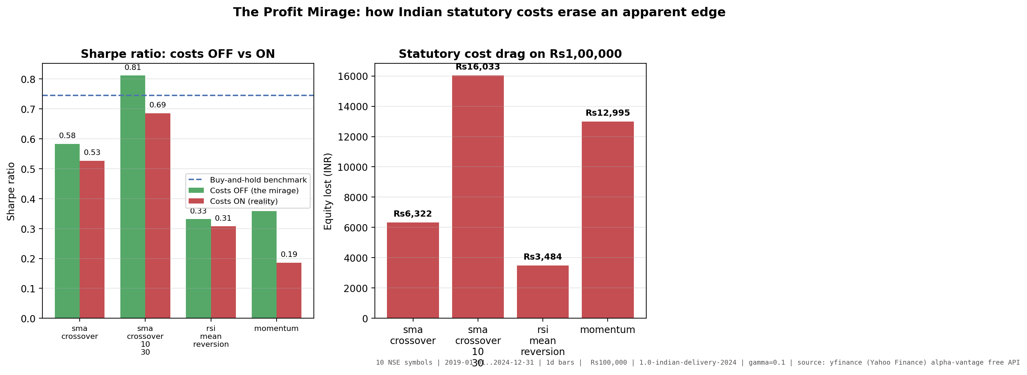
The Profit Mirage — What Costs Actually Cost
6
Momentum(20)
costs OFF → ON
Sharpe 0.359 → 0.186
48.2% of risk-adjusted return removed
Equity Rs165,368
→ Rs152,373
Rs12,995 destroyed
on Rs100,000 of capital
Same strategy. Same data. Same execution clock. Only the statutory stack changes — and it takes almost half the edge.
GTU DI05000341 · Pramaan

Slide 7
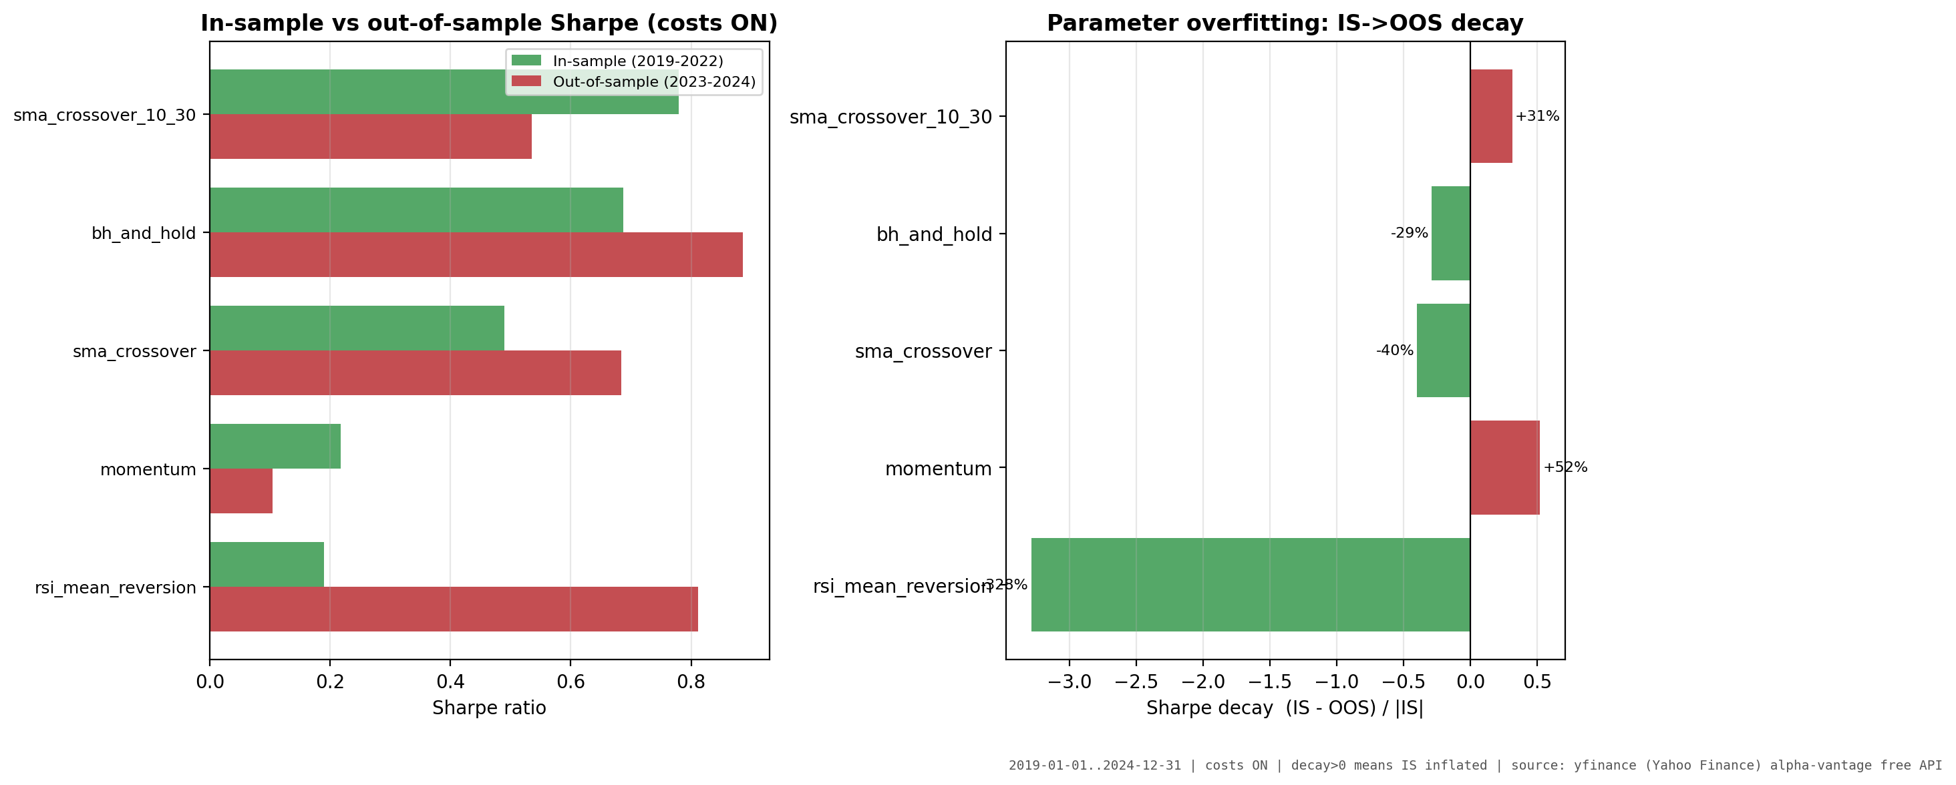
Overfitting: Measured, Not Assumed
7
PBO = 60.0%
95% CI: [44.4%, 73.3%] · 133 configs · 45 paths
probability in-sample winner underperforms OOS
▪ Momentum decays 52% from IS to OOS
▪ SMA(10,30) decays 31%
▪ Embargo validated on AR(1) ground truth — leakage was detected, then removed
Choosing the best in-sample parameter set is a selection filter that loses roughly two times in three. That is not a caveat — it is the product.
GTU DI05000341 · Pramaan

Slide 8
Engineering Rigour
8
72 automated tests
up from 9 at baseline (100% offline via seeded fixtures)
Verification discipline
▪ Every claim carries a verification record — method and evidence path
▪ Positive and negative results are logged with equal weight
▪ Every figure carries a parameter stamp tying it to a run ID
▪ Reproduce everything with clean checkout commands:
python scripts/run_experiments.py
python scripts/generate_real_charts.py
Then: pytest tests/ -q → 72 passed in ~7s
5 defects found by testing
RSI inverted signal, duplicate dates, missing scipy, synthetic charts, cash-based sizing
Determinism enforced
byte-identical equity curve, verified by hash
GTU DI05000341 · Pramaan

Slide 9
What Pramaan Is Not
9
No live trading No broker connection, no order routing, no execution.
No intraday or tick data Daily bars only.
No derivatives or other asset classes NSE cash equities only.
No short selling or leverage Long-only positions.
Not investment advice A simulation and validation tool.
Stating boundaries explicitly is a feature. An evaluator is entitled to them before the demo — not after.
GTU DI05000341 · Pramaan

Slide 10
Conclusion
Under realistic Indian costs over 2019–2024, none of the four classic strategies beat passive ownership on a risk-adjusted basis.
Student Reflections (Syllabus 5.4): Zero-lookahead execution and statutory friction explain why over 90% of retail strategies fail live. An honest tool measures true worth.
48%
of Sharpe removed
by the cost stack
Rs12,995
destroyed on
Rs1,00,000
60%
probability of
backtest overfitting
An honest backtesting tool does not tell you your idea works.
It tells you what your idea is actually worth.
GTU DI05000341 · Pramaan · Aayush Bankar & Meet Patel · Apache 2.0

