Slide 1
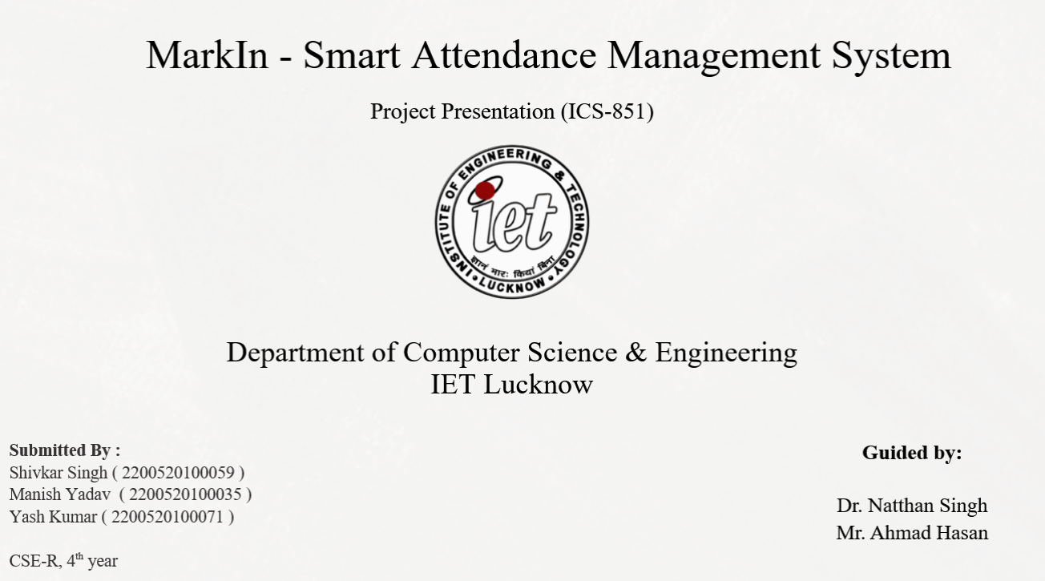
DeforSense: Illegal Deforestation Detection System
Aayush Vishwakarma (2200520100001)
Prof. M H Khan
Abhay Sachan (2200520100003)
Jannu Hans (2200520100031)
Dr. Aditi Sharma

Slide 2
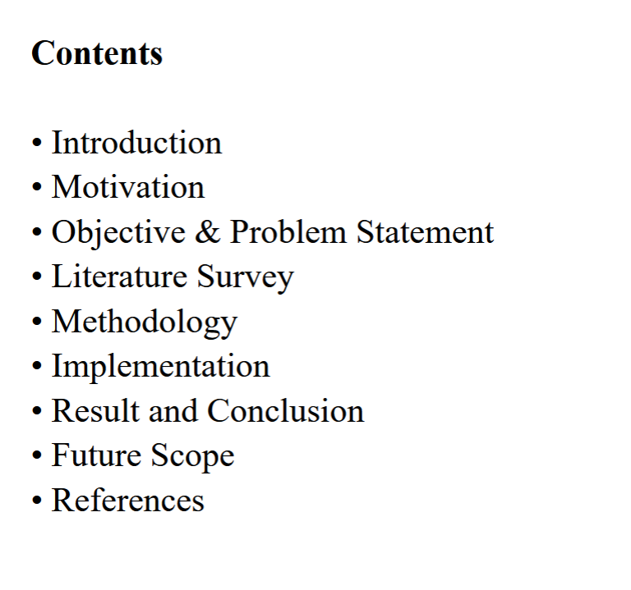

Slide 3
Introduction
Forest monitoring is a critical component of environmental management, used for tracking ecosystem health, biodiversity conservation, and climate change mitigation.
Traditional methods such as ground surveys, manual inspections, and periodic reporting suffer from:
Limited coverage over large or remote areas
High operational cost and time consumption
Delayed detection of deforestation activities
Human errors and subjectivity
Lack of continuous, real-time monitoring
With advancements in satellite technology and geospatial analysis, remote sensing has become a powerful tool for large-scale environmental monitoring.
Vegetation indices like NDVI (Normalized Difference Vegetation Index) enable efficient detection of forest cover and changes over time.
However, basic threshold-based approaches may face challenges such as:
Cloud cover interference
Seasonal vegetation variations
Noise in satellite imagery
Difficulty distinguishing natural vs human-induced changes
This project proposes DeforSense, a Satellite-Based Illegal Deforestation Detection System that integrates:
Satellite imagery processing using Google Earth Engine
NDVI-based vegetation analysis
Temporal change detection techniques

Slide 4
Motivation
Traditional forest monitoring methods are often inefficient and limited in effectiveness, leading to:
Delayed detection of deforestation activities
Heavy reliance on manual surveys and reporting
Incomplete or inaccurate environmental records
Lack of continuous, real-time monitoring
Environmental agencies and organizations require a modern, scalable, and automated solution that ensures timely detection and monitoring of forest changes.
Large forest areas are difficult to supervise consistently, making them vulnerable to:
Illegal logging in remote regions
Gradual land clearing for agriculture or urban expansion
Undetected environmental degradation
Delayed response to critical changes
Motivation:
To develop a reliable, automated, and scalable deforestation monitoring platform that enables early detection of vegetation loss, improves accuracy, and supports effective environmental protection and decision-making.
Environmental agencies and organizations require a modern, scalable, and automated solution that ensures timely detection and monitoring of forest changes.

Slide 5
Objective & Problem Statement
The main objectives of this project are:
Develop an AI-driven system for detecting deforestation using satellite imagery
Implement NDVI-based vegetation analysis for identifying forest cover
Detect temporal changes in vegetation using multi-date satellite data
Identify and flag regions with significant vegetation loss
Provide an interactive platform for visualizing deforestation patterns
Enable automated, scalable, and near real-time monitoring of large forest areas
Maintain a centralized database for storing alerts, regions, and analysis results
Improve accuracy and efficiency in detecting potential illegal deforestation activities
Support future enhancements such as machine learning-based land classification and advanced analytics
Problem Statement:
Existing forest monitoring systems lack a fast, scalable, and automated approach to accurately detect and analyze deforestation. They often fail to provide timely insights, struggle with large-scale coverage, and cannot effectively distinguish significant vegetation loss. There is a need for an intelligent system that can continuously monitor forests, detect changes using satellite data, and provide actionable insights through a modern and user-friendly platform

Slide 6
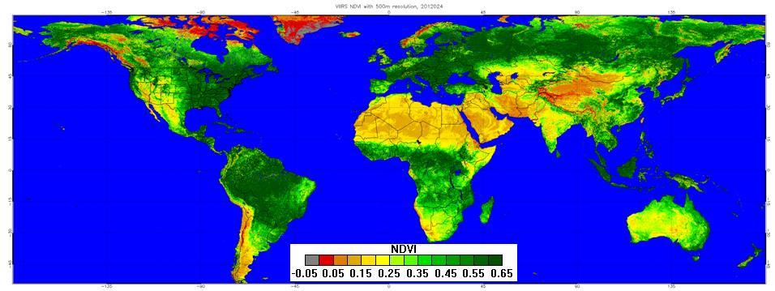
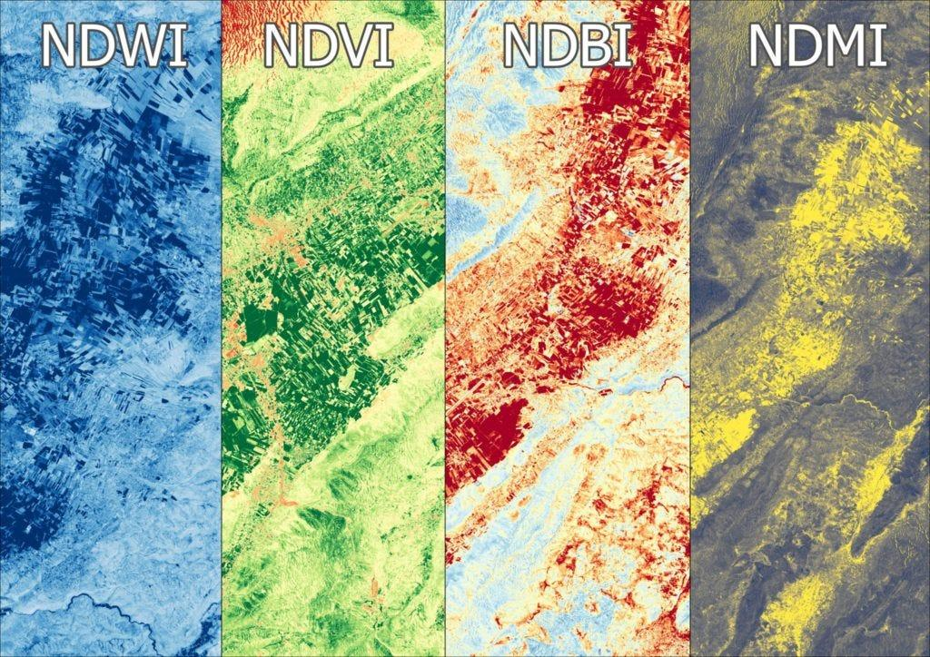
Literature Survey
4.1 NDVI-Based Vegetation Change Detection Using Remote Sensing – Gandhi et al. (2015)
Overview
Gandhi et al. (2015) proposed a vegetation change detection method using the Normalized Difference Vegetation Index (NDVI) derived from multispectral satellite imagery. The study highlights how NDVI can effectively classify land cover into vegetation, water bodies, barren land, and urban regions. The approach is widely used in environmental monitoring due to its simplicity and ability to process large-scale satellite datasets.
Methodology
The authors utilized Landsat satellite images and computed NDVI values using near-infrared (NIR) and red bands. Change detection was performed using NDVI differencing, where vegetation changes are identified by comparing NDVI values across time. Threshold values were applied to classify areas into dense vegetation, sparse vegetation, and non-vegetated regions.
Relevance to Proposed System
This work is directly relevant to the proposed Smart Attendance Management System, where liveness detection is
crucial to prevent spoofing via photos or screen replays. The EAR-based blink detection approach provides a
lightweight, real-time liveness signal that can be integrated into the attendance pipeline. In our project, we adopt
the eye-blink-based liveness concept from this paper, combining it with deep learning face recognition to ensure
that attendance is marked only when a real, live student is present in front of the came

Slide 7
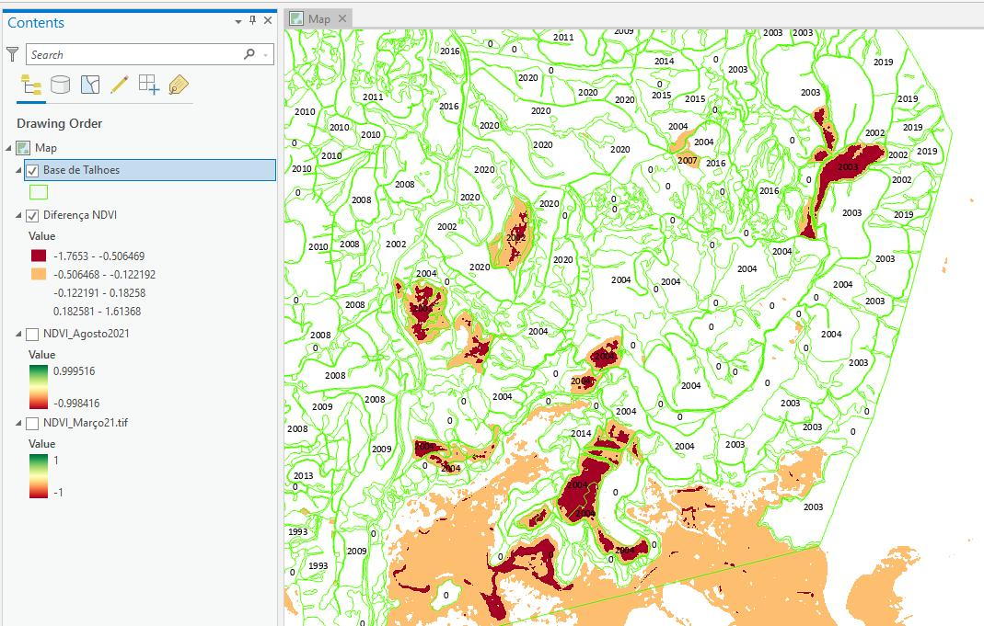
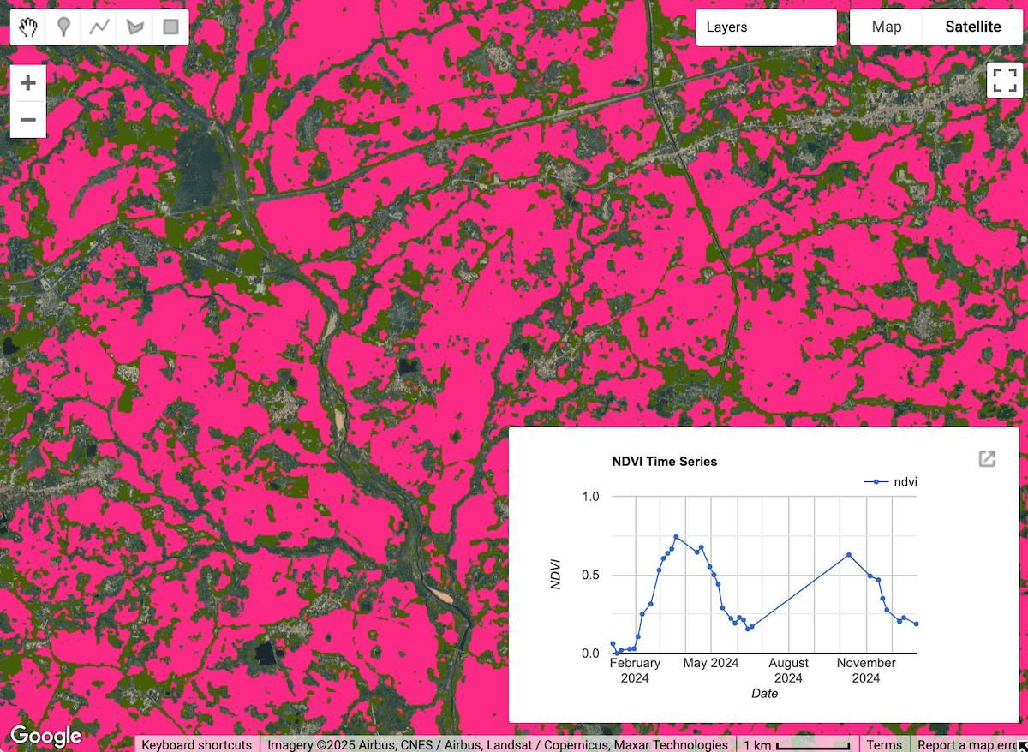
Literature Survey
4.2 Bora et al. (2025 Study)
Overview
This study focuses on spatiotemporal analysis of forest cover changes using NDVI and GIS techniques. It highlights how remote sensing data can be used to monitor vegetation patterns over time and detect human-induced environmental changes such as deforestation. The research emphasizes the importance of combining satellite imagery with geographic information systems for large-scale environmental monitoring.
Methodology
Satellite imagery collected over multiple time periods is processed using NDVI to classify land into different categories such as dense vegetation, sparse vegetation, and non-vegetated areas. The study integrates GIS tools to perform Land Use Land Cover (LULC) classification and temporal comparison. By analyzing NDVI values across different time intervals, the system identifies patterns of vegetation loss and growth
Relevance to Proposed System
This paper directly supports the mapping and visualization module of Deforesense. It validates the use of NDVI combined with spatial analysis for detecting forest changes. While the study focuses on analysis and visualization, this project extends this approach by incorporating real-time monitoring, automated alerts, and an interactive dashboard, making the system more practical and responsive for real-world applications.

Slide 8
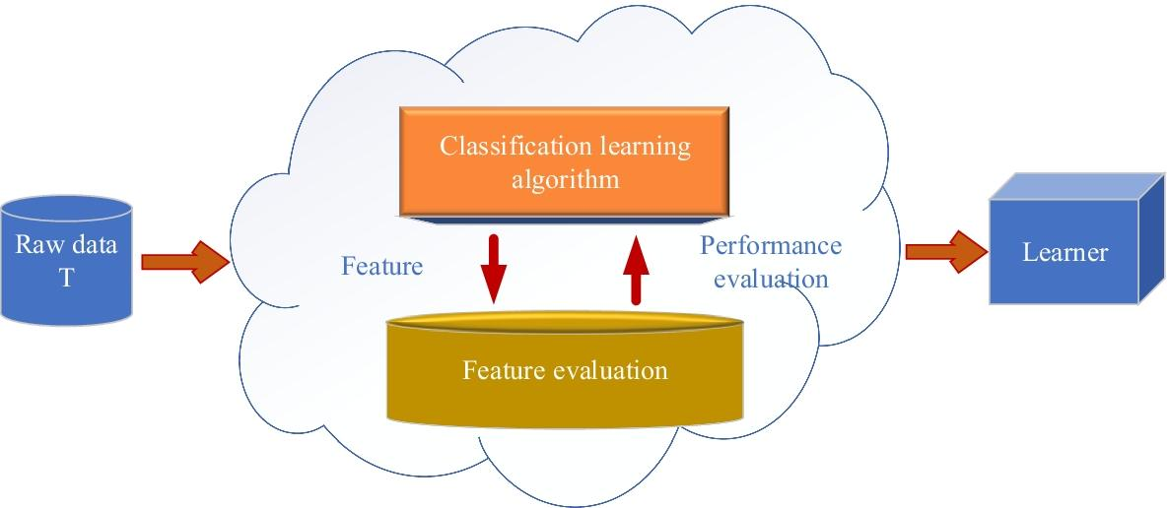
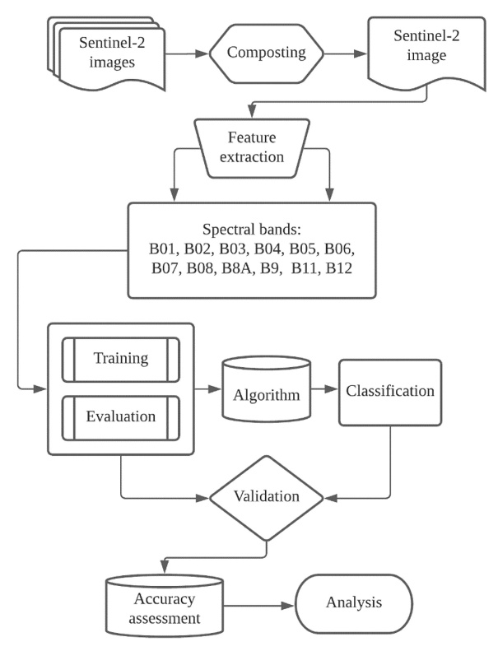
Literature Survey
4.3 Aziz et al. (2024)
Overview
This study explores the use of machine learning algorithms for forest monitoring using remote sensing data. It demonstrates how ML techniques can improve classification accuracy compared to traditional methods by learning patterns from large-scale satellite datasets. The research highlights the importance of automated data-driven models in environmental monitoring systems.
Methodology
The methodology involves extracting features from satellite imagery, including vegetation indices such as NDVI, and using them as input for machine learning models. Algorithms like Random Forest and other classifiers are trained on labeled datasets to distinguish between forest and non-forest areas. The trained models are then used to classify new satellite data and monitor changes over time, improving detection accuracy and reducing errors.
Relevance to Proposed System
This paper supports the machine learning enhancement capability of this project. While the current system relies on NDVI-based threshold detection, integrating machine learning models can significantly improve accuracy, reduce false positives, and enable more intelligent classification of forest changes. It provides a strong foundation for future system upgrades involving AI-based detection mechanisms

Slide 9
Methodology
Existing
Traditional Forest Monitoring Systems
Overview
Traditional deforestation monitoring methods rely on manual inspection, periodic surveys, and basic satellite comparisons. Government agencies and environmental organizations analyze satellite images manually or use simple threshold-based techniques.
These systems are often:
Time-consuming
Not real-time
Prone to human error
Difficult to scale across large forest areas
Limitations of Existing Systems
No automated detection of deforestation
Delayed response to illegal activities
Lack of real-time alerts
Minimal use of advanced AI/ML techniques
Poor visualization and user interaction

Slide 10
Methodology
Proposed Methodology
Deforesense Forest Monitoring Systems
System Workflow
When a user selects a region:
Fetch satellite imagery (T1 and T2)
Apply preprocessing (cloud masking, normalization)
Compute NDVI maps
Perform change detection (ΔNDVI)
Identify vegetation loss regions
Apply clustering & filtering
Flag suspicious areas
Store results and visualize on dashboard

Slide 11
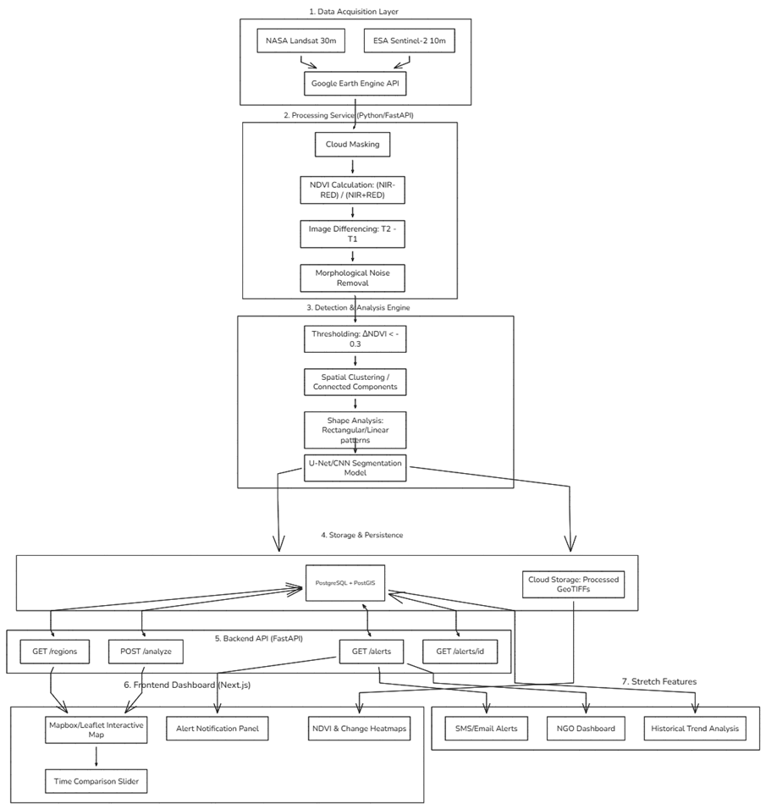

Implementation
1. Data Acquisition
Satellite data is fetched using:
Google Earth Engine
Landsat / Sentinel-2 datasets
Input:
Region (GeoJSON / bounding box)
Time range (T1, T2)
2. Preprocessing
Cloud masking to remove noisy pixels
Image normalization for consistency
Tiling (256×256 patches) for performance
3. Vegetation Analysis (NDVI)
​
Calculates vegetation density using spectral bands
Generates NDVI heatmap
4. Change Detection​
ΔNDVI=NDVIT2​−NDVIT1
​Compares vegetation over time Threshold applied:
ΔNDVI < -0.3 → vegetation loss
7. Storage & API Layer
Database: PostgreSQL + PostGIS
Stores:
Regions
Alerts
Processed images
APIs:
/analyze
/alerts
/regions

Slide 12
Expected Result
Accurate detection of vegetation loss using satellite imagery
Early identification of suspicious deforestation activities
Automated monitoring of large forest regions without manual intervention
Interactive dashboard for visualizing NDVI and change detection
Real-time or periodic alerts for detected forest loss
Centralized geospatial database for storing and tracking deforestation events
Efficient end-to-end pipeline from satellite data to actionable insights
Scalable system capable of handling large geographic areas

Slide 13
Future Scope
• Cloud Deployment
Deploy the system on cloud platforms (AWS / GCP) for large-scale monitoring
Enable real-time processing of multiple regions simultaneously
Improve scalability and accessibility for government and NGOs
• IoT + Edge-Based Monitoring
Deploy lightweight edge devices for local preprocessing in remote areas
Use edge computing to reduce latency and bandwidth usage
Combine satellite data with on-ground sensors for higher accuracy
• Real-Time Monitoring System
Implement automated weekly/daily satellite scans
Detect deforestation events as soon as new imagery is available
Trigger instant alerts for rapid response
• Advanced AI/ML Models
Implement deep learning models (U-Net, CNN) for precise segmentation
Reduce false positives in NDVI-based detection
Enable automatic classification of deforestation causes
• Integration with Government & Environmental Systems
Integrate with forest department databases and GIS systems
Support policy enforcement and environmental compliance tracking
Provide data sharing APIs for NGOs and research organizations
• Multi-Source Data Integration
Combine satellite imagery with:
Weather data
Topographical data
Drone imagery
Improve detection accuracy and contextual analysis

Slide 14
References
[1] G. M. Gandhi, S. Parthiban, N. Thummalu, and A. Christy, “NDVI: Vegetation change detection using remote sensing and GIS,” International Journal of Scientific & Engineering Research, vol. 6, no. 5, pp. 1–6, 2015.
[2] D. L. Torres et al., “Deep learning for deforestation detection in satellite imagery,” Remote Sensing, vol. 13, no. 5, pp. 1–18, 2021.
[3] K. Bora et al., “Spatiotemporal analysis of forest cover change using NDVI and GIS,” Environmental Monitoring Journal, 2025.
[4] A. Heidari et al., “3D convolutional neural networks for forest change detection using multi-temporal satellite imagery,” IEEE Geoscience and Remote Sensing, 2025.
[5] Y. A. Singgalen et al., “Hybrid CNN and NDVI-based land cover change detection,” Remote Sensing Applications, 2025.
[6] M. Aziz et al., “Machine learning approaches for forest monitoring using remote sensing data,” Environmental Data Science, 2024.

