Slide 1
HIVE Analytics on Customer Demographics Data
Prepared By
Aayushi Anand
Divya Anand
Lucy Singh
Gaurav Bishwakarma

Slide 2
PROJECT AGENDA
A company named “Adventure Works” wants to work on the database for its visiting customers and it is trying to analyse the year to date total revenue based on the database of retail sales data called adventure works. For this particular idea, company wants to use only customer, individual and credit card details.
These datasets comprise of bulk and raw data that needs to be transformed and cleaned in order to bring out the data for analytics purpose and getting the insights out of it.

Slide 3
Problem Solving Approach
Data is present in MySQL database.
Load the data from MySQL to HDFS using SQOOP.
Create and load data to HIVE table.
Read data from HIVE in Spark and perform data cleaning.
Load the data again to hive and perform analytics.

Slide 4
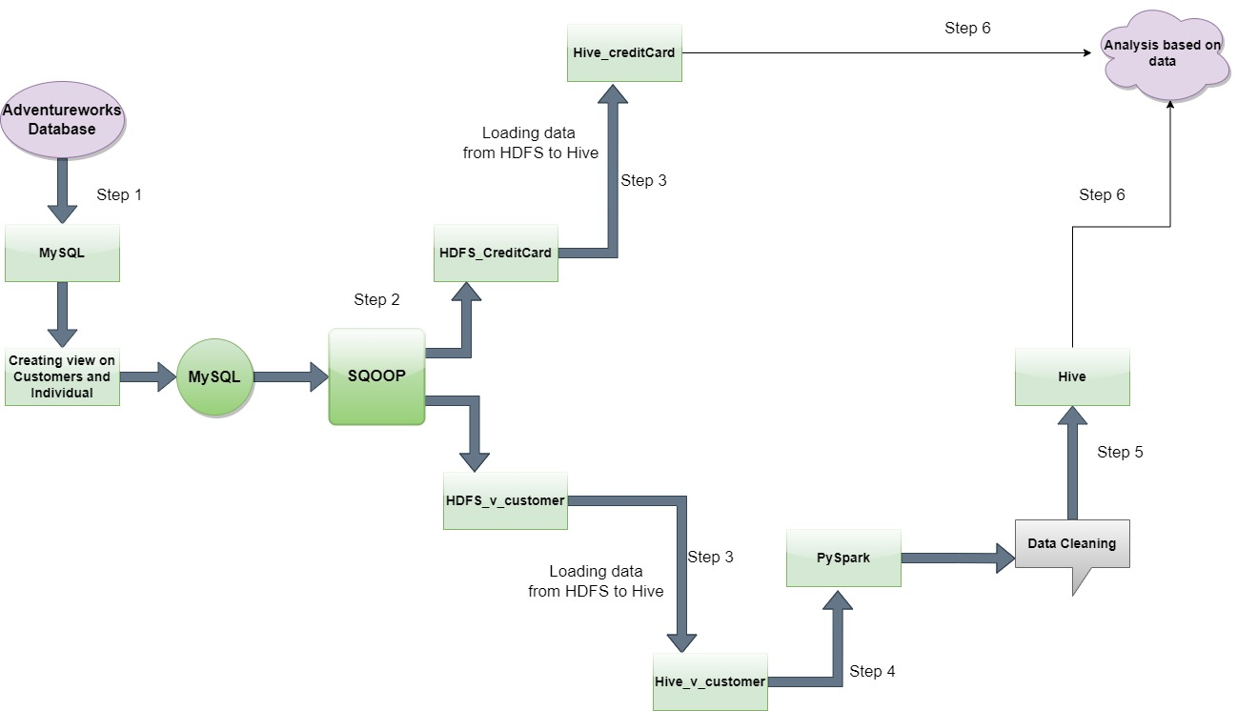
ARCHITECTURE

Slide 5
Road Blocks
There were 69 datasets present in Adventure Works datasets. It took us time to analyze correct datasets which is required for this particular requirement.
Data was not in proper format. So we faced difficulty in data cleansing.

Slide 6
Analysis
Analysis are based on below three requirements:
Total purchase YTD based on Education/Yearly Income.
Total purchase YTD based on Education/Occupation.
Numbers of cars owned based on territory id/ Gender.

Slide 7
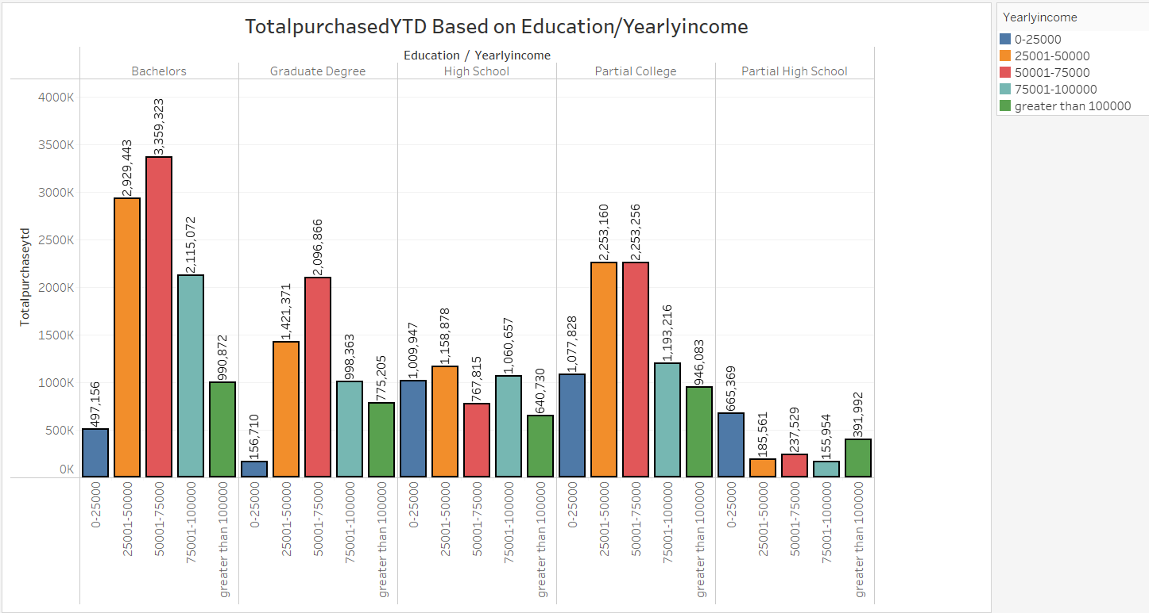
Total purchase YTD based on Education/Yearly Income

Slide 8
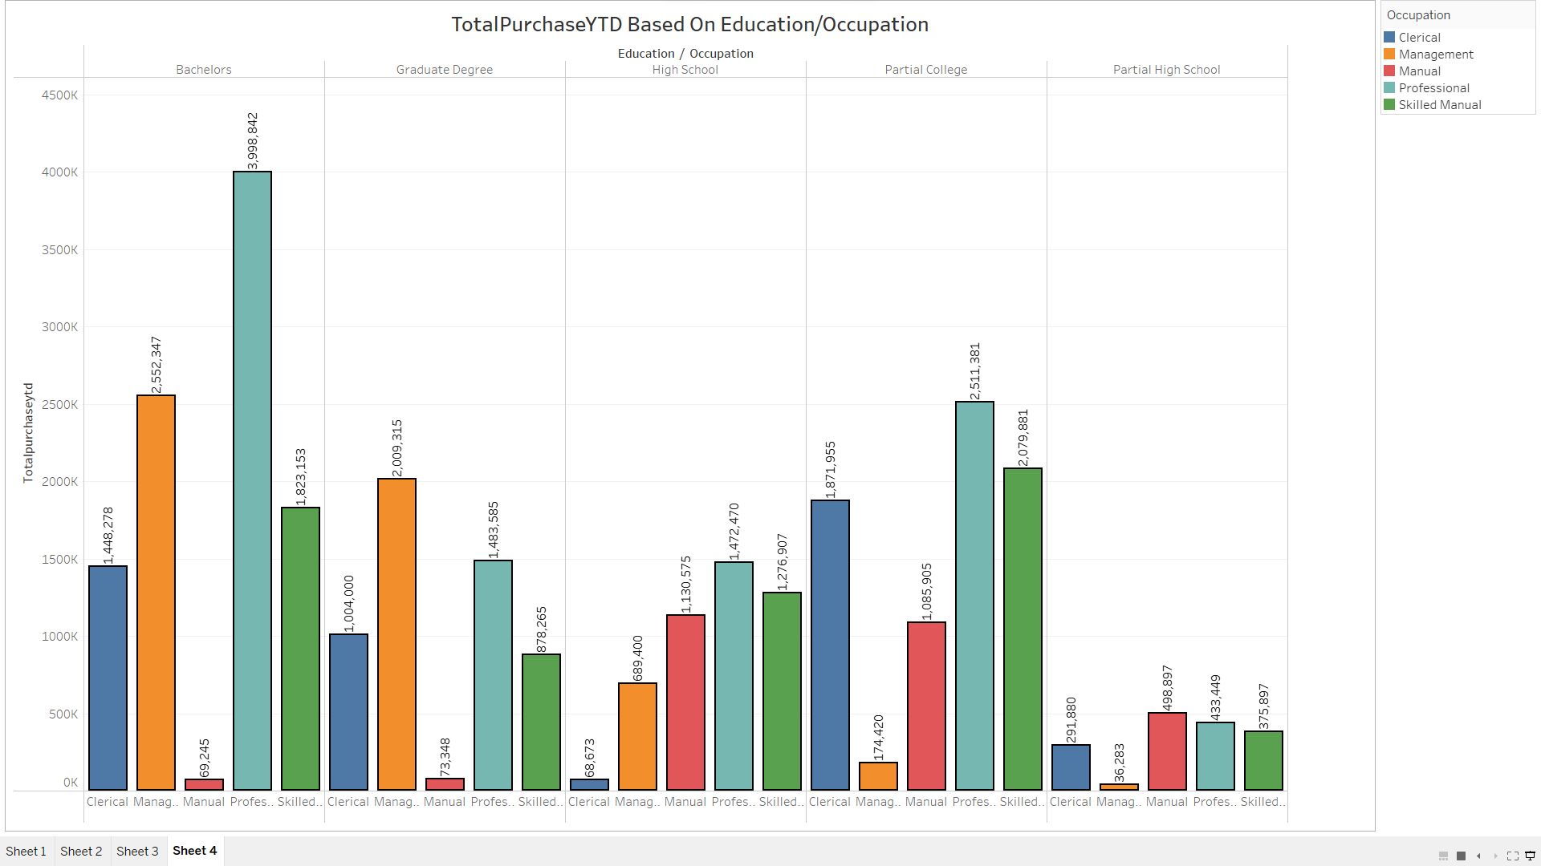
Total purchase YTD based on Education/Occupation

Slide 9
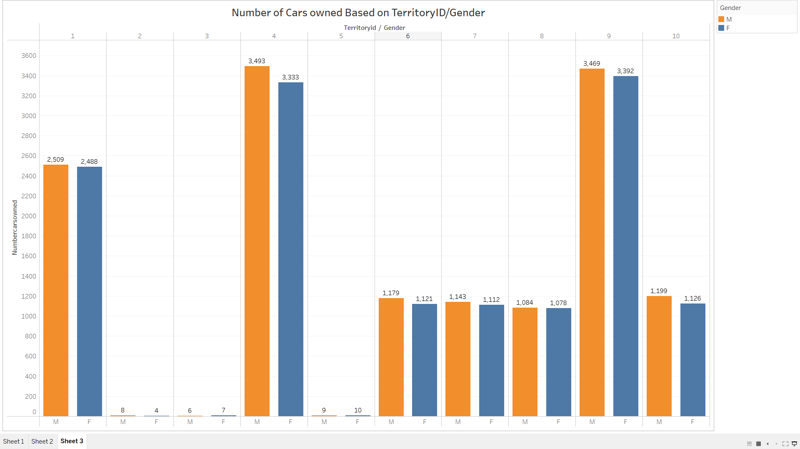
Numbers of cars owned based on territory id/ Gender

Slide 10


