Slide 1
ELECTRICITY DEMAND FORECASTING
WHICH FORECASTING MODEL PROVIDES THE MOST ACCURATE PREDICTION FOR DAY-AHEAD ELECTRICITY DEMAND IN NSW USING HISTORICAL ELECTRICITY DEMAND AND WEATHER VARIABLES?
Group 8:
Shanghong Dai
Qiye Gong
Zichao Luo
Aayushi Jha
Liyang Liu
Supervisor: Wei Tian

Slide 2
Elegant Black and White Thesis Defense
Chapter 1 Introduction
01
Best Performance Model about Day-Ahead Electricity Demand
Here is where your presentation begins
Why This
Topic Matters
Content Overview

Slide 3
01
Why This Topic Matters
Why Accurate Electricity Demand Forecasting Matters
Supports day-ahead scheduling and reserve decisions
Underestimation → risk of power shortages
Overestimation → unnecessary operating costs
Increasing importance with renewable energy integration
Real-world Impact
Power system stability
Cost efficiency
Energy management decisions

Slide 4
01
Electricity demand is mainly influenced by:
01
02
03
04
05
Weather Conditions
Calendar
Day-of-week Effects
Lagged Historical Demand
….
Factors

Slide 5
01
Content Overview
EDA
Methodology
Conclusion

Slide 6
Elegant Black and White Thesis Defense
Chapter 2 EDA
02
Exploratory Data Analysis
Here is where your presentation begins
Dataset Overview
Main EDA Patterns

Slide 7
Dataset Overview and Feature Construction
02
Dataset
The dataset contains 4,084 daily observations from 2010-01-08 to 2021-03-17.
The target variable is TOTAL_DEMAND.
Daily TOTAL_DEMAND was constructed by aggregating half-hourly NSW electricity demand records within each calendar-day window, using 00:00 as the daily boundary.
00:00-00:30 demand
00:30-01:00 demand
One 24-hour demand
23:30-00:00 demand

Slide 8
Dataset Overview and Feature Construction
02
Main feature groups
Lagged demand: DEMAND_LAG1, DEMAND_LAG7
Temperature: T_MAX, T_MIN, T_MEAN
Calendar: IS_HOLIDAY, DATE (YEAR, MONTH, DAY, WEEKDAY(Day of week), WEEKOFYEAR, DAYOFYEAR)

Slide 9
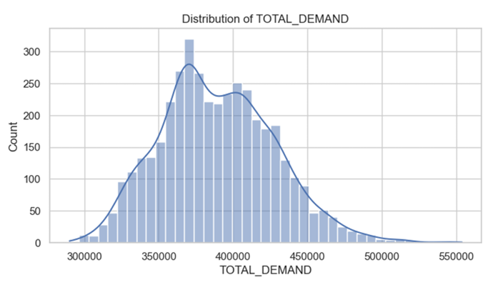
Main EDA Patterns
02
Distribution of TOTAL_DEMAND
Not severely skewed
No strong transformation was required

Slide 10
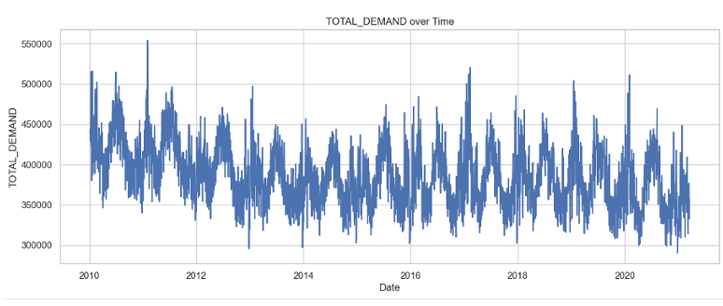
Main EDA Patterns
02
Daily trajectory of TOTAL_DEMAND
Not constant over time
Repeated upward and downward movements
Suggests temporal dependence

Slide 11
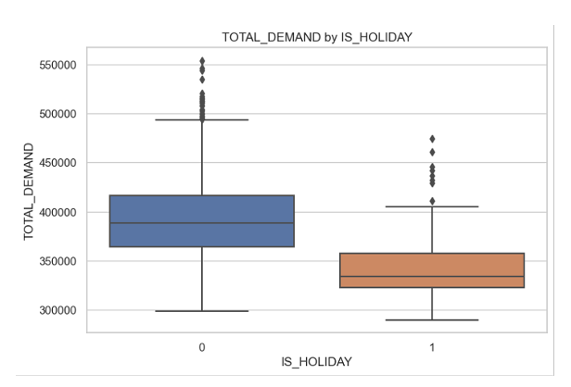
Main EDA Patterns
02
Difference in TOTAL_DEMAND between holidays and non-holidays
Calendar effects are also visible.
Holiday demand is about 12.1% lower than non-holiday demand on average.

Slide 12
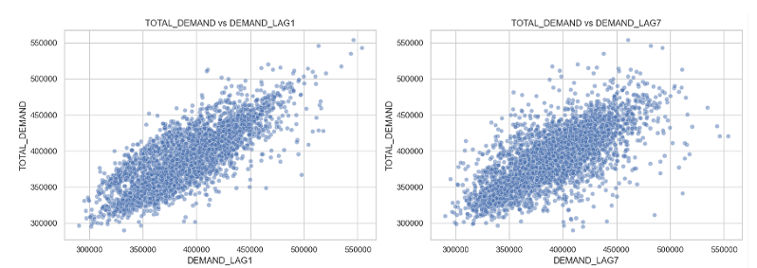
Main EDA Patterns
02
Scatterplots of TOTAL_DEMAND against DEMAND_LAG1 and DEMAND_LAG7
DEMAND_LAG1 and DEMAND_LAG7 show a strong positive relationship with TOTAL_DEMAND
DEMAND_LAG1 has a correlation of 0.7994 with the target. Short-term dependence
DEMAND_LAG7 has a correlation of 0.7154 with the target. Weekly dependence

Slide 13
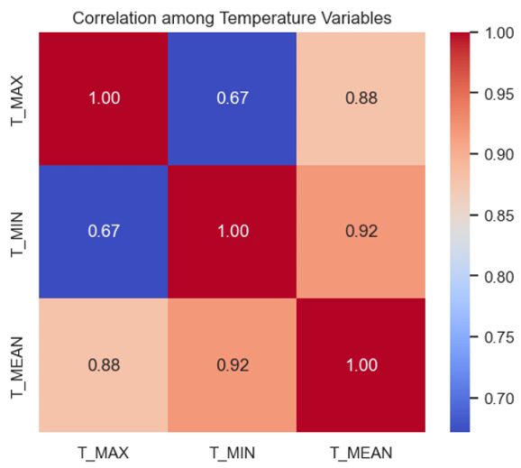
Main EDA Patterns
02
Temperature Multicollinearity
T_MAX, T_MIN, and T_MEAN are strongly correlated.
This may cause coefficient instability in linear models.
So, when building the linear models, deleting T_MEAN is a good choice to reduce multicollinearity.

Slide 14
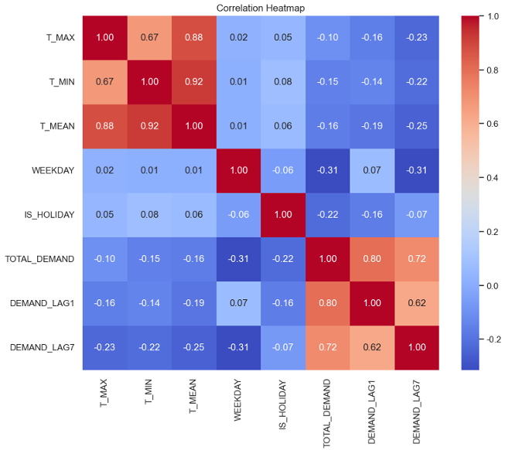
Main EDA Patterns
02
Key EDA Findings
Lagged demand is the strongest predictive signal.
DEMAND_LAG1 = 0.80, DEMAND_LAG7 = 0.72 with TOTAL_DEMAND
Calendar effects should be included.
WEEKDAY and IS_HOLIDAY show visible relationships with TOTAL_DEMAND
Temperature variables should be handled carefully.

Slide 15
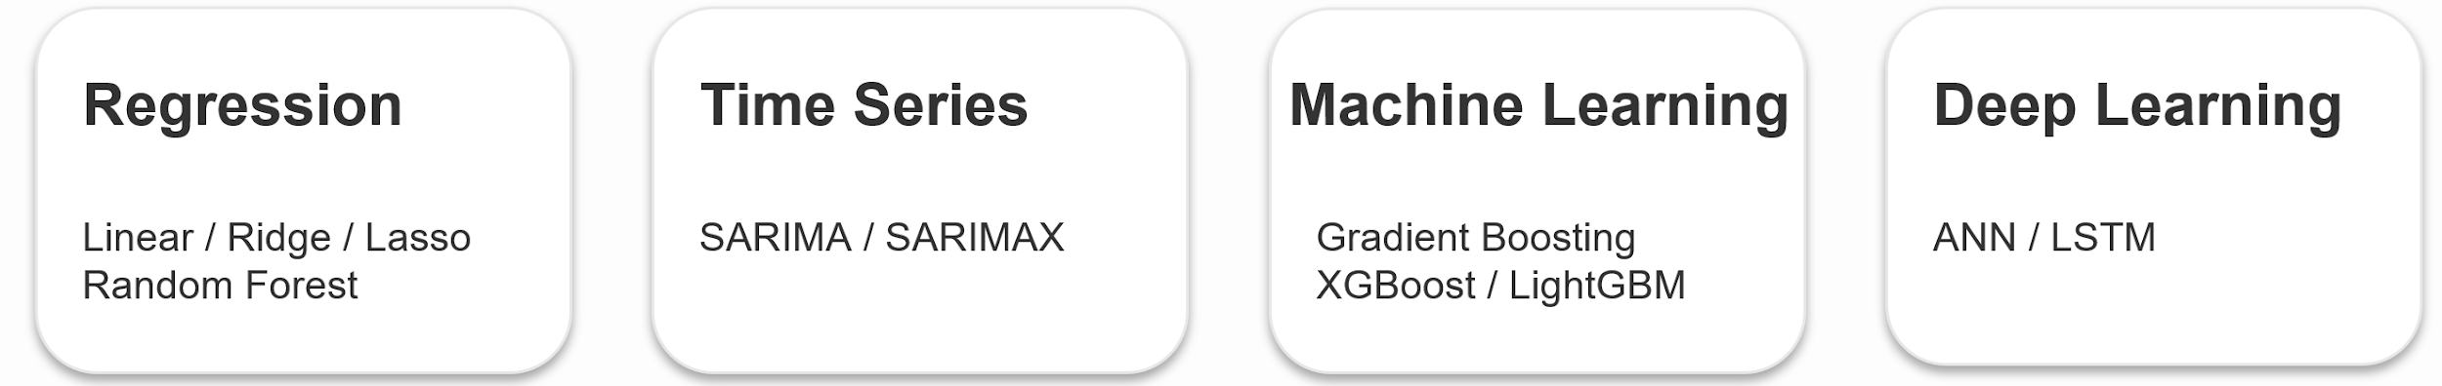
Elegant Black and White Thesis Defense
Chapter 3 Methodology
03
Day-ahead electricity demand forecasting in NSW
Focus: model design, training strategy and results
Here is where your presentation begins

Slide 16
03
Regression models
Why these models were selected and how they were trained
Model choice
Training strategy
Linear Regression
Ridge and Lasso for regularization
Random Forest for nonlinearity benchmark for comparison
Goal: compare interpretable linear baselines with a nonlinear ensemble benchmark
80% training set / 20% testing set
Chronological split to avoid leakage
GridSearchCV with TimeseriesSplit for hyperparameter tuning
Best model selected by Cross-validated RMSE
Evaluation: MAE, RMSE, MAPE, R²

Slide 17
03
Regression results
Random Forest was the strongest regression benchmark
Best MAE
Best RMSE
Best MAPE
Best R²
10,499.60
13,935.97
2.844%
0.8659
Model | MAE | RMSE | MAPE | R²
Random Forest | 10,500 | 13,936 | 2.844% | 0.8659
Lasso | 14,140 | 18,581 | 3.732% | 0.7616
Ridge | 14,141 | 18,585 | 3.732% | 0.7614
Linear Reg. | 14,193 | 18,616 | 3.748% | 0.7607
Key interpretation
Random Forest captures nonlinear effects and interactions better than the linear-family models.

Slide 18
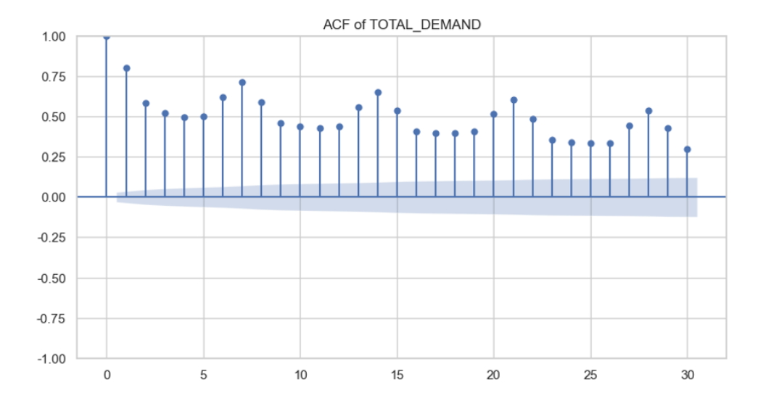
03
Time series models
SARIMA as a benchmark; SARIMAX with external variables
Model choice
SARIMA: demand history + seasonality only
SARIMAX: adds temperature, holiday and weekday variables
Purpose: whether adding external variables could improve forecasts performance
Training strategy
80% training / 20% testing
Orders selected by AIC grid search
Rolling one-step-ahead forecast
ACF shows strong short-term persistence and weekly seasonal pattern in electricity demand

Slide 19
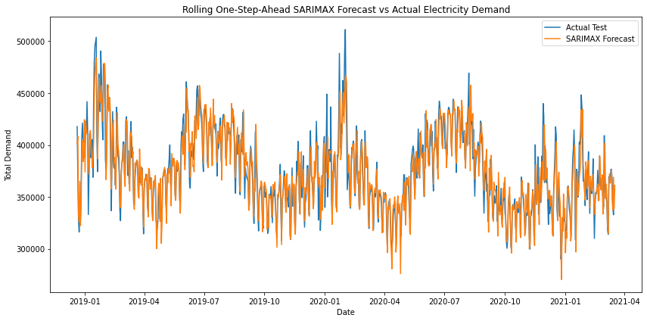
03
Time series results
SARIMAX improved over SARIMA on every metric
Model | MAE | RMSE | MAPE | R²
SARIMA | 14,267 | 19,809 | 3.779% | 0.729
SARIMAX | 11,326 | 15,753 | 2.991% | 0.828
Key insight
SARIMAX > SARIMA across MAE, RMSE, MAPE and R².
External variables added useful predictive information.
Forecasts still appeared smoother than the actual series, especially around sharp peaks.
SARIMAX followed the broad movement but missed some sharp fluctuations on sharp peaks.

Slide 20
03
Extending Traditional Models
Traditional Models
Extended Models
Nonlinear
relationships
+
Complex patterns
Linear relationships
+
Temporal
structure
Extended using Machine Learning & Deep Learning models
Notes:
Building on what Zichao just presented, we saw that regression and time series models capture linear relationships and temporal structure quite well.
However, electricity demand also involves more complex nonlinear interactions that these models may not fully capture.
So to address this, we extend the analysis using machine learning and deep learning approaches.

Slide 21
03
Modeling Framework
Standalone ML Models
Machine Learning
Hybrid (SARIMAX + ML)
ANN Model
Deep Learning
LSTM Model
Notes:
We structure our approach into two main modelling directions: machine learning and deep learning.
For machine learning, we consider both standalone models and a hybrid approach.
In the hybrid setup, SARIMAX is used to generate a baseline forecast, and machine learning models are applied to the residuals to perform error correction.
For deep learning, we compare two models: ANN and LSTM.
This framework allows us to systematically compare how different approaches capture nonlinear and temporal patterns in electricity demand.”

Slide 22
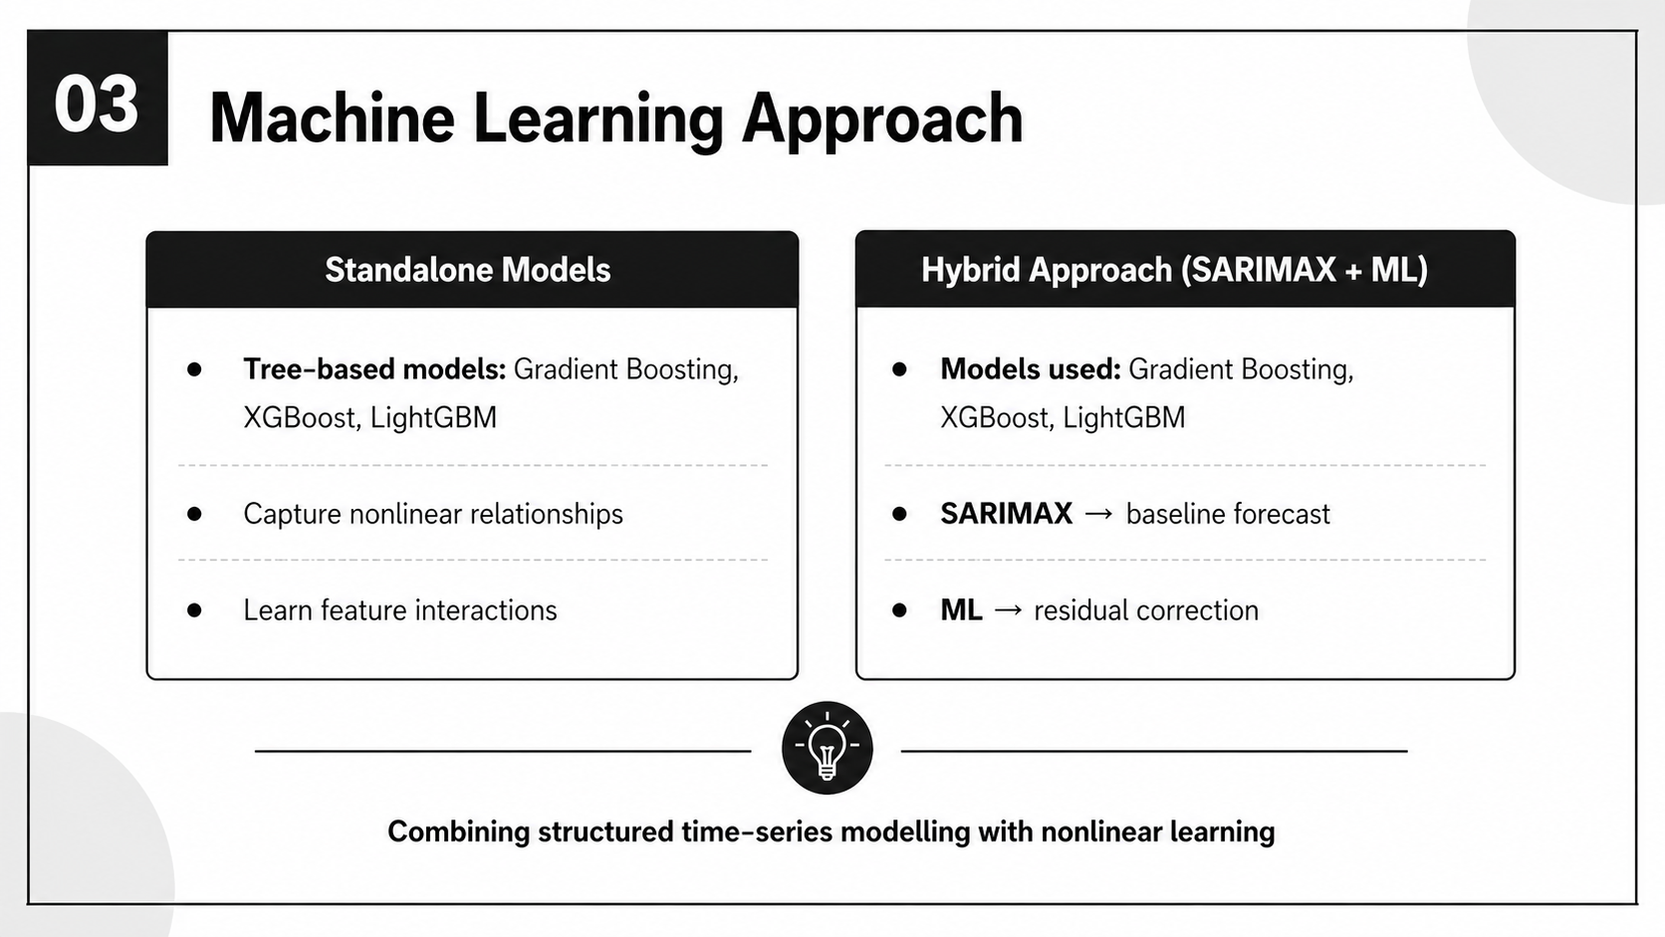
03
Machine Learning Approach

Slide 23
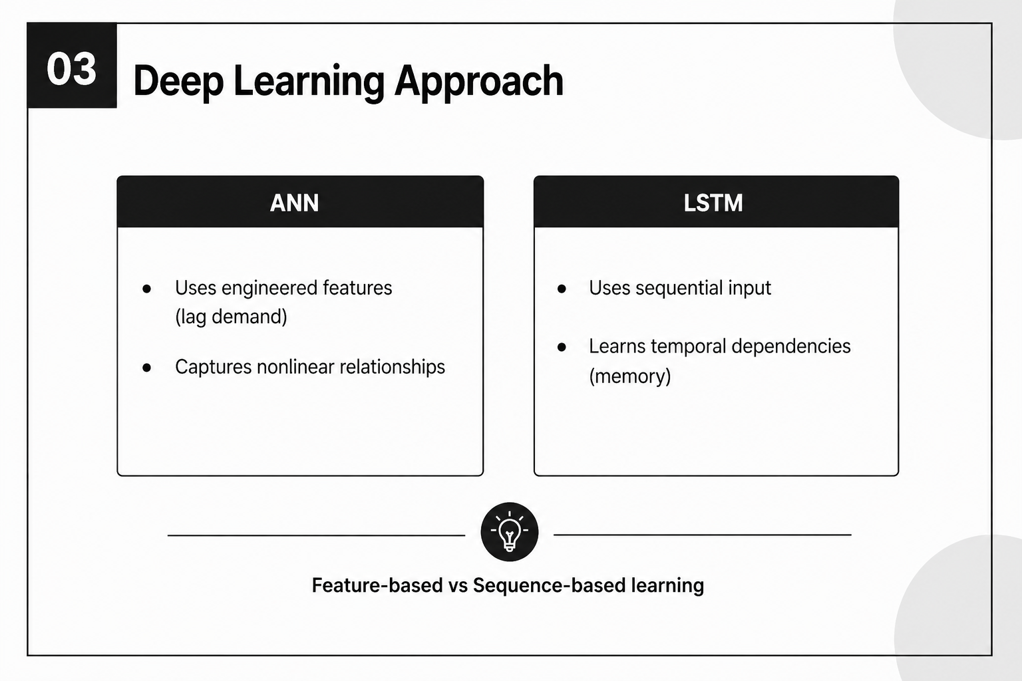
03
Deep Learning Approach

Slide 24
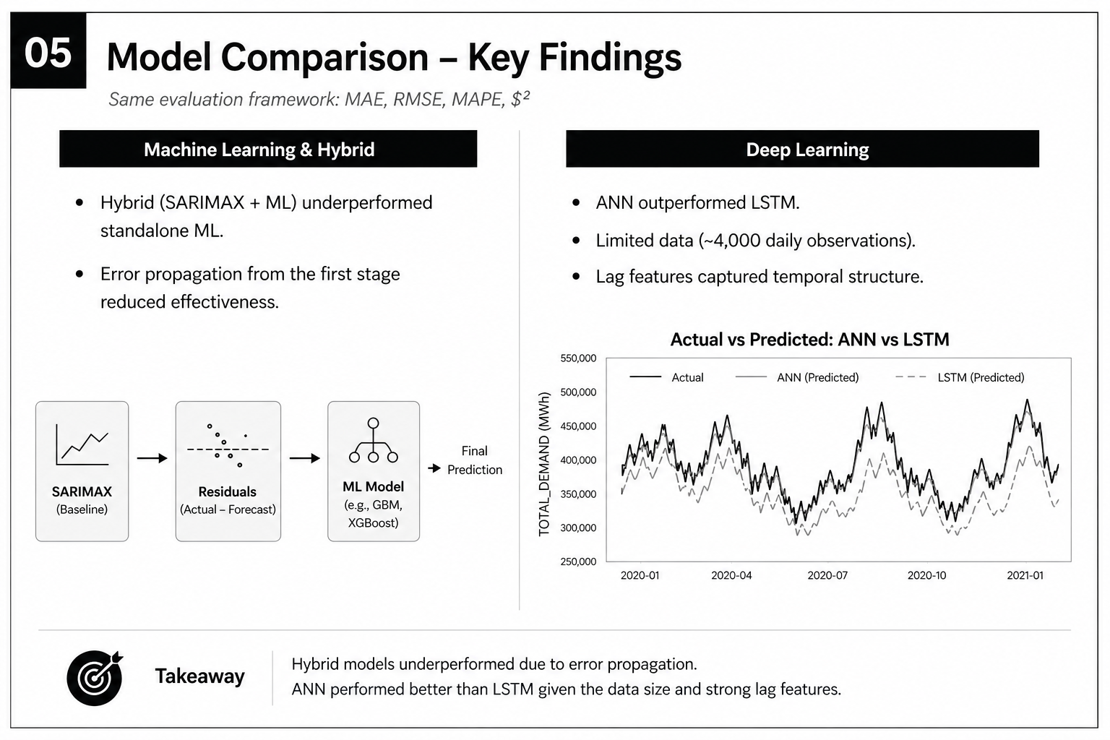
03
Machine Learning Results
Hybrid models underperformed standalone ML models
Error propagation between stages

Slide 25
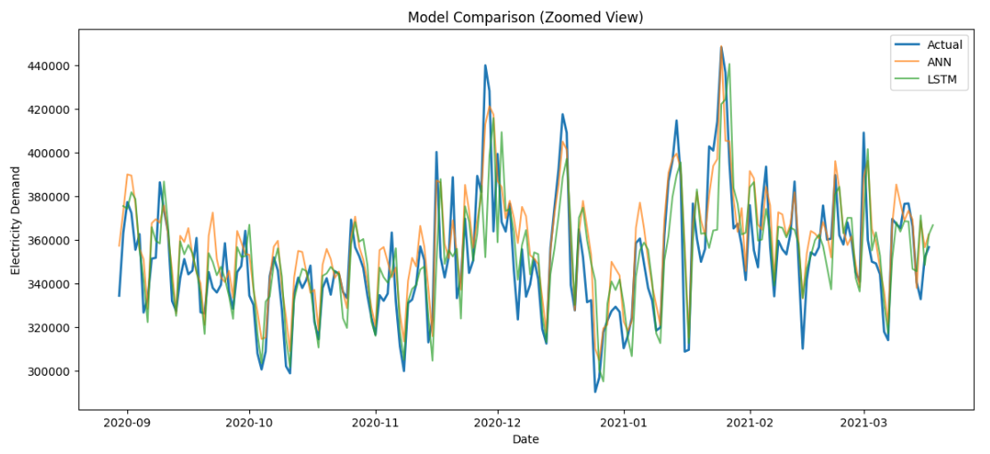
03
Deep Learning Results
ANN > LSTM
Limited data (~4,000 observations)
Lag features captured temporal structure

Slide 26

03
Key Takeaways
• Compared Traditional, ML and DL models
• Consistent evaluation framework
• ML performed strongly with engineered features
• ANN outperformed LSTM on limited data
Notes:
So overall, we are comparing traditional, machine learning, and deep learning approaches under the same evaluation framework.
This allows us to assess how different models capture nonlinear and temporal patterns in the data.
I’ll now hand over to Liyang, who will present the results and key findings

Slide 27
Elegant Black and White Thesis Defense
Chapter 4 Conclusion
04
Overall Comparison Between All Models
Here is where your presentation begins
Findings
Limitations

Slide 28
04
Overall Model Performance
Model | MAE | RMSE | MAPE (%) | R²
Gradient Boosting | 8,776 | 11,591 | 2.37 | 0.9072
LightGBM | 8,847 | 11,546 | 2.40 | 0.9079
XGBoost | 8,795 | 11,585 | 2.38 | 0.9073
SARIMAX + XGBoost | 9,792 | 17,371 | 2.64 | 0.7916
Random Forest | 10,500 | 13,936 | 2.84 | 0.8659
SARIMAX | 11,326 | 15,753 | 2.99 | 0.8280
ANN | 11,447 | 19,065 | 9.05 | 0.7743
LSTM | 12,884 | 21,681 | 9.54 | 0.7081
Linear / Ridge / Lasso | ~14,150 | ~18,590 | ~3.73 | ~0.762
SARIMA | 14,267 | 19,809 | 3.78 | 0.7290

Slide 29
04
Conclusion
Tree-based ensembles are the best fit for NSW day-ahead demand.
For lowest average error → Gradient Boosting (lowest MAE).
To minimise large misses → LightGBM (lowest RMSE).
Bigger picture:
within 1% of each other on MAE
feature design matters more than further algorithm switching.

Slide 30
04
Limitation
Gap between industrial use.(R² AEMO~0.9989 vs ours~0.9079).
Limited feature set.
Point forecasts only.
Unable to obtain real-time temperature data.

Slide 31
Thank you!
Q&A TIME

