Slide 1
What is a Debugger?
A debugger is a computer program used by programmers to test and debug a target program. Debuggers stop or halt the program according to specific conditions.
When a program crashes, debuggers show the position of the error in the target program. Most debuggers also are capable of running programs in a step-by-step mode, besides stopping on specific points.

Slide 2
Errors
There are three kinds of errors:
syntax errors
runtime errors
logic errors.

Slide 3
Setting our first breakpoint
What is a breakpoint?
A breakpoint is an intentional stopping or pausing place in a program, put in place for debugging purposes. It is also sometimes simply referred to as a pause. More generally, a breakpoint is a means of acquiring knowledge about a program during its execution. During the interruption, the programmer inspects the test environment to find out whether the program is functioning as expected.

Slide 4

Let's create a breakpoint on the very first line of our program:
Dog sparky = new Dog("sparky");
You'll create a breakpoint by clicking to the very right of the line number. Once a red dot appears then a breakpoint has been created

Slide 5
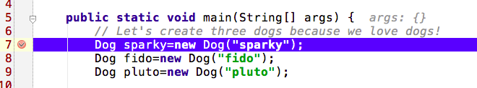
Fire up a debug session in IntelliJ
You can do this by simply clicking on Run -> Debug or clicking on icon.
Note: A blue breakpoint signifies that it has NOT executed yet!

Slide 6
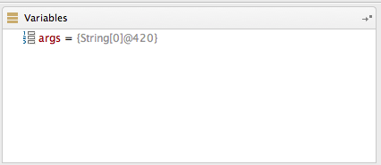
Variables Window
As we step through our code, the Variables window will become a very useful tool to help us understand which variables are presently in scope or in other words, which variables the debugger is currently aware of. This is what your Variables window should look like at this very point in time.

Slide 7
Specific Debugging Features
Step-over
The Step Over feature executes a line of code as a complete unit, and then steps to the next statement in the current method body. Therefore, the next statement displayed is the next statement in the current procedure regardless of whether the current statement is a call to another procedure or not.
Step-into
Almost identical to how the step-over feature works except that the difference is that if the statement is a call to a method, the next statement displayed is the first statement in the method.
Force Step-into
The Force Step Into command icons debugger actions force step into enables you to step into a method of a class not to be stepped into, for example, a standard Java SDK class.
Step-out
It is used to go back to the method from which we had step into a new method

Slide 8
Frames ( or Activation Records ) Window
Your local variables are created inside what is called a frame (otherwise known as an activation record ) on a structure known as the stack where the most recently added object is the first one that is eligible to be removed. In real life, a stack can be thought of as a pile of plates.
These details will help you understand the Frames window shown above. It currently only contains a frame for the main() method because the debugger is currently sitting in this method. However, every time we jump into a new method, a new frame is added to the top of the pile. This technique allows the cpu to dive into as many methods as necessary and then easily be able to unwind the stack and get back to where it initially started.

Slide 9
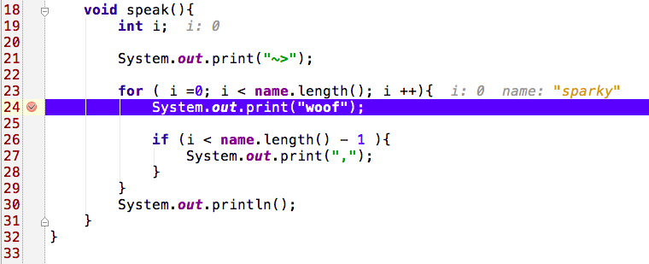
Conditional breakpoints
You need to set a conditional breakpoint in order to stop only when the given condition is satisfied.
Imagine that we wanted to set a breakpoint for charlie because we suspected a possible issue with the number of woofs that he produces.
So let's set a breakpoint in the for loop located in the speak method. The variable i keeps track of the number of letters in a dog's name which corresponds to the number of woofs produced. We might as well stick a breakpoint here and set the condition such that our breakpoints stops when i is equal to 6. ( Remember we're looking for charlie, which happens to have six letters in his name )

Slide 10
Setting the conditional breakpoint
When we right click on tht debugger we'll now see a dialog box and all you need to do at this point is ensure that the breakpoint that we want is properly selected within the list of all breakpoints located on the left hand side. We'll now ensure that the condition option is selected and finally, we set our condition. In this case our condition is i==6. Done!
If you restart your debug session, you'll now see that we'll stop ONLY when our condition statement becomes true.

Slide 11
Thank you!

