Slide 1



Mahavir Education Trust’s Shah & Anchor Kutchhi Engineering College Chembur, Mumbai-400088 (Autonomous College Affiliated to the University of Mumbai)

Slide 2

BEATS Music Website
41.Aayushi Ramani

Slide 3
BEATS Music Website
Content
Introduction
About us
Challenges
Purpose
How to contribute
References
Use of style sheet and javascript

Slide 4
Header
Navigation
Search Panel
Radio
My playlist
Discover
Body
Popular Music
Popular Singer
Footer
Media control symbols function
Homepage

Slide 5
Introduction
Welcome to the Music Streaming Platform ‘BEATS’ frontend project README!
Our project is a Music Streaming Platform's frontend. It includes several key pages for user interaction, such as:
**Header:** Navigation & the last song palyed by the user including lyrics.
**Landing Page:** The first page users see when they visit the platform. It provides an overview of the service and entices users to explore further.
**Discover Page:**The second page users has given a search history by using function(search_object())to handle input and toggle display.
**Pro tools:**The pro tools have individual pages in site such as playlist, recommendation, mylibrary,history,etc.
**Footer :**The footer shows the current album of song palyed by the user with special features like volume and timer.

Slide 6
Why Beats(Music Streaming Website)
Purpose-this project is to provide a visually appealing and user-friendly frontend for a Music Streaming Platform. By creating these frontend pages, we aim to give users a emotional,seamless,stressfree and enjoyable experience when using our platform.
Usuage-Our project's frontend pages are designed to be integrated with a backend system. The frontend pages provide the user interface for interacting with the platform. Users can explore music, create accounts, and access their accounts using the provided pages.
Navigate to the Project-Navigate to the project directory and open index.html in your web browser.
Technologies Used
- **HTML**: For structuring the web content.
**CSS**: For styling the user interface.
**JAVASCRIPT**: For structing dynamic and interactive webpage.
Conclusion-Music speaks where words fail,so music doesn’t lies to make one creative.Hope this platform help you all.

Slide 7
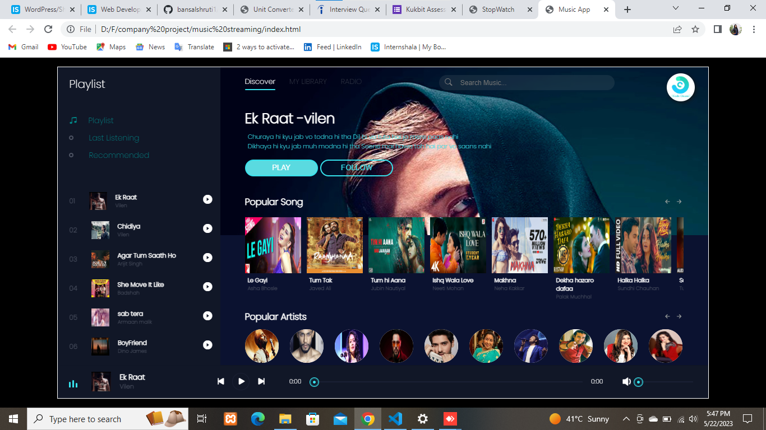
Home Page

Slide 8
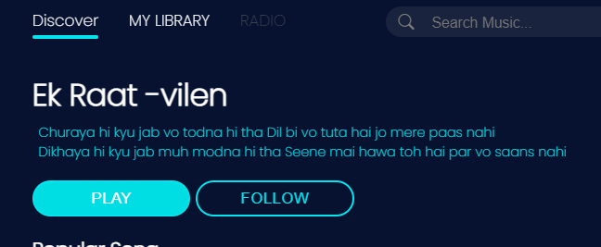
Use Of HTML
**Navigate to the Project:**
Navigate to the project directory and open index.html in your web browser.
**Search history:**
The users has given a choice by using the code in CSS style
function(search object())to handle input and toggle display as per the content .e.g. user text Believer in search history it display the song album ‘believer by dragons’.
**List:** use <li> for songs album and popular singer.
**Image:**image is add in website by using tag
.e.g.‘<img src=“img\logo.jpg”>’
**Button:**It is used to create clickable button, which can performs action such as submit, triggering JavaScript, navigating.

Slide 9
Some Imp Tags
<i id=“left_scrolls” class=“bi bi-arrow left short></i>The icon arrow appears left on the webpage, style is black by default and blue on hover.Icon just triggers the scrolling effect.
<span id="current End">0:00</span>This tag denotes the duration of the song initially from 0.00 to n min.
<i class="bi bi-search"></i>-The icon with bootstrap which gives user space to text.
<input type="text" placeholder="Search Music...">-This tag provides a hint to user to use characters and type the text in search option.
<link rel="stylesheet" href="style (2).css">This tag is very important to link style css with html for complete website.

Slide 10
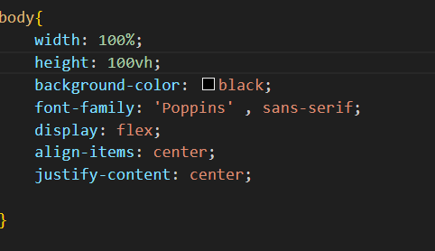
Use Of Css
**Style:** By adding width ,margin ,
background- Color , alignment,
font-family, display, justify content
and border ,etc.
**Special styles:**
overflow is hidden to control the area of thecontent.
Input button_ to activate a JavaScript function on click.
Backdrop_ it is add to blur the area behind element when the song is open.
Pseudo class_ It defines a special state of an elements. Here header in
website include .menue_side(navigation), .master_play and .Song_side
Here ‘header.song_side nav ul li:nth child()’is used Css to target specific<li> element within the structure defined by menue_side from header with no hover styles and highlights the text in blue.
Example-header .song_side .content .buttons button:hover

Slide 11
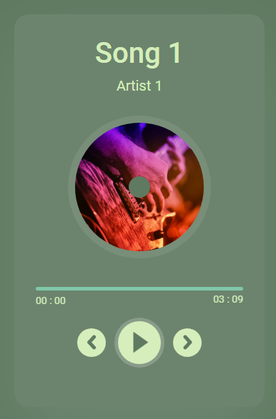
Bootstrap_It is free front-end framework for faster and easier web development, here it is used for navigation as well as image carousels.
<linkrel="stylesheet"href="https://cdn.jsdelivr.net/npm/bootstrap-icons@1.10.5/font/bootstrap-icons.css">
Z-index_It controls the stacking order of overlapping element on a page.
Transisition_It allows to change property values over a given duration here for 3s delay linear transition is add for a simple effect on click to song.
Animation_It need to specify keyframes for gradual
change from one to new style. Here animation duration
5s linear infinite for wave class in JavaScript
when the song is on play.

Slide 12
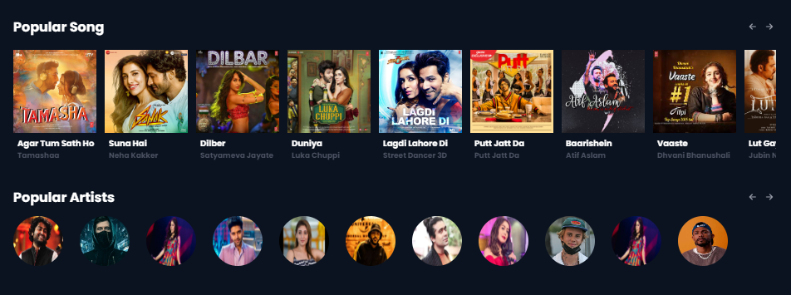

Slide 13
Uses Of JavaScript
Array in JavaScript are commonly used in music related website because they allow for efficient storage, management and manipulation of multiple pieces of related data.
It allows user to handle large volume of music data and deliver interactive and dynamic features for user.
History or recently played
Music Queue Functionality are often implemented using to manage the order in which songs are played.
Array.from(document.getElementsByClassName('songItem')).forEach((element, i)=>{
element.getElementsByTagName('img')[0].src = songs[i].poster;
element.getElementsByTagName('h5')[0].innerHTML = songs[i].songName;
})
In music website,currentstart could represent an element displaying the currnt playback time of a track.
let currentStart = document.getElementById('currentStart’);
To refer image represents a dynamic valueand updating the image based on current playlist.
play.src=‘img/${index}.jpg’;

Slide 14
To move next or forward in right direction to scroll the music album.
let right_scrolls document.getElementById('right_scrolls’);
For volume adjustment of song played and controling the span of the song quality it acts. On click the music starts and there is a volume button to adjust the volume at he footer.
{ let vol_a = vol.value; }
Filters the song array, to find the song object with an id matching index of the current song played (id or name ).
{
let {songName} = ele;
title.innerHTML = songName;
}
Where, Vol<50------{mute} Vol>50------{Full}

Slide 15
Challenges Faced
Building a music streaming website using HTML, CSS, and JavaScript can be an exciting and rewarding project, but it also presents several challenges. Here's a breakdown of some of the most common issues you might encounter:
1. Handling Audio Files Efficiently
File Formats: Different audio file formats (MP3, WAV, OGG) require careful consideration since browsers may support some formats but not others. For instance, MP3 is widely supported, but the OGG format might be preferred for open-source projects.
Compression and Size: Large audio files can impact page load time and cause performance issues, especially for users with slower internet connections. Balancing file quality with size optimization is essential.
Streaming vs. Downloading: If you're building a streaming site, you'll need to implement progressive downloading (streaming) so that users can start listening without waiting for the entire file to download.
2. Audio Player Design and Controls
Custom Controls: While HTML5 provides a native <audio> element with basic controls, customizing the audio player to match your design (play/pause buttons, volume control, seek bar, etc.) using just HTML, CSS, and JavaScript can be tricky.
Responsive Design: Ensuring the audio player looks and works well on different devices (desktop, tablet, mobile) requires thoughtful design with responsive CSS and sometimes additional JavaScript to handle layout changes.
Cross-Browser Compatibility: The behavior of custom audio players may vary across browsers
(Chrome, Firefox, Safari, etc.), so extensive testing and fallbacks may be required.

Slide 16
Challenges Faced
3. Error Handling and Edge Cases
Playback Errors: Handling situations where audio files fail to load or play due to network issues, unsupported formats, or corrupted files is critical. Providing clear error messages and fallback solutions (like default content or retry options) is essential.
Buffering: For streaming audio, buffering can occur, especially when the network is slow. Implementing smooth buffering indicators (e.g., loading spinners or progress bars) enhances the user experience.

Slide 17
Reference
Reference link | Images_name
https://2.bp.blogspot.com/-aGSH1XEgQ4Q/XJUP4QZy5oI/AAAAAAAAAtg/ndnZmaPg-G0iECGjf3nJJXvGz70jN4fjwCLcBGAs/s1600/Cover.jpg | Image/7.jpg
https://im.indiatimes.in/content/2022/Dec/HD-wallpaperarjithsinghbollywoodsinger_63aabf4433151.jpg | arjitsingh.jpg
 | badashah.jpeg
https://media.architecturaldigest.com/photos/607704a1236d601d0dba908e/16:9/w_2560%2Cc_limit/1228604432 | justinbieber.jpg
https://ik.imagekit.io/j83rchiauw/A_List_Star/DinoJamesBiography.jpg | dinojames.jpg
https://www.iwmbuzz.com/wp-content/uploads/2022/02/jubin-nautiyals-songs-for-a-dance-with-your-loved-one-take-a-look-920x690.jpg | jubinnautiyals.jpg
https://imgcache.joox.com/music/joox/photo_th_th/mid_singer_1000/5/4/7106e98198c278df85d3f5682c95c854.jpg | Image/1.jpg

Slide 18


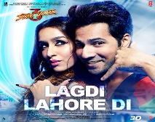
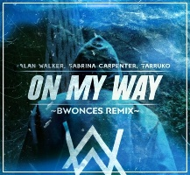

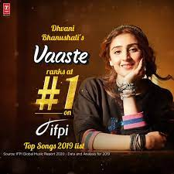
Reference link | Image_name
https://www.jiosaavn.com/song/dilbar/Byc-YRsJelA | Dilbar song mp3
https://drive.google.com/file/d/1GZtba-N81ggIYW182m7q5qgfToaG0H9p/view?usp=sharing | Faded mp3
Lagdi Lahore Di Mp3songdownload Pagworld.com | Lagid Lahore Di mp3
On My Way Mp3 Song Download Pagalworld.com | On My Way song mp3
https://gaana.com/album/ae-dil-hai-mushkil | Aa dil hai mushkil mp3
https://gaana.com/song/vaaste | Vaaste mp3

Slide 19
CONCLUSION
While Visual Studio Code (VS Code) is an excellent environment for building a music streaming website with HTML, CSS, and JavaScript, the challenges stem mostly from:
Setting up a proper development server for dynamic features
Organizing and debugging complex JavaScript logic
Handling audio playback controls and external API integrations
Ensuring responsiveness and cross-browser compatibility
To overcome these challenges, make use of VS Code’s built-in features, extensions, and best practices like using a local server for testing, employing JavaScript libraries for audio control, and ensuring your site’s performance is optimized for the best user experience.

