Slide 1
HOUSING: PRICE PREDICTION
Submitted By: MENTOR:
Aayushi lashkari Mr. SHUBHAM YADAV

Slide 2
Contents
Problem Statement
Data Analysis
Pre Processing Pipe Line
Data Modelling
Conclusion

Slide 3
Problem Statement
A US-based housing company named Surprise Housing has decided to enter the Australian market. The company uses data analytics to purchase houses at a price below their actual values and flip them at a higher price. For the same purpose, the company has collected a data set from the sale of houses in Australia

Slide 4
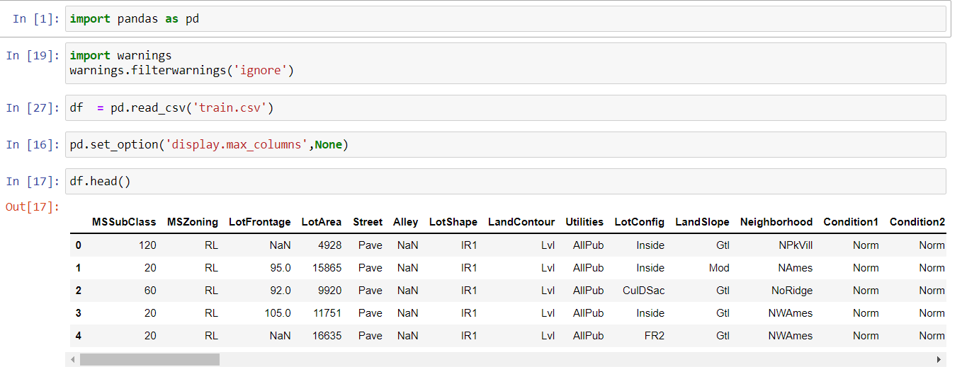
Data Analysis
The dataset contains 1163 rows and 81 columns (including the target variable). This is a standard regression problem where we need to predict Sale Price.

Slide 5
Independent Features
Out of 81 columns 38 columns are of numerical datatype.
43 columns are categorical columns.
In the numerical columns each column is imbalanced.
Handling null values and EDA are key challenges.
Four columns are dropped because of null values and same records.

Slide 6
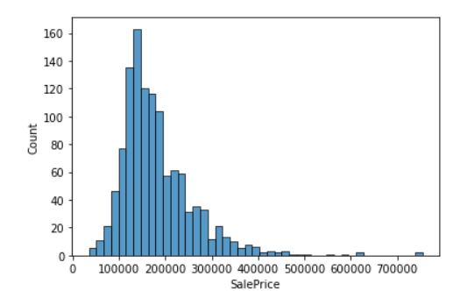
Dependent Variable
Range of Sale Price is from 100000 to 500000.
Price of Most of the houses is between 100000 to 200000

Slide 7
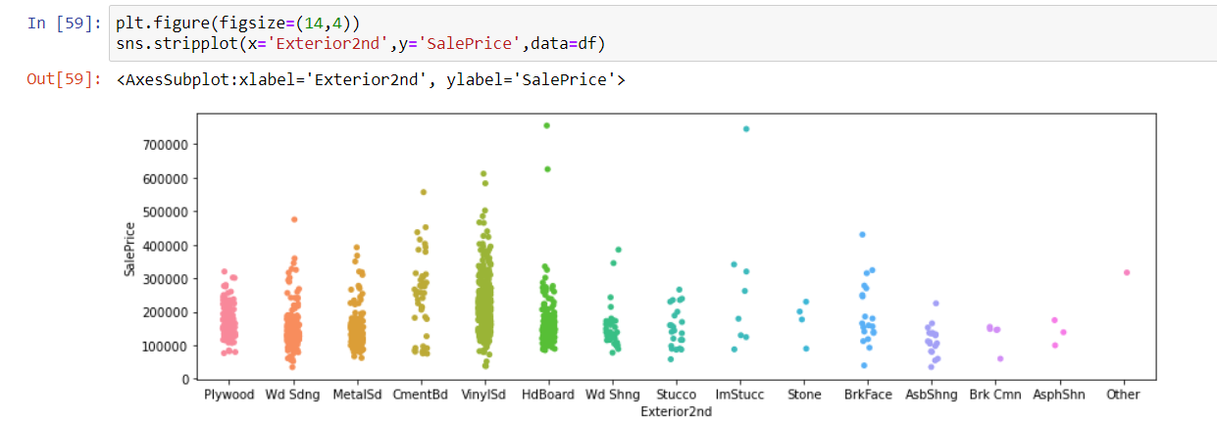
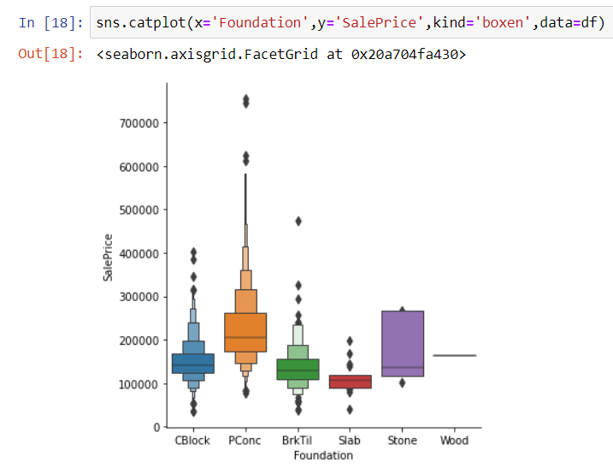
Glance at the Bi variate Analysis
Sale Price with Exterior2nd
Sale Price with Foundation

Slide 8
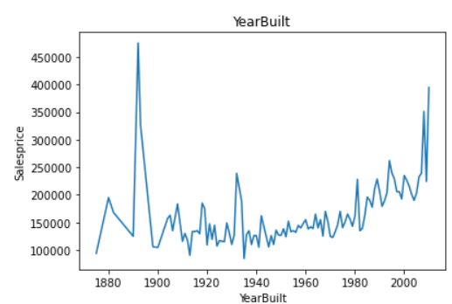
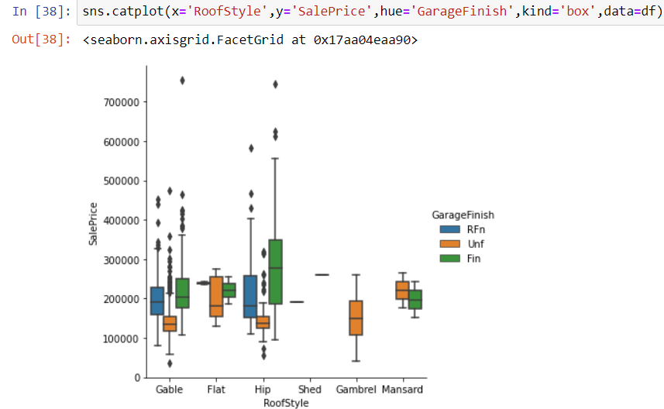
Conti..
Sale Price with Year Built
Sale Price with RoofStyle

Slide 9
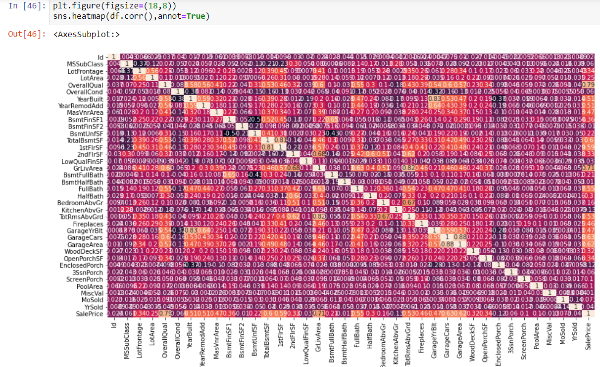
Multi Variate Analysis

Slide 10
Pre-Processing Pipe Line
Pre Processing is an important step to get better results.
Following are the steps I followed in the project for pre-processing:
Check and handle null values.
Handle the temporal columns.
Dropping non relevant columns.
Handle Skewness of the data.
Encoding of categorical features
Feature Selection.

Slide 11
Approaches For Pre Processing
Null Values:
For categorical Values replaced by mode or creating new categories depending upon the percentage of null values.
For numerical feature replaced by median.
Encoding:
For encoding I used ordinal encoder.
Skewness:
To treat skewness Power transformation is used

Slide 12
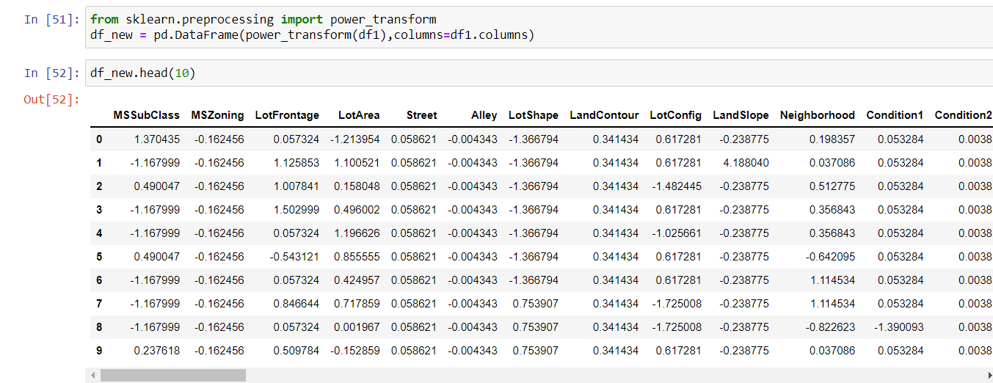
Data Set After Pre-processing

Slide 13
Data Modelling
This is a standard Regression Problem.
Following are the algorithms that I have used:
Some Standard Regression algorithms:
Linear Regression, Decision Tree Regressor , Support Vector Regressor, Kneigbors Regressor.
Ensemble Techniques:
Random Forest Regressor, Ada Boost Regressor, Gradient Boost Regressor.
Hyper Parametric Tuning of Gradient Boost Regressor

Slide 14
Performance of the Models
I have evaluated the performance of the models on the basis of r2 score and MSE/RMSE.
And regplot I have used to visualize the best-fitted line.
On the basis of r2 score and MSE Gradient Boost is giving best result with:
r2 score:0.87 and MSE: .14

Slide 15
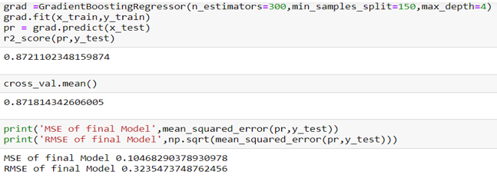
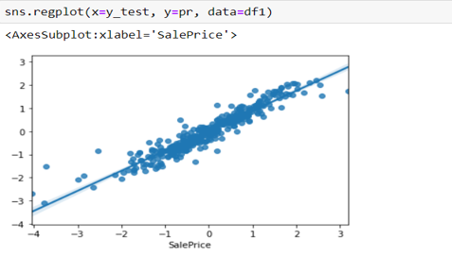
Best Model : Gradient Boost Regressor r2 score, MSE/RMSE Reg Plot

Slide 16
Conclusion
All the independent columns are imbalanced .
The key challenges of the problem were to handle null values and skewed data.
Predicting target variable after feature selection 2% score is less, therefore, I have not used that model because of the number of rows If for 1163 rows only it is affecting the accuracy for more rows it may not give a precise prediction.
Categories that have excellent category show high prices
The full bath is highly correlated with the sale price and the year sold is least correlated.

Slide 17
Thank You

