Slide 1
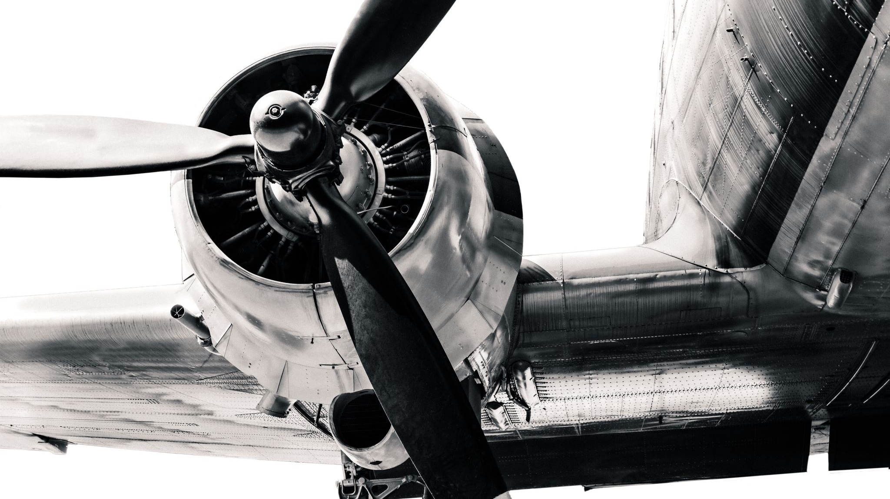

✈️ Airplane Crashes Through the Ages
A 100+ Year Data Story of Aviation Tragedies, Trends, and Turning Points
Made by: Aayushi Kumari
Gmail - gupaayu053@gmail.com

Slide 2

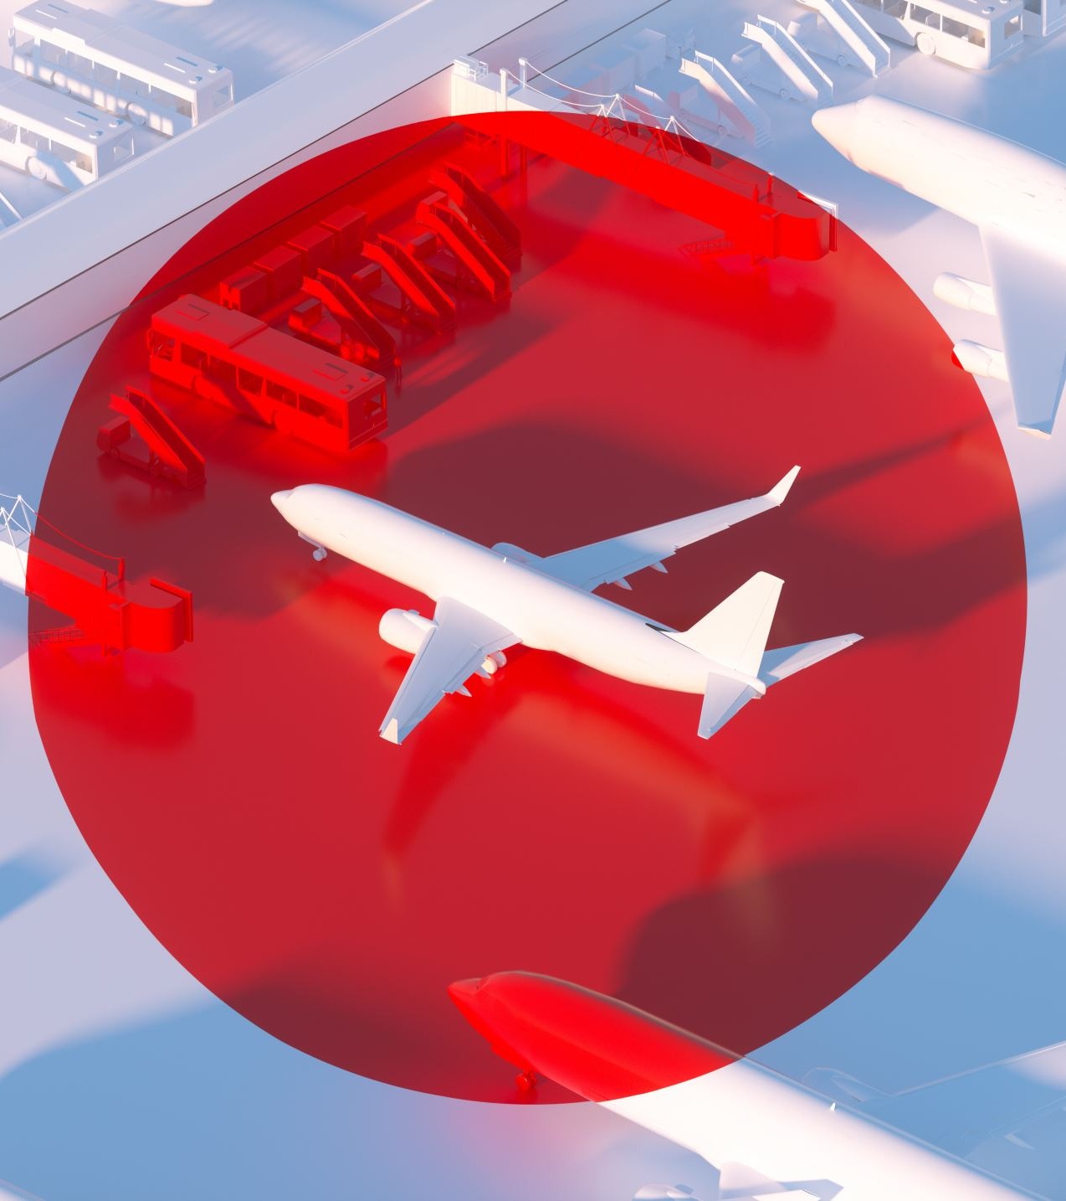
💥 Why Study Airplane Crashes?
Every crash carries data, patterns, and lessons.
Aviation is statistically safe — yet when it fails, it often does catastrophically.
By studying when, where, and why crashes happen, we can:
Identify risk factors
Inform better safety protocols
Understand the human cost and operational gaps

Slide 3

📦 What’s in the Data?
Sourced from Kaggle – Airplane Crashes and Fatalities (1908–2023)
Over 5,300 crash incidents recorded worldwide
Key Features: Date, Location, Aircraft Type, Total Aboard, Fatalities, Ground Fatalities
🔧 Data Preparation Steps:
Cleaned missing values, inconsistent entries
Feature engineered:
Year, Month, Time of Day
Military vs Civilian tag
Crash Severity, Fatality Ratio
Extracted keywords and themes from summaries

Slide 4
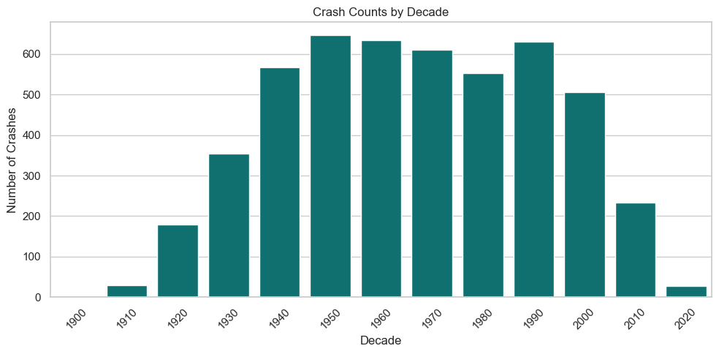
📈 A Century of Crashes
Crashes peaked between the 1950s and 1970s (600+ per decade).
A secondary spike in the 1990s may reflect improved global reporting.
Since 2010, crashes have declined sharply — thanks to tech, regulations & safety reforms.

Slide 5
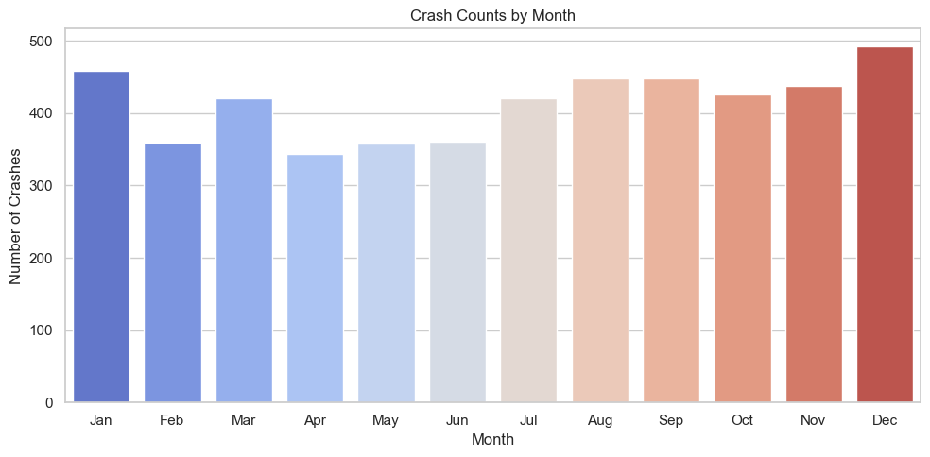
🔄 Patterns in the Clouds: Month-by-Month Crash Insights
Crashes are fairly consistent year-round, but December, January, and August–September show slight peaks.
Whether this is weather-related, traffic volume-related, or just noise in the data requires deeper context.
But Bad things do seem to love the holiday skies.

Slide 6
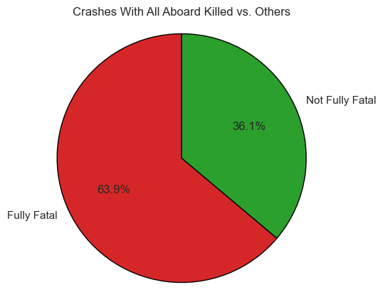
🧍‍♂️ Who Bears the Brunt?
Aviation crashes are often not survivable (63.85% fully fatal incidents).
Passenger deaths far outnumber crew deaths (90k vs 17k), but both groups are heavily affected.
241 crashes also killed people on the ground highlighting wider public risk in aviation disasters.

Slide 7
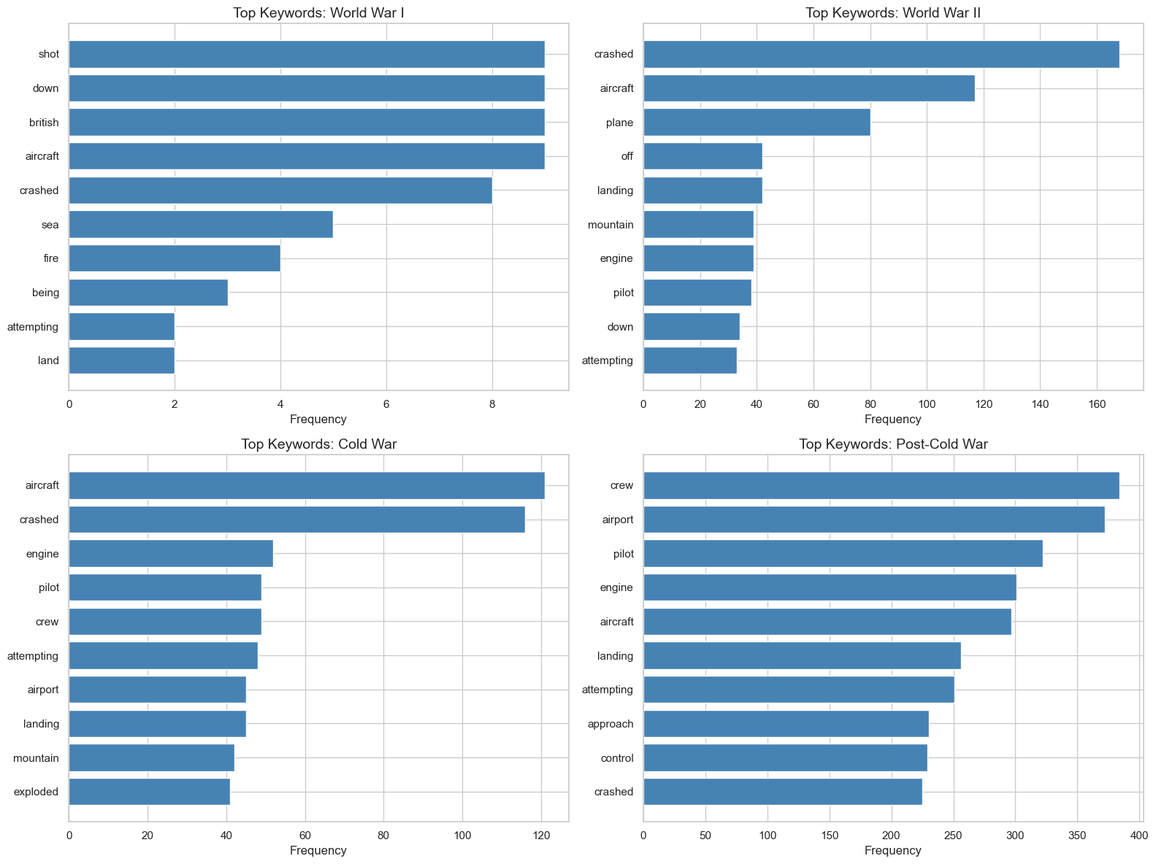
🕰️ Crashes Through the Ages: What the Words Reveal
WWI: Shot, Down, British, Aircraft → combat-focused military losses
WWII: Crashed, Pilot, Engine → large-scale wartime aviation
Cold War: Approach, Crew, Runway → structured military & civil ops
Post–Cold War: Airport, Flight, Pilot → modern commercial aviation issues
🔍 Insight: The crash vocabulary shifts from warfare to aviation safety, reflecting how the skies—and risks—have changed over time.

Slide 8
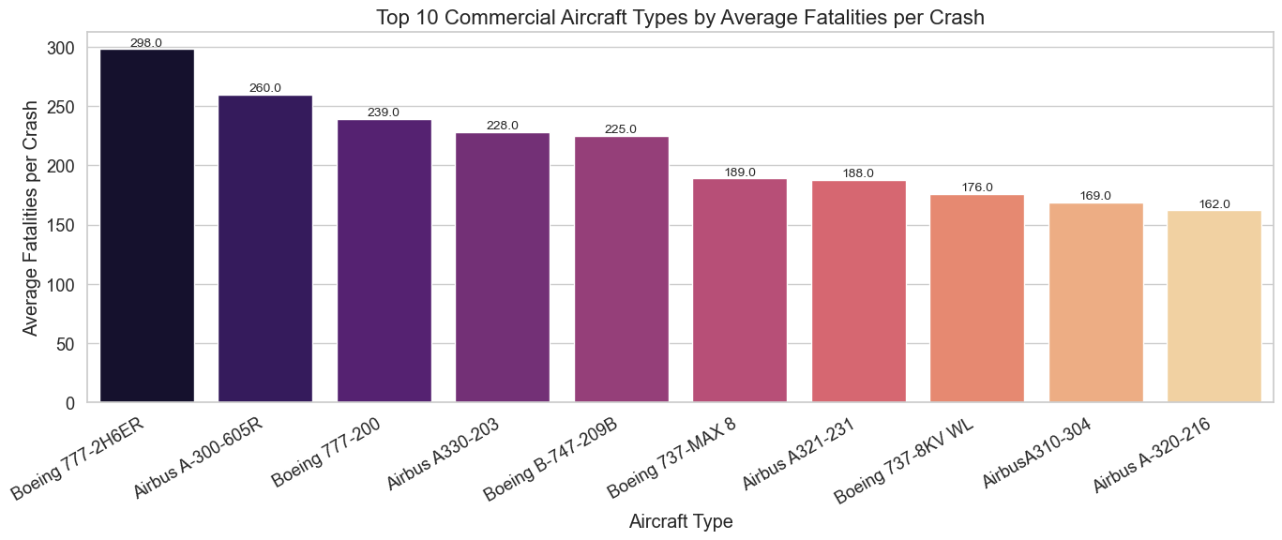
📉 The Risk List: Commercial Planes Behind the Most Losses since 2000
Modern jets like the Boeing 777, Airbus A300, and Boeing 737 MAX 8 top the list for highest average fatalities per crash.

Slide 9
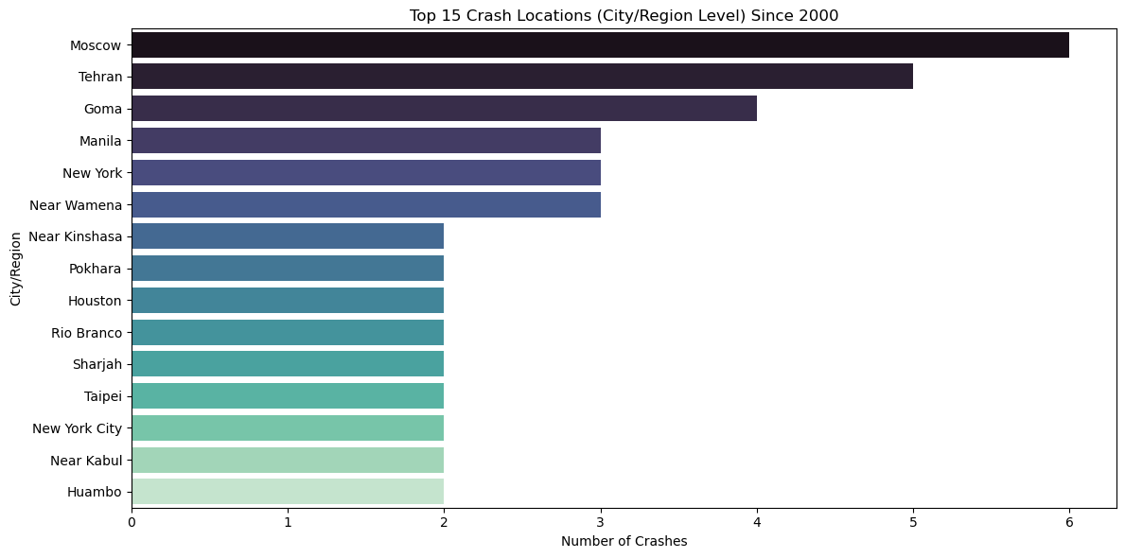
🌍 Where Do Crashes Happen Most? (since 2000)
High-frequency crash zones often correlate with air traffic volume or difficult approach paths.
The majority of crashes occurred on land. Crashes in island, water, and mountain locations are significantly fewer.

Slide 10
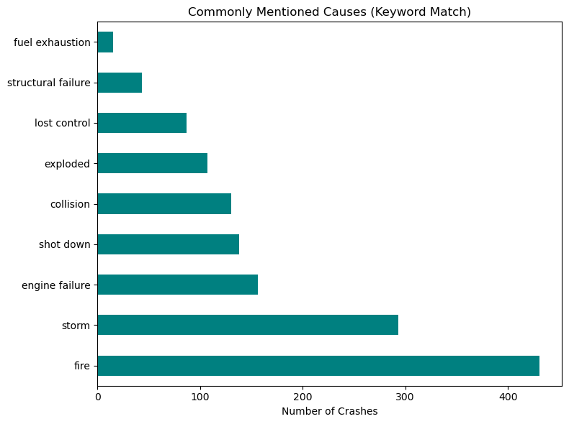
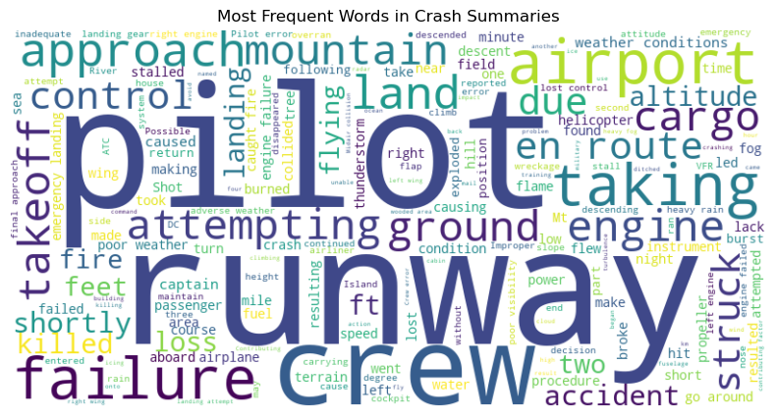
🔤 What Do Crash Summaries Reveal?
The most prominent keywords in crash summaries of the dataset.
The most cited causes in crash summaries include fire, storm, and engine failure.

Slide 11
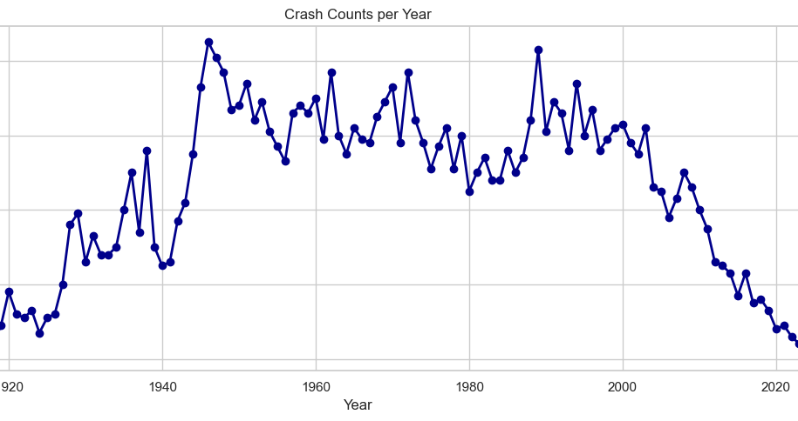
🧠 What We Learned
📉 Aviation has become significantly safer over the decades, with crash numbers and fatalities steadily declining post-2000.
Total-fatal crashes (no survivors): 63.85% of all crashes (3162/4952).
🌍 Crashes aren't random – certain countries, regions, and aircraft types show recurring patterns, revealing systemic or contextual risks.
🔤 Text analysis reveals common causes like engine failure, weather, or “unknown” — with vague reports more common before 2000.
🧑‍✈️ Military crashes were more frequent during wartime, but commercial aviation now dominates crash data.

Slide 12

📬 Thank You
📁 Open to Feedback: Feel free to suggest improvements or collaborations on GitHub Repo.

