Slide 1

B.TECH COMPUTER SCIENCE & ENGINEERING
LETSCART
E-Commerce Reimagined
Fast · Responsive · AI-Ready
A Modern AI-Ready E-Commerce Platform
Shop Smarter, Live Better
Presented by Aayush Kumar Prasad · Internship Evaluation & Placement Interview

Slide 2

ABOUT THE PROJECT
What is LETSCART?
LETSCART is a modern e-commerce platform designed to deliver a fast, responsive, and user-friendly shopping experience — built with production-quality code and scalability at its core.
Phase 1
Phase 3
Production frontend with reusable components
AI-powered search with personalized recommendations
Phase 2
Secure payments and scalable Node.js backend
The current version delivers a complete, polished frontend. Future versions will introduce AI-powered search, secure payments via Stripe, and a full scalable backend.

Slide 3



FRONTEND FEATURES
What's Built Today
Built using a component-based architecture for maximum reusability, consistency, and developer scalability.
🎨 UI & Experience
🛍️ Shopping Features
Responsive Design · Modern Homepage · Beautiful Animations · Clean Typography
Product Cards · Categories · Shopping Cart UI · Wishlist Ready
🧩 Developer-First
⚡ Performance
Reusable Components · Admin Components · Component-Based Architecture
Optimized rendering · Fast load times · Mobile-first design · Scalable codebase

Slide 4









TECHNOLOGY STACK
Built With Modern Technologies
⚙️ Frontend — Live Now
🚀 Future Backend Stack
Next.js 15
React 19
Node.js + Express
PostgreSQL + Redis
App Router · SSR · SSG
Hooks · Concurrent Mode
RESTful API Layer
Data & Caching Layer
Tailwind CSS 4
Python AI
Utility-First Styling
Sentence Transformers
Redux Toolkit
React Hot Toast
Stripe API
Lucide React

Slide 5
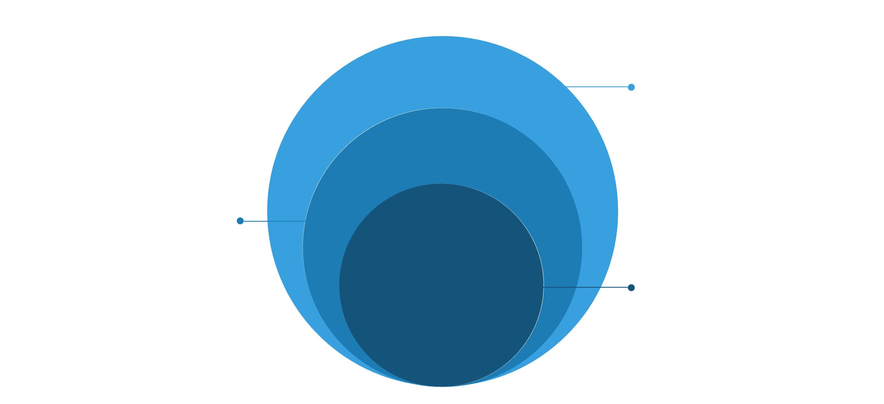
ARCHITECTURE
Project Architecture
Designed for scalability and future enhancements — each layer is modular and independently deployable.
AI & Payments
Python AI services and Stripe payment gateway
Backend & Data
Express REST API, PostgreSQL, Redis cache
Frontend
Next.js UI, pages, and state management
Every layer is independently scalable — from the React frontend to the Python AI microservice — ensuring the platform grows with user demand.

Slide 6




UNIQUE SELLING PROPOSITION
Why LETSCART?
A platform engineered not just for today's users — but designed to scale, adapt, and evolve with AI and modern commerce demands.
✅ Available Now
🔮 Coming Soon
AI-Ready Architecture
Scalable Backend Design
Structured from the ground up to integrate AI services without refactoring.
Node.js + PostgreSQL + Redis architecture built for high-traffic loads.
Responsive Modern UI
Semantic AI Search
Mobile-first design with beautiful animations and premium visual quality.
Python-powered Sentence Transformers for intelligent product discovery.
Component-Based Dev
Secure Payment Integration
Reusable, testable components enabling rapid feature development.
Stripe API integration for a seamless, safe checkout experience.

Slide 7



FUTURE ROADMAP
What's Coming Next
Authentication & Onboarding
Secure Login & Registration with JWT-based sessions and OAuth support.
AI-Powered Commerce
Semantic AI Search · Personalized Recommendations · Smart Filters
Payments, Admin & Vendor Dashboards
Stripe Checkout · Full Admin Controls · Multi-Vendor Marketplace Support
LETSCART is more than an online store — it's a scalable, AI-ready shopping platform built with modern web technologies.
Thank You 🙏
Questions? Let's discuss! · Aayush Kumar Prasad · B.Tech CSE

