Slide 1
CSE Seminar
School of Engineering, CUSAT
Search Engine Optimization
Guided by: Presented by:
Ms. Divya Prakash Ayush Kumar Bharti

Slide 2
Topic Outline
Introduction
How Search Engines Work
SEO Introduction
SEO techniques
White Hat SEO
Black Hat SEO
SEO Methods
On-Page Search Engine Optimization
Off-Page Search Engine Optimization
Conclusion
Bibliography

Slide 3
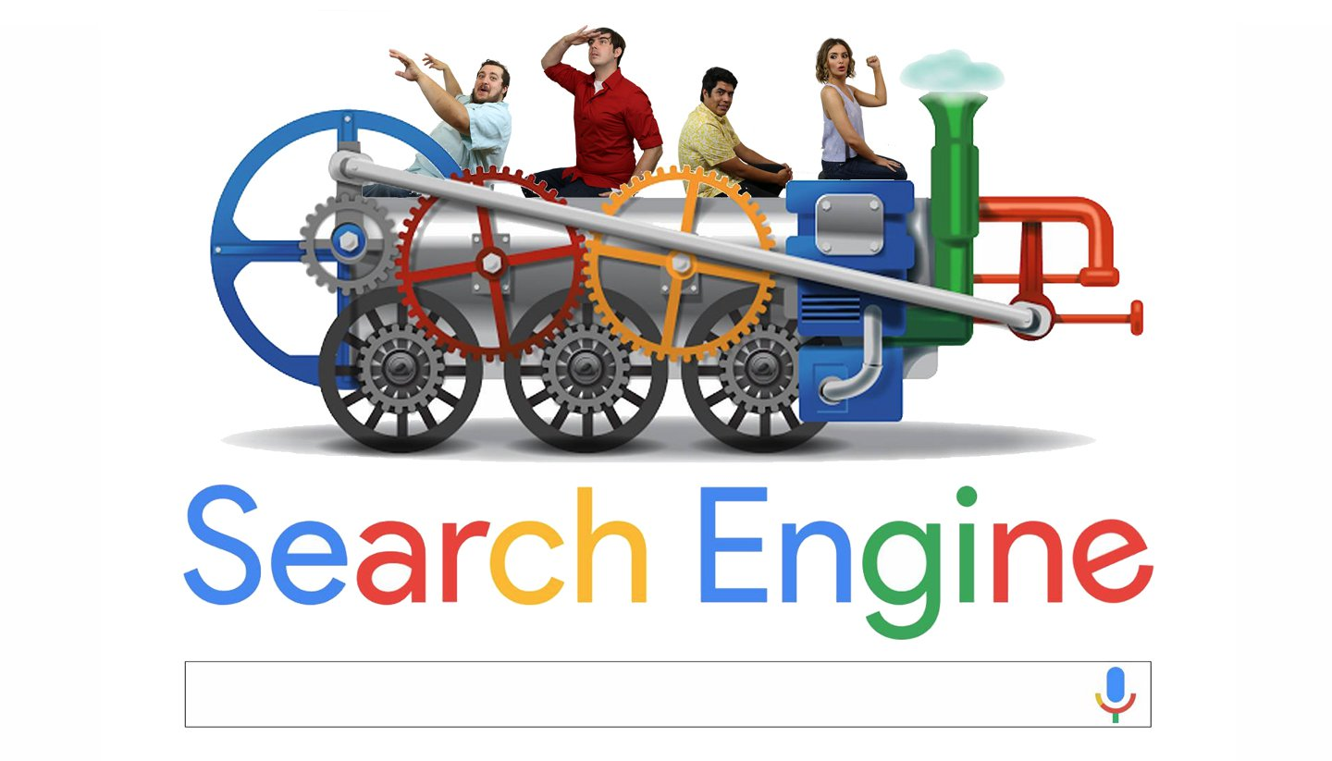

Slide 4
Introduction:
What is a Search Engine?
A search engine is a software system that is designed to search for information on the World Wide Web.
The search results are generally presented in a line of results often referred to as search engine results pages (SERPs). The information may be a mix of web pages, images, and other types of files.
Some search engines also mine data available in databases or open directories. Unlike web directories, which are maintained only by human editors, search engines also maintain real-time information by running an algorithm on a web crawler.

Slide 5
Different Types of Search Engines:
The different types of search engines are as follows:
Crawler-based search engine
Human-powered directories
Meta-search engines
1. Crawler-based search engines:The crawler-based search engines are the search engines like Google, Alta vista, and All the web, these websites make the listings automatically by a software to crawl the web and then make a list of all the site that it has searched.

Slide 6
2. Human-power directories:
The human powered directories are directories like yahoo directory, open directory and look smart, these depend on the human editors to make their listing.
3. Meta-search engine:
The meta-search engines are the search engines like Dogpile and Metacrawler, these search engines send the user supplied keywords at the same time to many individuals search engines for searching the required theme.

Slide 7


Slide 8
How Do Search Engines Work?
A search engine maintains the following processes in near real time and has three main functions:
1. Crawling (to discover content)
2. Indexing (to track and store content)
3. Retrieval (to fetch relevant content when users query the search engine)

Slide 9
1. Crawling:
Crawling is where it all begins: the acquisition of data about a website.
This involves scanning sites and collecting details about each page: titles, images, keywords, other linked pages, etc. Different crawlers may also look for different details, like page layouts, where advertisements are placed, whether links are crammed in, etc.
But how is a website crawled? An automated bot (called a “spider”) visits page after page as quickly as possible, using page links to find where to go next. Even in the earliest days, Google’s spiders could read several hundred pages per second. Nowadays, it’s in the thousands.

Slide 10
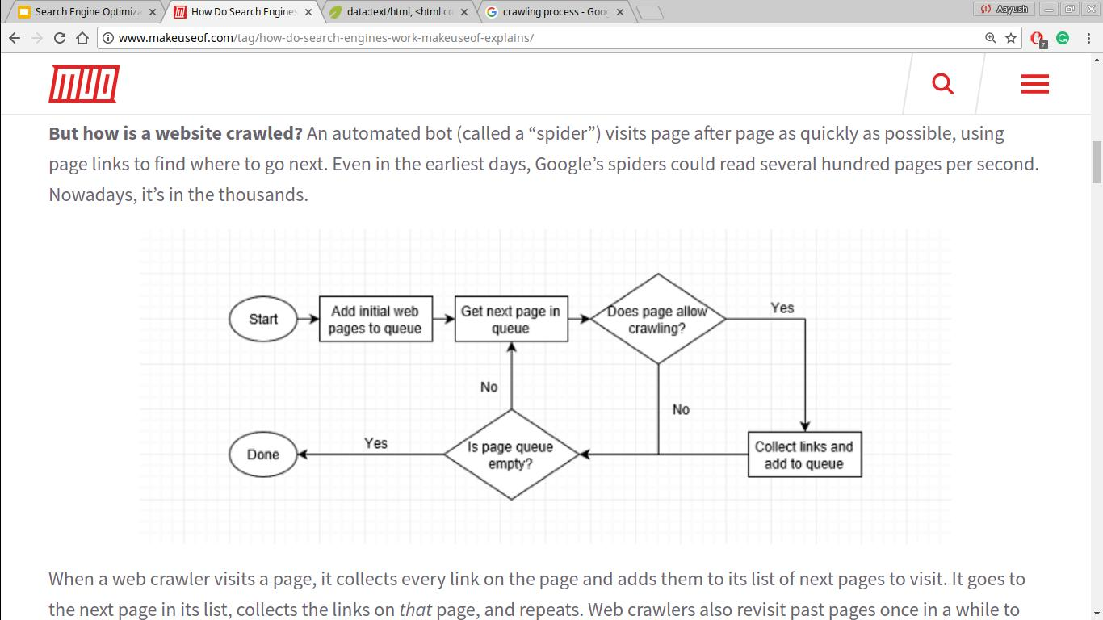
When a web crawler visits a page, it collects every link on the page and adds them to its list of next pages to visit. It goes to the next page in its list, collects the links on that page, and repeats. Web crawlers also revisit past pages once in a while to see if any changes happened.
This means any site that’s linked from an indexed site will eventually be crawled.

Slide 11
2. Indexing:
Indexing is the process of a search engine collecting, parses and stores data for use by the search engine. The actual search engine index is the place where all the data the search engine has collected is stored.
It is the search engine index that provides the results for search queries, and pages that are stored within the search engine index that appear on the search engine results page.

Slide 12
3. Retrieval:
Retrieval is when the search engine processes your search query and returns the most relevant pages that match your query.
Most search engines differentiate themselves through their retrieval methods: they use different criteria to pick and choose which pages fit best with what you want to find. That’s why search results vary between Google and Bing.

Slide 13
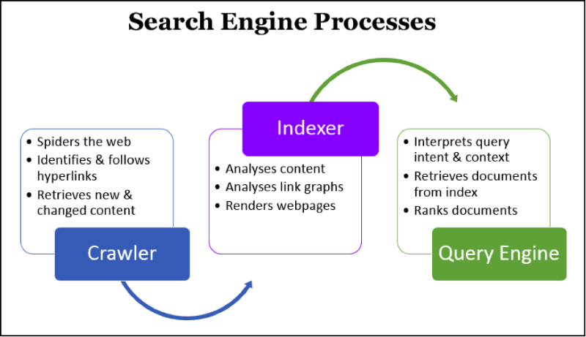

Slide 14
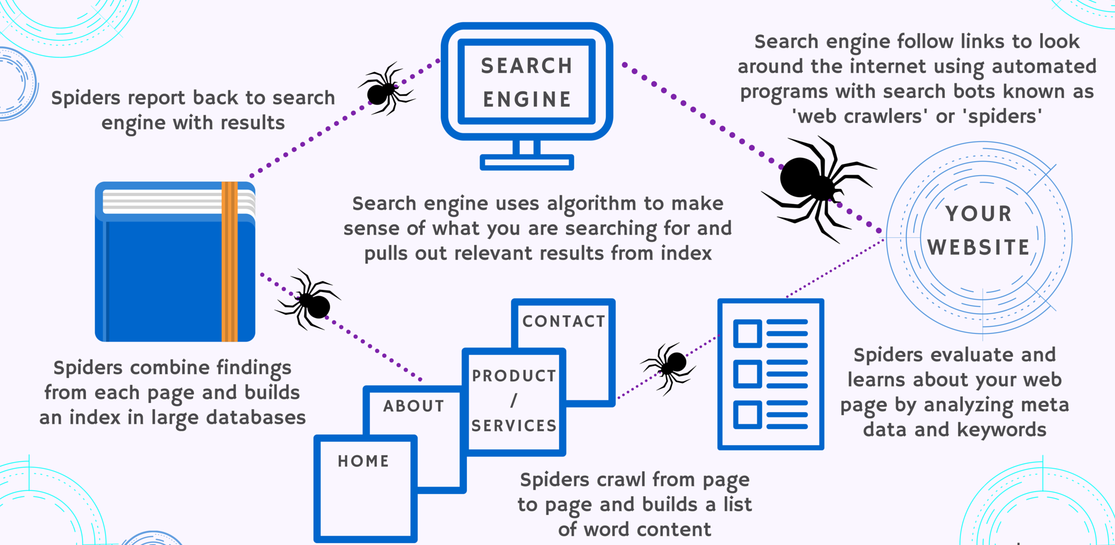

Slide 15
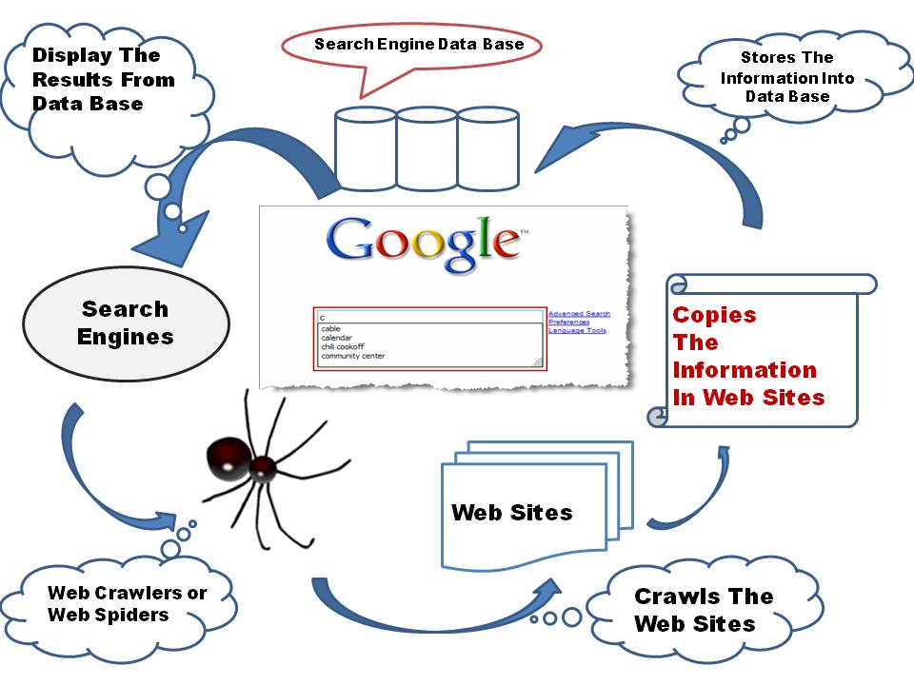

Slide 16
What is SEO ?
SEO stands for Search Engine Optimization. SEO is all about optimizing a website for search engines. SEO is a technique for:
Designing and developing a website to rank well in search engine results.
Improving the volume and quality of traffic to a website from search engines.
Improving rank by understanding how search algorithms work, and what human visitors might search.

Slide 17
SEO techniques:
SEO techniques are classified into two broad categories:
White Hat SEO - Techniques that search engines recommend as part of a good design.
Black Hat SEO - Techniques that search engines do not approve and attempt to minimize the effect of. These techniques are also known as spamdexing.
Notes:
Why do we need to work on seo ?

Slide 18
White Hat SEO:
An SEO tactic is considered as White Hat if it has the following features:
It conforms to the search engine's guidelines.
It does not involve in any deception.
It ensures that the content a search engine indexes, and subsequently ranks, is the same content a user will see.
It ensures that a web page content should have been created for the users and not just for the search engines.
It ensures good quality of the web pages.
It ensures availability of useful content on the web pages.

Slide 19
Black Hat SEO or Spamdexing:
An SEO tactic, is considered as Black Hat or Spamdexing if it has the following features:
Attempting ranking improvements that are disapproved by the search engines and/or involve deception.
Redirecting users to a page that was different from the page the search engine ranked.
Serving one version of a page to search engine spiders/bots and another version to human visitors. This is called Cloaking SEO tactic.

Slide 20
Using hidden or invisible text or with the page background color, using a tiny font size or hiding them within the HTML code such as "no frame" sections.
Repeating keywords in the metatags, and using keywords that are unrelated to the website content. This is called meta-tag stuffing.
Calculated placement of keywords within a page to raise the keyword count, variety, and density of the page. This is called keyword stuffing.
Creating low-quality web pages that contain very little content but are instead stuffed with very similar keywords and phrases. These pages are called Doorway or Gateway Pages.

Slide 21
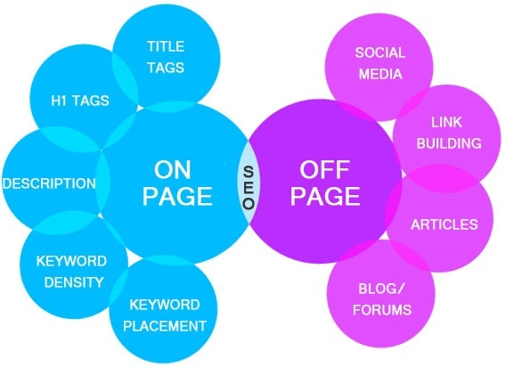
On-Page and Off-Page Search Engine Optimization:

Slide 22
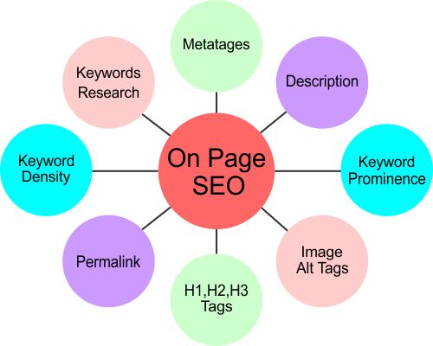
On-Page Search Engine Optimization:

Slide 23
Role of Metatages and Description:
The Metatages and description of your site give search engines somewhat more knowledge into what truly matters to your page.
Role of Image Name and ALT Tags:
If you utilize pictures on your site, you ought to consider befitting keywords for both the picture name and the alt tag. This aids search engines discover great pictures for their image-search for any specific keywords.
Role of Internal Links:
Internal link building is not only the opposite of external links. You can influence web crawlers take in more about your site by internally connecting to different pages on your site, via links within your own content.

Slide 24
Role of Header Tags:
Generally, an SEO friendly blog entry uses three distinct levels of HTML header labels that help break the content into different section and additionally let search engines find out about what really matters to each segment of a content.
The <H1></H1> labels encompass the post title – there ought to just be one arrangement of <H1></H1> tags for each page.
The <H2></H2> and <H3></H3> tags encompass subheadings on the page – there can be numerous occasions of both. Utilizing header labels helps both site-visitors and web search engines separate your content.

Slide 25
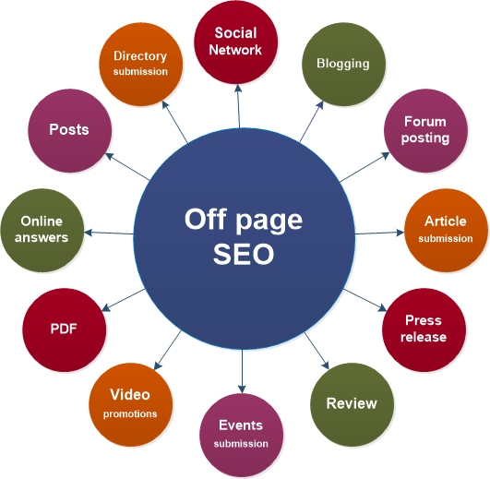
Off-Page Search Engine Optimization:

Slide 26
Search Engine Submission:
Search engines will eventually find your site online, but that can take a while. To speed everything up, you should submit your website to the most popular search engines like Google, Yahoo, Bing, etc.
Article Submission :
If you write your articles yourself, then you can submit them to popular article directory sites like; Ezine, Go Articles, Now Public, etc. This can help drive traffic to your site.
Review:
Write reviews about others businesses or ask your friends/clients to write a review of your business in major business review sites like RateitAll, Shvoong, Kaboodle, Stylefeeder, etc.

Slide 27
Photo Sharing:
If you have used any of your own photos or images on your site, then you can share then on many of the major photo sharing websites like Flickr, Picasa, Photo Bucket, etc. Other people will be able to see them and comment on them, hopefully following a link to your site.
Answer Question :
You can actively participate in answering questions on sites like Yahoo Answers. By answering and asking relevant questions on your site niche, you help to build up your reputation as someone that is an expert in your chosen field. You can place a link to your website in the source section if necessary so that people can easily find your site.

Slide 28
Conclusion:
In conclusion, Search Engine Optimization is constantly changing as new aspects come into play, and others go.
Users are progressively more using mobiles to access the web and it is known to soon outpace web access through personal computers.
Ranking for the key terms in a specific industry on mobile devices, allows a business to take control of users who are continuously searching on the go.
Mobile search is the future of SEO and Google is paying attention to websites that are ‘mobile friendly’.

Slide 29
Bibliography:
[1] http://ieeexplore.ieee.org/document/6113701/Search Engine Optimization Research for Website Promotion
Author Meng Cui and Songyun Hu
INSPEC Accession Number: 12508722, Date Added to IEEE Xplore: 29 December 2011
[2] http://ieeexplore.ieee.org/document/6463486/
How to Use Search Engine Optimization Techniques to Increase Website Visibility
Author John B. Killoran
INSPEC Accession Number: 13325812, Date of Publication: 15 February 2013
[3] https://www.computerhope.com/jargon/s/searengi.htm
[4] http://www.media-mosaic.com/blog/search-marketing/how-search-engines-work-and-know-about-seo-services-in-india/
[5] http://www.makeuseof.com/tag/how-do-search-engines-work-makeuseof-explains/
[6] http://www.totallycommunications.com/latest/search-engine-basics-crawling-indexing-ranking/
[7] https://tinobusiness.com/how-a-search-engine-works-an-explanation-in-3-steps/
[8] http://www.seobook.com/seobook53
[9] http://www.digitalvidya.com/blog/how-seo-works/

Slide 30


