Slide 1
IoT Network Intrusion Detection
Reproducing a CNN-LSTM intrusion detection system on CICIoT2023
Paper: Gueriani, Kheddar & Mazari, "Enhancing IoT Security with CNN and LSTM-Based Intrusion Detection Systems", IEEE PAIS 2024 (DOI 10.1109/PAIS62114.2024.10541178)
Aayushman (231CS105)
Ashutosh Kumar (231CS113)
Sahil Mengji (231CS151)
Notes:
Our project reproduces a published CNN-LSTM intrusion detection system for IoT networks and checks whether its reported 98.42% accuracy holds up on the CICIoT2023 dataset.

Slide 2
What we set out to do
Scientific reproduction and validation, not a new method
1
Rebuild the architecture
CNN-LSTM exactly as drawn in the paper's Fig. 2
98.42%
2
Train on real IoT traffic
CICIoT2023: 105 devices, benign traffic + 33 attack types
3
Detect benign vs malicious
accuracy reported by the paper on CICIoT2023 (binary)
Binary classification of network flows
4
Compare with the paper
Published abstract also reports F1 98.57%, FPR 9.17%, loss 0.0275
Accuracy, precision, recall, F1 vs the reported 98.42%
5
Document every deviation
What differs, and why the numbers might differ
Notes:
The paper claims 98.42% accuracy for binary benign-vs-malicious detection. Our five goals: rebuild the model, train it on the real dataset, get a working detector, compare metrics with the paper, and document every difference.

Slide 3
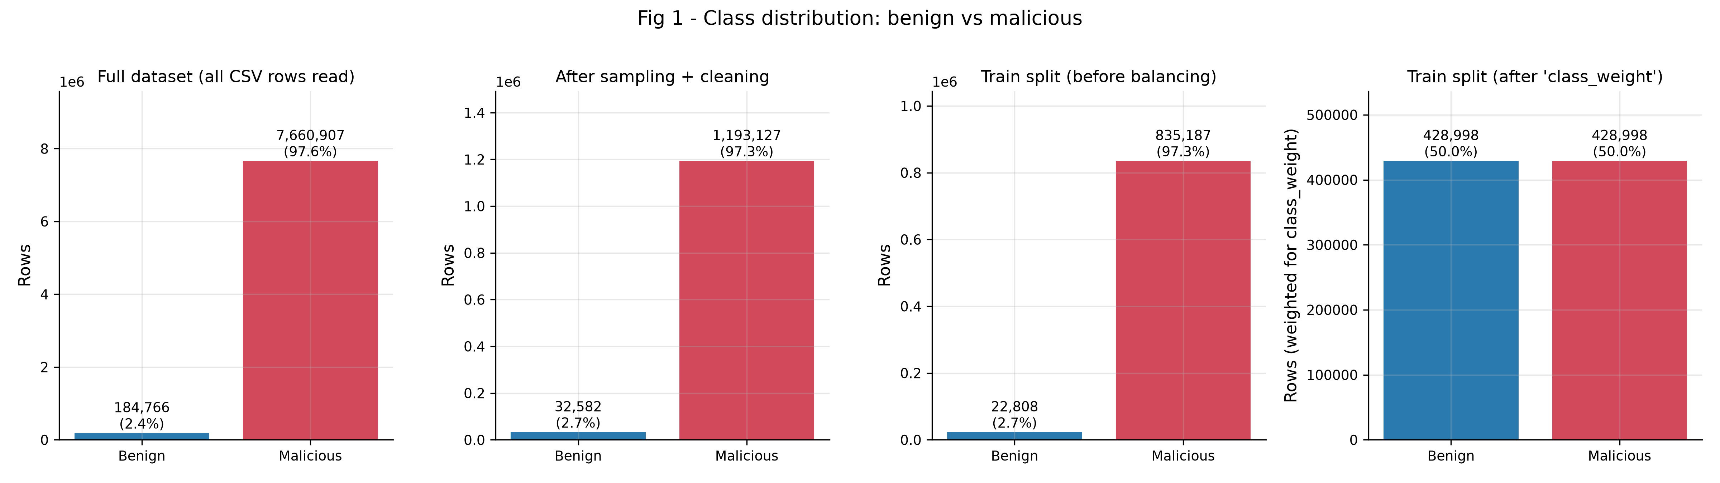
CICIoT2023: heavily skewed toward attacks
Canadian Institute for Cybersecurity, UNB - original 46-feature release
105
33
7.85M
97.3%
IoT devices in the testbed
attack types in 7 families
flows in the files we used
of test flows are attacks
Fig 1 - benign vs malicious counts in the full data, our sample, and the train split before/after class weighting.
Notes:
Only about 2.7% of flows are benign. That matters: a model that always says 'malicious' already gets 97.34% accuracy, so accuracy alone cannot tell us much.

Slide 4
A leakage-safe, resumable pipeline
Each stage saves its outputs and can be re-run on its own
prepare
train
baselines
cv
compare
edge
sample, clean,
split, scale
>
CNN-LSTM
25 epochs
>
CNN, LSTM,
MLP, RF
>
5-fold
stability
>
vs paper
>
TFLite
benchmark
1,399,311 flows sampled (stratified) from 7,845,673
173,602 exact duplicates removed before splitting
Split 70/15/15: 857,995 train / 183,857 val / 183,857 test
41 of 46 features (constant columns dropped)
No data leakage
Scaler, imputer and class weights are fitted on the training split only. Validation and test keep their natural class mix. Automated tests check all of this.
Notes:
Duplicates were dropped before the split so the same flow can never appear in both training and test data. Every statistic the model learns from is computed on training data only.

Slide 5
The CNN-LSTM model (paper Fig. 2)
79,902 parameters; two heads merged into one decision
Input 41x1
Conv1D 64, k3
BatchNorm + AvgPool
Conv1D 64, k3
AvgPool + Flatten
Dense 32
Dense 16
CNN part: finds local patterns across neighbouring flow features
Head A: Dense 2 (softmax)
Concatenate > Dense 2 (softmax)
benign / malicious
Head B: Reshape 16x1 > LSTM 64 > LSTM 64 > Dense 2 (sigmoid)
Assumed (not stated in the paper): pooling size 2, ReLU, batch 256, learning rate 1e-3, early stopping + LR reduction. Paper: Adam, 25 epochs.
Notes:
We read the layer shapes from the paper's architecture figure. The LSTM does not see time here: it reads the 16 numbers produced by the CNN as a short sequence. Hyperparameters the paper does not give are marked as assumptions in config.py.

Slide 6
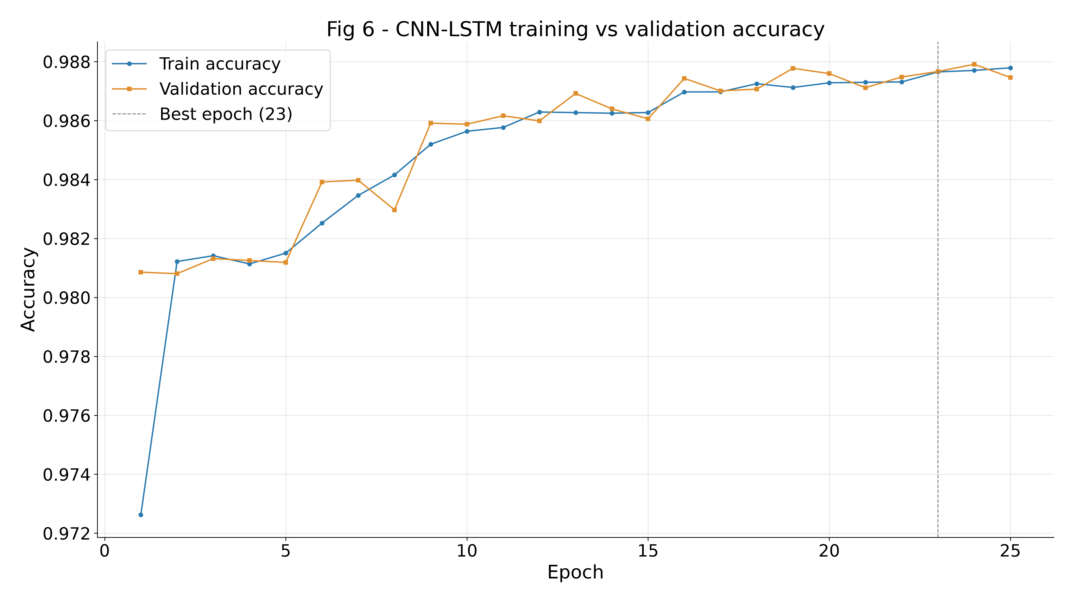
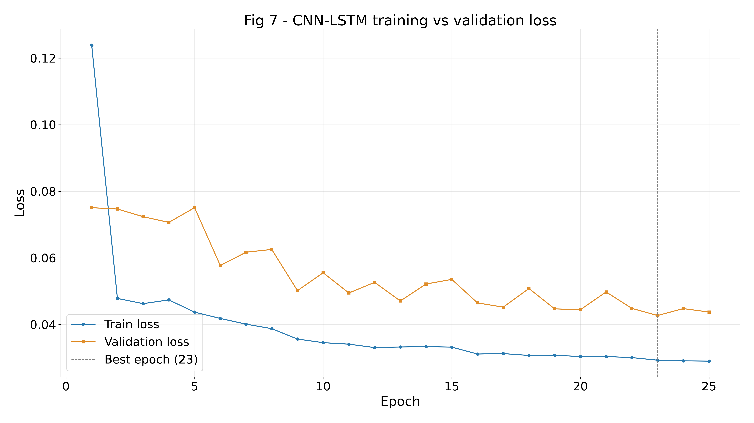
Training on the RTX 4060
25 epochs, best epoch 23, 16.6 min total (about 42 s per epoch)
Validation curves track training closely: no sign of overfitting. The learning rate was halved automatically when validation loss stalled.
Notes:
Training ran in WSL2 on the laptop GPU. The run is resumable: after an earlier crash we added per-epoch checkpoints and memory fixes, and peak RAM stayed below 3 GB.

Slide 7
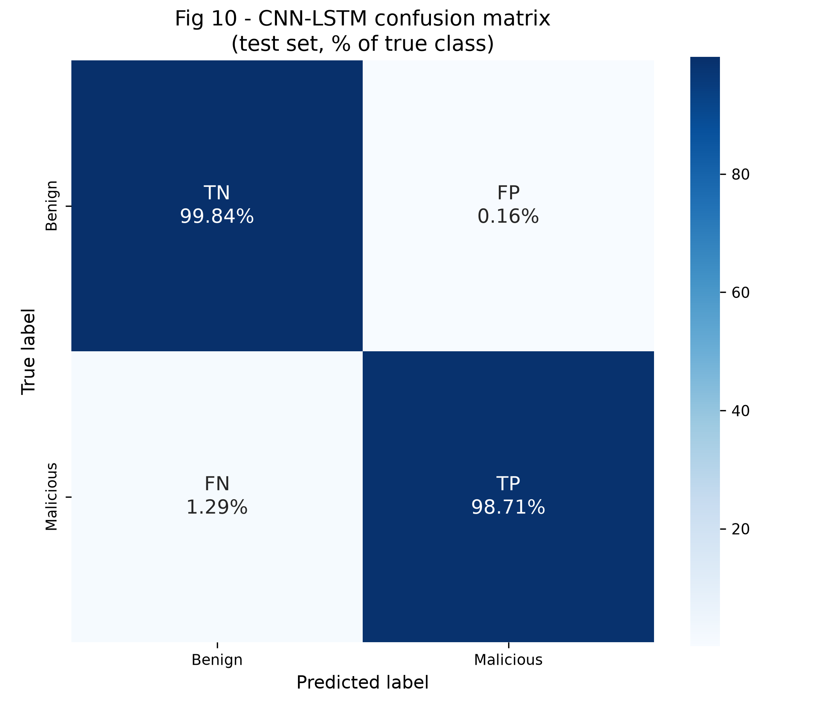
Result: 98.7% accuracy, matching the paper
Held-out test set, 183,857 flows
98.74%
0.818
accuracy (paper 98.42%)
MCC (0 = no skill)
0.16%
1.29%
false positive rate (paper 9.17%)
attacks missed (FNR)
Errors: 2,300 attacks missed vs only 8 false alarms.
Notes:
Our accuracy is 0.32 points above the paper. Our false positive rate is far lower than the paper's 9.17%, because we weighted the rare benign class; the price is that most of our errors are missed attacks.

Slide 8
Our reproduction vs the paper
Paper values from the published abstract; precision/recall only in the full text
Metric | Paper | Ours
Accuracy | 98.42% | 98.74%
F1 | 98.57% | 98.86%
FPR | 9.17% | 0.16%
Loss | 0.0275 | 0.0443
FPR gap: the paper flags about 1 in 11 benign flows. Our class-weighted model almost never does; retrained without class weights our FPR is 6.71%, close to the paper's.
Notes:
Accuracy and F1 land within a third of a point of the paper. Precision and recall are only in the paper's full-text table, which we could not access, so we do not compare them.

Slide 9
Accuracy hides the real story
MCC is robust to class imbalance - and the ranking changes
97.34%
accuracy for 'always malicious' - with MCC 0
0.818 vs 0.826
MCC of CNN-LSTM vs CNN-only: the LSTM branch adds nothing
99.61%
Random Forest accuracy, MCC 0.930 - best model
Notes:
Always predicting malicious scores 97% accuracy but MCC zero. By MCC, the LSTM branch adds nothing over the CNN alone on this data, and a plain Random Forest trained on 300k rows beats every neural model. The paper did not compare against tree models.

Slide 10
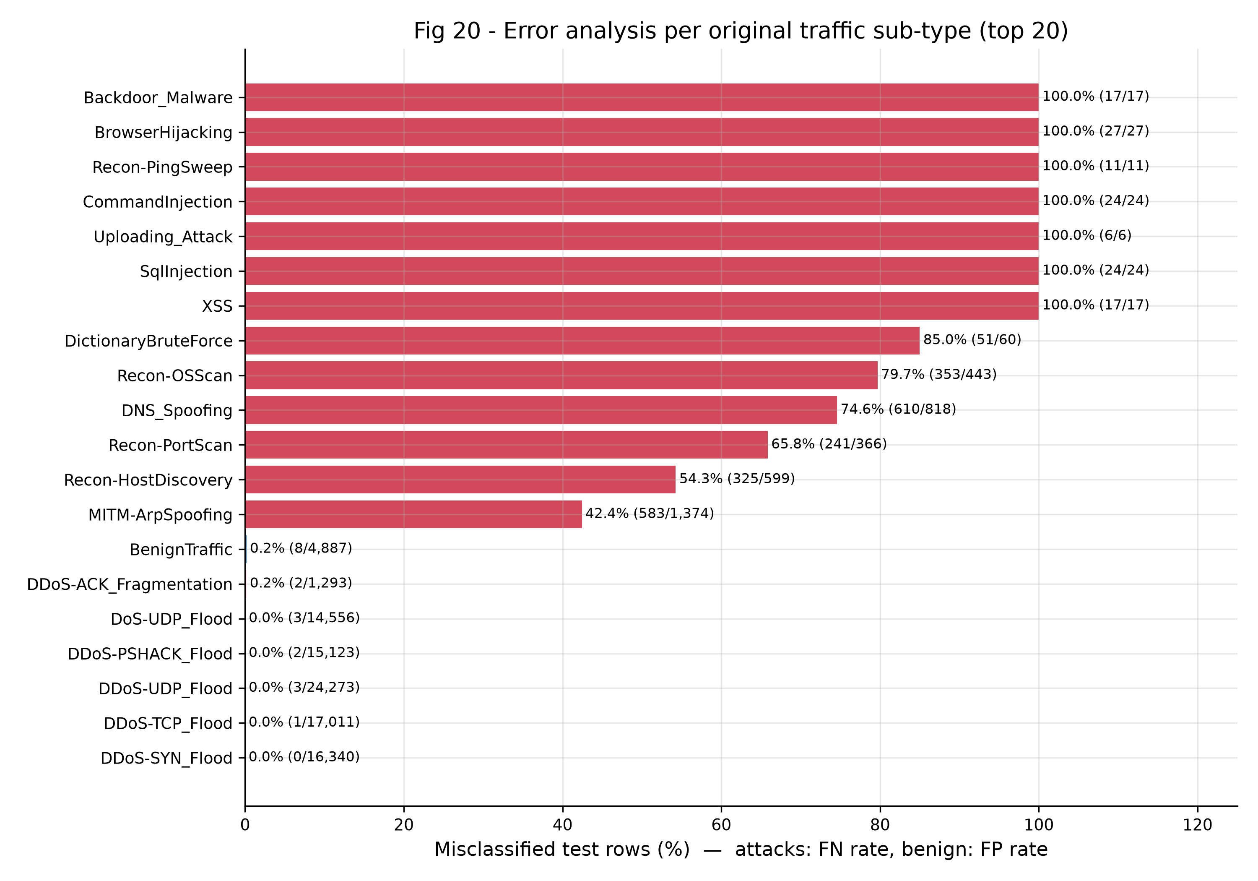
Where the model fails
Share of test flows misclassified, per original traffic type
Floods are easy
DDoS / DoS: close to 0% missed (e.g. DDoS-SYN 0%).
Quiet attacks are hard
Recon-OSScan 80%, DNS spoofing 75%, ARP spoofing 42% missed.
Web attacks: all missed
SQL injection, XSS, backdoor: only 6-27 test flows each; at flow level they look like normal traffic.
Notes:
The model is excellent on high-volume floods and weak on low-volume attacks. These are rare in the data and their flow statistics resemble benign traffic, so class weighting pushes them to 'benign'.

Slide 11
Tuning the trade-off: missed attacks vs false alarms
Threshold chosen on validation data only; test set untouched
Setting | Accuracy | MCC | Missed attacks | False alarms | FPR
Class weights, threshold 0.5 (main) | 98.74% | 0.818 | 2,300 | 8 | 0.16%
Class weights, threshold 0.048 | 99.08% | 0.846 | 1,442 | 257 | 5.26%
No class weights, threshold 0.5 | 99.30% | 0.875 | 951 | 328 | 6.71%
No class weights, threshold 0.543 | 99.28% | 0.873 | 1,058 | 270 | 5.52%
There is no free lunch: every setting moves errors between the two columns. For an IDS the right choice depends on whether analysts can tolerate false alarms or not.
Notes:
Two extra experiments: a decision threshold chosen on validation data, and training without class weights, which is probably closer to the paper's setup. Both cut missed attacks sharply at the cost of more false alarms. The unweighted model has the best MCC, and its false positive rate is close to the paper's 9.17%.

Slide 12
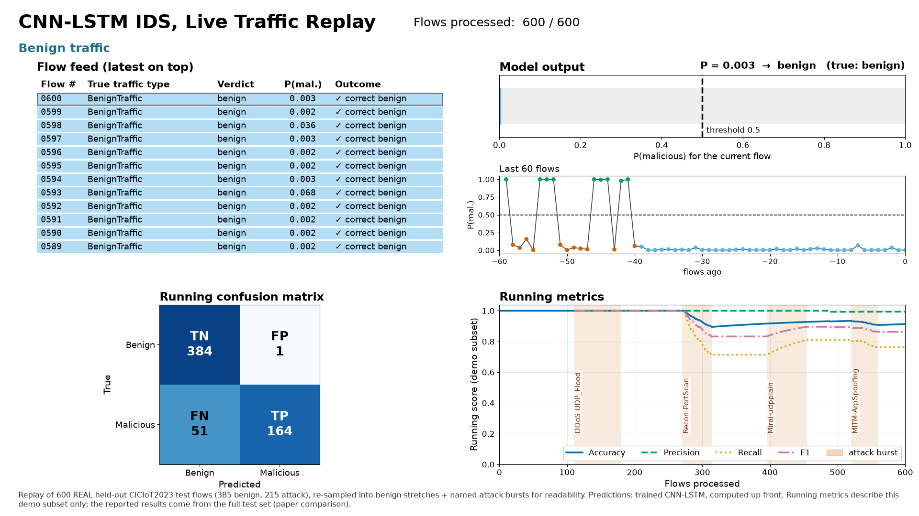
Stable, and small enough for the edge
5-fold cross-validation and TensorFlow Lite export
98.14%
None
CV accuracy, +/- 0.13 pp over 5 folds
accuracy lost by int8 quantization
0.20 MB
0.037 ms
int8 TFLite model size
per flow on CPU, batch 1
A Raspberry Pi could run this model on live flow features.
Live-replay demo: real test flows, real model output (see traffic_replay.mp4)
Notes:
Fold-to-fold spread is tiny. Quantized to int8, the model is 0.20 MB and classifies a flow in 0.037 ms on a CPU with no accuracy loss (float32 TFLite: 0.42 MB).

Slide 13
Why our numbers may differ from the paper
Documented in deviation_analysis.txt
1
Sample
2
Split
3
Duplicates
1.4M-row random sample vs paper's own 1.19M subset
70/15/15 stratified vs paper's 80/20 + separate test files
173,602 removed before splitting (paper: not mentioned)
4
Hyperparameters
5
Class weights
6
Features
batch size, learning rate, pooling assumed
we weight the rare benign class; paper does not say
41 used vs 45 in the paper
Notes:
None of these is a mistake in either work; they are choices the paper does not specify. Removing duplicates before splitting is the one we consider most important for an honest test score.

Slide 14
Conclusions
1
Reproduced: 98.74% accuracy vs the paper's 98.42%
The CNN-LSTM works as described on real CICIoT2023 traffic.
2
Accuracy is not enough
97% of flows are attacks; MCC 0.818 and per-attack errors tell the real story.
3
Simpler models do as well or better
No gain from the LSTM branch; Random Forest is strongest here.
4
Next steps
Multiclass detection, rare-attack handling, and a live Raspberry Pi deployment.
Notes:
We reproduced the paper's headline result, showed why accuracy alone is misleading on this data, and found that simpler models are at least as good. Code, figures and results are all in the repository.

