Slide 1
Securing IoT Networks
A lightweight, flow-based intrusion detector for the IoT gateway
Built by reproducing Gueriani, Kheddar & Mazari, "Enhancing IoT Security with CNN and LSTM-Based Intrusion Detection Systems", IEEE PAIS 2024, on the CICIoT2023 IoT testbed dataset.
Aayushman (231CS105)
Ashutosh Kumar (231CS113)
Sahil Mengji (231CS151)
Internet of Things
Instructor: Mr. Sridhar Sanshi
Notes:
Our topic is IoT security. IoT devices cannot defend themselves, so we look at a small detector that sits at the gateway and watches network traffic. The detector comes from a published paper, which we reproduced.

Slide 2
Why IoT devices are easy targets
They cannot protect themselves, so the network has to
1
Tiny hardware
2
Weak defaults
Little CPU and RAM: no room for antivirus or heavy security software
Default or hard-coded passwords, rarely patched firmware
3
Always on, always connected
4
Many device types
Cameras, plugs and sensors stay online 24/7 and are reachable from the internet
Different vendors and protocols make one-size-fits-all security hard
Result: one hacked camera can join a botnet, flood other sites, or scan the whole home network.
Notes:
IoT devices are constrained and often ship with weak credentials. They cannot run an antivirus. A compromised device is usually silent: the owner sees nothing, but the device attacks others.

Slide 3
What attacks hit IoT networks
The 7 attack families in CICIoT2023 (33 attack types in total)
DDoS
DoS
Mirai
Recon
Many hacked devices flood one target (ICMP, UDP, SYN floods)
A single source floods a target until it stops responding
Botnet malware traffic: greeth, UDP and similar floods
Port scan, OS scan, vulnerability scan: mapping the network
Spoofing
Web
Brute force
Benign
ARP and DNS spoofing: man-in-the-middle on the LAN
SQL injection, XSS, command injection, backdoor, upload attacks
Dictionary attack on device or service passwords
Normal device traffic: what the IDS must NOT flag
Red = high-volume floods. Amber = quiet attacks that look like normal traffic.
Notes:
Floods are loud and easy to see. Reconnaissance, spoofing and web attacks are quiet and are the hard cases, as our error analysis will show later.

Slide 4
Our idea: an IDS at the IoT gateway
Every device's traffic passes through the gateway, so one detector protects them all
IP camera
IoT gateway
Internet / cloud
1 Group packets into flows
Smart plug
2 Compute flow features
Sensor
3 Lightweight ML model: benign or attack?
ALERT / block the device
Notes:
The detector does not run on the tiny devices. It runs on the gateway, where all traffic is visible. This slide is the proposed deployment. In this project we evaluated the detector on a recorded dataset; running it live on a gateway is future work.

Slide 5
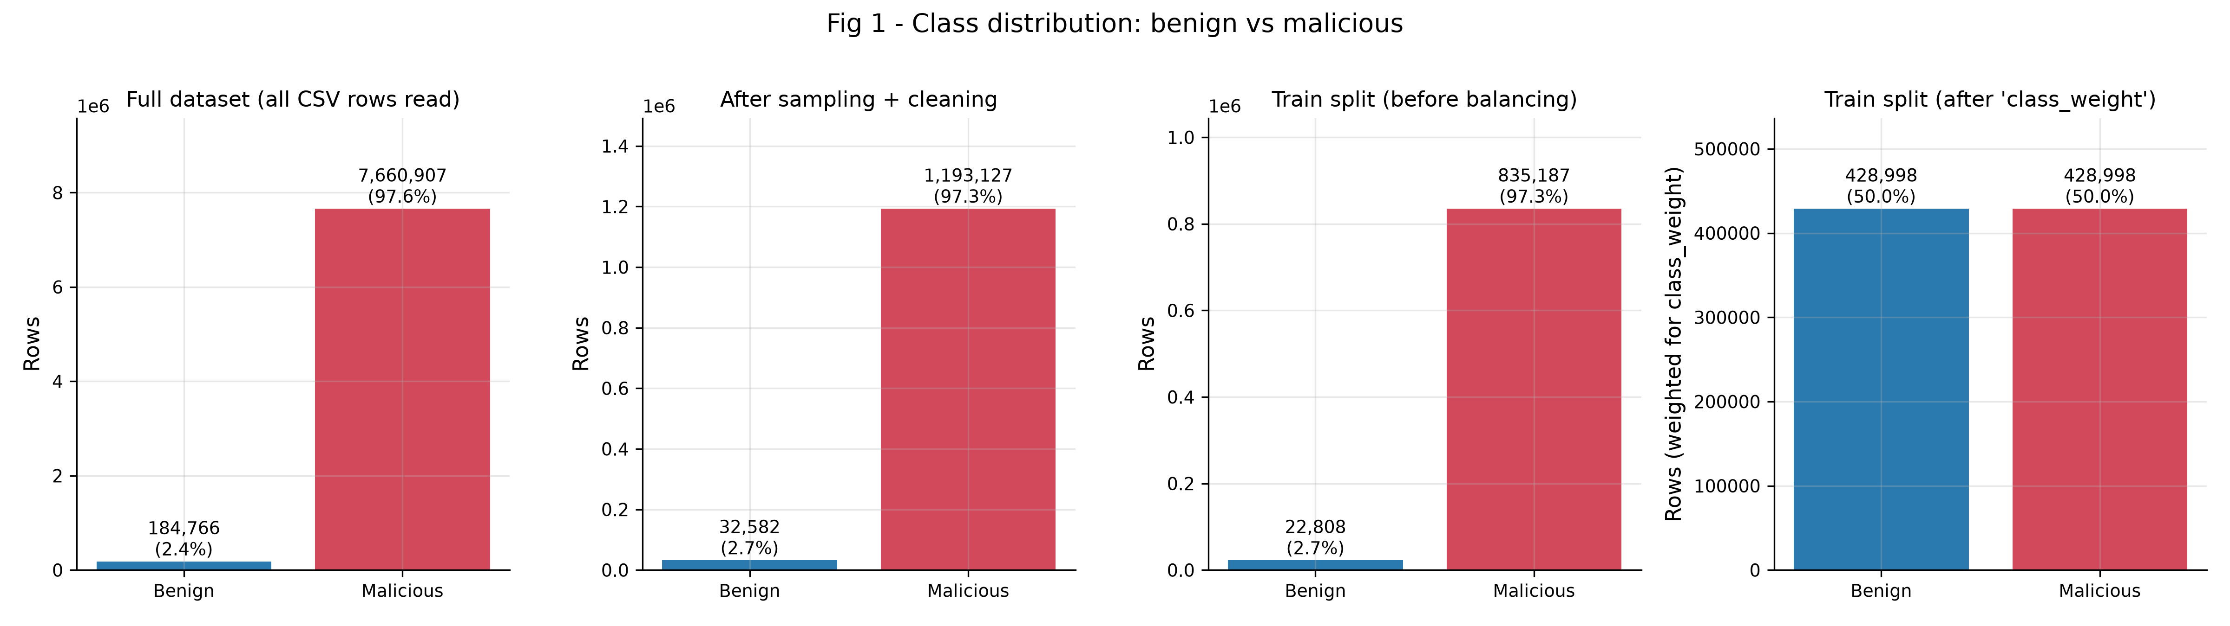
Data: CICIoT2023, captured from a real IoT lab
Canadian Institute for Cybersecurity (UNB): attacks launched against real devices
105
33
7.8M
97.3%
real IoT devices in the testbed
attack types, 7 families
network flows in the files we used
of the flows are attacks
Fig 1 - benign vs malicious counts: full data, our sample, and the training split before/after class weighting.
Notes:
The data is recorded traffic from a real IoT lab with 105 devices. We use this recorded traffic; we did not capture our own. Only about 2.7% of flows are benign, which will matter when we read the results.

Slide 6
From raw traffic to a decision
The detector sees flows, not individual packets
Packets
Flows
46 features
Model
Alert
>
>
>
>
raw network
traffic
one connection =
one flow
per flow
benign or
malicious
if malicious
Example flow features
Why this works for IoT
Flow duration, packet rate
TCP flag counts: SYN, ACK, FIN, RST
Protocol: TCP, UDP, ICMP, DNS, HTTP, ARP
Packet size and inter-arrival time statistics
A flood has a huge packet rate and many SYN flags; a scan sends many tiny probes; IoT devices normally talk in simple, repetitive patterns. Attacks break those patterns, and the flow features capture that.
Notes:
CICIoT2023 already provides flow-level features, which is what we train on. In a live system, a flow extractor such as CICFlowMeter would have to produce the same features on the gateway.

Slide 7
The detector: a small neural network
Design goal: accurate enough, and small enough for an edge device
41 flow
features
CNN layers
Dense layers
LSTM branch
Benign /
Malicious
>
>
>
>
79,902
1.0 MB
25 epochs
parameters in total
model file (Keras)
17 min on a laptop GPU
CNN-LSTM exactly as in the paper's Fig. 2. Unstated details (batch size, learning rate, pooling) are documented assumptions. The deep-learning internals are in our report; here we care about what it means for IoT.
Notes:
We keep the model description short on purpose. It is a convolutional layer stack followed by an LSTM branch, about 80 thousand parameters. The important number for IoT is the size: around one megabyte.

Slide 8
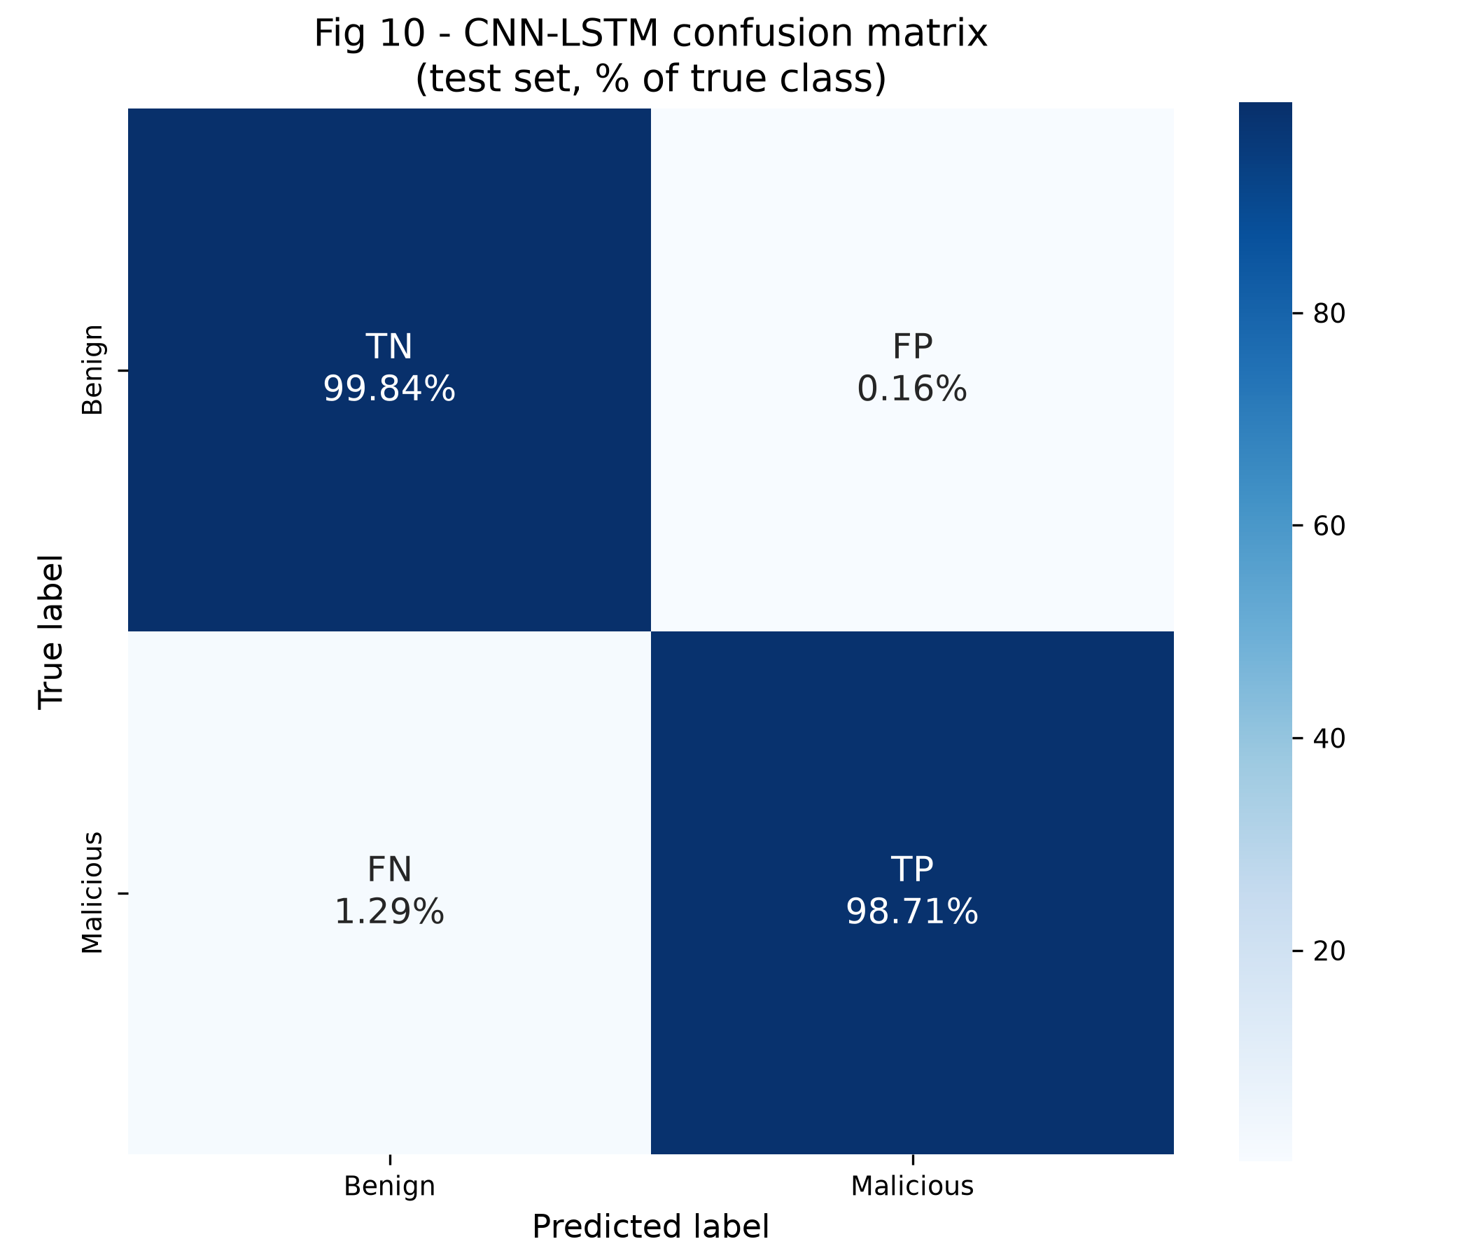
Result: it catches almost every attack
Held-out test set: 183,857 flows the model never saw
98.74%
98.7%
accuracy (paper: 98.42%)
of attacks detected
8
2,300
false alarms on benign traffic (0.16%)
attacks missed (1.29%)
False alarms matter for IoT: a wrongly blocked device (a door lock, a camera) is a real outage. Here only 8 benign flows were flagged.
Caution: 97.3% of flows are attacks, so even "always say attack" scores 97.3% accuracy. That is why we also report false alarms and MCC (0.82).
Notes:
Accuracy is 98.74%, 0.32 points above the paper's 98.42%. But accuracy alone is misleading on this imbalanced data, so we focus on attacks caught and false alarms.

Slide 9
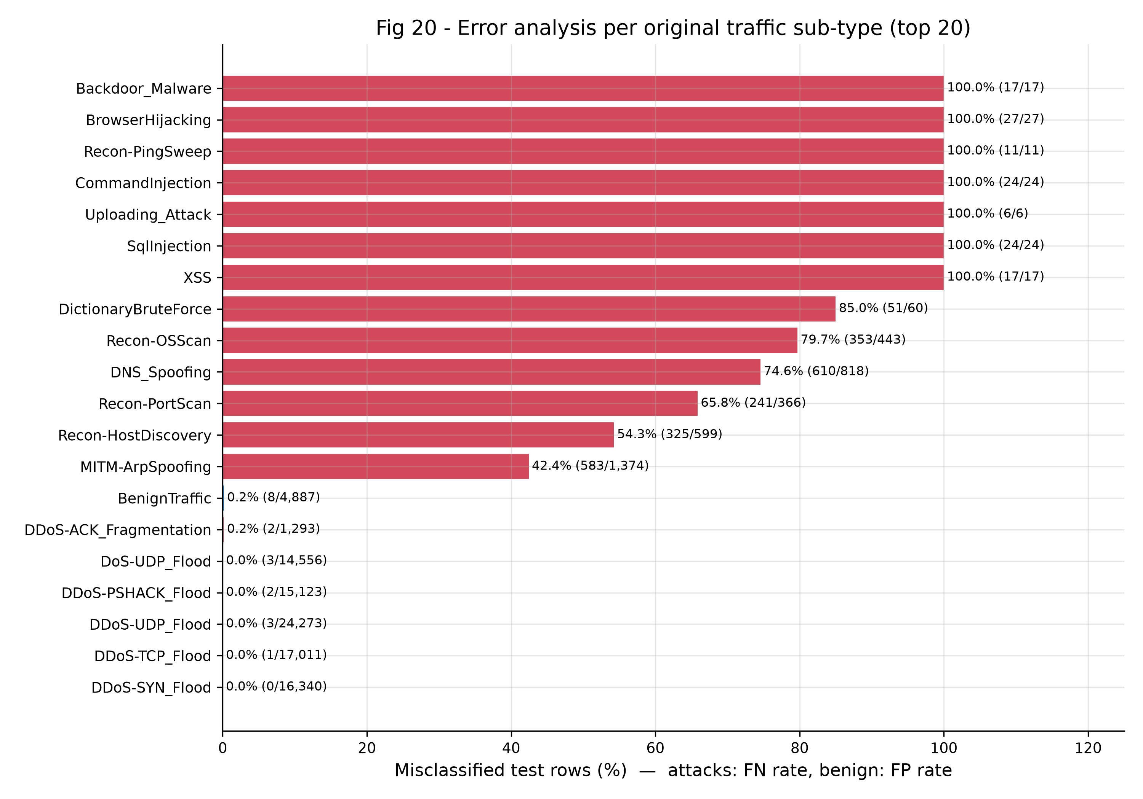
Which IoT attacks does it miss?
Share of test flows misclassified, per original traffic type
Floods: easy
DDoS and DoS are almost never missed (DDoS-SYN 0%).
Quiet attacks: hard
Recon-OSScan 80%, DNS spoofing 75%, ARP spoofing 42% missed.
Web attacks: mostly missed
SQL injection, XSS, backdoor: few samples and they look like normal traffic at flow level.
Implication: a flow-level IDS is one layer. Pair it with device hardening and application-level checks.
Notes:
The detector is excellent on loud attacks and weak on quiet ones. That is an honest limit of looking at flow statistics only, and it is why we describe the IDS as one security layer, not the whole solution.

Slide 10
Small and fast enough for a gateway
TensorFlow Lite export, measured on a laptop CPU, one flow at a time
0.20 MB
int8 model: 5x smaller than Keras
0.037 ms
to classify one flow on a CPU
No loss
of accuracy after int8 quantization
Not yet tested on real IoT hardware (e.g. Raspberry Pi): that is our next step.
Notes:
Quantized to int8 the model is 0.20 MB and takes 0.037 ms per flow on a CPU, with no accuracy loss. This suggests it would fit a gateway like a Raspberry Pi, but we have only measured on a laptop CPU, so we say 'suggests', not 'proves'.

Slide 11
Do we even need the CNN-LSTM?
An honest finding for resource-limited IoT: simpler models do as well
Model | Accuracy | False alarms | Missed attacks | MCC | Size (MB)
CNN-LSTM (paper) | 98.74% | 8 | 2,300 | 0.818 | 1.04
CNN only | 98.82% | 8 | 2,167 | 0.826 | 0.41
Random Forest | 99.61% | 94 | 620 | 0.930 | 4.38
The LSTM branch adds nothing: CNN-only MCC 0.826 vs CNN-LSTM 0.818.
A Random Forest trained on only 300,000 flows is the strongest (accuracy 99.61%, MCC 0.93).
The paper did not compare against classical models. For constrained IoT gateways, a simple model is attractive: easier to deploy and to audit.
Notes:
This is our main critical finding. The paper's architecture works, but its LSTM branch gives no measurable benefit, and a plain Random Forest beats it. For IoT, where simplicity matters, that is a useful result.

Slide 12
Reproduction check against the paper
Paper values from the published abstract
Metric | Paper | Ours
Accuracy | 98.42% | 98.74%
F1 | 98.57% | 98.86%
False pos. rate | 9.17% | 0.16%
Our false positive rate is far lower because we weighted the rare benign class. Without class weights it is 6.71%, close to the paper's 9.17%. Data subset, split and hyperparameters also differ.
Notes:
The headline claim reproduces. Differences come from the data subset, the split, removed duplicates and unstated hyperparameters; all are listed in our report.

Slide 13
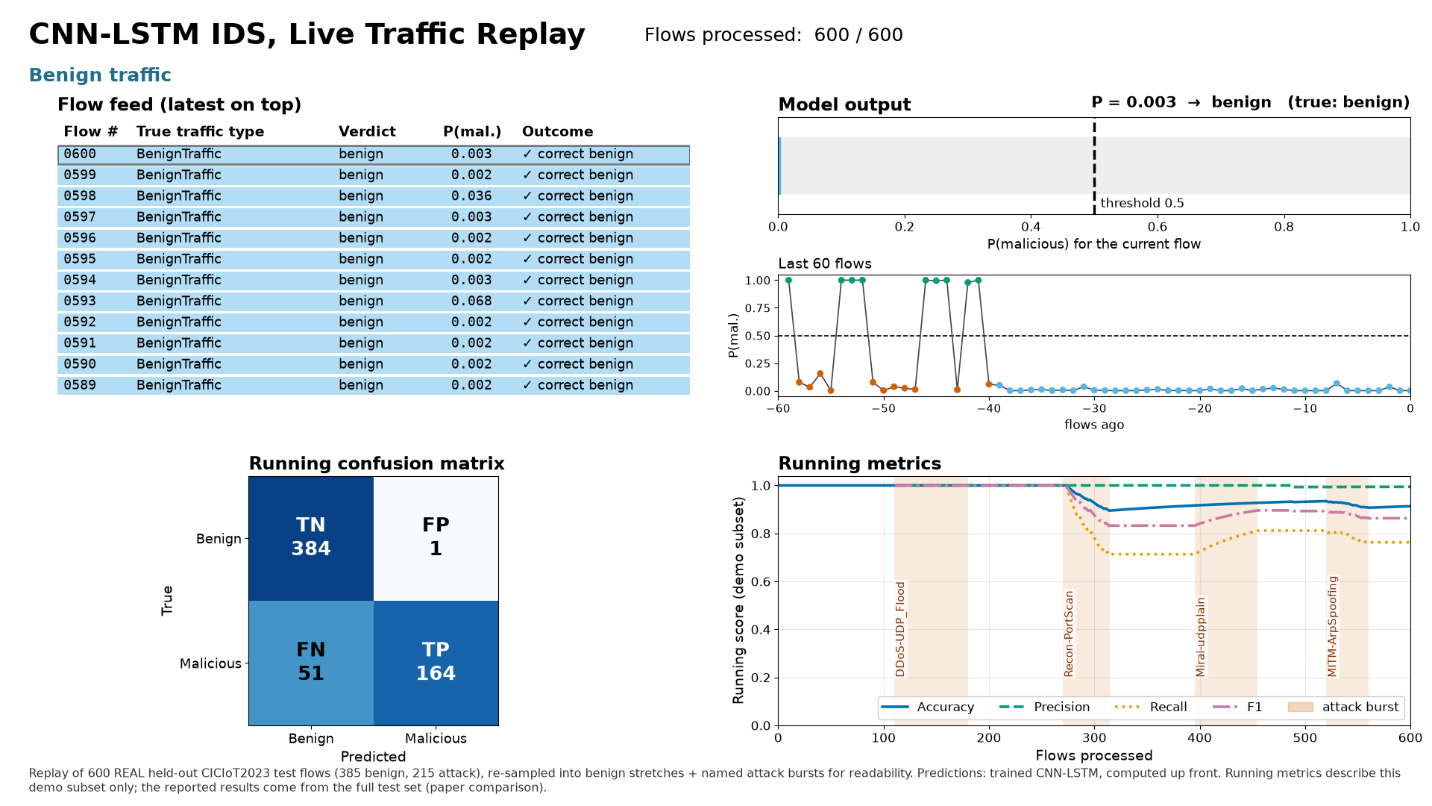
Demo: replaying real IoT flows through the detector
Real held-out test flows, real model output (traffic_replay.mp4)
Benign flows stay far below the alert threshold
A DDoS burst pushes the score to ~1.0 and fires the alert
Quiet recon and spoofing flows are sometimes missed
This is a replay of recorded flows, not live network traffic. The stream is re-sampled to be watchable, so its running numbers are not the reported results.
Notes:
Play traffic_replay.mp4 here. Stress that this is recorded data replayed, not a live network.

Slide 14
Limits and next steps toward a real IoT deployment
What we did, and what is still missing
Done
Not done yet
Detector trained on real IoT lab traffic
98.7% accuracy, only 8 false alarms in 183,857 flows
5-fold CV: stable at 98.1%
Exported to 0.20 MB TFLite model
Run on real gateway hardware (Raspberry Pi)
Live packet capture and flow extraction with the same 46 features
Detect unseen attacks and new devices
Better coverage of quiet attacks (recon, spoofing, web)
Notes:
Be upfront: we did not deploy on hardware and we did not capture live traffic. The biggest practical gap is live flow-feature extraction that matches the dataset's feature definitions exactly.

Slide 15
Takeaways
1
IoT devices cannot defend themselves
A gateway IDS protects all of them without loading the devices.
2
It works: 98.74% accuracy, 8 false alarms
Reproduces the paper's 98.42% on real IoT lab traffic.
3
Small enough for the edge
0.20 MB and 0.037 ms per flow (laptop CPU, no accuracy loss).
4
Honest limits
Quiet attacks are missed, a Random Forest does as well, and live hardware deployment is future work.
Notes:
Close on the IoT message: protect many weak devices from one place, with a model small enough for the edge.

