Slide 1
EAS 587 - Phase 4 - Spring 2026
Lending Club
Loan Default Prediction
Same use case, four implementations:
pandas -> scikit-learn -> Spark + MCP -> conversational UI
Team - 404 Team Not Found
Aayush Nepal | Junwei Zhang | Lusi Zhang
Final presentations: week of May 4, 2026

Slide 2
The use case
A peer-to-peer lender's question, restated as a binary classification problem
The lender's question
314,212
"Given a loan application, what is the probability
this borrower will charge off rather than fully repay?"
completed loans 2017 (test set)
21.0%
Decisions the model supports
actual charge-off rate
- Approve / decline at origination
- Risk-based pricing (interest rate)
- Portfolio-level default rate forecast
~4 to 1
- Manual-review queue for borderline loans
fully paid : default class imbalance
EAS 587 Phase 4 - Lending Club Loan Default Prediction
2 / 13

Slide 3
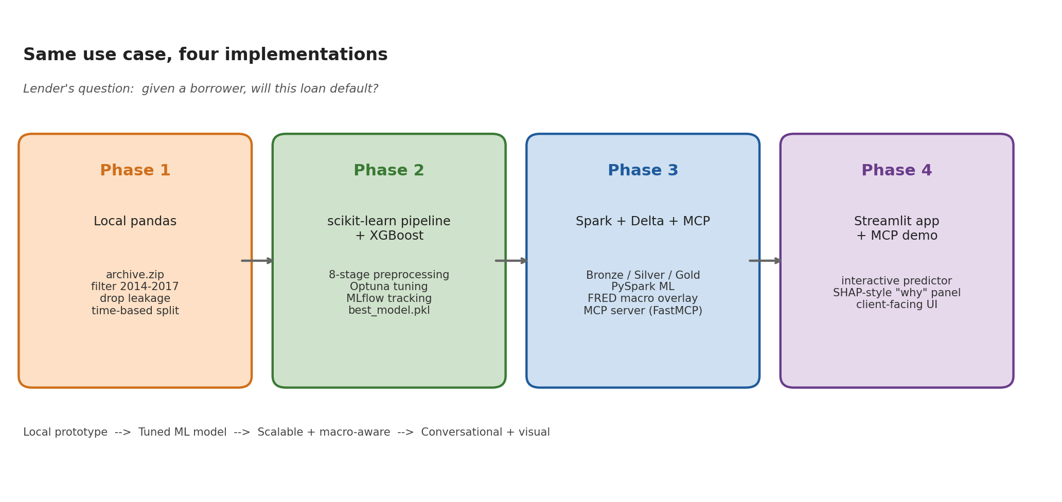
Project evolution
One question, four artifacts of increasing scale and reach
Phases 1+2 received perfect scores; we retained the time-based split, leakage discipline, and 8-stage pipeline and built on top.
EAS 587 Phase 4 - Lending Club Loan Default Prediction
3 / 13

Slide 4
Data foundations
PHASE 1
Filter, define the target, and split with leakage discipline
FILTER - 2014 to 2017
TARGET - charged_off
SPLIT - time-based
- Pre-2014 issuance volume too sparse to be representative.
- Keep only loans with terminal status (Fully Paid / Charged Off).
- Train: first 80% of 2014 to 2016 by issue_d.
- Post-2017 loans not matured: charge-off labels unreliable.
- Class balance: ~80% paid / 20% default.
- Val: last 20% of 2014 to 2016.
- ~1.2M completed loans after filter, sorted chronologically.
- No SMOTE or class re-weighting -- model handles imbalance natively.
- Test: ALL of 2017 (held out, ~314k loans).
- Random splits would leak the macro environment.
Leakage discipline -- our most defensible Phase 1 decision
We dropped 21 post-loan columns that only get values AFTER the outcome is known: total_pymnt*, recoveries, last_pymnt_*, last_fico_range_*, hardship_flag, and full settlement details. Most public Lending Club notebooks accidentally train on these.
EAS 587 Phase 4 - Lending Club Loan Default Prediction
4 / 13

Slide 5
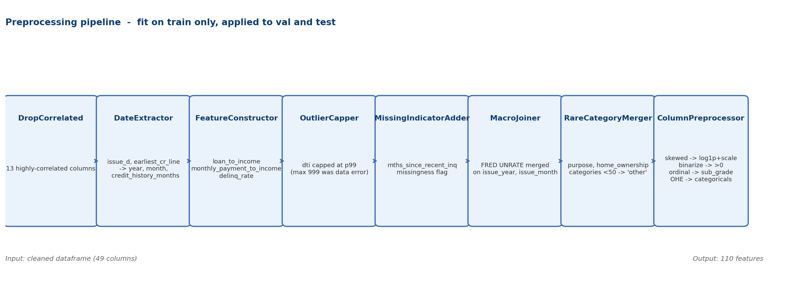
8-stage preprocessing pipeline
PHASE 2
Custom scikit-learn transformers, fit on train only, applied identically to val + test
Engineered features
Macro overlay
loan_to_income, monthly_payment_to_income, delinq_rate,
credit_history_months, issue_year, issue_month
FRED UNRATE merged on issue (year, month).
Secondary data source flagged in the rubric.
EAS 587 Phase 4 - Lending Club Loan Default Prediction
5 / 13

Slide 6
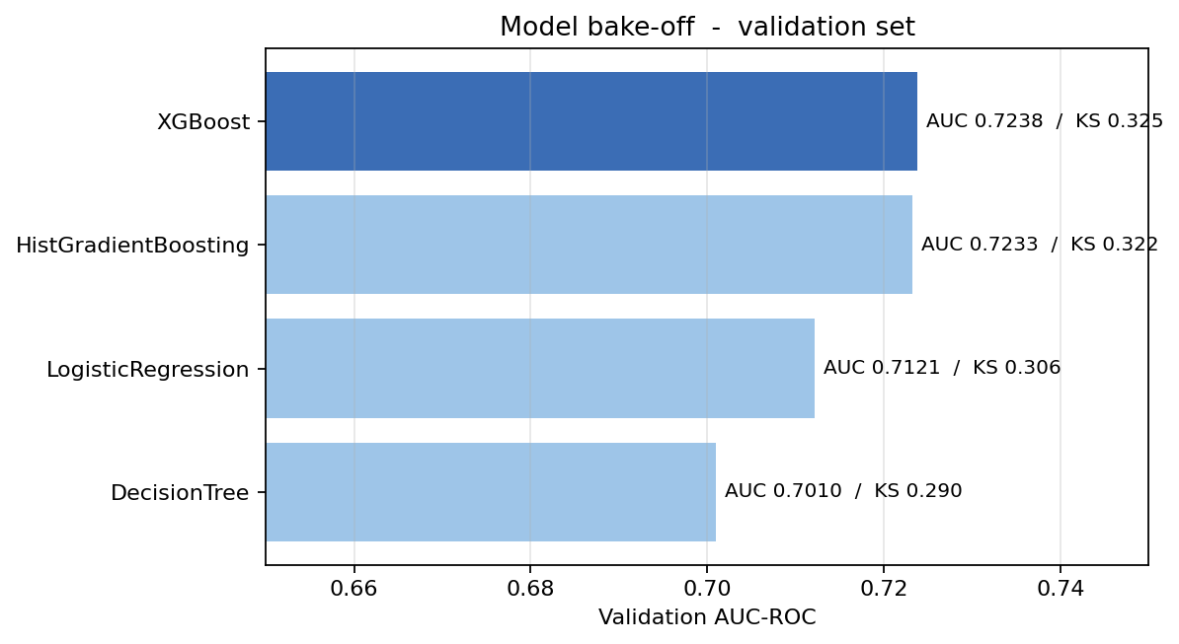
Model bake-off
PHASE 2
Four algorithms, 50 Optuna trials each, MLflow tracked, validated on the 2014-16 hold-out
WINNER
XGBoost
Why it won
- Highest validation AUC-ROC (0.7238).
- Highest KS statistic (0.325).
- 5x faster than HGB at fit time.
- Native pred_contribs (SHAP) for explainability.
Tuning: Optuna TPE, 50 trials per model, optimizing val AUC-ROC. All 200+ trials logged to MLflow at models/mlruns/.
EAS 587 Phase 4 - Lending Club Loan Default Prediction
6 / 13

Slide 7
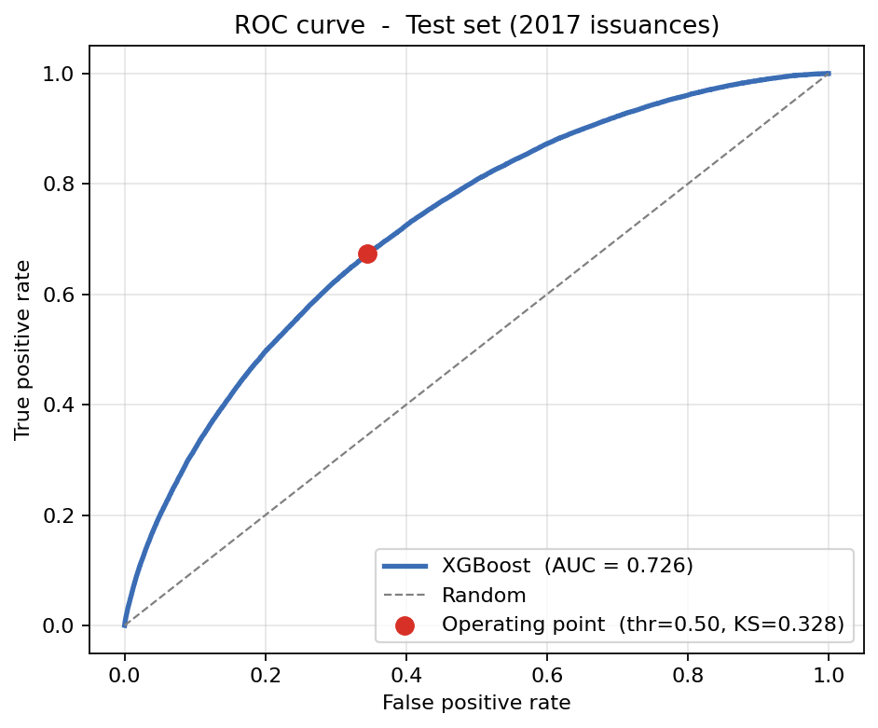
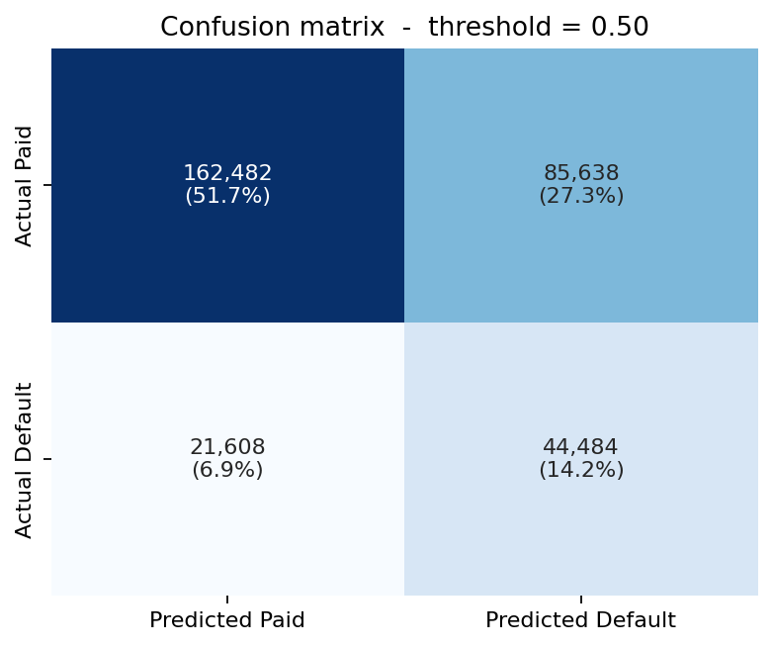
Hold-out test results
PHASE 2
All 314,212 loans issued in 2017 -- never seen during training or tuning
0.726
0.410
0.328
67.3%
AUC-ROC
AUC-PR
KS
Recall on defaults
(at Youden threshold)
EAS 587 Phase 4 - Lending Club Loan Default Prediction
7 / 13

Slide 8
Scaling on Spark + Delta Lake
PHASE 3
Same data, same target, rebuilt on Databricks using the medallion architecture
BRONZE
SILVER
GOLD
bronze_loans
silver_loans
gold_loans_train / val / test
Kaggle download landed as-is.
Filtered 2014-2017.
Written to Unity Catalog volume.
Cleaned and type-fixed.
Leakage columns dropped.
Schema enforced.
Time-based split.
Stratified samples for train/val.
Full 2017 test set retained.
Why rebuild on Spark
Phase 1+2 ran in pandas on a laptop and would not survive the full 2.9M-row Lending Club archive. Bronze->Silver->Gold gives us reproducible, versioned tables and lets us re-run the whole pipeline on the cluster without touching local CSVs.
EAS 587 Phase 4 - Lending Club Loan Default Prediction
8 / 13

Slide 9
Macro overlay + MCP deployment
PHASE 3
Two ideas borrowed from outside the loan dataset itself
Secondary data source: FRED
MCP deployment server
U.S. monthly unemployment (UNRATE)
FastMCP + Claude Desktop
- Pulled at fit-time via pandas-datareader.
- Loads best_model.pkl and preprocessing_pipeline.pkl on startup.
- Joined on (issue_year, issue_month) per loan.
- Exposes predict_loan_default tool over stdio MCP.
- Validates inputs, fills 24 secondary defaults, runs the same transform path as training.
- Captures macro pressure that borrower features cannot.
- Returns probability + risk tier + decision recommendation.
- Falls back to 5.0% if FRED is unreachable -- prevents pipeline crash on offline runs.
- Demonstrated live in the Phase 4 demo.
Why it matters: 2014-2017 spans a falling-unemployment regime; the model learns that loans issued during weaker labor markets default more often.
EAS 587 Phase 4 - Lending Club Loan Default Prediction
9 / 13

Slide 10
PHASE 4
LIVE DEMO
Streamlit predictor
+ MCP cherry-on-top
1
Pick a preset
2
Predict
Sidebar: Safe / Borderline / Risky profiles for instant fill.
Plotly gauge + 5-tier risk badge + decision recommendation.
3
Why this prediction
4
Same model, conversational
Top 8 SHAP contributions from XGBoost's native pred_contribs.
Switch to Claude Desktop -- describe a loan in plain English, MCP runs the same pipeline.
If the live demo fails: Streamlit screenshots in the appendix; MCP can be invoked as a backup prompt.

Slide 11
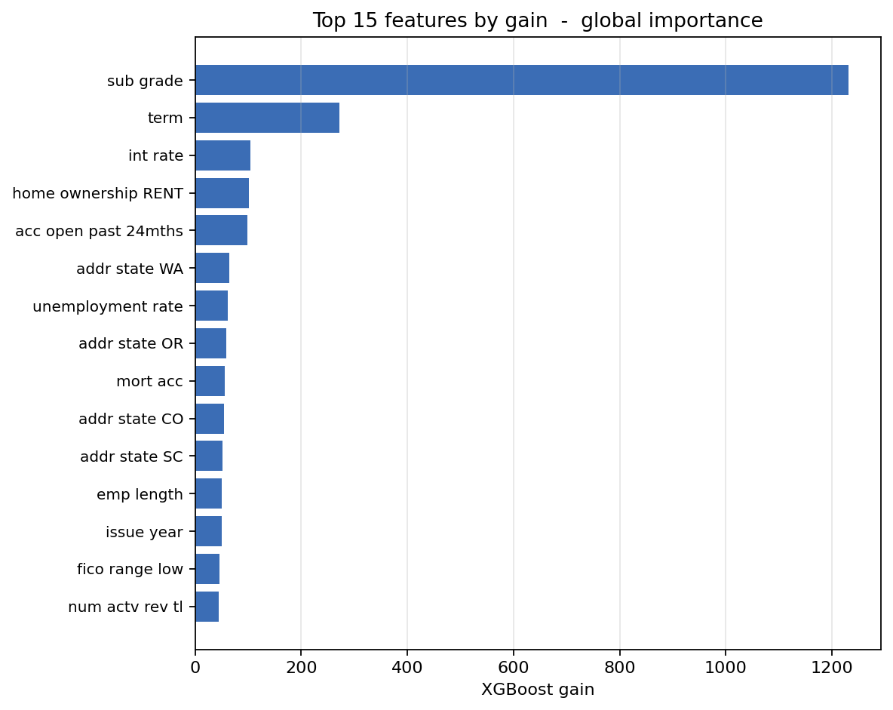
Insights
What the model learned -- and what that says about the lending market
Sub-grade dominates
sub_grade carries ~3x more gain than the next feature. Lending Club's own grade letter is already a near-sufficient summary of borrower risk -- our pipeline mostly refines it.
Term length is a hidden risk lever
Longer 60-month loans default substantially more often than 36-month loans at the same grade. The model picks this up without being told.
Macro context matters
unemployment_rate (FRED) consistently appears in the top contributions. Removing it dropped val AUC by ~0.5 points -- secondary data earns its keep.
Renting > owning, all else equal
home_ownership = RENT pushes toward default; MORTGAGE pulls away. Likely a wealth proxy.
EAS 587 Phase 4 - Lending Club Loan Default Prediction
11 / 13

Slide 12
Limitations + what's next
Honest about what we did NOT solve, and where this work goes
Limitations
What's next
- Class imbalance left as-is
- Real-time scoring API
We did not resample. Any deployment with a different operating cost-ratio needs threshold re-tuning.
Wrap the same pipeline in a FastAPI service; the MCP server already shows the loading pattern.
- Concept drift after 2017
- Fairness + adverse-action layer
Training cohort spans falling unemployment. Model is not validated on COVID-era loan books.
Disparate-impact metrics by protected group + per-prediction reason codes for compliant denial letters.
- No fairness audit
- Retraining cadence
Lending data has well-documented protected-class disparities. Disparate-impact testing was out of scope.
Quarterly re-fit on the latest closed cohort; alarm on AUC drift > 0.02.
- FICO-only credit signal
- More macro signals
We use fico_range_low; richer bureau features would likely add lift but were absent from this dataset.
FRED unemployment is one series; rates, housing, and consumer sentiment likely add lift.
EAS 587 Phase 4 - Lending Club Loan Default Prediction
12 / 13

Slide 13
Thank you
Questions?
404 Team Not Found - Aayush Nepal | Junwei Zhang | Lusi Zhang
WHAT WE BUILT
HEADLINE METRIC
WHY IT MATTERS
End-to-end loan default predictor: pandas pipeline, Spark medallion, MCP server, Streamlit app.
AUC-ROC 0.726 on 314k held-out 2017 loans -- never seen during training or tuning.
The same model is reachable two ways: a visual UI for analysts, a conversational tool for everyone else.
Repository: github.com/Aayushnepal09/Eas587_project | EAS 587 Spring 2026

