Slide 1
Talkdemy Real-time anonymous communication platform
By: Aayush Rajkarnikar

Slide 2
Introduction
Talkdemy is a real time communication platform for classrooms that enable students to communicate with their teachers.
There is high correlation between student performance and teacher-student communication.

Slide 3
Problem Statement
Many Students hesitate to ask their questions due to fear of judgment.
Lack of real time interaction platform that help student and teacher to communicate that provide a focused learning environment.

Slide 4
Objective
To enable anonymous interaction form students with the teacher.
To design a user-friendly, real-time communication platform between teacher and student in a focused learning environment.

Slide 5
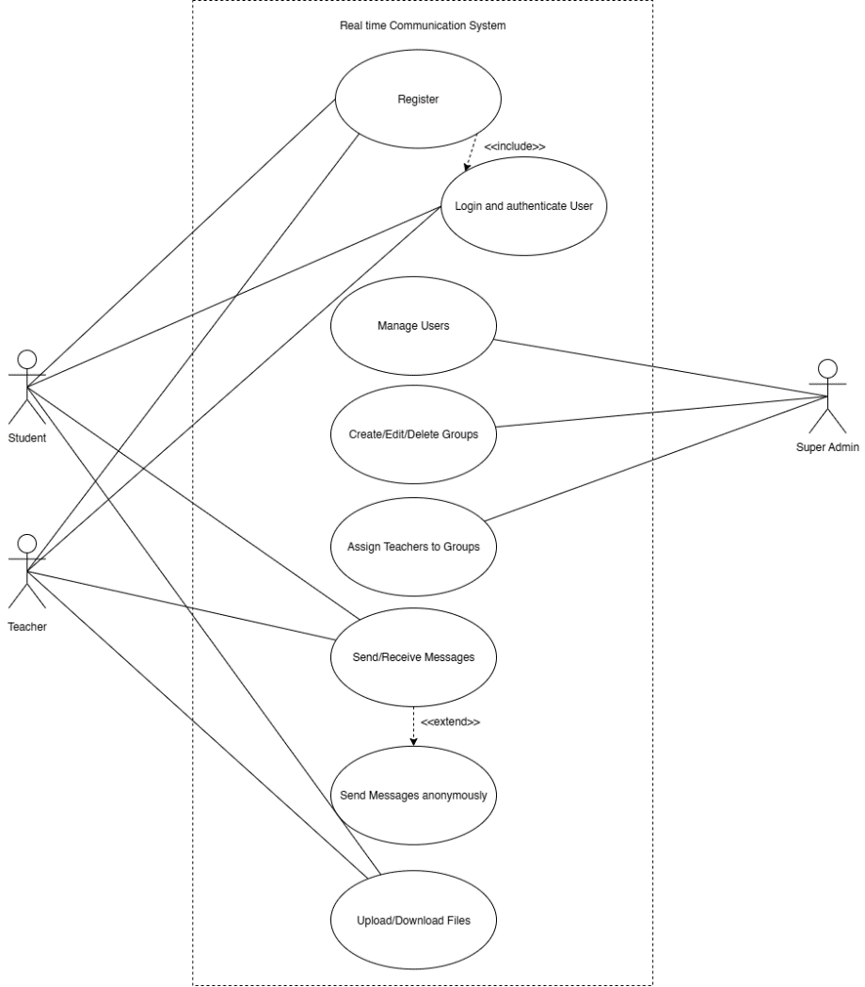
Use Case diagram

Slide 6
Tools used
Frontend : React and tailwind css
Backend : Node.js with Express
Database: MongoDB
Websocket: socket.io

Slide 7
Conclusion
Talkdemy creates a safe, anonymous space where students can freely ask questions and share knowledge without fear of judgment. By removing social barriers and distractions, it helps to create a focused learning environment.

