Slide 1


DAVV – IIPS session 2k19-20

Slide 2

Digital Computer Organisation

Slide 3

Ayush sankhla
IC-2k18-15

Slide 4
Introduction To Computer Orgasnisation

Slide 5
Introduction To Computer Orgasnisation
It is the way the hardware components operate.
Organization is how features are implemented
Control signals, interfaces, memory technology.
All Intel x86 family share the same basic architecture
The IBM System/370 family share the same basic architecture

Slide 6
Introduction To Computer Orgasnisation
This gives backward code compatibility.
Organization differs between different versions.

Slide 7
INTRODUCTION TO THE COMPUTER ORGANISATION
Computer organization and architecture mainly focuses on various parts of the computer in order to reduce the execution time of the program, improve the performance of each part. Generally, we tend to think computer organization and computer architecture as same but there is slight difference.
DIFFERENCE:
Computer Organization is study of the system from software point of view and gives overall description of the system and working principles without going into much detail. In other words, it is mainly about the programmer’s or user point of view.
Computer Architecture is study of the system from hardware point of view and emphasis on how the system is implemented. Basically, throws light on the designer’s point of view.

Slide 8
Von Neuman Architecture
The modern computers are based on a stored-program concept introduced by John Von Neumann.
In this stored-program concept, programs and data are stored in a separate storage unit called memories and are treated the same.
It is having three basic units:
1.The Central Processing Unit (CPU)
2.The Main Memory Unit
3.The Input/Output Device

Slide 9
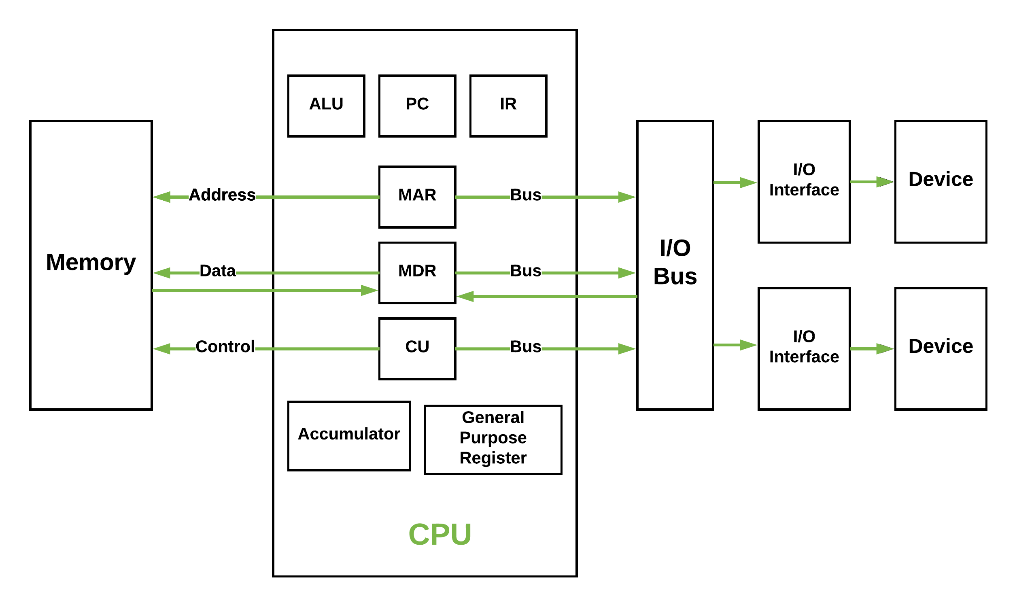
Von Neuman Architecture

Slide 10
Von Neuman Architecture
Control Unit
A control unit (CU) handles all processor control signals.
It directs all input and output flow.
Fetches code for instructions and controlling how data moves around the system.
Arithmetic and Logic Unit (ALU)
The arithmetic logic unit is that part of the CPU that handles all the calculations the CPU may need.
e.g. Addition, Subtraction, Comparisons. It performs Logical Operations, Bit Shifting Operations, and Arithmetic Operation.
Main Memory Unit (Registers)

Slide 11
Von Neuman Architecture
Main Memory Unit (Registers)
Accumulator: Stores the results of calculations made by ALU.
Program Counter (PC): Keeps track of the memory location of the next instructions to be dealt with. The PC then passes this next address to Memory Address Register (MAR).
Memory Address Register (MAR): It stores the memory locations of instructions that need to be fetched from memory or stored into memory.
Memory Data Register (MDR): It stores instructions fetched from memory or any data that is to be transferred to, and stored in, memory.
Current Instruction Register (CIR): It stores the most recently fetched instructions while it is waiting to be coded and executed.
Instruction Buffer Register (IBR): The instruction that is not to be executed immediately is placed in the instruction buffer register IBR

Slide 12
Von Neuman Architecture
Input/Output Devices
Program or data is read into main memory from the input device or secondary storage under the control of CPU input instruction.
Output devices are used to output the information from a computer.
With the help of output devices, we can present result to the user.

Slide 13
INTERCONNECTION STRUCTURES
A computer consists of a set of components or modules of three basic types (processor, memory, I/O) that communicate with each other. In effect, a computer is a network of basic modules. Thus, there must be paths for connecting the modules. The collection of paths connecting the various modules is called the interconnection structure. The design of this structure will depend on the exchanges that must be made among modules. Figure below suggests the types of exchanges that are needed by indicating the major forms of input and output for each module type.

Slide 14
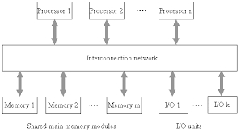
• Memory: Typically, a memory module will consist of N words of equal length. Each word is assigned a unique numerical address (0, 1, . . . , N – 1). A word of data can be read from or written into the memory.The nature of the operation is indicated by read and write control signals. The location for the operation is specified by an address.
• I/O module: From an internal (to the computer system) point of view, I/O is functionally similar to memory. There are two operations, read and write. Further, an I/O module may control more than one external device. We can refer to each of the interfaces to an external device as a port and give each a unique address (e.g., 0, 1,…, M – 1). In addition, there are external data paths for the input and output of data with an external device. Finally, an I/O module may be able to send interrupt

Slide 15
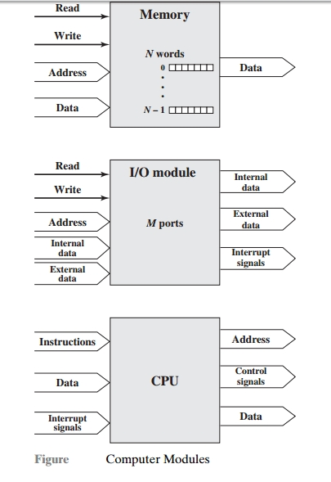
• Processor: The processor reads in instructions and data, writes out data after processing, and uses control signals to control the overall operation of the system. It also receives interrupt signals. The preceding list defines the data to be exchanged. The interconnection structure must support the following types of transfers:
• Memory to processor: The processor reads an instruction or a unit of data from memory. • Processor to memory: The processor writes a unit of data to memory. • I/O to processor:The processor reads data from an I/O device via an I/O module. • Processor to I/O: The processor sends data to the I/O device. • I/O to or from memory: For these two cases, an I/O module is allowed to exchange data directly with memory, without going through the processor, using direct memory access (DMA).
Though a number of interconnection structures have been tried. By far the most common is the bus and various multiple-bus structures

Slide 16
BUS Connection
Data is transmitted from one part of a computer to another, connecting all major internal components to the CPU and memory, by the means of Buses.
Types:-
Data Bus: It carries data among the memory unit, the I/O devices, and the processor.
Address Bus: It carries the address of data (not the actual data) between memory and processor.
Control Bus: It carries control commands from the CPU (and status signals from other devices) in order to control and coordinate all the activities within the computer.

Slide 17
Input Output Organization

Slide 18
I/O Interface
The method of transfer of information between internal storage and external I/O devices is known as I/O interface.
The CPU is interfaced using special communication links by the peripherals connected to any computer system.
These communication links are used to resolve the differences between CPU and peripheral.
Interface units: There exists special hardware components between CPU and peripherals to supervise and synchronize all the input and output transfers.

Slide 19
I/O Interface
Mode of Transfer
The binary information that is received from an external device is stored in the memory unit.
The information that is transferred from the CPU to the external device is originated from the memory unit.
CPU merely processes the information but the source and target is always the memory unit.
Data transfer between CPU and the I/O devices may be done in different modes.
Data transfer to and from the peripherals may be done in three possible ways:-
Programmed I/O.
Interrupt- initiated I/O.
Direct memory access( DMA).

Slide 20
Interrupt Driven I/O
By using interrupt facility to inform the interface to issue an interrupt request signal whenever data is available from any device.
In the meantime the CPU can proceed for any other program execution.
The interface meanwhile keeps monitoring the device.
Whenever it is determined that the device is ready for data transfer it initiates an interrupt request signal to the computer.
Upon detection of an external interrupt signal the CPU stops momentarily the task that it was already performing, branches to the service program to process the I/O transfer, and then return to the task it was originally performing.

Slide 21
Priority Interupt I/O
Priority Interrupt System
The concept of defining the priority among devices so as to know which one is to be serviced first in case of simultaneous requests .
This involves two types:
Software method
ex - Polling
Hardware method
ex – Daisy chaining
DAISY CHAINING
The daisy-chaining method involves connecting all the devices that can request an interrupt in a serial manner.
This configuration is governed by the priority of the devices.
The device with the highest priority is placed first followed by the second highest priority device and so on.

Slide 22
DAISY CHAINING
The daisy-chaining method involves connecting all the devices that can request an interrupt in a serial manner.
This configuration is governed by the priority of the devices.
The device with the highest priority is placed first followed by the second highest priority device and so on.

Slide 23
DAISY CHAINING
Working –
There is an interrupt request line which is common to all the devices and goes into the CPU.
When no interrupts are pending, the line is in HIGH state. But if any of the devices raises an interrupt, it places the interrupt request line in the LOW state.
The CPU acknowledges this interrupt request from the line and then enables the interrupt acknowledge line in response to the request.
This signal is received at the PI(Priority in) input of device 1.
If the device has not requested the interrupt, it passes this signal to the next device through its PO(priority out) output. (PI = 1 & PO = 1)
However, if the device had requested the interrupt, (PI =1 & PO = 0)
The device consumes the acknowledge signal and block its further use by placing 0 at its PO(priority out) output.
The device then proceeds to place its interrupt vector address(VAD) into the data bus of CPU.
The device puts its interrupt request signal in HIGH state to indicate its interrupt has been taken care of.

Slide 24
Direct Memory Access
The data transfer between a fast storage media such as magnetic disk and memory unit is limited by the speed of the CPU
we can allow the peripherals directly communicate with each other using the memory buses, removing the intervention of the CPU.
During DMA the CPU is idle and it has no control over the memory buses.
The DMA controller takes over the buses to manage the transfer directly between the I/O devices and the memory unit.

Slide 25
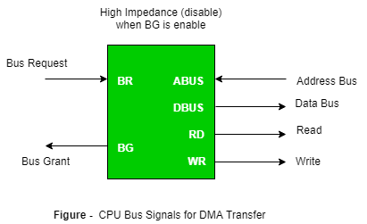
Direct Memory Access

Slide 26
Direct Memory Access
Bus Request :
It is used by the DMA controller to request the CPU to relinquish the control of the buses.
Bus Grant :
It is activated by the CPU to Inform the external DMA controller that the buses are in high impedance state and the requesting DMA can take control of the buses.
Once the DMA has taken the control of the buses it transfers the data. This transfer can take place in many ways.
Types of DMA transfer using DMA controller:
Burst transfer
Cyclic stealing
Interleaved mode

Slide 27
Input-Output Processor
Explain –
The Input Output Processor (IOP) is just like a CPU that handles the details of I/O operations.
The IOP can fetch and execute its own instructions.
In addition to the I/O – related tasks, it can perform other processing tasks like arithmetic, logic, branching and code translation.
The main memory unit takes the pivotal role.
It communicates with processor by the means of DMA.
Advantages –
The I/O devices can directly access the main memory without the intervention by the processor in I/O processor based systems.
It is used to address the problems that are arises in Direct memory access method.

Slide 28
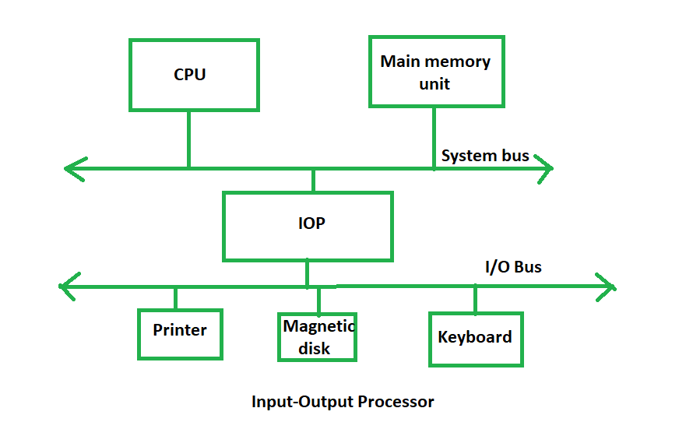
Input-Output Processor

Slide 29
Synchronous Data Transfer
In Synchronous data transfer, the sending and receiving units are enabled with same clock signal.
The master performs a sequence of instructions for data transfer in a predefined order.
All these actions are synchronized with the common clock.
Both the master and slave performs their own task of transferring data at designed clock period.

Slide 30
Synchronous Data Transfer
Advantages –
The design procedure is easy. The master does not wait for any acknowledges signal from the slave through the master waits for a time equal to slave’s response time.
The slave does not generate acknowledge signal, though it obeys the timing rules as per the protocol set by the master or system designer.
Disadvantages –
If a slow speed unit connected to a common bus, it can degrade overall rate of transfer in the system.
If the slave operates at a slow speed, the master will be idle for some time during data transfer and vice versa.

Slide 31
Asynchronous Data Transfer
Asynchronous input output is a form of input output processing that allows others devices to do processing before the transmission or data transfer is done.
This problem is solved by following mechanism:
Strobe
Handshaking

Slide 32
Strobe mechanism
Source initiated Strobe –
When source initiates the process of data transfer. Strobe is just a signal.
(i) First, source puts data on the data bus and ON the strobe signal. (ii) Destination on seeing the ON signal of strobe, read data from the data bus. (iii) After reading data from the data bus by destination, strobe gets OFF.
Destination initiated signal –
When destination initiates the process of data transfer.
(i) First, the destination ON the strobe signal to ensure the source to put the fresh data on the data bus. (ii) Source on seeing the ON signal puts fresh data on the data bus. (iii) Destination reads the data from the data bus and strobe gets OFF signal.

Slide 33
Handshaking Mechanism
Source initiated Handshaking –
When source initiates the data transfer process. It consists of signals:
DATA VALID: if ON tells data on the data bus is valid otherwise invalid.
DATA ACCEPTED: if ON tells data is accepted otherwise not accepted.
(i) Source places data on the data bus and enable Data valid signal. (ii) Destination accepts data from the data bus and enable Data accepted signal. (iii) After this, disable Data valid signal means data on data bus is invalid now. (iv) Disable Data accepted signal and the process ends.
Destination initiated Handshaking –
When destination initiates the process of data transfer.
REQUEST FOR DATA: if ON requests for putting data on the data bus.
DATA VALID: if ON tells data is valid on the data bus otherwise invalid data.
i) When destination is ready to receive data, Request for Data signal gets activated. (ii) source in response puts data on the data bus and enabled Data valid signal. (iii) Destination then accepts data from the data bus and after accepting data, disabled Request for Data signal. (iv) At last, Data valid signal gets disabled means data on the data bus is no more valid data.

Slide 34
Working mechanism of Peripherals

Slide 35
Peripheral devices
A peripheral device is any auxiliary device that connects to and works with the computer to either put information into it or get information out of it.
A peripheral device may also be referred to as an external peripheral, integrated peripheral, auxiliary component, or I/O (input/output) device.

Slide 36
Peripheral devices
Types of Peripheral Devices
There are many different peripheral devices, but they fall into three general categories:
Input devices, such as a mouse and a keyboard
Output devices, such as a monitor and a printer
Storage devices, such as a hard drive or flash d

Slide 37
Peripheral devices
Some devices fall into more than one category. Consider a CD-ROM drive; you can use it to read data or music (input), and you can use it to write data to a CD (output).
Peripheral devices can be external or internal. For example, a printer is an external device that you connect using a cable, while an optical disc drive is typically located inside the computer case. Internal peripheral devices are also referred to as integrated peripherals. When most people refer to peripherals, they typically mean external ones.
The concept of what exactly is 'peripheral' is therefore somewhat fluid. For a desktop computer, a keyboard and a monitor are considered peripherals - you can easily connect and disconnect them and replace them if needed. For a laptop computer, these components are built into the computer system and can't be easily removed.

Slide 38
Peripheral devices
Some devices fall into more than one category. Consider a CD-ROM drive; you can use it to read data or music (input), and you can use it to write data to a CD (output).
Peripheral devices can be external or internal. For example, a printer is an external device that you connect using a cable, while an optical disc drive is typically located inside the computer case. Internal peripheral devices are also referred to as integrated peripherals. When most people refer to peripherals, they typically mean external ones.
The concept of what exactly is 'peripheral' is therefore somewhat fluid. For a desktop computer, a keyboard and a monitor are considered peripherals - you can easily connect and disconnect them and replace them if needed. For a laptop computer, these components are built into the computer system and can't be easily removed.

Slide 39
Keyboard
Working Principle of a Keyboard:-Inside the keyboard, there are metallic plate, circuit board and processor, which are responsible for transferring information from the keyboard to the computer. Depending upon the working principle, there are two main types of keys, namely, capacitive and hard-contact. Let's discuss in brief about the functioning of capacitive and hard contact key.When a capacitive key is pressed, the metal plunger applies a gentle pressure to the circuit board. The pressure is identified by the computer and the circuit flow is initiated, resulting in the transfer of information from the circuit to the currently installed software. The key identifying to computer is identified using a keyboard driver and finding the preferred key called source code.

Slide 40
Mouse
A mouse is play a important role play in computers all the work. A mouse has a small size but its works is very large.
Working of a mouse--- > With most of the system you will find mechanical mouse.The primary mechanical part of a mouse is a ball on the bottom of the mouse. There are these little wheels which turn/rotate when the ball moves against them. The wheels are monitored electronically. When they trun or rotate they transmit how much they have turned to the computer. Out of these three wheels the two wheels perpendicular to each other are used for tracking the motion on X-axis and Y-axis. The third one just balances the two.

Slide 41
Mouse
When the mouse is moved on a flat surface the roller ball moves in the locking ring. When the mouse is positioned on the desktop the actuators register the mouse balls movement in X-axis and Y-axis direction. The sensors attached to it generate a series of pulses representing movement on both axis. The pulse generated are in same ratio as the mouse movement i.e. More pulse mean more movement. Normally a mouse is used along with a mouse pad. Place the mouse pad on a flat surface and place the mouse on it. Move the mouse pad and the pointer moves in the direction of the movement of mouse. --Various terms related to the use of mouse are :- > Click > Double click > Drag

Slide 42
Mouse
1. When the left button of mouse is pressed and released quickly then this we can say ' clicking the mouse '. 2. The double clicking is used to initiate some action on the selected item. Basically it selects and initiases the action. For this the enter key is pressed and relieased sticky twice. 3. If AN object is to be moved from one part of screen to other part then dragging is used.

Slide 43
Scanners
A scanner is a device that is used for producing an exact digital image replica of a photo, text written in paper, or even an object. This digital image can be saved as a file to your computer and can be used to alter/enhance the image or apply it to the web. The most comonly used scanner is the flatbed scanner, in which you keep the object on top of the glass window. The scanned output will be obtained in your computer. The image and text are obtained exactly through the process of optical character recognition [OCR].
Handheld scanners use the same basic technology as a flatbed scanner, but rely on the user to move them instead of a motorized belt. This type of scanner typically does not provide good image quality. However, it can be useful for quickly capturing text.

Slide 44
Scanners
Drum scanners are used by the publishing industry to capture incredibly detailed images. They use a technology called a photomultiplier tube (PMT). In PMT, the document to be scanned is mounted on a glass cylinder. At the center of the cylinder is a sensor that splits light bounced from the document into three beams. Each beam is sent through a color filter into a photomultiplier tube where the light is changed into an electrical signal.
The basic principle of a scanner is to analyze an image and process it in some way. Image and text capture (optical character recognition or OCR) allow you to save information to a file on your computer.

Slide 45
Video Display
Video display device means an electronic device with an output surface that displays, or is capable of displaying, moving graphical images or a visual representation of image sequences or pictures, showing a number of quickly changing images on a screen in fast succession to create the illusion of motion, including, if applicable, a device that is an integral part of the display, in that it cannot be easily removed from the display by the consumer, that produces the moving image on the screen. A video display device may use, but is not limited to, a cathode ray tube (CRT), liquid crystal display (LCD), gas plasma, digital light processing, or other image projection technology.

Slide 46
Video Display
Video display device means a printer or a unit capable of presenting images electronically on a screen, with a video display greater than four inches when measured diagonally, that are viewed by the user, and includes televisions, computer monitors, laptop computers, cathode ray tubes, plasma displays, liquid crystal displays, rear and front enclosed projection devices, and other similar displays that may be developed.

Slide 47
Touch screen
Different kinds of touchscreen work in different ways. Some can sense only one finger at a time and get extremely confused if you try to press in two places at once. Others can easily detect and distinguish more than one key press at once. These are some of the main technologies:

Slide 48
Resistive
Resistive touchscreens (currently the most popular technology) work a bit like "transparent keyboards" overlaid on top of the screen. There's a flexible upper layer of conducting polyester plastic bondedd to a rigid lower layer of conducting glass and separated by an insulating membrane. When you press on the screen, you force the polyester to touch the glass and complete a circuit—just like pressing the key on a keyboard. A chip inside the screen figures out the coordinates of the place you touched.

Slide 49
Capacitive
These screens are made from multiple layers of glass. The inner layer conducts electricity and so does the outer layer, so effectively the screen behaves like two electrical conductors separated by an insulator—in other words, a capacitor.When you bring your finger up to the screen, you alter the electrical field by a certain amount that varies according to where your hand is. Capacitive screens can be touched in more than one place at once. Unlike most other types of touchscreen, they don't work if you touch them with a plastic stylus (because the plastic is an insulator and stops your hand from affecting the electric field).

Slide 50
Infrared
Just like the magic eye beams in an intruder alarm, an infrared touchscreen uses a grid pattern of LEDs and light-detector photocells arranged on opposite sides of the screen. The LEDs shine infrared light in front of the screen—a bit like an invisible spider's web. If you touch the screen at a certain point, you interrupt two or more beams. A microchip inside the screen can calculate where you touched by seeing which beams you interrupted. The touchscreen on Sony Reader ebooks (like the one pictured in our top photo) works this way. Since you're interrupting a beam, infrared screens work just as well whether you use your finger or a stylus

Slide 51
Memory organization

Slide 52
Memory organisation
Memories are made up of registers. Each register in the memory is one storage location. Storage location is also called as memory location. Memory locations are identified using Address. The total number of bit a memory can store is its capacity.
A storage element is called a Cell. Each register is made up of storage element in which one bit of data is stored. The data in a memory are stored and retrieved by the process called writing and reading respectively.
A word is a group of bits where a memory unit stores binary information. A word with group of 8 bits is called a byte.
Data lines provide the information to be stored in memory. The control inputs specify the direction transfer. The k-address lines specify the word chosen.
When there are k address lines, 2^{k} memory word can be accessed.

Slide 53
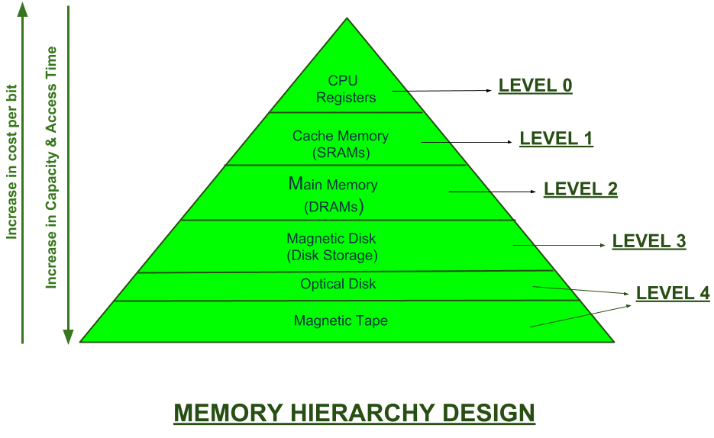
Memory Hierarchy
Memory hierarchy
In the Computer System Design, Memory Hierarchy is an enhancement to organize the memory such that it can minimize the access time. The Memory Hierarchy was developed based on a program behavior known as locality of references.The figure below clearly demonstrates the different levels of memory hierarchy :

Slide 54
Memory Hierarchy
This Memory Hierarchy Design is divided into 2 main types:
External Memory or Secondary Memory – Comprising of Magnetic Disk, Optical Disk, Magnetic Tape i.e. peripheral storage devices which are accessible by the processor via I/O Module.
Internal Memory or Primary Memory – Comprising of Main Memory, Cache Memory & CPU registers. This is directly accessible by the processor.

Slide 55
Memory Hierarchy
We can infer the following characteristics of Memory Hierarchy Design from above figure:
Capacity: It is the global volume of information the memory can store. As we move from top to bottom in the Hierarchy, the capacity increases.
Access Time: It is the time interval between the read/write request and the availability of the data. As we move from top to bottom in the Hierarchy, the access time increases.
Performance: Earlier when the computer system was designed without Memory Hierarchy design, the speed gap increases between the CPU registers and Main Memory due to large difference in access time. This results in lower performance of the system and thus, enhancement was required. This enhancement was made in the form of Memory Hierarchy Design because of which the performance of the system increases. One of the most significant ways to increase system performance is minimizing how far down the memory hierarchy one has to go to manipulate data.
Cost per bit: As we move from bottom to top in the Hierarchy, the cost per bit increases i.e. Internal Memory is costlier than External Memory.

Slide 56
A memory unit is the collection of storage units or devices together. The memory unit stores the binary information in the form of bits. Generally, memory/storage is classified into 2 categories:
Volatile Memory: This loses its data, when power is switched off.
Non-Volatile Memory: This is a permanent storage and does not lose any data when power is switched off.

Slide 57
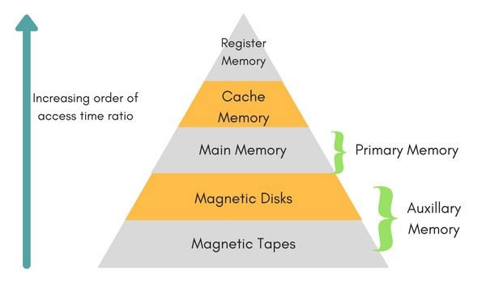
Memory Hierarchy

Slide 58
Internal Memory
Internal memory typically refers to main memory (RAM), but may also refer to ROM and flash memory. In either case, internal memory generally refers to chips rather than disks or tapes.
In a computer, all of the storage spaces that are accessible by a processor without the use of the computer input-output Internal memory usually includes several types of storage, such as main storage, cache memory, and special registers, all of which can be directly accessed by the processor.
Primary storage (or main memory or internal memory), often referred to simply as memory, is the only one directly accessible to the CPU. The CPU continuously reads instructions stored there and executes them as required. Any data actively operated on is also stored there in uniform manner.

Slide 59
Types of Internal memory
RAM (Random Access Memory)
Random access memory, or RAM, is memory storage on a computer that holds data while the computer is running so that it can be accessed quickly by the processor.
RAM holds the operating system, application programs and data that is currently being used.
RAM data is much faster to read than data stored on the hard disk. RAM is stored in microchips and contains much less data than the hard disk. RAM can never run out of memory, but the processor must overwrite old data if the RAM is filled, which results in slower computer function. Any file stored in RAM can be accessed directly if the user knows the row and column where the data is stored.

Slide 60
Random access memory is used to store temporary but necessary information on a computer for quick access by open programs or applications.
RAM, is a volatile yet fast type of memory used in computers. RAM is more expensive to incorporate.
RAM allows reading and writing (electrically) of data at the byte level
RAM is the Volatile memory.

Slide 61
Types of RAM
Static RAM
Static RAM stores a bit of information in a flip-flop. Static RAM is usually used for applications that do not require large capacity RAM memory.
Static(RAM) is a memory technology based on flip-flops. SRAM has an access time of 2 – 10 nanoseconds. All of main memory can be viewed as fabricated from SRAM, although such a memory would be unrealistically expensive

Slide 62
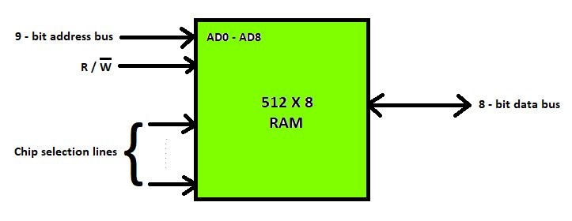

Slide 63
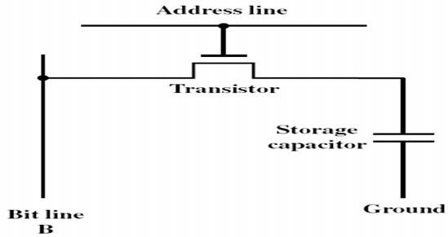
Dynamic RAM
Dynamic RAM data store one bit of information as a payload. Dynamic RAM using a substrate capacitance gate MOS transistors as memory cells shut. To keep dynamic RAM stored data remains intact, the data should be refreshed again by reading and re-write the data into memory. Dynamic RAM is used for applications that require large RAM capacity, for example in a personal computer.

Slide 64
EDO (Extended Data-output) and SD (Synchronous Dynamic Random Access Memory) are type of Dynamic RAM.
Dynamic RAM (DRAM) is a memory technology based on capacitors
Dynamic RAM is cheaper than static RAM and can be packed more densely on a computer chip
DRAM has an access time in the order of 60 – 100 nanoseconds, slower than SRAM.

Slide 65
ROM (Read only memory)
Sometimes can be erased for reprogramming, but might have odd requirements such as UV light or erasure only at the block level.
Data are written into a ROM when it is manufactured.
ROM is mask programmed by the manufacturer in the factory with the contents ordered by the customers.
The contents are fixed by metal masks used during chip fabrication.
Once programmed, the contents cannot be erased.
Even a single bit wrongly programmed the ROM chip is useless

Slide 66
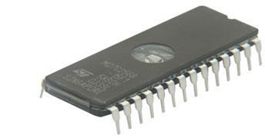
Applications
Used to store control programs such as micro program.
Character generation, code conversion
Permanent storage – nonvolatile
Microprogramming
Library subroutines
Systems programs (BIOS)
Function tables
Embedded system code

Slide 67
Types of ROM
PROM (Programmable Read Only Memory)
EPROM (Erasable Programmable Read Only Memory )
EEPROM (Electrically Erasable Programable Read Only Memory)
If the content is determined by the vendor ROM, PROM sold empty and can then be filled with a program by the user. Having completed the program, fill PROM cannot be removed.

Slide 68
PROM
(Programmable Read Only Memory)
PROM is a field programmable device.
The customer buy a blank PROM and store desired data using PROM programmer(burner).
Programmability achieved by inserting a fuse at point P.
Before programmed, the memory contains all 0s
The user can insert 1 by burning out the fuse in the particular cell using high current pulse.
The PROM chip can be programmed only once and its contents cannot be erased.
PROM are flexible, faster and less expensive because they can be programmed directly by the user.

Slide 69
EPROM (Erasable Programmable Read Only Memory )
A rewritable chip that holds its contents without power. Previous data can be erased and new data can be inserted
EPROM chips are written on an external programming device before being placed on the circuit board. Capable of retaining stored information for a long time.
Eraser contd., requires breakup the charges trapped in the transistors of memory cell.[this is done by break the chip to ultraviolet light].
This reason EPROM packaged with transparent window.
Disadvantages: Entire EPROM is erased as a whole and selective erasing is not possible. Should be removed from the chip for reprogramming.
Unlike the PROM, EPROM contents can be deleted after being programmed. Elimination is done by using ultraviolet light.

Slide 70
EEPROM
(Electrically Erasable Programable Read Only Memory)
EEPROM can store data permanently, but its contents can still be erased electrically through the program. One type EEPROM is Flash Memory. Flash Memory commonly used in digital cameras, video game consoles, and the BIOS chip.
It can be both programmed and erased electrically ( flashed back to Zero).
They do not need to removed when the chip content erasure.
Also, erase selected content in the chip.
Erasing and programming dynamically without removing the EEPROM from the circuit.

Slide 71
Disadvantages
Different voltages are required for erasing, reading and writing the data.

Slide 72
External Memory
External memory typically refers to storage in an external hard drive or on the Internet. The main “memory” in the computer is the computer work-space, not its storage facility.
External memory which is sometimes called backing store or secondary memory, allows the permanent storage of large quantities of data. Some method of magnetic recording on magnetic disks or tapes is most commonly used.
The capacity of external memory is high, usually measured in hundreds of megabytes or even in gigabytes
The most common form of external memory is a hard disc which is permanently installed in the computer and will typically have a capacity of hundreds of megabytes

Slide 73
Types of External memory
Magnetic Tapes Hard disk Magnetic Disk
Optical Drives (CD-R/W, CD-ROM)

Slide 74
Cache Memory
Cache memory, also called CPU memory, is high-speed static random access memory (SRAM) that a computer microprocessor can access more quickly than it can access regular random access memory (RAM). This memory is typically integrated directly into the CPU chip or placed on a separate chip that has separate bus interconnect with the CPU. The purpose of cache memory is to store program instructions and data that are used repeatedly in the operation of programs or information that the CPU is likely to need next. The computer processor can access this information quickly from the cache rather than having to get it from computer’s main memory. Fast access to these instructions increases the overall speed of the program.

Slide 75
As the microprocessor processes data, it looks first in the cache memory. If it finds the instructions or data it's looking for there from a previous reading of data, it does not have to perform a more time-consuming reading of data from larger main memory or other data storage devices. Cache memory is responsible for speeding up computer operations and processing.
Once they have been opened and operated for a time, most programs use few of a computer's resources. That's because frequently re-referenced instructions tend to be cached. This is why system performance measurements for computers with slower processors but larger caches can be faster than those for computers with faster processors but less cache space.

Slide 76
Cache memory mapping
Caching configurations continue to evolve, but cache memory traditionally works under three different configurations:
Direct mapped cache has each block mapped to exactly one cache memory location. Conceptually, direct mapped cache is like rows in a table with three columns: the data block or cache line that contains the actual data fetched and stored, a tag with all or part of the address of the data that was fetched, and a flag bit that shows the presence in the row entry of a valid bit of data.

Slide 77
Fully associative cache mapping is similar to direct mapping in structure but allows a block to be mapped to any cache location rather than to a prespecified cache memory location as is the case with direct mapping.
Set associative cache mapping can be viewed as a compromise between direct mapping and fully associative mapping in which each block is mapped to a subset of cache locations. It is sometimes called N-way set associative mapping, which provides for a location in main memory to be cached to any of "N" locations in the L1 cache.

Slide 78
Virtual Memory
Virtual memory is a memory management capability of an operating system (OS) that uses hardware and software to allow a computer to compensate for physical memory shortages by temporarily transferring data from random access memory (RAM) to disk storage.
Virtual address space is increased using active memory in RAM and inactive memory in hard disk drives (HDDs) to form contiguous addresses that hold both the application and its data.

Slide 79
Virtual memory was developed at a time when physical memory -- the installed RAM -- was expensive. Computers have a finite amount of RAM, so memory can run out, especially when multiple programs run at the same time. A system using virtual memory uses a section of the hard drive to emulate RAM. With virtual memory, a system can load larger programs or multiple programs running at the same time, allowing each one to operate as if it has infinite memory and without having to purchase more RAM.
While copying virtual memory into physical memory, the OS divides memory into pagefiles or swap files with a fixed number of addresses. Each page is stored on a disk and when the page is
needed, the OS copies it from the disk to main memory and translates the virtual addresses into real addresses.

Slide 80
Pros of using virtual memory
Among the primary benefits of virtual memory is its ability to handle twice as many addresses as main memory. It uses software to consume more memory by using the HDD as temporary storage while MMUs translate virtual memory addresses to physical addresses via the CPU. Programs use virtual addresses to store instructions and data; when a program is executed, the virtual addresses are converted into actual memory addresses.

Slide 81
Secondary Storage
Secondary memory (or secondary storage) is the slowest and cheapest form of memory. It cannot be processed directly by the CPU. It must first be copied into primary storage (also known as RAM).

Slide 82
Characteristics of Secondary Memory
It is non-volatile, i.e. It retains data when power is switched off It is large capacities to the tune of terabytes
It is cheaper as compared to primary memory

Slide 83
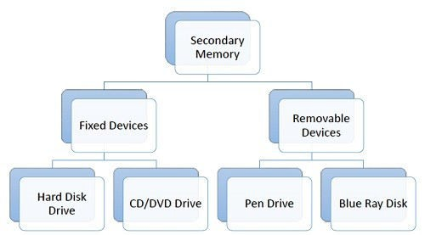

Slide 84
CD Drive
CD stands for Compact Disk. CDs are circular disks that use optical rays, usually lasers, to read and write data. They are very cheap as you can get 700 MB of storage space for less than a dollar. CDs are inserted in CD drives built into CPU cabinet. They are portable as you can eject the drive, remove the CD and carry it with you. There are three types of CDs −
CD-ROM (Compact Disk – Read Only Memory) − The data on these CDs are recorded by the manufacturer. Proprietary Software, audio or video are released on CD-ROMs.
CD-R (Compact Disk – Recordable) − Data can be written by the user once on the CD-R. It cannot be deleted or modified later.
CD-RW (Compact Disk – Rewritable) − Data can be written and deleted on these optical disks again and again.

Slide 85
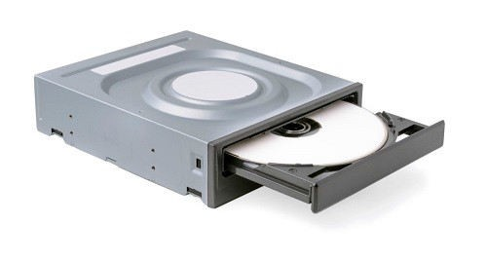
DVD Drive
DVD stands for Digital Video Display. DVD are optical devices that can store 15 times the data held by CDs. They are usually used to store rich multimedia files that need high storage capacity. DVDs also come in three varieties – read only, recordable and rewritable.

Slide 86
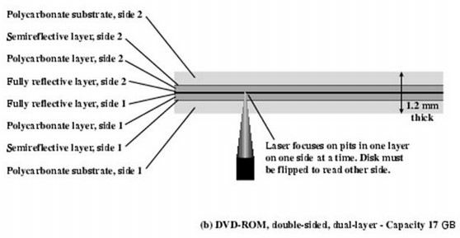

Slide 87
Magnetic Disk
A magnetic disk primarily consists of a rotating magnetic surface and a mechanical arm that moves over it. The mechanical arm is used to read from and write to the disk. The data on a magnetic disk is read and written using a magnetization process. Data is organized on the disk in the form of tracks and sectors, where tracks are the circular divisions of the disk. Tracks are further divided into sectors that contain blocks of data. All read and write operations on the magnetic disk are performed on the sectors.
Magnetic disks have traditionally been used as primary storage in computers. With the advent of solid-state drives (SSDs), magnetic disks are no longer considered the only option, but are still commonly used.

Slide 88
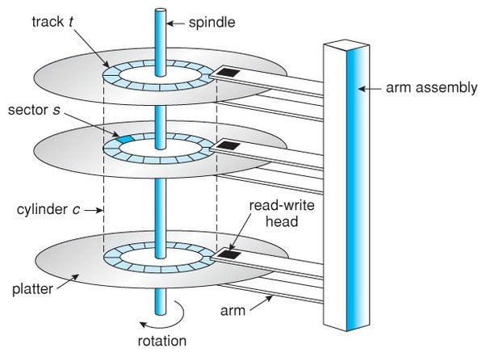

Slide 89
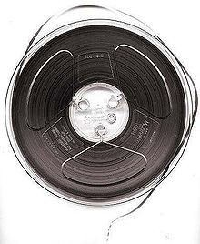
Magnetic Tape
Originally, magnetic tape was designed to record sound. In computing, it holds binary data. In recent years, magnetic tape devices have become more scarce with the emergence of digital imaging and audiovisual media storage.
Magnetic tape was used in many of the larger and less complex mainframe computers that predated today’s personal computers (PC).

Slide 90
Uses the same reading and recording techniques as disk systems.
Medium is flexible polyester tape coated with magnetizable material.
Data on the tape are structured as a number of parallel tracks running lengthwise.
Data are laid out as a sequence of bits along each track.
Data are read and written in contiguous blocks called physical records.
Blocks on the tape are separated by gaps referred to as inter-record gaps

Slide 91
CPU Organisation

Slide 92
CPU Organisation
General Resistor Organisation
Stack organisation and Accumulator types
Instruction Format
Addressing Modes

Slide 93
Introduction
The part of computer that performs the bulk of data-processing operations is called central processing unit and is referred to as the CPU. The CPU is made up of three major parts.
The register set stores intermediate data used during the execution of the instructions.
The arithmetic logic unit(ALU) performs the required microoperations for executing the instructions.
The control unit supervises the transfer of information among the registers and instruct the ALU as to which operation to perform.

Slide 94
The CPU performs a variety of functions dictated by the type of instruction that are incorporated in the computer.
This includes the instruction formats, addressing modes, the instruction set, and the general organisation of the CPU registers leading to two computer architectures as reduced instruction set computer(RISC) and complex instruction set computer(CISC).

Slide 95
General Register Organisation
When a large number of registers are included in the CPU, it is most efficient to connect them through a common bus system. The registers communicate with each other not only for direct data transfers, but also while performing various microoperations. Hence it is necessary to provide a common unit that can perform all the arithmetic, logic, and shift microoperations in the processor.
BUS SYSTEM
A bus organisation for seven CPU registers is shown. The output of each register is connected to two multiplexers(MUX) to form the two buses A and B. The selection lines in each mutliplexer select one register or the input data for the particular bus.

Slide 96
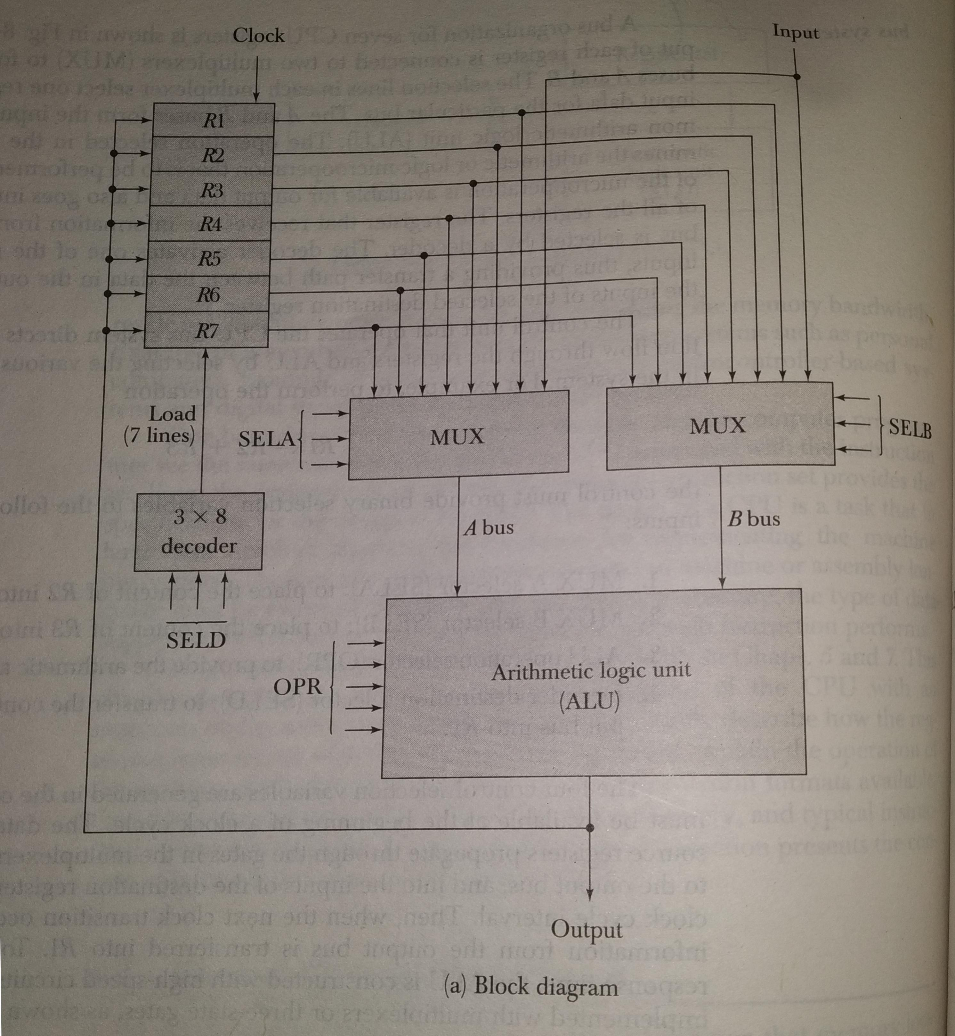

Slide 97
The A and B buses from the inputs to a common arithmetic logical unit(ALU). The operation selected in the ALU determines the arithmetic or logic microoperation that is to be performed. The result of the microoperation is available for output data and also goes into the inputs of all the resisters. The resister that receives the information from the output bus is selected by a decoder. The decoder activates one of the register load inputs of the selected destination register.

Slide 98
CONTROL WORD
There are 14 binary selectioninputs in the unit, and their combined value specifies a control word . The 14-bit control word is defined in the fig. b. It consists of four fields. Three fields contain three bit each , and one has five bits. The three bit of SELA select a source register for the A input of the ALU. the three bits of SELD select a destination registor for the B input of the ALU. The three bits of SELD select a destination register using the decoder and its seven load outputs. The five bits of OPR select one of the operations in the ALU. The 14- bit control word when applied to the selection inputs specify a particular microoperation.

Slide 99
ALU
The ALU provides arithmetic and logic operations. In addition, the CPU must provide shift operations. The shifter may be placed in the input of the ALU to provide a preshift capability, or at the output of the ALU to provide postshifting capability. In some cases, the shift operations are included with the ALU. An arithmetic logic and shift unit was designed in Sec. 4-7. The functiton table for this ALU is listed in Table 4-8. The encoding of the ALU operations for the CPU is taken from Sec.4-7 and is specified in Table 8-2. The OPR field has five bits and each operation is designated with a symbolic name.

Slide 100
STACK ORGANIZATION
A useful feature that is included in the CPU of most computers is a stack or last-in, first-out (LIFO) list. A stack is a storage device that stores information in such a manner that the item stored last is the first item retrieved. The operation of a stack can be compared to a stack of trays. The last tray placed on top of the stack is the first to be taken off.
The stack in digital computers is essentially a memory unit with an address register that can count only ( after an inital value is loaded into it ). The register that holds the address for the stack is called a stack pointer (SP ) because its value always points at the top item in the stack. Contrary to a stack of trays where the tray itself may be taken out or inserted, the physical registers of a stack are always available for reading or writing. It is the content of the word that is inserted or deleted.

Slide 101
The two operations of a stack are the insertion and deletion of items. The operation of insertion is called push ( or push-down ) because it can be thought of as the result of pushing a new item on top. The operation of deletion is called pop ( or pop-up ) because it can be thought of as the result of removing one item so that the stack pops up. However, nothing is pushed or popped in a computer stack.' The operations are simulated by incrementing or decrementing the stack pointer register

Slide 102
ACCUMULATOR TYPE ORGANISATION
The computers, present in the early days of computer history, had accumulator based CPUs. In this type of CPU organization, the accumulator register is used implicitly for processing all instructions of a program and store the results into the accumulator. The instruction format that is used by this CPU Organisation is One address field. Due to this the CPU is known as One Address Machine.
The main points about Single Accumulator based CPU Organisation are:
In this CPU Organization, the first ALU operand is always stored into the Accumulator and the second operand is present either in Registers or in the Memory.
Accumulator is the default address thus after data manipulation the results are stored into the accumulator.
One address instruction is used in this type of organization.

Slide 103
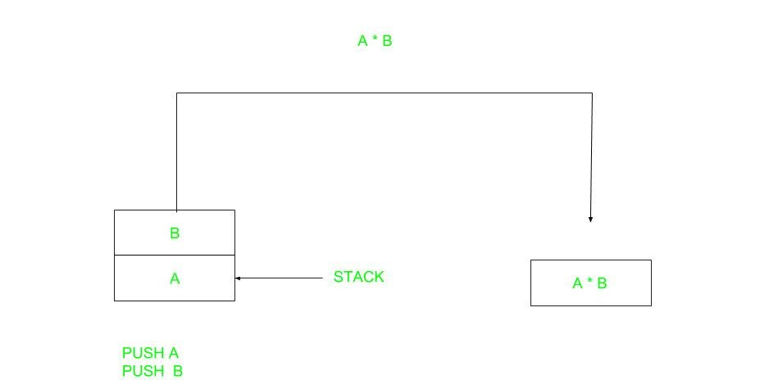
Instruction Formats
Zero Address Instructions –

Slide 104
A stack based computer do not use address field in instruction.To evaluate a expression first it is converted to revere Polish Notation i.e. Post fix Notation.
Expression: X = (A+B)*(C+D) Postfixed : X = AB+CD+* TOP means top of stack M[X] is any memory location.
PUSH | A | TOP = A
PUSH | B | TOP = B
ADD |  | TOP = A+B
PUSH | C | TOP = C
PUSH | D | TOP = D
ADD |  | TOP = C+D
MUL |  | TOP = (C+D)*(A+B)
POP | X | M[X] = TOP

Slide 105
ONE ADDRESS ACCUMULATOR
One Address Instructions – This use a implied ACCUMULATOR register for data manipulation.One operand is in accumulator and other is in register or memory location.Implied means that the CPU already know that one operand is in accumulator so there is no need to specify it.

Slide 106
LOAD | A | AC = M[A]
ADD | B | AC = AC + M[B]
STORE | T | M[T] = AC
LOAD | C | AC = M[C]
ADD | D | AC = AC + M[D]
MUL | T | AC = AC * M[T]
STORE | X | M[X] = AC

Slide 107
Two Address Instructions – This is common in commercial computers.Here two address can be specified in the instruction.Unlike earlier in one address instruction the result was stored in accumulator here result cab be stored at different location rather than just accumulator, but require more number of bit to represent address.
MOV | R1, A | R1 = M[A]
ADD | R1, B | R1 = R1 + M[B]
MOV | R2, C | R2 = C
ADD | R2, D | R2 = R2 + D
MUL | R1, R2 | R1 = R1 * R2
MOV | X, R1 | M[X] = R1

Slide 108
Three Address Instructions – This has three address field to specify a register or a memory location. Program created are much short in size but number of bits per instruction increase. These instructions make creation of program much easier but it does not mean that program will run much faster because now instruction only contain more information but each micro operation (changing content of register, loading address in address bus etc.) will be performed in one cycle only.
ADD | R1, A, B | R1 = M[A] + M[B]
ADD | R2, C, D | R2 = M[C] + M[D]
MUL | X, R1, R2 | M[X] = R1 * R2

Slide 109
Control unit

Slide 110
Instruction word format
Computer perform task on the basis of instruction provided.
A instruction in computer comprises of groups called fields.
These field contains different information as for computers every thing is in 0 and 1
The most common fields are:
Operation field which specifies the operation to be performed like addition.
Address field which contain the location of operand, i.e., register or memory location.
Mode field which specifies how operand is to be founded.
A instruction is of various length depending upon the number of addresses it contain. Generally CPU organization are of three types on the basis of number of address fields:
Single Accumulator organization
General register organization
Stack organization

Slide 111
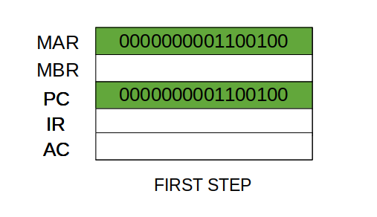
Fetch cycle
Step 1: The address in the program counter is moved to the memory address register(MAR), as this is the only register which is connected to address lines of the system bus.

Slide 112
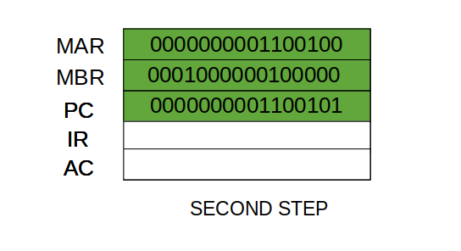
Fetch cycle
Step 2: The address in MAR is placed on the address bus, now the control unit issues a READ command on the control bus, and the result appears on the data bus and is then copied into the memory buffer register(MBR). Program counter is incremented by one, to get ready for the next instruction.(These two action can be performed simultaneously to save time)

Slide 113
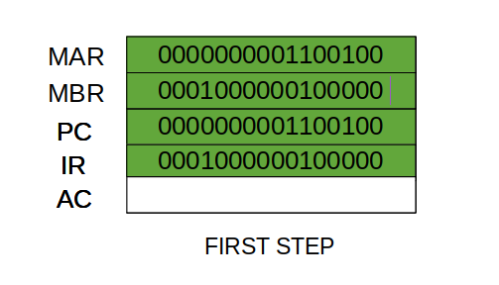
Fetch cycle
Step 3: The content of the MBR is moved to the instruction register(IR)

Slide 114
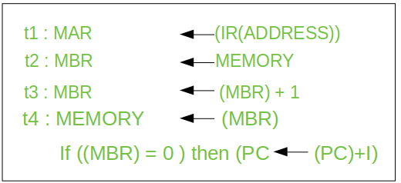
Execute cycle
Step 1: The address portion of IR is loaded into the MAR.
Step 2: The address field of the IR is updated from the MBR, so the reference memory location is read.
Step 3: Now, the contents of R and MBR are added by the ALU.

Slide 115
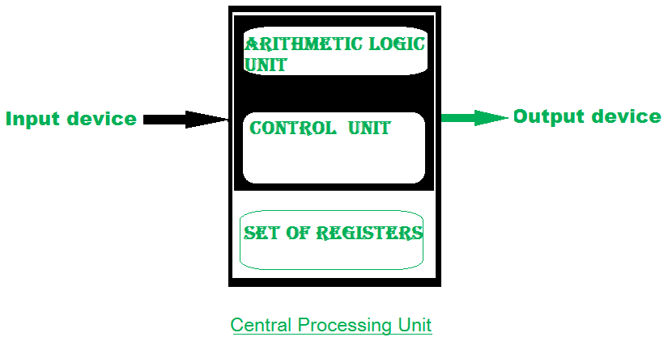
Control Of Arithmetic Operations
The ALU is a digital circuit that provides arithmetic and logic operation. It is the fundamental building block of central processing unit of a computer.

Slide 116
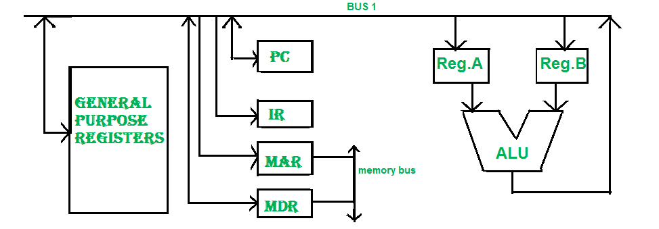
Bus

Slide 117
Bus
In early computers “BUS” were parallel electrical wires with multiple hardware connections.
Therefore a bus is communication system that transfers data between component inside a computer, or between computers. It includes hardware components like wires, optical fibers, etc and software, including communication protocols.
The Registers, ALU and the interconnecting BUS are collectively referred as data path.
Types of bus are:
Address bus: The buses which are used to carry address.
Data bus: The buses which are used to carry data.
Control bus: If the bus is carrying control signals .
Power bus: If it is carrying clock pulse, power signals it is known as power bus, and so on.

Slide 118
Bus
Program Counter – A program counter (PC) is a CPU register in the computer processor which has the address of the next instruction to be executed from memory. As each instruction gets fetched, the program counter increases its stored value by 1. It is a digital counter needed for faster execution of tasks as well as for tracking the current execution point.
Instruction Register – In computing, an instruction register (IR) is the part of a CPU’s control unit that holds the instruction currently being executed or decoded. An instruction register is the part of a CPU’s control unit that holds the instruction currently being executed or decoded. Instruction register specifically holds the instruction and provides it to instruction decoder circuit.

Slide 119
Bus
Memory Address Register – The Memory Address Register (MAR) is the CPU register that either stores the memory address from which data will be fetched from the CPU, or the address to which data will be sent and stored. It is a temporary storage component in the CPU(central processing unit) which temporarily stores the address (location) of the data sent by the memory unit until the instruction for the particular data is executed.
Memory Data Register – The memory data register (MDR) is the register in a computer’s processor, or central processing unit, CPU, that stores the data being transferred to and from the immediate access storage. Mmemory data register (MDR) is also known as memory buffer register (MBR).
General Purpose Register – General purpose registers are used to store temporary data within the microprocessor. It is a multipurpose register. They can be used either by programmer or by a user.

Slide 120
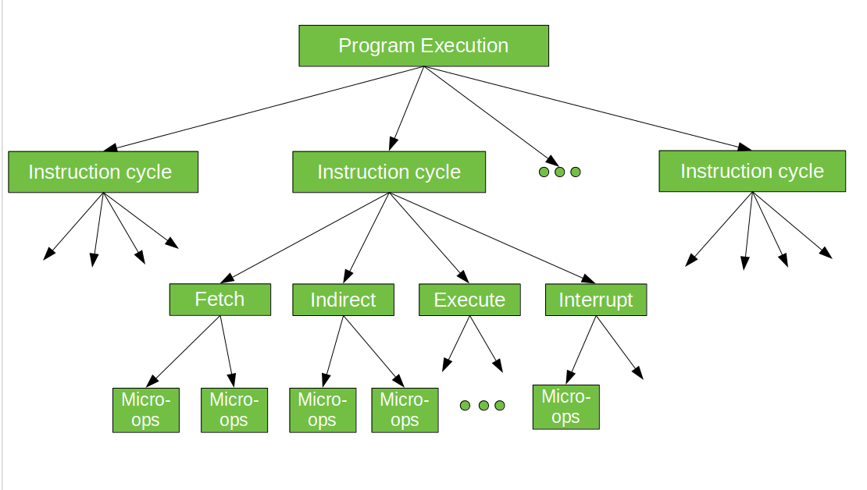
Micro-programming concepts

Slide 121
Micro-programming concepts
The control signals associated with operations are stored in special memory units inaccessible by the programmer as Control Words.
Control signals are generated by a program are similar to machine language programs.
Micro-programmed control unit is slower in speed because of the time it takes to fetch microinstructions from the control memory.
Some Important Terms –
Control Word : A control word is a word whose individual bits represent various control signals.
Micro-routine : A sequence of control words corresponding to the control sequence of a machine instruction constitutes the micro-routine for that instruction.
Micro-instruction : Individual control words in this micro-routine are referred to as microinstructions.
Micro-program : A sequence of micro-instructions is called a micro-program, which is stored in a ROM or RAM called a Control Memory (CM).
Control Store : the micro-routines for all instructions in the instruction set of a computer are stored in a special memory called the Control Store.

Slide 122
Thank you

