Slide 1
Master's Thesis Proposal
Supervisor Prof. Dr. Artur Guided By – Guoyang Weng

Slide 2
Domain
The project is rooted in the field of Automated Software Engineering, with a specific emphasis on Automated Code Defect Identification and Fixing. This domain aims to streamline the debugging process by reducing manual effort and increasing accuracy in detecting and resolving software bugs.

Slide 3
Problem Statement
Debugging and fixing software defects is one of the most time-consuming tasks in software development, often requiring significant manual effort and expertise. Existing Automated Program Repair (APR) systems leverage Large Language Models (LLMs) such as GPT-4, but their performance can be limited by inefficiencies in two critical areas:
Bug Localization: Many systems fail to pinpoint the exact sections of code responsible for errors. This results in LLMs being tasked with analyzing entire codebases, leading to reduced efficiency and suboptimal fixes.
Context Understanding: LLMs struggle to handle long sequences of code effectively, which impairs their ability to provide accurate and robust bug fixes.

Slide 4
Working Title Enhancing Automatic Bug Fixing by Integrating Spectral Analysis and Reinforcement Learning

Slide 5
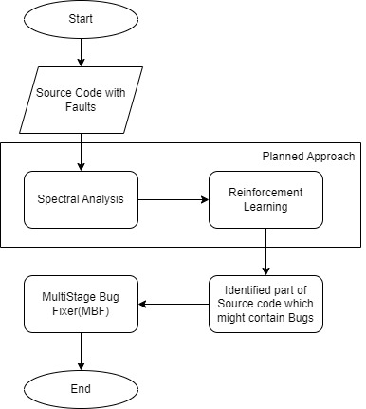
Proposed Solution

Slide 6
Spectral Analysis
Spectral analysis is a technique that evaluates the behavior of a program by analyzing execution patterns and identifying irregularities.
In this project, it is going to be used -
To Detect and highlight critical code sections
Provides an initial, preprocessed dataset for reinforcement learning, improving overall accuracy and efficiency.

Slide 7
Reinforcement Learning (RL)
Reinforcement learning is a machine learning approach where an agent learns to make decisions by receiving rewards or penalties.
In this project, it is going to be used -
Prioritizes specific code regions most likely to include bugs, narrowing the scope for fixes.
Acts as an intermediary step, preparing data for the Multi-Stage Bug Fixer (MBF)

Slide 8
Multi-Stage Bug Fixer (MBF)
Phase 1: Explanation Generation and Voting
Model generates multiple hypotheses about fault location and explanation
Model votes on these explanations to select most likely one
Phase 2: Bug fix Generation and Voting
Based on chosen explanation, model generates multiple bug fix proposals.
Model votes on these proposals and the highest rated proposal is elected as the final solution.

Slide 9
Summarize
This focuses on combining Spectral Analysis, Reinforcement Learning (RL), and fine-tuned Large Language Models (LLMs) to enhance automated program repair.
The process begins with spectral analysis, which identifies and highlights the critical parts of the code.
Followed by reinforcement learning, where an RL agent iteratively refines the fault localization process by selecting the specific code regions that are most likely to include the bug.
Finally, The Multi-Stage Bug Fixer (MBF) systematically generates and evaluates potential solutions, delivering reliable and maintainable fixes for identified issues. This structured approach ensures an accurate and efficient automated pipeline for detecting and resolving software bugs.

Slide 10
Open for feedbacks Thank you for your time

