Slide 1

FUNDFLUENT
Team HACKIES
MEMBERS:-
AAYUSI BISWAS
KHUSHBOO MAHESHWARI (Sophomores - CSE Deptt.)

Slide 2
Problem Statement
How might we make micro-financing institutions like Self Help Groups independent and affordable (explicitly for women)?

Slide 3
TAM (for the year 2016-17)
116,114 crore rupees
15% (mean interest on self help group loans)
As per NABARD - A study on Micro finances of India.

Slide 4
Our Solution

Slide 5
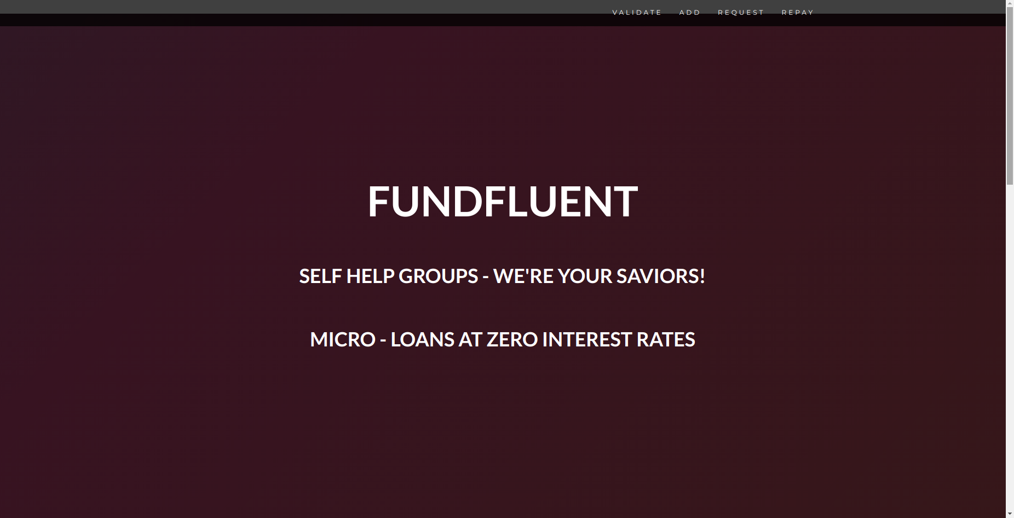

Slide 6
Aadhar
Architecture
3 months
Members
Pool Money
Request Money
Assign Loan
Display allowed address for loan
Initial Members
Add Members
Pay Loan

Slide 7
Key points (our value proposition)
Zero interest rates (no predatory money lenders required)
Automated book keeping by smart contracts (rural India doesn’t trust banks)
Anonymity ensures equality (casteism eradicated)
Members need to validate others - credibility ensured without a credit score
Peer pressure introduced if not paid

Slide 8
Technology Used
Programming language: Solidity
Framework : Web3 and truffle
IDE: Remix
Ropsten Testnet
Metamask
Aadhar API

Slide 9
Revenue Model : SAAS
Plans to partner with the Government

Slide 10
Future Plans
Integrate Google Translator API
Work on the adoption scheme (can be challenging).
Solve the difference in unit of currency (has to be Ether for now)

Slide 11
