Slide 1
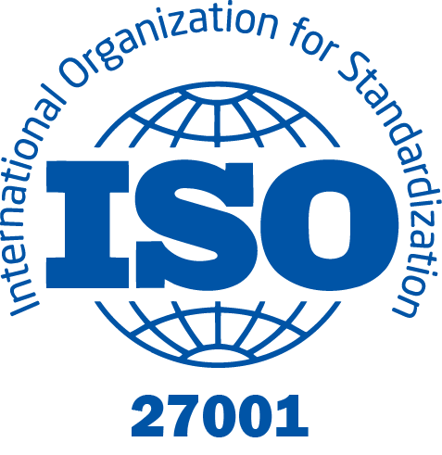
ISO/IEC 27001:2022 Implementation Project – <Organization Name>
Prepared by : IT23151710 – Aazaf Ritha
Module: IE3102 – Enterprise Standards for Information Security

Slide 2
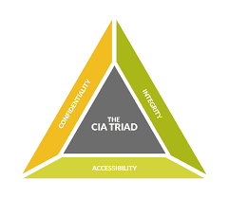
ISO/IEC 27001
ISO 27001 defines an international framework for managing information security.
Focus: confidentiality, integrity, and availability of data.

Slide 3

Purpose of the Standard
Provides a structure to manage and protect information assets.
Ensures risk-based control implementation and supports certification readiness.

Slide 4
Benefits of ISO/IEC 27001
Builds customer trust and business credibility.
Enhances compliance and governance.
Reduces security risks and promotes continual improvement.

Slide 5
Project Overview
Objective: Implement ISO 27001:2022 ISMS at <Organization>.
Focus: documentation, gap, risk management, audits, improvement.
Duration: <Start – End Month, Year>.

Slide 6

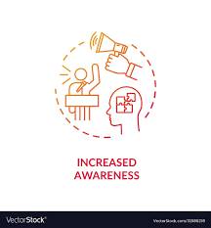
Objectives
Establish a compliant ISMS.
Protect information assets and reduce risks.
Enhance awareness and accountability.

Slide 7
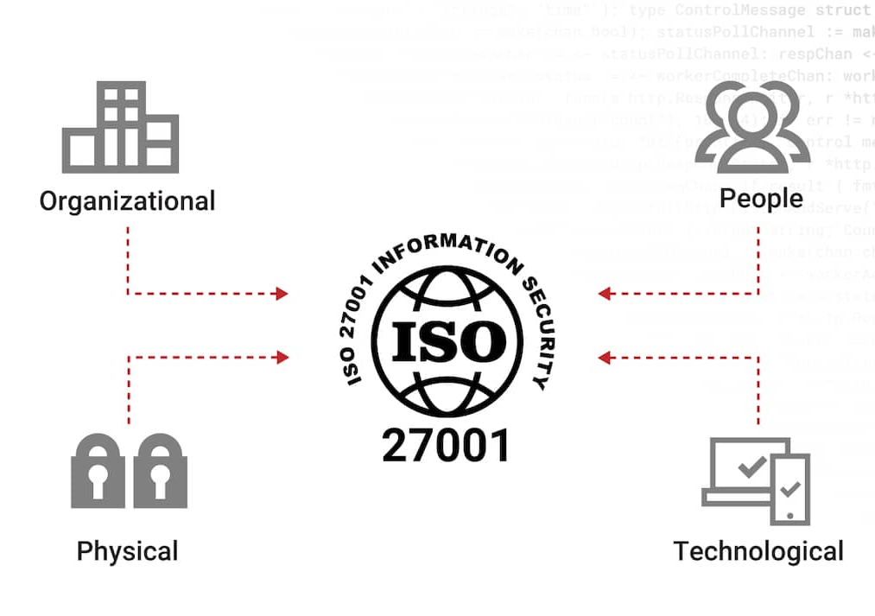
Scope
Covers departments, processes, and systems under ISMS.
Includes people, processes, and technology handling organizational data.

Slide 8
Implementation Phases
1. Gap Assessment
2. Risk Assessment & Treatment
3. Statement of Applicability (SoA)
4. Policies & Procedures
5. Internal Audit
6. Management Review
7. Continual Improvement

Slide 9
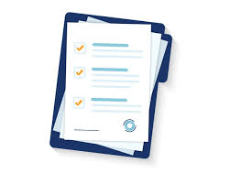
Documents Developed
ISMS Scope
Policy
Risk Methodology
Risk Register
SOA
Access Control
Backup & Recovery
Supplier
Incident
Audit Plan
Checklists
Review minutes
Corrective & improvement logs

Slide 10
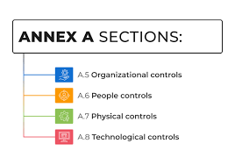
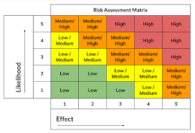
Risk Assessment & SoA
Risks identified, analyzed, and treated.
SoA justified control selection across domains (A.5–A.8).

Slide 11
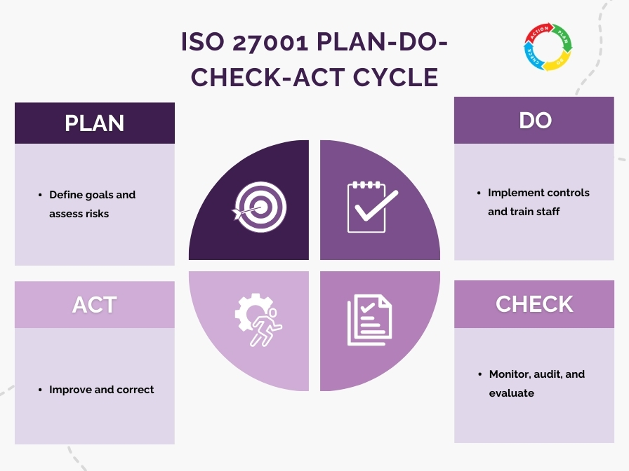
PDCA Cycle
Plan – Identify risks and define objectives.
Do – Implement controls and train staff.
Check – Audit, monitor, and review ISMS.
Act – Correct and continually improve.

Slide 12
Internal Audit & Management Review
Internal audit verified control implementation.
Management review confirmed ISMS effectiveness and resource adequacy.

Slide 13
Key Benefits
Stronger governance – clear roles and accountability.
Stronger risk management – systematic risk mitigation.
Higher staff awareness – improved security culture.
Improved resilience and compliance – better recovery and adherence.

Slide 14

Challenges & Lessons Learned
Challenges: Limited awareness, resource gaps.
Lessons: Awareness training improved adoption; phased rollout ensured success.

Slide 15

Results & Next Steps
ISMS fully implemented and operational.
Organization ready for ISO 27001 certification.
Next: Maintain audits, training, and certification process.

Slide 16

Thank You
ISO/IEC 27001: 2022 Implementation <Organization>

