Slide 1
Cars
Presented By : Aazan Amir

Slide 2
Content
Title
Definition of Cars
Types of Cars
Comparison
Picture using Title Slide
Picture
Thank You Slide

Slide 3
Cars
A car (or automobile) is a wheeled motor vehicle that is used for transportation. Most definitions of cars say that they run primarily on roads, seat one to eight people, have four wheels, and mainly transport people instead of goods.
The year 1886 is regarded as the birth year of the car when German inventor Carl Benz patented his Benz Patent-Motorwagen. Cars became widely available during the 20th century. One of the first cars affordable by the masses was the 1908 Model T, an American car manufactured by the Ford Motor Company. Cars were rapidly adopted in the US, where they replaced animal-drawn carriages and carts. In Europe and other parts of the world, demand for automobiles did not increase until after World War II. The car is considered an essential part of the developed economy.

Slide 4
Types of Cars
A sedan is defined as a 4-door passenger car with a trunk that is separate from the passengers with a three-box body: the engine, the area for passengers, and the trunk. Throughout the generations, the definition of a sedan has been the same.
Some of the primary competitors were the Chevrolet Camaro, Pontiac GTO, Shelby Cobra, Oldsmobile 442 and Buick Gran Sport. Muscle car manufacturers were all trying to get the fastest speeds, most powerful engines and the lowest price to reach a wide swath of buyers.27-Jan-2021

Slide 5
Comparison
Muscle Car
Super Car
Muscle car is a description according to Merriam-Webster Dictionary that came to use in 1966 for "a group of American-made two-door sports coupes with powerful gas powered engines designed for high-performance driving."
A supercar – also called exotic car – is a loosely defined description of street-legal, high-performance sports cars. Since the 2000s or 2010s, the term hypercar has come into use for the highest performing supercars.

Slide 6
MODELS
Porsche 911. Now on its 992 Series or eight generation.
Ford GT. ...
Ferrari Enzo. ...
Bugatti Veyron. ...
Ferrari LaFerrari. ...
Lamborghini Huracan. ...
Audi R8. ...
Ferrari 488.

Slide 7
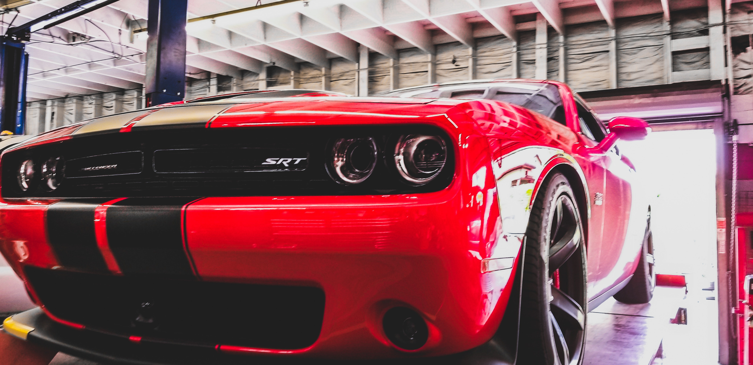
Cars

Slide 8
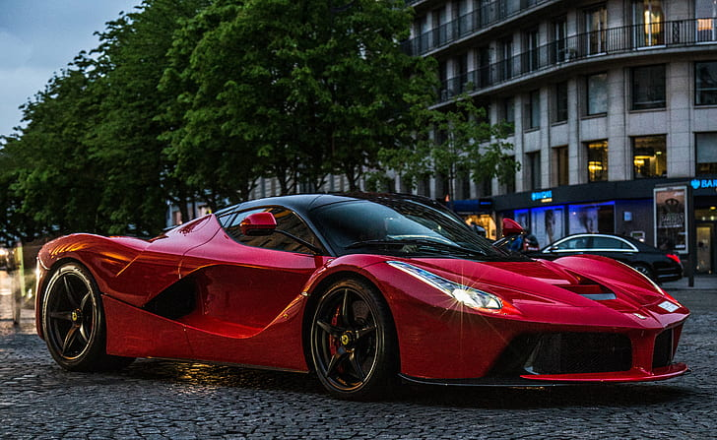

Slide 9


