Slide 1
Polymorphism

Slide 2
Polymorphism
The word polymorphism means having many forms. Typically, polymorphism occurs when there is a hierarchy of classes and they are related by inheritance.
C++ polymorphism means that a call to a member function will cause a different function to be executed depending on the type of object that invokes the function.

Slide 3
Function Overriding
Giving new implementation of base class method into derived class is called function overriding.
Signature of base class method and derived class must be same.
Signature involves:
Number of arguments
Type of arguments
Sequence of arguments

Slide 4
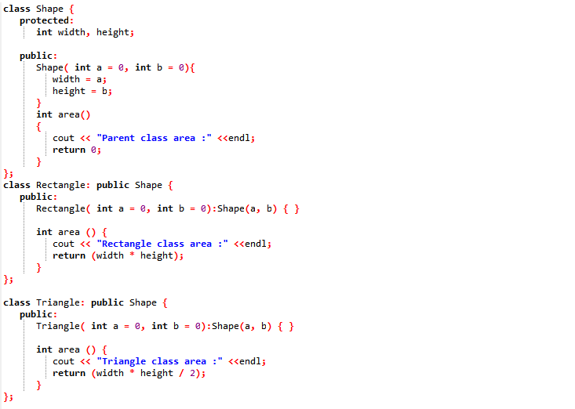
Overridden Functions

Slide 5
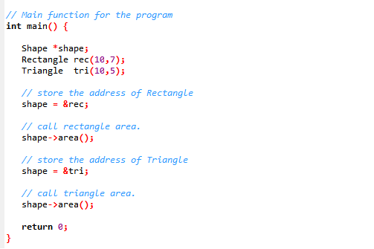
Output ?

Slide 6
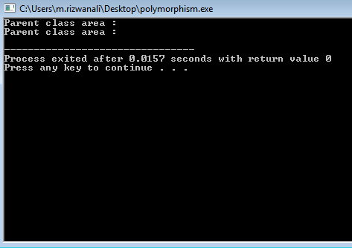

Slide 7
Why Incorrect Output ?
The reason for the incorrect output is that the call of the function area() is being set once by the compiler as the version defined in the base class. This is called static resolution of the function call, or static linkage - the function call is fixed before the program is executed. This is also sometimes called early binding because the area() function is set during the compilation of the program.

Slide 8
Solution
A virtual function is a function in a base class that is declared using the keyword virtual. Defining in a base class a virtual function, with another version in a derived class, signals to the compiler that we don't want static linkage for this function.
What we want is the selection of the function to be called at any given point in the program to be based on the kind of object for which it is called. This sort of operation is referred to as dynamic linkage, or late binding.

Slide 9
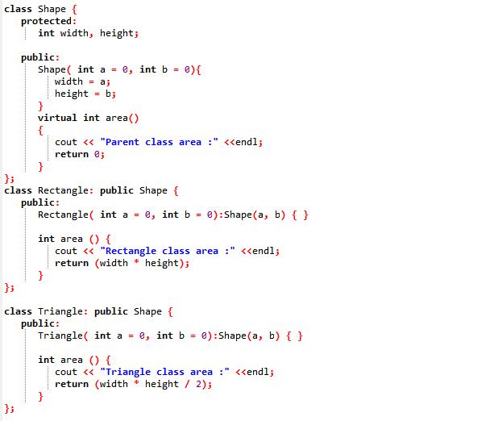
Virtual Function

Slide 10
Output ?

Slide 11
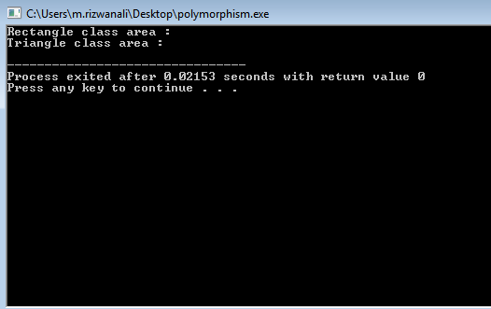

Slide 12
Abstract Class
A class is made abstract by declaring at least one of its functions as pure virtual function.
A pure virtual function is specified by placing "= 0" in its declaration.
The purpose of an abstract class (often referred to as an ABC) is to provide an appropriate base class from which other classes can inherit.

Slide 13
Abstract Class
Abstract classes cannot be used to instantiate objects and serves only as an interface.
Attempting to instantiate an object of an abstract class causes a compilation error.
Thus, if a subclass of an ABC needs to be instantiated, it has to override each of the pure virtual function of ABC.

Slide 14
Abstract Class
Failure to override a pure virtual function in a derived class, then attempting to instantiate objects of derived class, is a compilation error.
Classes that can be used to instantiate objects are called concrete classes.

Slide 15
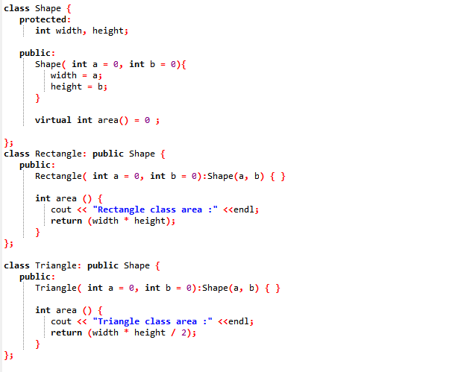
Pure Virtual Function
The = 0 tells the compiler that the function has no body

